Slide 1

Ernie's Exit
Forensic Science
Blood Typing Lab Activity
T. Trimpe 2006 http://sciencespot.net/

Slide 2
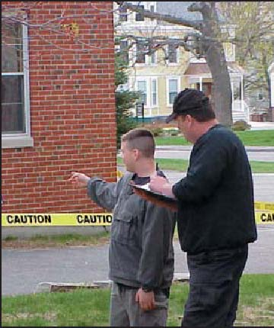
The Crime Report
A small pool of blood and a weapon was found near a garbage dumpster. After examining the area, the CSI on the scene discovered a body in the garbage dumpster and identified him as Earnest “One-Eyed” Earl. Earl had a wound to his chest that will be analyzed by the medical examiner.
The CSI tested blood samples from the blood pool and the weapon at the crime scene. It was determined that it was human blood, but he needs to know the blood type to help identify if it was from the victim or the person who murdered him. He has come up with three suspects that either knew the victim or were seen in the area before the body was discovered. He would like to question them further while he waits for DNA test results.
Follow your teacher’s directions to complete the lab.
Remember to be careful to prevent cross-contamination of the blood samples!
Image: http://www.fbi.gov/publications/leb/2005/apr2005/apr2005leb_img_3.jpg

Slide 3
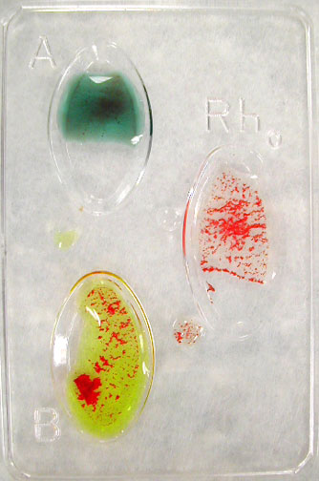
What’s the type?
We will be determining blood types using Anti-A serums, Anti-B serums, and Anti-RH serums. Use the chart to help you determine the blood type of each sample and its Rh factor (+ or -).
Clumping = + (Positive) No Clumping = - (Negative)
Type | Reaction w/ Anti-A Serum | Reaction w/ Anti-B Serum
A
B
AB
O
Rh Serum - Clumping = Rh+ blood
Get your materials …
1 blood typing tray Paper towel
3 toothpicks Blood & serum samples
Safety goggles
Step 1: Place 2 drops of the blood sample in each of the A, B, and Rh wells.
Step 2: Place 2 drops of the anti-A serum on the blood in the A well and use a clean toothpick to stir the serum into the A sample for a few seconds.
Step 3: Place 2 drops of the anti-B serum on the blood in the B well and use a clean toothpick to stir the serum into the B sample for a few seconds.
Step 4: Place 2 drops of the anti-Rh serum on the blood in the Rh well and use a clean toothpick to stir the serum into the Rh sample for a few seconds.
Step 5: Record your results (+ or -) in the correct location on your lab sheet.
No clumping
Clumping

Slide 4
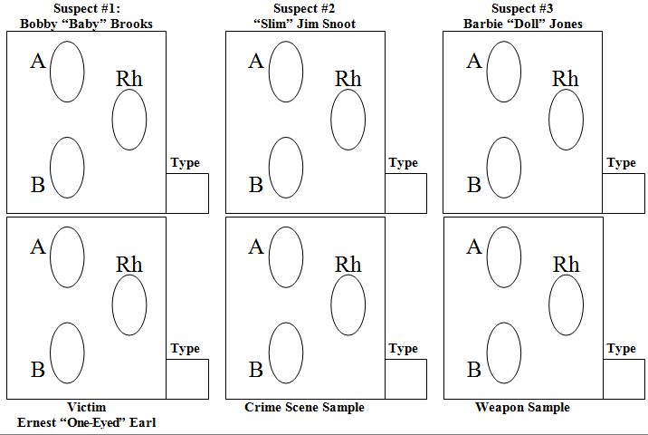
Lab Results
Clumping =
+ (Positive)
No Clumping =
- (Negative)
What do your results show?
What should investigators do next?
Conclusion

