Slide 2

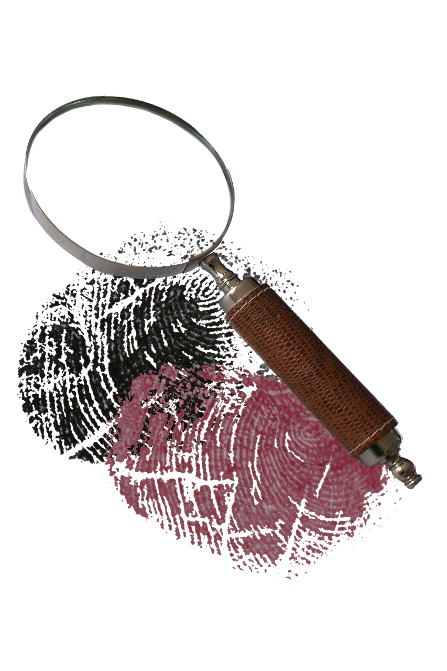

What is Forensic Science?
Forensic Science is the application of scientific methods and techniques to investigate crimes and analyse evidence.
This field combines knowledge from various scientific disciplines, including biology, chemistry, physics and mathematics, to help solve legal cases.
Forensic scientists play a crucial role in the criminal justice system by providing objective evidence that can be used in court.

Slide 3
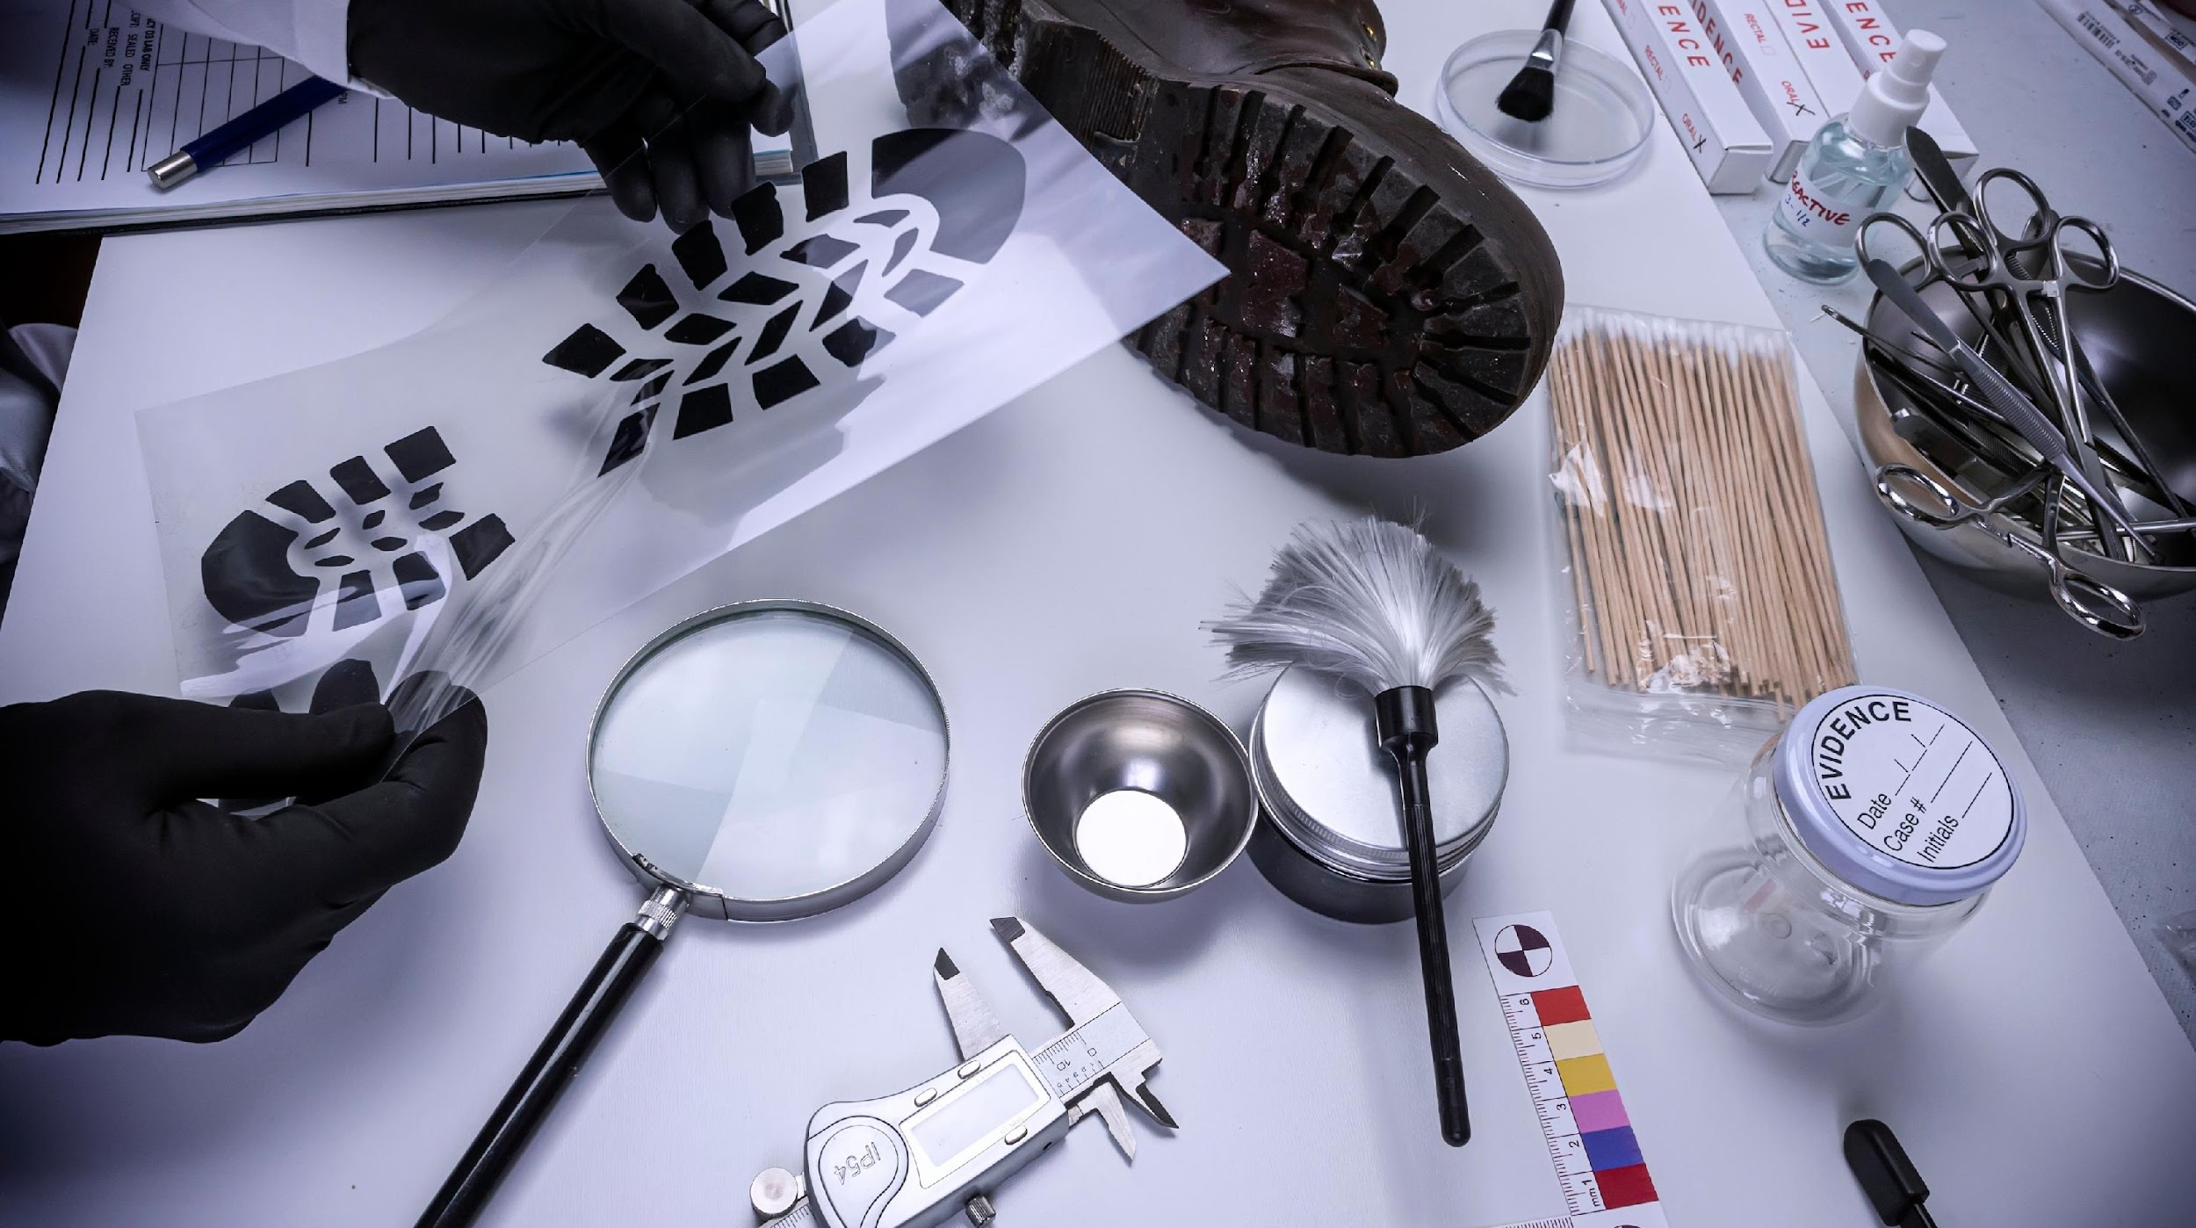
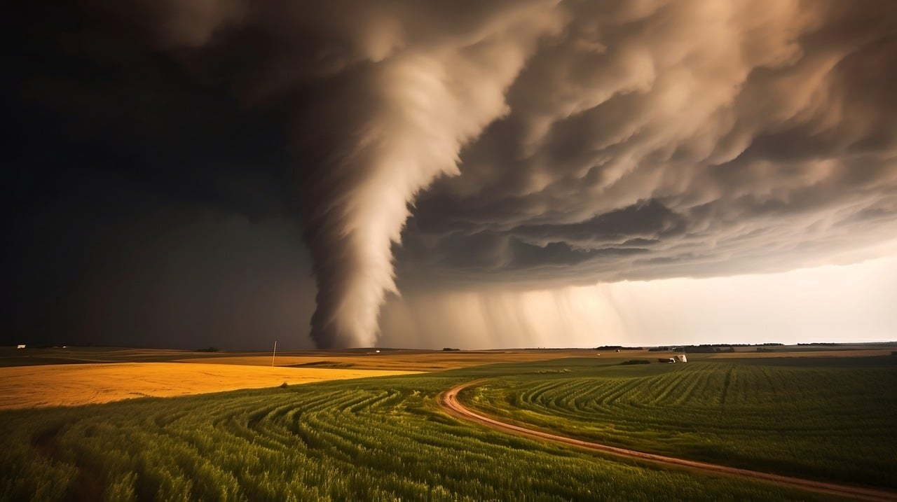
What Do Forensic Scientists Do?
Forensic scientists collect, preserve and analyse physical evidence from crime scenes. Their work includes:
Analysing DNA samples to identify suspects or victims.
Examining fingerprints to match them with individuals.
Testing substances to determine the presence of drugs or toxins.
Studying blood spatter patterns to understand the events of a crime.
Using digital forensics to recover and examine data from electronic devices.

Slide 4
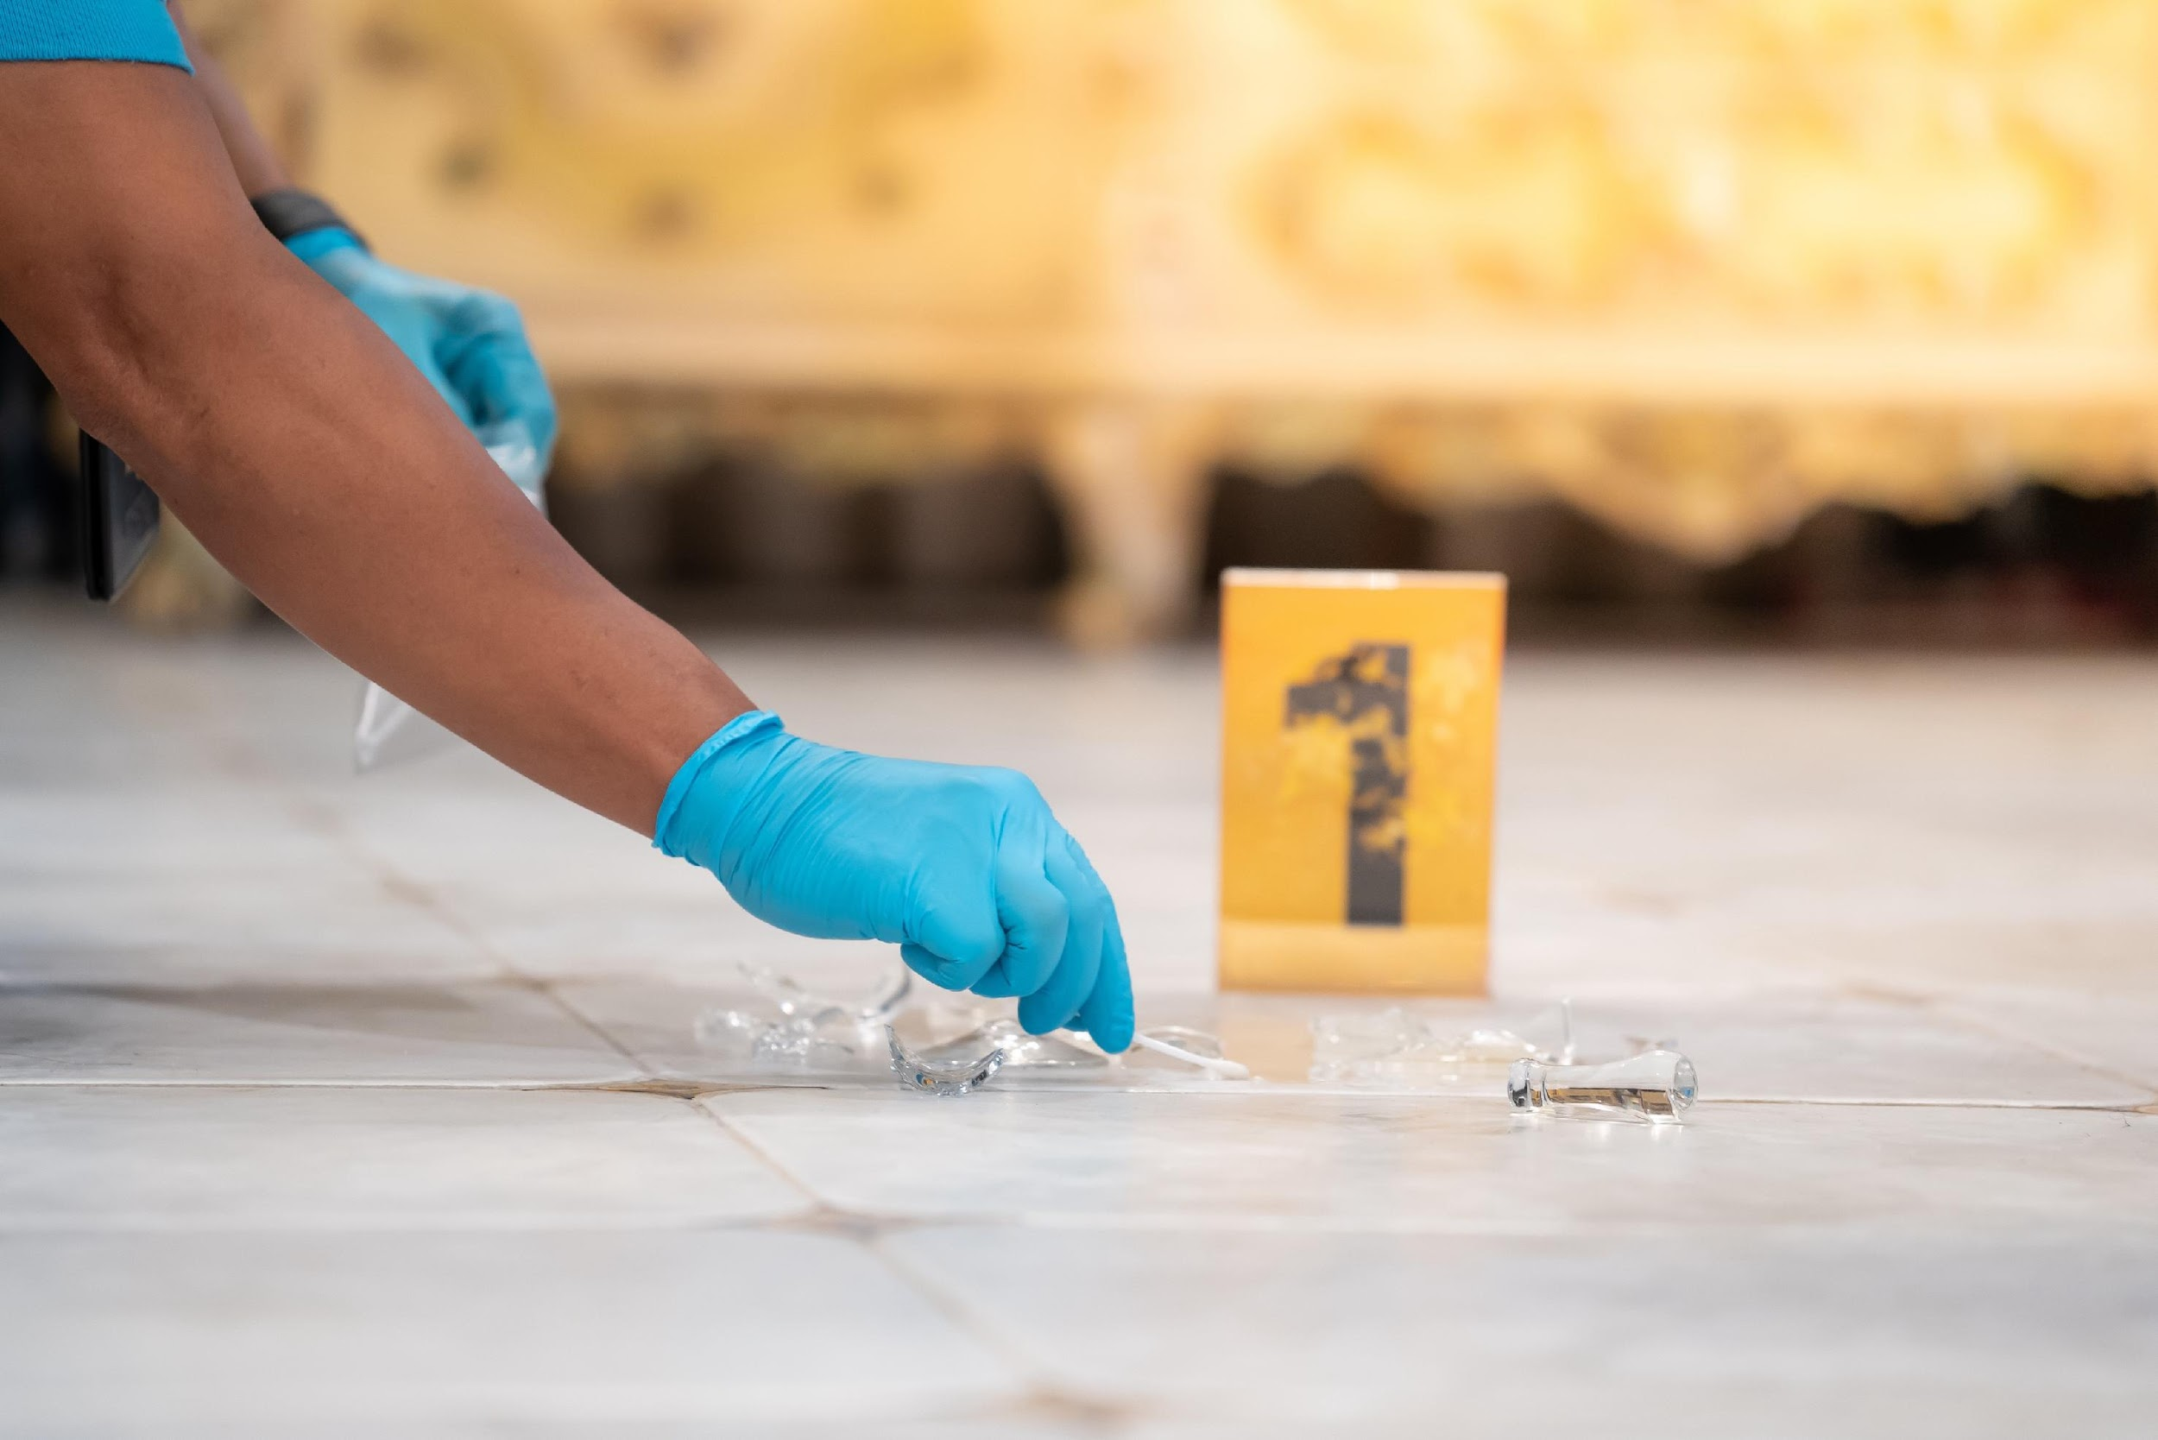
Why is Forensic Science Important?
Forensic science is important because it provides objective, scientific evidence that can:
help law enforcement agencies solve crimes.
protect the innocent and ensure justice is served.
provide crucial information in legal cases, aiding judges and juries in making informed decisions.
support public safety by identifying and understanding criminal behaviour.

Slide 5
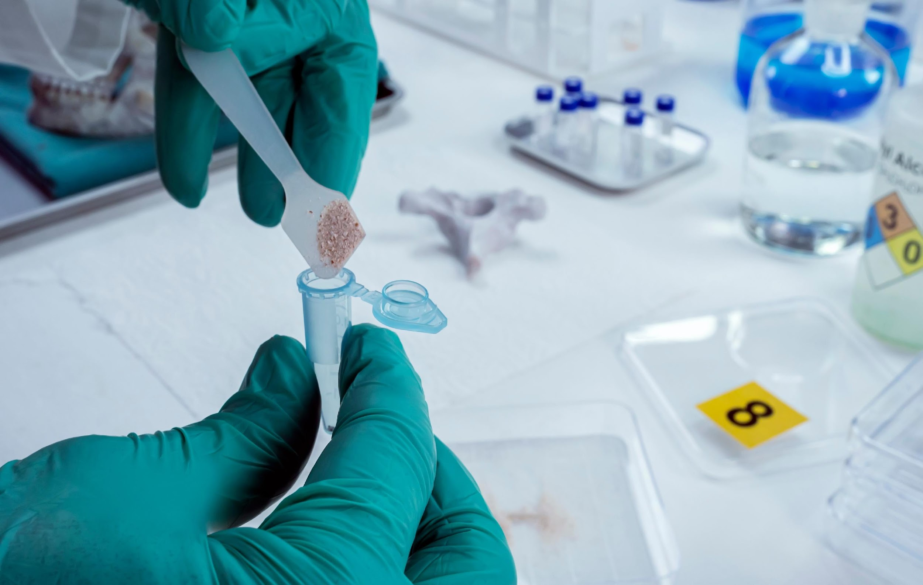
Types of Forensic Scientists
Forensic science is a diverse field with various specialisations, including:
Forensic Pathologist:
Examines bodies to determine the cause and manner of death.
Forensic Anthropologist:
Analyses skeletal remains to identify individuals and assess how they died.

Slide 6
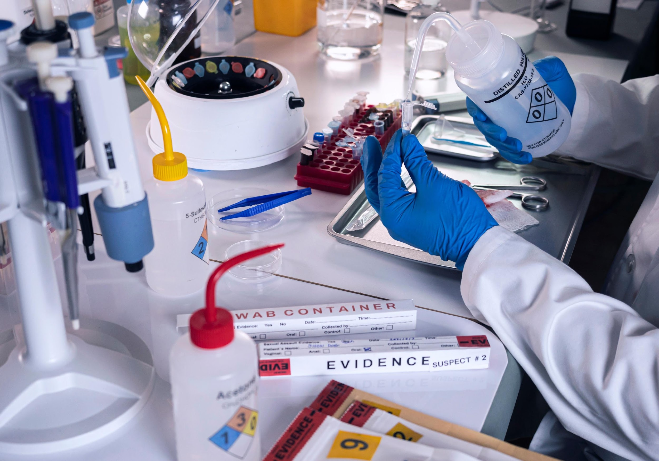
Types of Forensic Scientists
Forensic Odontologist:
Uses dental records to identify human remains and analyse bite marks.
Forensic Toxicologist:
Tests bodily fluids and tissues to detect drugs, alcohol and poisons.

Slide 7

Types of Forensic Scientists
Forensic Entomologist:
Studies insects on decomposing bodies to estimate the time of death.
Digital Forensic Scientist:
Recovers and analyses data from computers, smartphones and other electronic devices.

Slide 8
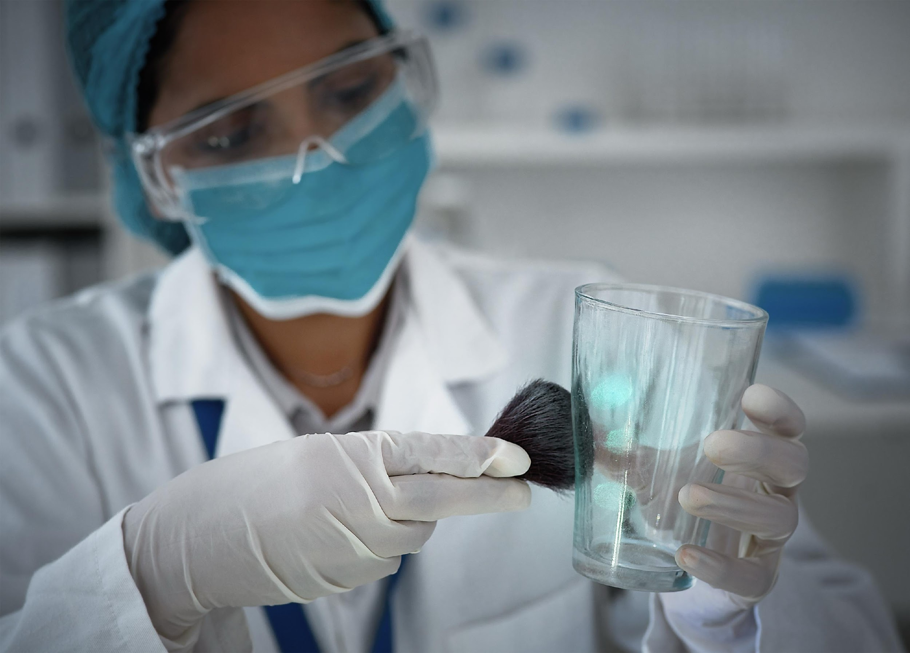
Great Discoveries in Forensic Science
Some significant discoveries in forensic science include:
The development of DNA fingerprinting, which revolutionised the way crimes are solved by providing a reliable method for identifying individuals.
Advances in fingerprint analysis, including automated fingerprint identification systems (AFIS) that have improved the speed and accuracy of matching prints.

Slide 9
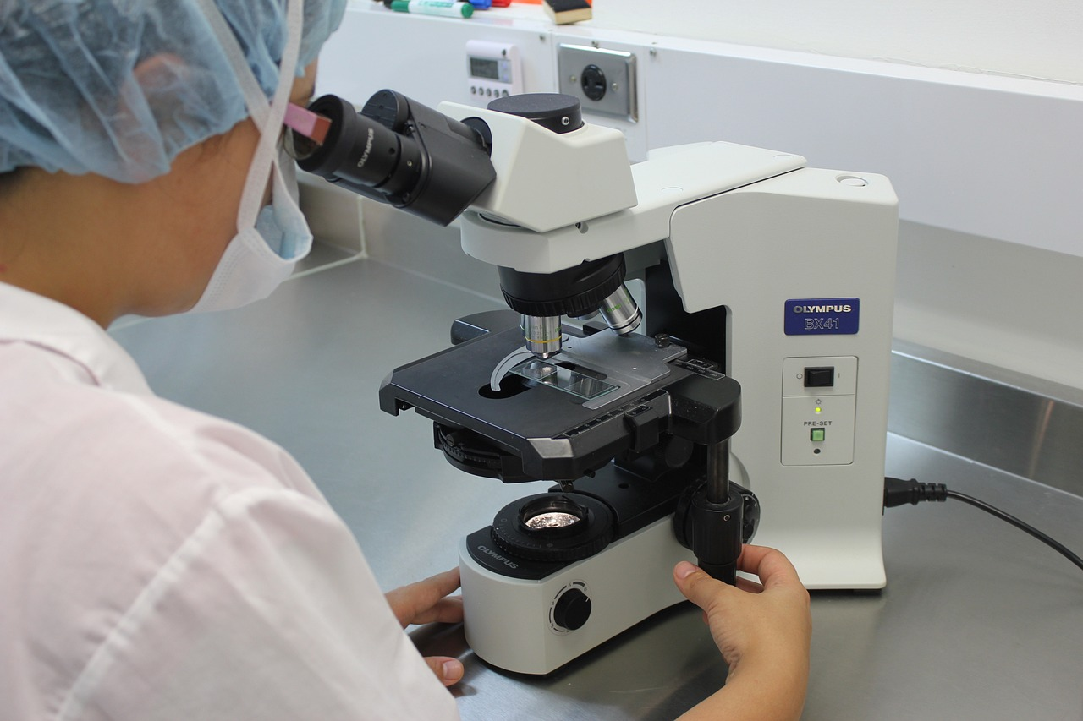
Tools and Technology Used in Forensic Science
Forensic scientists use a variety of tools and technologies, such as:
Microscopes:
For examining tiny pieces of evidence like fibres, hair and bullet casings.
DNA Sequencers:
To analyse genetic material from samples like blood, saliva and skin cells.

Slide 10
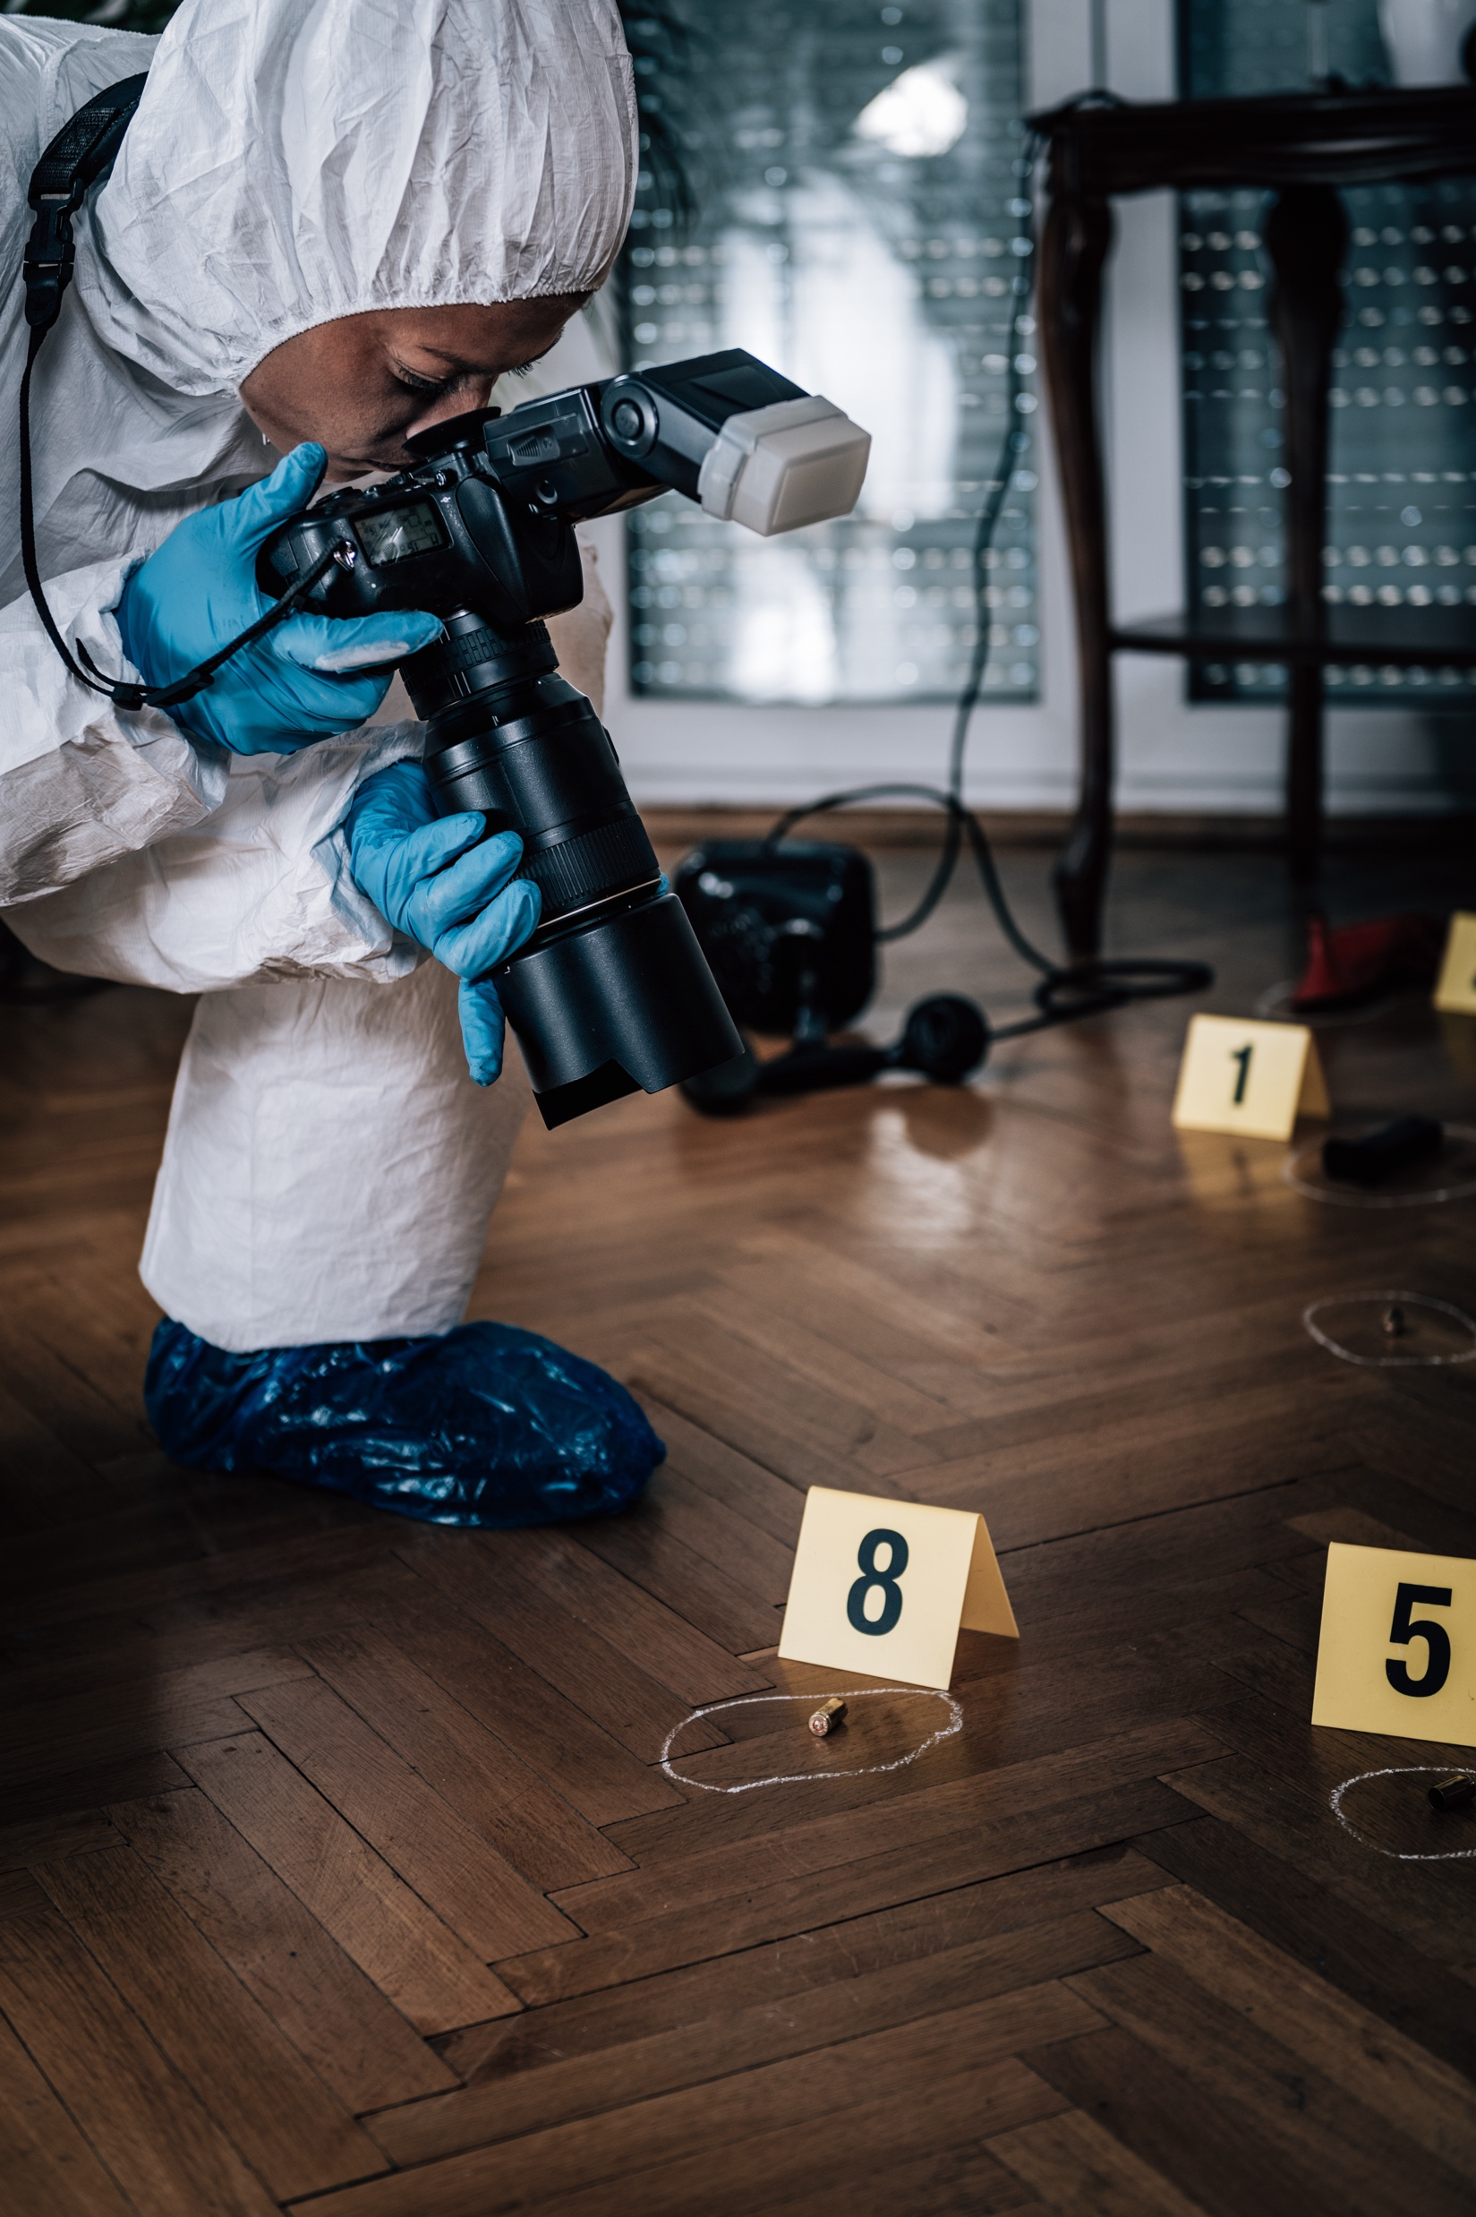
Tools and Technology Used in Forensic Science
Spectrometers:
For identifying chemical substances and analysing unknown materials.
Cameras and Imaging Devices:
To document crime scenes and evidence.

Slide 11
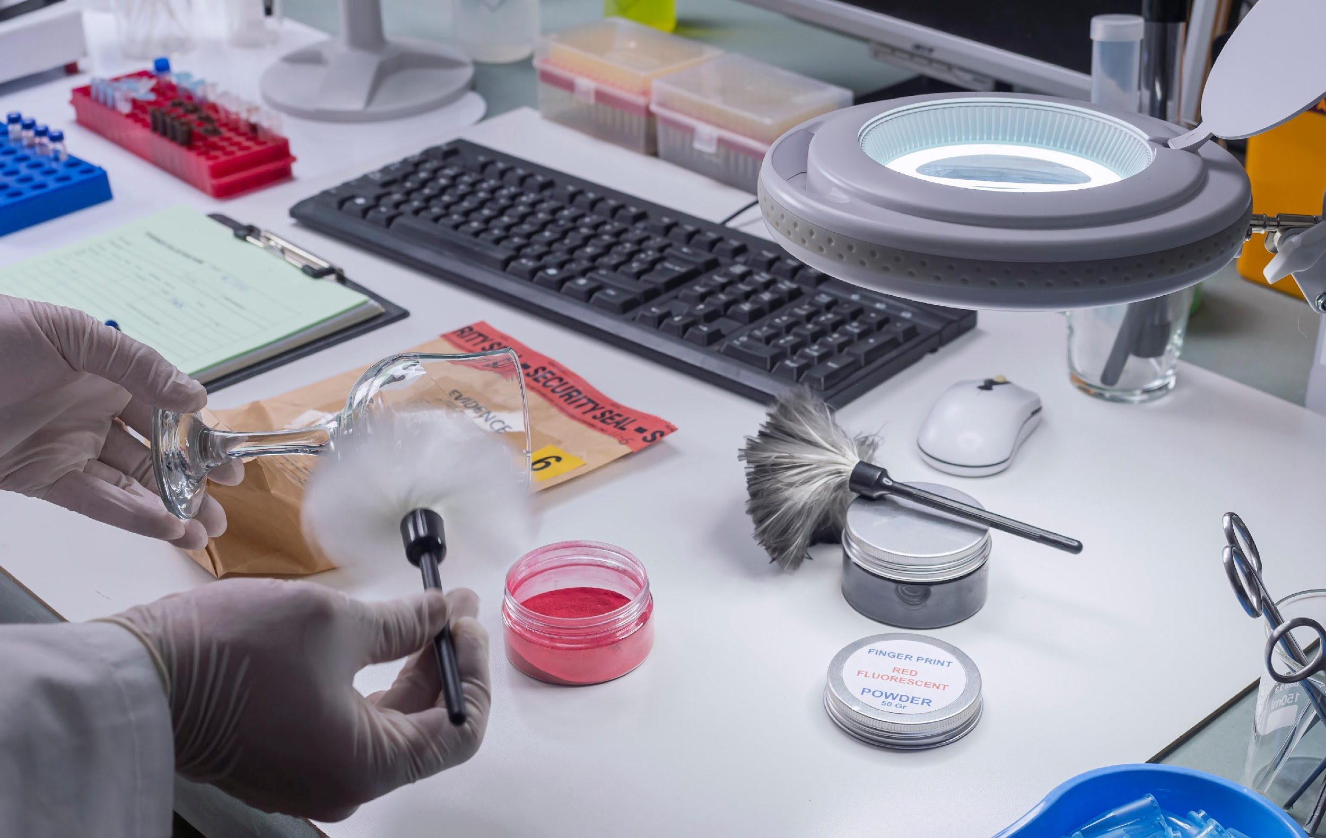
How is STEM Used in Forensic Science?
STEM is integral to forensic science:
Science: Forensic scientists use biology, chemistry and physics to analyse evidence.
Technology: Advances in technology improve forensic techniques and allow for more precise analysis.
Engineering: Engineering principles are applied in developing new forensic tools and equipment.
Mathematics: Statistical analysis and probability help interpret data and provide reliable results in court.

Slide 12
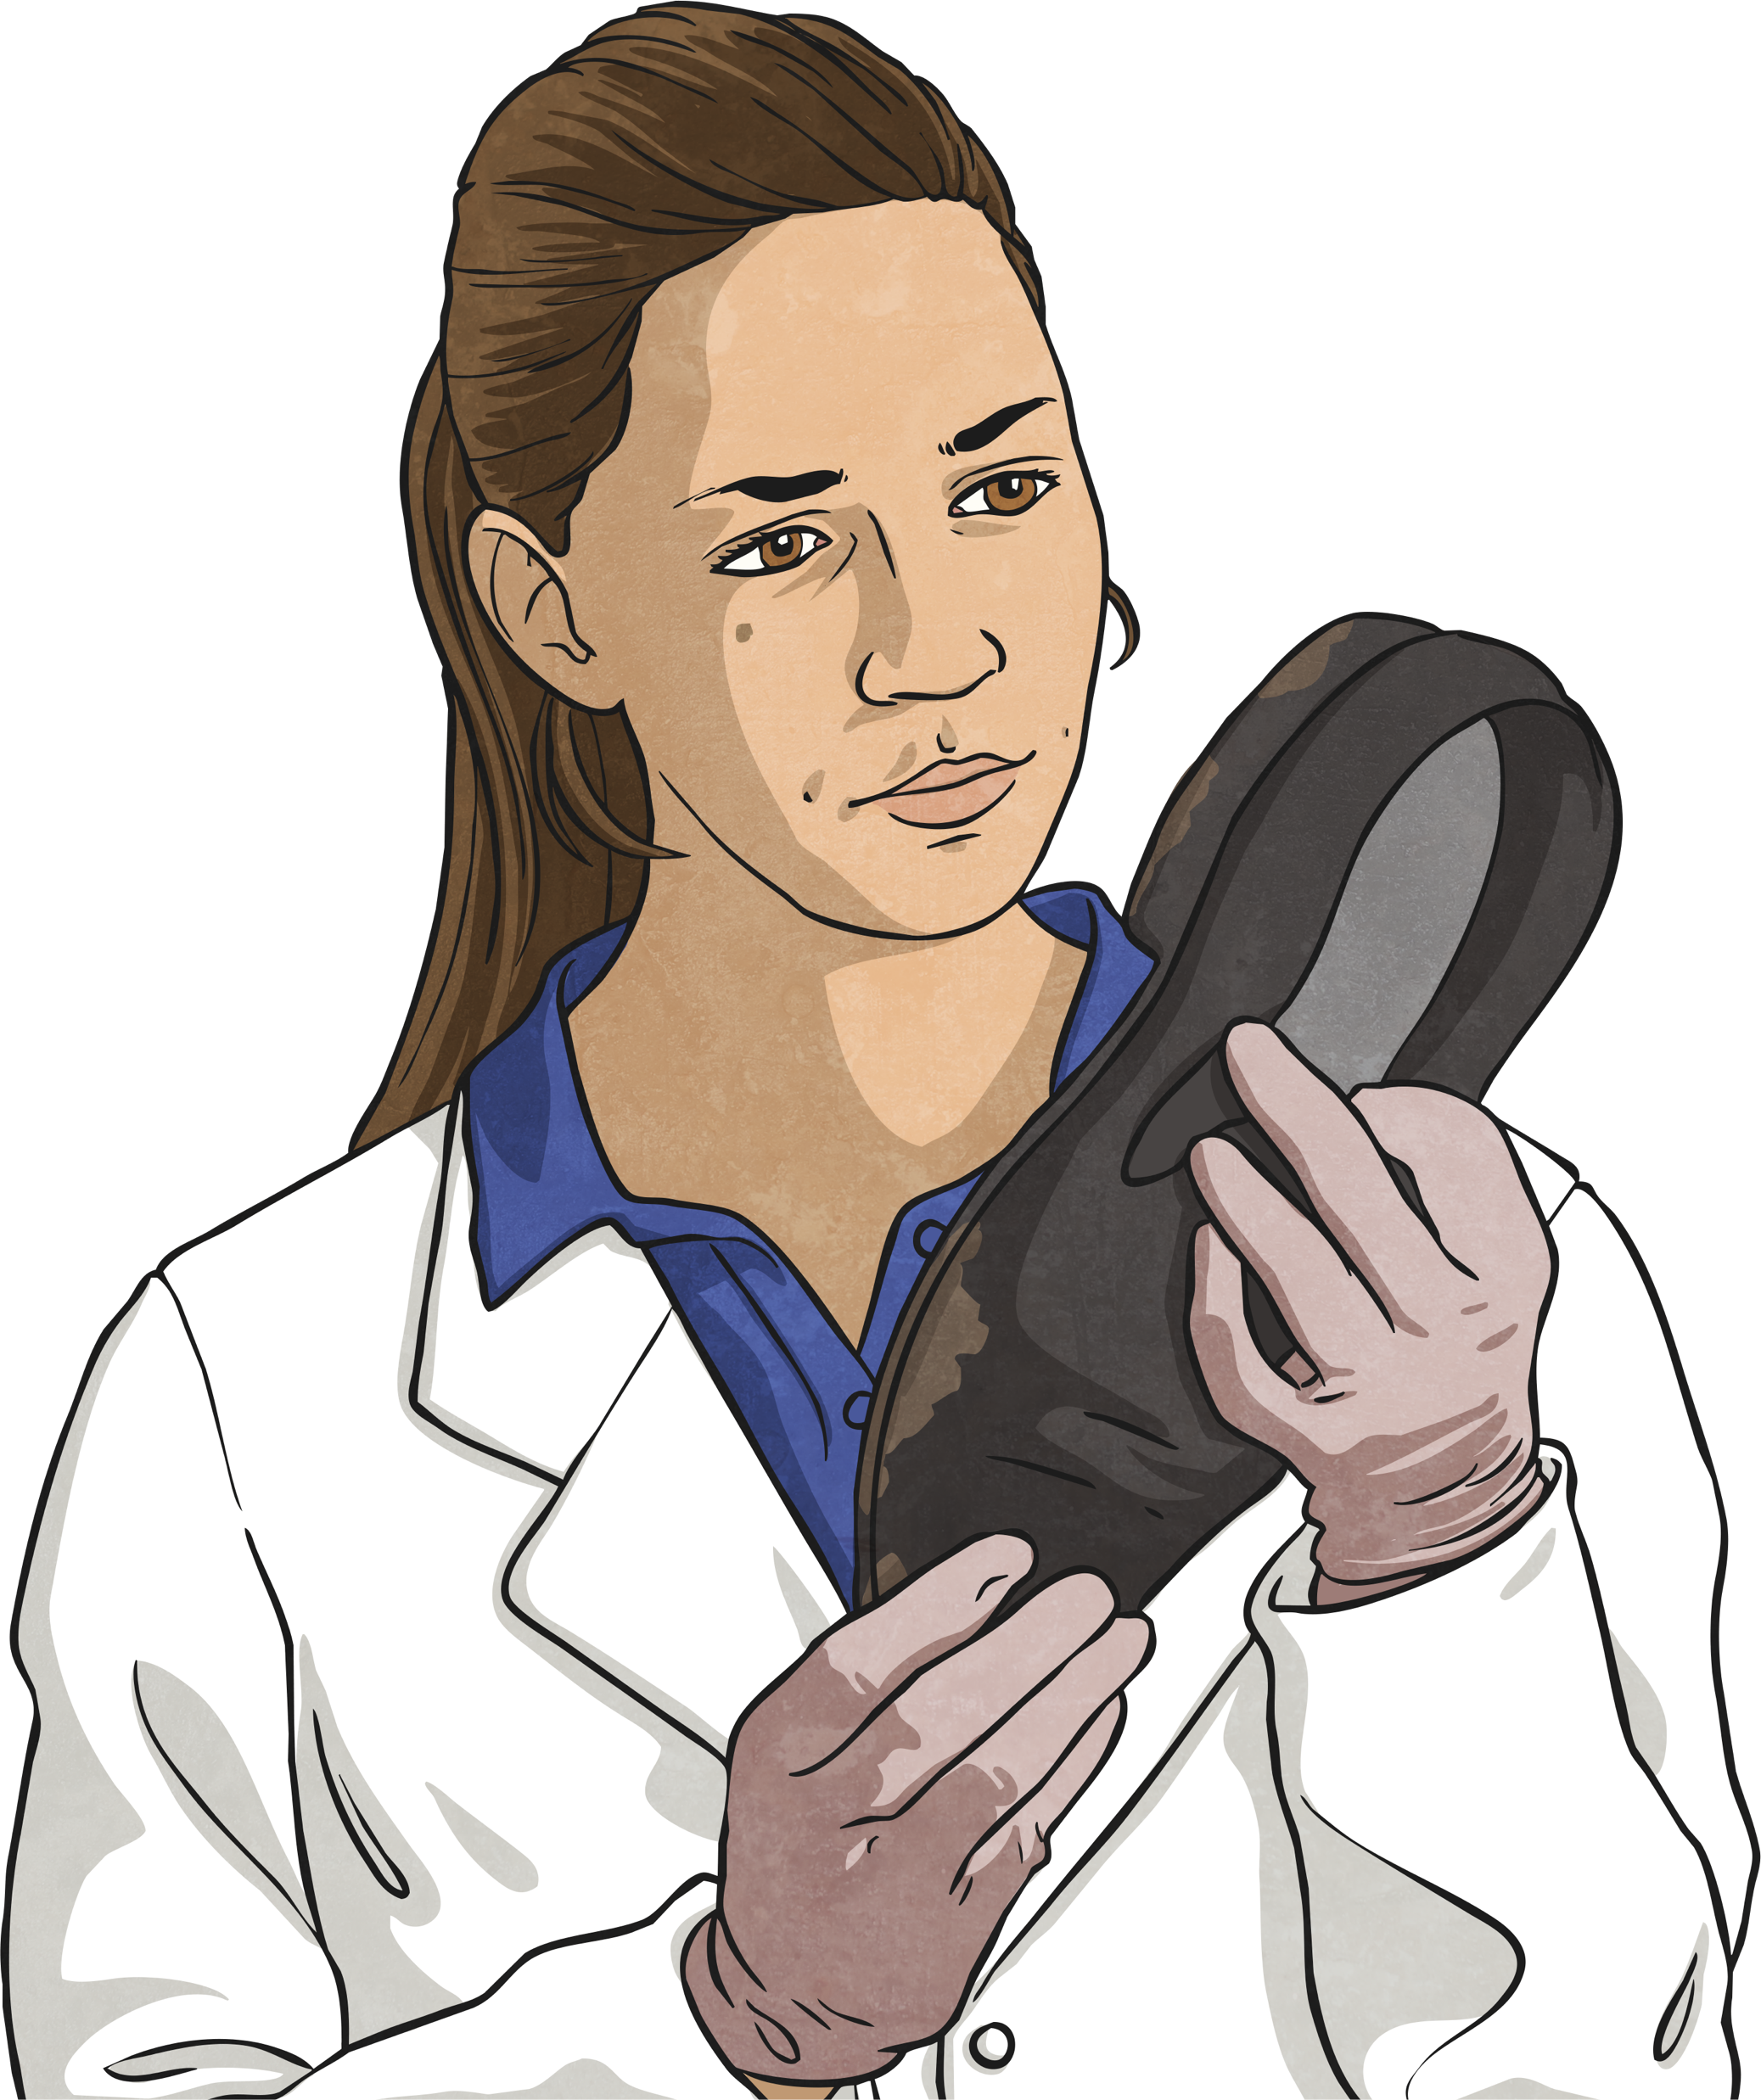
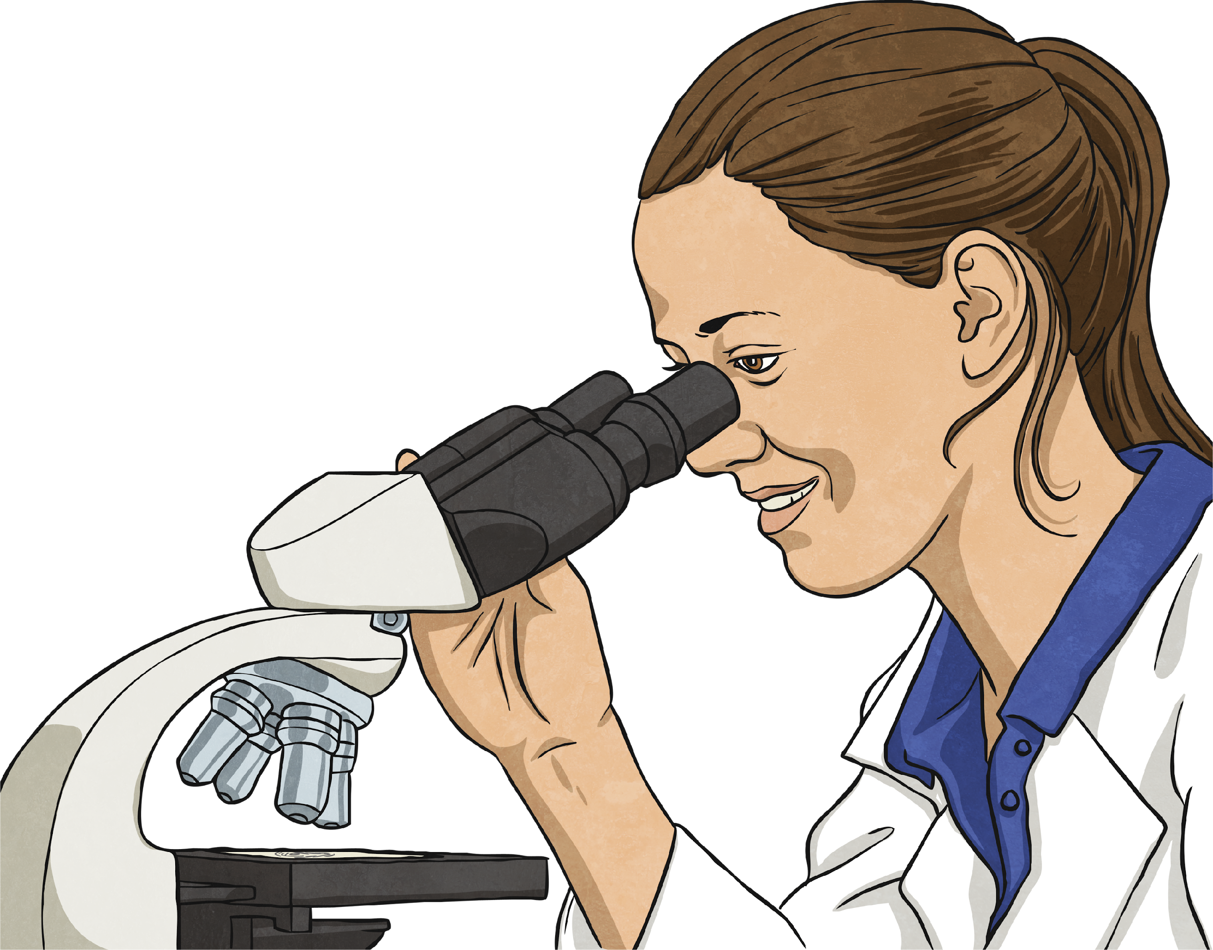
Discussion
Can you explain what forensic science is in your own words?
Why do you think forensic science is important for solving crimes and ensuring justice?
Which type of forensic scientist do you find most interesting and why?
How do you think science and technology work together in forensic science?
How can forensic science help in everyday situations, not just in solving crimes?
After learning about forensic science, would you consider a career as a forensic scientist? Why or why not?

Slide 13
GOOD
LUCK!

