Slide 3
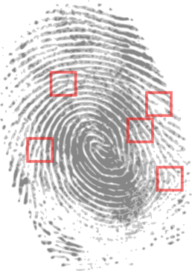

Would You Rather…
analyse fingerprints?
analyse DNA samples to solve a crime?

Slide 4
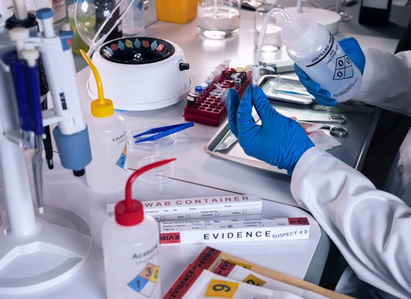
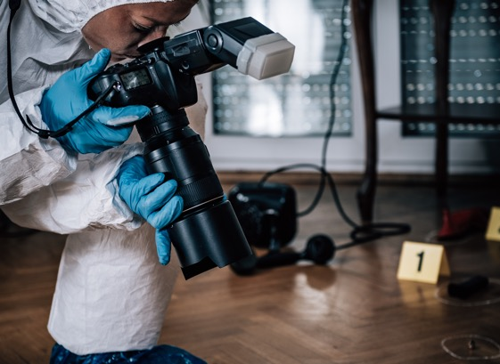
Would You Rather…
work in a laboratory?
work at a crime scene?

Slide 5
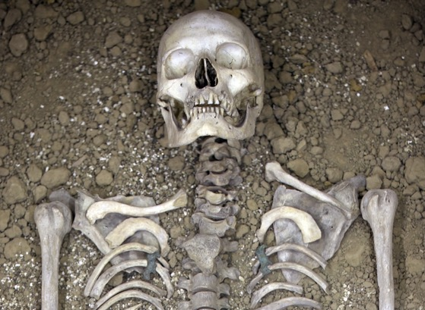
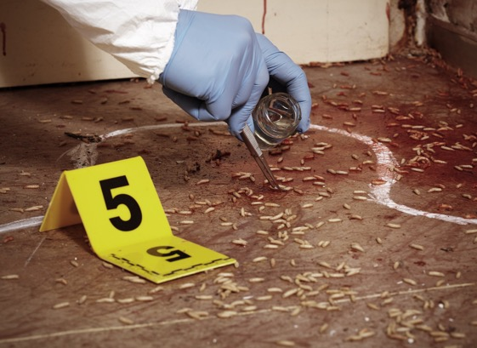
Would You Rather…
be an expert in anthropology?
be an expert in
forensic entomology?

Slide 6
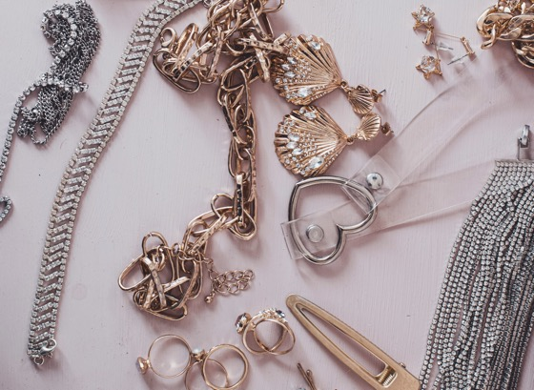
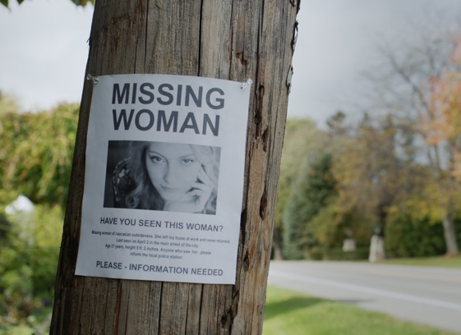
Would You Rather…
solve a case involving
stolen jewellery?
solve a case involving a missing person?

Slide 7
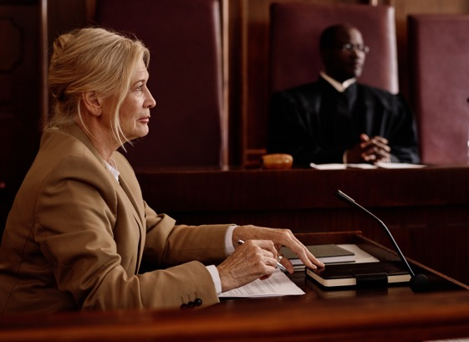

Would You Rather…
testify in court as an expert witness?
write detailed
forensic reports?

Slide 8
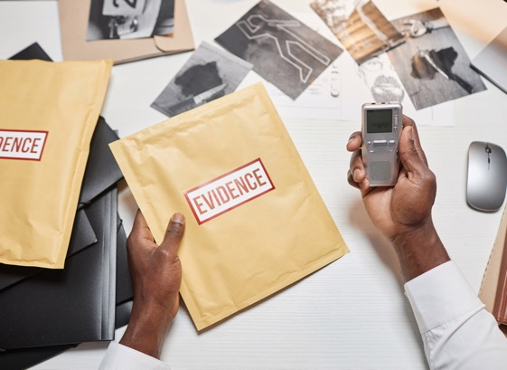
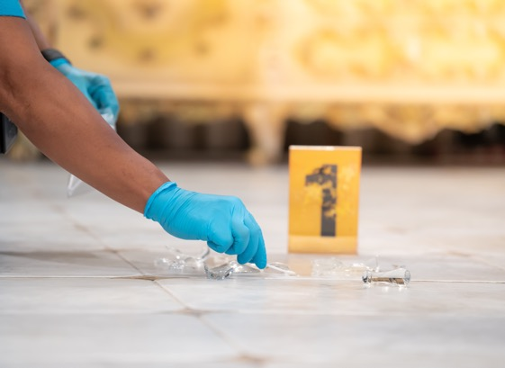
Would You Rather…
work on cold cases?
work on active investigations?

