Slide 1
Britain’s Shipwrecks Protected Using Forensic Marking

Slide 2
^{Disclaimer}
This resource refers to topical events in the news and is provided for informational and educational purposes only. Events in the news may emotionally impact your learners. You should consider whether this content is appropriate for your situation. It is also your responsibility to ensure that the information/activity this resource contains is safe and appropriate to use in your situation. You should not rely on the material included within this resource and Twinkl does not accept any responsibility if you do.

Slide 3



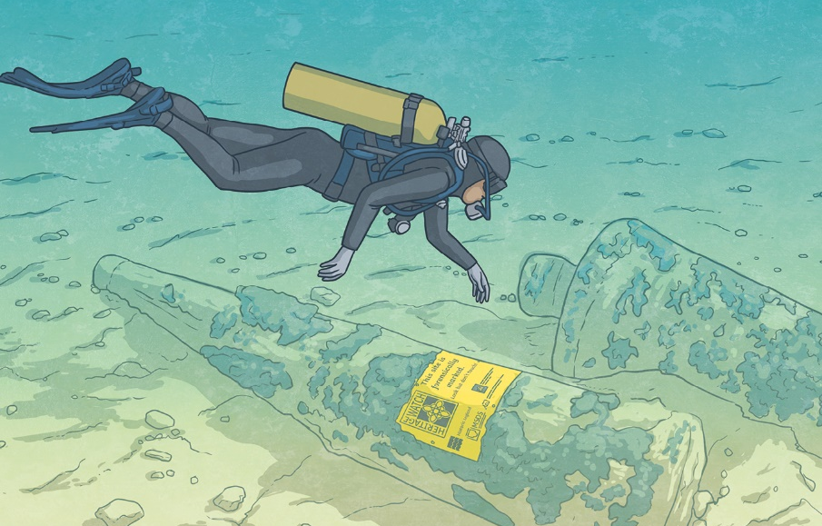

Daily News
Technology UK News
21st October 2023
Britain’s Shipwrecks Protected Using Forensic Marking
Some of Britain’s 57 protected shipwreck sites are being protected using a new technology. It’s a special liquid known as forensic marking.
According to Historic England, it has taken eight years to create.
Alison James works for MSDS Marine. She says that the technology “is a game changer for maritime archaeology and how authorities protect sites underwater”.
Historic England hopes the technology will act as a deterrent and stop people from stealing underwater artefacts.
The sites will have a label showing
that they are marked with the new technology. That’s because it cannot be seen by the naked eye.
If someone were to dive down and remove something, the special liquid would transfer to their clothing and skin.
Illustration: A diver inspecting a forensically marked site.
Comprehension Questions
Today’s Big Question
Notes:
Teacher Note - Please do not let the next video automatically play at the end of the clip. Please check the content in this link, including any comments, is suitable for your educational environment before showing. Twinkl accepts no responsibility for the content of third party websites.

Slide 4

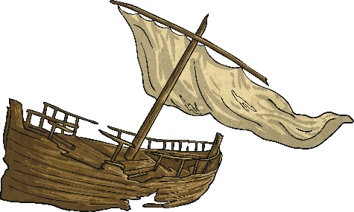
Did You Know…?
This year marks 50 years since The Protection of Wrecks Act was introduced in England. This act means that the area around a wreck can be protected.
There are approximately 37,000 shipwrecks around Britain’s
coasts.
One of these is known as the Klein Hollandia. It is a Dutch warship and has only recently been identified. It had been known previously as the ‘Unknown Wreck off Eastbourne’.
Glossary
Word | Definition
forensic | Scientific tests used by the police when solving crimes.
maritime | Linked to ships and the sea.
archaeology | The study of the past through exploration of sites and objects found.
deterrent | Something that makes a person less likely to do something.

Slide 5
Comprehension Questions
Click to reveal each answer
1. According to the article, how long has it taken to create the forensic marking technology?
eight years
2. Which of the following synonyms could be used as an alternative to ‘protected’ as it is used in the opening sentence?
✓
developed
guarded
removed
decorated
3. Using information from the article, fill in the missing words to complete the sentence.
forensic
Historic England hopes that the technology will be a
to underwater thieves.
deterrent

Slide 6




Big Question
Why might someone want to steal some of Britain’s history?
Try to think critically, and see the argument from both sides. There doesn’t have to be a right answer so feel free to play with ideas and explore why you hold certain beliefs.
Talk to the person next to you and tell them what you think. Then, listen to what they have to say.

