Slide 1
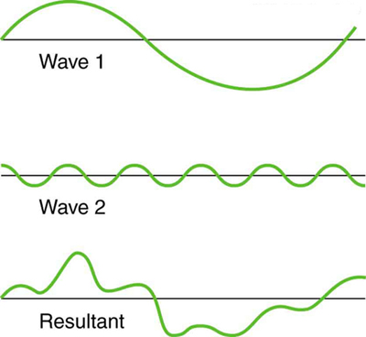
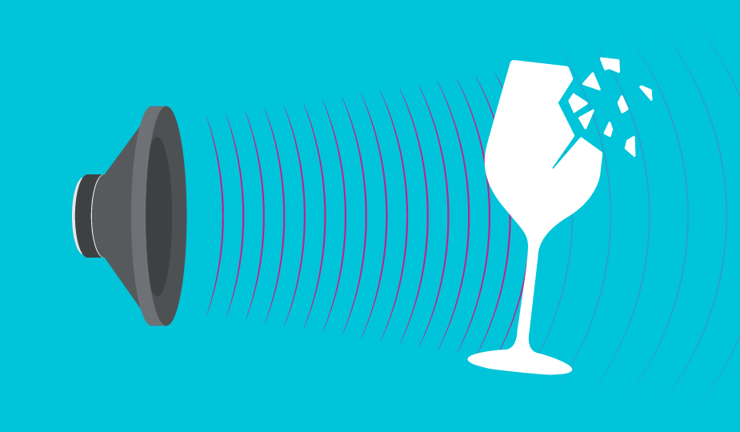
SUPERPOSITION AND INTERFERENCE
RESONANCE

Slide 2
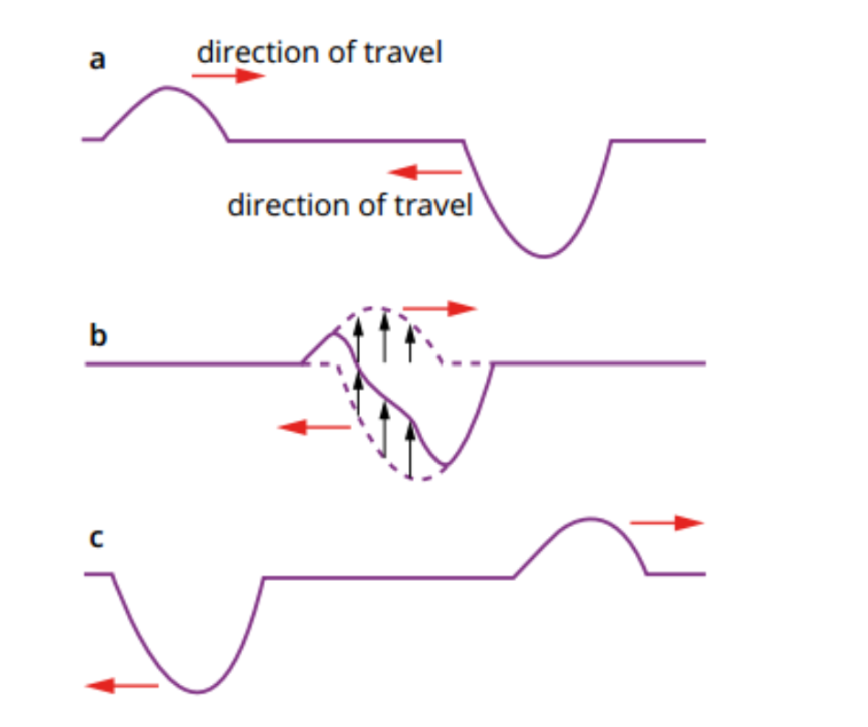
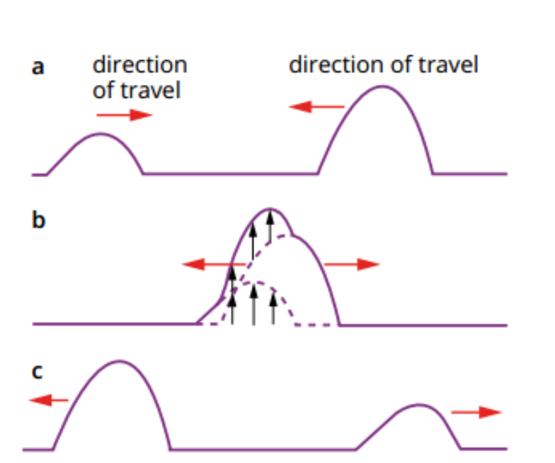
Superposition and Interference
Interaction of waves, add waves vectorially
Constructive Interference
Destructive Interference
Waves add to produce waves of larger displacement .
Waves with opposite displacements add to produce waves of smaller displacement .
After the waves travel past each other they go back to their original shape..

Slide 3
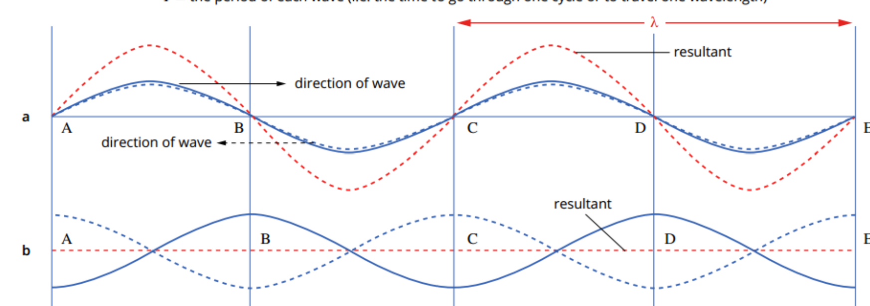
COMPLETE CONSTRUCTIVE INTERFERENCE
Waves are in-phase, have the same frequency and amplitude
COMPLETE DESTRUCTIVE INTERFERENCE
Waves are 180° out-phase, have the same frequency and amplitude

Slide 4
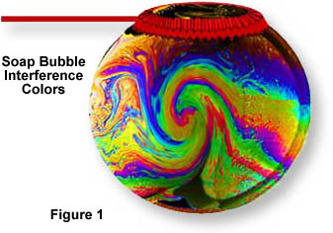

Superposition and Interference

Slide 5

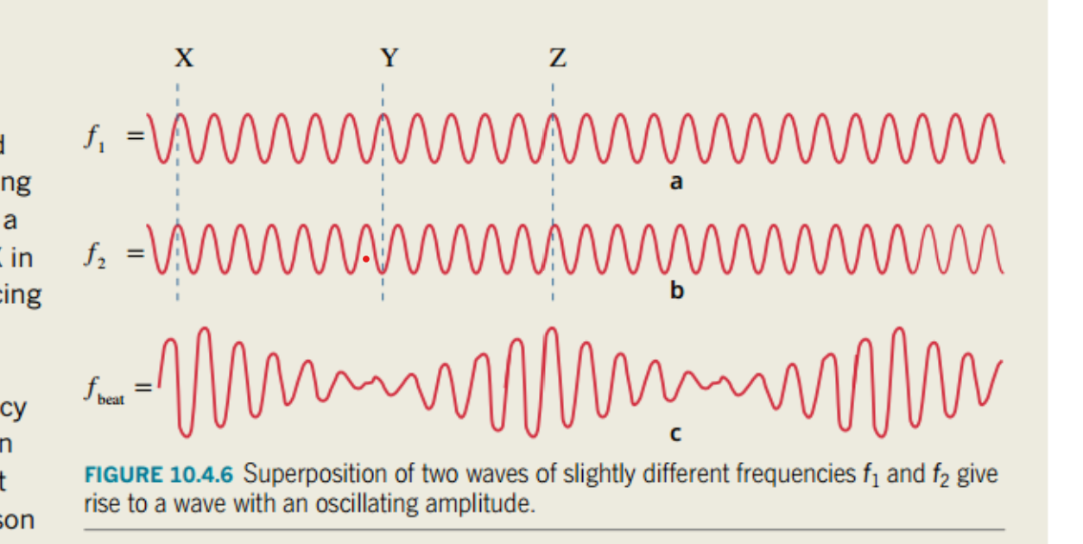

Slide 6
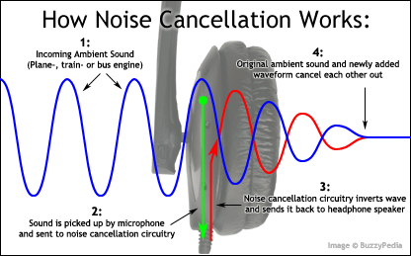
Noise Cancelling Earphones

Slide 7

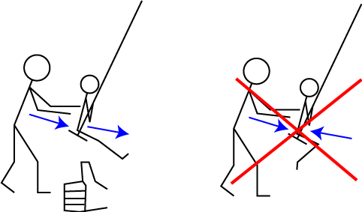
RESONANCE
Pearson 10.4
All objects vibrate at a
natural frequency or resonant frequency
Resonance occurs when
Forcing frequency = resonant frequency
Forcing frequency
Effects of Resonance
The amplitude of oscillations within the resonant object increase dramatically.
Maximum possible energy from the source creating the forced vibration is transferred to the resonating object.
natural frequency of the
swing

Slide 8
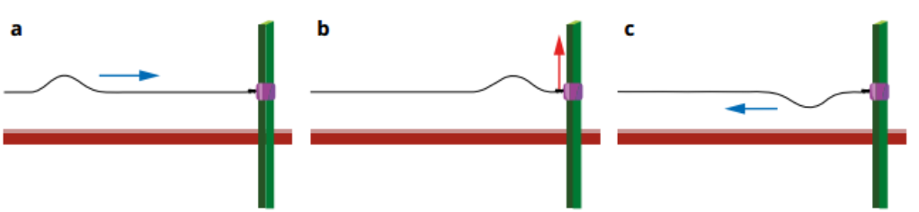
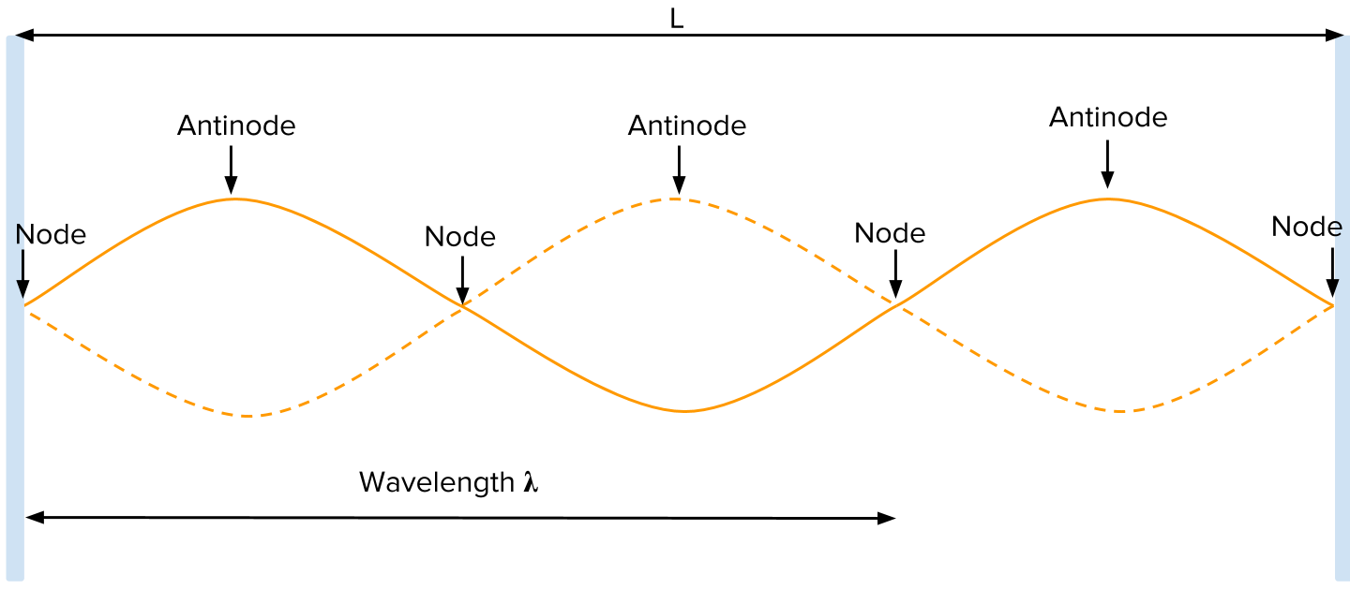
STANDING WAVES
Standing waves are formed from two waves of same frequency and amplitude
travelling in opposite directions.
One wave is often the reflection of the other.
Fixed end – wave inverts on reflection
Shaking the rope at just the right frequency will result in new wave that interferes and appears to form a single , larger amplitude standing wave.

Slide 9
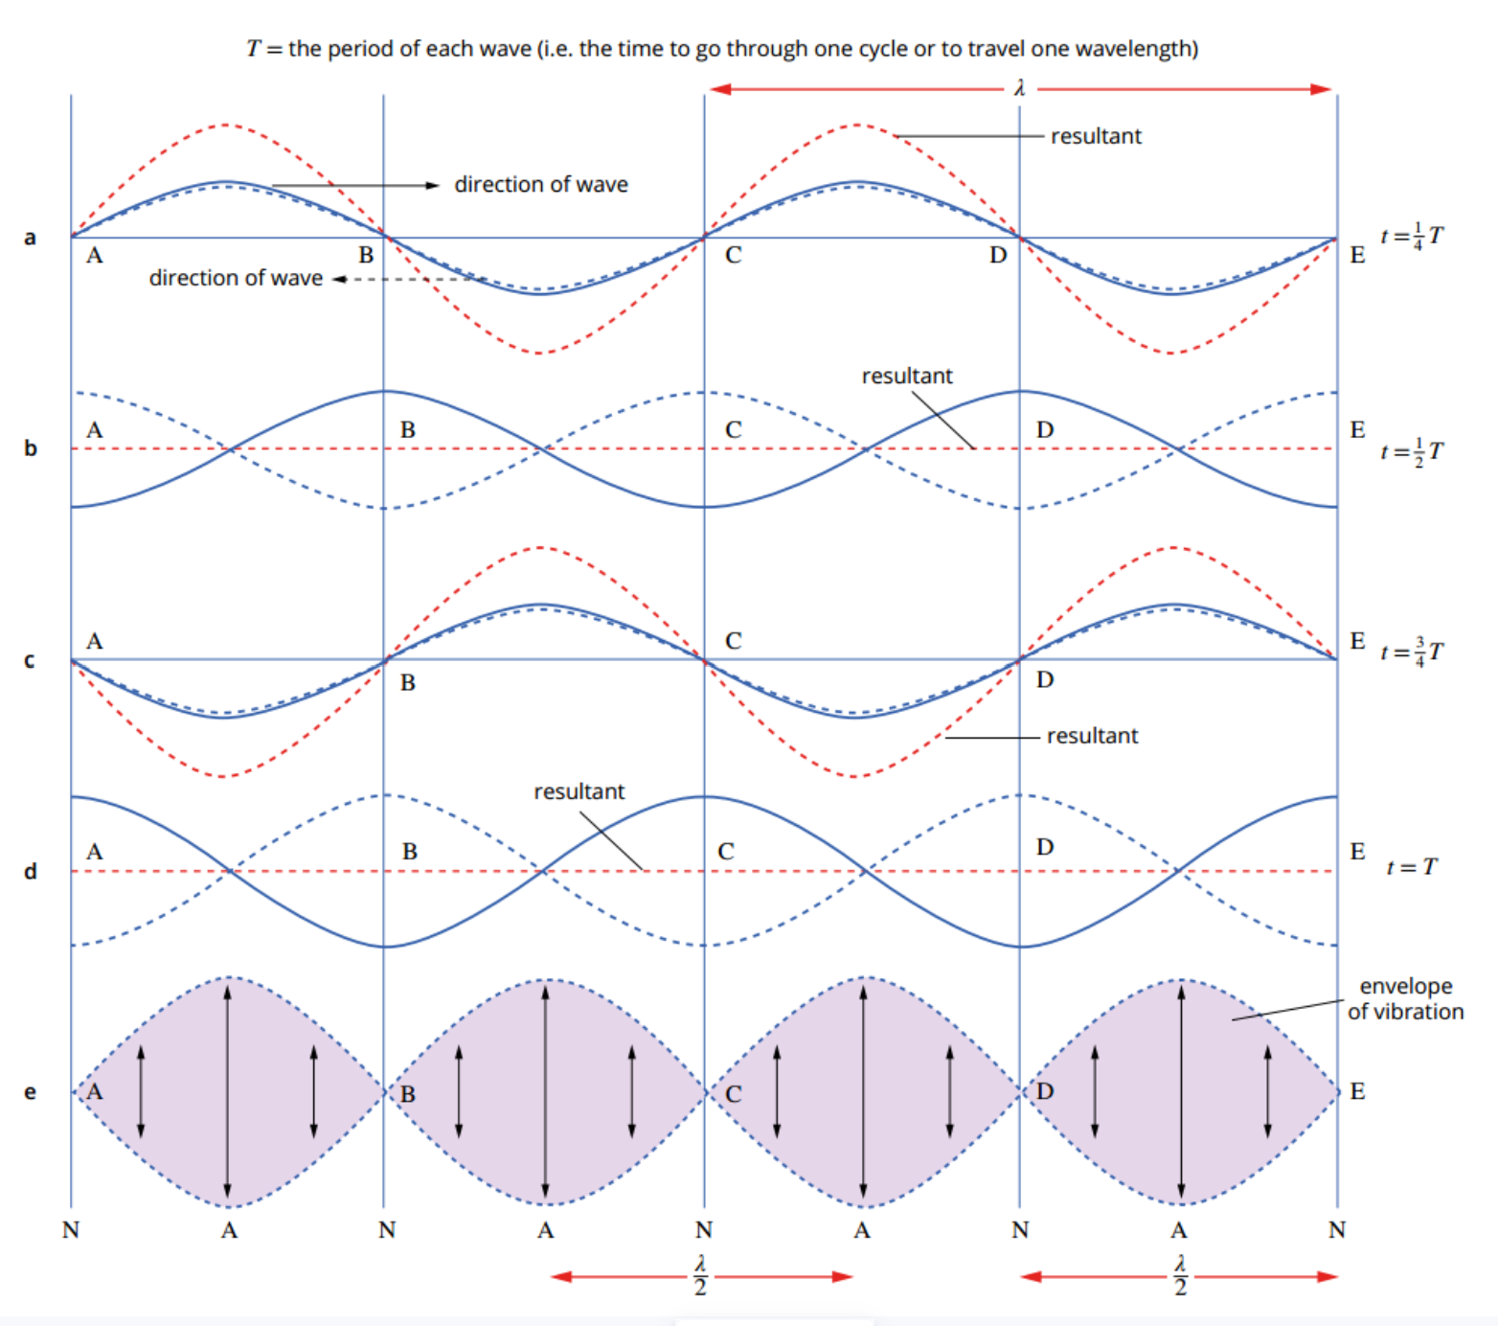
Two waves completely superimposed
Complete constructive interference
Waves have each moved
180° out of phase
Complete destructive interference
Complete constructive interference
Complete destructive interference
Forms a standing wave

Slide 10
Antinodes and nodes are fixed for a particular frequency
Note, the rope itself is not stationary, it is the interference of waves travelling back and forth on the rope.
Nodes are points along the wave which always have zero displacement
Antinodes are points along the wave vibrate from maximum positive displacement through maximum negative displacement

Slide 11
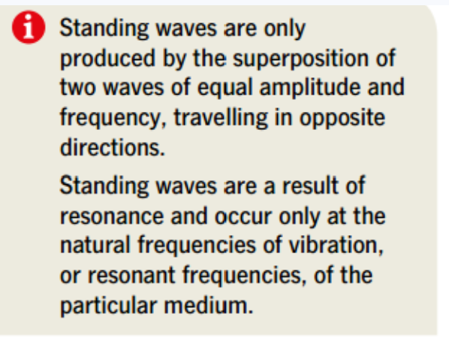

Slide 12
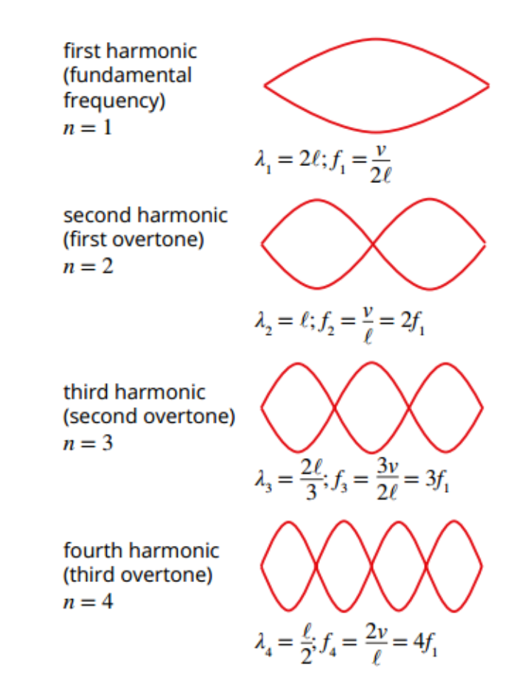
HARMONICS IN A STRING
String fixed at both ends

Slide 13
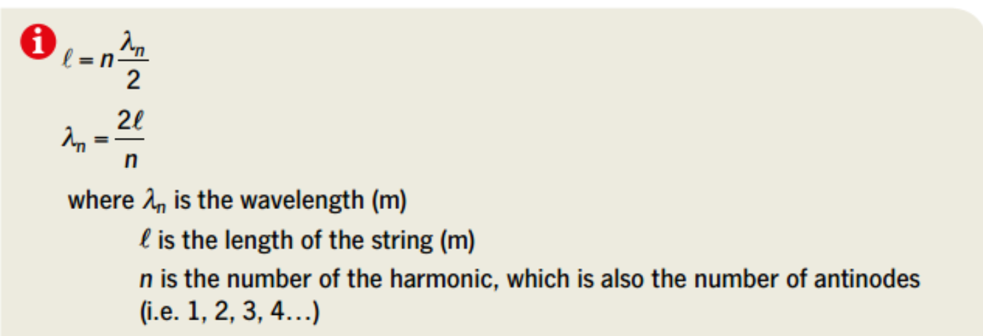
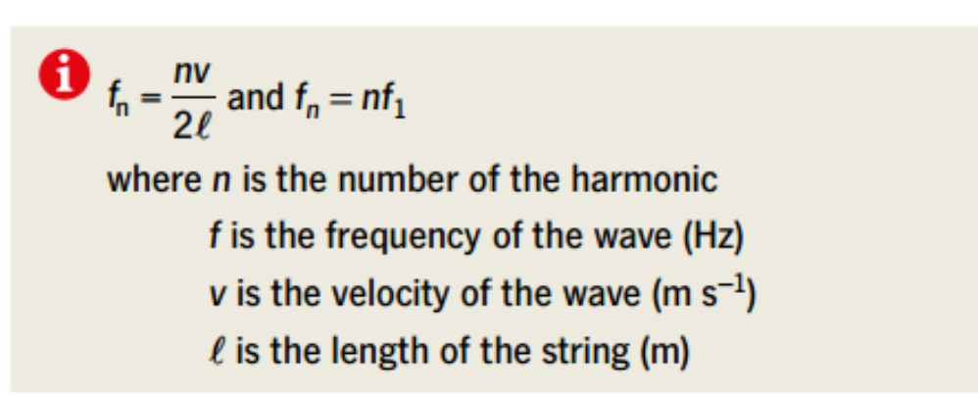
HARMONICS IN A STRING
Can you derive a general expression:

Slide 14
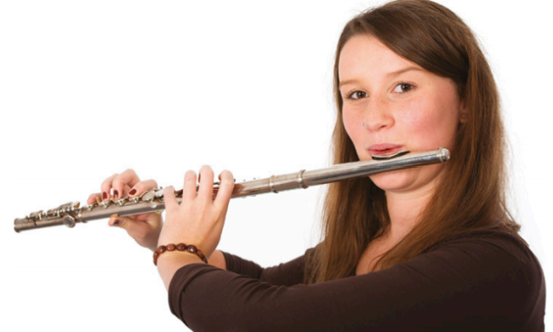
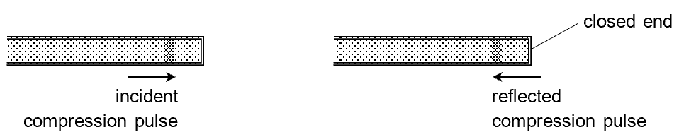
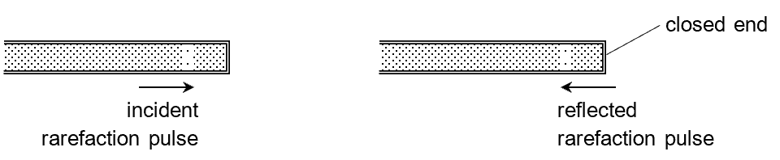
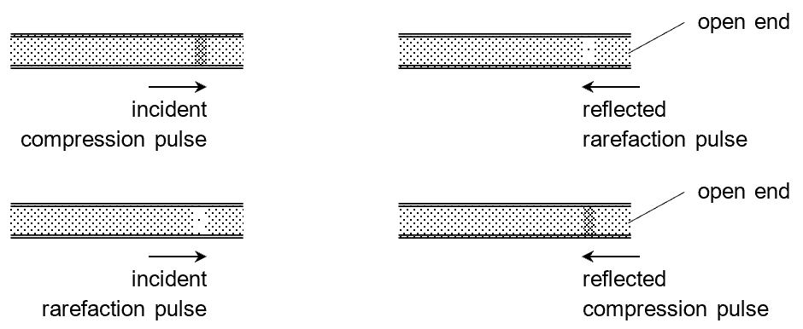
WIND INSTRUMENTS AND HARMONICS
Compressions and rarefactions reflect from the end of a pipe.
Closed at one end
Open at both ends

Slide 15
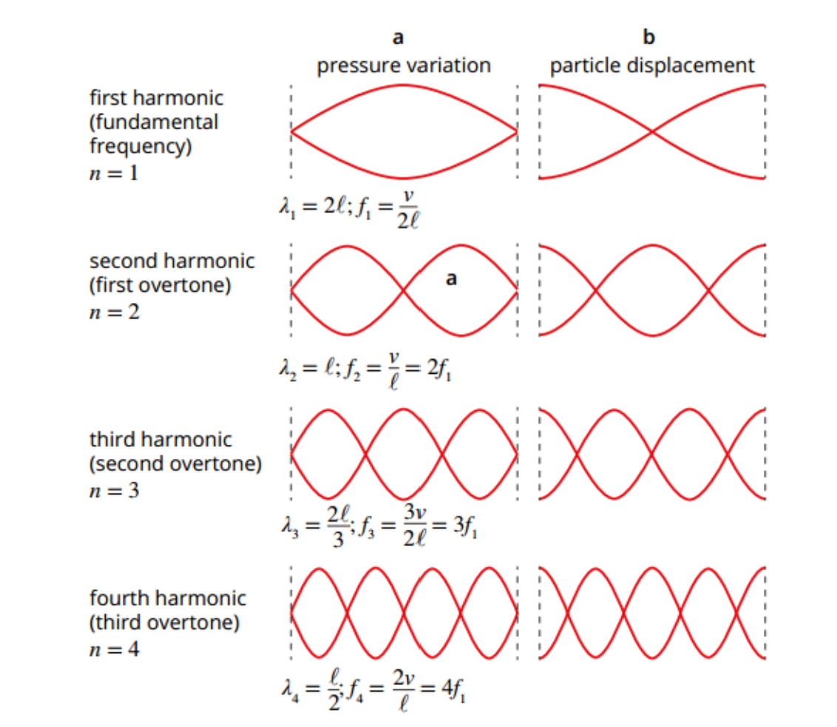
Drawing it using sine waves
Antinode
Node
Compression
Antinode
Node

Slide 16
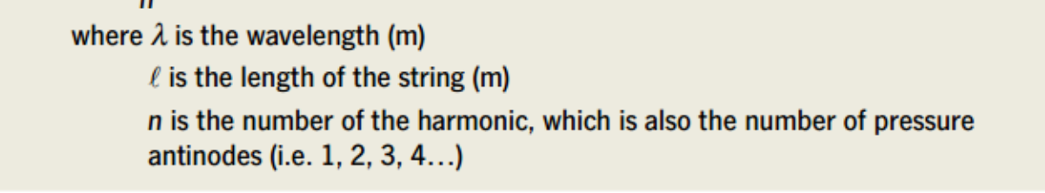
HARMONICS, PIPE OPEN AT BOTH ENDS
Note pressure variation behaves the same as string with two fixed ends

Slide 17
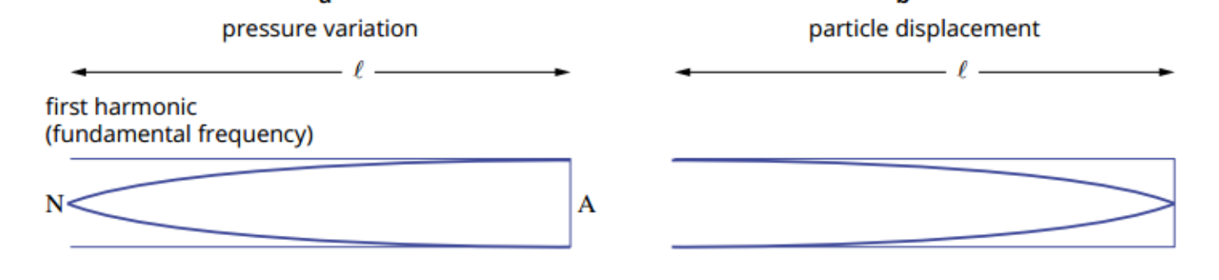
HARMONICS, PIPE CLOSED AT ONE END
Open end reflects a sound wave with a change of phase
So, there is a node at the end.
Closed end reflects a sound wave with no change of phase.
Waves interfere constructively
So, there is an antinode at the end.

Slide 18
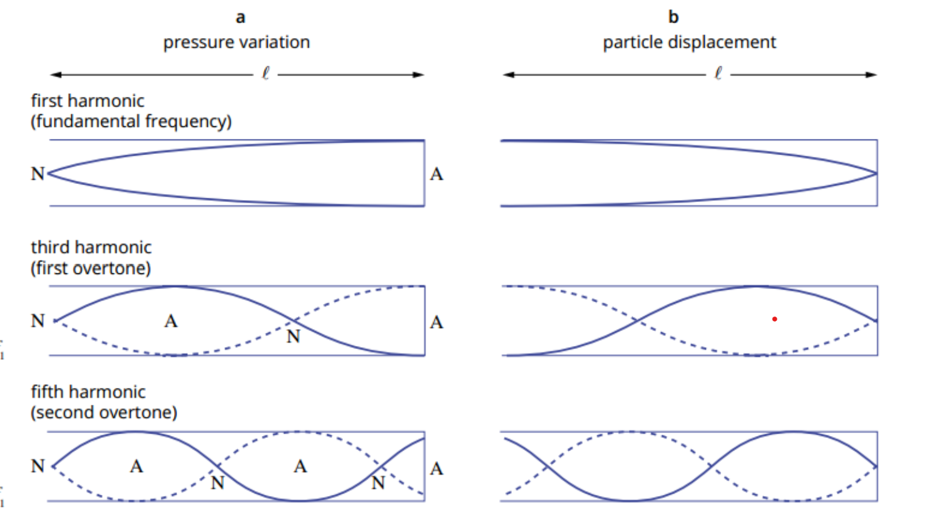
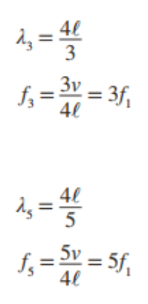
Note, the 2nd and 4th harmonic can’t form

Slide 19
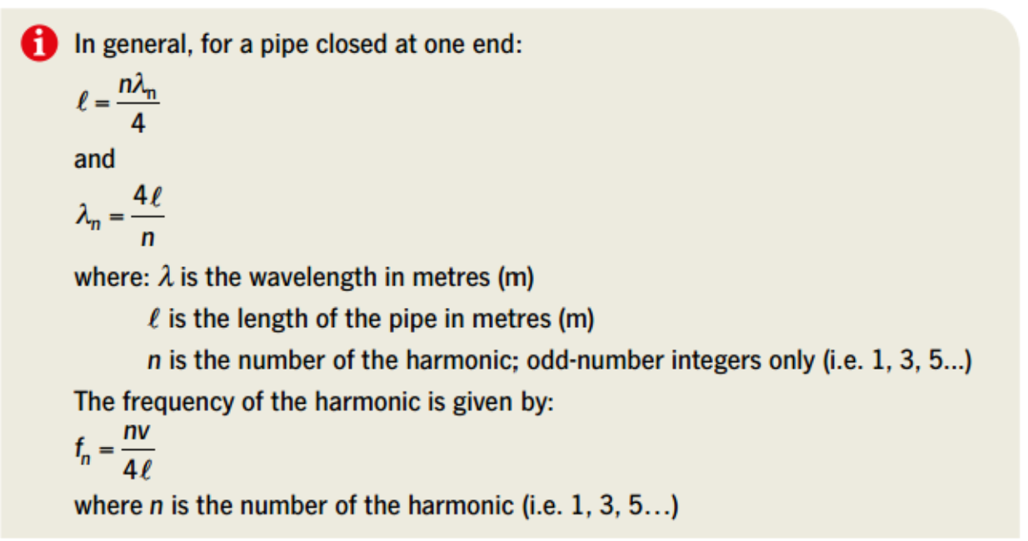
This is easier to understand!

Slide 20
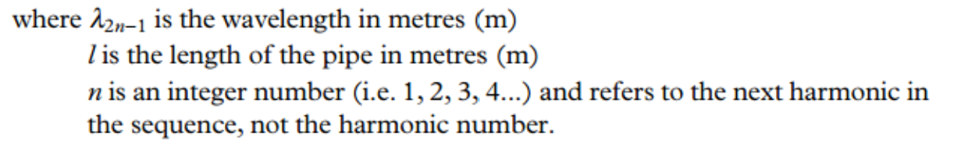
However, in the data sheet you have this!
2n-1 refers to the harmonic number
For n= 1, 2n-1= 2x1-1=1 , which is the first harmonic
For n= 2, 2n-1= 2x2-1=3 , which is the third harmonic
For n= 3, 2n-1= 2x3-1=5 , which is the fifth harmonic
I would use the other one!
All you have to do is change 2n-1 to n; remember n=1, 3, 5…. then you get the previous formula.

Slide 21
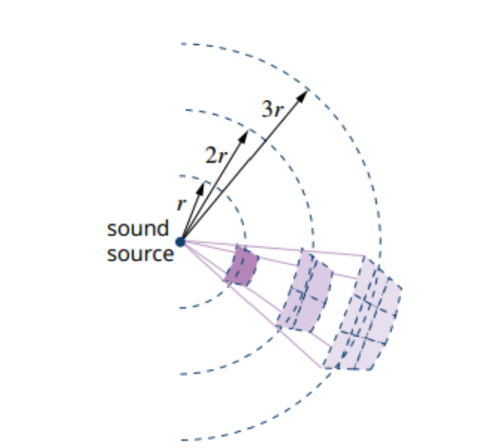
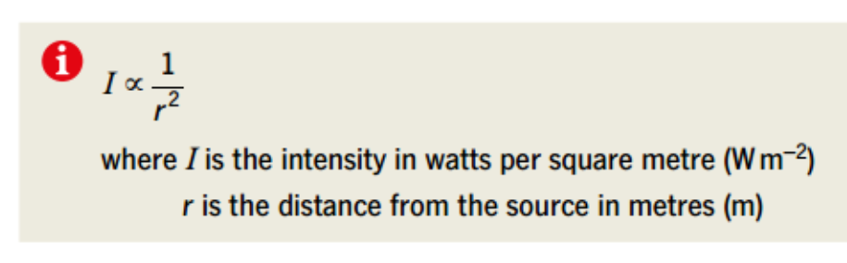
WAVE INTENSITY

