Slide 1
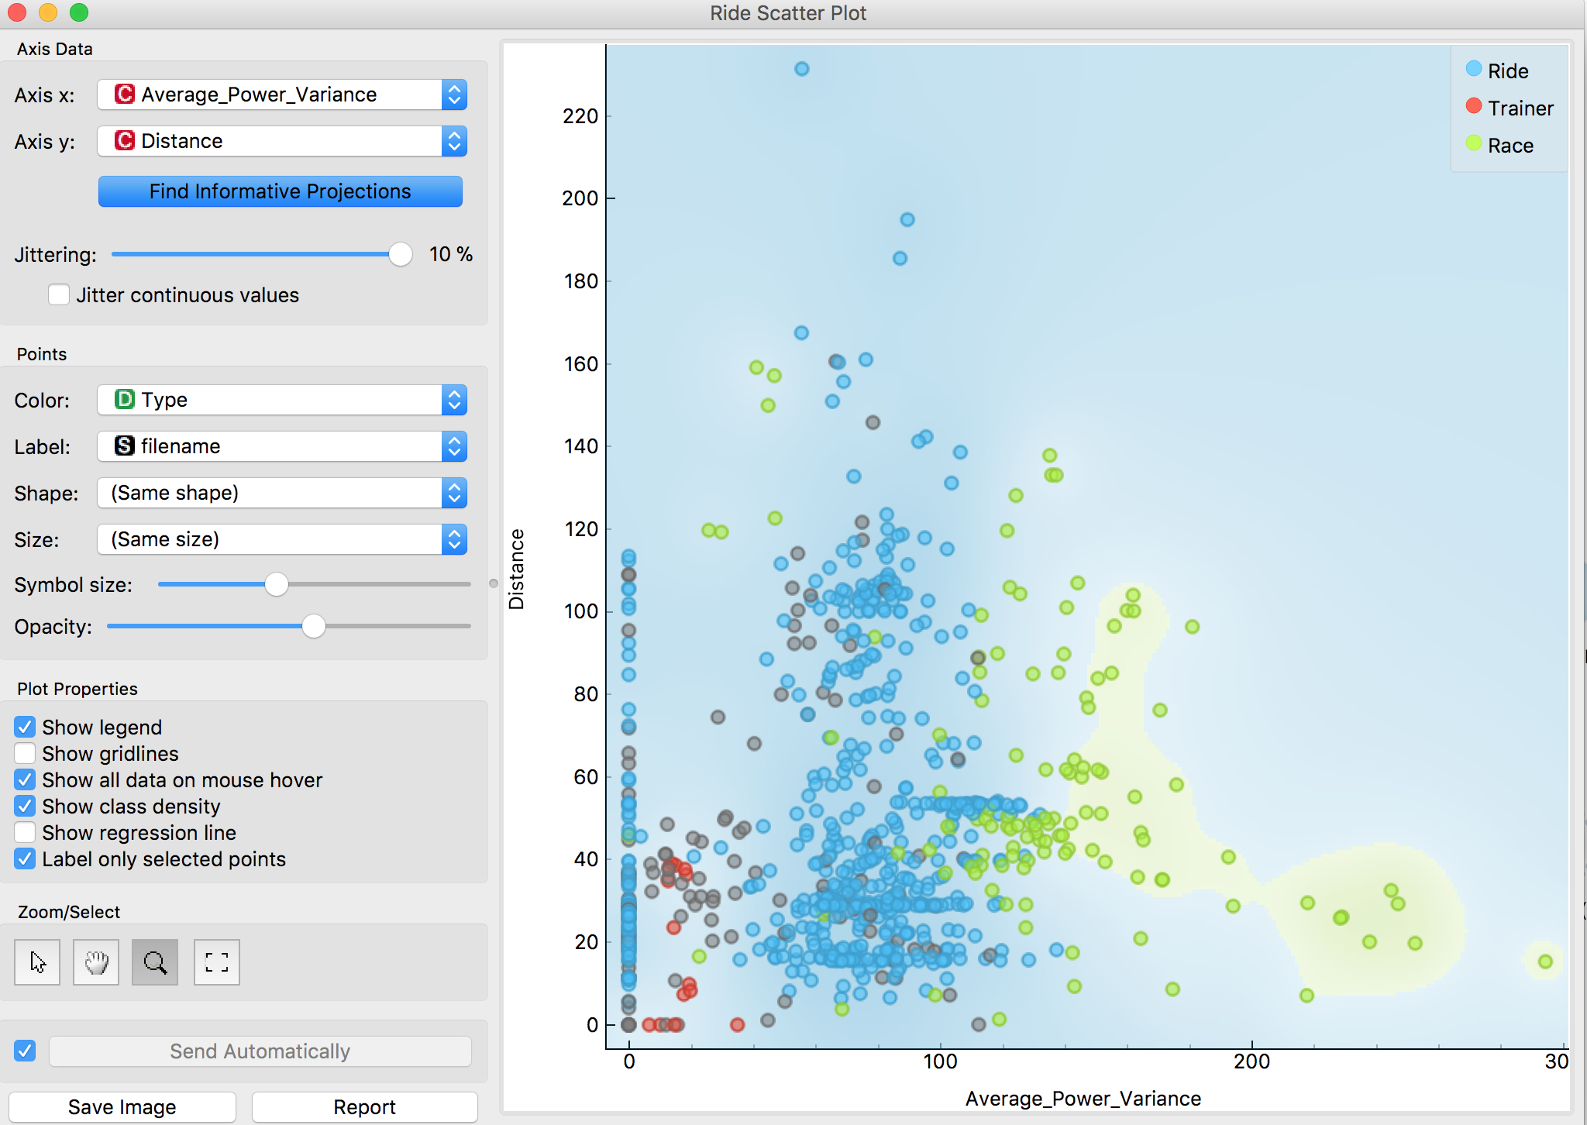
Haute
Route
Longer races
Club rides
Surrey League
Sat club rides
Circuits
Short TTs
Hill climbs
Street crit races

