Slide 1


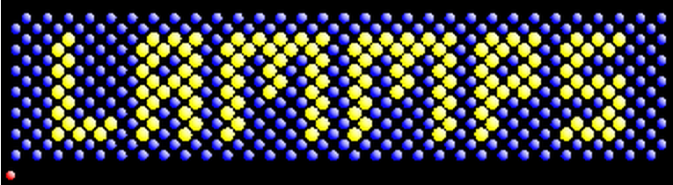
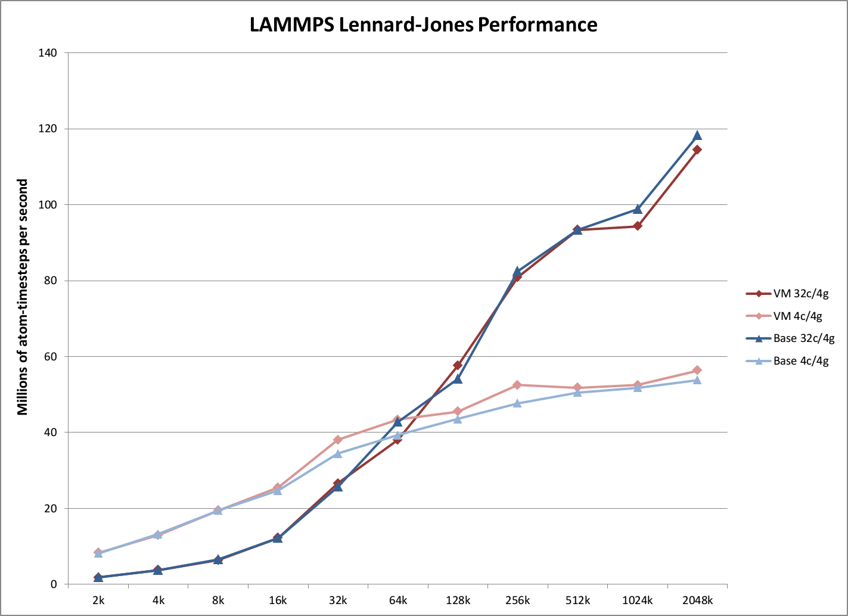
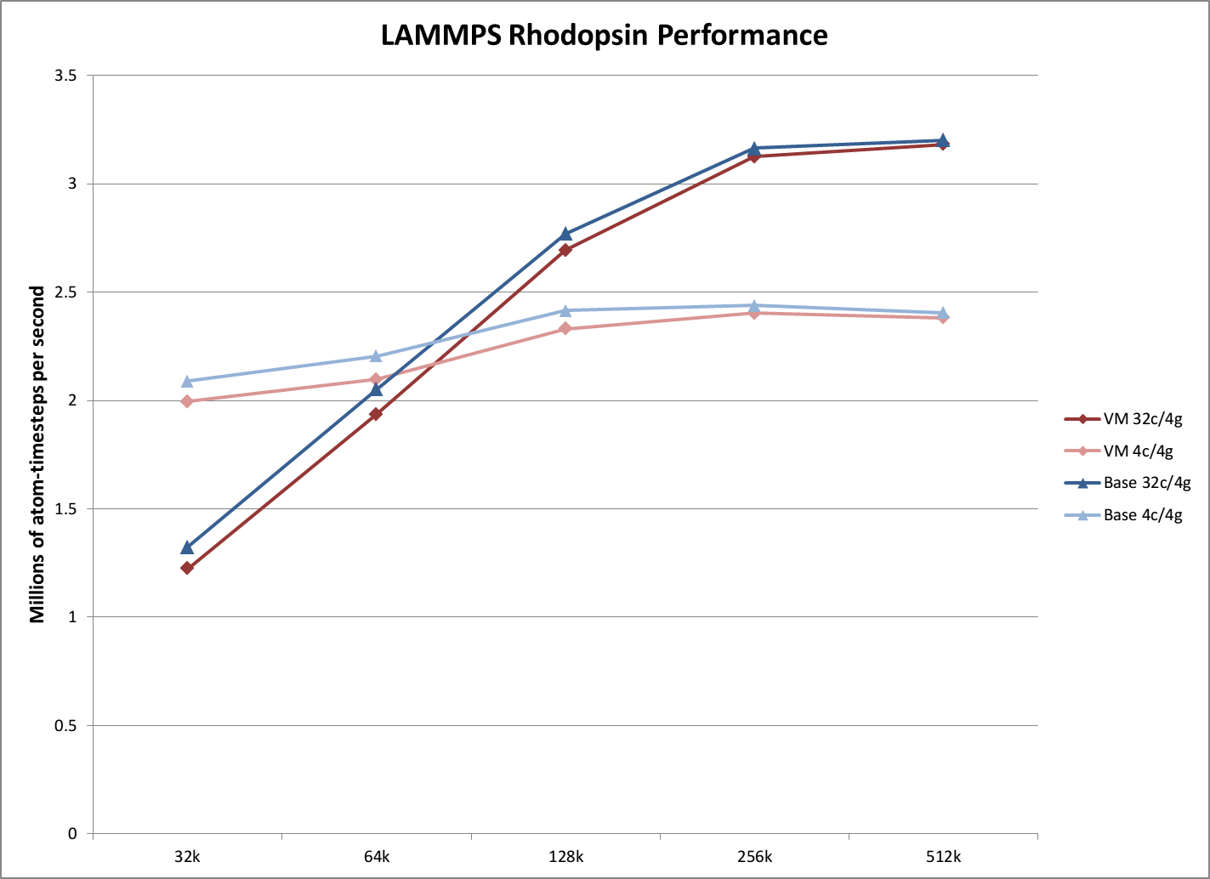

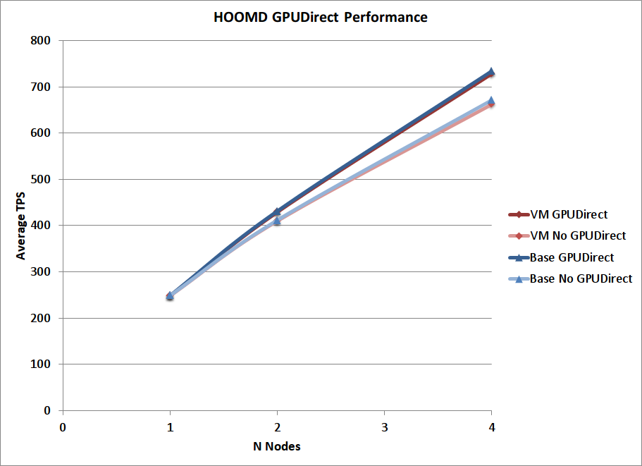
High Performance Molecular Dynamics in Cloud Infrastructure with SR-IOV and GPUDirect
Andrew J. Younge*, John Paul Walters⁺, Geoffrey C. Fox*
* School of Informatics & Computing, Indiana University
901 E. 10th St., Bloomington, IN 47408 U.S.A.
⁺ Information Sciences Institute, University of Southern California
3811 North Fairfax Drive, Suite 200, Arlington, VA 22203 U.S.A.
Introduction
Benchmarks
Results
Conclusion
At present we stand at the inevitable intersection between High Performance Computing (HPC) and Clouds. Various platform tools such as Hadoop and MapReduce, among others have already percolated into data intensive computing within HPC [1]. Alternatively, there are efforts to support traditional HPC-centric scientific computing applications in virtualized Cloud infrastructure. The reasons for supporting parallel computation on Cloud infrastructure is bounded only by the advantages of Cloud computing itself [2]. For users, this includes features such as dynamic scalability, specialized operating environments, simple management interfaces, fault tollarance, and enhanced quality of service, to name a few. The growing importance of supporting advanced scientific computing using cloud infrastructure can be seen by a variety of new efforts, including the NSF-funded XSEDE Comet resource at SDSC [3].
Reluctantly, there exists a past notion that virtualization used in today’s Cloud infrastructure is inherently inefficient. Historically, Cloud infrastructure has also done little to provide the necessary advanced hardware capabilities that have become almost mandatory in Supercomputers today, most notably advanced GPUs and high-speed, low-latency interconnects. The result of these notions has hindered the use of virtualized environments for parallel computation, where performance must be paramount.
Recent advances in hypervisor performance [4] coupled with the newfound availably of HPC hardware in virtual machines analogous to the most powerful supercomputers used today, we see can see the formation of a High Performance Cloud infrastructure. While our previous advanced in this are have focused on single-node advancements, it is now imparative to ensure real-world applications can also operate at scale. Furthermore, the tight and exact integration into an open source Cloud infrastructure framework such as OpenStack also
becomes a critical next step.
Historically running advanced scientific applications in a virtualized infrastructure has been limited by both performance and advanced hardware availability
Recent advancements allow for the use of both GPUs and InfiniBand fabric to be leveraged directly in VMs
LAMMPS and HOOMD represent Molecular Dynamics tools commonly used on the most powerful supercomputers
Virtualized performance for both applications at near-native
96.7% and 99.3% efficiency for LAMMPS LJ 2048k and RHODO 512k simulations
98.5% efficiency for HOOMD LJ 256k simulation
Support for new GPUDirect RDMA features in virtualized system
Large-scale virtualized Cloud Infrastructure can now support many of the same advanced scientific computations that are commonly found running on today’s supercomputers.
LAMMPS
HOOMD-Blue
References
[1] S. Jha, J. Qiu, A. Luckow, P. K. Mantha, and G. C. Fox, “A tale of two data-intensive paradigms: Applications, abstractions, and architectures,” in Proceedings of the 3rd International Congress on Big Data (BigData 2014), 2014.
[2] M. Armbrust, A. Fox, R. Griffith, A. D. Joseph, R. Katz, A. Konwinski, G. Lee, D. Patterson, A. Rabkin, I. Stoica, and M. Zaharia, “A view of cloud computing,” Commun. ACM, vol. 53, no. 4, pp. 50–58, Apr. 2010.
[3] M. Norman and R. Moore, “NSF awards 12 million to sdsc to deploy comet supercomputer,” Web page, 2013.
[4] A. J. Younge, R. Henschel, J. T. Brown, G. von Laszewski, J. Qiu, and G. C. Fox, “Analysis of Virtualization Technologies for High Performance Computing Environments,” in Proceedings of the 4th International Conference on Cloud Computing (CLOUD 2011). Washington, DC: IEEE,
July 2011.
[5] J. P. Walters, A. J. Younge, D.-I. Kang, K.-T. Yao, M. Kang, S. P. Crago, and G. C. Fox, “GPU-Passthrough Performance: A Comparison of KVM, Xen, VMWare ESXi, and LXC for CUDA and OpenCL Applications,” in Proceedings of the 7th IEEE International Conference on Cloud
Computing (CLOUD 2014), IEEE. Anchorage, AK: IEEE, 2014.
[6] J. Jose, M. Li, X. Lu, K. C. Kandalla, M. D. Arnold, and D. K. Panda, “SR-IOV support for virtualization on infiniband clusters: Early experience,” in Cluster Computing and the Grid, IEEE International
Symposium on, 2013, pp. 385–392.
[7] M. Musleh, V. Pai, J. P. Walters, A. J. Younge, and S. P. Crago, “Bridging the Virtualization Performance Gap for HPC using SR-IOV for InfiniBand,” in Proceedings of the 7th IEEE International Conference on Cloud Computing (CLOUD 2014), IEEE. Anchorage, AK: IEEE, 2014.
[8] W. M. Brown, “GPU acceleration in LAMMPS
[9] J. Anderson, A. Keys, C. Phillips, T. Dac Nguyen, and S. Glotzer, “HOOMD-Blue, general-purpose many-body dynamics on the GPU,” in APS Meeting Abstracts, vol. 1, 2010, p. 18008.
Focus Areas
Hypervisor Performance
Virtualization can operate with near-native performance.
IO Virtualization
Leverage VT-d/IOMMU extensions to pass PCI-based hardware directly to a guest VM.
GPUs and Accelerators
Utilize PCI Passthrough in to provide GPUs to VMs
Many hypervisors now able to support GPU Passthrough – we use KVM for best performance.
High Speed Interconnects
Using SR-IOV, we can create multiple VFs from a single PCI devicee, each assigned directly to a VM.
Use Mellanox ConnectX3 VPI InfiniBand.
QDR/FDR InfiniBand now possible within Cloud IaaS!
OpenStack Integration
Integrate virtualization advances to the OpenStack Cloud IaaS.
Prototype available, some features available today

