Slide 1
XMS Scientific Impact
PEARC17 XMS Advisory Committee meeting
July 2017

Slide 2
Scientific Impact Metrics for XSEDE
Scientific Impact portal showing the impact metrics
E.g., publication/citation count by Field of Study, by Organization, by Geographical locations
https://sciimp.ccr.xdmod.org/xdportalpub/overview
Quarterly report as an appendix for XSEDE NSF report
Monthly updated overall scientific impact metrics
Historical trends of the metrics

Slide 3
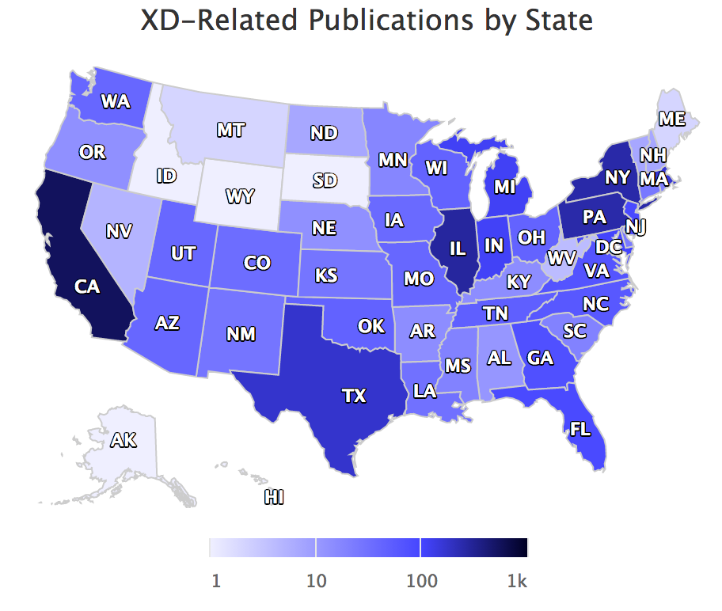
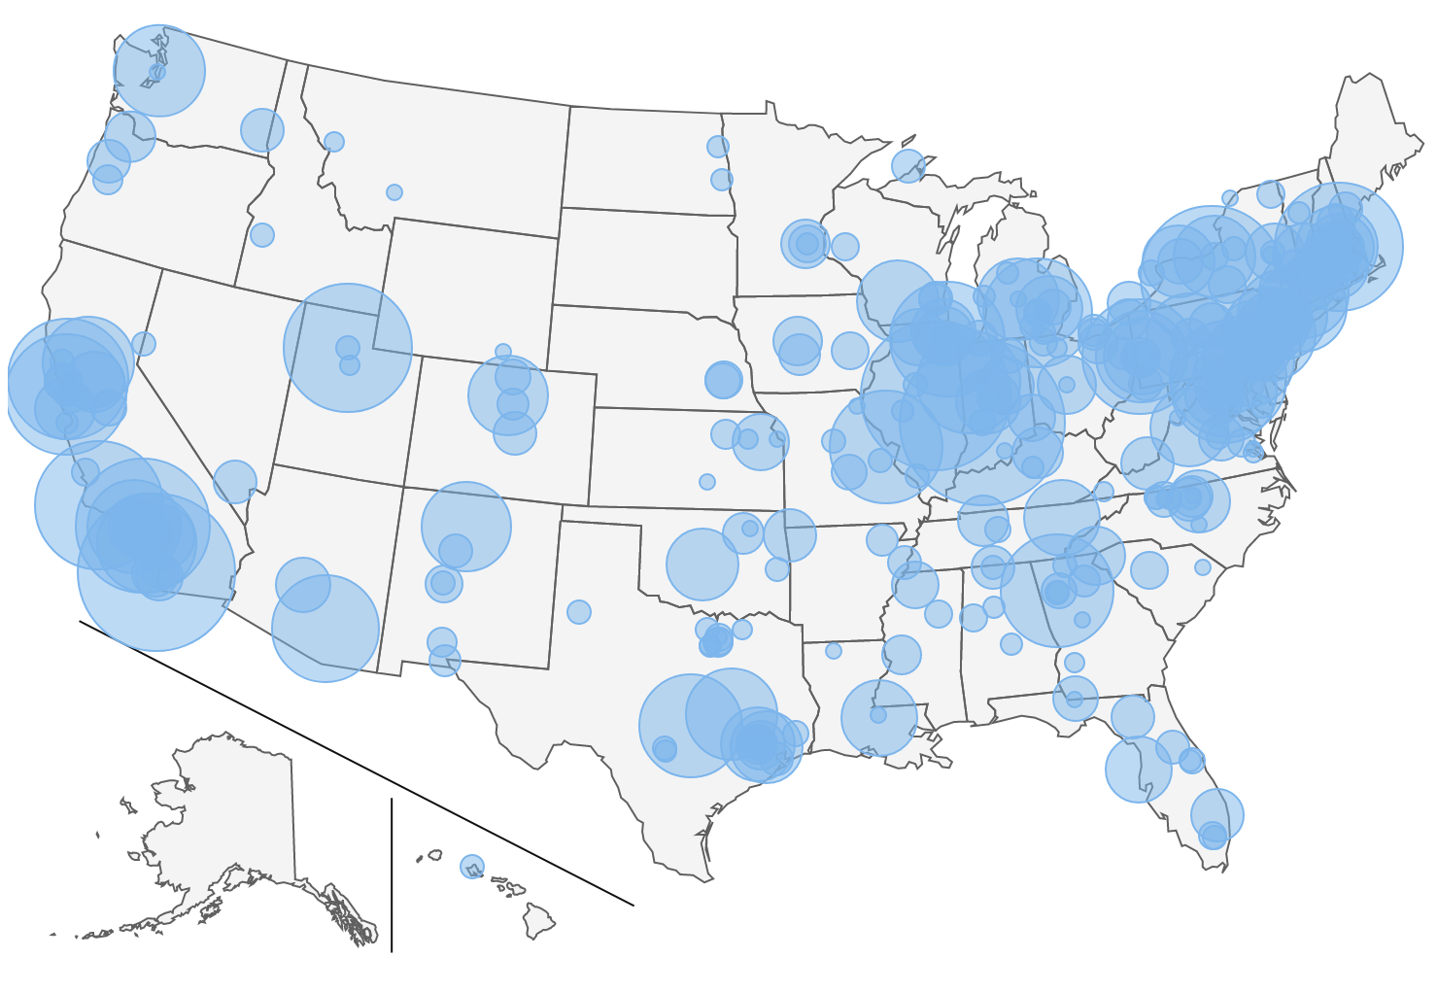
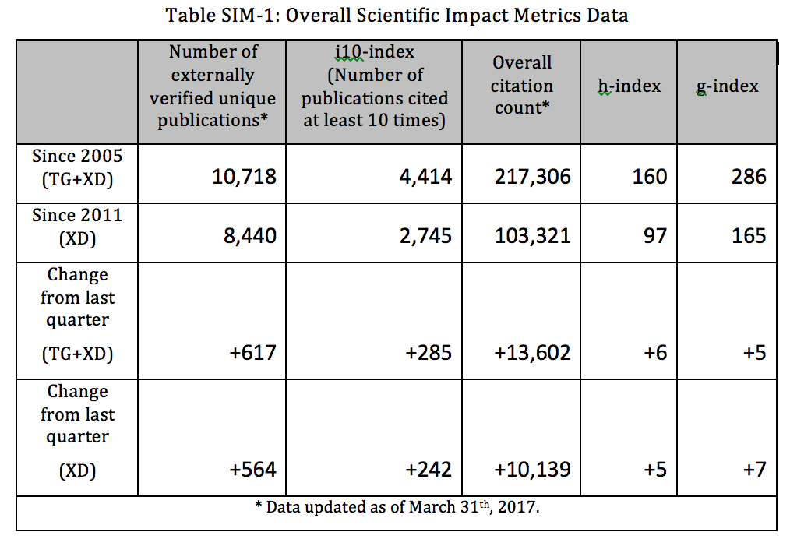
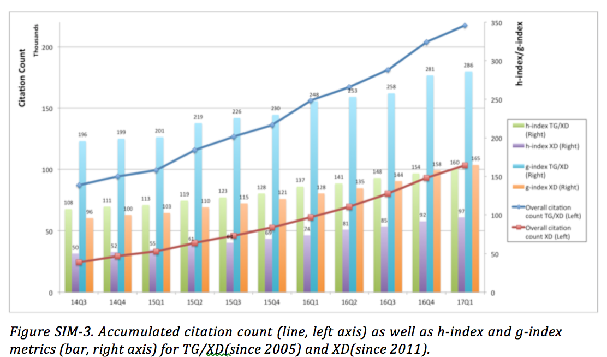

Slide 4
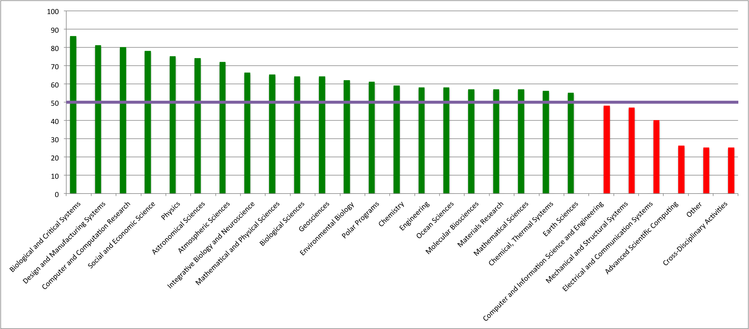
Impact Analysis for XSEDE and other facilities
Peer comparison for XSEDE publications. E.g., picture blow showing citation percentile of XSEDE publications comparing to the peers in the same journal issues, by Field of Study
Similar analysis for ECSS publications within XSEDE, NCAR, BlueWaters, and Bridges

Slide 5
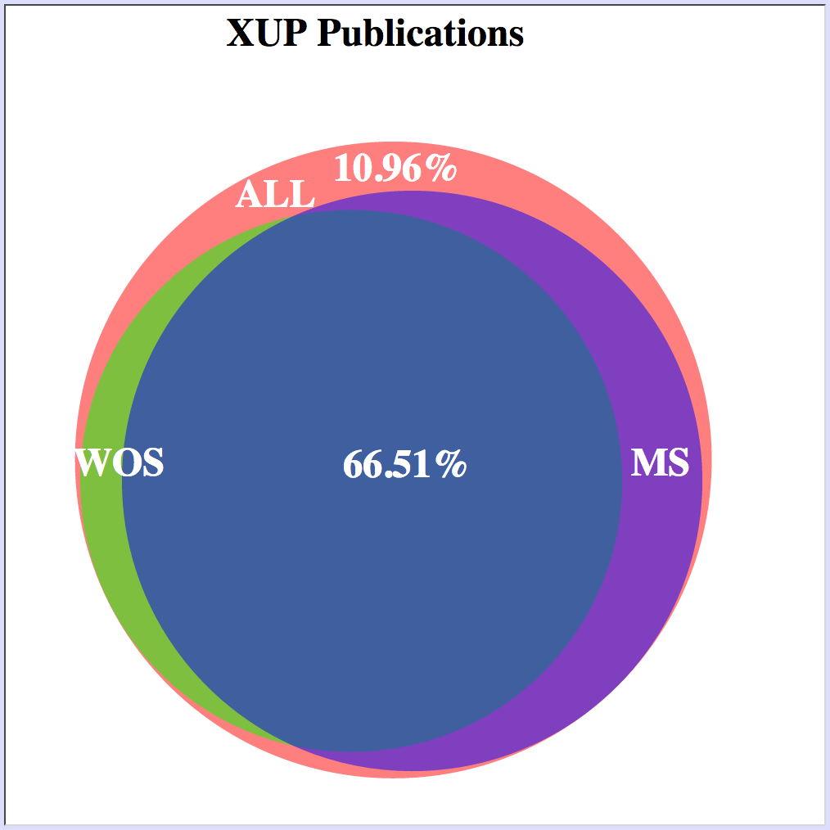
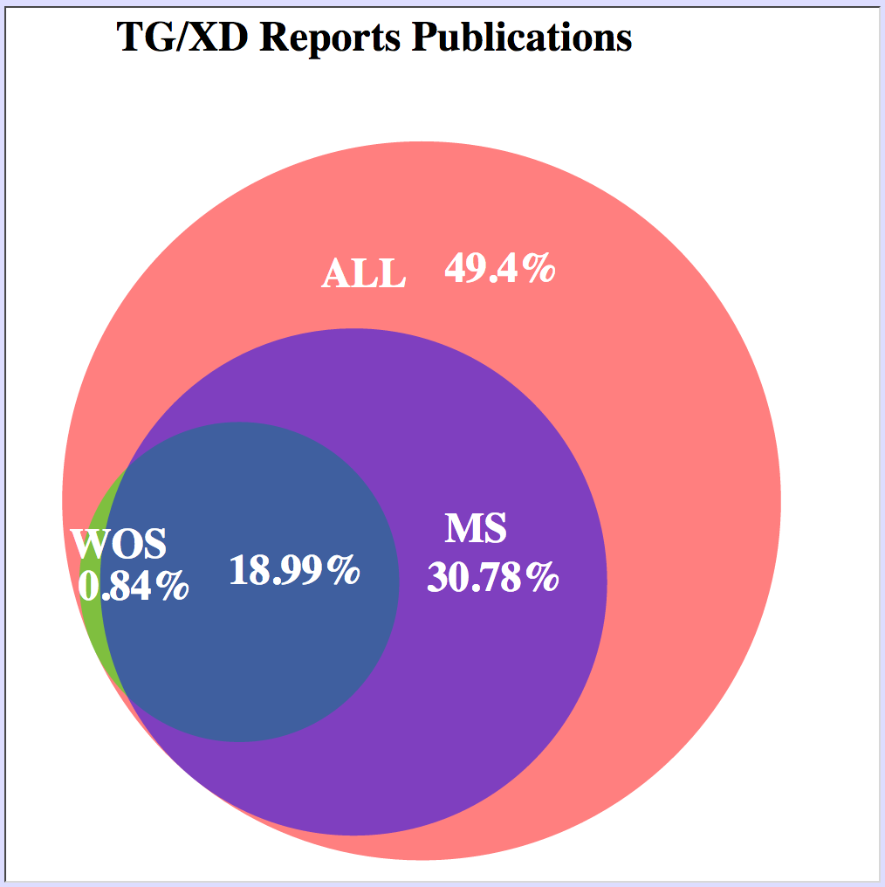
New data source enables FWCI
Microsoft Academic Knowledge API
~60M publications from 2005 – 2016
Comparison to ISI WoS results shows promising possibility to use MS as a data source (picture below showing XSEDE publications - those user submitted via the XUP; those parsed from past TeraGrid/XSEDE NSF reports - found in each data source)
Updating Peer comparison with more recent data and for more journals (in progress)
Field Weighted Citation Impact made available (in progress)

