Slide 1
Scientific Impact Evaluation of XSEDE/SP – Peers Comparison
Fugang Wang
Gregor von Laszewski
Dec 22, 2014

Slide 2
Summary of Previous Efforts
A software framework
to obtain publication/citation data from multiple sources and create a mashup database
to generate various impact metrics
lightweight portal and RESTful services to present and communicate the results
RESTful service being utilized by XUP
Statistical analysis of the impact metrics while correlating to XSEDE entities (User; Organization; Project; Allocation; FOS)

Slide 3
Architecture
IU TAS
Interface
Layer
IU TAS
Database Mashup
REST API
Portal
IU TAS
Service
Layer
IU TAS REST Services
XSEDE
Portal
IU TAS Publications Mashup
IU TAS
Publication
Mashup
NSF Award
DB Mining
3rd Party
Queries
IU NSF Awards
Publication data
for XSEDE Users
3rd Party Data
XD Entities
Mashup
Microsoft Academic Search
Google Scholar (User profiles)
UB TAS Databases &Reports
XSEDE Databases
NSF Database
ISI Web of Science
XDMoD
Warehous
XDcDB Mirror
Publications & Accounts
XSEDE
Quarterly Reports
POPS
Proposal Data
NSF Awards
Original
Data Source
Citeseer, PUBMed, ACM, IEEE, …
Mendeley

Slide 4
Peers Comparison
How researches supported by XSEDE/SPs compare to their peers?
Approaches
Comparing Publications
Comparing Researchers
Define XSEDE/SP supported researchers?
Impact attributing to XSEDE/SP?
Choosing/Defining Peers?

Slide 5
Peers Comparison - Publications
XSEDE/SP publications
XUP
Parsed from Past TG/XD Quarterly Reports
Verified with external source (ISI Web of Knowledge)
About 5,000 confirmed ones via ISI
Peers
Given one XSEDE/SP publication, we need to identify all the publications that appeared in the same journal issue with the same document type
Obtained about 1.3M publications from the journals that XSEDE/SP publications appeared (source: ISI)
Parsed the data and grouped into comparison groups

Slide 6
Peers Comparison – Publications cont’d
Define a metric based on percentile ranking of frequency of citation among peers.
Approach
Rank each XSEDE/SP publication among their peers (percentile ranking)
Count how many of them fall into each ranking quarter (top 1Q, 2Q, 3Q, 4Q) and compute the percentage of each
Grouped by each journal

Slide 7
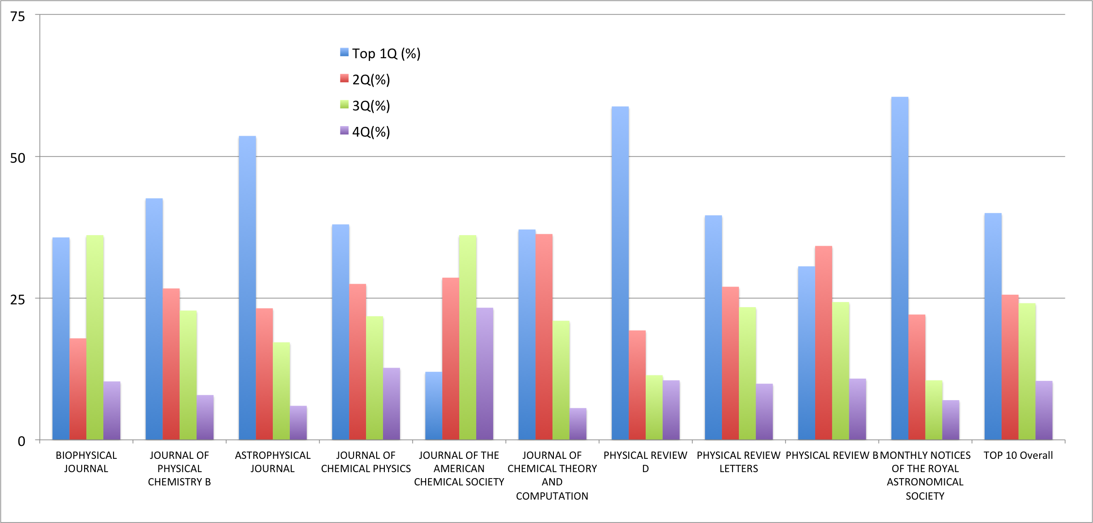
Results – top 10 Journals based on # of XSEDE/SP Publications

Slide 8
Results – Top 10 journals (Portion zoomed in – first half)
XSEDE/SP publications that fall into each quarters

Slide 9
Results – Top 10 journals (Portion zoomed in – second half)

Slide 10
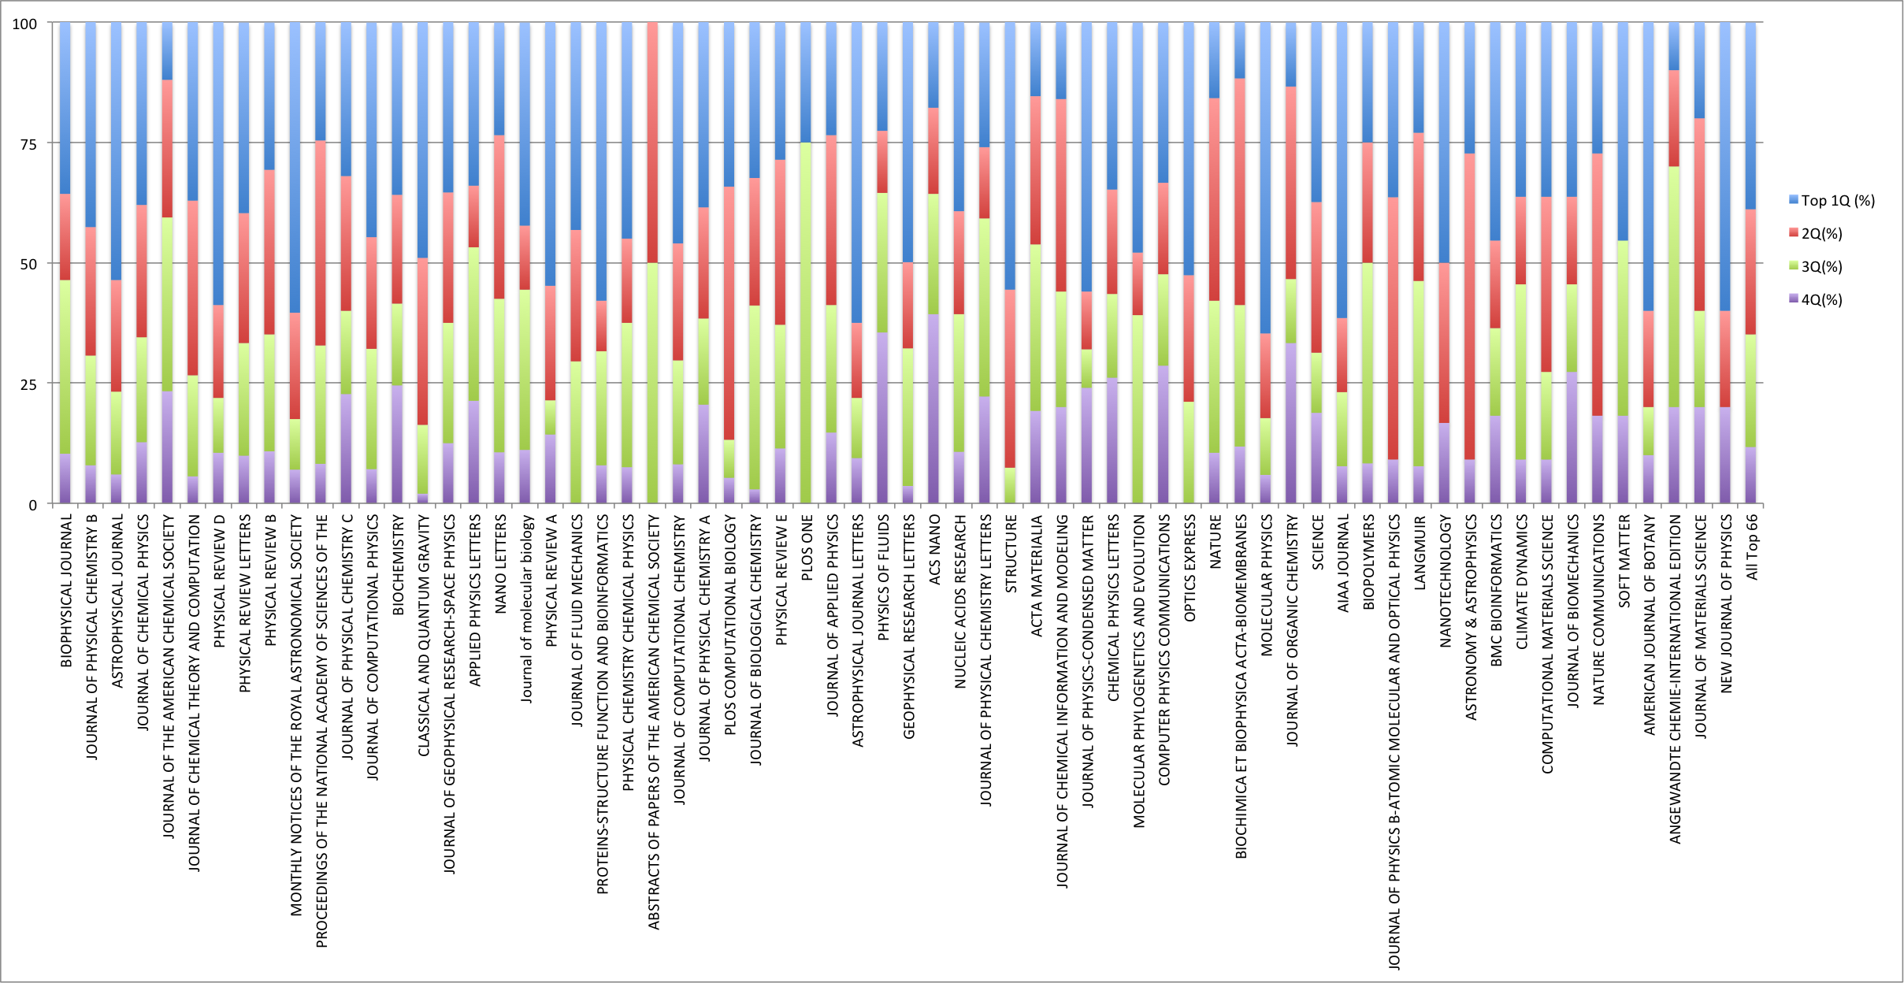
Results – top 66 Journals based on # of XSEDE/SP Publications
* This covered all journals with at least 10 XSEDE/SP publications appeared since 2005

Slide 11
Peers Comparison – Ranking Scores
Defining a score
S = 1*P_{Q1} + 0.5*P_{Q2}+ (-0.5)*P_{Q3} + (-1)*P_{Q4}
P_{Qi} Percentage of pubs falling into the top i quarter. P_{Qi} in [0,1] and ΣP_{Qi} = 1
S has its value from [-1 , 1]. Positive implies more on upper half and negative means more on lower half

Slide 12
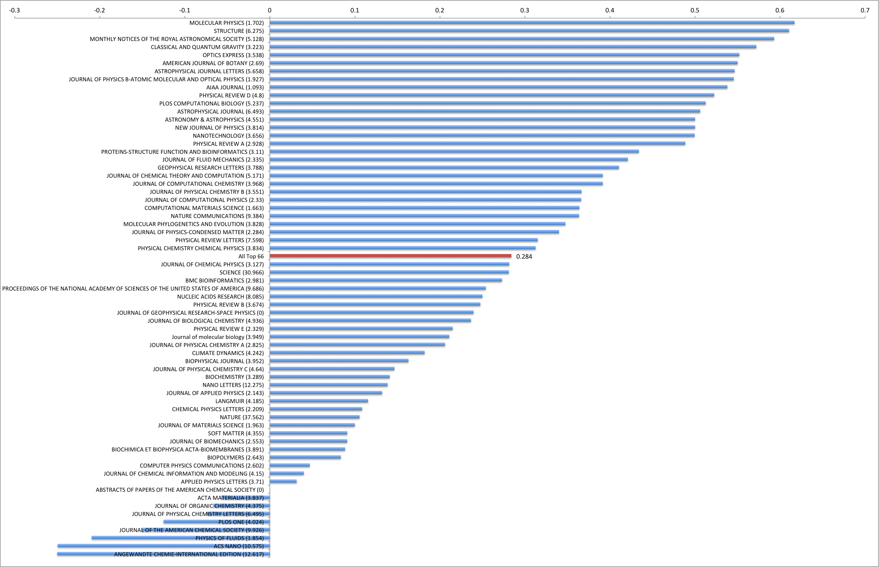
Results – Ranking Scores

Slide 13
Results – Ranking Scores (Portion zoomed in)

Slide 14
Results – Ranking Scores (Data table)
Journal | Journal Impact Factor | Score
MOLECULAR PHYSICS | 1.70 | 0.617
STRUCTURE | 6.28 | 0.611
MONTHLY NOTICES OF THE ROYAL ASTRONOMICAL SOCIETY | 5.13 | 0.593
CLASSICAL AND QUANTUM GRAVITY | 3.22 | 0.572
OPTICS EXPRESS | 3.54 | 0.552
AMERICAN JOURNAL OF BOTANY | 2.69 | 0.550
……
All Top 66 |  | 0.284
……
PLOS ONE | 4.02 | -0.125
JOURNAL OF THE AMERICAN CHEMICAL SOCIETY | 9.93 | -0.151
PHYSICS OF FLUIDS | 1.85 | -0.210
ACS NANO | 10.58 | -0.250
ANGEWANDTE CHEMIE-INTERNATIONAL EDITION | 12.62 | -0.250

Slide 15
Peers Comparison for Publications - Discussion
In general on positive side, meaning XSEDE/SP supported publications tend to receiver more citations (among peers in the same journal issue)
Difference between FOS
Discipline (Large impact on Physics, Astronomy)
Require Intensive computation or not?
The results shows XSEDE/SP does help researchers to boost their impact (based on citations).

Slide 16
Peers Comparison – Impact on FOS (discipline difference)

Slide 17
Peers Comparison for Publications – ongoing activities
Introduced an comparison model based on descriptive statistics
A Bayesian based comparison model
For the same prior distribution, based on the data set (XSEDE/SP vs peers), what is the posterior distribution (of average citation e.g.)
Confidence interval
Predictive

Slide 18
Thank you!
Questions?
Discussion
Prior results:
F. Wang, G. von Laszewski, G. C. Fox, T. R. Furlani, R. L. DeLeon, S. M. Gallo, "Towards a Scientific Impact Measuring Framework for Large Computing Facilities - a Case Study on XSEDE", in Proceedings of the Conference on Extreme Science and Engineering Discovery Environment: Gateway to Discovery (XSEDE '14), Atlanta, Georgia, July 13 - 18, 2014.
PDF available at: https://github.com/cyberaide/paper-tas/blob/master/vonLaszewski-tas.pdf?raw=true
Plans for publication
We will be preparing a new article to publish these results among others

