Slide 1
Scientific Impact Metrics Update
Gregor von Laszewski, Fugang Wang
Indiana University
Jul 2020

Slide 2
Updated Scientific Impact Metrics Data for XSEDE
Maintaining the publication and citation mashup database and keep the data updated
Monthly update of publication data (from XUP) and citation data (from Web of Science)
Metrics generation and mashup analysis
Current snapshot highlights
6056 XSEDE users are authors of at least one XSEDE related publication.
They are from 720 organizations.
Or 2242 XSEDE projects.
Overall publications 18,076 (externally verified).
Total citations 628,395.

Slide 3
Current Scientific Impact Metrics of XSEDE (as of Jun 30th, 2020)
 | Number of externally verified unique publications* | i10-index (Number of publications cited at least 10 times) | Overall citation count* | h-index | g-index
Since 2005 (TG+XD) | 18,076 | 10,338 | 628,395 | 260 | 468
Since 2011 (XD) | 15,530 | 8,307 | 427,135 | 206 | 359
Change since last quarter¹ (TG+XD) | +736 | +491 | +37,404 | +7 | +13
Change since last year² (TG+XD) | +2,323 | +1,698 | +127,266 | +28 | +45
Change since last quarter¹ (XD) | +719 | +475 | +32,322 | +10 | +15
Change since last year² (XD) | +2,278 | +1,651 | +112,452 | +33 | +57
Data updated as of Jun 30th, 2020. Note 1: Quarterly change was compared to the data as of Mar 31st 2020. Note 2: Yearly change was compared to the data as of June 30th 2019.

Slide 4
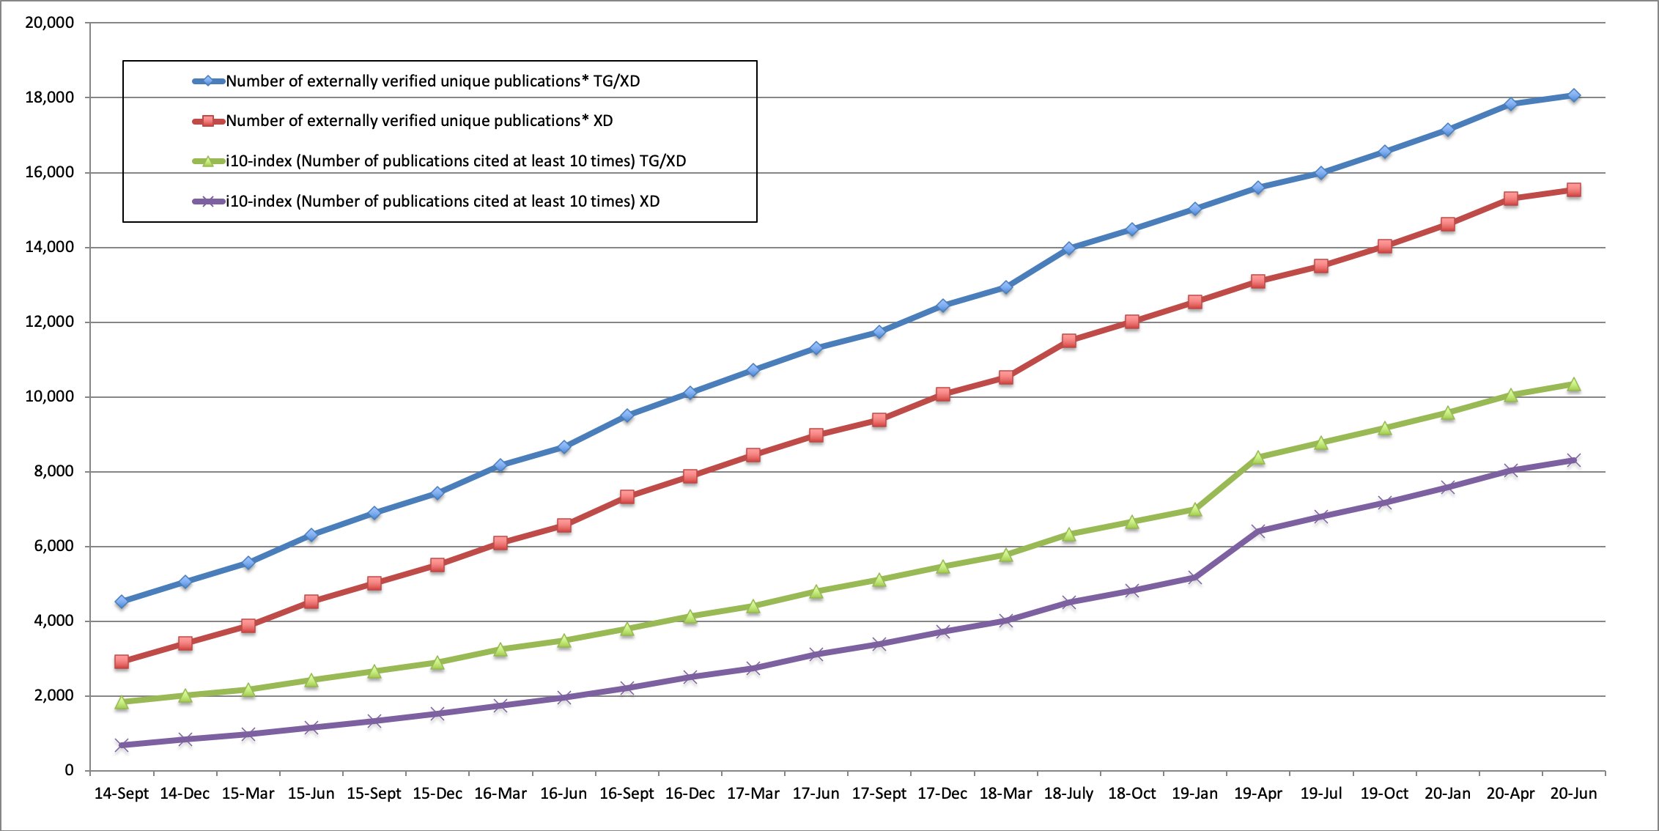
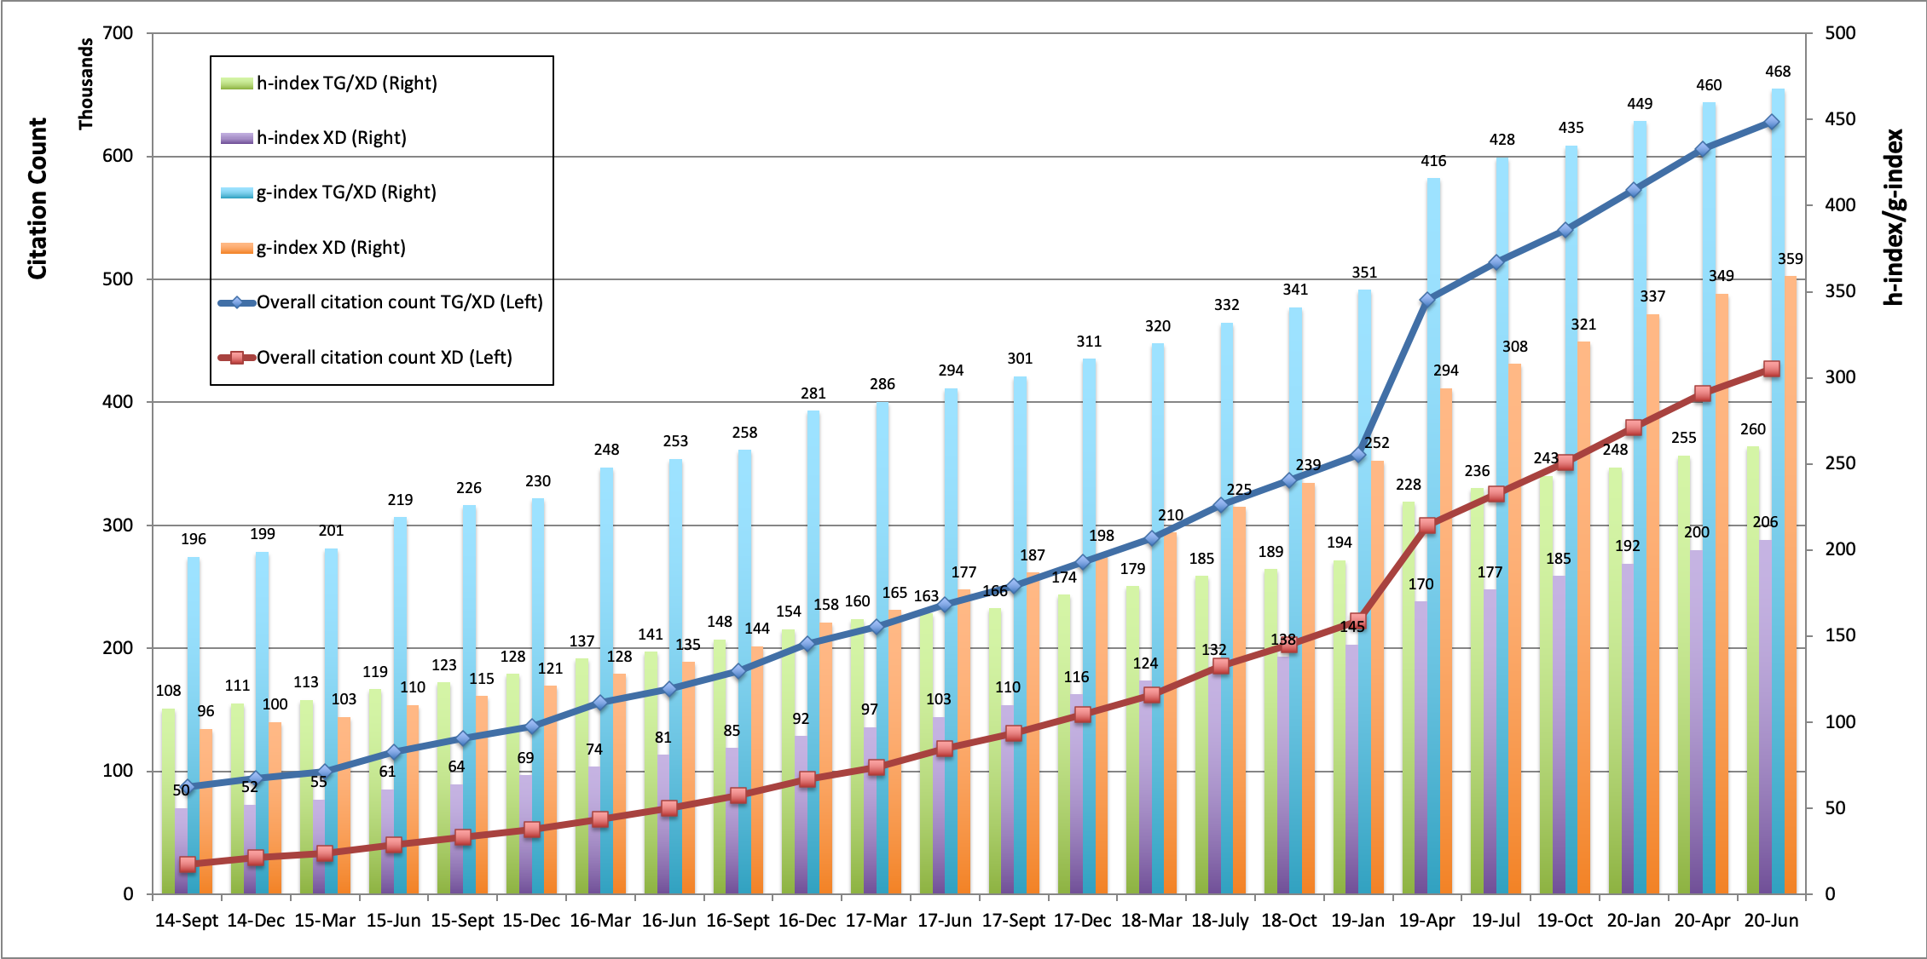
Historical Trends
Monthly data update and metrics snapshot makes it possible to generate customized report and observe historical trends.

Slide 5
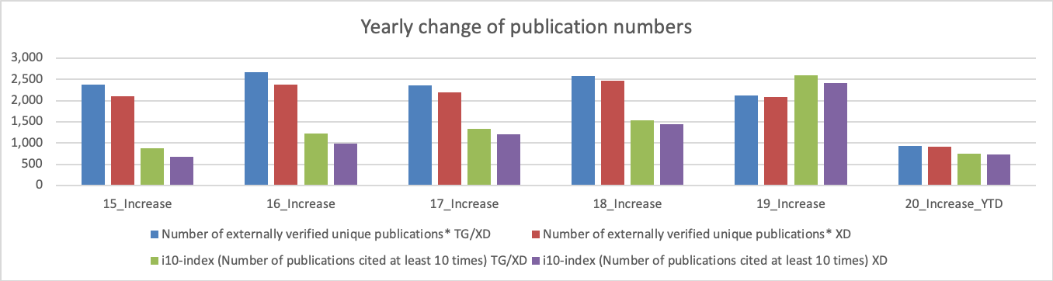
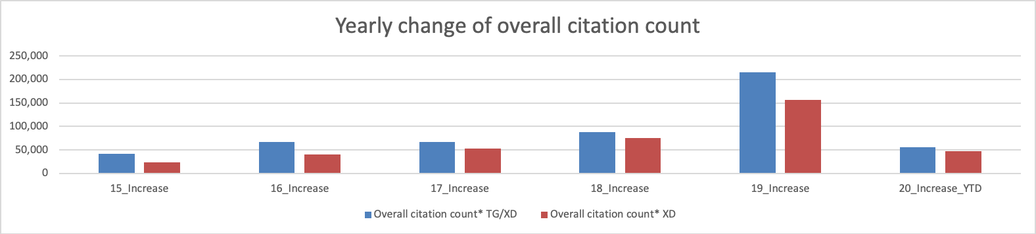
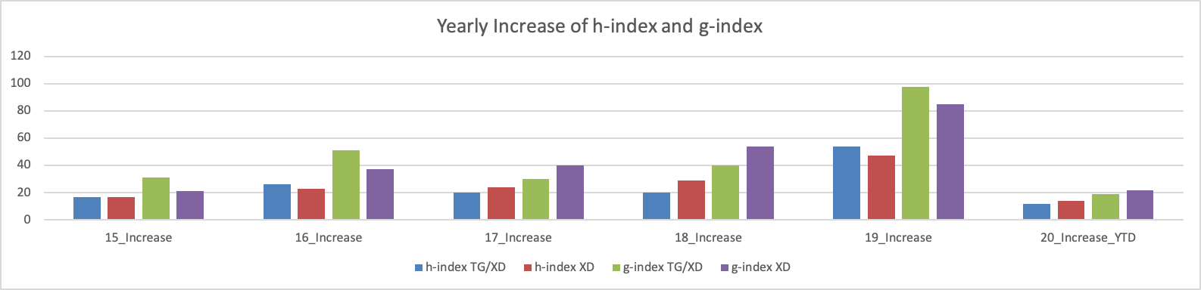
Historical Trends – Yearly Changes

Slide 6
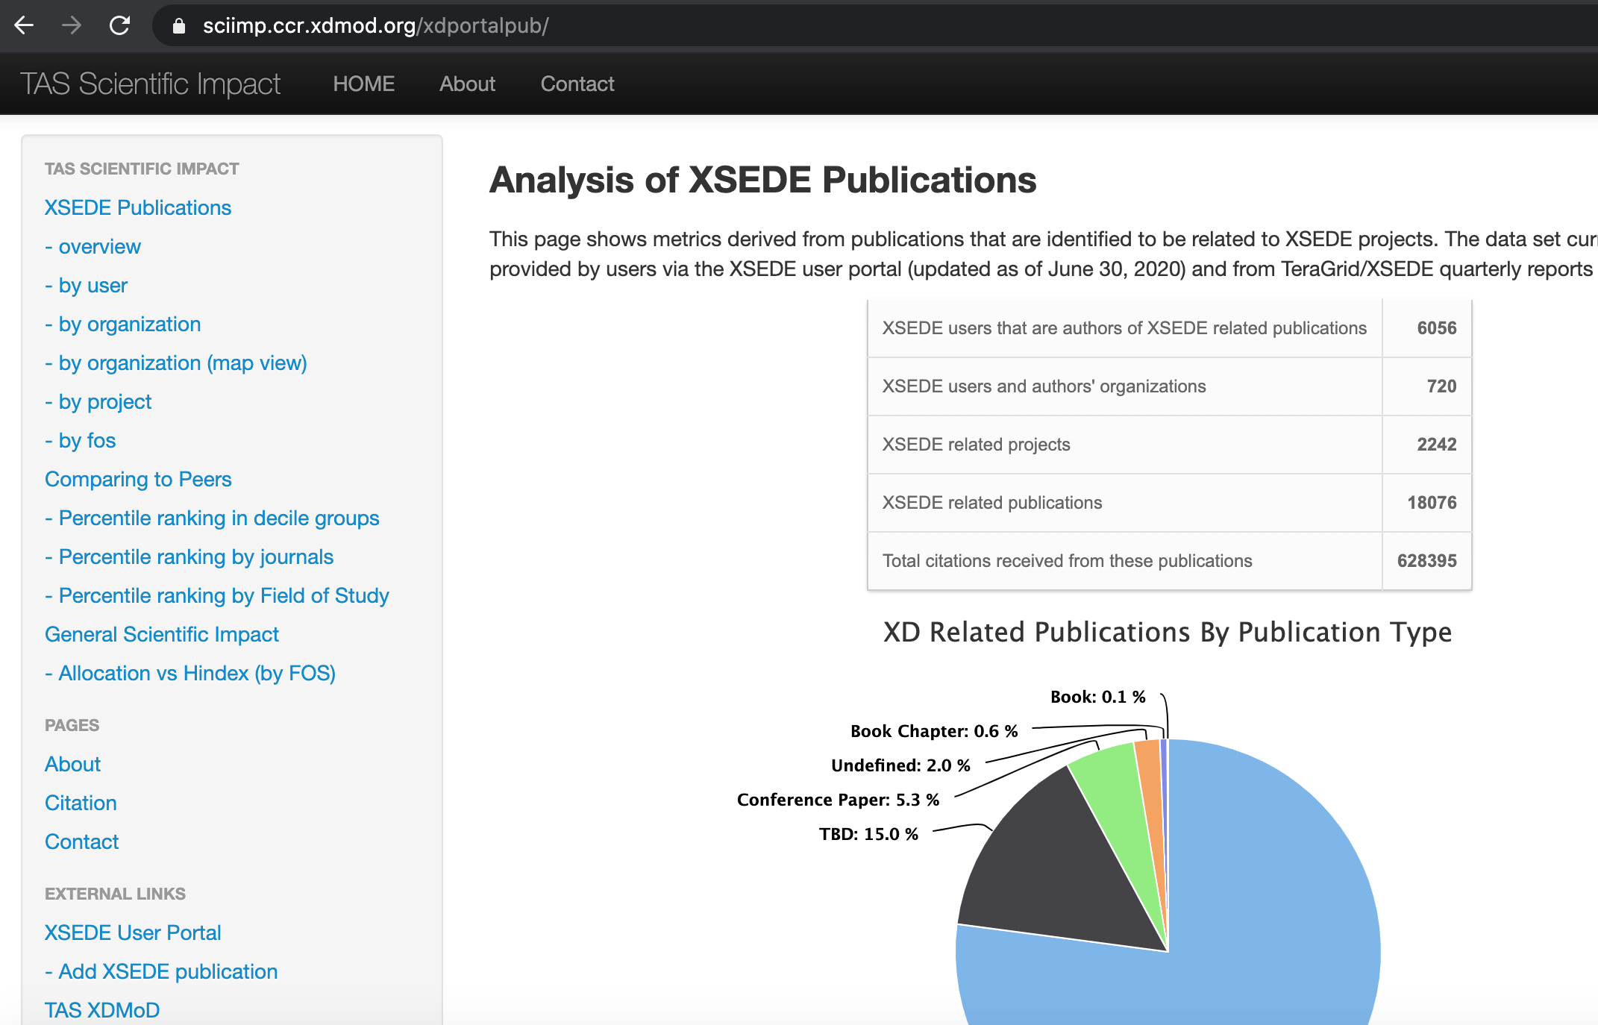
Scientific Impact Metrics Portal as part of XDMoD
Updated metrics and other related statistical analysis available from the portal: https://sciimp.ccr.xdmod.org/xdportalpub/

Slide 7
Ongoing Activities and Future Plans
Scientific Impact Metrics Generation and Impact Analysis for other organizations/projects
Kepler/K2
PSU Anton project
Continue maintaining the mashup database and related portal and web services. Keep data and metrics updated monthly. Generate reports as needed.
Revisit other related data sources and assess the possibility for data ingestion and integration
E.g., publication and/or funding related data services provided by NSF
Pubmed?

Slide 8
Summary Highlight from Past

Slide 9
Journal Publication Based Peers Comparison - Introduction
We compare the XSEDE publications to their peers that were published in the same journal issue.
We calculate the percentile rank of the citation count of the publications.
50% means a paper ranked just in the middle based on the citations received.
80% means the paper’s citation count is more than 80% of the papers published in the same journal issue.

Slide 10
Journal Publication Based Peers Comparison - Process
XSEDE publications to be compared
User submitted data from XUP
Parsed from Past TG/XD Quarterly Reports
Verified with external source (ISI Web of Knowledge)
~9k confirmed publications and ~5k in compared groups (from 122 journals that had at least 10 XD publications appeared in them)
Identify Peers
Given one XSEDE/SP publication, we need to identify all the publications that appeared in the same journal issue
Obtained more than 2M publications from the journals that XSEDE/SP publications appeared (source: Web of Science)
Parsed the data and grouped into comparison groups
Calculate percentile rank of citation count for each XD publication within the journal issue it appeared on
Largest know database for comparison for XSEDE publications
Notes:
Identify valid XSEDE publications;
Identify peers;
Calculating percentile rank among comparing groups

Slide 11
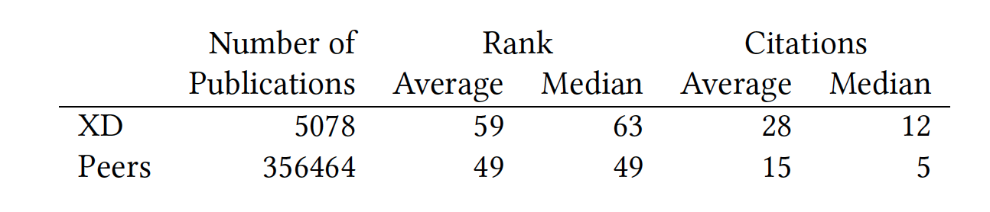
Peers Comparison Summary Statistics
Nonparametric analysis showing difference of sample
Mann-Whitney-Wilcoxon test, Mood’s median test, and Kruskal-Wallis test.
T-test showing quantitative difference (Both statistically significant difference)
Citation count. 95% confidence interval: [10.90,16.32]
Percentile ranking. 95% confidence interval: [9.07,10.59]
Notes:
Nonparametric for qualitative analysis – XD sample and peers sample different
T-test showing quantitative difference with statistically significance
Average XSEDE paper received 10.90-16.32 citations more than their peers;
Average XSEDE paper’s citation ranked 9.07%-10.59% higher than their peers.

Slide 12
Histogram of Percentile Ranking, in Decile Groups
Notes:
Percentile rank scores in each 10% groups.
More on higher end.

Slide 13
Peers Comparison by Journal
Average percentile ranking data grouped by journal name
Purple horizontal line indicates the 50% percentile
GREEN bars greater than 50% and RED less than 50%
XSEDE publications in most journals tend to receive more citation than their peers do.
Analysis using median instead of average show similar results. Aggregating by FOS showing similar results as well (more graph on reports and paper).
Notes:
Peers comparison data grouped by journal names
Average data
Green > 50%, better half
Red < 50%, below average

Slide 14
Peers Comparison for Publications - Discussion
Overall percentile ranking scores skewed on the higher end (the histogram graph)
With 95% confidence level (from T-test):
Average XSEDE paper receives 10.90-16.32 citations more than their peers
Average XSEDE paper ranks 9.07%-10.59% higher than their peers judging by citations received
peers meaning in the same journal issue
While grouping by each journal, results shows that XSEDE publications in most journals tend to receive more citation than their peers do.
Notes:
In general GOOD
FOS difference. Most good, some below average

Slide 15
Fields Weighted Citation Impact (FWCI)
Introduced as part of the snowball metrics (https://www.snowballmetrics.com/)
Definition: The ratio of the average citation of XSEDE publications to that of ALL the publications in the same Field of Study
FWCI value 1: Received citations as expected
FWCI value > 1: Received more than expected citations
FWCI value < 1: Received less than expected citations
E.g., a FWCI value 2.5 means the studied group received 1.5 times more citations than expected

Slide 16
Field and FWCI by Publication Count
Notes:
Data point values – FWCI (XD publication number/publication number in the field)
Sorted by publication count of field to emphasize the impact of the FOS more tightly related to XD
Most above 1 (better than expected) – political science below, but only 3 data points thus not statistically significant
Overall 4.3 pretty high. 4.3 times the average from ALL, or 3.3 times more than expected

Slide 17
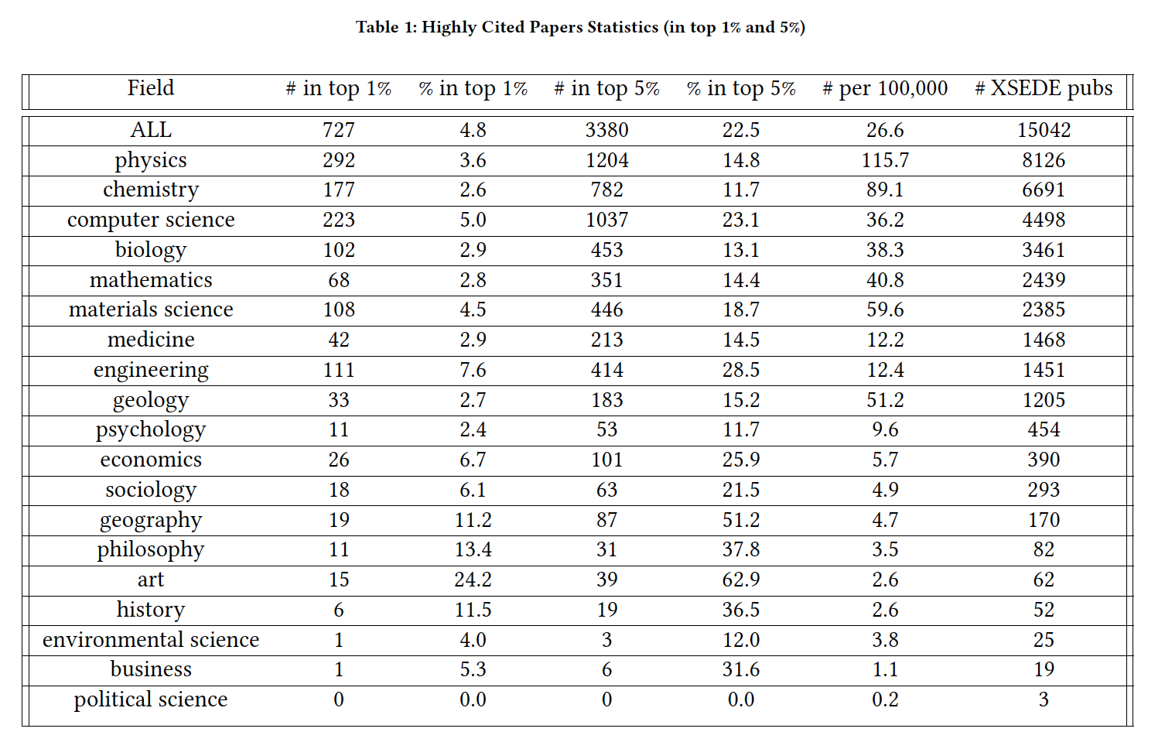
Highly Cited Papers
Notes:
How many, and in what percentage, of XD papers fall into the highly cited papers group?
Overall, 4.8% XD papers in top 1% highly cited group; 22.5% in top 5%. Out of proportionally good.
Again, XD papers more on the higher end.

