Slide 1
Scientific Impact Evaluation of XSEDE
Fugang Wang, Gregor von Laszewski, Timothy Whitson, Geoffrey Fox, Thomas Furlani, Robert Deleon, Steven Gallo
Jul 2018

Slide 2
Agenda
Objective
Dataset, processing workflow and software
Journal Publication-based Peers Comparison
Field Weighted Citation Impact (FWCI) analysis
Conclusions

Slide 3
Agenda
Objective
Dataset, processing workflow and software
Journal Publication-based Peers Comparison
Field Weighted Citation Impact (FWCI) analysis
Conclusions

Slide 4
Objective
Evaluate the scientific impact of XSEDE*
Use published papers of projects using XSEDE resources to measure scientific output
Bibliometric approach
How does the impact metrics look like?
How does the XSEDE papers compare to non-XSEDE ones?
*Due to the historical continuity of the TeraGrid/XSEDE/XSEDE2 projects, this study covered the time since beginning of TeraGrid

Slide 5
Agenda
Objective
Dataset, processing workflow and software
Journal Publication-based Peers Comparison
Field Weighted Citation Impact (FWCI) analysis
Conclusions

Slide 6
Dataset, processing workflow and software architecture
Acquiring publication data
Parsing from past reports to NSF (publication appendix)
User submitted data to XSEDE user portal
Curating and verification
Publication data mashup database
Externally verified with other data sources (ISI WoS; Microsoft MAG)
Obtaining citation data and calculate various impact metrics
Web portal and RESTful service to present the metrics and analysis results; and to integrate with other systems (XDMoD portal; XSEDE user portal)

Slide 7
Software Architecture
IU XMS
Interface
Layer
IU XMS Sciimp
Database Mashup
REST API
Portal
XDMoD
Portal
IU XMS
Service
Layer
XSEDE
Portal
IU XMS REST Services
IU XMS Publications Mashup
IU XMS
Publication
Mashup
NSF Award
DB Mining
3rd Party
Queries
IU NSF Awards
Publication data
for XSEDE Users
3rd Party Data
XD Entities
Mashup
Microsoft Academic Search
Google Scholar (User profiles)
UB TAS Databases &Reports
XSEDE Databases
NSF Database
ISI Web of Science
XDMoD
Warehous
XDcDB Mirror
Publications & Accounts
XSEDE
Quarterly Reports
POPS
Proposal Data
NSF Awards
Original
Data Source
Citeseer, PUBMed, ACM, IEEE, …
Mendeley

Slide 8
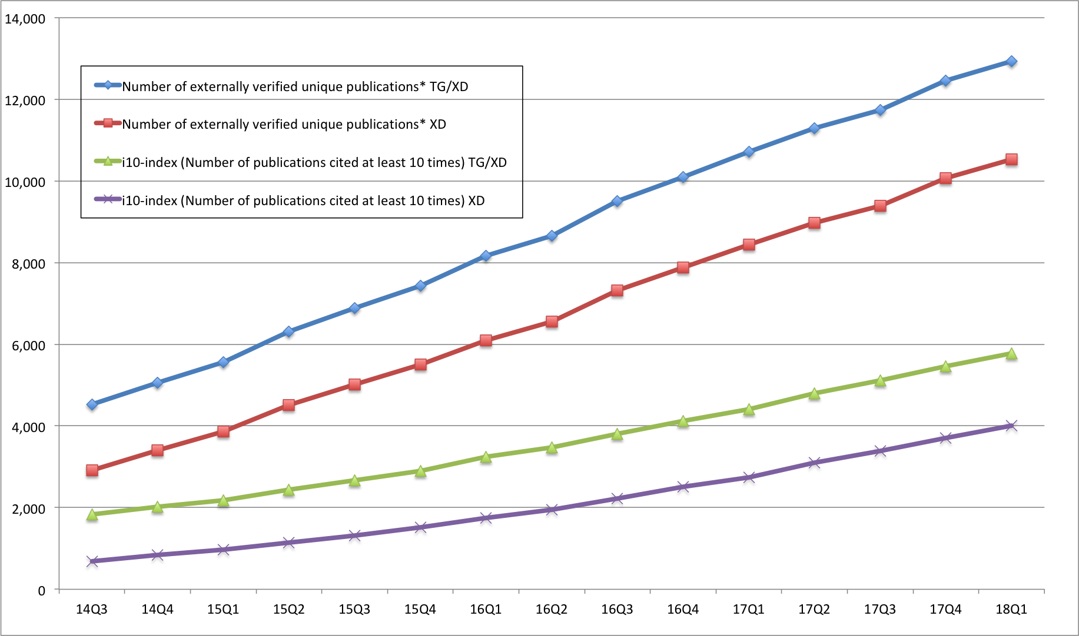
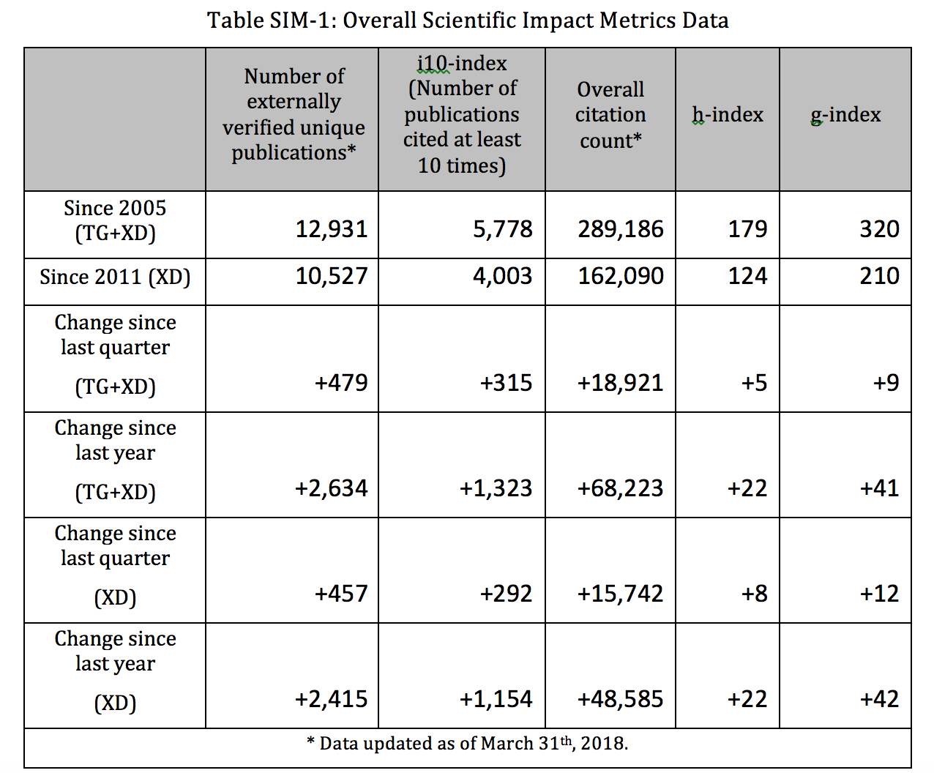
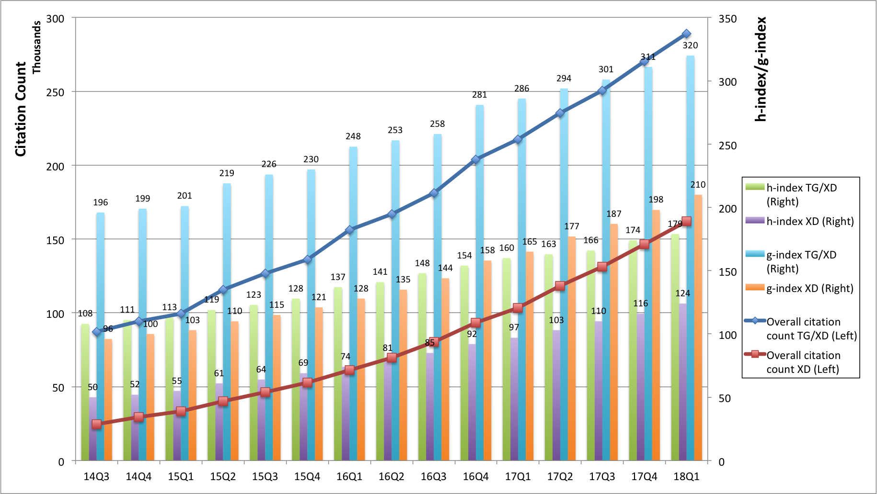
Quarterly updated XSEDE scientific impact report

Slide 9
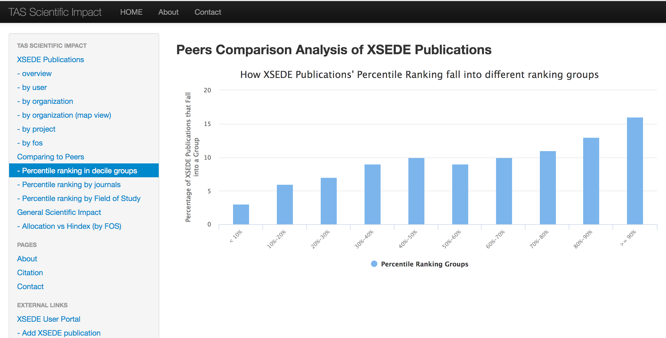
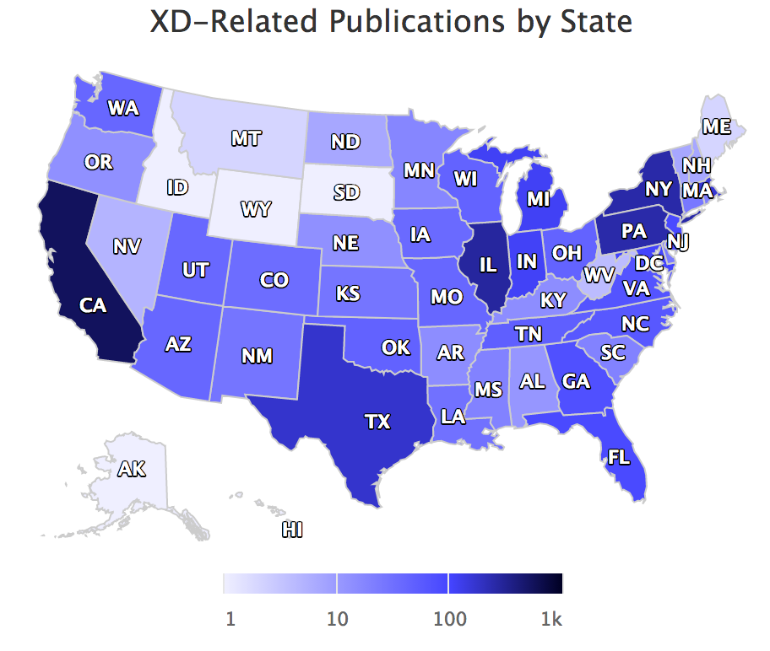
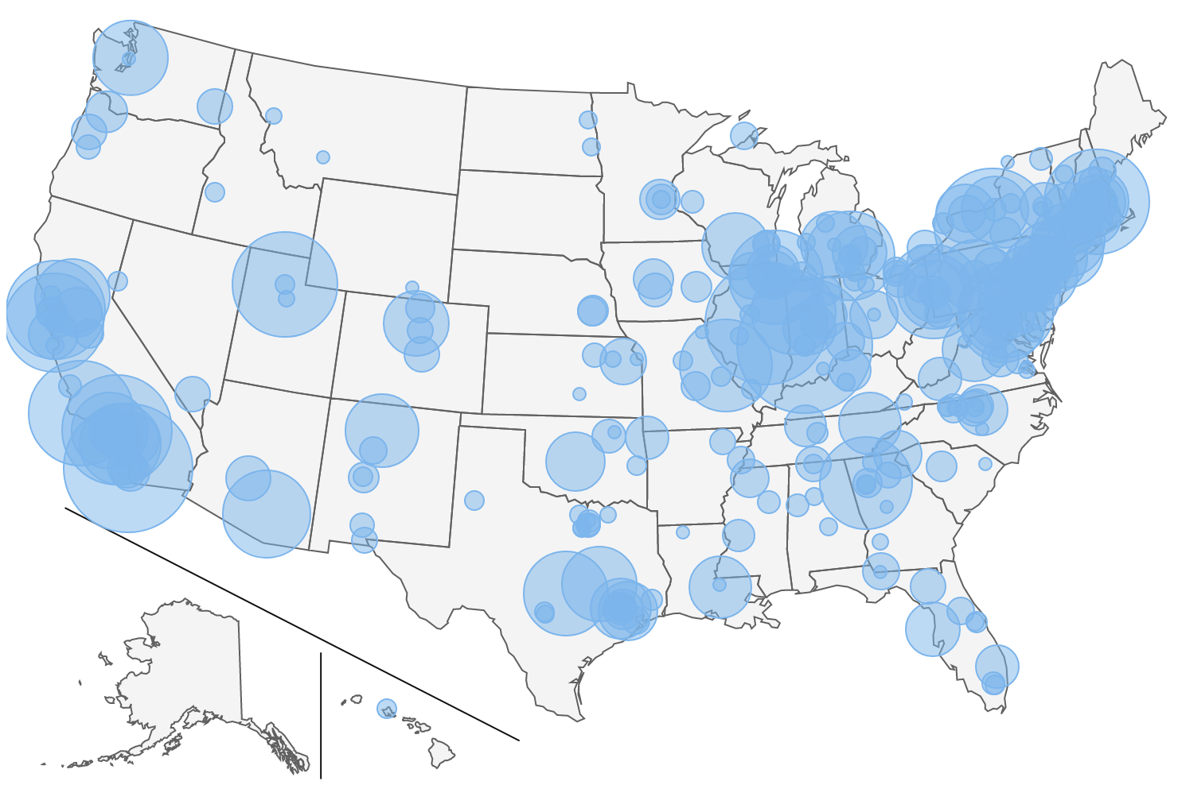
Scientific Impact portal showing the impact metrics
E.g., publication/citation count by Field of Study, by Organization, by Geographical locations
https://sciimp.ccr.xdmod.org/xdportalpub/overview

Slide 10
Agenda
Objective
Dataset and processing workflow
Journal Publication-based Peers Comparison
Field Weighted Citation Impact (FWCI) analysis
Conclusions

Slide 11
Journal Publication-based Peers Comparison
XSEDE publications to be compared
User submitted data from XUP
Parsed from Past TG/XD Quarterly Reports
Verified with external source (ISI Web of Knowledge)
~9k confirmed publications and ~5k in compared groups (from 122 journals that had at least 10 XD publications appeared in them)
Identify Peers
Given one XSEDE/SP publication, we need to identify all the publications that appeared in the same journal issue
Obtained more than 2M publications from the journals that XSEDE/SP publications appeared (source: ISI WoS)
Parsed the data and grouped into comparison groups
Calculate percentile rank of citation count for each XD publication within the journal issue it appeared on

Slide 12
Peers Comparison, by Journal, Average – WoS data

Slide 13
Peers Comparison, by Journal, Median – WoS data

Slide 14
Peers Comparison, by FOS – WoS data

Slide 15
Histogram of Percentile Ranking, in Decile Groups

Slide 16
Empirical Cumulative Distribution of Percentile Ranks

Slide 17
Kernel Density of the Distribution

Slide 18
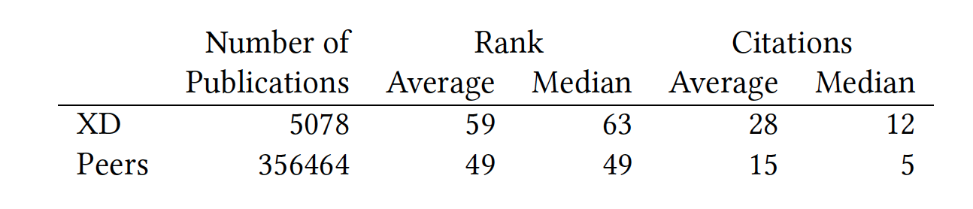
Peers Comparison Summary Statistics
Non parametrical analysis showing difference of sample
Mann-Whitney-Wilcoxon test, Mood’s median test, and Kruskal-Wallis test.
T-test showing quantitative difference (Both statistically significant difference)
Citation count Test 95% confidence interval: [10.90,16.32]
Percentile ranking 95% confidence interval: [9.07,10.59]

Slide 19
Peers Comparison for Publications - Discussion
In general on positive side, meaning XSEDE supported publications tend to receiver more citations (among peers in the same journal issue)
Difference between FOS
Discipline (Large impact on Physics, Astronomy)
Require Intensive computation or not?

Slide 20
Agenda
Objective
Dataset and processing workflow
Journal Publication-based Peers Comparison
Field Weighted Citation Impact (FWCI) analysis
Conclusions

Slide 21
FWCI Analysis based on MAG data
Microsoft Academic Knowledge API
~ 60M publications from 2005 – 2016
Comparison to ISI WoS results shows good coverage from the new data source
Access to the ‘whole’ publications in the world enabling Field Weighted Citation Impact analysis

Slide 22
Field by FWCI value

Slide 23
Field and FWCI by Publication Count

Slide 24
Expected Citation vs Actual Citation, with FWCI

Slide 25
Expected vs Extra Citation

Slide 26
Peers Comparison, by Journal, Average – MS data

Slide 27
Peers Comparison, by Journal, Median – MS data

Slide 28
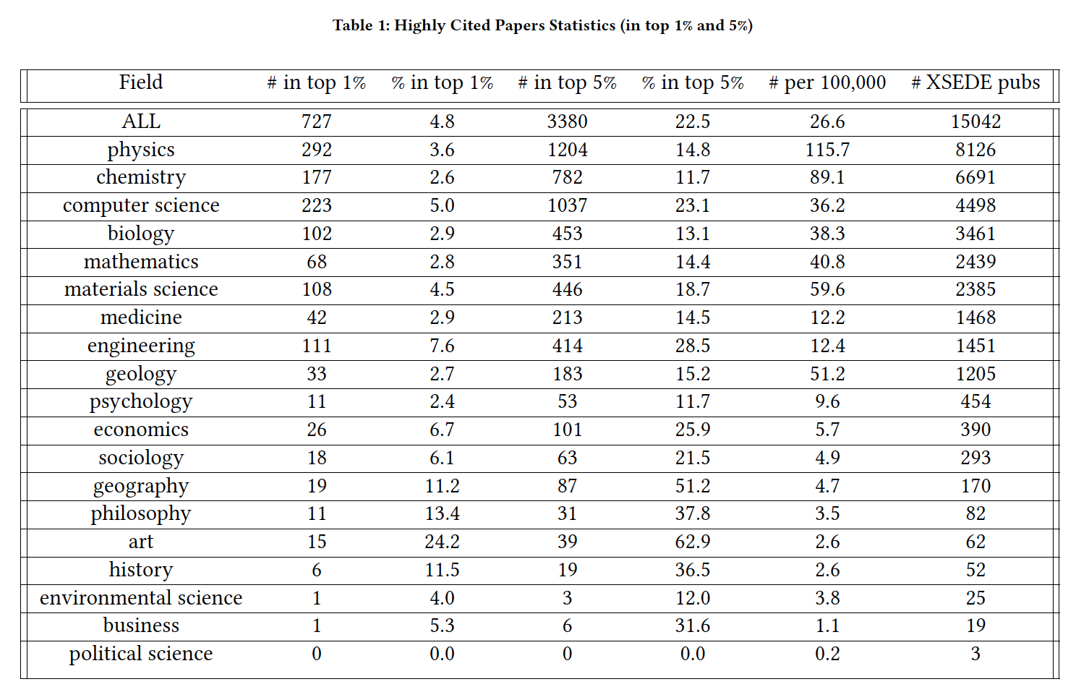
Highly Cited Papers

Slide 29
Conclusions
A software framework and analysis workflow
to obtain publication/citation data from multiple sources and create a mashup database
to generate various impact metrics
Web portal and RESTful services to present and communicate the results
Statistical analysis of the impact metrics while correlating to XSEDE entities (User; Organization; Project; Allocation; FOS)
Journal publication-based peers comparison shows that TG/XD publications tend to receive more citation than their peers do
FWCI analysis shows that TG/XD publications performed much better than expected in all fields
Highly cited papers analysis shows that TG/XD publications performed disproportionally better in all fields
Impact Analysis for other facilities utilizing the same analysis framework possible
E.g., Peer comparison study for ECSS publications within XSEDE, NCAR, BlueWaters, Bridge, and others

