Slide 1
Scientific Impact Metrics Update
Fugang Wang, Gregor von Laszewski
Indiana University
Jul 2020

Slide 2
Updated Scientific Impact Metrics Data for XSEDE
Maintaining the publication and citation mashup database and keep the data updated
Monthly update of publication data (from XUP) and citation data (from Web of Science)
Metrics generation and mashup analysis
Current snapshot highlights
6056 XSEDE users are authors of at least one XSEDE related publication.
They are from 720 organizations.
Or 2242 XSEDE projects.
Overall publications 18,076 (externally verified).
Total citations 628,395.

Slide 3
Current Scientific Impact Metrics of XSEDE (as of Jun 30th, 2020)
 | Number of externally verified unique publications* | i10-index (Number of publications cited at least 10 times) | Overall citation count* | h-index | g-index
Since 2005 (TG+XD) | 18,076 | 10,338 | 628,395 | 260 | 468
Since 2011 (XD) | 15,530 | 8,307 | 427,135 | 206 | 359
Change since last quarter¹ (TG+XD) | +736 | +491 | +37,404 | +7 | +13
Change since last year² (TG+XD) | +2,323 | +1,698 | +127,266 | +28 | +45
Change since last quarter¹ (XD) | +719 | +475 | +32,322 | +10 | +15
Change since last year² (XD) | +2,278 | +1,651 | +112,452 | +33 | +57
Data updated as of Jun 30th, 2020. Note 1: Quarterly change was compared to the data as of Mar 31st 2020. Note 2: Yearly change was compared to the data as of June 30th 2019.

Slide 4
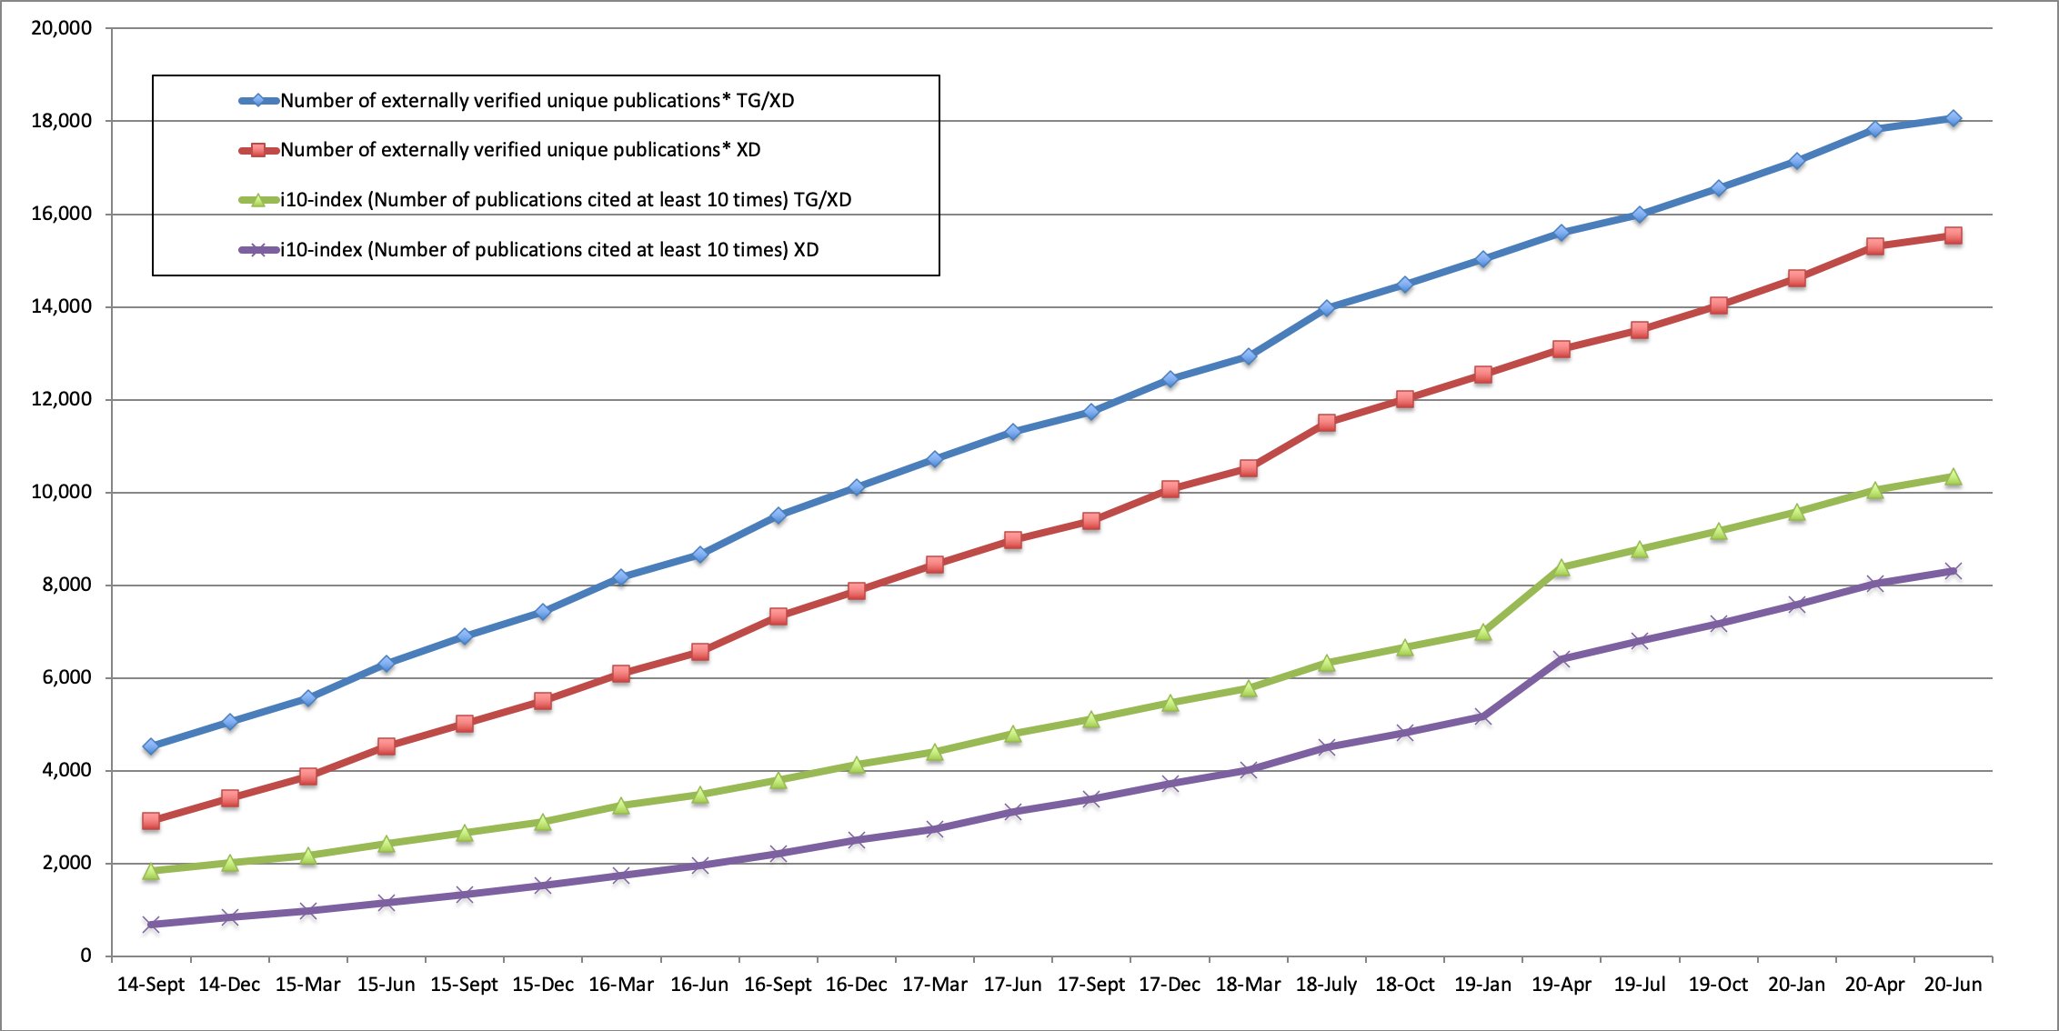
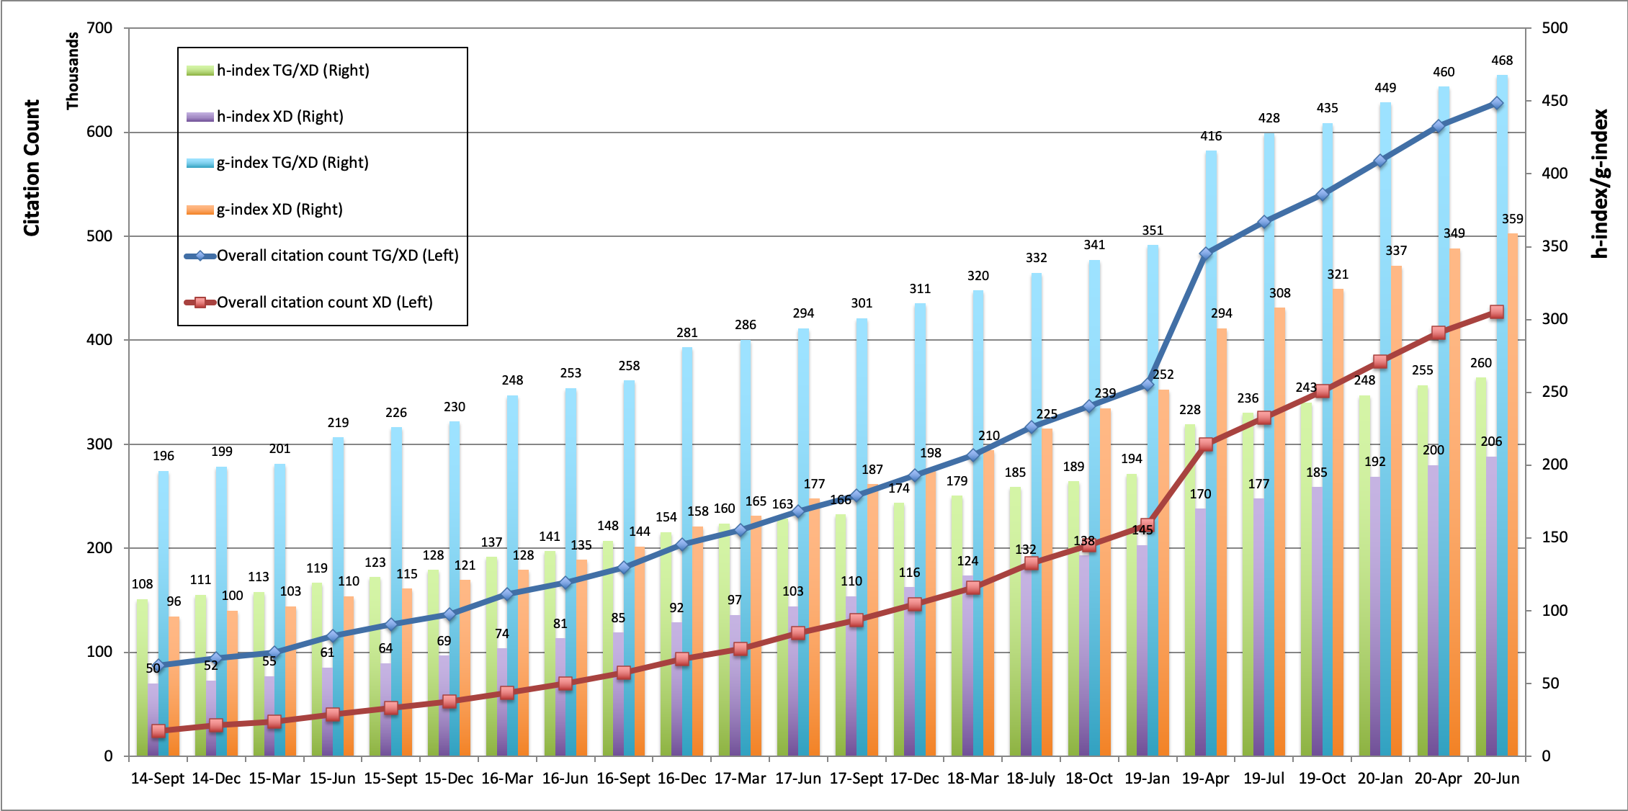
Historical Trends
Monthly data update and metrics snapshot makes it possible to generate customized report and observe historical trends.

Slide 5
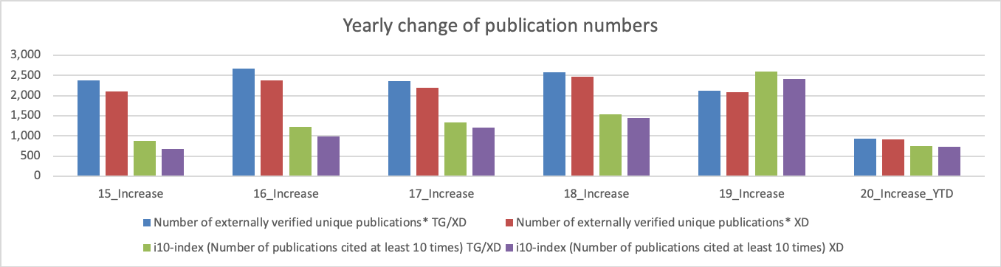
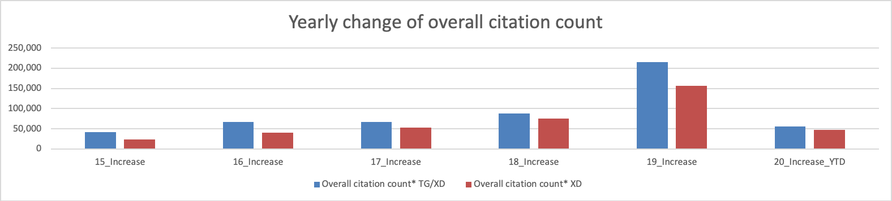
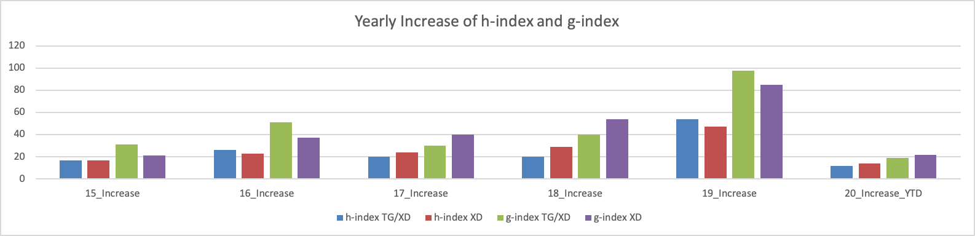
Historical Trends – Yearly Changes

Slide 6
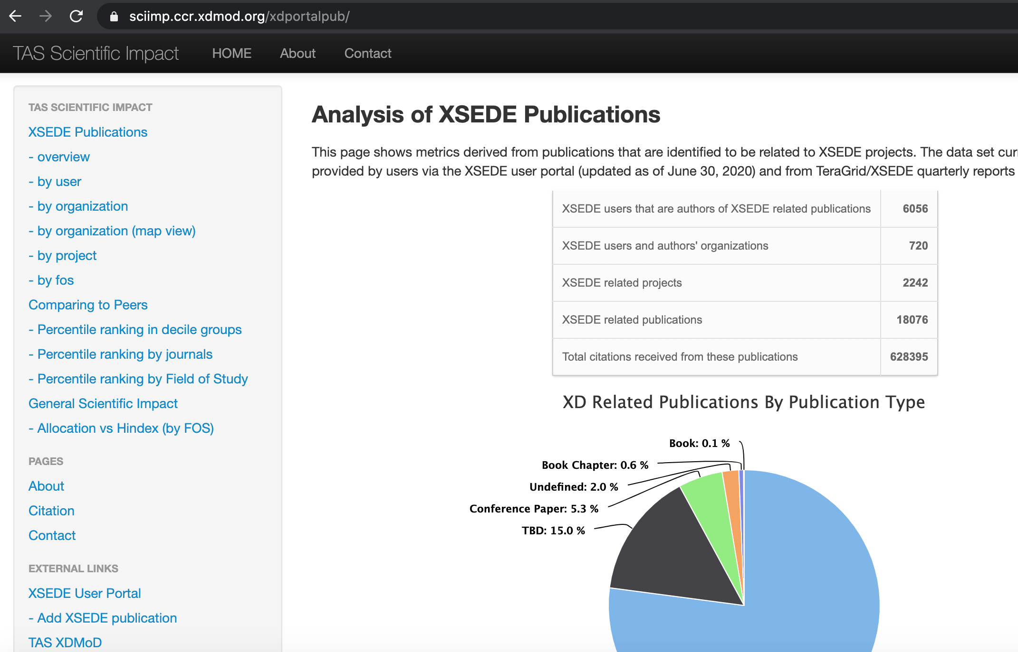
Scientific Impact Metrics Portal as part of XDMoD
Updated metrics and other related statistical analysis available from the portal: https://sciimp.ccr.xdmod.org/xdportalpub/

Slide 7
Ongoing Activities and Future Plans
Scientific Impact Metrics Generation and Impact Analysis for other organizations/projects
Kepler/K2
PSU Anton project
Continue maintaining the mashup database and related portal and web services. Keep data and metrics updated monthly. Generate reports as needed.
Revisit other related data sources and assess the possibility for data ingestion and integration
E.g., publication and/or funding related data services provided by NSF
Pubmed?

