Slide 1
Tutorial on Support Vector Machine
Prof. Dr. Loc Nguyen, PhD, PostDoc
Director of Sunflower Soft Company, Vietnam
Email: ng_phloc@yahoo.com
Homepage: www.locnguyen.net

Slide 2
Abstract
Support vector machine is a powerful machine learning method in data classification. Using it for applied researches is easy but comprehending it for further development requires a lot of efforts. This report is a tutorial on support vector machine with full of mathematical proofs and example, which help researchers to understand it by the fastest way from theory to practice. The report focuses on theory of optimization which is the base of support vector machine.

Slide 3
Table of contents
Support vector machine
Sequential minimal optimization
An example of data classification by SVM
Conclusions

Slide 4
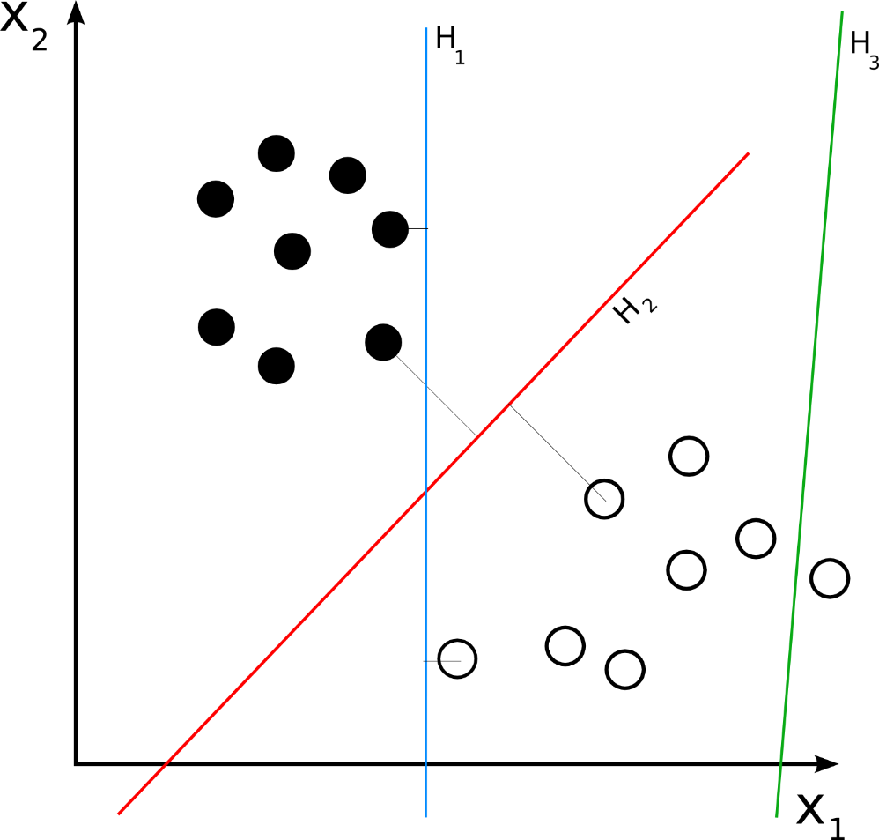
1. Support vector machine
Support vector machine (SVM) (Law, 2006) is a supervised learning algorithm for classification and regression. Given a set of p-dimensional vectors in vector space, SVM finds the separating hyperplane that splits vector space into sub-set of vectors; each separated sub-set (so-called data set) is assigned by one class. There is the condition for this separating hyperplane: “it must maximize the margin between two sub-sets”. Figure 1.1 (Wikibooks, 2008) shows separating hyperplanes H₁, H₂, and H₃ in which only H₂ gets maximum margin according to this condition. Suppose we have some p-dimensional vectors; each of them belongs to one of two classes. We can find many p–1 dimensional hyperplanes that classify such vectors but there is only one hyperplane that maximizes the margin between two classes. In other words, the nearest between one side of this hyperplane and other side of this hyperplane is maximized. Such hyperplane is called maximum-margin hyperplane and it is considered as the SVM classifier.
Figure 1.1. Separating hyperplanes

Slide 5
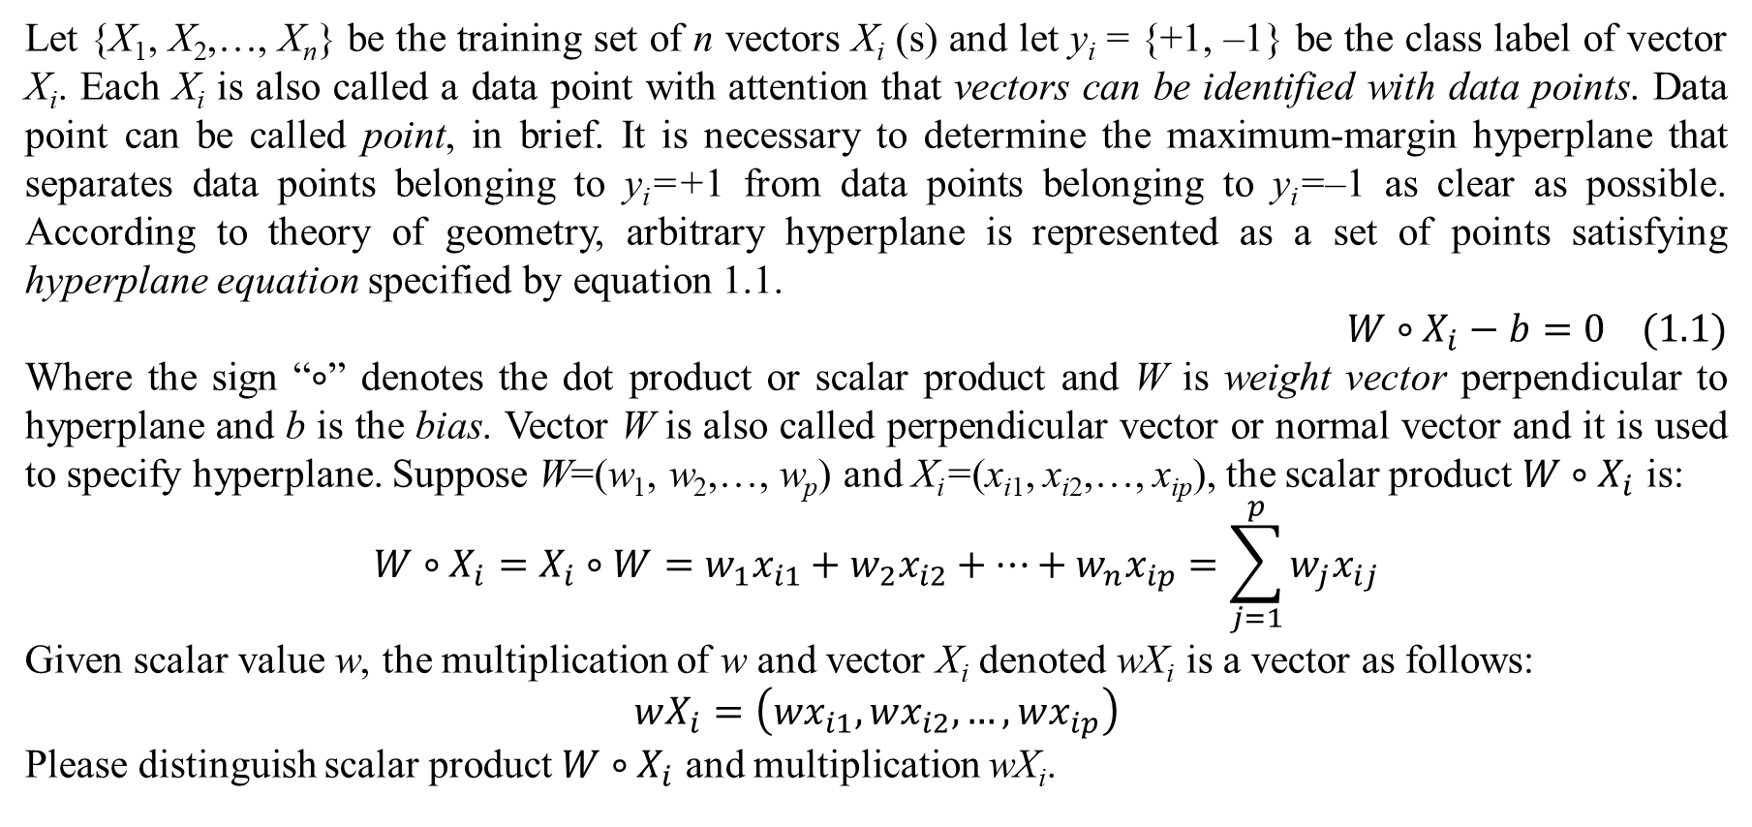
1. Support vector machine
Let {X₁, X₂,…, X_{n}} be the training set of n vectors X_{i} (s) and let y_{i} = {+1, –1} be the class label of vector X_{i}. Each X_{i} is also called a data point with attention that vectors can be identified with data points. Data point can be called point, in brief. It is necessary to determine the maximum-margin hyperplane that separates data points belonging to y_{i}=+1 from data points belonging to y_{i}=–1 as clear as possible. According to theory of geometry, arbitrary hyperplane is represented as a set of points satisfying hyperplane equation specified by equation 1.1.
$$W∘X_{i}−b=0 (1.1)$$
Where the sign “$∘$” denotes the dot product or scalar product and W is weight vector perpendicular to hyperplane and b is the bias. Vector W is also called perpendicular vector or normal vector and it is used to specify hyperplane. Suppose W=(w₁, w₂,…, w_{p}) and X_{i}=(x_{i1}, x_{i2},…, x_{ip}), the scalar product $W∘X_{i}$ is:
$$W∘X_{i}=X_{i}∘W=w_{1}x_{i1}+w_{2}x_{i2}+…+w_{n}x_{ip}=\sum_{j=1}^{p}{w_{j}x_{ij}}$$
Given scalar value w, the multiplication of w and vector X_{i} denoted wX_{i} is a vector as follows:
$$wX_{i}=\left(wx_{i1},wx_{i2},…,wx_{ip}\right)$$
Please distinguish scalar product $W∘X_{i}$ and multiplication wX_{i}.

Slide 6
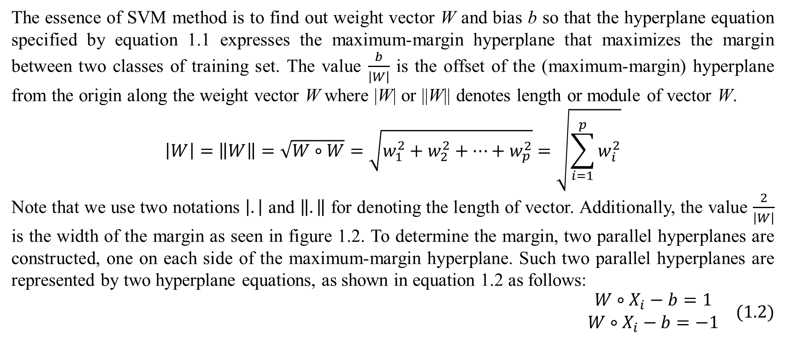
1. Support vector machine
The essence of SVM method is to find out weight vector W and bias b so that the hyperplane equation specified by equation 1.1 expresses the maximum-margin hyperplane that maximizes the margin between two classes of training set. The value $\frac{b}{\left|W\right|}$ is the offset of the (maximum-margin) hyperplane from the origin along the weight vector W where |W| or ||W|| denotes length or module of vector W.
$$\left|W\right|=\left\|W\right\|=\sqrt{W∘W}=\sqrt{w_{1}^{2}+w_{2}^{2}+…+w_{p}^{2}}=\sqrt{\sum_{i=1}^{p}{w_{i}^{2}}}$$
Note that we use two notations $\left|.\right|$ and $\left\|.\right\|$ for denoting the length of vector. Additionally, the value $\frac{2}{\left|W\right|}$ is the width of the margin as seen in figure 1.2. To determine the margin, two parallel hyperplanes are constructed, one on each side of the maximum-margin hyperplane. Such two parallel hyperplanes are represented by two hyperplane equations, as shown in equation 1.2 as follows:
$$\begin{matrix}W∘X_{i}−b=1 \\ W∘X_{i}−b=−1\end{matrix} (1.2)$$

Slide 7
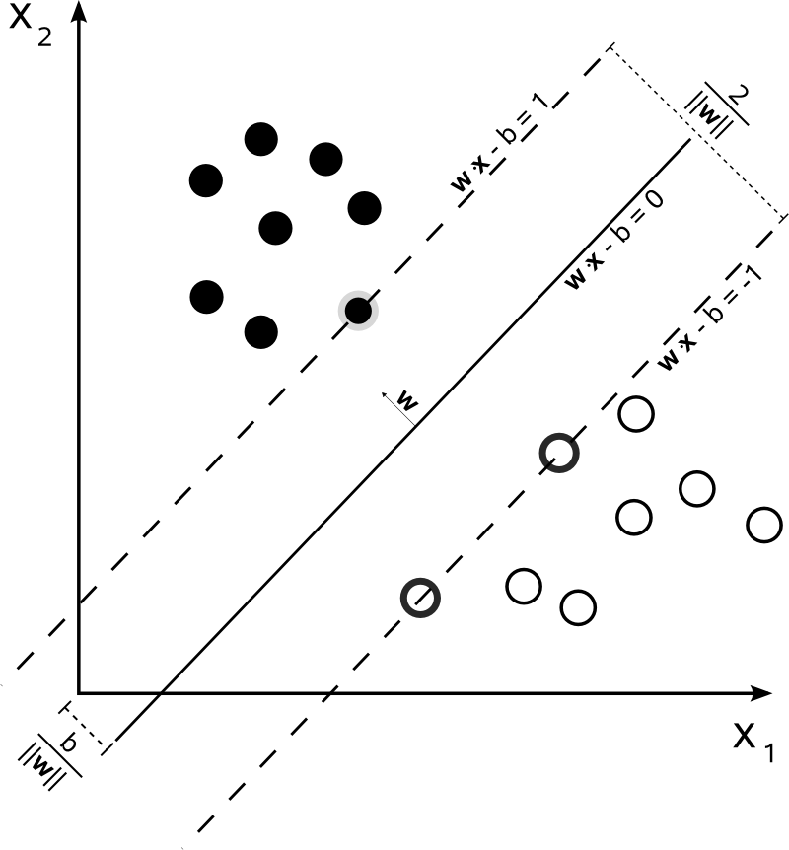
1. Support vector machine
Figure 1.2 (Wikibooks, 2008) illustrates maximum-margin hyperplane, weight vector W and two parallel hyperplanes. As seen in the figure 1.2, the margin is limited by such two parallel hyperplanes. Exactly, there are two margins (each one for a parallel hyperplane) but it is convenient for referring both margins as the unified single margin as usual. You can imagine such margin as a road and SVM method aims to maximize the width of such road. Data points lying on (or being very near to) two parallel hyperplanes are called support vectors because they construct mainly the maximum-margin hyperplane in the middle. This is the reason that the classification method is called support vector machine (SVM).
Figure 1.2. Maximum-margin hyperplane, parallel hyperplanes and weight vector W

Slide 8
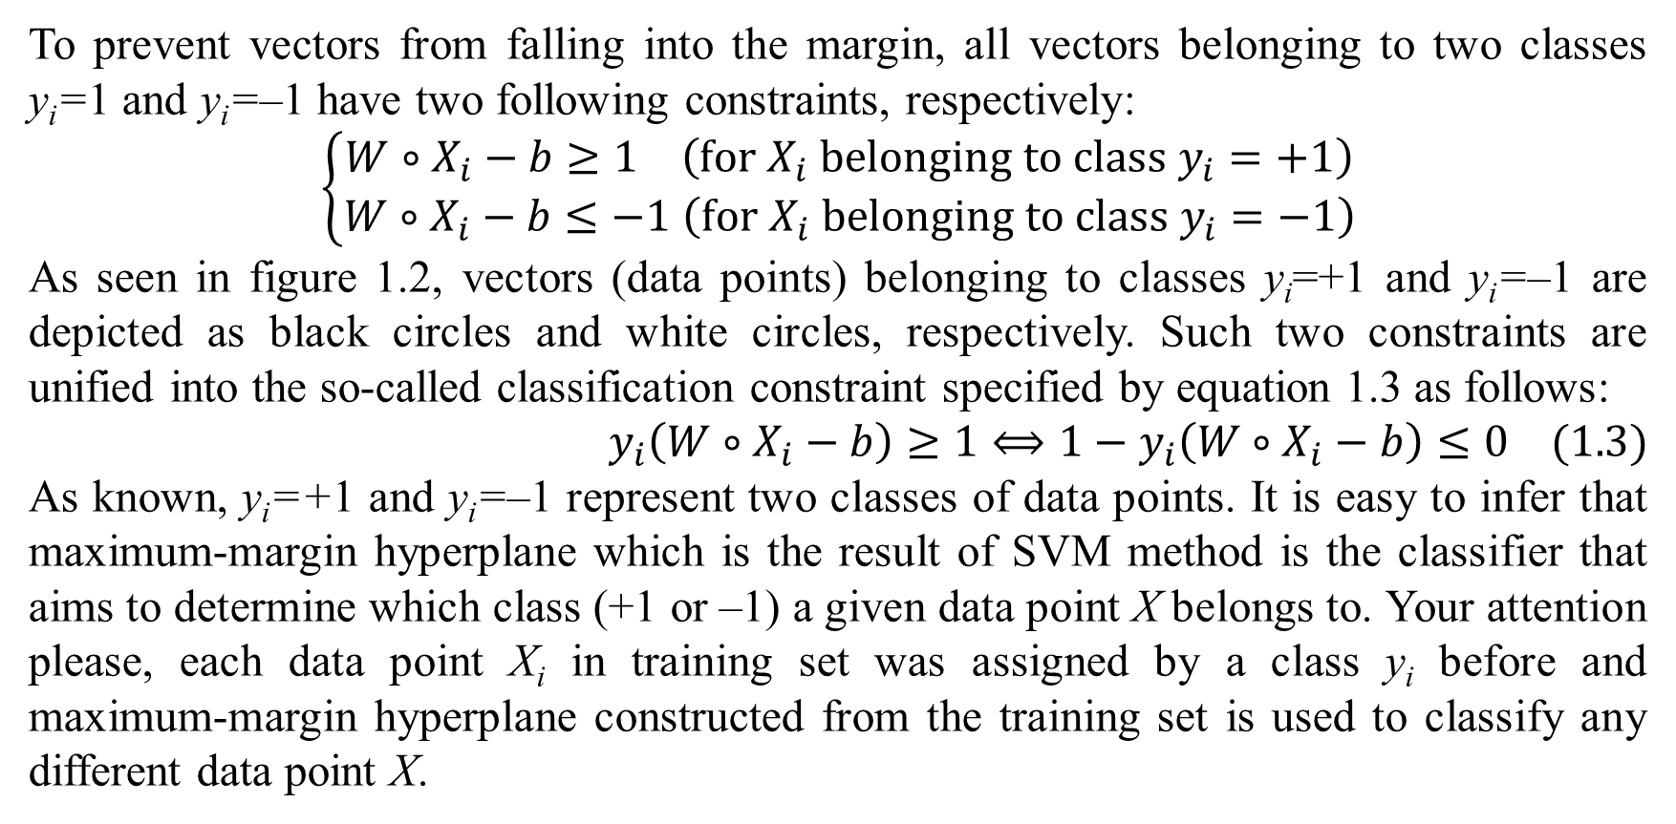
1. Support vector machine
To prevent vectors from falling into the margin, all vectors belonging to two classes y_{i}=1 and y_{i}=–1 have two following constraints, respectively:
$$\left\{\begin{matrix}W∘X_{i}−b≥1 \left(for X_{i} belonging to class y_{i}=+1\right) \\ W∘X_{i}−b≤−1 \left(for X_{i} belonging to class y_{i}=−1\right)\end{matrix}\right.$$
As seen in figure 1.2, vectors (data points) belonging to classes y_{i}=+1 and y_{i}=–1 are depicted as black circles and white circles, respectively. Such two constraints are unified into the so-called classification constraint specified by equation 1.3 as follows:
$$y_{i}\left(W∘X_{i}−b\right)≥1⟺1−y_{i}\left(W∘X_{i}−b\right)≤0 (1.3)$$
As known, y_{i}=+1 and y_{i}=–1 represent two classes of data points. It is easy to infer that maximum-margin hyperplane which is the result of SVM method is the classifier that aims to determine which class (+1 or –1) a given data point X belongs to. Your attention please, each data point X_{i} in training set was assigned by a class y_{i} before and maximum-margin hyperplane constructed from the training set is used to classify any different data point X.

Slide 9
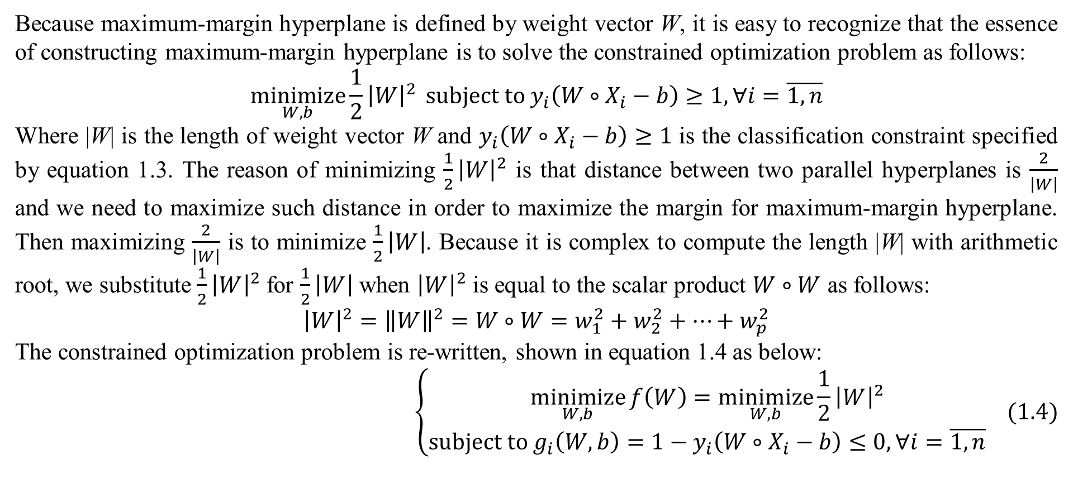
1. Support vector machine
Because maximum-margin hyperplane is defined by weight vector W, it is easy to recognize that the essence of constructing maximum-margin hyperplane is to solve the constrained optimization problem as follows:
$$\underset{W,b}{minimize}{\frac{1}{2}{\left|W\right|}^{2}} subject to y_{i}\left(W∘X_{i}−b\right)≥1,∀i=\overline{1,n}$$
Where |W| is the length of weight vector W and $y_{i}\left(W∘X_{i}−b\right)≥1$ is the classification constraint specified by equation 1.3. The reason of minimizing $\frac{1}{2}{\left|W\right|}^{2}$ is that distance between two parallel hyperplanes is $\frac{2}{\left|W\right|}$ and we need to maximize such distance in order to maximize the margin for maximum-margin hyperplane. Then maximizing $\frac{2}{\left|W\right|}$ is to minimize $\frac{1}{2}\left|W\right|$. Because it is complex to compute the length |W| with arithmetic root, we substitute $\frac{1}{2}{\left|W\right|}^{2}$ for $\frac{1}{2}\left|W\right|$ when ${\left|W\right|}^{2}$ is equal to the scalar product $W∘W$ as follows:
$${\left|W\right|}^{2}={\left\|W\right\|}^{2}=W∘W=w_{1}^{2}+w_{2}^{2}+…+w_{p}^{2}$$
The constrained optimization problem is re-written, shown in equation 1.4 as below:
$$\left\{\begin{matrix}\underset{W,b}{minimize}{f\left(W\right)}=\underset{W,b}{minimize}{\frac{1}{2}{\left|W\right|}^{2}} \\ subject to g_{i}\left(W,b\right)=1−y_{i}\left(W∘X_{i}−b\right)≤0,∀i=\overline{1,n}\end{matrix} (1.4)\right.$$

Slide 10
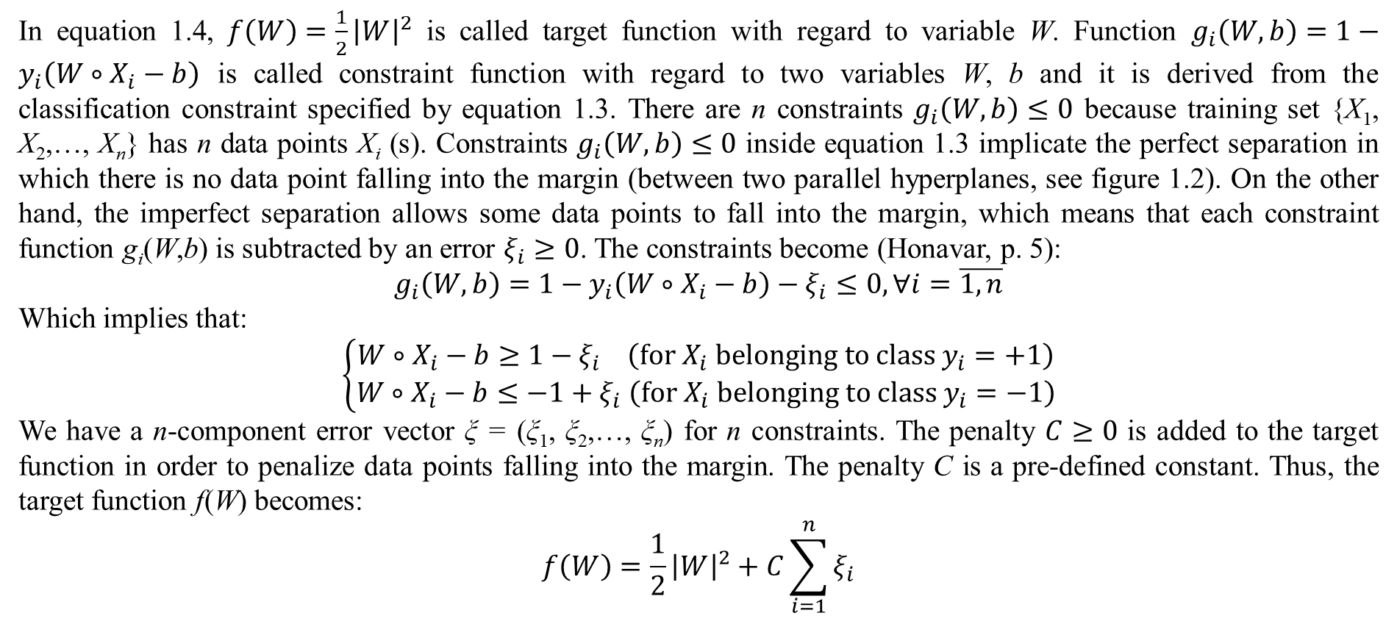
1. Support vector machine
In equation 1.4, $f\left(W\right)=\frac{1}{2}{\left|W\right|}^{2}$ is called target function with regard to variable W. Function $g_{i}\left(W,b\right)=1−y_{i}\left(W∘X_{i}−b\right)$ is called constraint function with regard to two variables W, b and it is derived from the classification constraint specified by equation 1.3. There are n constraints $g_{i}\left(W,b\right)≤0$ because training set {X₁, X₂,…, X_{n}} has n data points X_{i} (s). Constraints $g_{i}\left(W,b\right)≤0$ inside equation 1.3 implicate the perfect separation in which there is no data point falling into the margin (between two parallel hyperplanes, see figure 1.2). On the other hand, the imperfect separation allows some data points to fall into the margin, which means that each constraint function g_{i}(W,b) is subtracted by an error $ξ_{i}≥0$. The constraints become (Honavar, p. 5):
$$g_{i}\left(W,b\right)=1−y_{i}\left(W∘X_{i}−b\right)−ξ_{i}≤0,∀i=\overline{1,n}$$
Which implies that:
$$\left\{\begin{matrix}W∘X_{i}−b≥1−ξ_{i} \left(for X_{i} belonging to class y_{i}=+1\right) \\ W∘X_{i}−b≤−1+ξ_{i} \left(for X_{i} belonging to class y_{i}=−1\right)\end{matrix}\right.$$
We have a n-component error vector ξ = (ξ₁, ξ₂,…, ξ_{n}) for n constraints. The penalty $C≥0$ is added to the target function in order to penalize data points falling into the margin. The penalty C is a pre-defined constant. Thus, the target function f(W) becomes:
$$f\left(W\right)=\frac{1}{2}{\left|W\right|}^{2}+C\sum_{i=1}^{n}{ξ_{i}}$$

Slide 11
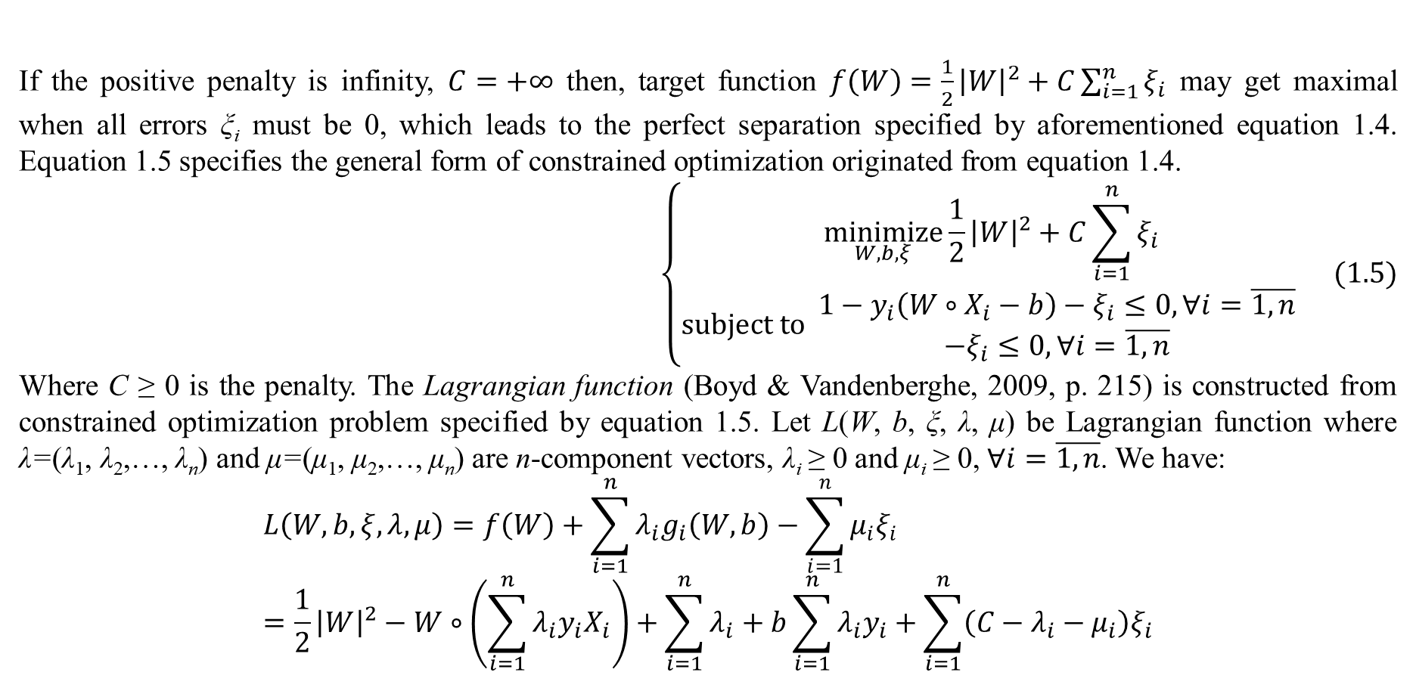
1. Support vector machine
If the positive penalty is infinity, $C=+∞$ then, target function $f\left(W\right)=\frac{1}{2}{\left|W\right|}^{2}+C\sum_{i=1}^{n}{ξ_{i}}$ may get maximal when all errors ξ_{i} must be 0, which leads to the perfect separation specified by aforementioned equation 1.4. Equation 1.5 specifies the general form of constrained optimization originated from equation 1.4.
$$\left\{\begin{matrix}\underset{W,b,ξ}{minimize}{\frac{1}{2}{\left|W\right|}^{2}+C\sum_{i=1}^{n}{ξ_{i}}} \\ subject to \begin{matrix}1−y_{i}\left(W∘X_{i}−b\right)−ξ_{i}≤0,∀i=\overline{1,n} \\ −ξ_{i}≤0,∀i=\overline{1,n}\end{matrix} \end{matrix}\right. (1.5)$$
Where C ≥ 0 is the penalty. The Lagrangian function (Boyd & Vandenberghe, 2009, p. 215) is constructed from constrained optimization problem specified by equation 1.5. Let L(W, b, ξ, λ, μ) be Lagrangian function where λ=(λ₁, λ₂,…, λ_{n}) and μ=(μ₁, μ₂,…, μ_{n}) are n-component vectors, λ_{i} ≥ 0 and μ_{i} ≥ 0, $∀i=\overline{1,n}$. We have:
$$L\left(W,b,ξ,λ,μ\right)=f\left(W\right)+\sum_{i=1}^{n}{λ_{i}g_{i}\left(W,b\right)}−\sum_{i=1}^{n}{μ_{i}ξ_{i}}=\frac{1}{2}{\left|W\right|}^{2}−W∘\left(\sum_{i=1}^{n}{λ_{i}y_{i}X_{i}}\right)+\sum_{i=1}^{n}{λ_{i}}+b\sum_{i=1}^{n}{λ_{i}y_{i}}+\sum_{i=1}^{n}{\left(C−λ_{i}−μ_{i}\right)ξ_{i}}$$

Slide 12
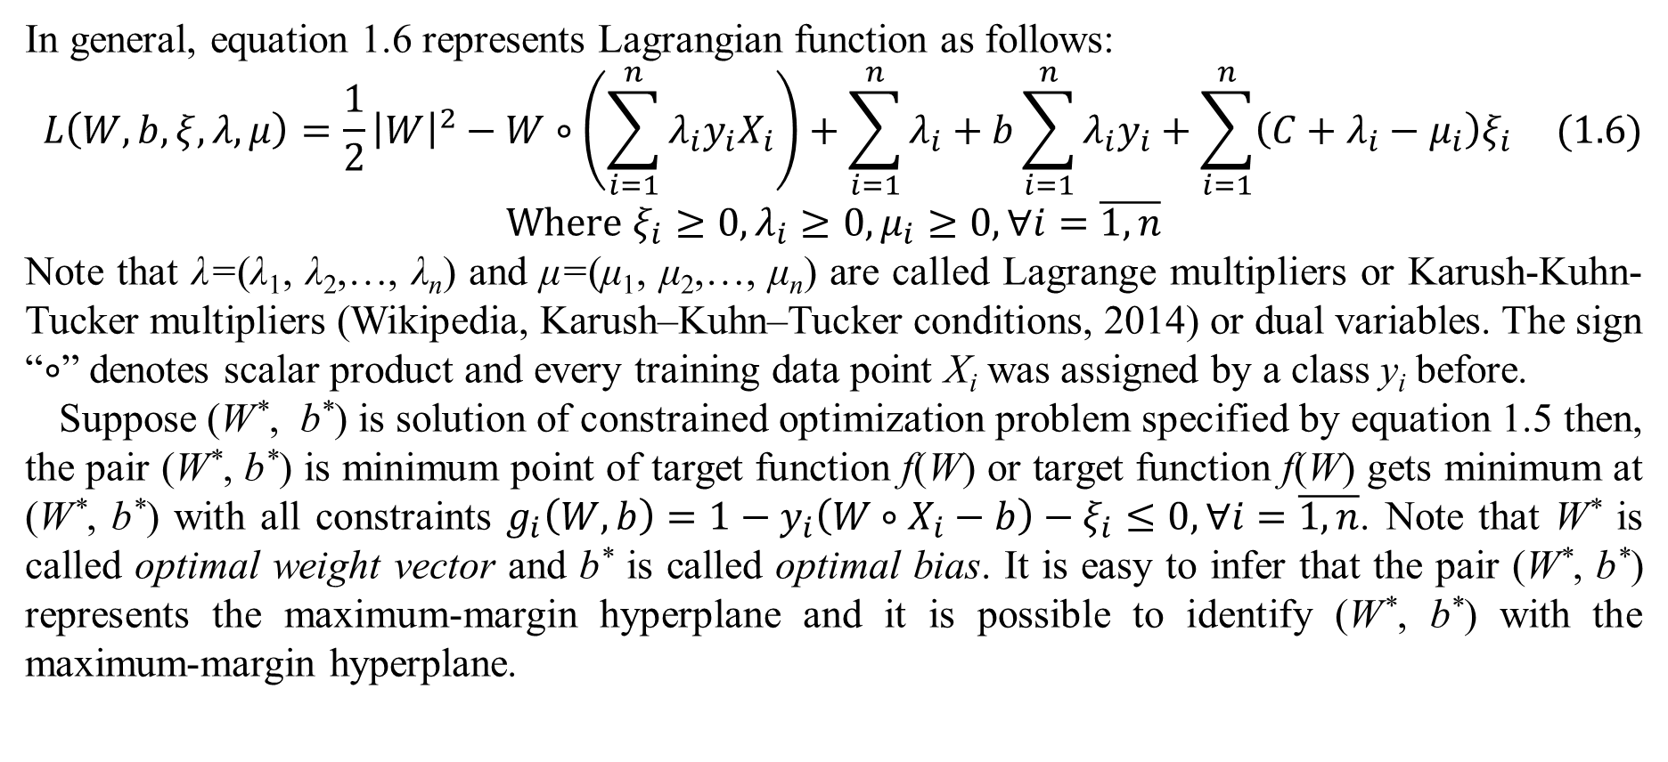
1. Support vector machine
In general, equation 1.6 represents Lagrangian function as follows:
$$L\left(W,b,ξ,λ,μ\right)=\frac{1}{2}{\left|W\right|}^{2}−W∘\left(\sum_{i=1}^{n}{λ_{i}y_{i}X_{i}}\right)+\sum_{i=1}^{n}{λ_{i}}+b\sum_{i=1}^{n}{λ_{i}y_{i}}+\sum_{i=1}^{n}{\left(C+λ_{i}−μ_{i}\right)ξ_{i}} (1.6)$$
$$Where ξ_{i}≥0,λ_{i}≥0,μ_{i}≥0,∀i=\overline{1,n}$$
Note that λ=(λ₁, λ₂,…, λ_{n}) and μ=(μ₁, μ₂,…, μ_{n}) are called Lagrange multipliers or Karush-Kuhn-Tucker multipliers (Wikipedia, Karush–Kuhn–Tucker conditions, 2014) or dual variables. The sign “$∘$” denotes scalar product and every training data point X_{i} was assigned by a class y_{i} before.
Suppose (W*, b*) is solution of constrained optimization problem specified by equation 1.5 then, the pair (W*, b*) is minimum point of target function f(W) or target function f(W) gets minimum at (W*, b*) with all constraints $g_{i}\left(W,b\right)=1−y_{i}\left(W∘X_{i}−b\right)−ξ_{i}≤0,∀i=\overline{1,n}$. Note that W* is called optimal weight vector and b* is called optimal bias. It is easy to infer that the pair (W*, b*) represents the maximum-margin hyperplane and it is possible to identify (W*, b*) with the maximum-margin hyperplane.

Slide 13
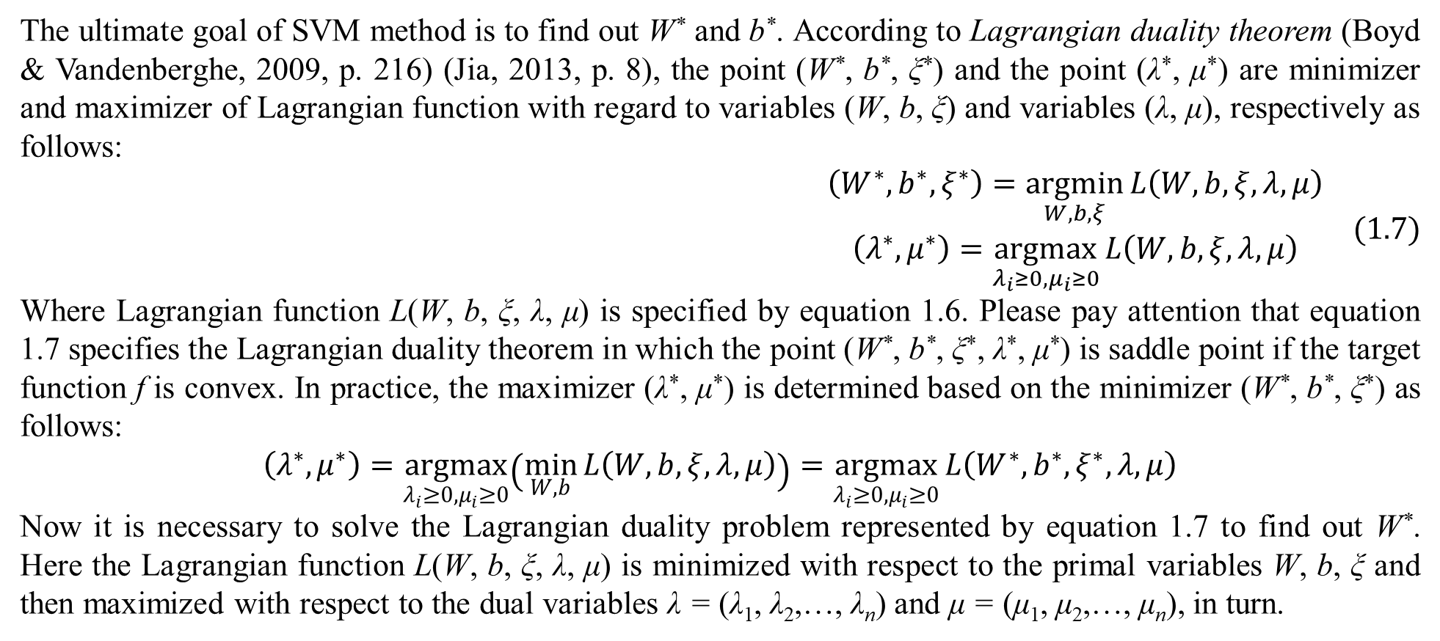
1. Support vector machine
The ultimate goal of SVM method is to find out W* and b*. According to Lagrangian duality theorem (Boyd & Vandenberghe, 2009, p. 216) (Jia, 2013, p. 8), the point (W*, b*, ξ*) and the point (λ*, μ*) are minimizer and maximizer of Lagrangian function with regard to variables (W, b, ξ) and variables (λ, μ), respectively as follows:
$$\begin{matrix}\left(W^{∗},b^{∗},ξ^{∗}\right)=\underset{W,b,ξ}{argmin}{L\left(W,b,ξ,λ,μ\right)} \\ \left(λ^{∗},μ^{∗}\right)=\underset{λ_{i}≥0,μ_{i}≥0}{argmax}{L\left(W,b,ξ,λ,μ\right)}\end{matrix} (1.7)$$
Where Lagrangian function L(W, b, ξ, λ, μ) is specified by equation 1.6. Please pay attention that equation 1.7 specifies the Lagrangian duality theorem in which the point (W*, b*, ξ*, λ*, μ*) is saddle point if the target function f is convex. In practice, the maximizer (λ*, μ*) is determined based on the minimizer (W*, b*, ξ*) as follows:
$$\left(λ^{∗},μ^{∗}\right)=\underset{λ_{i}≥0,μ_{i}≥0}{argmax}\left(\min_{W,b}{L\left(W,b,ξ,λ,μ\right)}\right)=\underset{λ_{i}≥0,μ_{i}≥0}{argmax}{L\left(W^{∗},b^{∗},ξ^{∗},λ,μ\right)}$$
Now it is necessary to solve the Lagrangian duality problem represented by equation 1.7 to find out W*. Here the Lagrangian function L(W, b, ξ, λ, μ) is minimized with respect to the primal variables W, b, ξ and then maximized with respect to the dual variables λ = (λ₁, λ₂,…, λ_{n}) and μ = (μ₁, μ₂,…, μ_{n}), in turn.

Slide 14
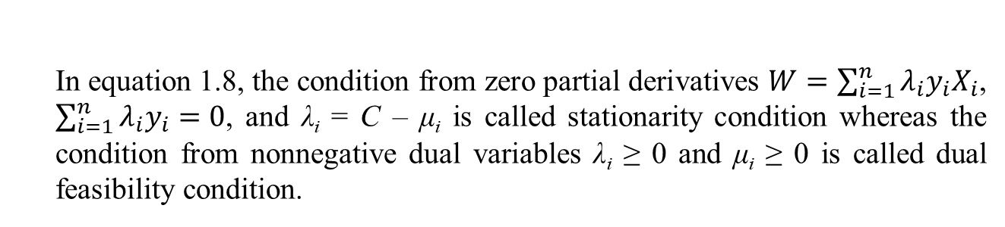
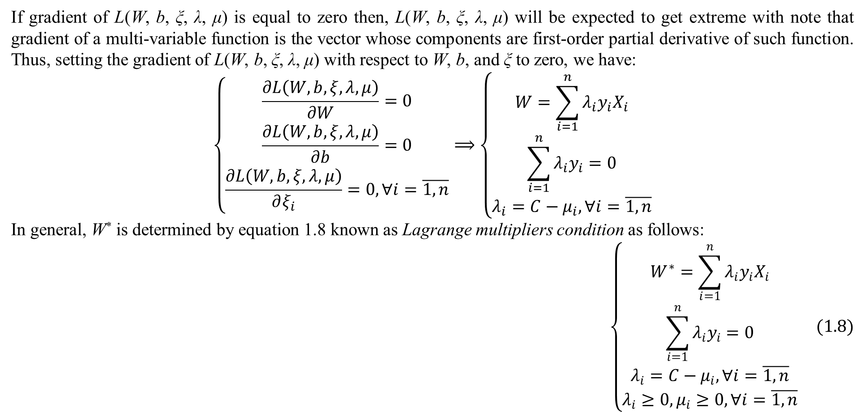
1. Support vector machine
If gradient of L(W, b, ξ, λ, μ) is equal to zero then, L(W, b, ξ, λ, μ) will be expected to get extreme with note that gradient of a multi-variable function is the vector whose components are first-order partial derivative of such function. Thus, setting the gradient of L(W, b, ξ, λ, μ) with respect to W, b, and ξ to zero, we have:
$$\left\{\begin{matrix}\frac{∂L\left(W,b,ξ,λ,μ\right)}{∂W}=0 \\ \frac{∂L\left(W,b,ξ,λ,μ\right)}{∂b}=0 \\ \frac{∂L\left(W,b,ξ,λ,μ\right)}{∂ξ_{i}}=0,∀i=\overline{1,n}\end{matrix}\right.⟹\left\{\begin{matrix}W=\sum_{i=1}^{n}{λ_{i}y_{i}X_{i}} \\ \sum_{i=1}^{n}{λ_{i}y_{i}}=0 \\ λ_{i}=C−μ_{i},∀i=\overline{1,n}\end{matrix}\right.$$
In general, W* is determined by equation 1.8 known as Lagrange multipliers condition as follows:
$$\left\{\begin{matrix}W^{∗}=\sum_{i=1}^{n}{λ_{i}y_{i}X_{i}} \\ \sum_{i=1}^{n}{λ_{i}y_{i}}=0 \\ λ_{i}=C−μ_{i},∀i=\overline{1,n} \\ λ_{i}≥0,μ_{i}≥0,∀i=\overline{1,n}\end{matrix}\right. (1.8)$$
In equation 1.8, the condition from zero partial derivatives $W=\sum_{i=1}^{n}{λ_{i}y_{i}X_{i}}$, $\sum_{i=1}^{n}{λ_{i}y_{i}}=0$, and λ_{i} = C – μ_{i} is called stationarity condition whereas the condition from nonnegative dual variables λ_{i} ≥ 0 and μ_{i} ≥ 0 is called dual feasibility condition.

Slide 15
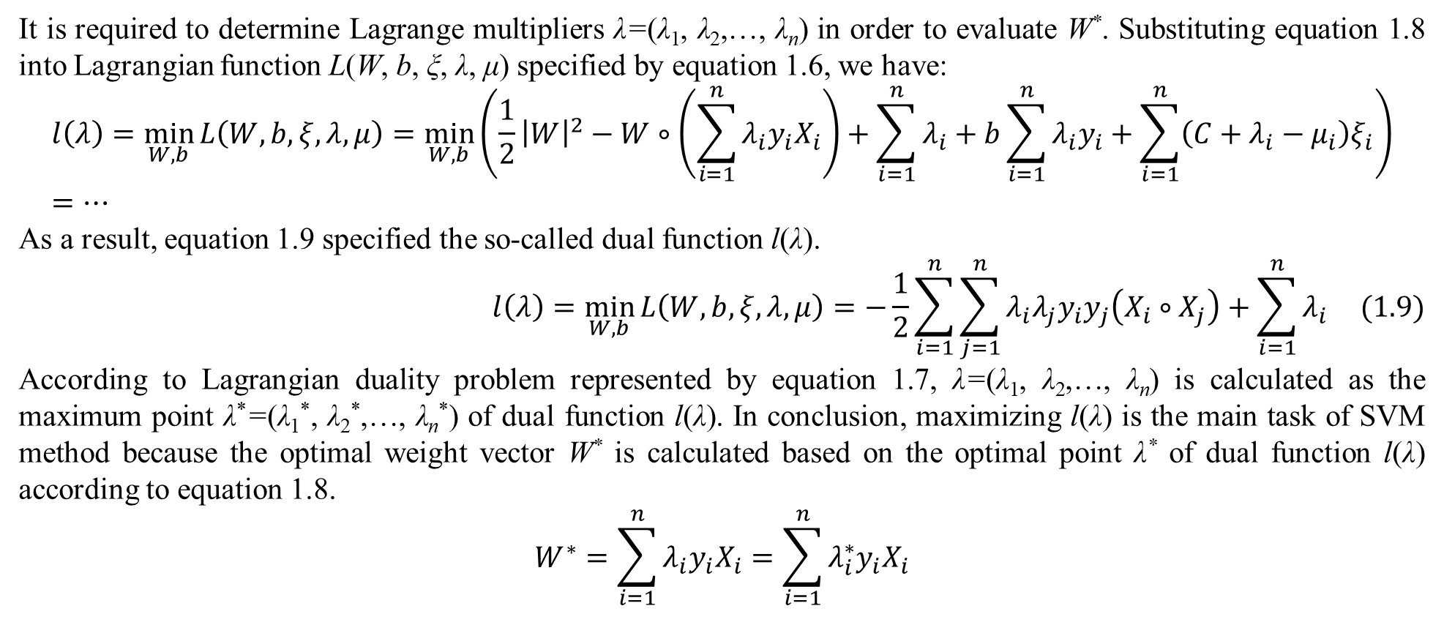
1. Support vector machine
It is required to determine Lagrange multipliers λ=(λ₁, λ₂,…, λ_{n}) in order to evaluate W*. Substituting equation 1.8 into Lagrangian function L(W, b, ξ, λ, μ) specified by equation 1.6, we have:
$$l\left(λ\right)=\min_{W,b}{L\left(W,b,ξ,λ,μ\right)}=\min_{W,b}\left(\frac{1}{2}{\left|W\right|}^{2}−W∘\left(\sum_{i=1}^{n}{λ_{i}y_{i}X_{i}}\right)+\sum_{i=1}^{n}{λ_{i}}+b\sum_{i=1}^{n}{λ_{i}y_{i}}+\sum_{i=1}^{n}{\left(C+λ_{i}−μ_{i}\right)ξ_{i}}\right)=…$$
As a result, equation 1.9 specified the so-called dual function l(λ).
$$l\left(λ\right)=\min_{W,b}{L\left(W,b,ξ,λ,μ\right)}=−\frac{1}{2}\sum_{i=1}^{n}{\sum_{j=1}^{n}{λ_{i}λ_{j}y_{i}y_{j}\left(X_{i}∘X_{j}\right)}}+\sum_{i=1}^{n}{λ_{i}} (1.9)$$
According to Lagrangian duality problem represented by equation 1.7, λ=(λ₁, λ₂,…, λ_{n}) is calculated as the maximum point λ*=(λ₁*, λ₂*,…, λ_{n}*) of dual function l(λ). In conclusion, maximizing l(λ) is the main task of SVM method because the optimal weight vector W* is calculated based on the optimal point λ* of dual function l(λ) according to equation 1.8.
$$W^{∗}=\sum_{i=1}^{n}{λ_{i}y_{i}X_{i}}=\sum_{i=1}^{n}{λ_{i}^{∗}y_{i}X_{i}}$$

Slide 16
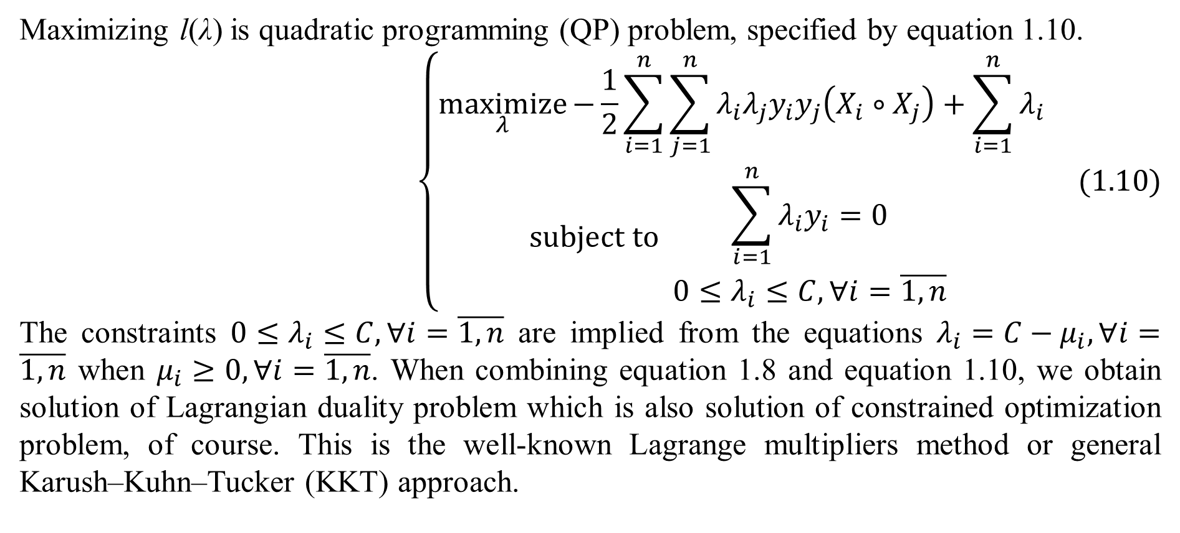
1. Support vector machine
Maximizing l(λ) is quadratic programming (QP) problem, specified by equation 1.10.
$$\left\{\begin{matrix}\underset{λ}{maximize}{−\frac{1}{2}\sum_{i=1}^{n}{\sum_{j=1}^{n}{λ_{i}λ_{j}y_{i}y_{j}\left(X_{i}∘X_{j}\right)}}+\sum_{i=1}^{n}{λ_{i}}} \\ subject to \begin{matrix}\sum_{i=1}^{n}{λ_{i}y_{i}}=0 \\ 0≤λ_{i}≤C,∀i=\overline{1,n}\end{matrix} \end{matrix}\right. (1.10)$$
The constraints $0≤λ_{i}≤C,∀i=\overline{1,n}$ are implied from the equations $λ_{i}=C−μ_{i},∀i=\overline{1,n}$ when $μ_{i}≥0,∀i=\overline{1,n}$. When combining equation 1.8 and equation 1.10, we obtain solution of Lagrangian duality problem which is also solution of constrained optimization problem, of course. This is the well-known Lagrange multipliers method or general Karush–Kuhn–Tucker (KKT) approach.

Slide 17
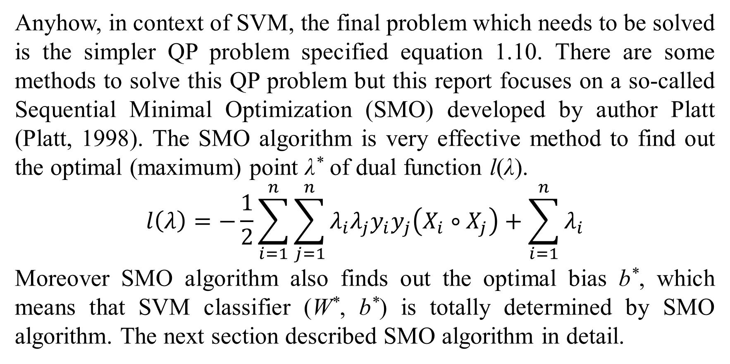
1. Support vector machine
Anyhow, in context of SVM, the final problem which needs to be solved is the simpler QP problem specified equation 1.10. There are some methods to solve this QP problem but this report focuses on a so-called Sequential Minimal Optimization (SMO) developed by author Platt (Platt, 1998). The SMO algorithm is very effective method to find out the optimal (maximum) point λ* of dual function l(λ).
$$l\left(λ\right)=−\frac{1}{2}\sum_{i=1}^{n}{\sum_{j=1}^{n}{λ_{i}λ_{j}y_{i}y_{j}\left(X_{i}∘X_{j}\right)}}+\sum_{i=1}^{n}{λ_{i}}$$
Moreover SMO algorithm also finds out the optimal bias b*, which means that SVM classifier (W*, b*) is totally determined by SMO algorithm. The next section described SMO algorithm in detail.

Slide 18
2. Sequential minimal optimization
The ideology of SMO algorithm is to divide the whole QP problem into many smallest optimization problems. Each smallest problem relates to only two Lagrange multipliers. For solving each smallest optimization problem, SMO algorithm includes two nested loops as shown in table 2.1 (Platt, 1998, pp. 8-9):
SMO algorithm solves each smallest optimization problem via two nested loops:
The outer loop finds out the first Lagrange multiplier λ_{i} whose associated data point X_{i} violates KKT condition (Wikipedia, Karush–Kuhn–Tucker conditions, 2014). Violating KKT condition is known as the first choice heuristic.
The inner loop finds out the second Lagrange multiplier λ_{j} according to the second choice heuristic. The second choice heuristic that maximizes optimization step will be described later.
Two Lagrange multipliers λ_{i} and λ_{j} are optimized jointly according to QP problem specified by equation 1.10.
SMO algorithm continues to solve another smallest optimization problem. SMO algorithm stops when there is convergence in which no data point violating KKT condition is found; consequently, all Lagrange multipliers λ₁, λ₂,…, λ_{n} are optimized.
Table 2.1. Ideology of SMO algorithm
The ideology of violating KKT condition as the first choice heuristic is similar to the event that wrong things need to be fixed priorly.

Slide 19

2. Sequential minimal optimization
Before describing SMO algorithm in detailed, KKT condition with subject to SVM is mentioned firstly because violating KKT condition is known as the first choice heuristic of SMO algorithm. For solving constrained optimization problem, KKT condition indicates both partial derivatives of Lagrangian function and complementary slackness are zero (Wikipedia, Karush–Kuhn–Tucker conditions, 2014). Referring Eqs. 1.8 and 1.4, KKT condition of SVM is summarized as Eq. 2.1:
$$\left\{\begin{matrix}W=\sum_{i=1}^{n}{λ_{i}y_{i}X_{i}} \\ \sum_{i=1}^{n}{λ_{i}y_{i}}=0 \\ λ_{i}=C−μ_{i},∀i \\ 1−y_{i}\left(W∘X_{i}−b\right)−ξ_{i}≤0,∀i \\ −ξ_{i}≤0,∀i \\ λ_{i}≥0,μ_{i}≥0,∀i \\ λ_{i}\left(1−y_{i}\left(W∘X_{i}−b\right)−ξ_{i}\right)=0,∀i \\ −{μ_{i}ξ}_{i}=0,∀i\end{matrix}\right.(2.1)$$
In equation 2.1, the complementary slackness is λ_{i}(1 – y_{i} (W∘X_{i} – b) – ξ_{i}) = 0 and –μ_{i}ξ_{i} = 0 for all i because of the primal feasibility condition 1 – y_{i} (W∘X_{i} – b) – ξ_{i} ≤ 0 and –ξ_{i} ≤ 0 for all i. KKT condition specified by equation 2.1 implies Lagrange multipliers condition specified by equation 1.8, which aims to solve Lagrangian duality problem whose solution (W*, b*, ξ*, λ*, μ*) is saddle point of Lagrangian function. This is the reason that KKT condition is known as general form of Lagrange multipliers condition. It is easy to deduce that QP problem for SVM specified by equation 1.10 is derived from KKT condition within Lagrangian duality theory.

Slide 20
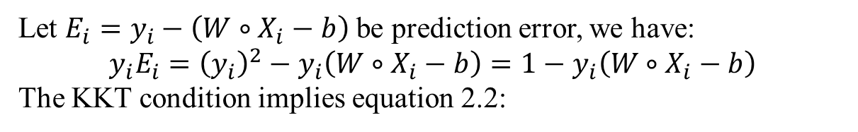
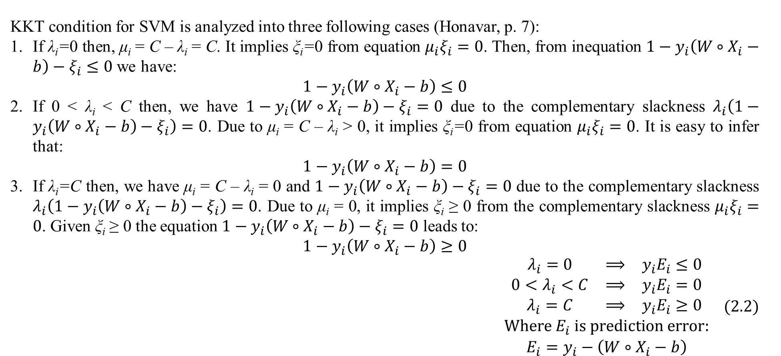
2. Sequential minimal optimization
KKT condition for SVM is analyzed into three following cases (Honavar, p. 7):
If λ_{i}=0 then, μ_{i} = C – λ_{i} = C. It implies ξ_{i}=0 from equation ${μ_{i}ξ}_{i}=0$. Then, from inequation $1−y_{i}\left(W∘X_{i}−b\right)−ξ_{i}≤0$ we have:
$$1−y_{i}\left(W∘X_{i}−b\right)≤0$$
If 0 < λ_{i} < C then, we have $1−y_{i}\left(W∘X_{i}−b\right)−ξ_{i}=0$ due to the complementary slackness $λ_{i}\left(1−y_{i}\left(W∘X_{i}−b\right)−ξ_{i}\right)=0$. Due to μ_{i} = C – λ_{i} > 0, it implies ξ_{i}=0 from equation ${μ_{i}ξ}_{i}=0$. It is easy to infer that:
$$1−y_{i}\left(W∘X_{i}−b\right)=0$$
If λ_{i}=C then, we have μ_{i} = C – λ_{i} = 0 and $1−y_{i}\left(W∘X_{i}−b\right)−ξ_{i}=0$ due to the complementary slackness $λ_{i}\left(1−y_{i}\left(W∘X_{i}−b\right)−ξ_{i}\right)=0$. Due to μ_{i} = 0, it implies ξ_{i} ≥ 0 from the complementary slackness ${μ_{i}ξ}_{i}=0$. Given ξ_{i} ≥ 0 the equation $1−y_{i}\left(W∘X_{i}−b\right)−ξ_{i}=0$ leads to:
$$1−y_{i}\left(W∘X_{i}−b\right)≥0$$
$$\begin{matrix}\begin{matrix}λ_{i}=0 & ⟹ & y_{i}E_{i}≤0 \\ 0<λ_{i}<C & ⟹ & y_{i}E_{i}=0 \\ λ_{i}=C & ⟹ & y_{i}E_{i}≥0\end{matrix} \\ Where E_{i} is prediction error: \\ E_{i}=y_{i}−\left(W∘X_{i}−b\right)\end{matrix} (2.2)$$
Let $E_{i}=y_{i}−\left(W∘X_{i}−b\right)$ be prediction error, we have:
$$y_{i}E_{i}={\left(y_{i}\right)}^{2}−y_{i}\left(W∘X_{i}−b\right)=1−y_{i}\left(W∘X_{i}−b\right)$$
The KKT condition implies equation 2.2:

Slide 21
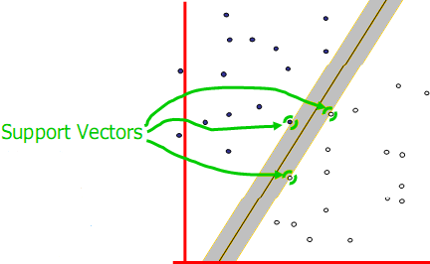
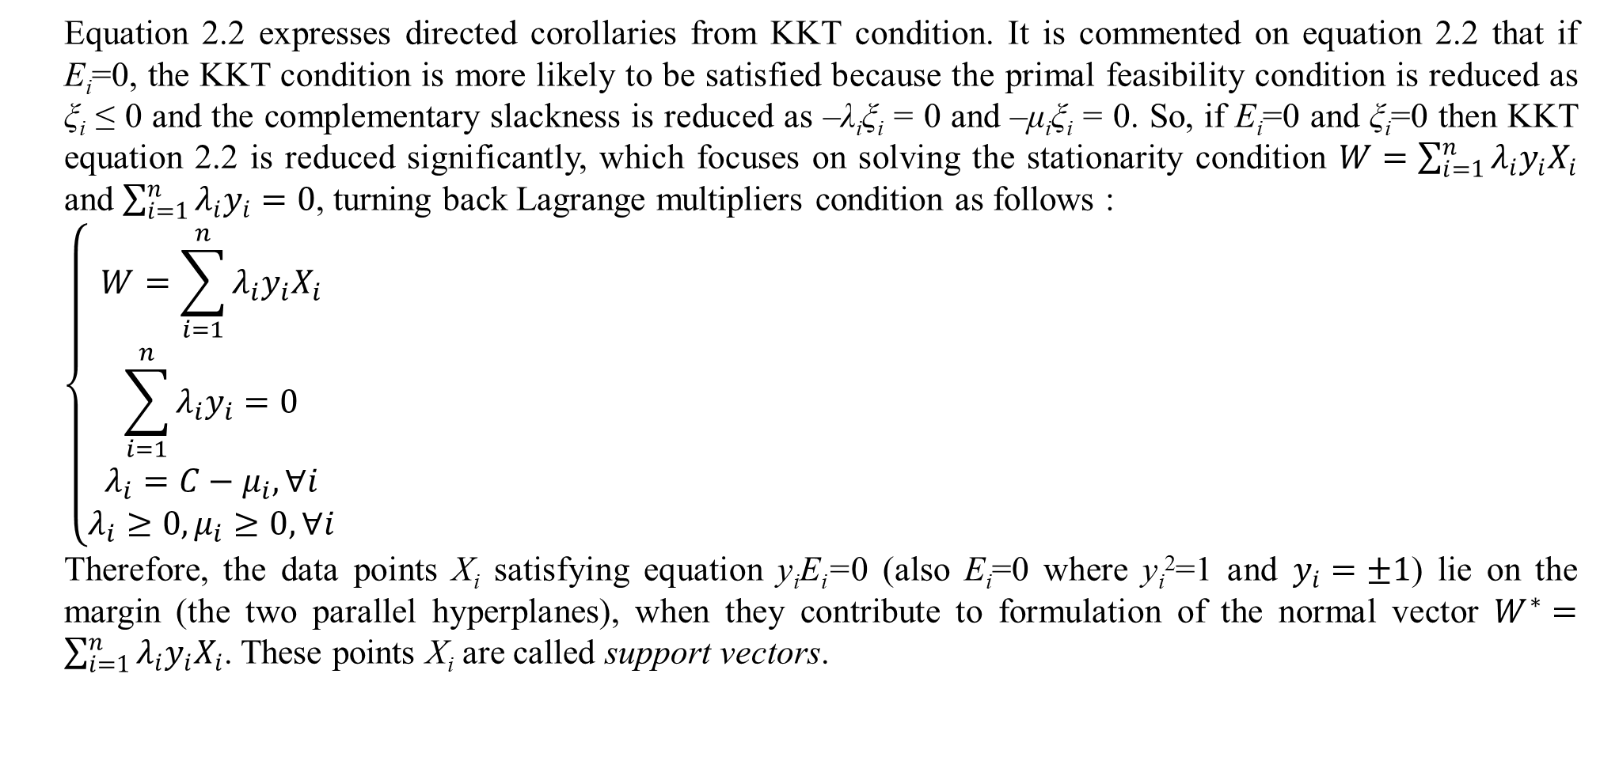
2. Sequential minimal optimization
Equation 2.2 expresses directed corollaries from KKT condition. It is commented on equation 2.2 that if E_{i}=0, the KKT condition is more likely to be satisfied because the primal feasibility condition is reduced as ξ_{i} ≤ 0 and the complementary slackness is reduced as –λ_{i}ξ_{i} = 0 and –μ_{i}ξ_{i} = 0. So, if E_{i}=0 and ξ_{i}=0 then KKT equation 2.2 is reduced significantly, which focuses on solving the stationarity condition $W=\sum_{i=1}^{n}{λ_{i}y_{i}X_{i}}$ and $\sum_{i=1}^{n}{λ_{i}y_{i}}=0$, turning back Lagrange multipliers condition as follows :
$$\left\{\begin{matrix}W=\sum_{i=1}^{n}{λ_{i}y_{i}X_{i}} \\ \sum_{i=1}^{n}{λ_{i}y_{i}}=0 \\ λ_{i}=C−μ_{i},∀i \\ λ_{i}≥0,μ_{i}≥0,∀i\end{matrix}\right.$$
Therefore, the data points X_{i} satisfying equation y_{i}E_{i}=0 (also E_{i}=0 where y_{i}²=1 and $y_{i}=±1$) lie on the margin (the two parallel hyperplanes), when they contribute to formulation of the normal vector $W^{∗}=\sum_{i=1}^{n}{λ_{i}y_{i}X_{i}}$. These points X_{i} are called support vectors.
Figure 2.1. Support vectors

Slide 22

2. Sequential minimal optimization
Recall that support vectors satisfying equation y_{i}E_{i}=0 also E_{i}=0 lie on the margin (see figure 2.1). According to KKT condition specified by equation 2.1, support vectors are always associated with non-zero Lagrange multipliers such that 0<λ_{i}<C because they will not contribute to the normal vector $W^{∗}=\sum_{i=1}^{n}{λ_{i}y_{i}X_{i}}$ if their λ_{i} are zero or C. Note, errors ξ_{i} of support vectors are 0 because of the reduced complementary slackness (–λ_{i}ξ_{i} = 0 and –μ_{i}ξ_{i} = 0) when E_{i}=0 along with λ_{i}>0. When ξ_{i}=0 then μ_{i} can be positive from equation μ_{i}ξ_{i} = 0, which can violate the equation λ_{i} = C – μ_{i} if λ_{i}=C. Such Lagrange multipliers 0<λ_{i}<C are also called non-boundary multipliers because they are not bounds such as 0 and C. So, support vectors are also known as non-boundary data points. It is easy to infer from equation 1.8:
$$W^{∗}=\sum_{i=1}^{n}{λ_{i}y_{i}X_{i}}$$
that support vectors along with their non-zero Lagrange multipliers form mainly the optimal weight vector W* representing the maximum-margin hyperplane – the SVM classifier. This is the reason that this classification approach is called support vector machine (SVM). Figure 2.1 (Moore, 2001, p. 5) illustrates an example of support vectors.
Figure 2.1. Support vectors

Slide 23
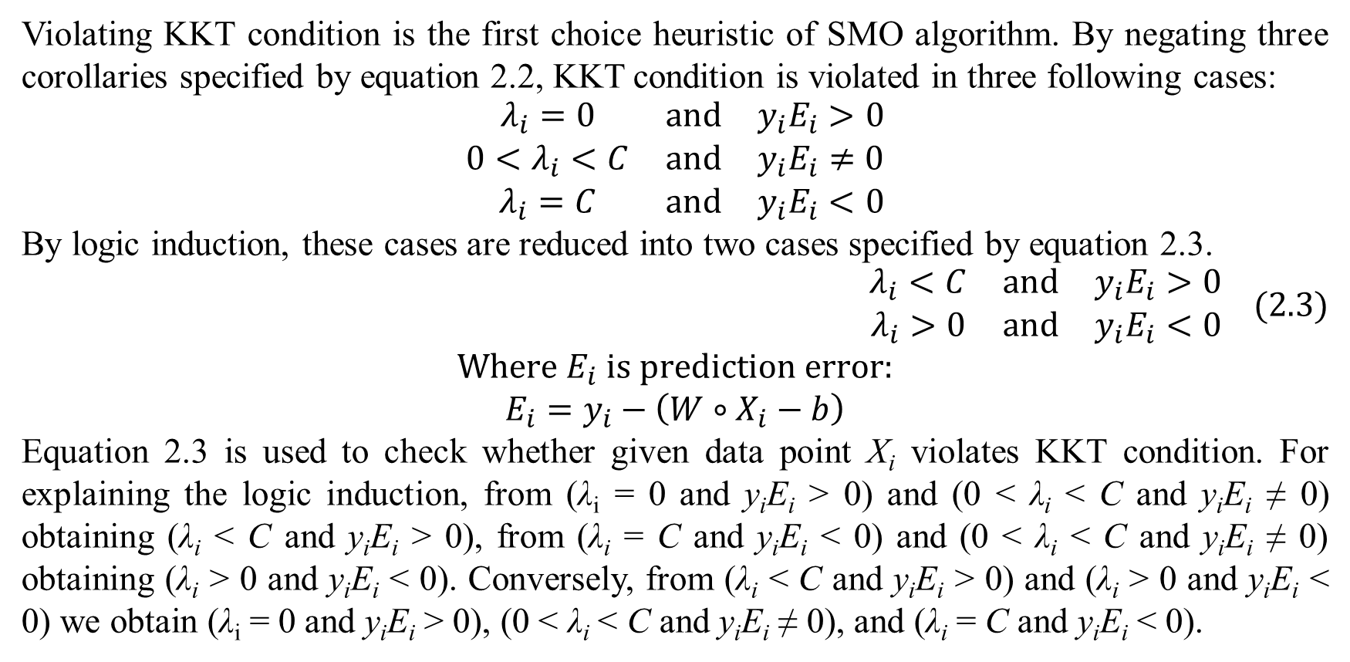
2. Sequential minimal optimization
Violating KKT condition is the first choice heuristic of SMO algorithm. By negating three corollaries specified by equation 2.2, KKT condition is violated in three following cases:
$$\begin{matrix}λ_{i}=0 & and & y_{i}E_{i}>0 \\ 0<λ_{i}<C & and & y_{i}E_{i}≠0 \\ λ_{i}=C & and & y_{i}E_{i}<0\end{matrix}$$
By logic induction, these cases are reduced into two cases specified by equation 2.3.
$$\begin{matrix}λ_{i}<C & and & y_{i}E_{i}>0 \\ λ_{i}>0 & and & y_{i}E_{i}<0\end{matrix} (2.3)$$
$$Where E_{i} is prediction error:$$
$$E_{i}=y_{i}−\left(W∘X_{i}−b\right)$$
Equation 2.3 is used to check whether given data point X_{i} violates KKT condition. For explaining the logic induction, from (λ_{i} = 0 and y_{i}E_{i} > 0) and (0 < λ_{i} < C and y_{i}E_{i} ≠ 0) obtaining (λ_{i} < C and y_{i}E_{i} > 0), from (λ_{i} = C and y_{i}E_{i} < 0) and (0 < λ_{i} < C and y_{i}E_{i} ≠ 0) obtaining (λ_{i} > 0 and y_{i}E_{i} < 0). Conversely, from (λ_{i} < C and y_{i}E_{i} > 0) and (λ_{i} > 0 and y_{i}E_{i} < 0) we obtain (λ_{i} = 0 and y_{i}E_{i} > 0), (0 < λ_{i} < C and y_{i}E_{i} ≠ 0), and (λ_{i} = C and y_{i}E_{i} < 0).

Slide 24
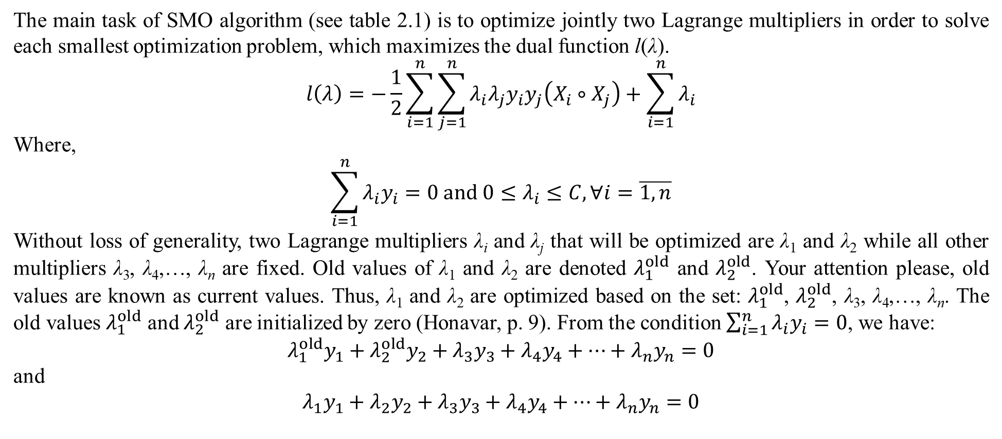
2. Sequential minimal optimization
The main task of SMO algorithm (see table 2.1) is to optimize jointly two Lagrange multipliers in order to solve each smallest optimization problem, which maximizes the dual function l(λ).
$$l\left(λ\right)=−\frac{1}{2}\sum_{i=1}^{n}{\sum_{j=1}^{n}{λ_{i}λ_{j}y_{i}y_{j}\left(X_{i}∘X_{j}\right)}}+\sum_{i=1}^{n}{λ_{i}}$$
Where,
$$\begin{matrix}\sum_{i=1}^{n}{λ_{i}y_{i}}=0 and 0≤λ_{i}≤C,∀i=\overline{1,n}\end{matrix}$$
Without loss of generality, two Lagrange multipliers λ_{i} and λ_{j} that will be optimized are λ₁ and λ₂ while all other multipliers λ₃, λ₄,…, λ_{n} are fixed. Old values of λ₁ and λ₂ are denoted $λ_{1}^{old}$ and $λ_{2}^{old}$. Your attention please, old values are known as current values. Thus, λ₁ and λ₂ are optimized based on the set: $λ_{1}^{old}$, $λ_{2}^{old}$, λ₃, λ₄,…, λ_{n}. The old values $λ_{1}^{old}$ and $λ_{2}^{old}$ are initialized by zero (Honavar, p. 9). From the condition $\sum_{i=1}^{n}{λ_{i}y_{i}}=0$, we have:
$$λ_{1}^{old}y_{1}+λ_{2}^{old}y_{2}+λ_{3}y_{3}+λ_{4}y_{4}+…+λ_{n}y_{n}=0$$
and
$$λ_{1}y_{1}+λ_{2}y_{2}+λ_{3}y_{3}+λ_{4}y_{4}+…+λ_{n}y_{n}=0$$

Slide 25
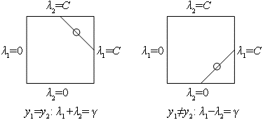
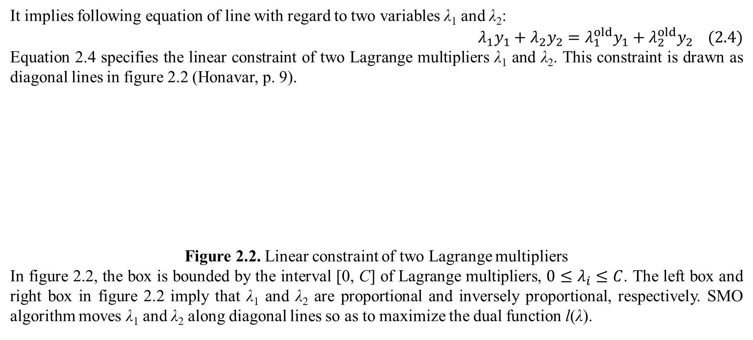
2. Sequential minimal optimization
It implies following equation of line with regard to two variables λ₁ and λ₂:
$$λ_{1}y_{1}+λ_{2}y_{2}=λ_{1}^{old}y_{1}+λ_{2}^{old}y_{2} (2.4)$$
Equation 2.4 specifies the linear constraint of two Lagrange multipliers λ₁ and λ₂. This constraint is drawn as diagonal lines in figure 2.2 (Honavar, p. 9).
Figure 2.2. Linear constraint of two Lagrange multipliers
In figure 2.2, the box is bounded by the interval [0, C] of Lagrange multipliers, $0≤λ_{i}≤C$. The left box and right box in figure 2.2 imply that λ₁ and λ₂ are proportional and inversely proportional, respectively. SMO algorithm moves λ₁ and λ₂ along diagonal lines so as to maximize the dual function l(λ).

Slide 26
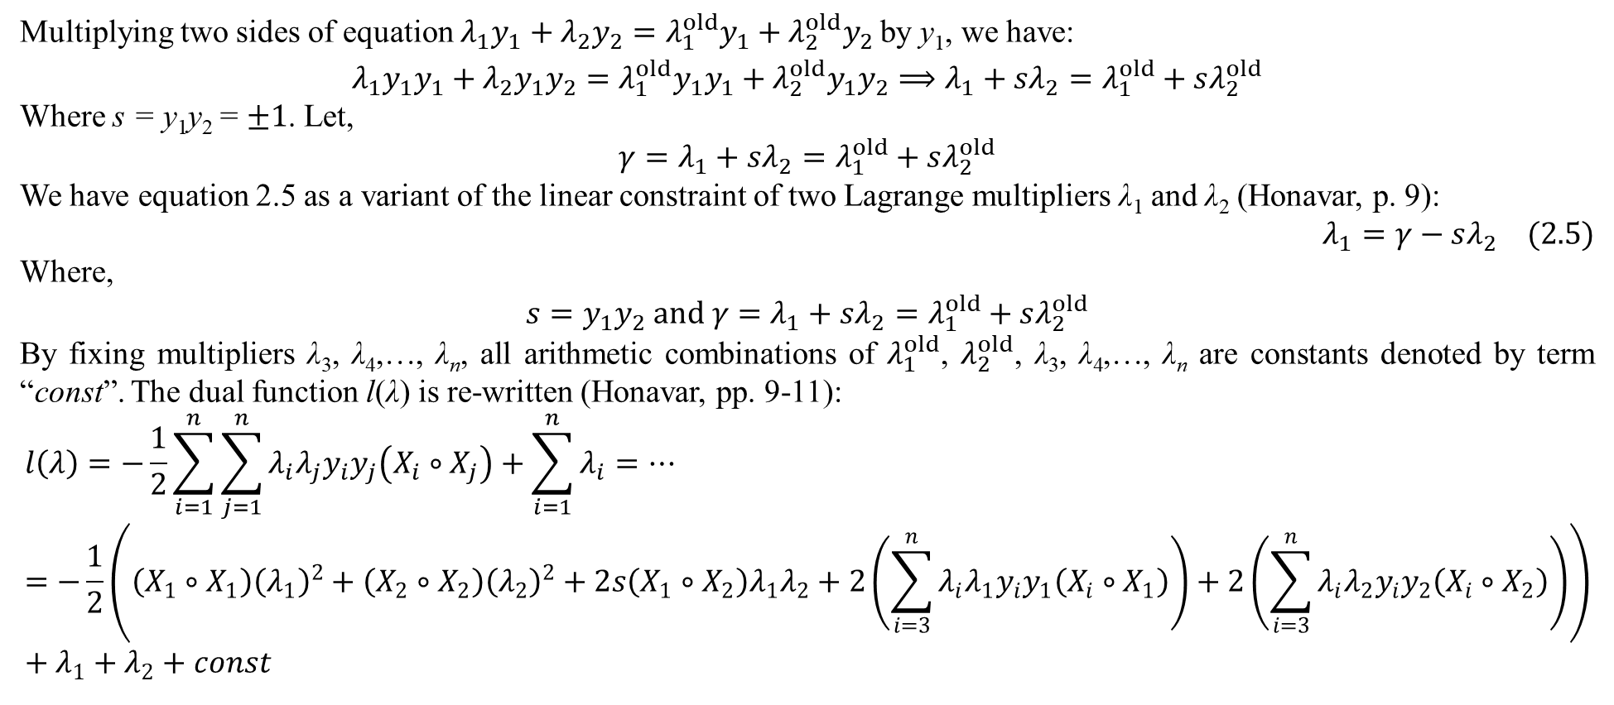
2. Sequential minimal optimization
Multiplying two sides of equation $λ_{1}y_{1}+λ_{2}y_{2}=λ_{1}^{old}y_{1}+λ_{2}^{old}y_{2}$by y₁, we have:
$$λ_{1}y_{1}y_{1}+λ_{2}y_{1}y_{2}=λ_{1}^{old}y_{1}y_{1}+λ_{2}^{old}y_{1}y_{2}⟹λ_{1}+sλ_{2}=λ_{1}^{old}+sλ_{2}^{old}$$
Where s = y₁y₂ = $±1$. Let,
$$γ=λ_{1}+sλ_{2}=λ_{1}^{old}+sλ_{2}^{old}$$
We have equation 2.5 as a variant of the linear constraint of two Lagrange multipliers λ₁ and λ₂ (Honavar, p. 9):
$$λ_{1}=γ−sλ_{2} (2.5)$$
Where,
$$s=y_{1}y_{2} and γ=λ_{1}+sλ_{2}=λ_{1}^{old}+sλ_{2}^{old}$$
By fixing multipliers λ₃, λ₄,…, λ_{n}, all arithmetic combinations of $λ_{1}^{old}$, $λ_{2}^{old}$, λ₃, λ₄,…, λ_{n} are constants denoted by term “const”. The dual function l(λ) is re-written (Honavar, pp. 9-11):
$$l\left(λ\right)=−\frac{1}{2}\sum_{i=1}^{n}{\sum_{j=1}^{n}{λ_{i}λ_{j}y_{i}y_{j}\left(X_{i}∘X_{j}\right)}}+\sum_{i=1}^{n}{λ_{i}}=…=−\frac{1}{2}\left(\left(X_{1}∘X_{1}\right){\left(λ_{1}\right)}^{2}+\left(X_{2}∘X_{2}\right){\left(λ_{2}\right)}^{2}+2s\left(X_{1}∘X_{2}\right)λ_{1}λ_{2}+2\left(\sum_{i=3}^{n}{λ_{i}λ_{1}y_{i}y_{1}\left(X_{i}∘X_{1}\right)}\right)+2\left(\sum_{i=3}^{n}{λ_{i}λ_{2}y_{i}y_{2}\left(X_{i}∘X_{2}\right)}\right)\right)+λ_{1}+λ_{2}+const$$

Slide 27
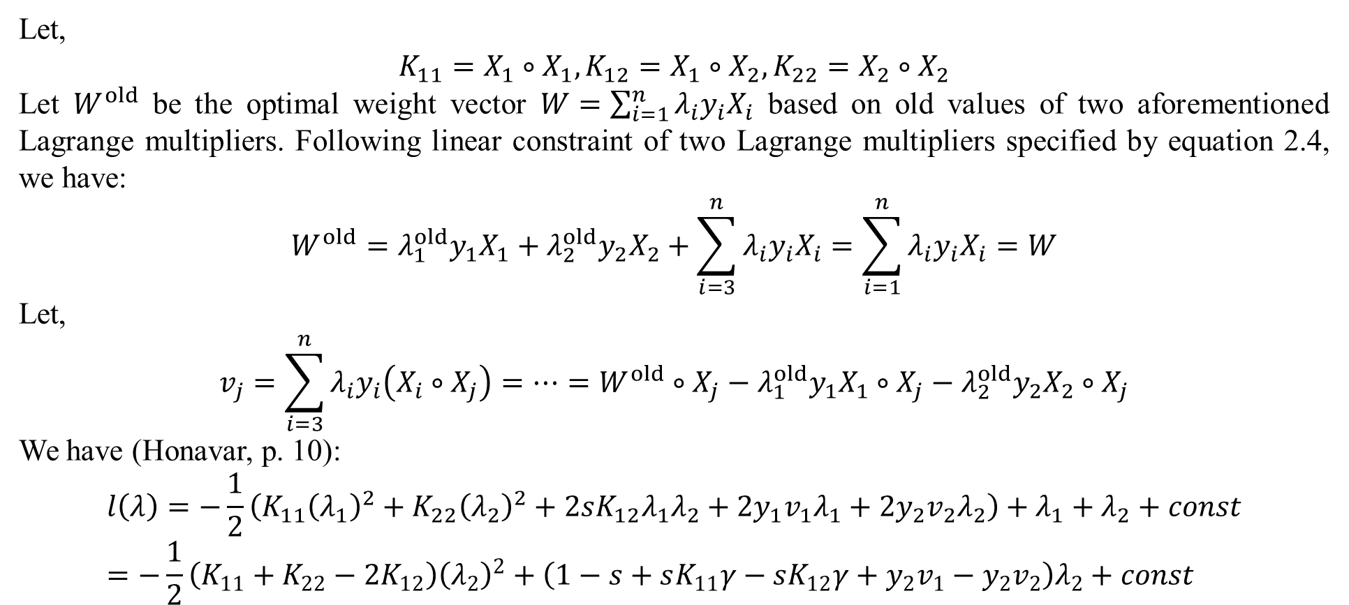
2. Sequential minimal optimization
Let,
$$K_{11}=X_{1}∘X_{1},K_{12}=X_{1}∘X_{2},K_{22}=X_{2}∘X_{2}$$
Let $W^{old}$ be the optimal weight vector $W=\sum_{i=1}^{n}{λ_{i}y_{i}X_{i}}$ based on old values of two aforementioned Lagrange multipliers. Following linear constraint of two Lagrange multipliers specified by equation 2.4, we have:
$$W^{old}=λ_{1}^{old}y_{1}X_{1}+λ_{2}^{old}y_{2}X_{2}+\sum_{i=3}^{n}{λ_{i}y_{i}X_{i}}=\sum_{i=1}^{n}{λ_{i}y_{i}X_{i}}=W$$
Let,
$$v_{j}=\sum_{i=3}^{n}{λ_{i}y_{i}\left(X_{i}∘X_{j}\right)}=…=W^{old}∘X_{j}−λ_{1}^{old}y_{1}X_{1}∘X_{j}−λ_{2}^{old}y_{2}X_{2}∘X_{j}$$
We have (Honavar, p. 10):
$$l\left(λ\right)=−\frac{1}{2}\left(K_{11}{\left(λ_{1}\right)}^{2}+K_{22}{\left(λ_{2}\right)}^{2}+2sK_{12}λ_{1}λ_{2}+2y_{1}v_{1}λ_{1}+2y_{2}v_{2}λ_{2}\right)+λ_{1}+λ_{2}+const=−\frac{1}{2}\left(K_{11}+K_{22}−2K_{12}\right){\left(λ_{2}\right)}^{2}+\left(1−s+sK_{11}γ−sK_{12}γ+y_{2}v_{1}−y_{2}v_{2}\right)λ_{2}+const$$

Slide 28
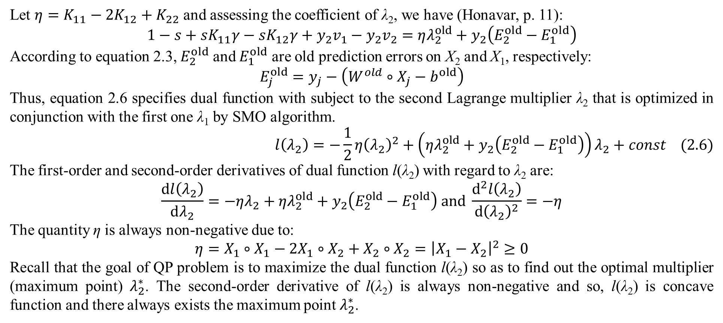
2. Sequential minimal optimization
Let $η=K_{11}−2K_{12}+K_{22}$ and assessing the coefficient of λ₂, we have (Honavar, p. 11):
$$1−s+sK_{11}γ−sK_{12}γ+y_{2}v_{1}−y_{2}v_{2}=ηλ_{2}^{old}+y_{2}\left(E_{2}^{old}−E_{1}^{old}\right)$$
According to equation 2.3, $E_{2}^{old}$ and $E_{1}^{old}$ are old prediction errors on X₂ and X₁, respectively:
$$E_{j}^{old}=y_{j}−\left(W^{old}∘X_{j}−b^{old}\right)$$
Thus, equation 2.6 specifies dual function with subject to the second Lagrange multiplier λ₂ that is optimized in conjunction with the first one λ₁ by SMO algorithm.
$$l\left(λ_{2}\right)=−\frac{1}{2}η{\left(λ_{2}\right)}^{2}+\left(ηλ_{2}^{old}+y_{2}\left(E_{2}^{old}−E_{1}^{old}\right)\right)λ_{2}+const (2.6)$$
The first-order and second-order derivatives of dual function l(λ₂) with regard to λ₂ are:
$$\frac{dl\left(λ_{2}\right)}{dλ_{2}}=−ηλ_{2}+ηλ_{2}^{old}+y_{2}\left(E_{2}^{old}−E_{1}^{old}\right) and \frac{d^{2}l\left(λ_{2}\right)}{d{\left(λ_{2}\right)}^{2}}=−η$$
The quantity η is always non-negative due to:
$$η=X_{1}∘X_{1}−2X_{1}∘X_{2}+X_{2}∘X_{2}={\left|X_{1}−X_{2}\right|}^{2}≥0$$
Recall that the goal of QP problem is to maximize the dual function l(λ₂) so as to find out the optimal multiplier (maximum point) $λ_{2}^{∗}$. The second-order derivative of l(λ₂) is always non-negative and so, l(λ₂) is concave function and there always exists the maximum point $λ_{2}^{∗}$.

Slide 29
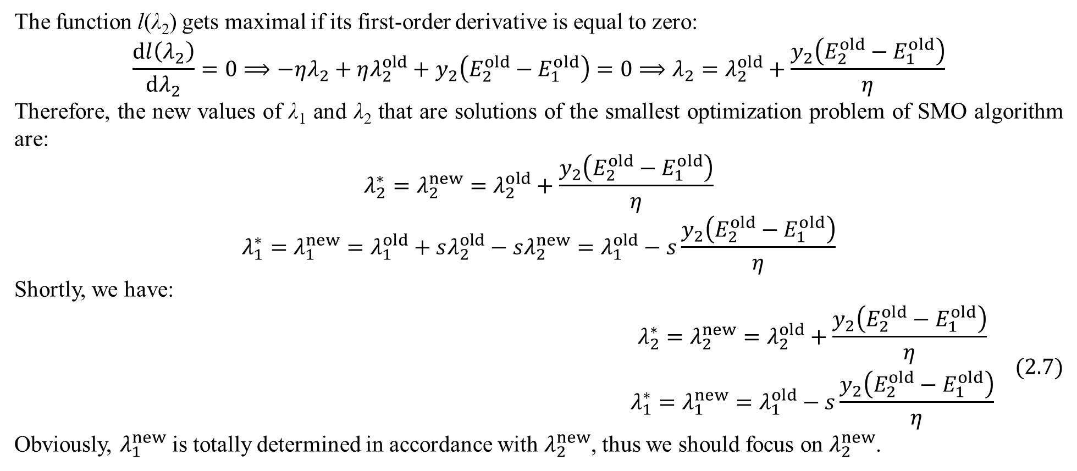
2. Sequential minimal optimization
The function l(λ₂) gets maximal if its first-order derivative is equal to zero:
$$\frac{dl\left(λ_{2}\right)}{dλ_{2}}=0⟹−ηλ_{2}+ηλ_{2}^{old}+y_{2}\left(E_{2}^{old}−E_{1}^{old}\right)=0⟹λ_{2}=λ_{2}^{old}+\frac{y_{2}\left(E_{2}^{old}−E_{1}^{old}\right)}{η}$$
Therefore, the new values of λ₁ and λ₂ that are solutions of the smallest optimization problem of SMO algorithm are:
$$λ_{2}^{∗}=λ_{2}^{new}=λ_{2}^{old}+\frac{y_{2}\left(E_{2}^{old}−E_{1}^{old}\right)}{η}$$
$$λ_{1}^{∗}=λ_{1}^{new}=λ_{1}^{old}+sλ_{2}^{old}−sλ_{2}^{new}=λ_{1}^{old}−s\frac{y_{2}\left(E_{2}^{old}−E_{1}^{old}\right)}{η}$$
Shortly, we have:
$$\begin{matrix}λ_{2}^{∗}=λ_{2}^{new}=λ_{2}^{old}+\frac{y_{2}\left(E_{2}^{old}−E_{1}^{old}\right)}{η} \\ λ_{1}^{∗}=λ_{1}^{new}=λ_{1}^{old}−s\frac{y_{2}\left(E_{2}^{old}−E_{1}^{old}\right)}{η}\end{matrix} (2.7)$$
Obviously, $λ_{1}^{new}$ is totally determined in accordance with $λ_{2}^{new}$, thus we should focus on $λ_{2}^{new}$.

Slide 30
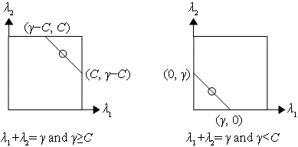
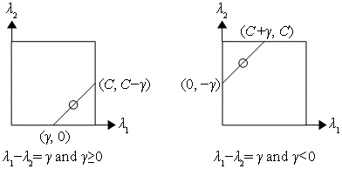
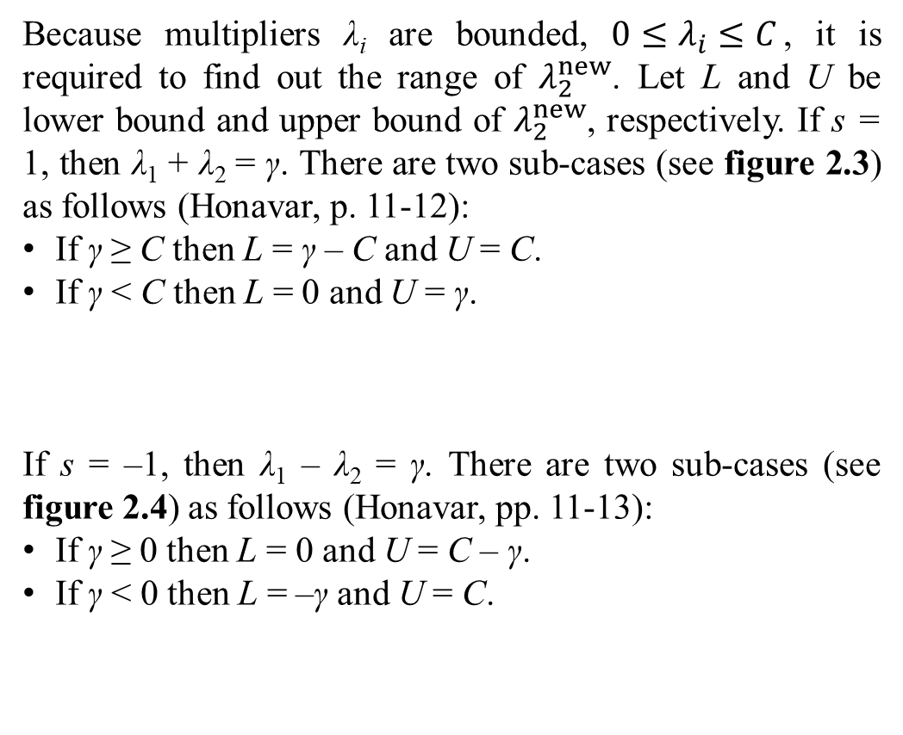
2. Sequential minimal optimization
Because multipliers λ_{i} are bounded, $0≤λ_{i}≤C$, it is required to find out the range of $λ_{2}^{new}$. Let L and U be lower bound and upper bound of $λ_{2}^{new}$, respectively. If s = 1, then λ₁ + λ₂ = γ. There are two sub-cases (see figure 2.3) as follows (Honavar, p. 11-12):
If γ ≥ C then L = γ – C and U = C.
If γ < C then L = 0 and U = γ.
If s = –1, then λ₁ – λ₂ = γ. There are two sub-cases (see figure 2.4) as follows (Honavar, pp. 11-13):
If γ ≥ 0 then L = 0 and U = C – γ.
If γ < 0 then L = –γ and U = C.

Slide 31
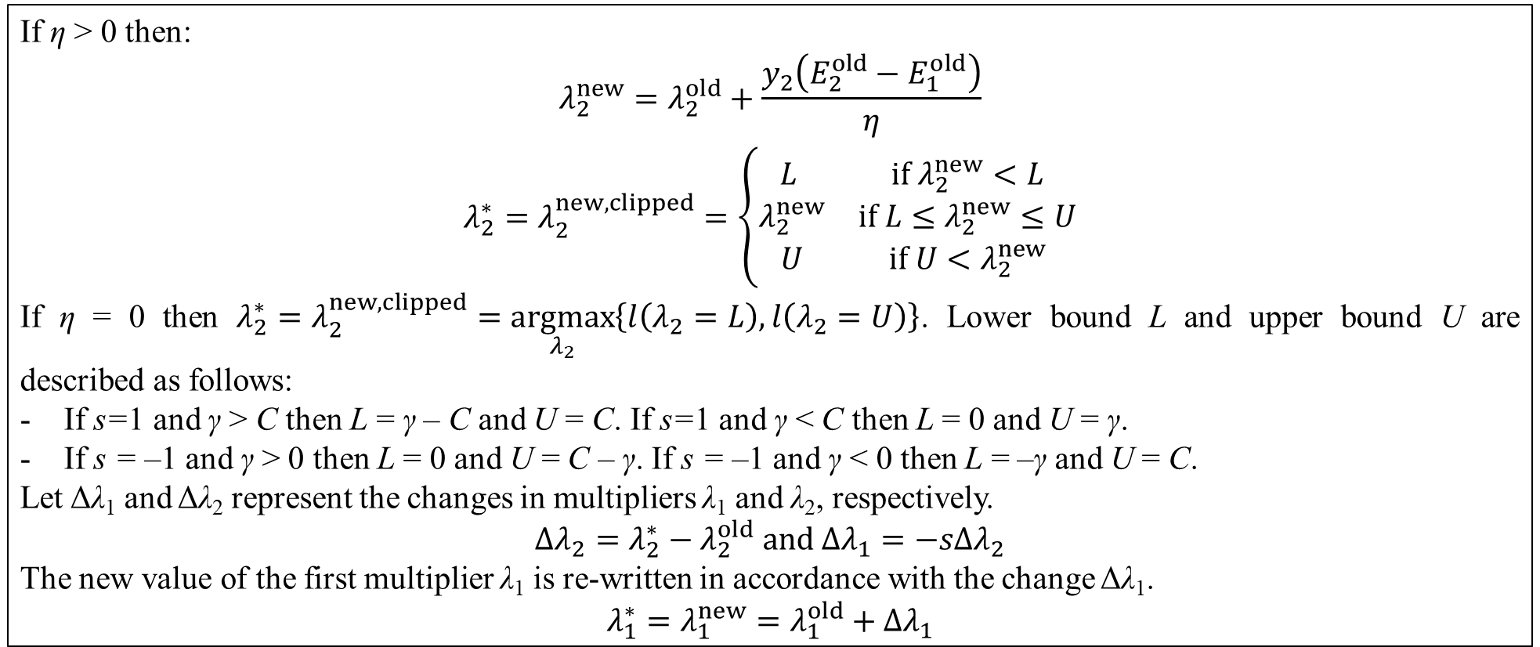
2. Sequential minimal optimization
In general, table 2.2 below summarizes how SMO algorithm optimizes jointly two Lagrange multipliers.
If η > 0 then:
$$\begin{matrix}λ_{2}^{new}=λ_{2}^{old}+\frac{y_{2}\left(E_{2}^{old}−E_{1}^{old}\right)}{η} \\ λ_{2}^{∗}=λ_{2}^{new,clipped}=\left\{\begin{matrix}L & if λ_{2}^{new}<L \\ λ_{2}^{new} & if L≤λ_{2}^{new}≤U \\ U & if U<λ_{2}^{new}\end{matrix}\right.\end{matrix}$$
If η = 0 then $λ_{2}^{∗}=λ_{2}^{new,clipped}=\underset{λ_{2}}{argmax}\left\{l\left(λ_{2}=L\right),l\left(λ_{2}=U\right)\right\}$. Lower bound L and upper bound U are described as follows:
If s=1 and γ > C then L = γ – C and U = C. If s=1 and γ < C then L = 0 and U = γ.
If s = –1 and γ > 0 then L = 0 and U = C – γ. If s = –1 and γ < 0 then L = –γ and U = C.
Let Δλ₁ and Δλ₂ represent the changes in multipliers λ₁ and λ₂, respectively.
$$Δλ_{2}=λ_{2}^{∗}−λ_{2}^{old} and Δλ_{1}=−sΔλ_{2}$$
The new value of the first multiplier λ₁ is re-written in accordance with the change Δλ₁.
$$λ_{1}^{∗}=λ_{1}^{new}=λ_{1}^{old}+Δλ_{1}$$

Slide 32
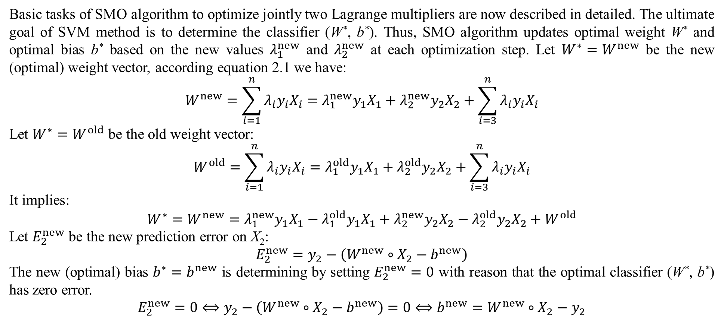
2. Sequential minimal optimization
Basic tasks of SMO algorithm to optimize jointly two Lagrange multipliers are now described in detailed. The ultimate goal of SVM method is to determine the classifier (W*, b*). Thus, SMO algorithm updates optimal weight W* and optimal bias b* based on the new values $λ_{1}^{new}$ and $λ_{2}^{new}$ at each optimization step. Let $W^{∗}=W^{new}$ be the new (optimal) weight vector, according equation 2.1 we have:
$$W^{new}=\sum_{i=1}^{n}{λ_{i}y_{i}X_{i}}=λ_{1}^{new}y_{1}X_{1}+λ_{2}^{new}y_{2}X_{2}+\sum_{i=3}^{n}{λ_{i}y_{i}X_{i}}$$
Let $W^{∗}=W^{old}$ be the old weight vector:
$$W^{old}=\sum_{i=1}^{n}{λ_{i}y_{i}X_{i}}=λ_{1}^{old}y_{1}X_{1}+λ_{2}^{old}y_{2}X_{2}+\sum_{i=3}^{n}{λ_{i}y_{i}X_{i}}$$
It implies:
$$W^{∗}=W^{new}=λ_{1}^{new}y_{1}X_{1}−λ_{1}^{old}y_{1}X_{1}+λ_{2}^{new}y_{2}X_{2}−λ_{2}^{old}y_{2}X_{2}+W^{old}$$
Let $E_{2}^{new}$ be the new prediction error on X₂:
$$E_{2}^{new}=y_{2}−\left(W^{new}∘X_{2}−b^{new}\right)$$
The new (optimal) bias $b^{∗}=b^{new}$ is determining by setting $E_{2}^{new}=0$ with reason that the optimal classifier (W*, b*) has zero error.
$$E_{2}^{new}=0⟺y_{2}−\left(W^{new}∘X_{2}−b^{new}\right)=0⟺b^{new}=W^{new}∘X_{2}−y_{2}$$

Slide 33
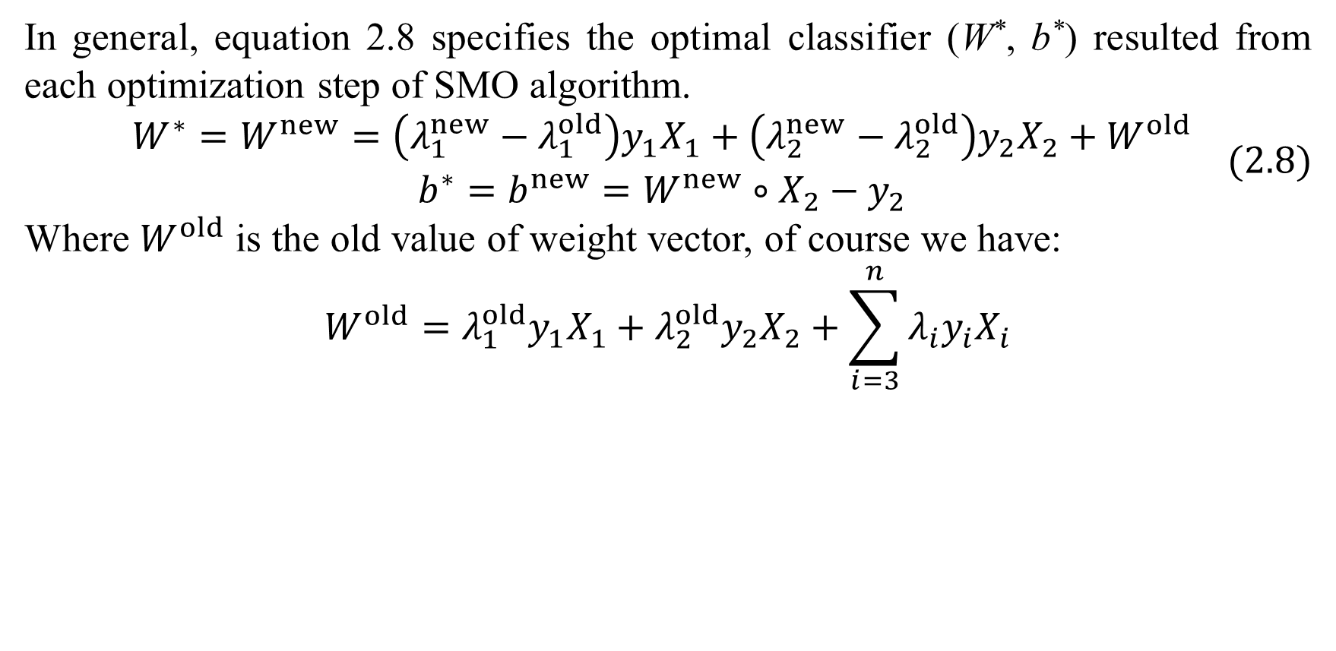
2. Sequential minimal optimization
In general, equation 2.8 specifies the optimal classifier (W*, b*) resulted from each optimization step of SMO algorithm.
$$\begin{matrix}W^{∗}=W^{new}=\left(λ_{1}^{new}−λ_{1}^{old}\right)y_{1}X_{1}+\left(λ_{2}^{new}−λ_{2}^{old}\right)y_{2}X_{2}+W^{old} \\ b^{∗}=b^{new}=W^{new}∘X_{2}−y_{2}\end{matrix} (2.8)$$
Where $W^{old}$ is the old value of weight vector, of course we have:
$$W^{old}=λ_{1}^{old}y_{1}X_{1}+λ_{2}^{old}y_{2}X_{2}+\sum_{i=3}^{n}{λ_{i}y_{i}X_{i}}$$

Slide 34
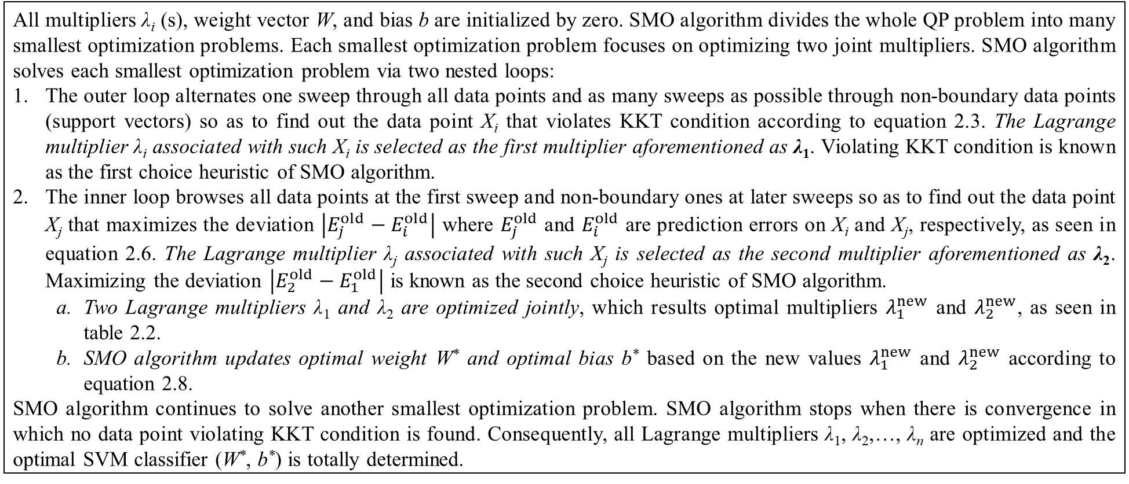
2. Sequential minimal optimization
By extending the ideology shown in table 2.1, SMO algorithm is described particularly in table 2.3 (Platt, 1998, pp. 8-9) (Honavar, p. 14).
All multipliers λ_{i} (s), weight vector W, and bias b are initialized by zero. SMO algorithm divides the whole QP problem into many smallest optimization problems. Each smallest optimization problem focuses on optimizing two joint multipliers. SMO algorithm solves each smallest optimization problem via two nested loops:
The outer loop alternates one sweep through all data points and as many sweeps as possible through non-boundary data points (support vectors) so as to find out the data point X_{i} that violates KKT condition according to equation 2.3. The Lagrange multiplier λ_{i} associated with such X_{i} is selected as the first multiplier aforementioned as λ₁. Violating KKT condition is known as the first choice heuristic of SMO algorithm.
The inner loop browses all data points at the first sweep and non-boundary ones at later sweeps so as to find out the data point X_{j} that maximizes the deviation $\left|E_{j}^{old}−E_{i}^{old}\right|$ where $E_{j}^{old}$ and $E_{i}^{old}$ are prediction errors on X_{i} and X_{j}, respectively, as seen in equation 2.6. The Lagrange multiplier λ_{j} associated with such X_{j} is selected as the second multiplier aforementioned as λ₂. Maximizing the deviation $\left|E_{2}^{old}−E_{1}^{old}\right|$ is known as the second choice heuristic of SMO algorithm.
Two Lagrange multipliers λ₁ and λ₂ are optimized jointly, which results optimal multipliers $λ_{1}^{new}$ and $λ_{2}^{new}$, as seen in table 2.2.
SMO algorithm updates optimal weight W* and optimal bias b* based on the new values $λ_{1}^{new}$ and $λ_{2}^{new}$ according to equation 2.8.
SMO algorithm continues to solve another smallest optimization problem. SMO algorithm stops when there is convergence in which no data point violating KKT condition is found. Consequently, all Lagrange multipliers λ₁, λ₂,…, λ_{n} are optimized and the optimal SVM classifier (W*, b*) is totally determined.

Slide 35
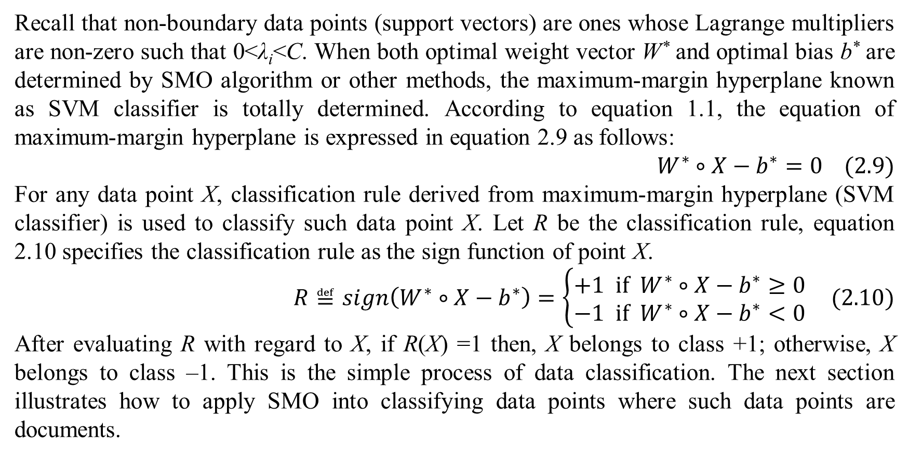
2. Sequential minimal optimization
Recall that non-boundary data points (support vectors) are ones whose Lagrange multipliers are non-zero such that 0<λ_{i}<C. When both optimal weight vector W* and optimal bias b* are determined by SMO algorithm or other methods, the maximum-margin hyperplane known as SVM classifier is totally determined. According to equation 1.1, the equation of maximum-margin hyperplane is expressed in equation 2.9 as follows:
$$W^{∗}∘X−b^{∗}=0 (2.9)$$
For any data point X, classification rule derived from maximum-margin hyperplane (SVM classifier) is used to classify such data point X. Let R be the classification rule, equation 2.10 specifies the classification rule as the sign function of point X.
$$R≝sign\left(W^{∗}∘X−b^{∗}\right)=\left\{\begin{matrix}+1 if { W}^{∗}∘X−b^{∗}≥0 \\ −1 if W^{∗}∘X−b^{∗}<0\end{matrix}\right. (2.10)$$
After evaluating R with regard to X, if R(X) =1 then, X belongs to class +1; otherwise, X belongs to class –1. This is the simple process of data classification. The next section illustrates how to apply SMO into classifying data points where such data points are documents.

Slide 36
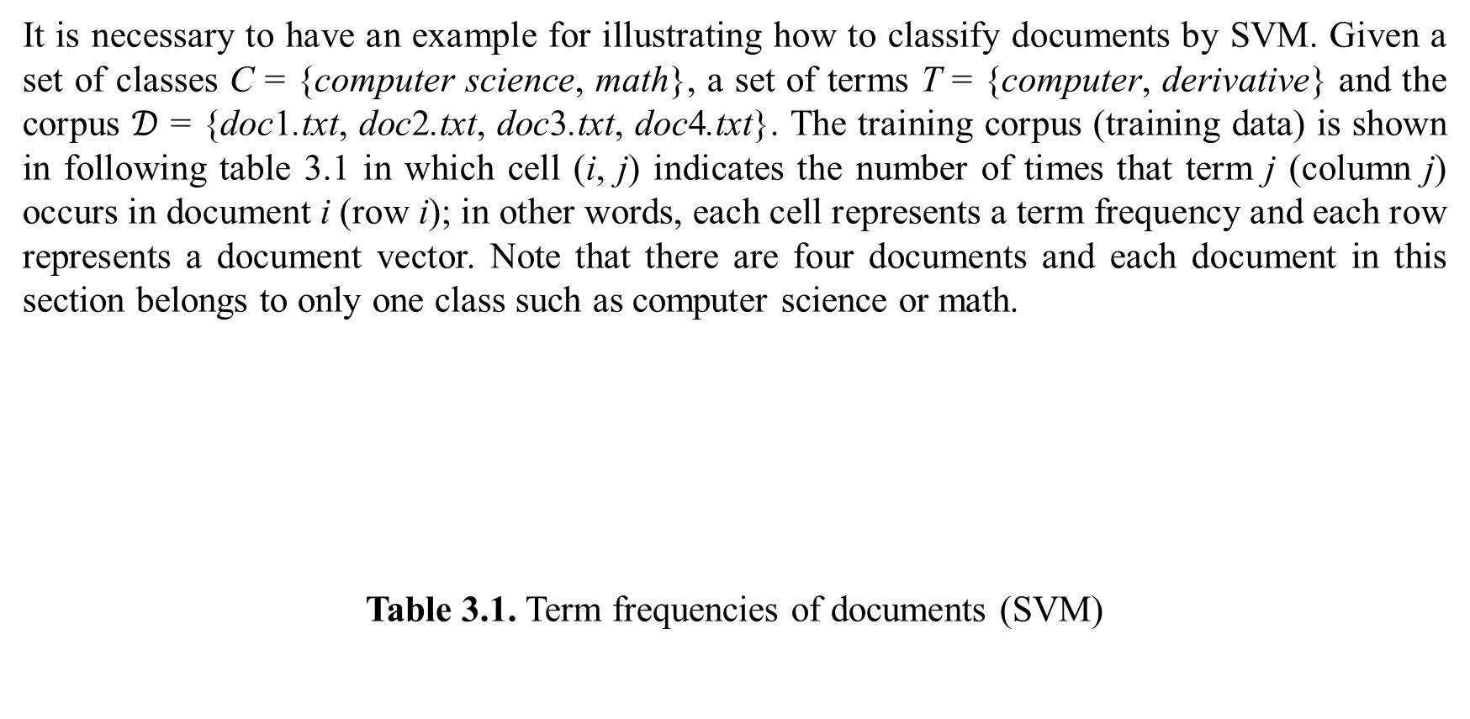
3. An example of data classification by SVM
It is necessary to have an example for illustrating how to classify documents by SVM. Given a set of classes C = {computer science, math}, a set of terms T = {computer, derivative} and the corpus $𝒟$ = {doc1.txt, doc2.txt, doc3.txt, doc4.txt}. The training corpus (training data) is shown in following table 3.1 in which cell (i, j) indicates the number of times that term j (column j) occurs in document i (row i); in other words, each cell represents a term frequency and each row represents a document vector. Note that there are four documents and each document in this section belongs to only one class such as computer science or math.
Table 3.1. Term frequencies of documents (SVM)
 | computer | derivative | class
doc1.txt | 20 | 55 | math
doc2.txt | 20 | 20 | computer science
doc3.txt | 15 | 30 | math
doc4.txt | 35 | 10 | computer science

Slide 37
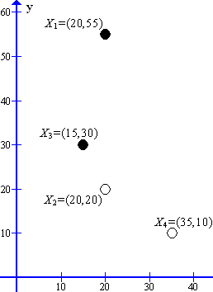
3. An example of data classification by SVM
Let X_{i} be data points representing documents doc1.txt, doc2.txt, doc3.txt, doc4.txt. We have X₁=(20,55), X₂=(20,20), X₃=(15,30), and X₄=(35,10). Let y_{i}=+1 and y_{i}=–1 represent classes “math” and “computer science”, respectively. Let x and y represent terms “computer” and “derivative”, respectively and so, for example, it is interpreted that the data point X₁=(20,55) has abscissa x=20 and ordinate y=55. Therefore, term frequencies from table 3.1 is interpreted as SVM input training corpus shown in table 3.2 below.
Data points X₁, X₂, X₃, and X₄ are depicted in figure 3.1 (next) in which classes “math” (y_{i}=+1) and “computer” (y_{i} = –1) are represented by shading and hollow circles, respectively.
 | x | y | y_{i}
X₁ | 20 | 55 | +1
X₂ | 20 | 20 | –1
X₃ | 15 | 30 | +1
X₄ | 35 | 10 | –1

Slide 38
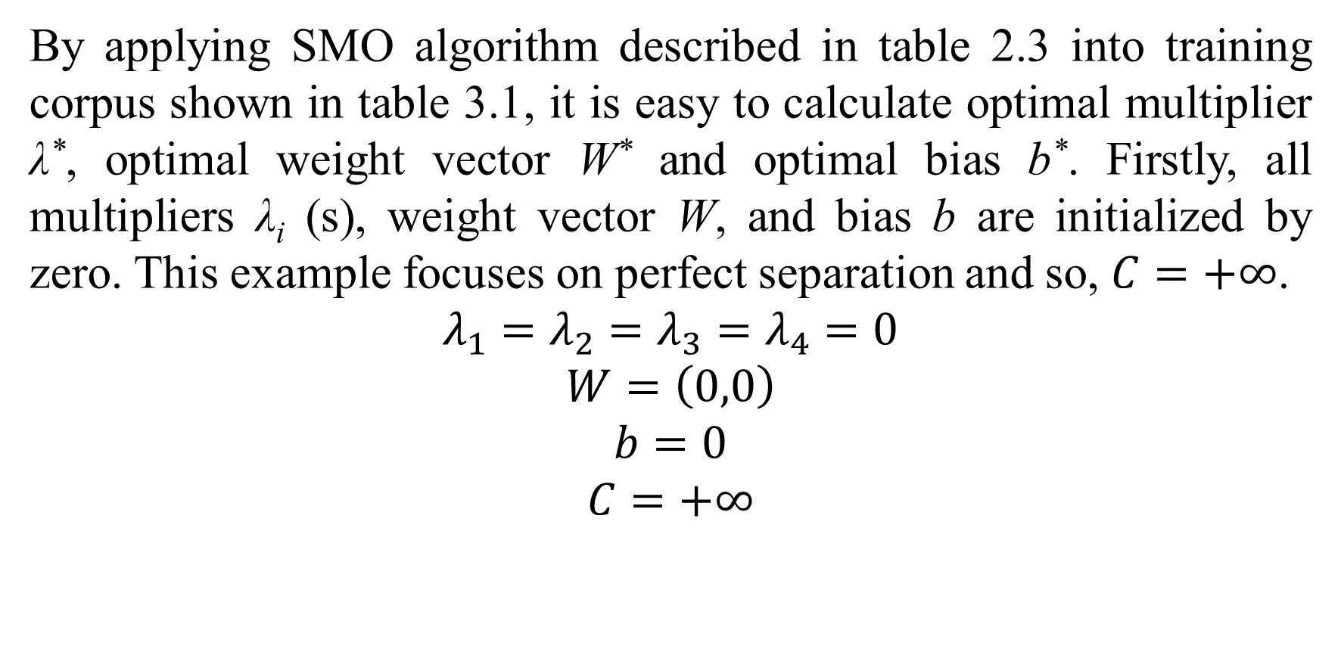
3. An example of data classification by SVM
By applying SMO algorithm described in table 2.3 into training corpus shown in table 3.1, it is easy to calculate optimal multiplier λ*, optimal weight vector W* and optimal bias b*. Firstly, all multipliers λ_{i} (s), weight vector W, and bias b are initialized by zero. This example focuses on perfect separation and so, $C=+∞$.
$$λ_{1}=λ_{2}=λ_{3}=λ_{4}=0$$
$$W=\left(0,0\right)$$
$$b=0$$
$$C=+∞$$

Slide 39
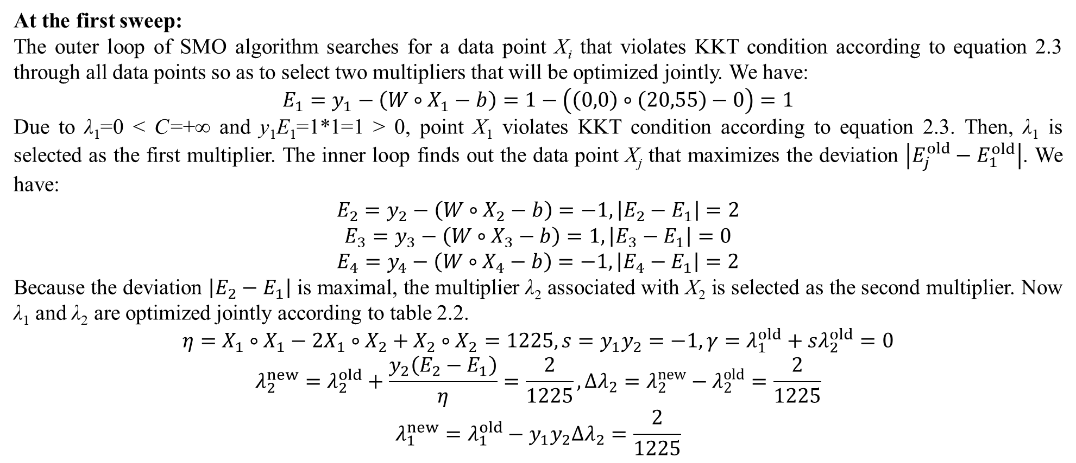
3. An example of data classification by SVM
At the first sweep:
The outer loop of SMO algorithm searches for a data point X_{i} that violates KKT condition according to equation 2.3 through all data points so as to select two multipliers that will be optimized jointly. We have:
$$E_{1}=y_{1}−\left(W∘X_{1}−b\right)=1−\left(\left(0,0\right)∘\left(20,55\right)−0\right)=1$$
Due to λ₁=0 < C=+∞ and y₁E₁=1*1=1 > 0, point X₁ violates KKT condition according to equation 2.3. Then, λ₁ is selected as the first multiplier. The inner loop finds out the data point X_{j} that maximizes the deviation $\left|E_{j}^{old}−E_{1}^{old}\right|$. We have:
$$E_{2}=y_{2}−\left(W∘X_{2}−b\right)=−1,\left|E_{2}−E_{1}\right|=2$$
$$E_{3}=y_{3}−\left(W∘X_{3}−b\right)=1,\left|E_{3}−E_{1}\right|=0$$
$$E_{4}=y_{4}−\left(W∘X_{4}−b\right)=−1,\left|E_{4}−E_{1}\right|=2$$
Because the deviation $\left|E_{2}−E_{1}\right|$ is maximal, the multiplier λ₂ associated with X₂ is selected as the second multiplier. Now λ₁ and λ₂ are optimized jointly according to table 2.2.
$$η=X_{1}∘X_{1}−2X_{1}∘X_{2}+X_{2}∘X_{2}=1225,s=y_{1}y_{2}=−1,γ=λ_{1}^{old}+sλ_{2}^{old}=0$$
$$λ_{2}^{new}=λ_{2}^{old}+\frac{y_{2}\left(E_{2}−E_{1}\right)}{η}=\frac{2}{1225},∆λ_{2}=λ_{2}^{new}−λ_{2}^{old}=\frac{2}{1225}$$
$$λ_{1}^{new}=λ_{1}^{old}−y_{1}y_{2}∆λ_{2}=\frac{2}{1225}$$

Slide 40
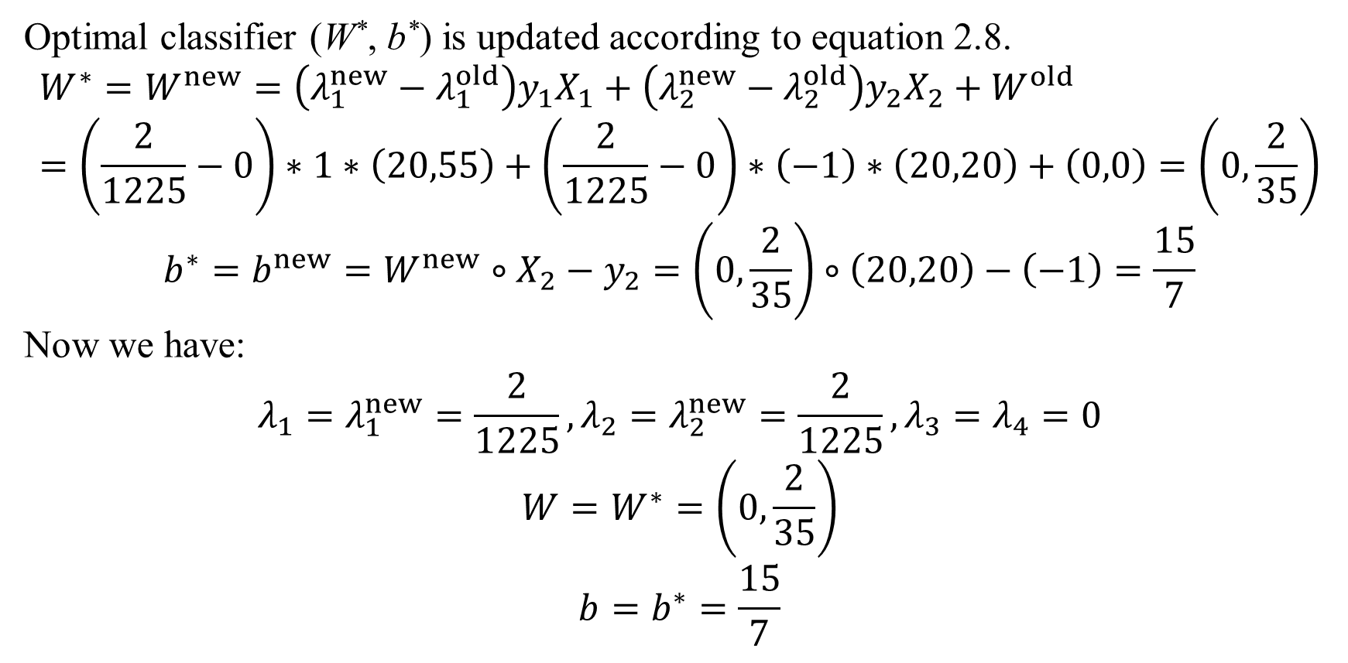
3. An example of data classification by SVM
Optimal classifier (W*, b*) is updated according to equation 2.8.
$$W^{∗}=W^{new}=\left(λ_{1}^{new}−λ_{1}^{old}\right)y_{1}X_{1}+\left(λ_{2}^{new}−λ_{2}^{old}\right)y_{2}X_{2}+W^{old}=\left(\frac{2}{1225}−0\right)∗1∗\left(20,55\right)+\left(\frac{2}{1225}−0\right)∗\left(−1\right)∗\left(20,20\right)+\left(0,0\right)=\left(0,\frac{2}{35}\right)$$
$$b^{∗}=b^{new}=W^{new}∘X_{2}−y_{2}=\left(0,\frac{2}{35}\right)∘\left(20,20\right)−\left(−1\right)=\frac{15}{7}$$
Now we have:
$$λ_{1}=λ_{1}^{new}=\frac{2}{1225},λ_{2}=λ_{2}^{new}=\frac{2}{1225},λ_{3}=λ_{4}=0$$
$$W=W^{∗}=\left(0,\frac{2}{35}\right)$$
$$b=b^{∗}=\frac{15}{7}$$

Slide 41
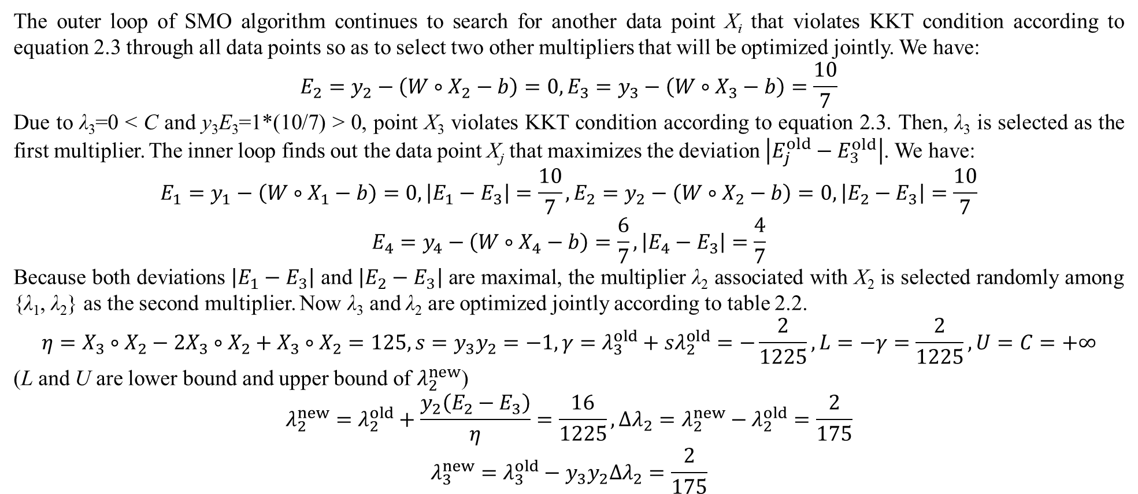
3. An example of data classification by SVM
The outer loop of SMO algorithm continues to search for another data point X_{i} that violates KKT condition according to equation 2.3 through all data points so as to select two other multipliers that will be optimized jointly. We have:
$$E_{2}=y_{2}−\left(W∘X_{2}−b\right)=0,E_{3}=y_{3}−\left(W∘X_{3}−b\right)=\frac{10}{7}$$
Due to λ₃=0 < C and y₃E₃=1*(10/7) > 0, point X₃ violates KKT condition according to equation 2.3. Then, λ₃ is selected as the first multiplier. The inner loop finds out the data point X_{j} that maximizes the deviation $\left|E_{j}^{old}−E_{3}^{old}\right|$. We have:
$$E_{1}=y_{1}−\left(W∘X_{1}−b\right)=0,\left|E_{1}−E_{3}\right|=\frac{10}{7},E_{2}=y_{2}−\left(W∘X_{2}−b\right)=0,\left|E_{2}−E_{3}\right|=\frac{10}{7}$$
$$E_{4}=y_{4}−\left(W∘X_{4}−b\right)=\frac{6}{7},\left|E_{4}−E_{3}\right|=\frac{4}{7}$$
Because both deviations $\left|E_{1}−E_{3}\right|$ and $\left|E_{2}−E_{3}\right|$ are maximal, the multiplier λ₂ associated with X₂ is selected randomly among {λ₁, λ₂} as the second multiplier. Now λ₃ and λ₂ are optimized jointly according to table 2.2.
$$η=X_{3}∘X_{2}−2X_{3}∘X_{2}+X_{3}∘X_{2}=125,s=y_{3}y_{2}=−1,γ=λ_{3}^{old}+sλ_{2}^{old}=−\frac{2}{1225},L=−γ=\frac{2}{1225},U=C=+∞$$
(L and U are lower bound and upper bound of $λ_{2}^{new}$)
$$λ_{2}^{new}=λ_{2}^{old}+\frac{y_{2}\left(E_{2}−E_{3}\right)}{η}=\frac{16}{1225},∆λ_{2}=λ_{2}^{new}−λ_{2}^{old}=\frac{2}{175}$$
$$λ_{3}^{new}=λ_{3}^{old}−y_{3}y_{2}∆λ_{2}=\frac{2}{175}$$

Slide 42
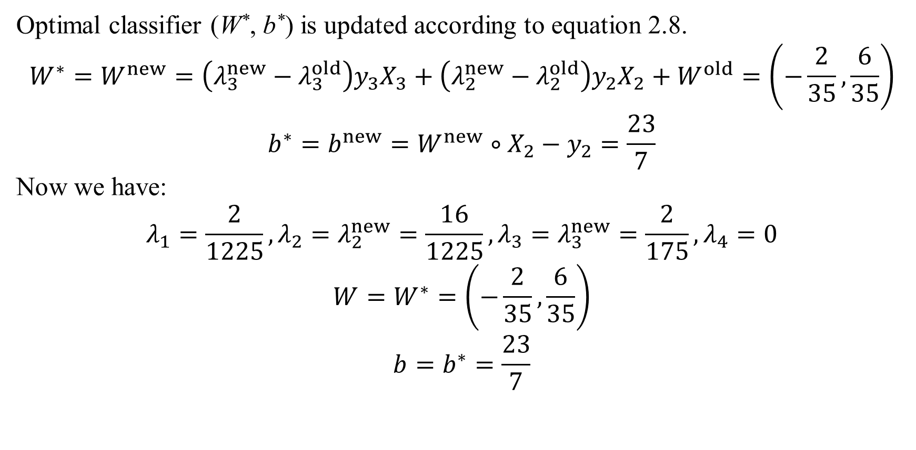
3. An example of data classification by SVM
Optimal classifier (W*, b*) is updated according to equation 2.8.
$$W^{∗}=W^{new}=\left(λ_{3}^{new}−λ_{3}^{old}\right)y_{3}X_{3}+\left(λ_{2}^{new}−λ_{2}^{old}\right)y_{2}X_{2}+W^{old}=\left(−\frac{2}{35},\frac{6}{35}\right)$$
$$b^{∗}=b^{new}=W^{new}∘X_{2}−y_{2}=\frac{23}{7}$$
Now we have:
$$λ_{1}=\frac{2}{1225},λ_{2}=λ_{2}^{new}=\frac{16}{1225},λ_{3}=λ_{3}^{new}=\frac{2}{175},λ_{4}=0$$
$$W=W^{∗}=\left(−\frac{2}{35},\frac{6}{35}\right)$$
$$b=b^{∗}=\frac{23}{7}$$

Slide 43
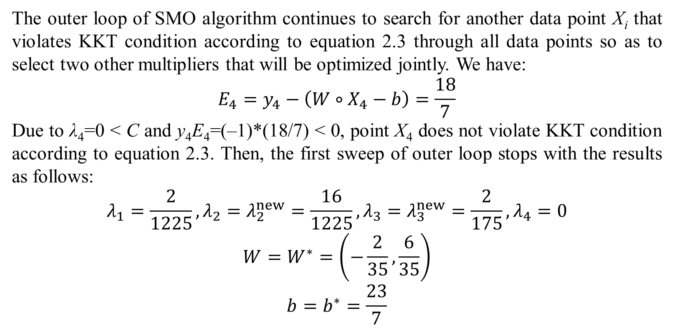
3. An example of data classification by SVM
The outer loop of SMO algorithm continues to search for another data point X_{i} that violates KKT condition according to equation 2.3 through all data points so as to select two other multipliers that will be optimized jointly. We have:
$$E_{4}=y_{4}−\left(W∘X_{4}−b\right)=\frac{18}{7}$$
Due to λ₄=0 < C and y₄E₄=(–1)*(18/7) < 0, point X₄ does not violate KKT condition according to equation 2.3. Then, the first sweep of outer loop stops with the results as follows:
$$λ_{1}=\frac{2}{1225},λ_{2}=λ_{2}^{new}=\frac{16}{1225},λ_{3}=λ_{3}^{new}=\frac{2}{175},λ_{4}=0$$
$$W=W^{∗}=\left(−\frac{2}{35},\frac{6}{35}\right)$$
$$b=b^{∗}=\frac{23}{7}$$

Slide 44
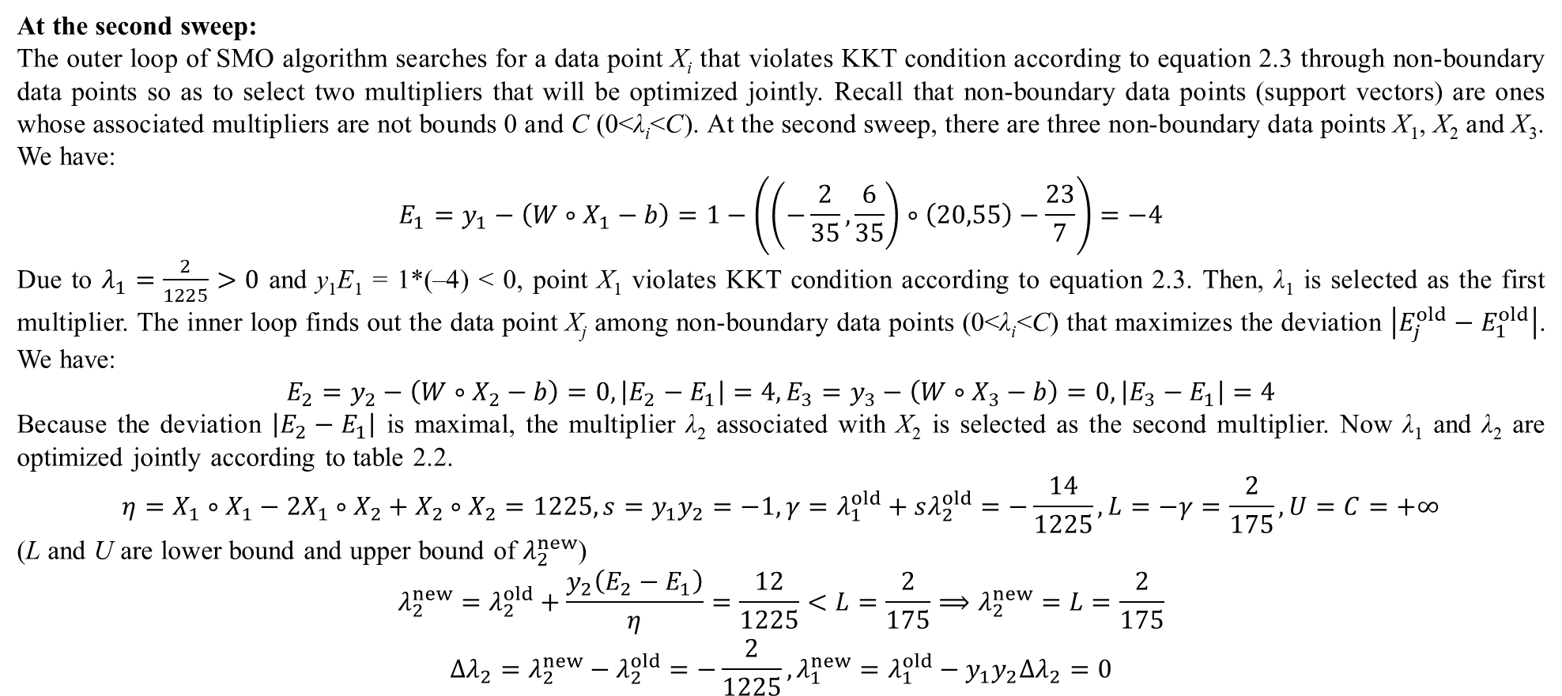
3. An example of data classification by SVM
At the second sweep:
The outer loop of SMO algorithm searches for a data point X_{i} that violates KKT condition according to equation 2.3 through non-boundary data points so as to select two multipliers that will be optimized jointly. Recall that non-boundary data points (support vectors) are ones whose associated multipliers are not bounds 0 and C (0<λ_{i}<C). At the second sweep, there are three non-boundary data points X₁, X₂ and X₃. We have:
$$E_{1}=y_{1}−\left(W∘X_{1}−b\right)=1−\left(\left(−\frac{2}{35},\frac{6}{35}\right)∘\left(20,55\right)−\frac{23}{7}\right)=−4$$
Due to $λ_{1}=\frac{2}{1225}>0$ and y₁E₁ = 1*(–4) < 0, point X₁ violates KKT condition according to equation 2.3. Then, λ₁ is selected as the first multiplier. The inner loop finds out the data point X_{j} among non-boundary data points (0<λ_{i}<C) that maximizes the deviation $\left|E_{j}^{old}−E_{1}^{old}\right|$. We have:
$$E_{2}=y_{2}−\left(W∘X_{2}−b\right)=0,\left|E_{2}−E_{1}\right|=4,E_{3}=y_{3}−\left(W∘X_{3}−b\right)=0,\left|E_{3}−E_{1}\right|=4$$
Because the deviation $\left|E_{2}−E_{1}\right|$ is maximal, the multiplier λ₂ associated with X₂ is selected as the second multiplier. Now λ₁ and λ₂ are optimized jointly according to table 2.2.
$$η=X_{1}∘X_{1}−2X_{1}∘X_{2}+X_{2}∘X_{2}=1225,s=y_{1}y_{2}=−1,γ=λ_{1}^{old}+sλ_{2}^{old}=−\frac{14}{1225},L=−γ=\frac{2}{175},U=C=+∞$$
(L and U are lower bound and upper bound of $λ_{2}^{new}$)
$$λ_{2}^{new}=λ_{2}^{old}+\frac{y_{2}\left(E_{2}−E_{1}\right)}{η}=\frac{12}{1225}<L=\frac{2}{175}⟹λ_{2}^{new}=L=\frac{2}{175}$$
$$Δλ_{2}=λ_{2}^{new}−λ_{2}^{old}=−\frac{2}{1225},λ_{1}^{new}=λ_{1}^{old}−y_{1}y_{2}Δλ_{2}=0$$

Slide 45
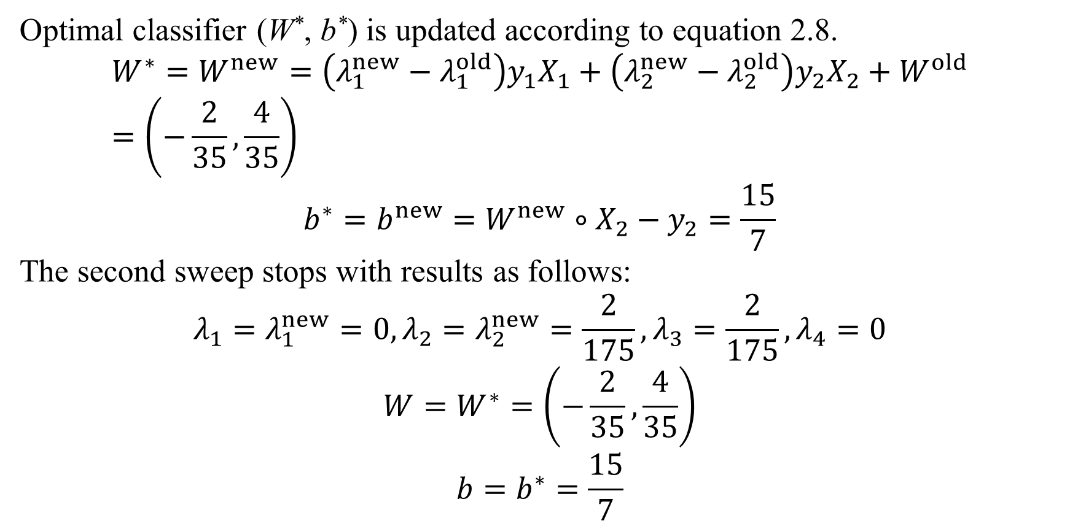
3. An example of data classification by SVM
Optimal classifier (W*, b*) is updated according to equation 2.8.
$$W^{∗}=W^{new}=\left(λ_{1}^{new}−λ_{1}^{old}\right)y_{1}X_{1}+\left(λ_{2}^{new}−λ_{2}^{old}\right)y_{2}X_{2}+W^{old}=\left(−\frac{2}{35},\frac{4}{35}\right)$$
$$b^{∗}=b^{new}=W^{new}∘X_{2}−y_{2}=\frac{15}{7}$$
The second sweep stops with results as follows:
$$λ_{1}=λ_{1}^{new}=0,λ_{2}=λ_{2}^{new}=\frac{2}{175},λ_{3}=\frac{2}{175},λ_{4}=0$$
$$W=W^{∗}=\left(−\frac{2}{35},\frac{4}{35}\right)$$
$$b=b^{∗}=\frac{15}{7}$$

Slide 46
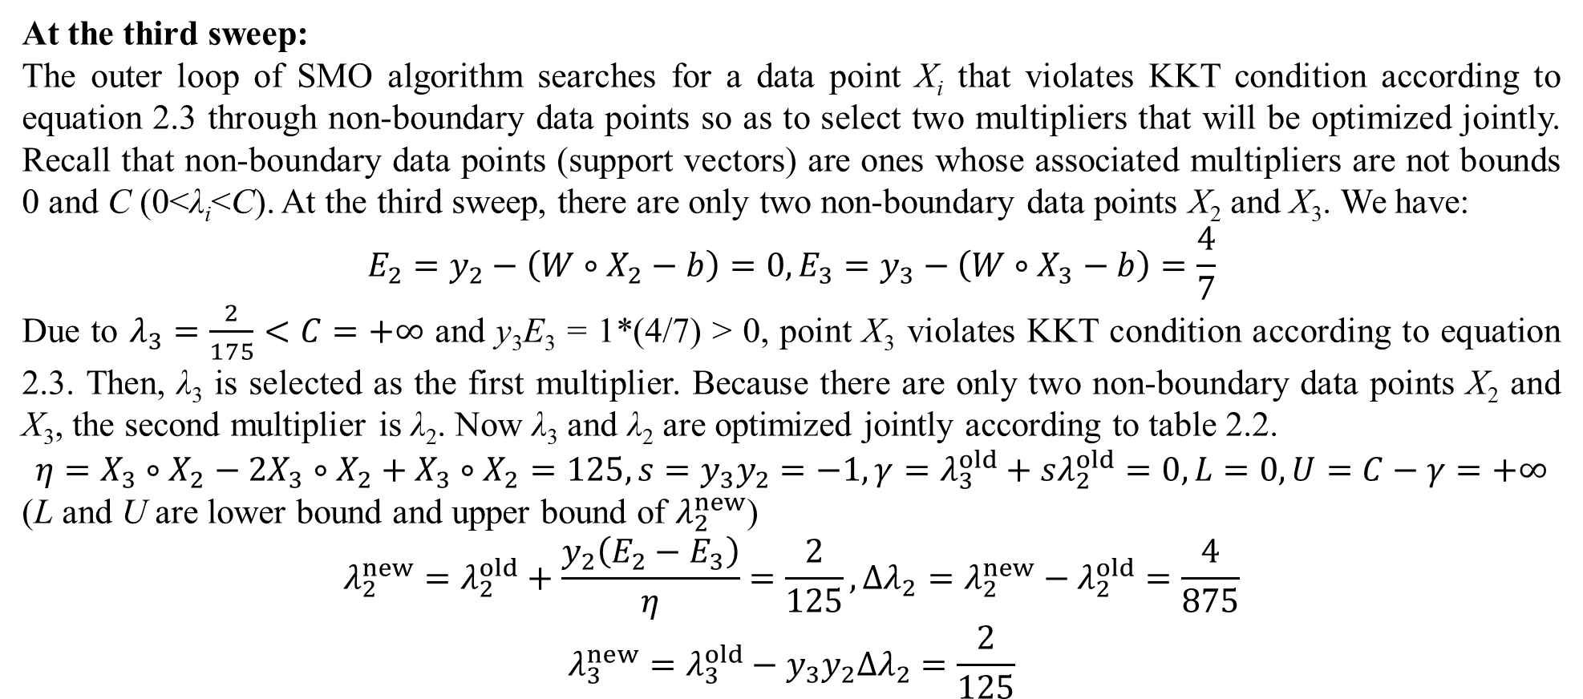
3. An example of data classification by SVM
At the third sweep:
The outer loop of SMO algorithm searches for a data point X_{i} that violates KKT condition according to equation 2.3 through non-boundary data points so as to select two multipliers that will be optimized jointly. Recall that non-boundary data points (support vectors) are ones whose associated multipliers are not bounds 0 and C (0<λ_{i}<C). At the third sweep, there are only two non-boundary data points X₂ and X₃. We have:
$$E_{2}=y_{2}−\left(W∘X_{2}−b\right)=0,E_{3}=y_{3}−\left(W∘X_{3}−b\right)=\frac{4}{7}$$
Due to $λ_{3}=\frac{2}{175}<C=+∞$ and y₃E₃ = 1*(4/7) > 0, point X₃ violates KKT condition according to equation 2.3. Then, λ₃ is selected as the first multiplier. Because there are only two non-boundary data points X₂ and X₃, the second multiplier is λ₂. Now λ₃ and λ₂ are optimized jointly according to table 2.2.
$$η=X_{3}∘X_{2}−2X_{3}∘X_{2}+X_{3}∘X_{2}=125,s=y_{3}y_{2}=−1,γ=λ_{3}^{old}+sλ_{2}^{old}=0,L=0,U=C−γ=+∞$$
(L and U are lower bound and upper bound of $λ_{2}^{new}$)
$$λ_{2}^{new}=λ_{2}^{old}+\frac{y_{2}\left(E_{2}−E_{3}\right)}{η}=\frac{2}{125},∆λ_{2}=λ_{2}^{new}−λ_{2}^{old}=\frac{4}{875}$$
$$λ_{3}^{new}=λ_{3}^{old}−y_{3}y_{2}∆λ_{2}=\frac{2}{125}$$

Slide 47
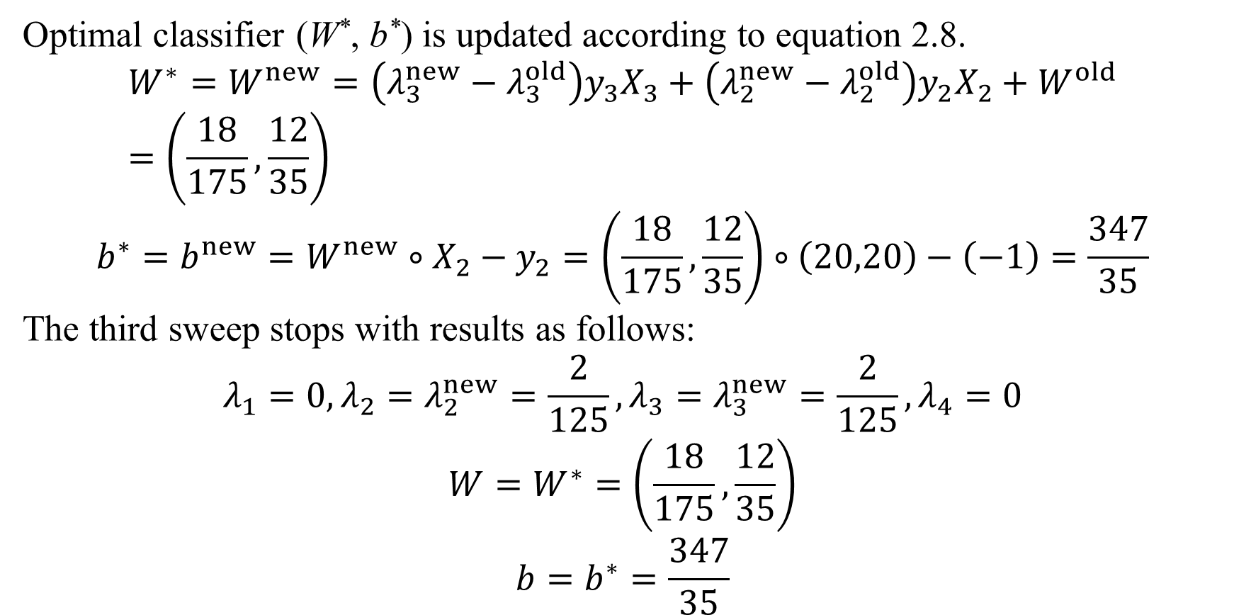
3. An example of data classification by SVM
Optimal classifier (W*, b*) is updated according to equation 2.8.
$$W^{∗}=W^{new}=\left(λ_{3}^{new}−λ_{3}^{old}\right)y_{3}X_{3}+\left(λ_{2}^{new}−λ_{2}^{old}\right)y_{2}X_{2}+W^{old}=\left(\frac{18}{175},\frac{12}{35}\right)$$
$$b^{∗}=b^{new}=W^{new}∘X_{2}−y_{2}=\left(\frac{18}{175},\frac{12}{35}\right)∘\left(20,20\right)−\left(−1\right)=\frac{347}{35}$$
The third sweep stops with results as follows:
$$λ_{1}=0,λ_{2}=λ_{2}^{new}=\frac{2}{125},λ_{3}=λ_{3}^{new}=\frac{2}{125},λ_{4}=0$$
$$W=W^{∗}=\left(\frac{18}{175},\frac{12}{35}\right)$$
$$b=b^{∗}=\frac{347}{35}$$

Slide 48
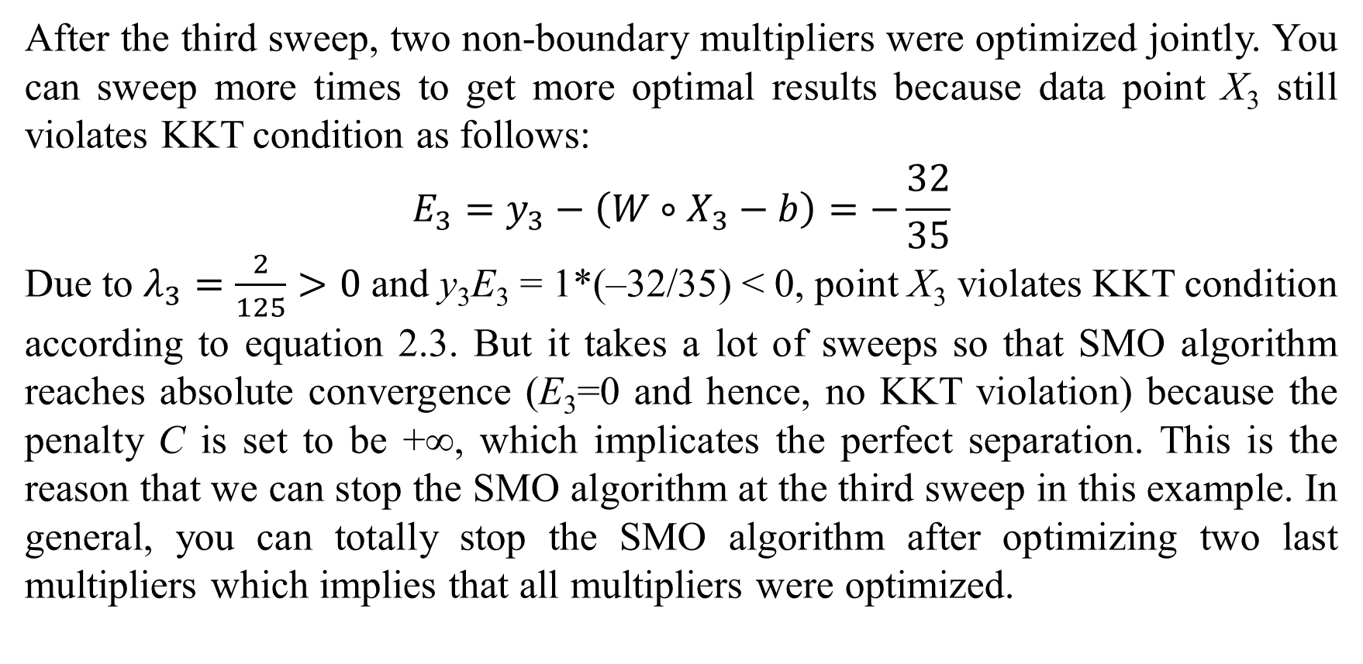
3. An example of data classification by SVM
After the third sweep, two non-boundary multipliers were optimized jointly. You can sweep more times to get more optimal results because data point X₃ still violates KKT condition as follows:
$$E_{3}=y_{3}−\left(W∘X_{3}−b\right)=−\frac{32}{35}$$
Due to $λ_{3}=\frac{2}{125}>0$ and y₃E₃ = 1*(–32/35) < 0, point X₃ violates KKT condition according to equation 2.3. But it takes a lot of sweeps so that SMO algorithm reaches absolute convergence (E₃=0 and hence, no KKT violation) because the penalty C is set to be +∞, which implicates the perfect separation. This is the reason that we can stop the SMO algorithm at the third sweep in this example. In general, you can totally stop the SMO algorithm after optimizing two last multipliers which implies that all multipliers were optimized.

Slide 49


3. An example of data classification by SVM
As a result, W* and b* were determined:
$$W^{∗}=\left(\frac{18}{175},\frac{12}{35}\right)$$
$$b^{∗}=\frac{347}{35}$$
The maximum-margin hyperplane (SVM classifier) is totally determined as below:
$$W^{∗}∘X−b^{∗}=0⟹y=−0.3x+28.92$$
The SVM classifier $y=−0.3x+28.9$ is depicted in figure 3.2. Where the maximum-margin hyperplane is drawn as bold line. Data points X₂ and X₃ are support vectors because their associated multipliers λ₂ and λ₃ are non-zero (0<λ₂=2/125<C=+∞, 0<λ₃=2/125<C=+∞).

Slide 50

3. An example of data classification by SVM
Derived from the above classifier $y=−0.3x+28.9$, the classification rule is:
$$R≝sign\left(0.3x+y−28.9 \right)=\left\{\begin{matrix}+1 if 0.3x+y−28.9 ≥0 \\ −1 if 0.3x+y−28.9 <0\end{matrix}\right.$$
Now we apply classification rule $R≝sign\left(0.3x+y−28.9 \right)$ into document classification. Suppose the numbers of times that terms “computer” and “derivative” occur in document D are 40 and 10, respectively. We need to determine which class document D=(40, 10) is belongs to. We have:
$$R\left(D\right)=sign\left(0.3∗40+10−28.9\right)=sign\left(−6.9\right)=−1$$
Hence, it is easy to infer that document D belongs to class “computer science” (y_{i} = –1).

Slide 51
4. Conclusions
In general, the main ideology of SVM is to determine the separating hyperplane that maximizes the margin between two classes of training data. Based on theory of optimization, such optimal hyperplane is specified by the weight vector W* and the bias b* which are solutions of constrained optimization problem. It is proved that there always exist these solutions but the main issue of SVM is how to find out them when the constrained optimization problem is transformed into quadratic programming (QP) problem. SMO which is the most effective algorithm divides the whole QP problem into many smallest optimization problems. Each smallest optimization problem focuses on optimizing two joint multipliers. It is possible to state that SMO is the best implementation version of the “architecture” SVM.
SVM is extended by concept of kernel function. The dot product in separating hyperplane equation is the simplest kernel function. Kernel function is useful in case of requirement of data transformation (Law, 2006, p. 21). There are many pre-defined kernel functions available for SVM. Readers are recommended to research more about kernel functions (Cristianini, 2001).

Slide 52
References
Boyd, S., & Vandenberghe, L. (2009). Convex Optimization. New York, NY, USA: Cambridge University Press.
Cristianini, N. (2001). Support Vector and Kernel Machines. The 28th International Conference on Machine Learning (ICML). Bellevue, Washington, USA: Website for the book "Support Vector Machines": http://www.support-vector.net. Retrieved 2015, from http://www.cis.upenn.edu/~mkearns/teaching/cis700/icml-tutorial.pdf
Honavar, V. G. (n.d.). Sequential Minimal Optimization for SVM. Iowa State University, Department of Computer Science. Ames, Iowa, USA: Vasant Honavar homepage.
Jia, Y.-B. (2013). Lagrange Multipliers. Lecture notes on course “Problem Solving Techniques for Applied Computer Science”, Iowa State University of Science and Technology, USA.
Johansen, I. (2012, December 29). Graph software. Graph version 4.4.2 build 543(4.4.2 build 543). GNU General Public License.
Law, M. (2006). A Simple Introduction to Support Vector Machines. Lecture Notes for CSE 802 course, Michigan State University, USA, Department of Computer Science and Engineering.
Moore, A. W. (2001). Support Vector Machines. Carnegie Mellon University, USA, School of Computer Science. Available at http://www. cs. cmu. edu/~awm/tutorials.
Platt, J. C. (1998). Sequential Minimal Optimization: A Fast Algorithm for Training Support Vector Machines. Microsoft Research.
Wikibooks. (2008, January 1). Support Vector Machines. Retrieved 2008, from Wikibooks website: http://en.wikibooks.org/wiki/Support_Vector_Machines
Wikipedia. (2014, August 4). Karush–Kuhn–Tucker conditions. (Wikimedia Foundation) Retrieved November 16, 2014, from Wikipedia website: http://en.wikipedia.org/wiki/Karush–Kuhn–Tucker_conditions

Slide 53
Thank you for listening

