Slide 1
Tutorial on Support Vector Machine
Prof. Dr. Loc Nguyen PhD, PostDoc
Director of Sunflower Soft Company, Vietnam
Email: ng_phloc@yahoo.com
Homepage: www.locnguyen.net

Slide 2
Abstract
Support vector machine is a powerful machine learning method in data classification. Using it for applied researches is easy but comprehending it for further development requires a lot of efforts. This report is a tutorial on support vector machine with full of mathematical proofs and example, which help researchers to understand it by the fastest way from theory to practice. The report focuses on theory of optimization which is the base of support vector machine.

Slide 3
Table of contents
Support vector machine
Sequential minimal optimization
An example of data classification by SVM
Conclusions

Slide 4
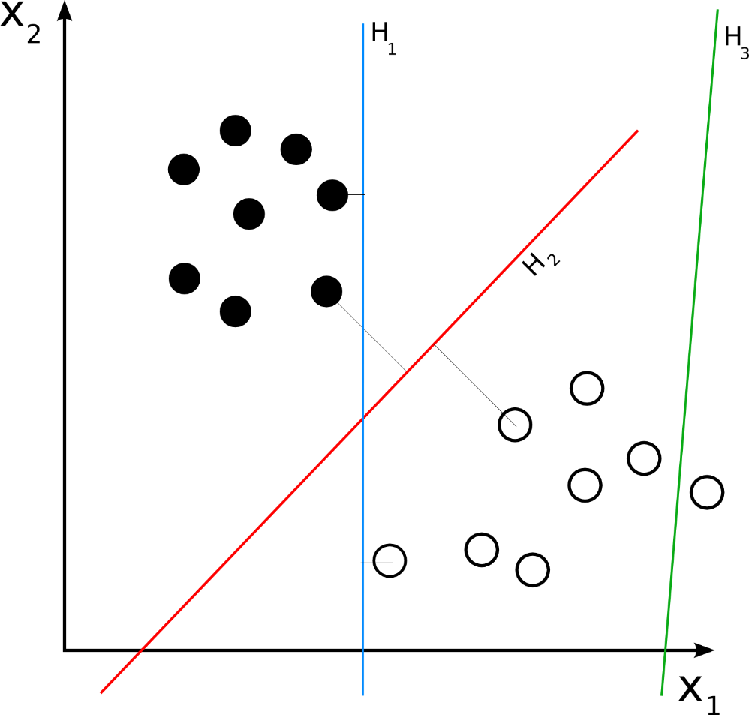
1. Support vector machine
Support vector machine (SVM) (Law, 2006) is a supervised learning algorithm for classification and regression. Given a set of p-dimensional vectors in vector space, SVM finds the separating hyperplane that splits vector space into sub-set of vectors; each separated sub-set (so-called data set) is assigned by one class. There is the condition for this separating hyperplane: “it must maximize the margin between two sub-sets”. Figure 1.1 (Wikibooks, 2008) shows separating hyperplanes H₁, H₂, and H₃ in which only H₂ gets maximum margin according to this condition. Suppose we have some p-dimensional vectors; each of them belongs to one of two classes. We can find many p–1 dimensional hyperplanes that classify such vectors but there is only one hyperplane that maximizes the margin between two classes. In other words, the nearest between one side of this hyperplane and other side of this hyperplane is maximized. Such hyperplane is called maximum-margin hyperplane and it is considered as the SVM classifier.
Figure 1.1. Separating hyperplanes

Slide 5
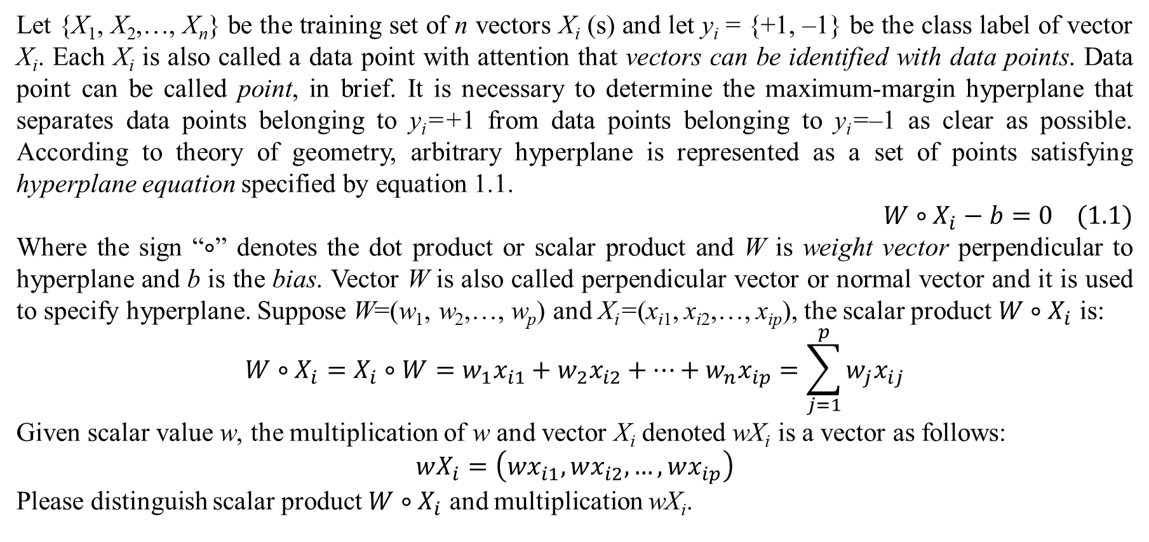
1. Support vector machine
Let {X₁, X₂,…, X_{n}} be the training set of n vectors X_{i} (s) and let y_{i} = {+1, –1} be the class label of vector X_{i}. Each X_{i} is also called a data point with attention that vectors can be identified with data points. Data point can be called point, in brief. It is necessary to determine the maximum-margin hyperplane that separates data points belonging to y_{i}=+1 from data points belonging to y_{i}=–1 as clear as possible. According to theory of geometry, arbitrary hyperplane is represented as a set of points satisfying hyperplane equation specified by equation 1.1.
$$W∘X_{i}−b=0 (1.1)$$
Where the sign “$∘$” denotes the dot product or scalar product and W is weight vector perpendicular to hyperplane and b is the bias. Vector W is also called perpendicular vector or normal vector and it is used to specify hyperplane. Suppose W=(w₁, w₂,…, w_{p}) and X_{i}=(x_{i1}, x_{i2},…, x_{ip}), the scalar product $W∘X_{i}$ is:
$$W∘X_{i}=X_{i}∘W=w_{1}x_{i1}+w_{2}x_{i2}+…+w_{n}x_{ip}=\sum_{j=1}^{p}{w_{j}x_{ij}}$$
Given scalar value w, the multiplication of w and vector X_{i} denoted wX_{i} is a vector as follows:
$$wX_{i}=\left(wx_{i1},wx_{i2},…,wx_{ip}\right)$$
Please distinguish scalar product $W∘X_{i}$ and multiplication wX_{i}.

Slide 6
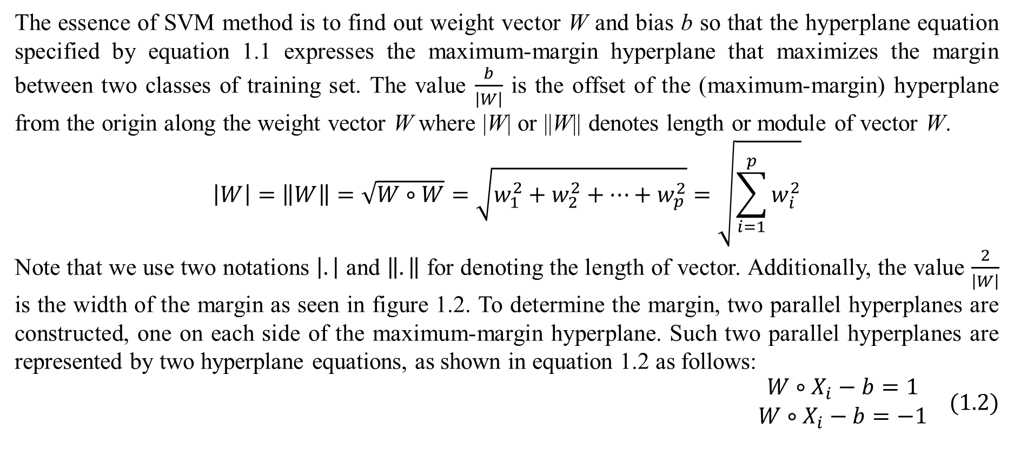
1. Support vector machine
The essence of SVM method is to find out weight vector W and bias b so that the hyperplane equation specified by equation 1.1 expresses the maximum-margin hyperplane that maximizes the margin between two classes of training set. The value $\frac{b}{\left|W\right|}$ is the offset of the (maximum-margin) hyperplane from the origin along the weight vector W where |W| or ||W|| denotes length or module of vector W.
$$\left|W\right|=\left\|W\right\|=\sqrt{W∘W}=\sqrt{w_{1}^{2}+w_{2}^{2}+…+w_{p}^{2}}=\sqrt{\sum_{i=1}^{p}{w_{i}^{2}}}$$
Note that we use two notations $\left|.\right|$ and $\left\|.\right\|$ for denoting the length of vector. Additionally, the value $\frac{2}{\left|W\right|}$ is the width of the margin as seen in figure 1.2. To determine the margin, two parallel hyperplanes are constructed, one on each side of the maximum-margin hyperplane. Such two parallel hyperplanes are represented by two hyperplane equations, as shown in equation 1.2 as follows:
$$\begin{matrix}W∘X_{i}−b=1 \\ W∘X_{i}−b=−1\end{matrix} (1.2)$$

Slide 7
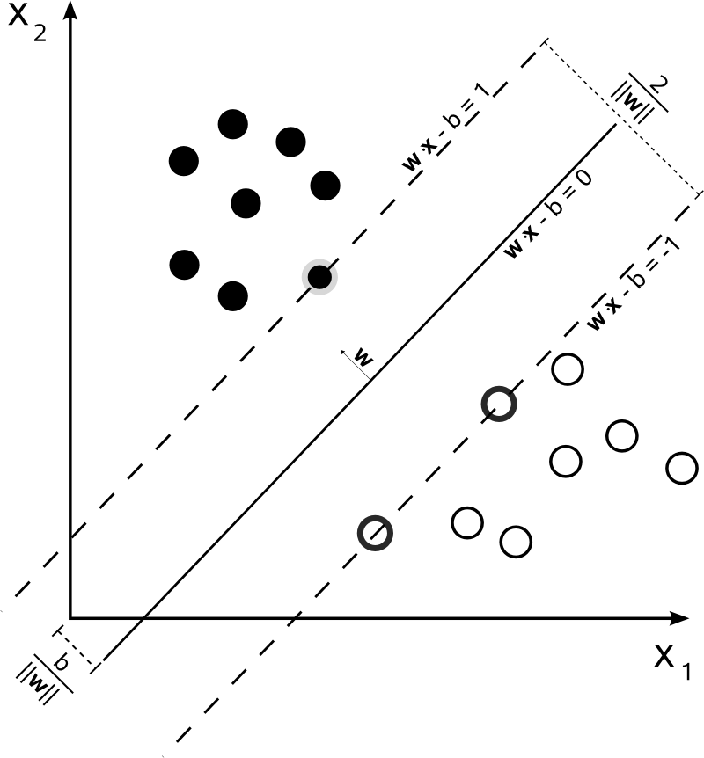
1. Support vector machine
Figure 1.2 (Wikibooks, 2008) illustrates maximum-margin hyperplane, weight vector W and two parallel hyperplanes. As seen in the figure 1.2, the margin is limited by such two parallel hyperplanes. Exactly, there are two margins (each one for a parallel hyperplane) but it is convenient for referring both margins as the unified single margin as usual. You can imagine such margin as a road and SVM method aims to maximize the width of such road. Data points lying on (or are very near to) two parallel hyperplanes are called support vectors because they construct mainly the maximum-margin hyperplane in the middle. This is the reason that the classification method is called support vector machine (SVM).
Figure 1.2. Maximum-margin hyperplane, parallel hyperplanes and weight vector W

Slide 8
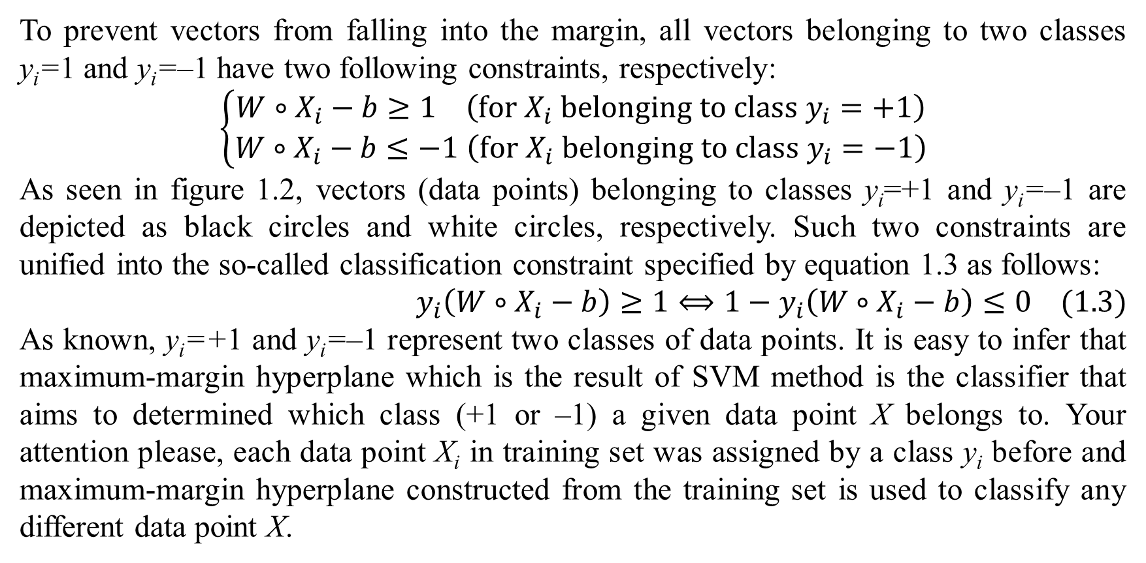
1. Support vector machine
To prevent vectors from falling into the margin, all vectors belonging to two classes y_{i}=1 and y_{i}=–1 have two following constraints, respectively:
$$\left\{\begin{matrix}W∘X_{i}−b≥1 \left(for X_{i} belonging to class y_{i}=+1\right) \\ W∘X_{i}−b≤−1 \left(for X_{i} belonging to class y_{i}=−1\right)\end{matrix}\right.$$
As seen in figure 1.2, vectors (data points) belonging to classes y_{i}=+1 and y_{i}=–1 are depicted as black circles and white circles, respectively. Such two constraints are unified into the so-called classification constraint specified by equation 1.3 as follows:
$$y_{i}\left(W∘X_{i}−b\right)≥1⟺1−y_{i}\left(W∘X_{i}−b\right)≤0 (1.3)$$
As known, y_{i}=+1 and y_{i}=–1 represent two classes of data points. It is easy to infer that maximum-margin hyperplane which is the result of SVM method is the classifier that aims to determined which class (+1 or –1) a given data point X belongs to. Your attention please, each data point X_{i} in training set was assigned by a class y_{i} before and maximum-margin hyperplane constructed from the training set is used to classify any different data point X.

Slide 9
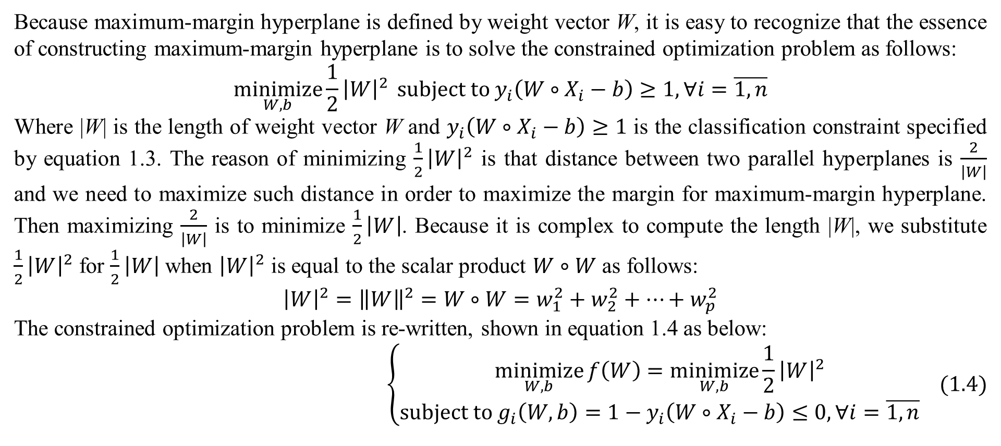
1. Support vector machine
Because maximum-margin hyperplane is defined by weight vector W, it is easy to recognize that the essence of constructing maximum-margin hyperplane is to solve the constrained optimization problem as follows:
$$\underset{W,b}{minimize}{\frac{1}{2}{\left|W\right|}^{2}} subject to y_{i}\left(W∘X_{i}−b\right)≥1,∀i=\overline{1,n}$$
Where |W| is the length of weight vector W and $y_{i}\left(W∘X_{i}−b\right)≥1$ is the classification constraint specified by equation 1.3. The reason of minimizing $\frac{1}{2}{\left|W\right|}^{2}$ is that distance between two parallel hyperplanes is $\frac{2}{\left|W\right|}$ and we need to maximize such distance in order to maximize the margin for maximum-margin hyperplane. Then maximizing $\frac{2}{\left|W\right|}$ is to minimize $\frac{1}{2}\left|W\right|$. Because it is complex to compute the length |W|, we substitute $\frac{1}{2}{\left|W\right|}^{2}$ for $\frac{1}{2}\left|W\right|$ when ${\left|W\right|}^{2}$ is equal to the scalar product $W∘W$ as follows:
$${\left|W\right|}^{2}={\left\|W\right\|}^{2}=W∘W=w_{1}^{2}+w_{2}^{2}+…+w_{p}^{2}$$
The constrained optimization problem is re-written, shown in equation 1.4 as below:
$$\left\{\begin{matrix}\underset{W,b}{minimize}{f\left(W\right)}=\underset{W,b}{minimize}{\frac{1}{2}{\left|W\right|}^{2}} \\ subject to g_{i}\left(W,b\right)=1−y_{i}\left(W∘X_{i}−b\right)≤0,∀i=\overline{1,n}\end{matrix} (1.4)\right.$$

Slide 10
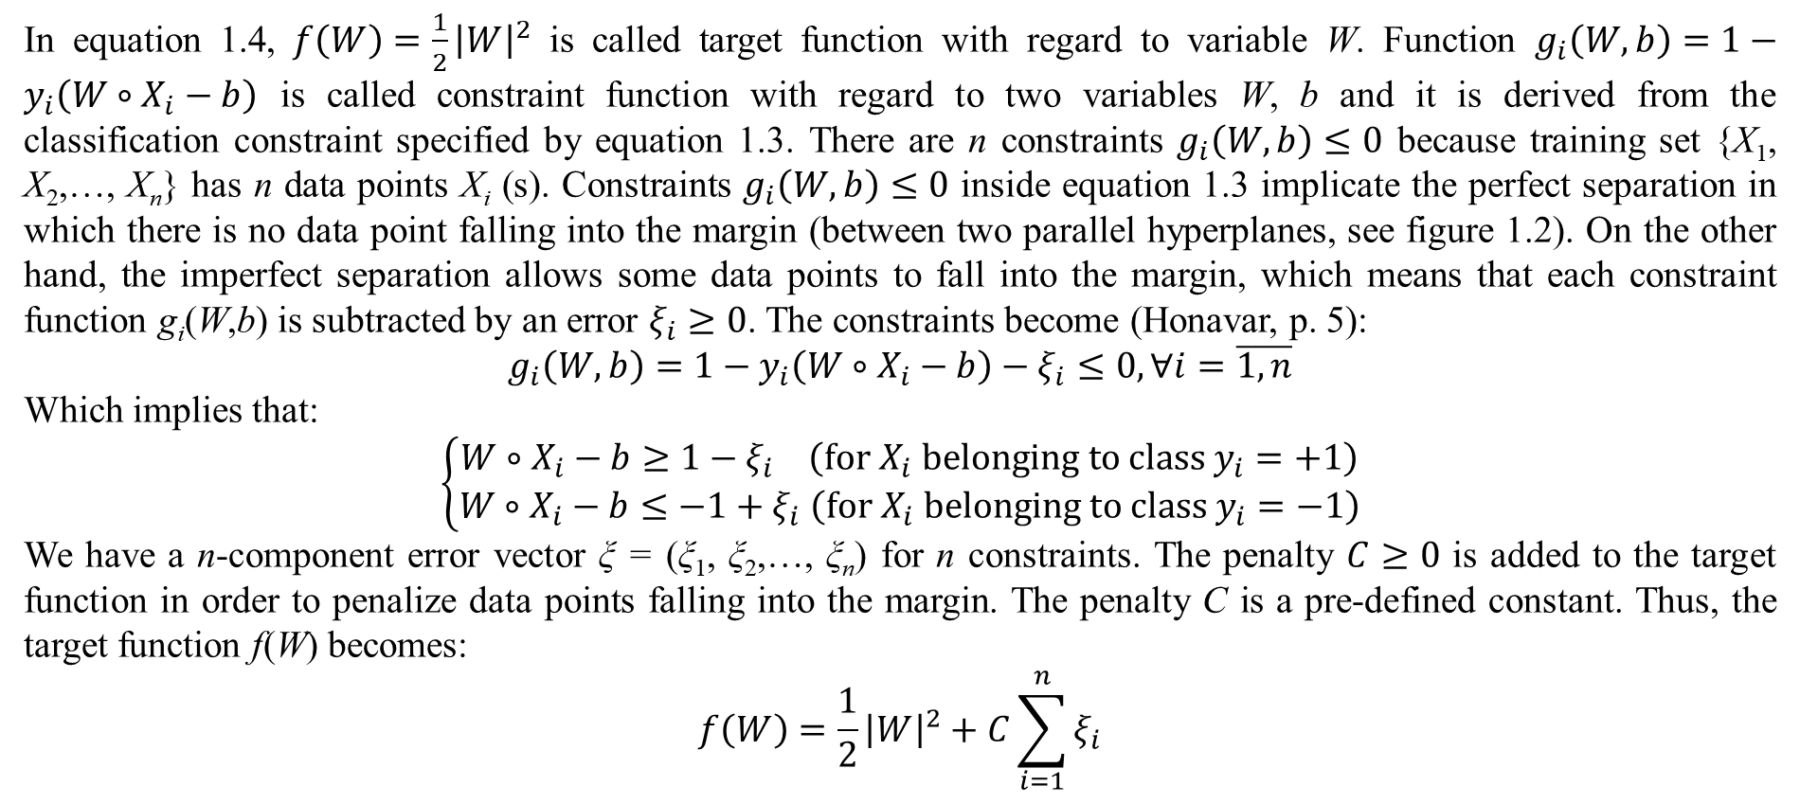
1. Support vector machine
In equation 1.4, $f\left(W\right)=\frac{1}{2}{\left|W\right|}^{2}$ is called target function with regard to variable W. Function $g_{i}\left(W,b\right)=1−y_{i}\left(W∘X_{i}−b\right)$ is called constraint function with regard to two variables W, b and it is derived from the classification constraint specified by equation 1.3. There are n constraints $g_{i}\left(W,b\right)≤0$ because training set {X₁, X₂,…, X_{n}} has n data points X_{i} (s). Constraints $g_{i}\left(W,b\right)≤0$ inside equation 1.3 implicate the perfect separation in which there is no data point falling into the margin (between two parallel hyperplanes, see figure 1.2). On the other hand, the imperfect separation allows some data points to fall into the margin, which means that each constraint function g_{i}(W,b) is subtracted by an error $ξ_{i}≥0$. The constraints become (Honavar, p. 5):
$$g_{i}\left(W,b\right)=1−y_{i}\left(W∘X_{i}−b\right)−ξ_{i}≤0,∀i=\overline{1,n}$$
Which implies that:
$$\left\{\begin{matrix}W∘X_{i}−b≥1−ξ_{i} \left(for X_{i} belonging to class y_{i}=+1\right) \\ W∘X_{i}−b≤−1+ξ_{i} \left(for X_{i} belonging to class y_{i}=−1\right)\end{matrix}\right.$$
We have a n-component error vector ξ = (ξ₁, ξ₂,…, ξ_{n}) for n constraints. The penalty $C≥0$ is added to the target function in order to penalize data points falling into the margin. The penalty C is a pre-defined constant. Thus, the target function f(W) becomes:
$$f\left(W\right)=\frac{1}{2}{\left|W\right|}^{2}+C\sum_{i=1}^{n}{ξ_{i}}$$

Slide 11
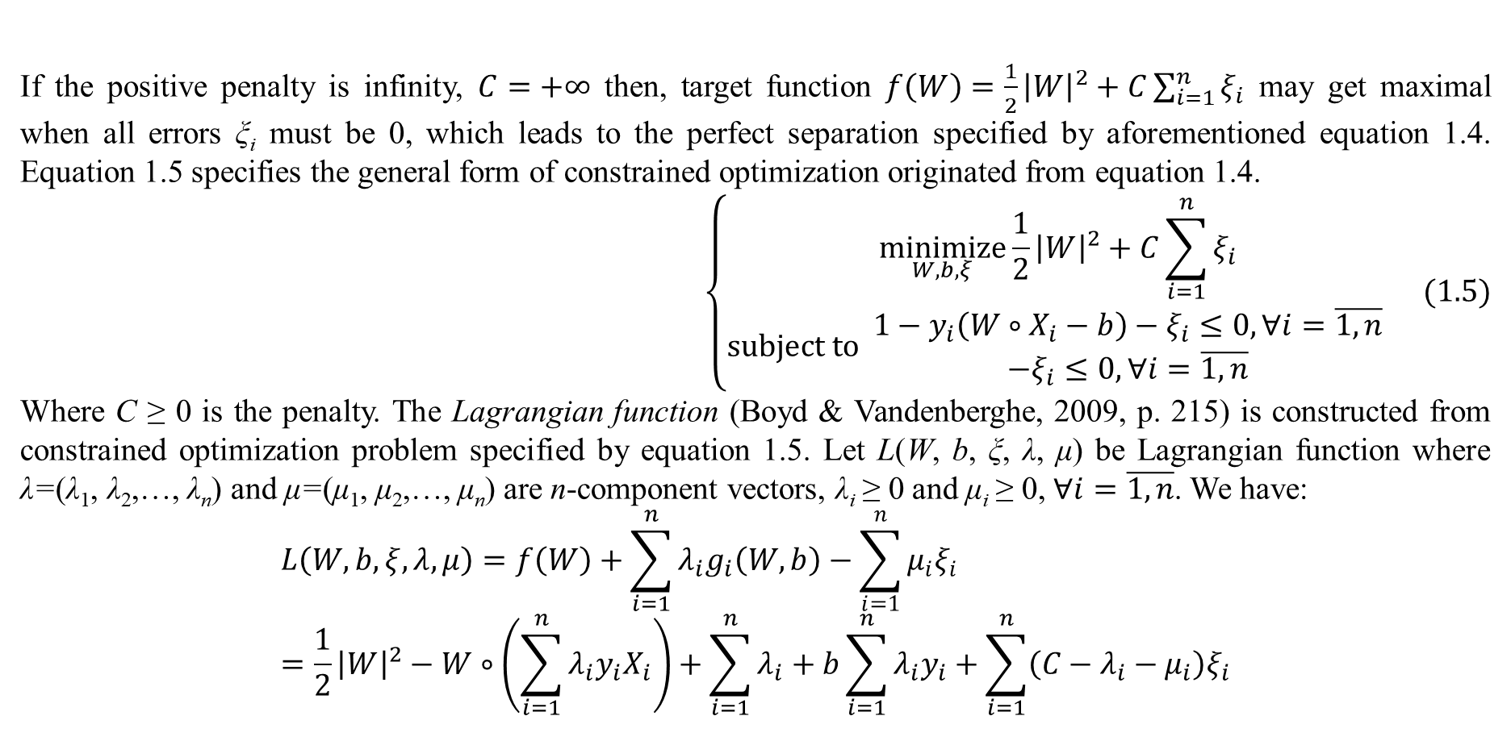
1. Support vector machine
If the positive penalty is infinity, $C=+∞$ then, target function $f\left(W\right)=\frac{1}{2}{\left|W\right|}^{2}+C\sum_{i=1}^{n}{ξ_{i}}$ may get maximal when all errors ξ_{i} must be 0, which leads to the perfect separation specified by aforementioned equation 1.4. Equation 1.5 specifies the general form of constrained optimization originated from equation 1.4.
$$\left\{\begin{matrix}\underset{W,b,ξ}{minimize}{\frac{1}{2}{\left|W\right|}^{2}+C\sum_{i=1}^{n}{ξ_{i}}} \\ subject to \begin{matrix}1−y_{i}\left(W∘X_{i}−b\right)−ξ_{i}≤0,∀i=\overline{1,n} \\ −ξ_{i}≤0,∀i=\overline{1,n}\end{matrix} \end{matrix}\right. (1.5)$$
Where C ≥ 0 is the penalty. The Lagrangian function (Boyd & Vandenberghe, 2009, p. 215) is constructed from constrained optimization problem specified by equation 1.5. Let L(W, b, ξ, λ, μ) be Lagrangian function where λ=(λ₁, λ₂,…, λ_{n}) and μ=(μ₁, μ₂,…, μ_{n}) are n-component vectors, λ_{i} ≥ 0 and μ_{i} ≥ 0, $∀i=\overline{1,n}$. We have:
$$L\left(W,b,ξ,λ,μ\right)=f\left(W\right)+\sum_{i=1}^{n}{λ_{i}g_{i}\left(W,b\right)}−\sum_{i=1}^{n}{μ_{i}ξ_{i}}=\frac{1}{2}{\left|W\right|}^{2}−W∘\left(\sum_{i=1}^{n}{λ_{i}y_{i}X_{i}}\right)+\sum_{i=1}^{n}{λ_{i}}+b\sum_{i=1}^{n}{λ_{i}y_{i}}+\sum_{i=1}^{n}{\left(C−λ_{i}−μ_{i}\right)ξ_{i}}$$

Slide 12
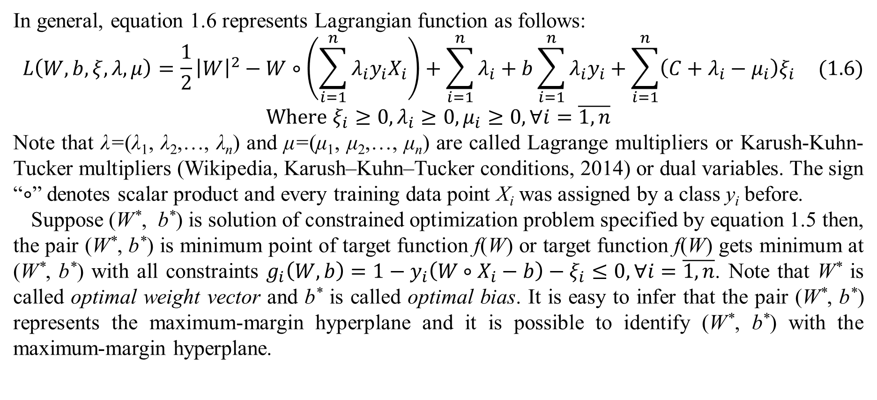
1. Support vector machine
In general, equation 1.6 represents Lagrangian function as follows:
$$L\left(W,b,ξ,λ,μ\right)=\frac{1}{2}{\left|W\right|}^{2}−W∘\left(\sum_{i=1}^{n}{λ_{i}y_{i}X_{i}}\right)+\sum_{i=1}^{n}{λ_{i}}+b\sum_{i=1}^{n}{λ_{i}y_{i}}+\sum_{i=1}^{n}{\left(C+λ_{i}−μ_{i}\right)ξ_{i}} (1.6)$$
$$Where ξ_{i}≥0,λ_{i}≥0,μ_{i}≥0,∀i=\overline{1,n}$$
Note that λ=(λ₁, λ₂,…, λ_{n}) and μ=(μ₁, μ₂,…, μ_{n}) are called Lagrange multipliers or Karush-Kuhn-Tucker multipliers (Wikipedia, Karush–Kuhn–Tucker conditions, 2014) or dual variables. The sign “$∘$” denotes scalar product and every training data point X_{i} was assigned by a class y_{i} before.
Suppose (W*, b*) is solution of constrained optimization problem specified by equation 1.5 then, the pair (W*, b*) is minimum point of target function f(W) or target function f(W) gets minimum at (W*, b*) with all constraints $g_{i}\left(W,b\right)=1−y_{i}\left(W∘X_{i}−b\right)−ξ_{i}≤0,∀i=\overline{1,n}$. Note that W* is called optimal weight vector and b* is called optimal bias. It is easy to infer that the pair (W*, b*) represents the maximum-margin hyperplane and it is possible to identify (W*, b*) with the maximum-margin hyperplane.

Slide 13
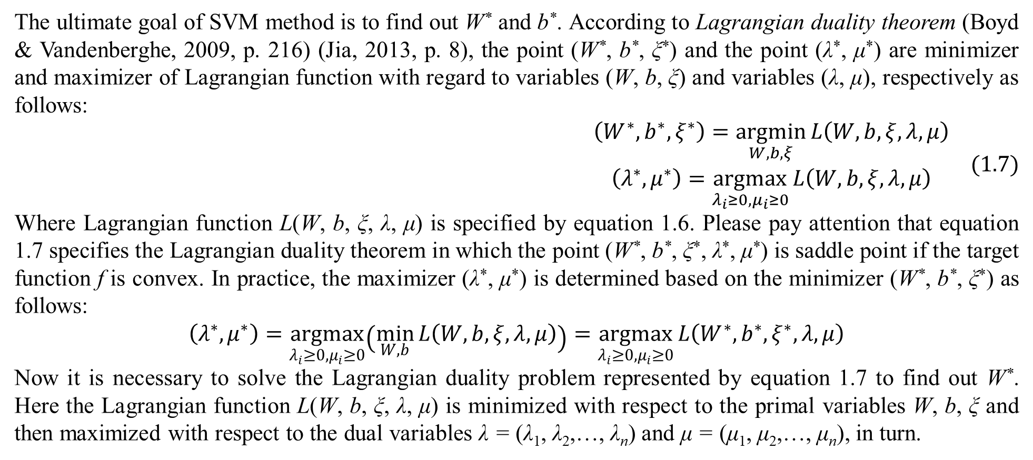
1. Support vector machine
The ultimate goal of SVM method is to find out W* and b*. According to Lagrangian duality theorem (Boyd & Vandenberghe, 2009, p. 216) (Jia, 2013, p. 8), the point (W*, b*, ξ*) and the point (λ*, μ*) are minimizer and maximizer of Lagrangian function with regard to variables (W, b, ξ) and variables (λ, μ), respectively as follows:
$$\begin{matrix}\left(W^{∗},b^{∗},ξ^{∗}\right)=\underset{W,b,ξ}{argmin}{L\left(W,b,ξ,λ,μ\right)} \\ \left(λ^{∗},μ^{∗}\right)=\underset{λ_{i}≥0,μ_{i}≥0}{argmax}{L\left(W,b,ξ,λ,μ\right)}\end{matrix} (1.7)$$
Where Lagrangian function L(W, b, ξ, λ, μ) is specified by equation 1.6. Please pay attention that equation 1.7 specifies the Lagrangian duality theorem in which the point (W*, b*, ξ*, λ*, μ*) is saddle point if the target function f is convex. In practice, the maximizer (λ*, μ*) is determined based on the minimizer (W*, b*, ξ*) as follows:
$$\left(λ^{∗},μ^{∗}\right)=\underset{λ_{i}≥0,μ_{i}≥0}{argmax}\left(\min_{W,b}{L\left(W,b,ξ,λ,μ\right)}\right)=\underset{λ_{i}≥0,μ_{i}≥0}{argmax}{L\left(W^{∗},b^{∗},ξ^{∗},λ,μ\right)}$$
Now it is necessary to solve the Lagrangian duality problem represented by equation 1.7 to find out W*. Here the Lagrangian function L(W, b, ξ, λ, μ) is minimized with respect to the primal variables W, b, ξ and then maximized with respect to the dual variables λ = (λ₁, λ₂,…, λ_{n}) and μ = (μ₁, μ₂,…, μ_{n}), in turn.

Slide 14
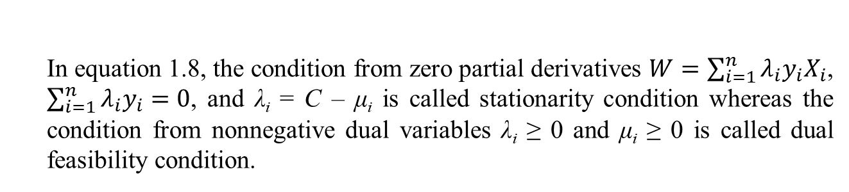
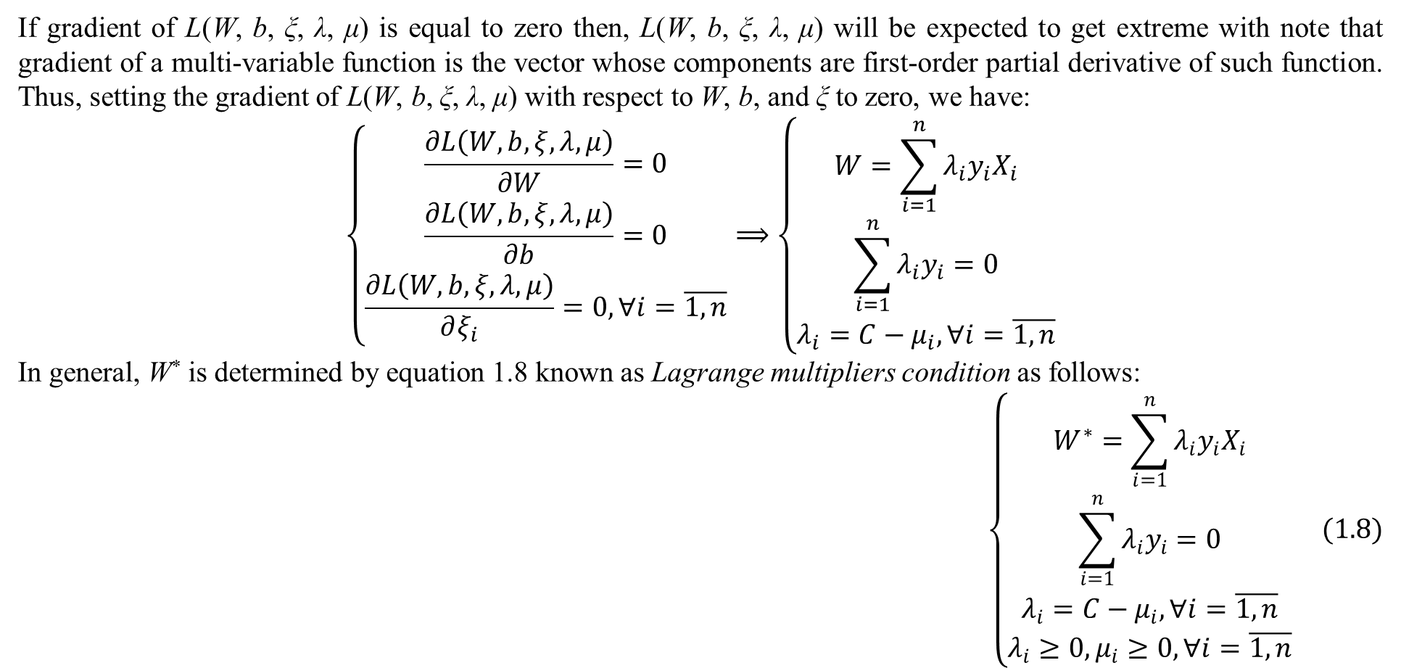
1. Support vector machine
If gradient of L(W, b, ξ, λ, μ) is equal to zero then, L(W, b, ξ, λ, μ) will be expected to get extreme with note that gradient of a multi-variable function is the vector whose components are first-order partial derivative of such function. Thus, setting the gradient of L(W, b, ξ, λ, μ) with respect to W, b, and ξ to zero, we have:
$$\left\{\begin{matrix}\frac{∂L\left(W,b,ξ,λ,μ\right)}{∂W}=0 \\ \frac{∂L\left(W,b,ξ,λ,μ\right)}{∂b}=0 \\ \frac{∂L\left(W,b,ξ,λ,μ\right)}{∂ξ_{i}}=0,∀i=\overline{1,n}\end{matrix}\right.⟹\left\{\begin{matrix}W=\sum_{i=1}^{n}{λ_{i}y_{i}X_{i}} \\ \sum_{i=1}^{n}{λ_{i}y_{i}}=0 \\ λ_{i}=C−μ_{i},∀i=\overline{1,n}\end{matrix}\right.$$
In general, W* is determined by equation 1.8 known as Lagrange multipliers condition as follows:
$$\left\{\begin{matrix}W^{∗}=\sum_{i=1}^{n}{λ_{i}y_{i}X_{i}} \\ \sum_{i=1}^{n}{λ_{i}y_{i}}=0 \\ λ_{i}=C−μ_{i},∀i=\overline{1,n} \\ λ_{i}≥0,μ_{i}≥0,∀i=\overline{1,n}\end{matrix}\right. (1.8)$$
In equation 1.8, the condition from zero partial derivatives $W=\sum_{i=1}^{n}{λ_{i}y_{i}X_{i}}$, $\sum_{i=1}^{n}{λ_{i}y_{i}}=0$, and λ_{i} = C – μ_{i} is called stationarity condition whereas the condition from nonnegative dual variables λ_{i} ≥ 0 and μ_{i} ≥ 0 is called dual feasibility condition.

Slide 15
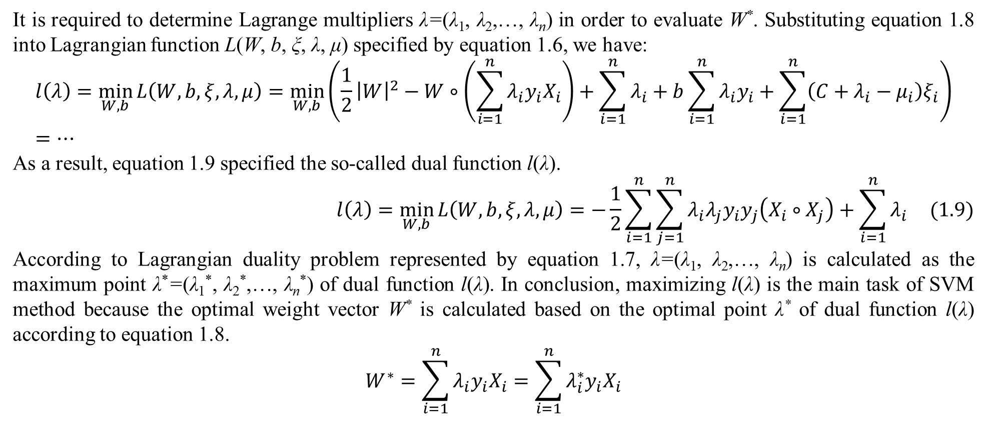
1. Support vector machine
It is required to determine Lagrange multipliers λ=(λ₁, λ₂,…, λ_{n}) in order to evaluate W*. Substituting equation 1.8 into Lagrangian function L(W, b, ξ, λ, μ) specified by equation 1.6, we have:
$$l\left(λ\right)=\min_{W,b}{L\left(W,b,ξ,λ,μ\right)}=\min_{W,b}\left(\frac{1}{2}{\left|W\right|}^{2}−W∘\left(\sum_{i=1}^{n}{λ_{i}y_{i}X_{i}}\right)+\sum_{i=1}^{n}{λ_{i}}+b\sum_{i=1}^{n}{λ_{i}y_{i}}+\sum_{i=1}^{n}{\left(C+λ_{i}−μ_{i}\right)ξ_{i}}\right)=…$$
As a result, equation 1.9 specified the so-called dual function l(λ).
$$l\left(λ\right)=\min_{W,b}{L\left(W,b,ξ,λ,μ\right)}=−\frac{1}{2}\sum_{i=1}^{n}{\sum_{j=1}^{n}{λ_{i}λ_{j}y_{i}y_{j}\left(X_{i}∘X_{j}\right)}}+\sum_{i=1}^{n}{λ_{i}} (1.9)$$
According to Lagrangian duality problem represented by equation 1.7, λ=(λ₁, λ₂,…, λ_{n}) is calculated as the maximum point λ*=(λ₁*, λ₂*,…, λ_{n}*) of dual function l(λ). In conclusion, maximizing l(λ) is the main task of SVM method because the optimal weight vector W* is calculated based on the optimal point λ* of dual function l(λ) according to equation 1.8.
$$W^{∗}=\sum_{i=1}^{n}{λ_{i}y_{i}X_{i}}=\sum_{i=1}^{n}{λ_{i}^{∗}y_{i}X_{i}}$$

Slide 16
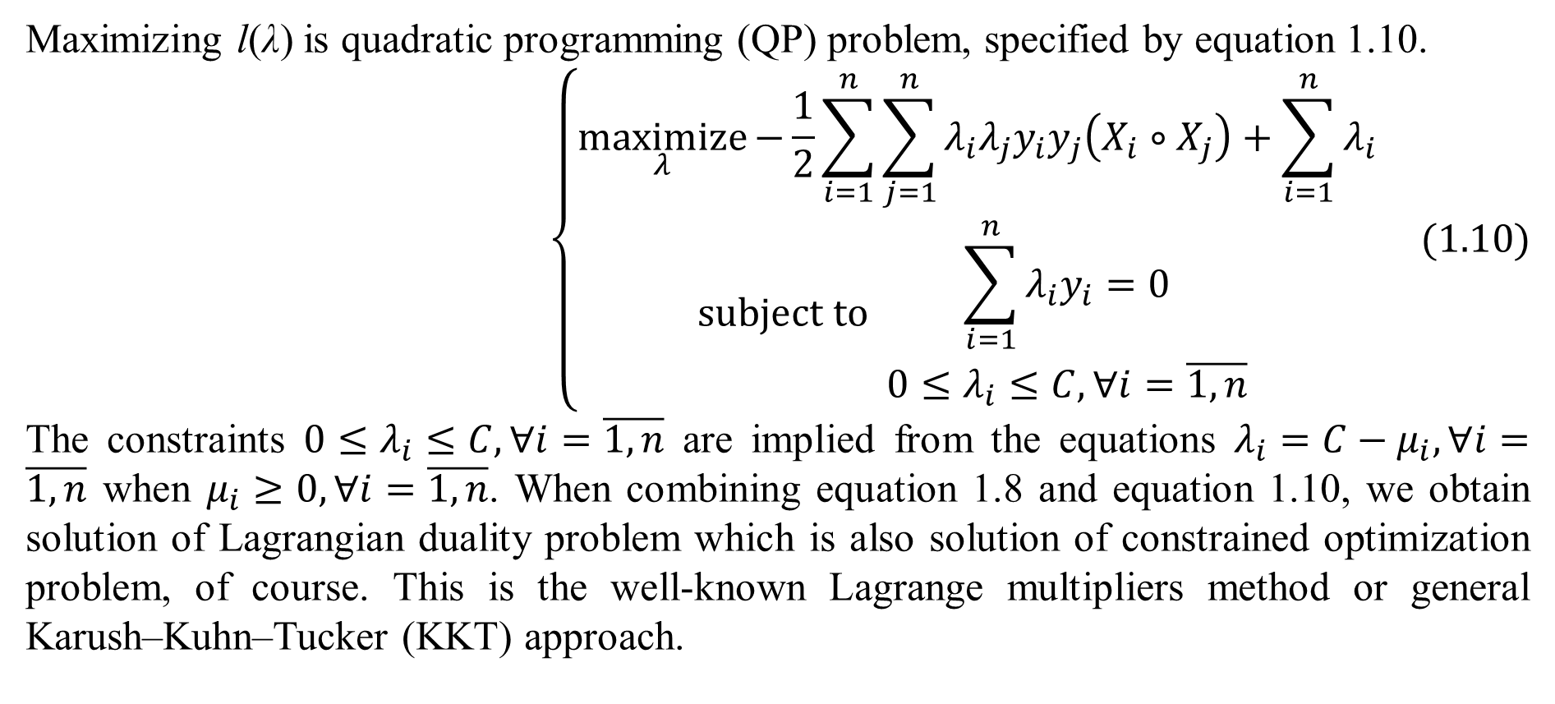
1. Support vector machine
Maximizing l(λ) is quadratic programming (QP) problem, specified by equation 1.10.
$$\left\{\begin{matrix}\underset{λ}{maximize}{−\frac{1}{2}\sum_{i=1}^{n}{\sum_{j=1}^{n}{λ_{i}λ_{j}y_{i}y_{j}\left(X_{i}∘X_{j}\right)}}+\sum_{i=1}^{n}{λ_{i}}} \\ subject to \begin{matrix}\sum_{i=1}^{n}{λ_{i}y_{i}}=0 \\ 0≤λ_{i}≤C,∀i=\overline{1,n}\end{matrix} \end{matrix}\right. (1.10)$$
The constraints $0≤λ_{i}≤C,∀i=\overline{1,n}$ are implied from the equations $λ_{i}=C−μ_{i},∀i=\overline{1,n}$ when $μ_{i}≥0,∀i=\overline{1,n}$. When combining equation 1.8 and equation 1.10, we obtain solution of Lagrangian duality problem which is also solution of constrained optimization problem, of course. This is the well-known Lagrange multipliers method or general Karush–Kuhn–Tucker (KKT) approach.

Slide 17
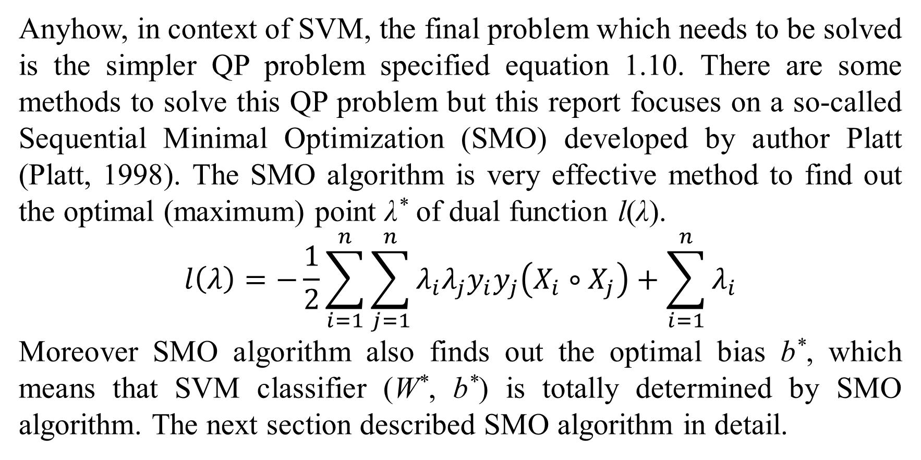
1. Support vector machine
Anyhow, in context of SVM, the final problem which needs to be solved is the simpler QP problem specified equation 1.10. There are some methods to solve this QP problem but this report focuses on a so-called Sequential Minimal Optimization (SMO) developed by author Platt (Platt, 1998). The SMO algorithm is very effective method to find out the optimal (maximum) point λ* of dual function l(λ).
$$l\left(λ\right)=−\frac{1}{2}\sum_{i=1}^{n}{\sum_{j=1}^{n}{λ_{i}λ_{j}y_{i}y_{j}\left(X_{i}∘X_{j}\right)}}+\sum_{i=1}^{n}{λ_{i}}$$
Moreover SMO algorithm also finds out the optimal bias b*, which means that SVM classifier (W*, b*) is totally determined by SMO algorithm. The next section described SMO algorithm in detail.

Slide 18
2. Sequential minimal optimization
The ideology of SMO algorithm is to divide the whole QP problem into many smallest optimization problems. Each smallest problem relates to only two Lagrange multipliers. For solving each smallest optimization problem, SMO algorithm includes two nested loops as shown in table 2.1 (Platt, 1998, pp. 8-9):
SMO algorithm solves each smallest optimization problem via two nested loops:
The outer loop finds out the first Lagrange multiplier λ_{i} whose associated data point X_{i} violates KKT condition (Wikipedia, Karush–Kuhn–Tucker conditions, 2014). Violating KKT condition is known as the first choice heuristic.
The inner loop finds out the second Lagrange multiplier λ_{j} according to the second choice heuristic. The second choice heuristic that maximizes optimization step will be described later.
Two Lagrange multipliers λ_{i} and λ_{j} are optimized jointly according to QP problem specified by equation 1.10.
SMO algorithm continues to solve another smallest optimization problem. SMO algorithm stops when there is convergence in which no data point violating KKT condition is found; consequently, all Lagrange multipliers λ₁, λ₂,…, λ_{n} are optimized.
Table 2.1. Ideology of SMO algorithm
The ideology of violating KKT condition as the first choice heuristic is similar to the event that wrong things need to be fixed priorly.

Slide 19

2. Sequential minimal optimization
Before describing SMO algorithm in detailed, KKT condition with subject to SVM is mentioned firstly because violating KKT condition is known as the first choice heuristic of SMO algorithm. For solving constrained optimization problem, KKT condition indicates both partial derivatives of Lagrangian function and complementary slackness are zero (Wikipedia, Karush–Kuhn–Tucker conditions, 2014). Referring Eqs. 1.8 and 1.4, KKT condition of SVM is summarized as Eq. 2.1:
$$\left\{\begin{matrix}W=\sum_{i=1}^{n}{λ_{i}y_{i}X_{i}} \\ \sum_{i=1}^{n}{λ_{i}y_{i}}=0 \\ λ_{i}=C−μ_{i},∀i \\ 1−y_{i}\left(W∘X_{i}−b\right)−ξ_{i}≤0,∀i \\ −ξ_{i}≤0,∀i \\ λ_{i}≥0,μ_{i}≥0,∀i \\ λ_{i}\left(1−y_{i}\left(W∘X_{i}−b\right)−ξ_{i}\right)=0,∀i \\ −{μ_{i}ξ}_{i}=0,∀i\end{matrix}\right.(2.1)$$
In equation 2.1, the complementary slackness is λ_{i}(1 – y_{i} (W∘X_{i} – b) – ξ_{i}) = 0 and –μ_{i}ξ_{i} = 0 for all i because of the primal feasibility condition 1 – y_{i} (W∘X_{i} – b) – ξ_{i} ≤ 0 and –ξ_{i} ≤ 0 for all i. KKT condition specified by equation 2.1 implies Lagrange multipliers condition specified by equation 1.8, which aims to solve Lagrangian duality problem whose solution (W*, b*, ξ*, λ*, μ*) is saddle point of Lagrangian function. This is the reason that KKT condition is known as general form of Lagrange multipliers condition. It is easy to deduce that QP problem for SVM specified by equation 1.10 is derived from KKT condition within Lagrangian duality theory.

Slide 20
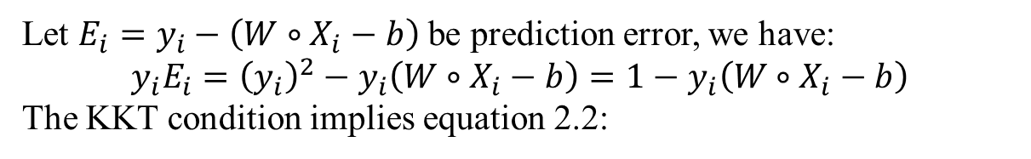
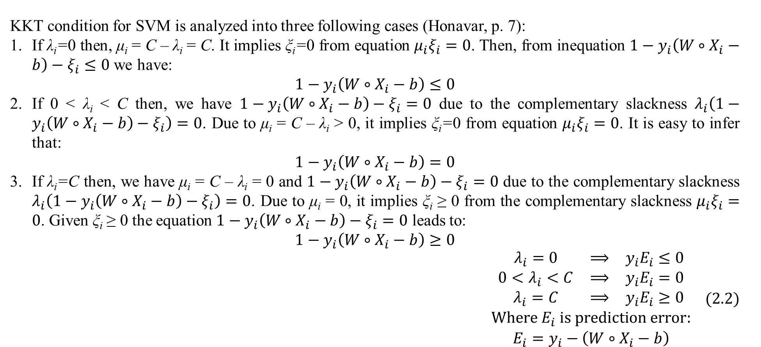
2. Sequential minimal optimization
KKT condition for SVM is analyzed into three following cases (Honavar, p. 7):
If λ_{i}=0 then, μ_{i} = C – λ_{i} = C. It implies ξ_{i}=0 from equation ${μ_{i}ξ}_{i}=0$. Then, from inequation $1−y_{i}\left(W∘X_{i}−b\right)−ξ_{i}≤0$ we have:
$$1−y_{i}\left(W∘X_{i}−b\right)≤0$$
If 0 < λ_{i} < C then, we have $1−y_{i}\left(W∘X_{i}−b\right)−ξ_{i}=0$ due to the complementary slackness $λ_{i}\left(1−y_{i}\left(W∘X_{i}−b\right)−ξ_{i}\right)=0$. Due to μ_{i} = C – λ_{i} > 0, it implies ξ_{i}=0 from equation ${μ_{i}ξ}_{i}=0$. It is easy to infer that:
$$1−y_{i}\left(W∘X_{i}−b\right)=0$$
If λ_{i}=C then, we have μ_{i} = C – λ_{i} = 0 and $1−y_{i}\left(W∘X_{i}−b\right)−ξ_{i}=0$ due to the complementary slackness $λ_{i}\left(1−y_{i}\left(W∘X_{i}−b\right)−ξ_{i}\right)=0$. Due to μ_{i} = 0, it implies ξ_{i} ≥ 0 from the complementary slackness ${μ_{i}ξ}_{i}=0$. Given ξ_{i} ≥ 0 the equation $1−y_{i}\left(W∘X_{i}−b\right)−ξ_{i}=0$ leads to:
$$1−y_{i}\left(W∘X_{i}−b\right)≥0$$
$$\begin{matrix}\begin{matrix}λ_{i}=0 & ⟹ & y_{i}E_{i}≤0 \\ 0<λ_{i}<C & ⟹ & y_{i}E_{i}=0 \\ λ_{i}=C & ⟹ & y_{i}E_{i}≥0\end{matrix} \\ Where E_{i} is prediction error: \\ E_{i}=y_{i}−\left(W∘X_{i}−b\right)\end{matrix} (2.2)$$
Let $E_{i}=y_{i}−\left(W∘X_{i}−b\right)$ be prediction error, we have:
$$y_{i}E_{i}={\left(y_{i}\right)}^{2}−y_{i}\left(W∘X_{i}−b\right)=1−y_{i}\left(W∘X_{i}−b\right)$$
The KKT condition implies equation 2.2:

Slide 21
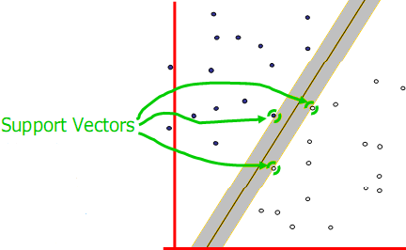
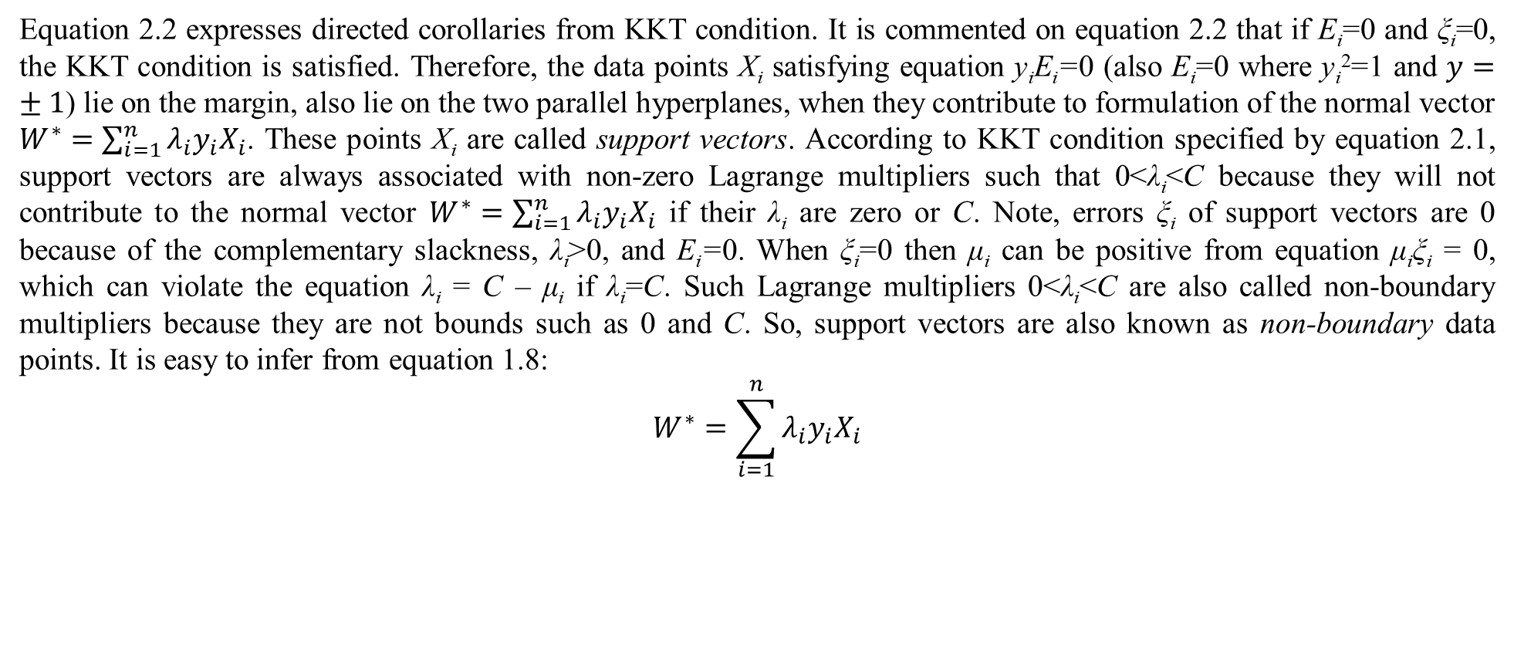
2. Sequential minimal optimization
Equation 2.2 expresses directed corollaries from KKT condition. It is commented on equation 2.2 that if E_{i}=0 and ξ_{i}=0, the KKT condition is satisfied. Therefore, the data points X_{i} satisfying equation y_{i}E_{i}=0 (also E_{i}=0 where y_{i}²=1 and $y=±1$) lie on the margin, also lie on the two parallel hyperplanes, when they contribute to formulation of the normal vector $W^{∗}=\sum_{i=1}^{n}{λ_{i}y_{i}X_{i}}$. These points X_{i} are called support vectors. According to KKT condition specified by equation 2.1, support vectors are always associated with non-zero Lagrange multipliers such that 0<λ_{i}<C because they will not contribute to the normal vector $W^{∗}=\sum_{i=1}^{n}{λ_{i}y_{i}X_{i}}$ if their λ_{i} are zero or C. Note, errors ξ_{i} of support vectors are 0 because of the complementary slackness, λ_{i}>0, and E_{i}=0. When ξ_{i}=0 then μ_{i} can be positive from equation μ_{i}ξ_{i} = 0, which can violate the equation λ_{i} = C – μ_{i} if λ_{i}=C. Such Lagrange multipliers 0<λ_{i}<C are also called non-boundary multipliers because they are not bounds such as 0 and C. So, support vectors are also known as non-boundary data points. It is easy to infer from equation 1.8:
$$W^{∗}=\sum_{i=1}^{n}{λ_{i}y_{i}X_{i}}$$
that support vectors along with their non-zero Lagrange multipliers form mainly the optimal weight vector W* representing the maximum-margin hyperplane – the SVM classifier. This is the reason that this classification approach is called support vector machine (SVM). Figure 2.1 (Moore, 2001, p. 5) illustrates an example of support vectors.
Figure 2.1. Support vectors

Slide 22
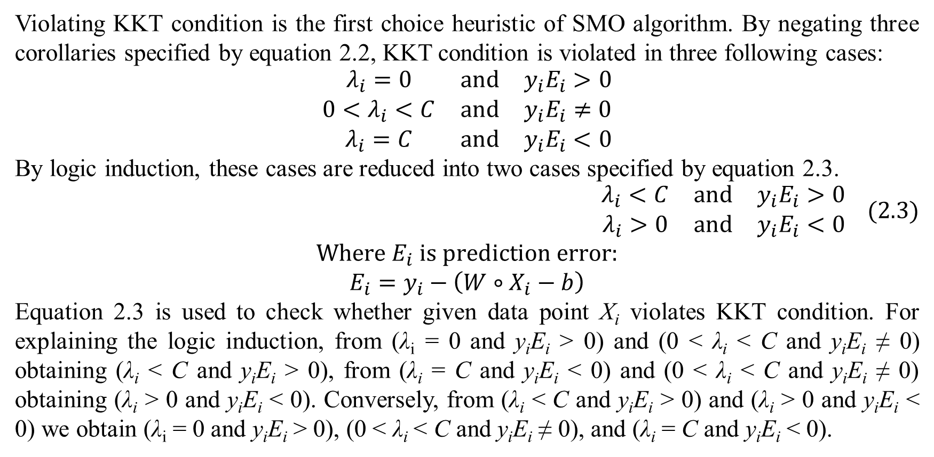
2. Sequential minimal optimization
Violating KKT condition is the first choice heuristic of SMO algorithm. By negating three corollaries specified by equation 2.2, KKT condition is violated in three following cases:
$$\begin{matrix}λ_{i}=0 & and & y_{i}E_{i}>0 \\ 0<λ_{i}<C & and & y_{i}E_{i}≠0 \\ λ_{i}=C & and & y_{i}E_{i}<0\end{matrix}$$
By logic induction, these cases are reduced into two cases specified by equation 2.3.
$$\begin{matrix}λ_{i}<C & and & y_{i}E_{i}>0 \\ λ_{i}>0 & and & y_{i}E_{i}<0\end{matrix} (2.3)$$
$$Where E_{i} is prediction error:$$
$$E_{i}=y_{i}−\left(W∘X_{i}−b\right)$$
Equation 2.3 is used to check whether given data point X_{i} violates KKT condition. For explaining the logic induction, from (λ_{i} = 0 and y_{i}E_{i} > 0) and (0 < λ_{i} < C and y_{i}E_{i} ≠ 0) obtaining (λ_{i} < C and y_{i}E_{i} > 0), from (λ_{i} = C and y_{i}E_{i} < 0) and (0 < λ_{i} < C and y_{i}E_{i} ≠ 0) obtaining (λ_{i} > 0 and y_{i}E_{i} < 0). Conversely, from (λ_{i} < C and y_{i}E_{i} > 0) and (λ_{i} > 0 and y_{i}E_{i} < 0) we obtain (λ_{i} = 0 and y_{i}E_{i} > 0), (0 < λ_{i} < C and y_{i}E_{i} ≠ 0), and (λ_{i} = C and y_{i}E_{i} < 0).

Slide 23
2. Sequential minimal optimization

Slide 24
3. An example of data classification by SVM
Result 1.
Result 2.
Result 3.
Discussion 1.
Discussion 2.
Discussion 3.

Slide 25
4. Conclusions
Conclusion 1.
Conclusion 2.
Conclusion 3.

Slide 26
Thank you for attention

Slide 27
References
Reference 1
Reference 2.
Reference 3.

