Slide 1
Global Optimization with Descending Region Algorithm
The third Science & Technology Conference of Ho Chi Minh University of Food & Industry
July 4, 2017, Ho Chi Minh, Vietnam
Loc Nguyen
Vietnam Institute of Mathematics, Hanoi, Vietnam

Slide 2
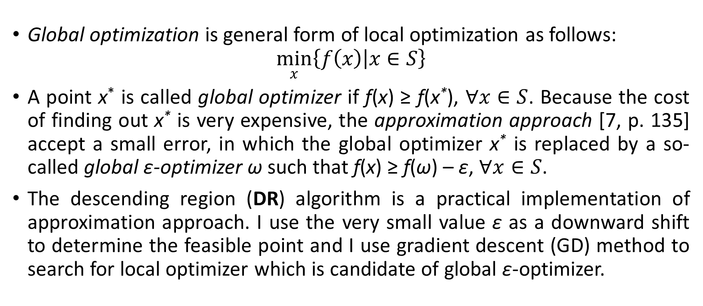
1. Descending region (DR) algorithm
Global optimization is general form of local optimization as follows:
$$\min_{x}\left\{\left.f\left(x\right)\right|x∈S\right\}$$
A point x* is called global optimizer if f(x) ≥ f(x*), $∀x∈S$. Because the cost of finding out x* is very expensive, the approximation approach [7, p. 135] accept a small error, in which the global optimizer x* is replaced by a so-called global ε-optimizer ω such that f(x) ≥ f(ω) – ε, $∀x∈S$.
The descending region (DR) algorithm is a practical implementation of approximation approach. I use the very small value ε as a downward shift to determine the feasible point and I use gradient descent (GD) method to search for local optimizer which is candidate of global ε-optimizer.

Slide 3
1. Descending region (DR) algorithm
The ideology of DR algorithm is that given a known local optimizer z*, the better local optimizer is searched only in a so-called descending region under the known point z*. If the target function has global minimum value, the local optimizer z* approaches the global optimizer z**.
The descending region is begun by a so-called descending point which is defined as the point under the optimizer z* and so the next better optimizer is searched under descending point.
Descending point is solution of a so-called intersection equation mentioned later.
DR algorithm has many iterations and each iteration includes two steps:
Step 1: Searching for local optimizer z* by GD method.
Step 2: Determining descending region (descending point)

Slide 4
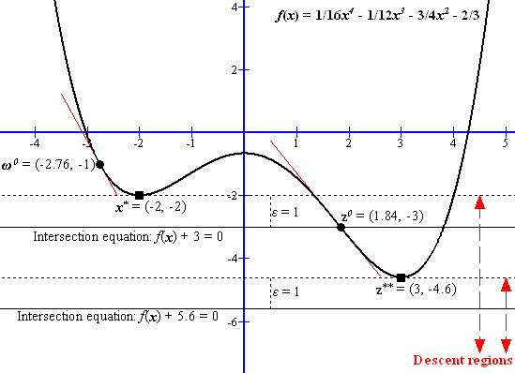
1. Descending region (DR) algorithm

Slide 5
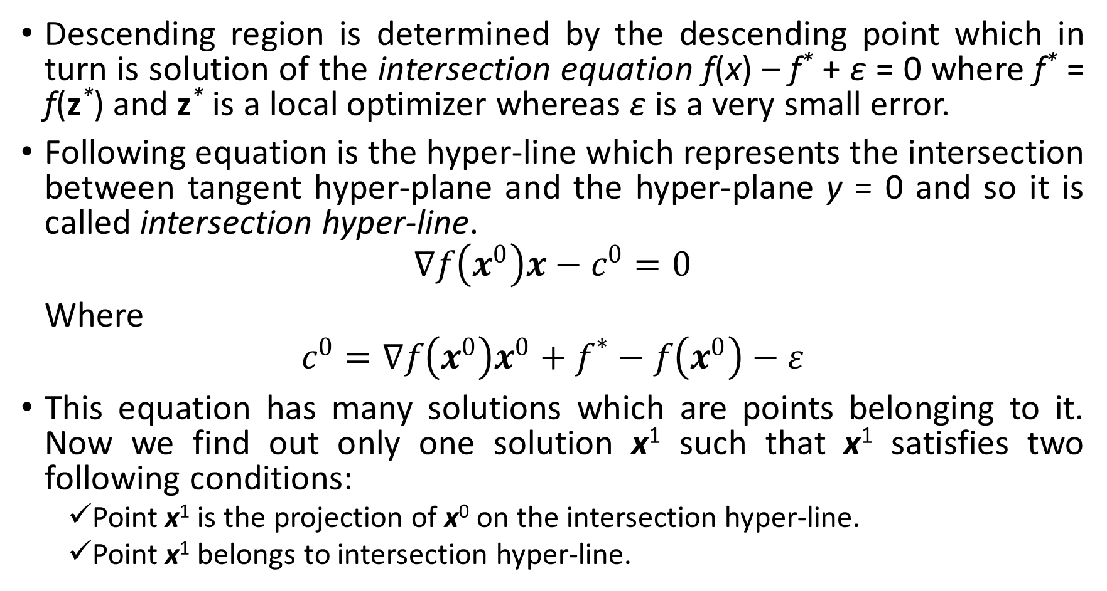
2. How to determine descending region
Descending region is determined by the descending point which in turn is solution of the intersection equation f(x) – f* + ε = 0 where f* = f(z*) and z* is a local optimizer whereas ε is a very small error.
Following equation is the hyper-line which represents the intersection between tangent hyper-plane and the hyper-plane y = 0 and so it is called intersection hyper-line.
$$∇f\left(x^{0}\right)x−c^{0}=0$$
Where
$$c^{0}=∇f\left(x^{0}\right)x^{0}+f^{∗}−f\left(x^{0}\right)−ε$$
This equation has many solutions which are points belonging to it. Now we find out only one solution x¹ such that x¹ satisfies two following conditions:
Point x¹ is the projection of x⁰ on the intersection hyper-line.
Point x¹ belongs to intersection hyper-line.

Slide 6
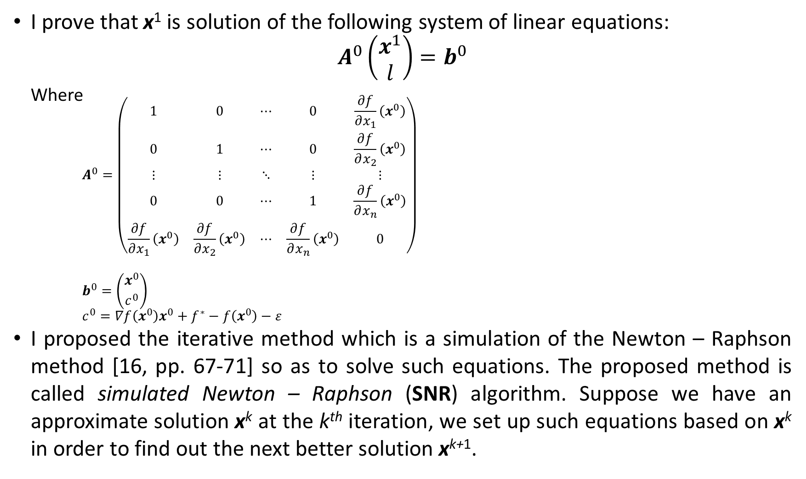
2. How to determine descending region
I prove that x¹ is solution of the following system of linear equations:
$$A^{0}\left(\begin{aligned}x^{1} \\ l\end{aligned}\right)=b^{0}$$
Where
$$A^{0}=\left(\begin{matrix}1 & 0 & ⋯ & 0 & \frac{∂f}{∂x_{1}}\left(x^{0}\right) \\ 0 & 1 & ⋯ & 0 & \frac{∂f}{∂x_{2}}\left(x^{0}\right) \\ ⋮ & ⋮ & ⋱ & ⋮ & ⋮ \\ 0 & 0 & ⋯ & 1 & \frac{∂f}{∂x_{n}}\left(x^{0}\right) \\ \frac{∂f}{∂x_{1}}\left(x^{0}\right) & \frac{∂f}{∂x_{2}}\left(x^{0}\right) & ⋯ & \frac{∂f}{∂x_{n}}\left(x^{0}\right) & 0\end{matrix}\right)$$
$$b^{0}=\left({x^{0} \atop c^{0}}\right)$$
$$c^{0}=∇f\left(x^{0}\right)x^{0}+f^{∗}−f\left(x^{0}\right)−ε$$
I proposed the iterative method which is a simulation of the Newton – Raphson method [16, pp. 67-71] so as to solve such equations. The proposed method is called simulated Newton – Raphson (SNR) algorithm. Suppose we have an approximate solution x^{k} at the k^{th} iteration, we set up such equations based on x^{k} in order to find out the next better solution x^{k+1}.

Slide 7
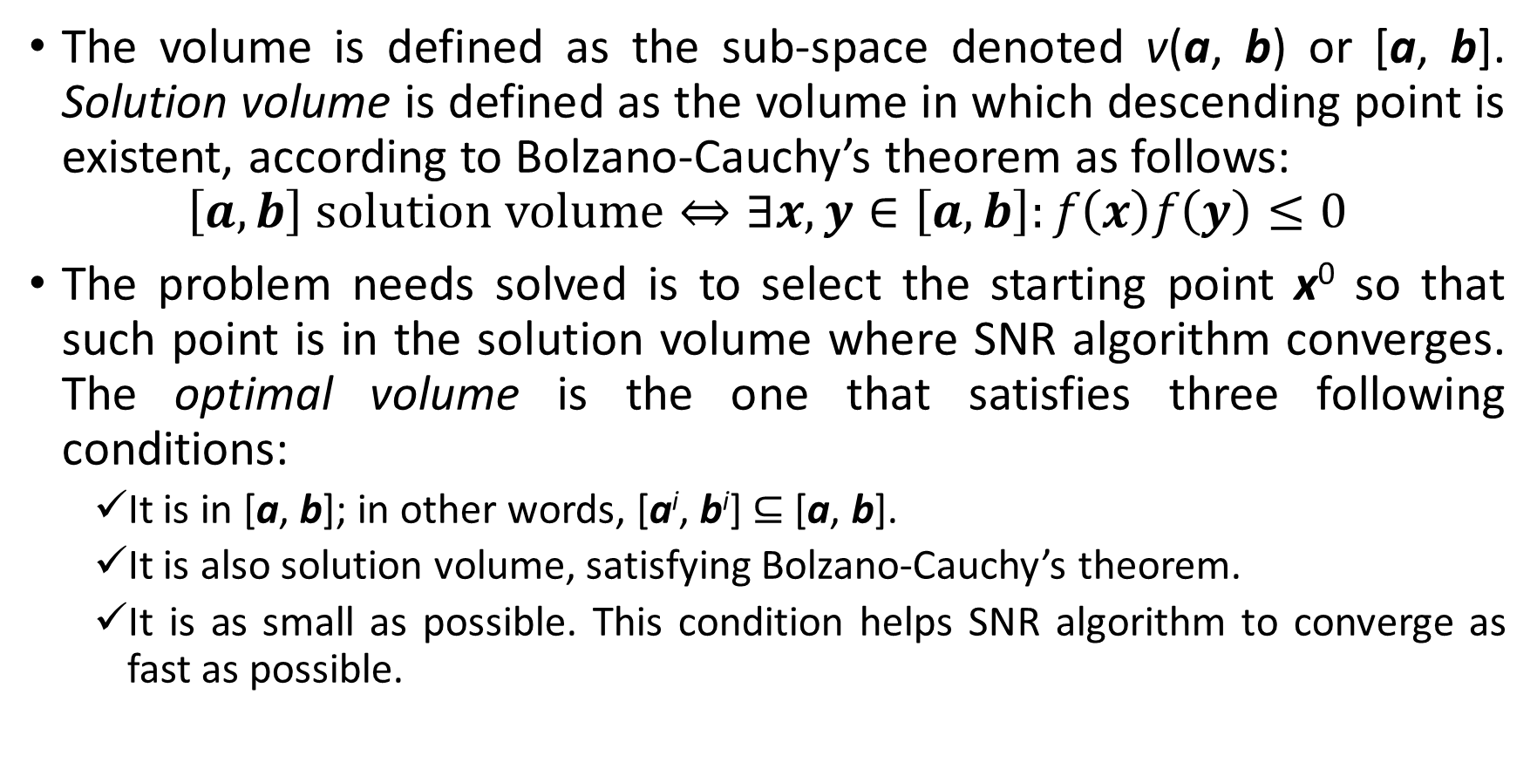
3. How to choose optimal starting point
The volume is defined as the sub-space denoted v(a, b) or [a, b]. Solution volume is defined as the volume in which descending point is existent, according to Bolzano-Cauchy’s theorem as follows:
$$\left[a,b\right] solution volume⇔∃x,y∈\left[a,b\right]:f\left(x\right)f\left(y\right)≤0$$
The problem needs solved is to select the starting point x⁰ so that such point is in the solution volume where SNR algorithm converges. The optimal volume is the one that satisfies three following conditions:
It is in [a, b]; in other words, [a^{i}, b^{i}] $⊆$ [a, b].
It is also solution volume, satisfying Bolzano-Cauchy’s theorem.
It is as small as possible. This condition helps SNR algorithm to converge as fast as possible.

Slide 8
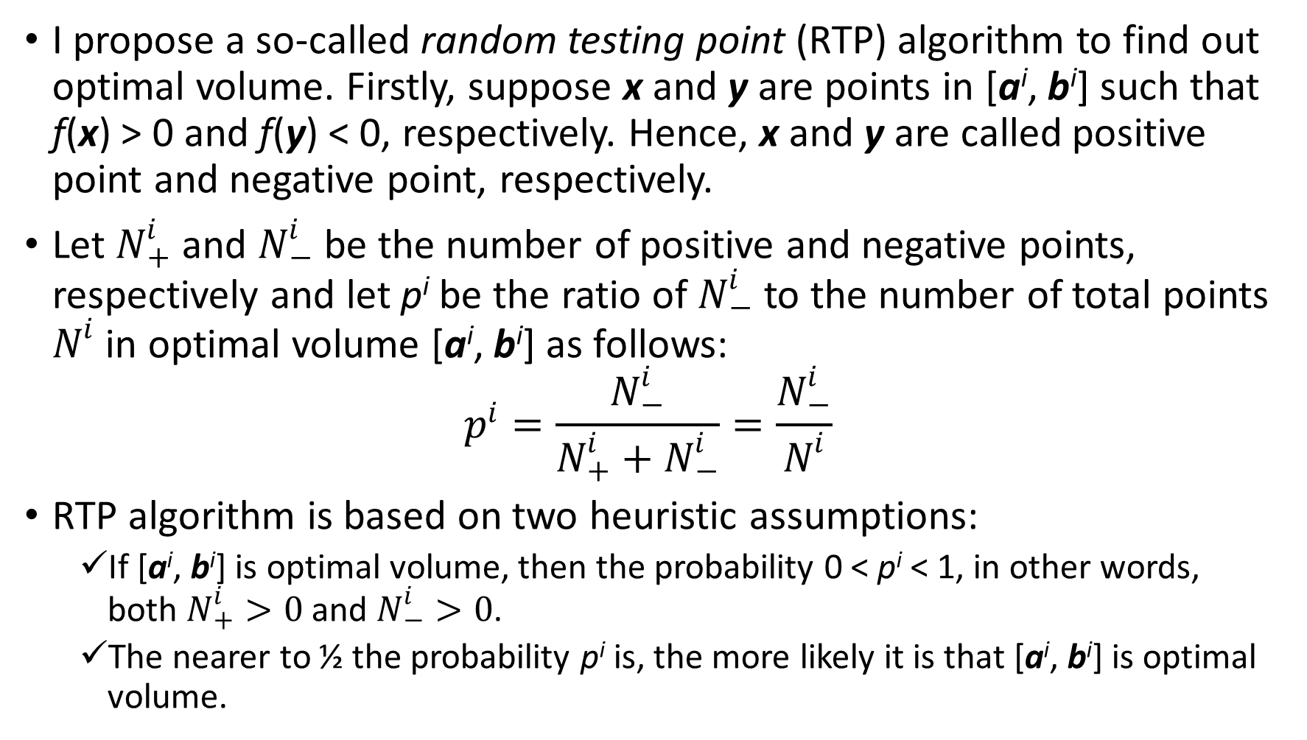
3. How to choose optimal starting point
I propose a so-called random testing point (RTP) algorithm to find out optimal volume. Firstly, suppose x and y are points in [a^{i}, b^{i}] such that f(x) > 0 and f(y) < 0, respectively. Hence, x and y are called positive point and negative point, respectively.
Let $N_{+}^{i}$ and $N_{−}^{i}$ be the number of positive and negative points, respectively and let p^{i} be the ratio of $N_{−}^{i}$ to the number of total points $N^{i}$ in optimal volume [a^{i}, b^{i}] as follows:
$$p^{i}=\frac{N_{−}^{i}}{N_{+}^{i}+N_{−}^{i}}=\frac{N_{−}^{i}}{N^{i}}$$
RTP algorithm is based on two heuristic assumptions:
If [a^{i}, b^{i}] is optimal volume, then the probability 0 < p^{i} < 1, in other words, both $N_{+}^{i}>0$ and $N_{−}^{i}>0$.
The nearer to ½ the probability p^{i} is, the more likely it is that [a^{i}, b^{i}] is optimal volume.

Slide 9
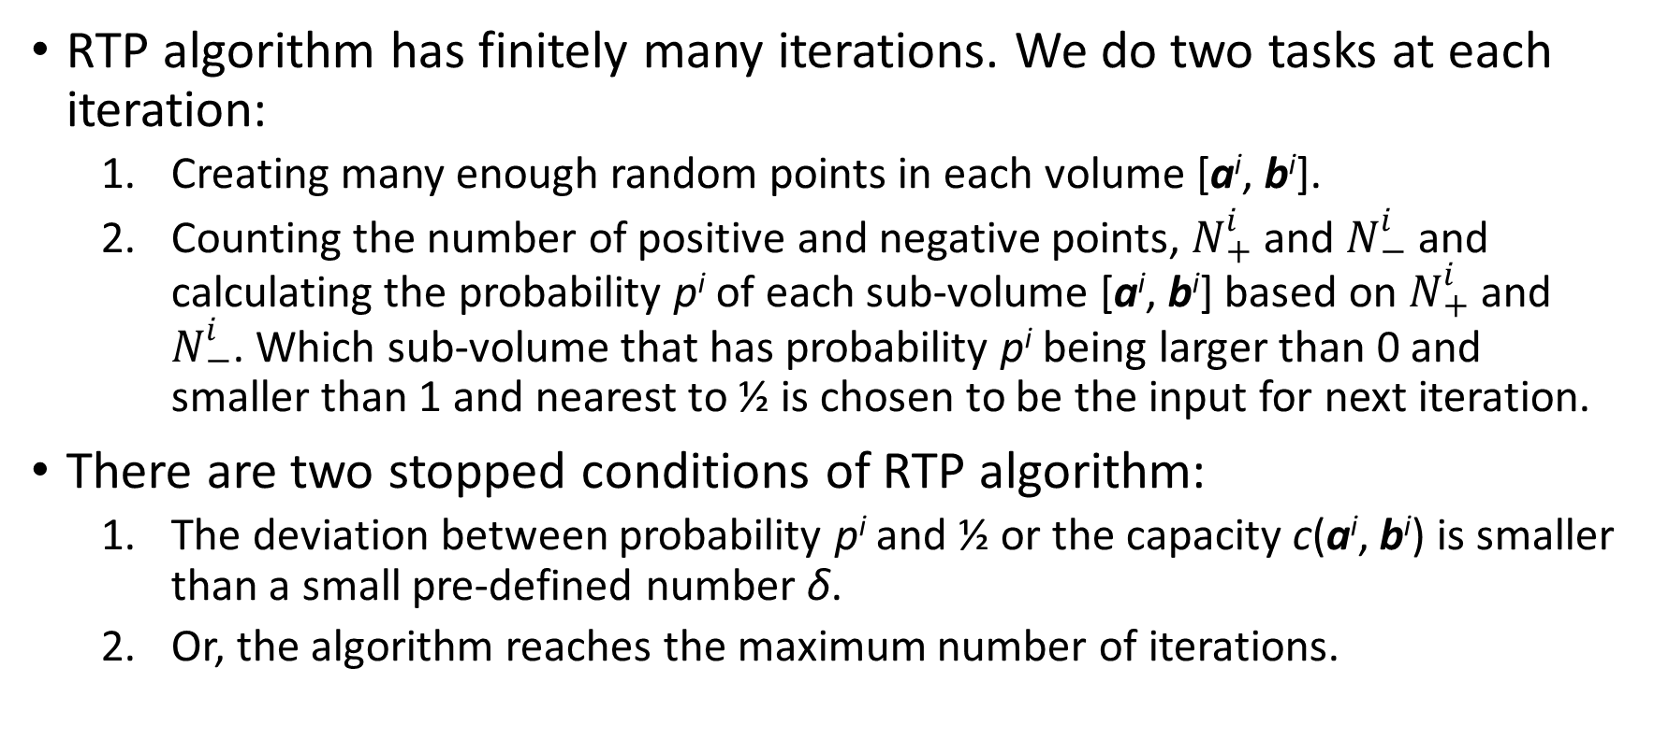
3. How to choose optimal starting point
RTP algorithm has finitely many iterations. We do two tasks at each iteration:
Creating many enough random points in each volume [a^{i}, b^{i}].
Counting the number of positive and negative points, $N_{+}^{i}$ and $N_{−}^{i}$ and calculating the probability p^{i} of each sub-volume [a^{i}, b^{i}] based on $N_{+}^{i}$ and $N_{−}^{i}$. Which sub-volume that has probability p^{i} being larger than 0 and smaller than 1 and nearest to ½ is chosen to be the input for next iteration.
There are two stopped conditions of RTP algorithm:
The deviation between probability p^{i} and ½ or the capacity c(a^{i}, b^{i}) is smaller than a small pre-defined number δ.
Or, the algorithm reaches the maximum number of iterations.

Slide 10
Conclusions
The essence of DR algorithm is to solve the linear system equation many enough times, which aims to solve intersection equation. In other words, the hazard problem of global optimization is turned back the most common problem with note that linear equation system is always solvable.
In general, I combine three algorithms such as DR, SNR, and RTP to solve the hazard problem of global optimization, in which DR is backbone to connect itself with SNR and RTP.
DR algorithm will be improved significantly if we can predict that intersection equation has no solution before solving it or we can predict the solution volume. In the future, I will research deeply how to approximate such equation into simpler forms such as exponent function and polynomial in order to apply easily prediction tools.

Slide 11
Conclusions
I suggest a so-called segmentation approach for solution prediction, in which the solution volume is split into many small enough segments.
Later on, for each segment, approximation methods such as feasible length and minimizing square error are applied to approximate intersection equation by a Taylor polynomial in such segment so that it is accurate to predict solution volume of such polynomial.
Final solution volume of intersection equation is the best one from many polynomials over all segments. This approach shares the same ideology of volume partitioning with RTP algorithm. It can be more complicated but better than RTP.

Slide 12
Thank you for your attention

Slide 13
References
M. D. Le and Y. H. Le, “Lecture Notes on Optimization,” Vietnam Institute of Mathematics, Hanoi, 2014.
S. Boyd and L. Vandenberghe, Convex Optimization, New York, NY: Cambridge University Press, 2009, p. 716.
Y.-B. Jia, “Lagrange Multipliers,” 2013.
A. P. Ruszczyński, Nonlinear Optimization, Princeton, New Jersey: Princeton University Press, 2006, p. 463.
Wikipedia, “Karush–Kuhn–Tucker conditions,” Wikimedia Foundation, 4 August 2014. [Online]. Available: http://en.wikipedia.org/wiki/Karush–Kuhn–Tucker_conditions. [Accessed 16 November 2014].
P. D. Ta, “Numerical Analysis Lecture Notes,” Vietnam Institute of Mathematics, Hanoi, 2014.
T. Hoang, Convex Analysis and Global Optimization, Dordrecht: Kluwer, 1998, p. 350.
J. Kennedy and R. Eberhart, “Particle Swarm Optimization,” in Proceedings of IEEE International Conference on Neural Networks, 1995.
Wikipedia, “Particle swarm optimization,” Wikimedia Foundation, 7 March 2017. [Online]. Available: https://en.wikipedia.org/wiki/Particle_swarm_optimization. [Accessed 8 April 2017].
R. Poli, J. Kennedy and T. Blackwell, “Particle swarm optimization,” Swarm Intelligence, vol. 1, no. 1, pp. 33-57, June 2007.
Wikipedia, “Quasi-Newton method,” Wikimedia Foundation, 4 April 2017. [Online]. Available: https://en.wikipedia.org/wiki/Quasi-Newton_method. [Accessed 8 April 2017].
H. Jiao, Z. Wang and Y. Chen, “Global optimization algorithm for sum of generalized polynomial,” Applied Mathematical Modelling, vol. 37, no. 1-2, pp. 187-197, 18 February 2012.
T. Larsson and M. Patriksson, “Global optimality conditions for discrete and nonconvex optimization - With applications to Lagrangian heuristics and column generation,” Operations Research, vol. 54, no. 3, pp. 436-453, 21 April 2003.
P. Dawkins, “Gradient Vector, Tangent Planes and Normal Lines,” Lamar University, 2003. [Online]. Available: http://tutorial.math.lamar.edu/Classes/CalcIII/GradientVectorTangentPlane.aspx. [Accessed 2014].
V. H. H. Nguyen, Linear Algebra, Hanoi: Hanoi National University Publishing House, 1999, p. 291.
R. L. Burden and D. J. Faires, Numerical Analysis, 9th Edition ed., M. Julet, Ed., Brooks/Cole Cengage Learning, 2011, p. 872.
L. Nguyen, “Feasible length of Taylor polynomial on given interval and application to find the number of roots of equation,” International Journal of Mathematical Analysis and Applications, vol. 1, no. 5, pp. 80-83, 10 January 2015.
L. Nguyen, “Improving analytic function approximation by minimizing square error of Taylor polynomial,” International Journal of Mathematical Analysis and Applications, vol. 1, no. 4, pp. 63-67, 21 October 2014.
Wikipedia, “Sturm’s theorem,” Wikimedia Foundation, 2014. [Online]. Available: https://en.wikipedia.org/wiki/Sturm%27s_theorem. [Accessed 30 August 2014].

