Slide 1
STUDYTRAX BioTrax·draft
Biobanking, inside StudyTrax
A walkthrough of our working design — built to be reshaped by your requirements today.
Prepared for the CSNK2A1 Foundation · working session · every screen is a live, clickable prototype · everything is a proposal
ScienceTrax · August 2026

Slide 2
STUDYTRAX BioTrax·draft
How to read this deck
Blue = what we propose. Gold = what we're asking you.
• Every screenshot is the live prototype, not a mockup — after today we change it and you watch it evolve at the same link.
• Two areas we think we've solved — kit definition and receiving — are presented specifically so you can challenge them.
• Three frames at the end are the real work: alignment, gaps from your perspective, and how we proceed.
FOR DISCUSSION Interrupt anywhere. The best version of this design is the one you argue with.

Slide 3
STUDYTRAX BioTrax·draft
The shape: one bank, inside your study platform
Your organization
storage fleet · kit template library · label formats · sample types
Each study
specimen schedule (visits AND surgical events) · its own frozen kit copies · collection entities like Lab Values
Each visit · clinical event · kit-by-mail return
specimens collected onto the study record, visible instantly
The bank (one menu item)
receiving · processing · storage · requests · shipments · results · custody · capacity
FOR DISCUSSION Same subjects, visits, forms, and audit trail your teams already use — the bank is not another silo.

Slide 4
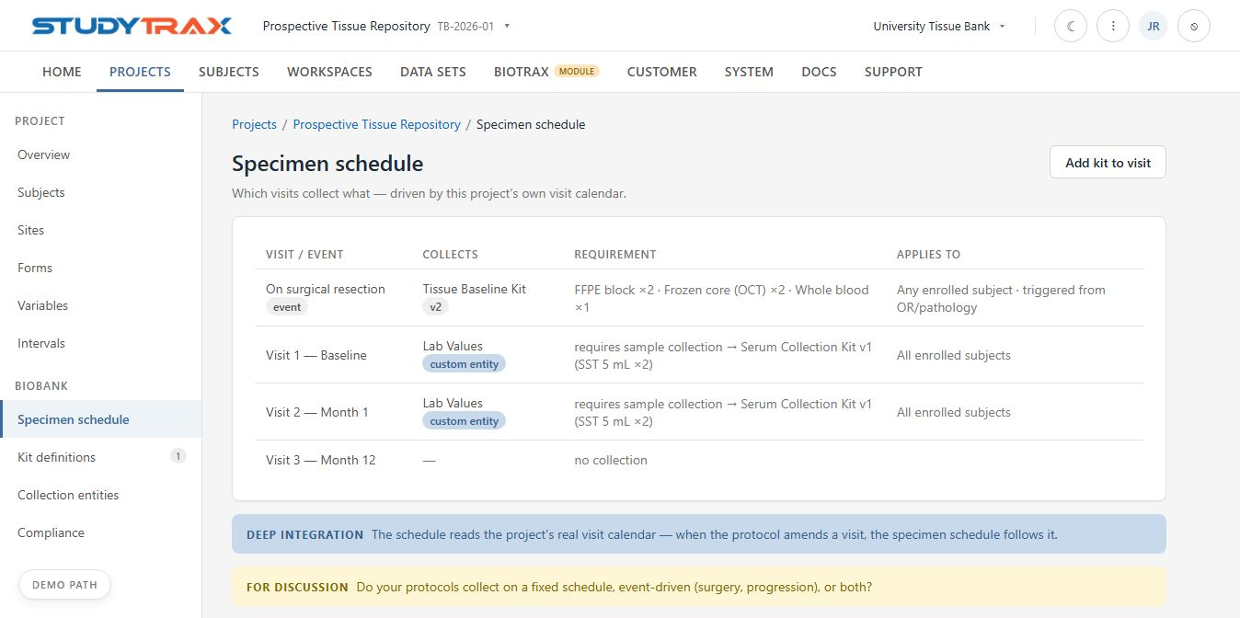
Specimen schedule — calendars AND surgical events
STUDYTRAX BioTrax·draft
Collection driven by the protocol: scheduled visits, or triggered from the OR / pathology.
FOR DISCUSSION Do your protocols collect on a study calendar, on clinical events, or when a family's kit comes back by mail?

Slide 5
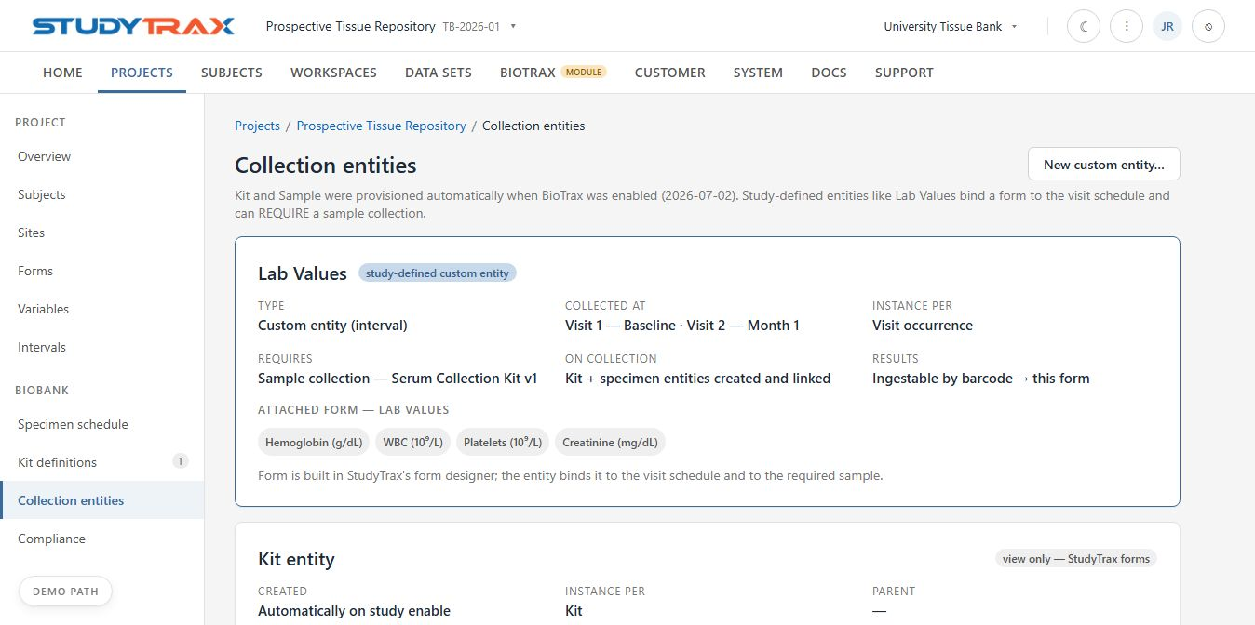
Lab Values — an assessment that requires a specimen
STUDYTRAX BioTrax·draft
A study-defined entity: bound to Baseline and Month 1, its form built in StudyTrax, and it REQUIRES a sample collection.
FOR DISCUSSION Which of your assessments need a specimen attached? Who defines them — the bank or the study team?

Slide 6
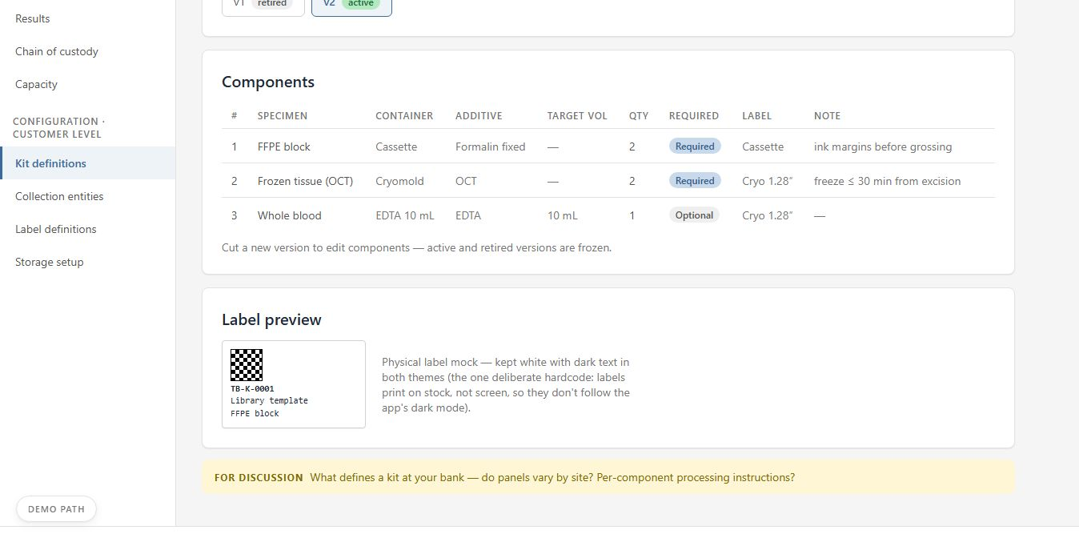
Kit design — a shared library, frozen per study
STUDYTRAX BioTrax·draft
Versioned templates; studies clone frozen copies so a running protocol never changes underneath you.
FOR DISCUSSION Who owns kit definitions at your organization? Do sites need variants of the same kit?

Slide 7
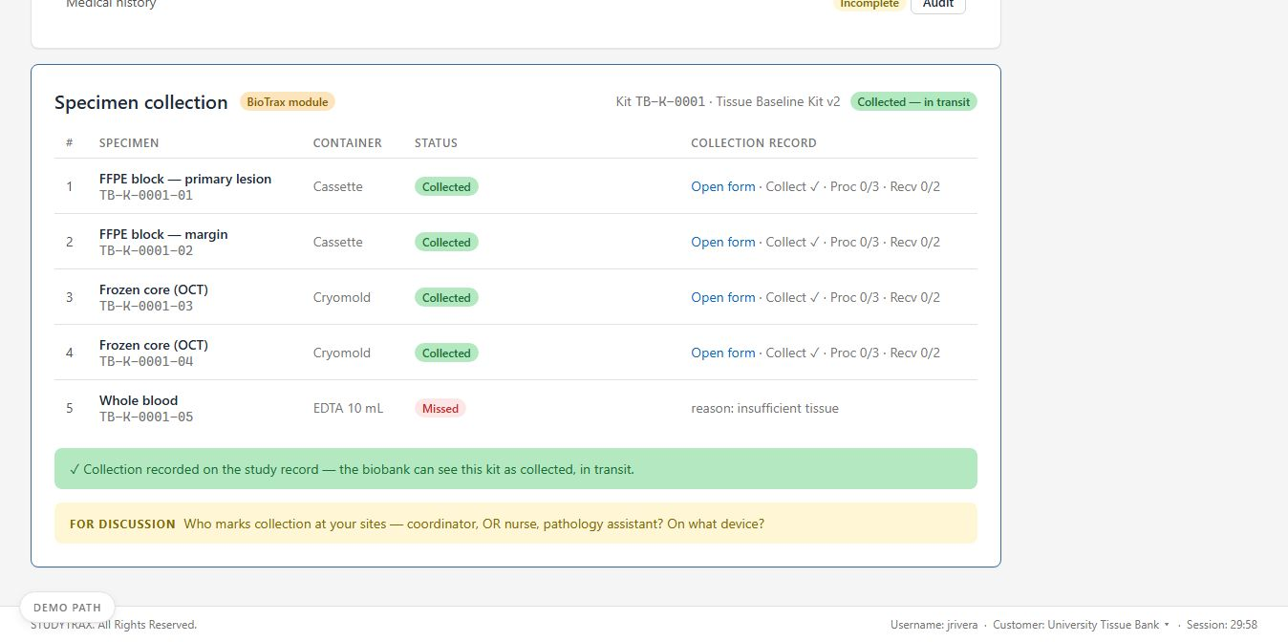
Collection — on the subject's study record
STUDYTRAX BioTrax·draft
Each specimen marked collected or missed at the event; the study team sees it the same minute.
FOR DISCUSSION Who marks collection at your sites — coordinator, OR nurse, pathology assistant? On what device?

Slide 8
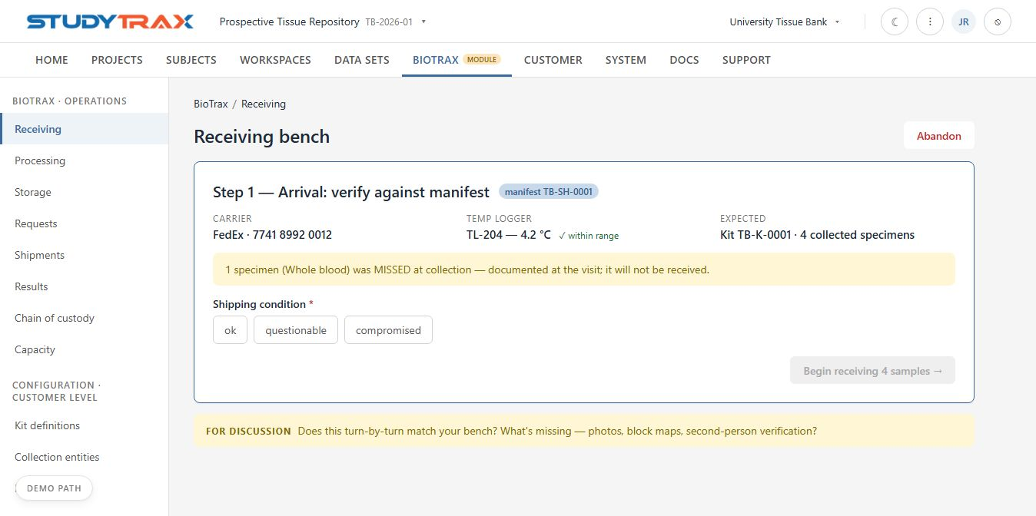
Receiving 1 of 2 — arrival, verified against the manifest
STUDYTRAX BioTrax·draft
Carrier, temperature logger, expected contents — and the missed specimen documented, not lost.

Slide 9
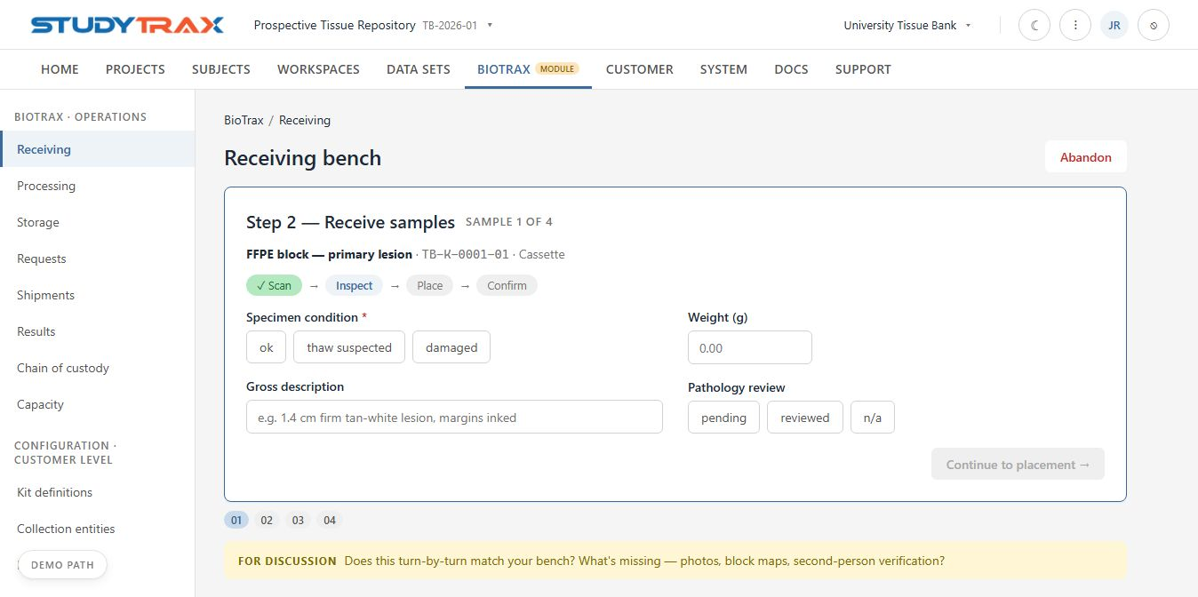
Receiving 2 of 2 — every sample, turn by turn
STUDYTRAX BioTrax·draft
Scan → inspect (condition, gross description, weight, pathology review) → place → confirm. Answers land on the StudyTrax form — audited, never retyped.
FOR DISCUSSION Does this match your bench? What's missing — photos, block maps, second-person verification?

Slide 10
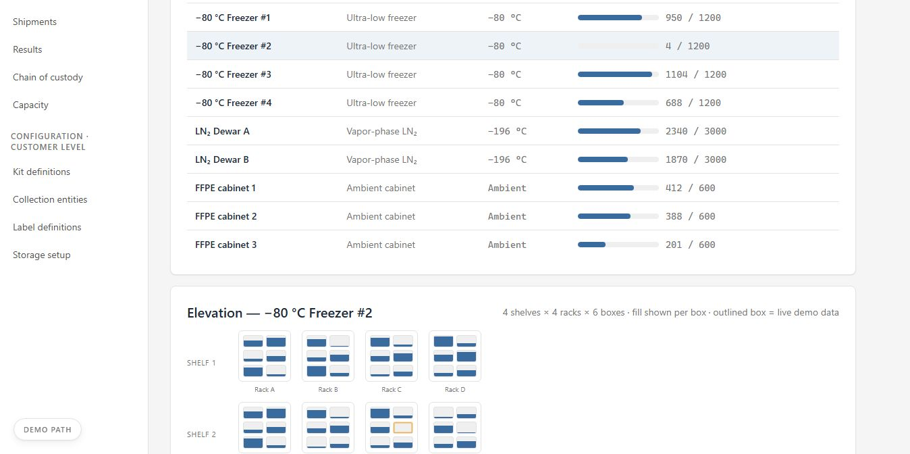
Storage — the physical world, modeled
STUDYTRAX BioTrax·draft
Sites → freezers → shelves → racks → boxes → positions, with fill shown at every level.
FOR DISCUSSION Map your real fleet: how many units, which sites, what geometry — boxes, canes, cassette drawers?

Slide 11
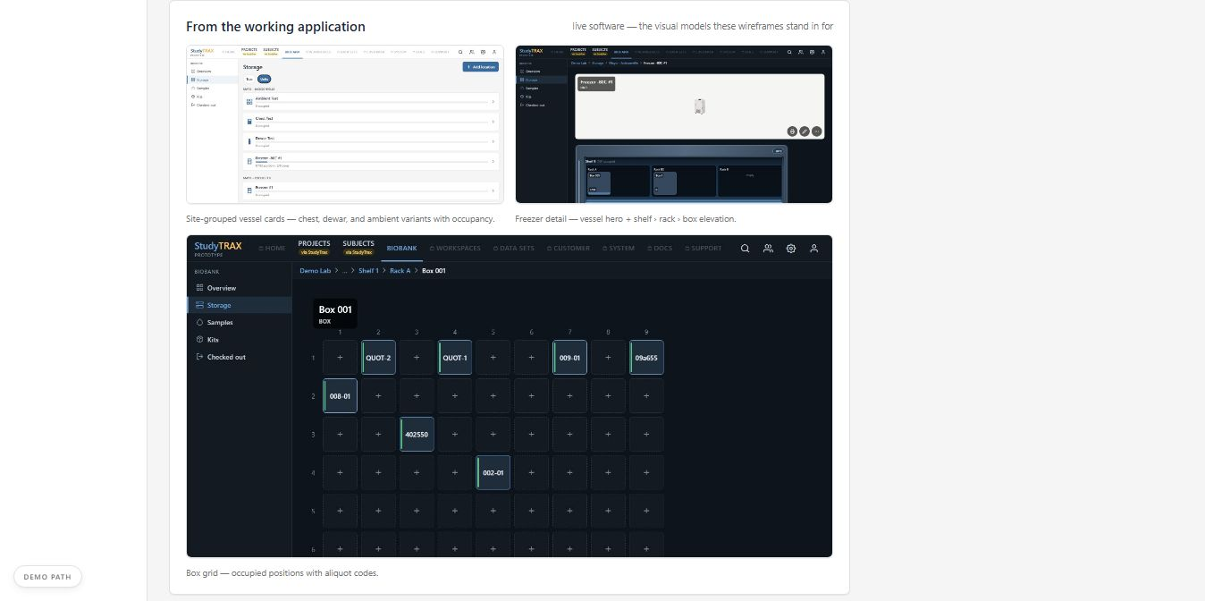
This is live software underneath
STUDYTRAX BioTrax·draft
The working application's storage views — the wireframes stand in front of a real system.

Slide 12
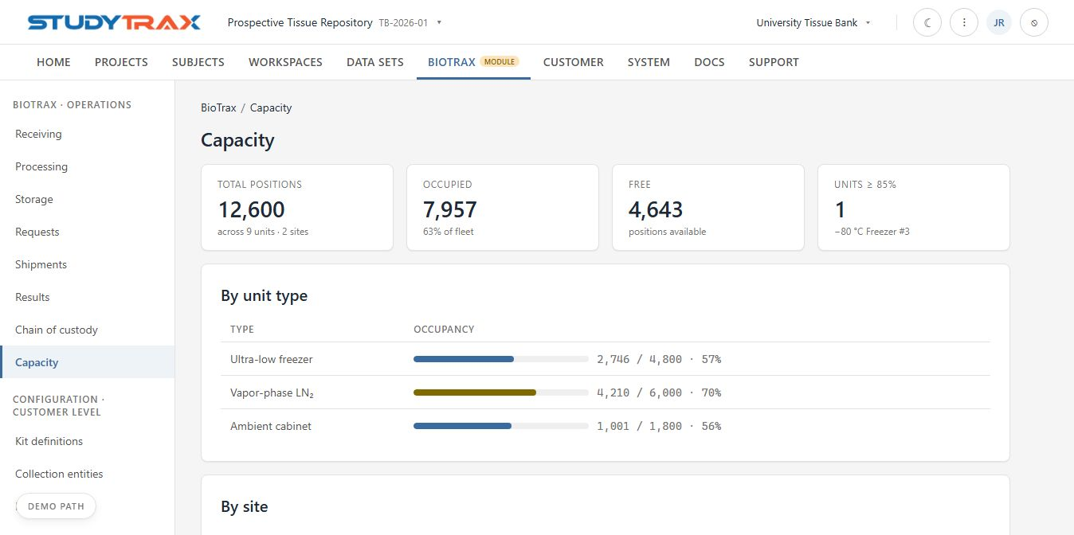
Capacity — see the wall before you hit it
STUDYTRAX BioTrax·draft
Fleet, by type, by site — with warning thresholds.
FOR DISCUSSION What threshold should warn you — 80%? 90%? — and who gets the alert?

Slide 13
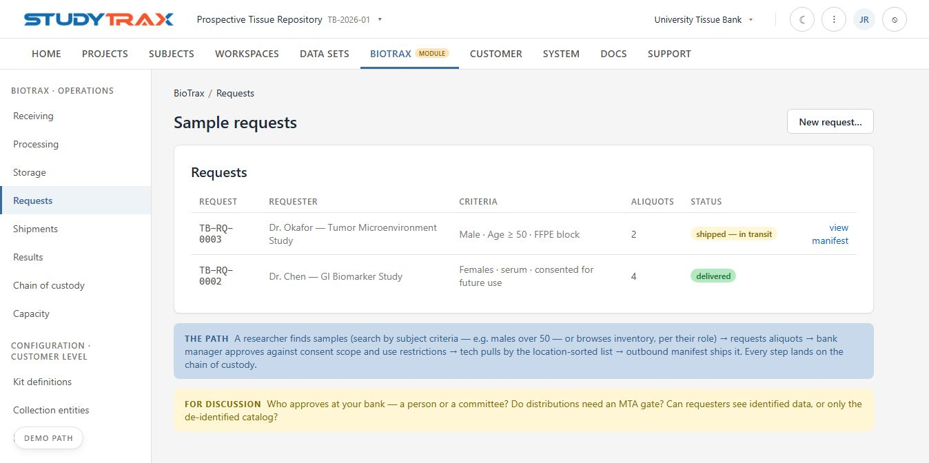
Requests — researchers ask, the bank governs
STUDYTRAX BioTrax·draft
Find samples by subject criteria, request aliquots; approval checks consent scope and use restrictions.
FOR DISCUSSION Who approves at your foundation — an access committee? Do distributions to qualified researchers need an MTA gate?

Slide 14
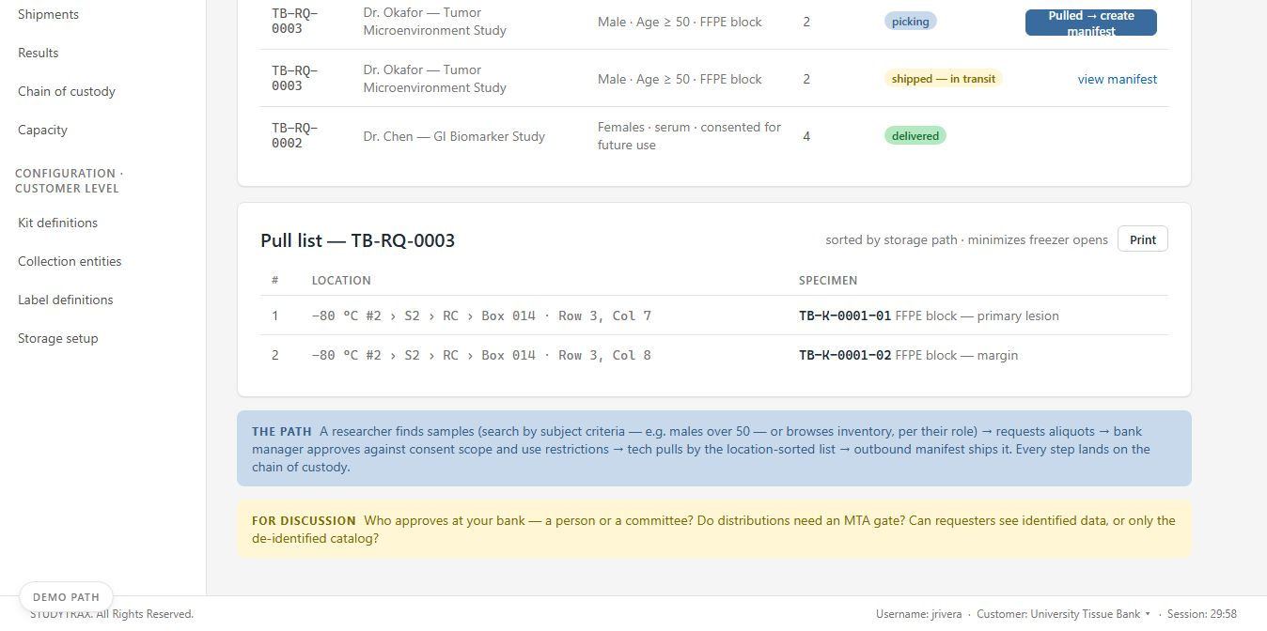
Fulfillment — a pull list sorted by the freezer
STUDYTRAX BioTrax·draft
Location-ordered picking to minimize door-open time; printable for the bench.

Slide 15
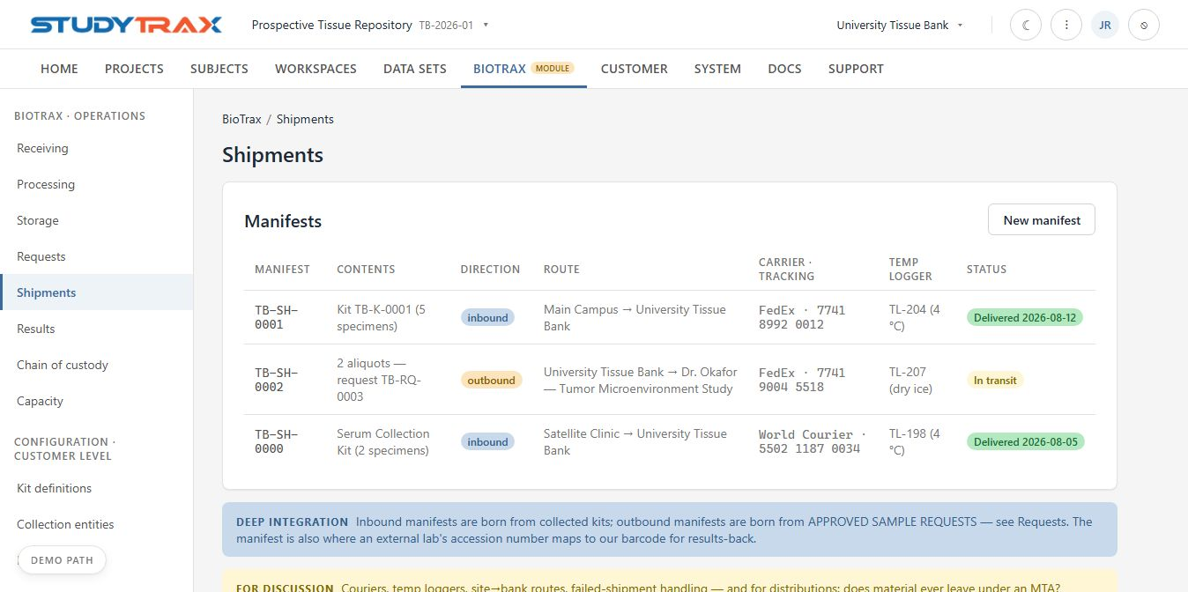
Shipments — both directions, one manifest model
STUDYTRAX BioTrax·draft
Inbound collections and outbound distributions; the manifest is also where an external lab's accession maps to our barcode.
FOR DISCUSSION Couriers, temp loggers, site-to-bank routes — and does material ever leave under an MTA?

Slide 16
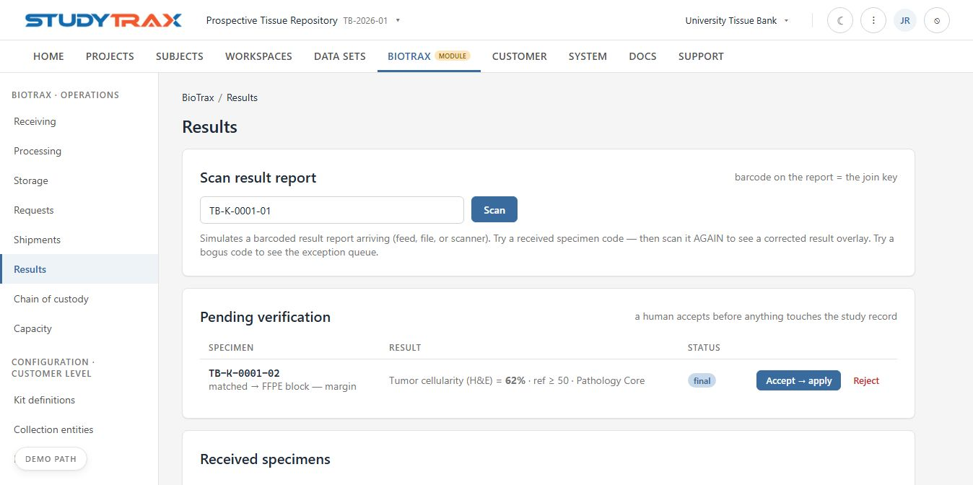
Results — scan it, verify it, it lands on the record
STUDYTRAX BioTrax·draft
Feed, file, or scanned report → matched by barcode → a human verifies → applied to the sample's form. Corrections overlay with full history.
FOR DISCUSSION Where do results come from at your labs — feed, file, portal, paper? Who should approve them?

Slide 17
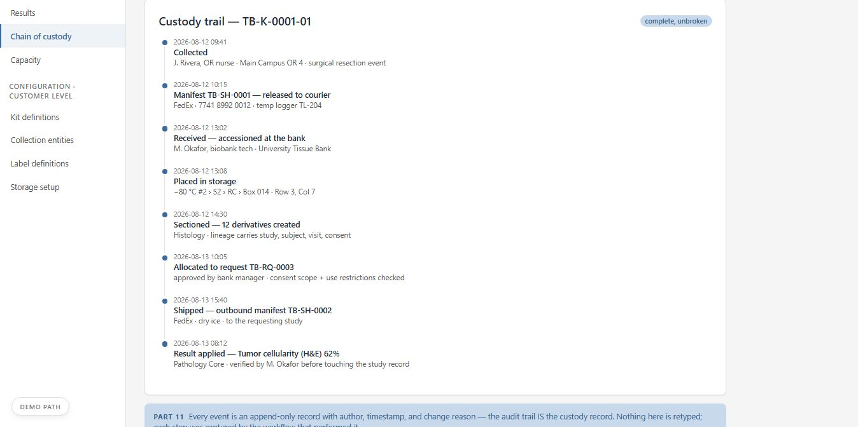
Chain of custody — the whole story, unbroken
STUDYTRAX BioTrax·draft
Collected → shipped → received → placed → allocated → distributed → resulted. Every event carries author, time, and reason.
FOR DISCUSSION Who signs custody transfers today — and does any step need an e-signature rather than a logged author?

Slide 18
STUDYTRAX BioTrax·draft
Alignment — where does this match your world?
Our six bets. Tell us which hold at your bank — and which don't.
1 Collection is decentralized — kit-by-mail from scattered families as often as clinic visits agree / adjust / wrong
2 Receiving is the bank's quality gate — turn-by-turn, not a batch form agree / adjust / wrong
3 Analysis stays in your lab systems; results flow back onto the study record (we are not a LIMS) agree / adjust / wrong
4 Sample requests need governance: consent stewardship, use restrictions, an access approver agree / adjust / wrong
5 One catalog, role-scoped — bench staff and researchers see different doors into the same bank agree / adjust / wrong
6 The specimen record belongs on the study record — StudyTrax-native, audited, exportable agree / adjust / wrong

Slide 19
STUDYTRAX BioTrax·draft
Gaps — from your perspective
We capture these live. Three columns; the prompts below are ours — the content is yours.
MISSING
Things your bank does that you haven't seen today
DIFFERENT
Things we showed that work another way at your site
DOESN'T FIT
Things that shouldn't exist in your world at all
Prompts we'll walk: processing depth · consent stewardship & MTA reality · your lab systems (LIMS? Beaker? files?) · volumes, sites, staffing · roles & approvals · reporting for sponsors, IRBs, auditors
FOR DISCUSSION Nothing here is precious. The gaps list becomes the build list.

Slide 20
STUDYTRAX BioTrax·draft
How we proceed
1 Today — Capture your requirements against everything you just saw — the gaps list is the contract.
2 Weeks, not months — We reshape the design and the LIVE prototype around them — same link, versioned, you watch it change.
3 Pilot — Your first tissue protocol configured; your coordinators and bank staff hands-on; we iterate on real friction.
4 Build — The module lands inside StudyTrax — same subjects, forms, and audit trail your teams already trust. Integration work is already staged.
You are the first bank shaping this. Your requirements set the direction.

