Slide 1


Slide 2
What is KDE?

Slide 3
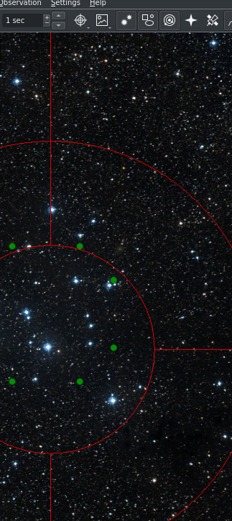
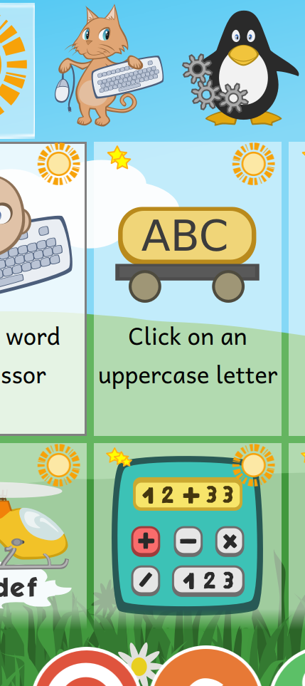
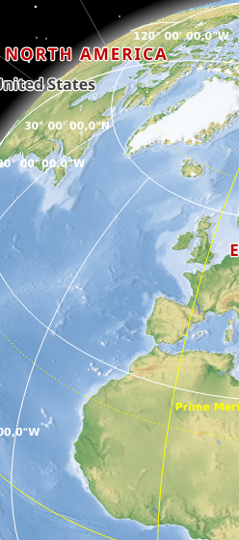
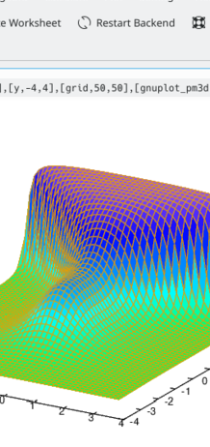
KDE makes Software

Slide 4
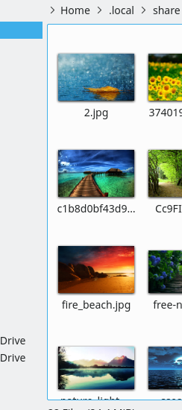
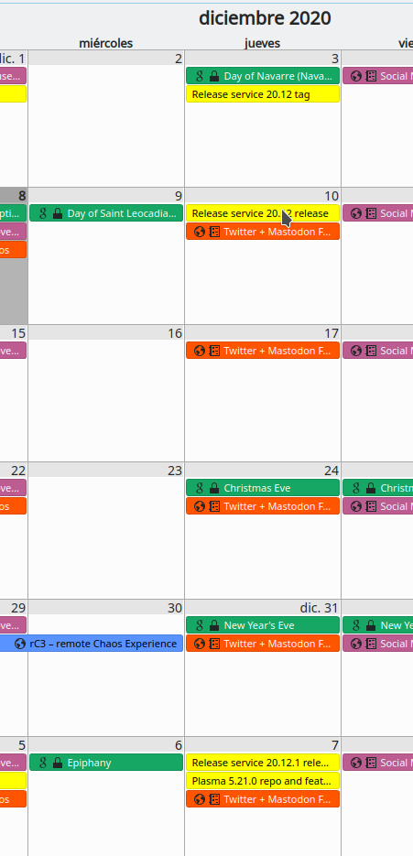
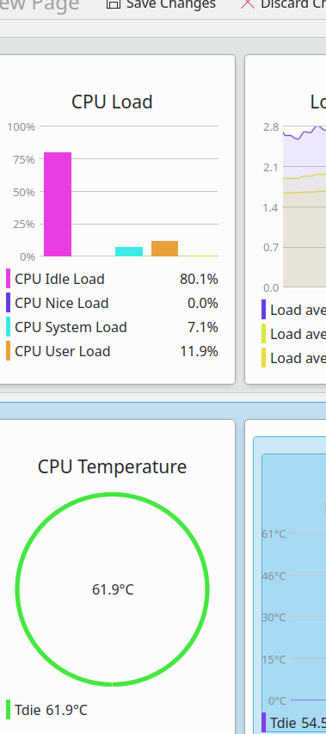
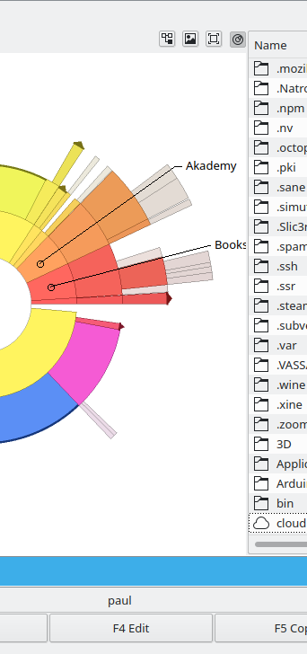
KDE makes Software

Slide 5
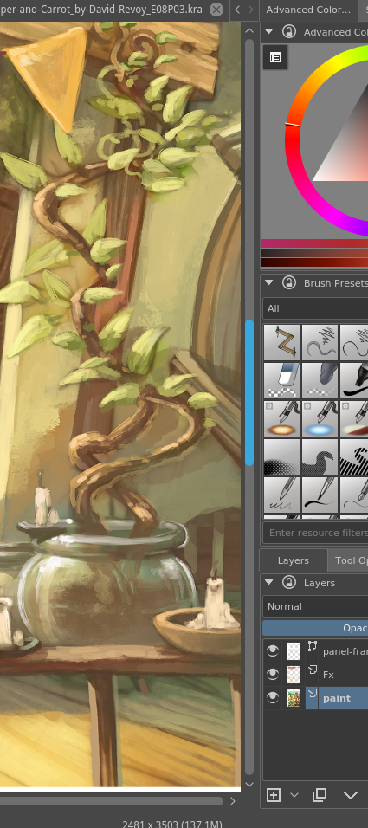
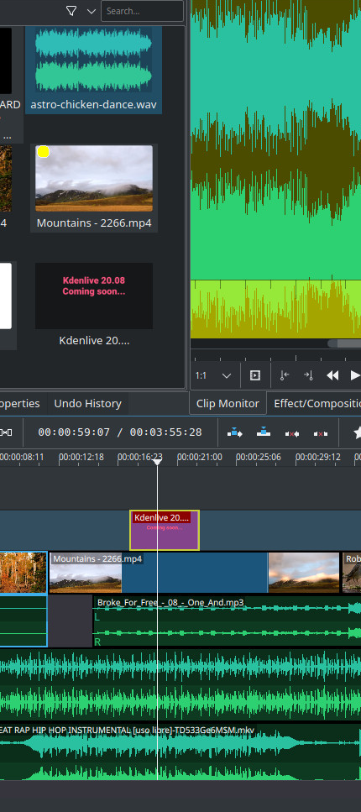
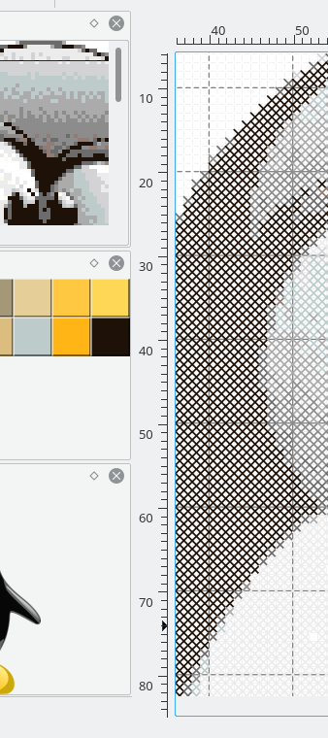
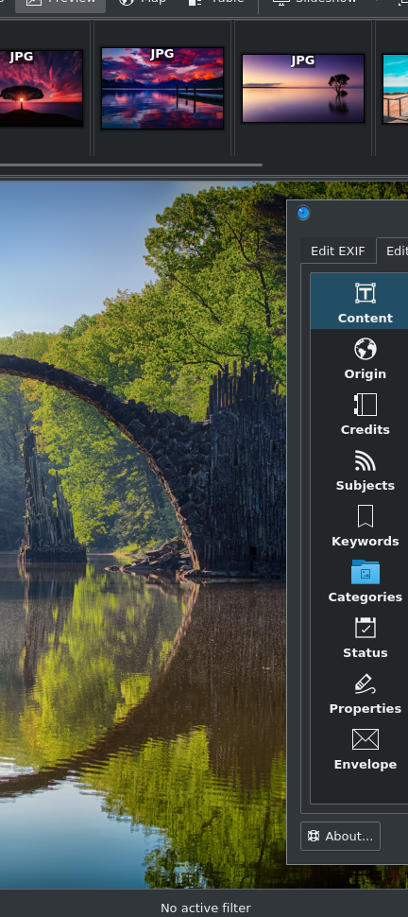
KDE makes Software

Slide 6

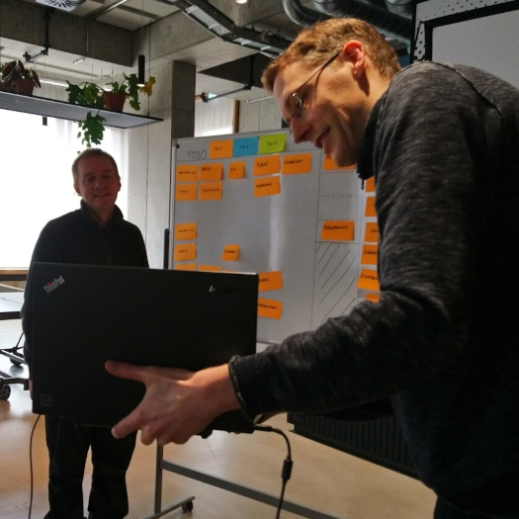
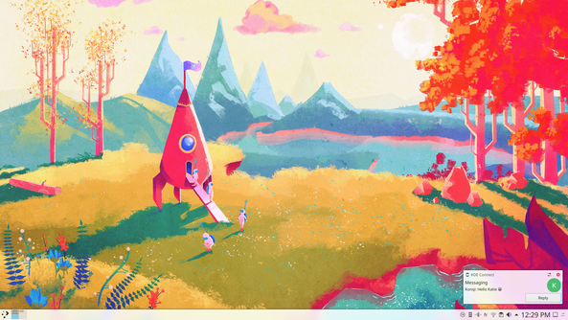

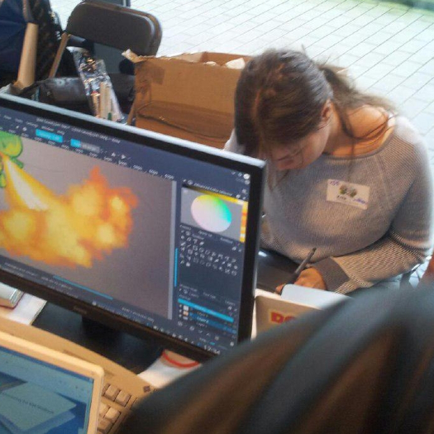
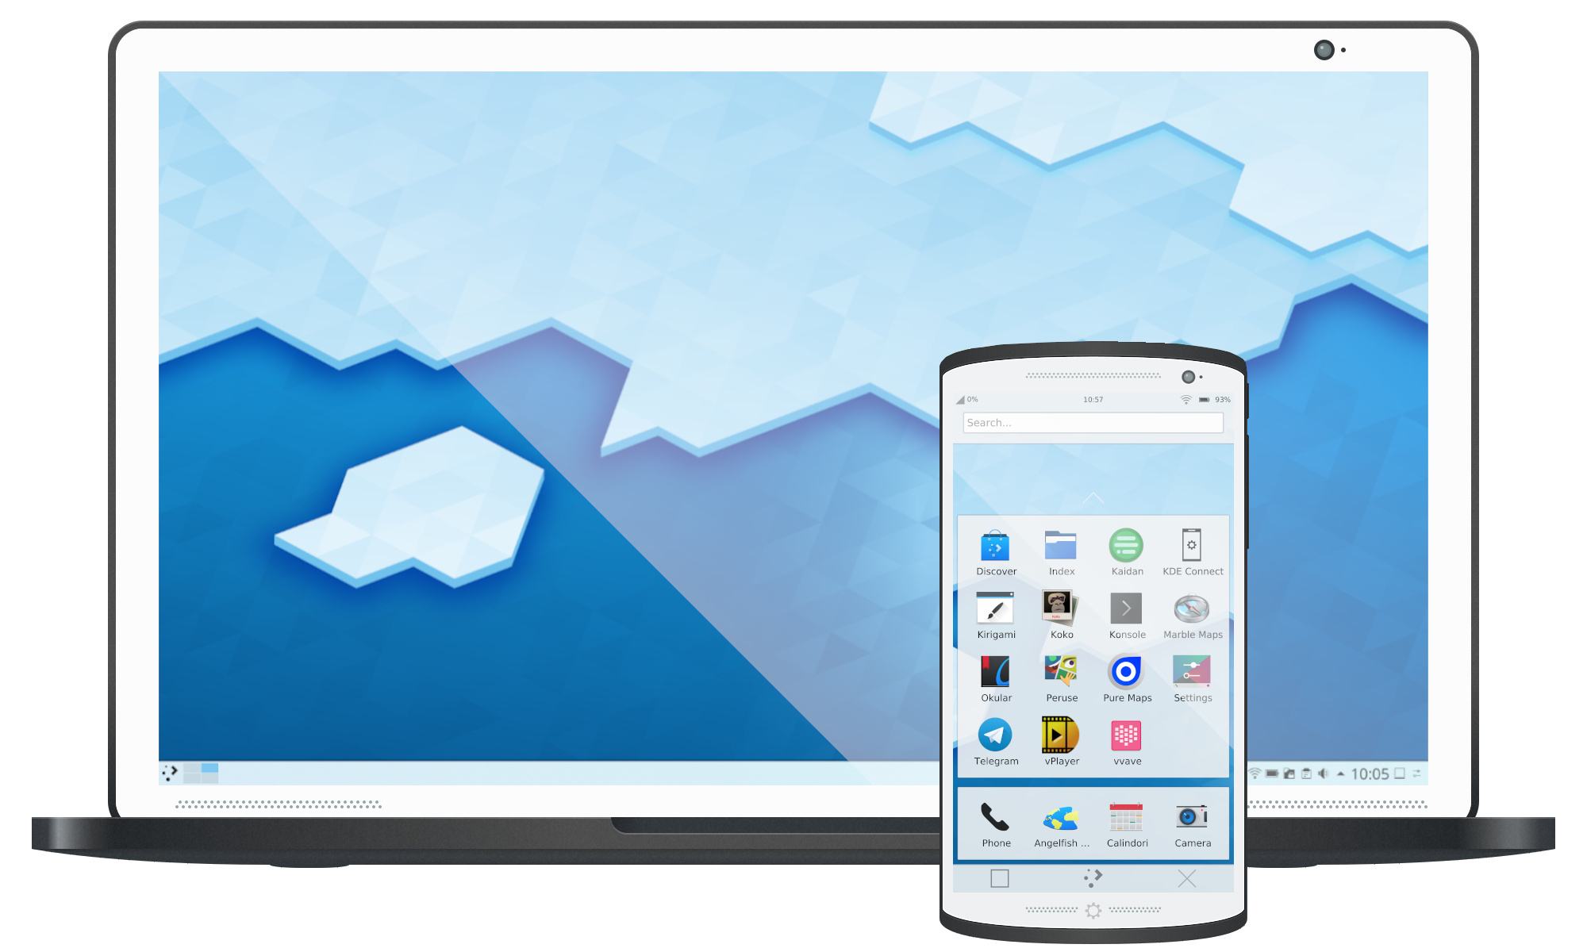
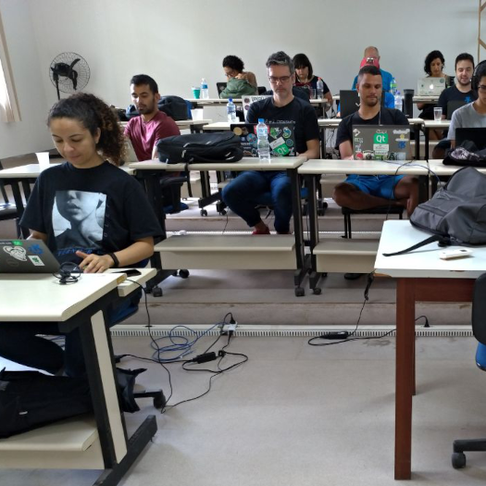
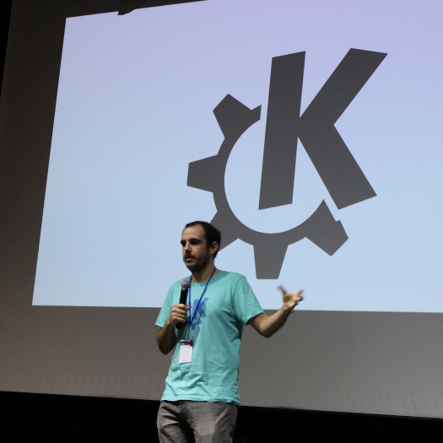
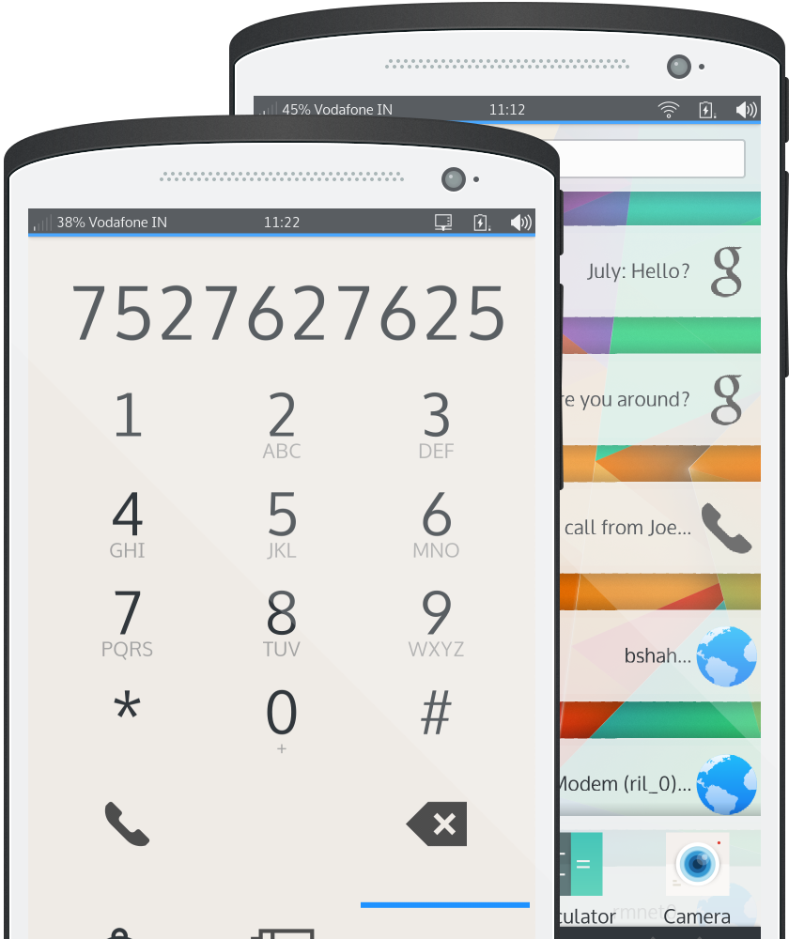
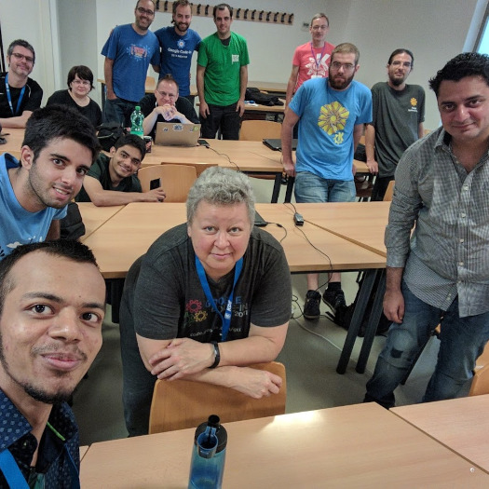
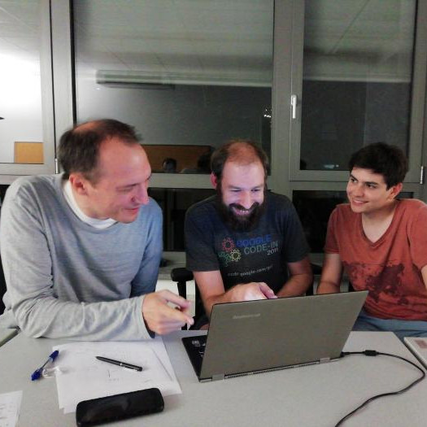
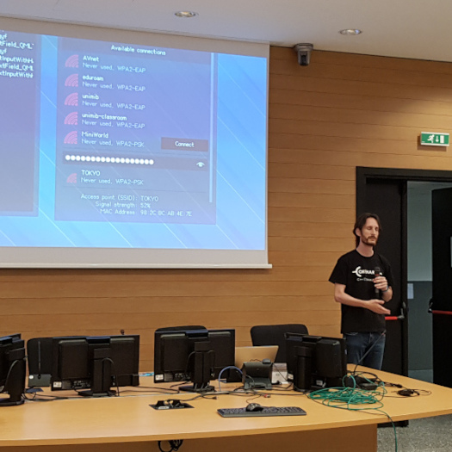
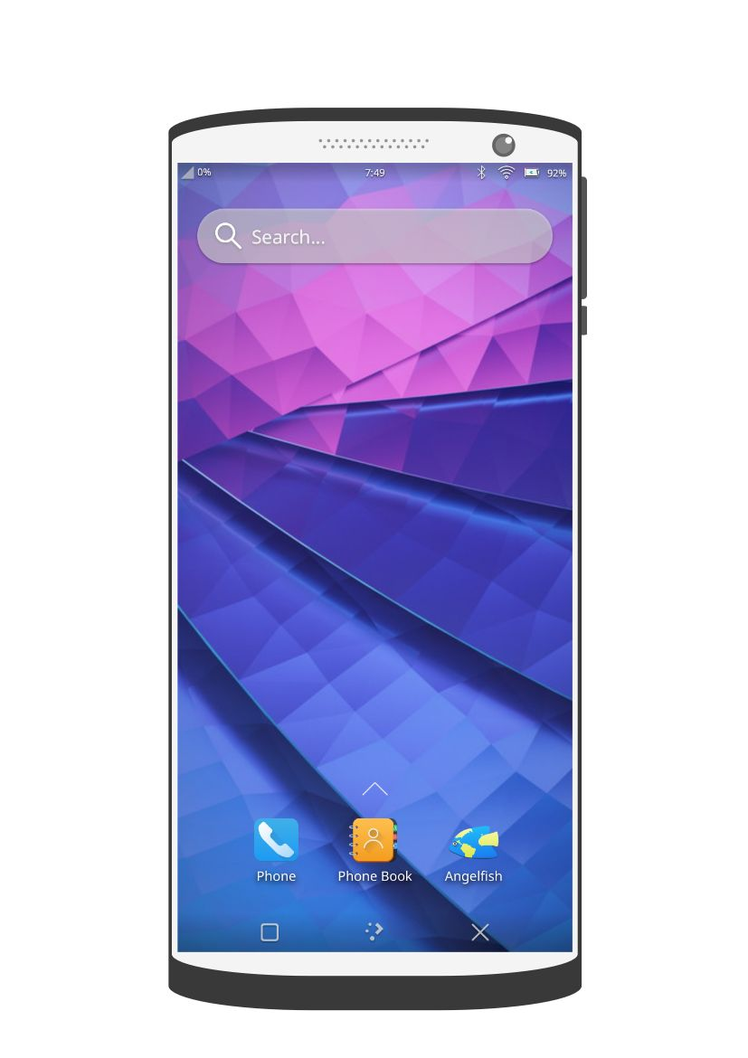
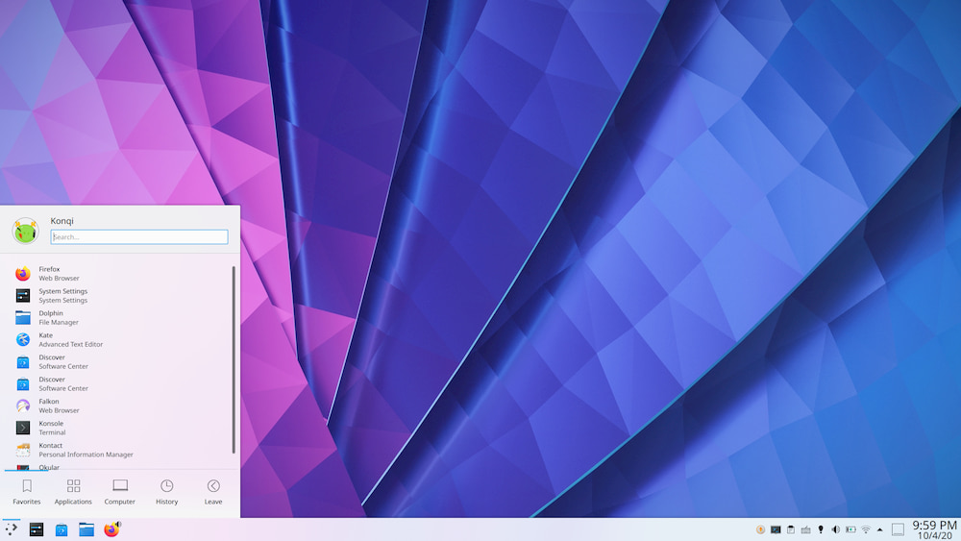

KDE promotes cooperation, freedom, privacy and Open Source

Slide 7
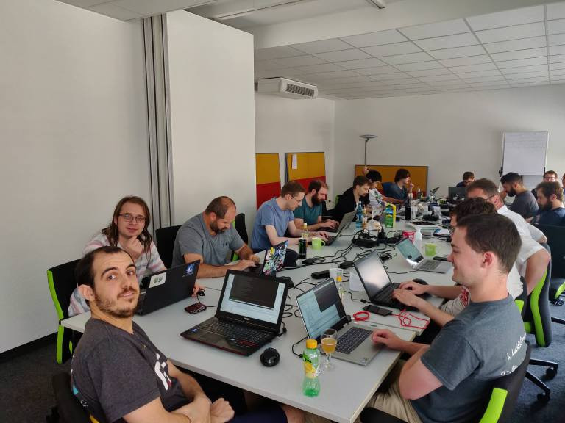
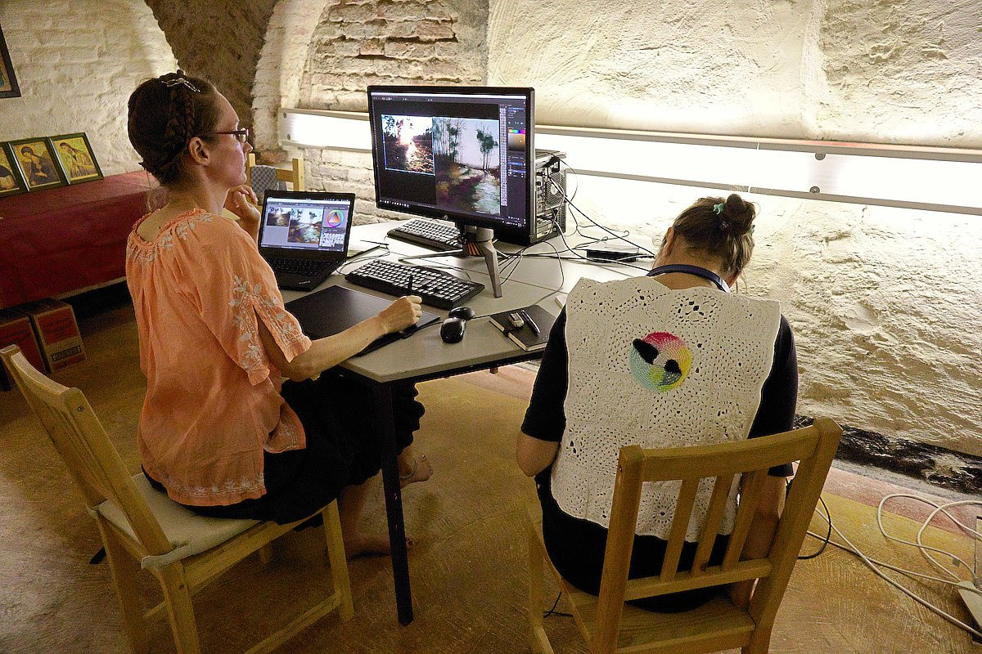
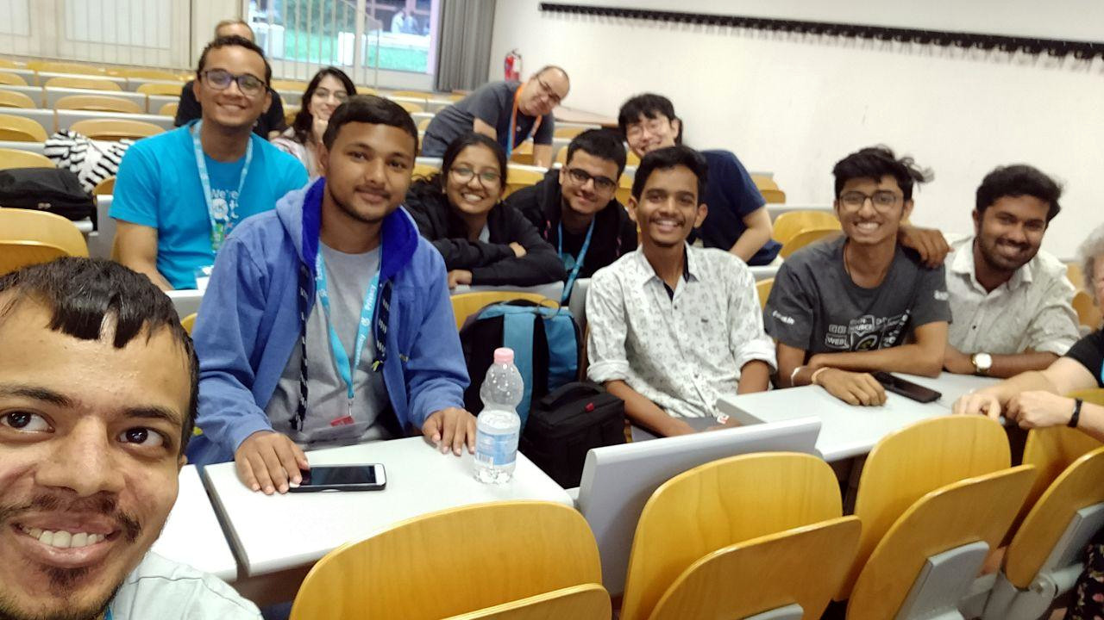


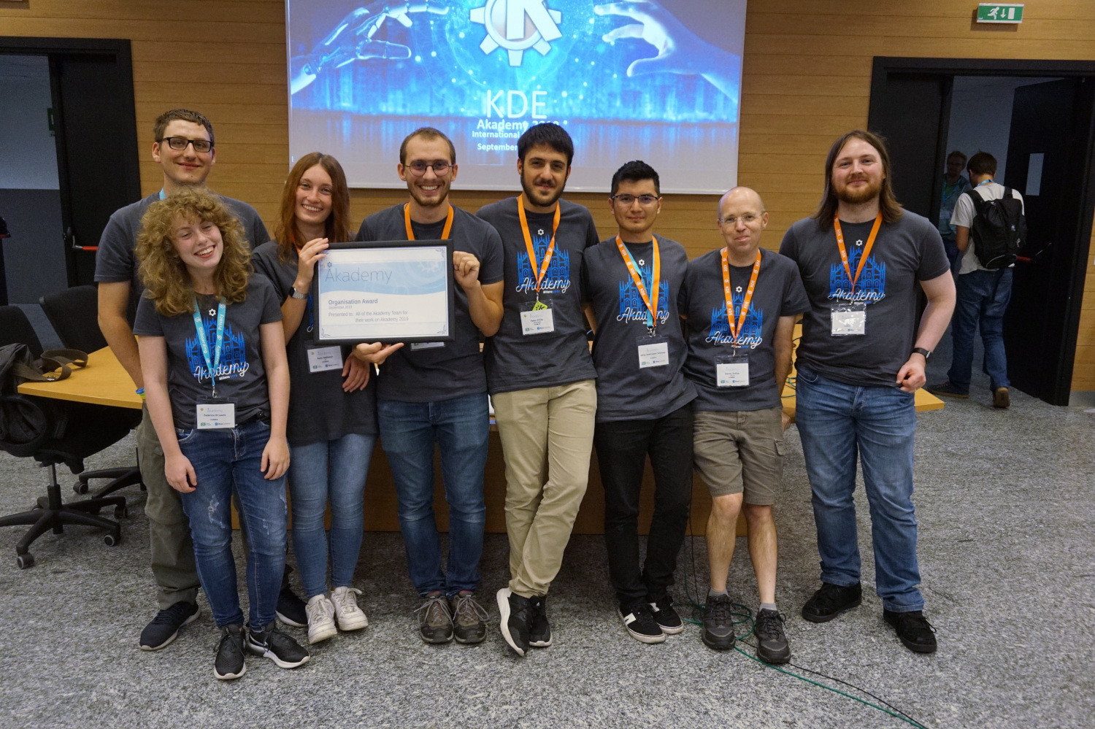
KDE is Community

Slide 8


KDE NETWORK NEPAL
The KDE Network is a group of KDE representatives in their respective cities or countries

Slide 9



Get Involved!
https://community.kde.org/Get_Involved
https://webchat.kde.org/#/room/#kde-welcome:kde.org

Slide 10
Let’s Play Some Games

Slide 11
Game 1
Find out what is the KDE product (Software) whose next version is going to be released very soon and is in beta testing right now.
Fastest will win a prize

Slide 12
Game 2
Install KDE connect on your laptop and your phone.
And connect them with each other.
Fastest will win a prize

Slide 13
Game 3
The first letters of the answers to the following questions in order makes a name of a KDE software. What is it and what does it do?
What does the K in KDE stand for?
What is the 18th alphabet?
What is the vector graphics app that open source and you can make logos with it?
What is the last name(caste) of the creator of Linux?
What is the name of archiving tool of KDE that helps you make or extract zips and tars.
Fastest will win a prize

