Slide 1


Open Source is…
@jwf@floss.social
Notes:
If you have ever heard me present on stage about open source before, you have probably heard me say this…

Slide 2

A method.
@jwf@floss.social
Notes:
Method to develop and distribute software
Set of best practices to make software and build teams that make software

Slide 3

A movement.
@jwf@floss.social
Notes:
Movement based on ideals and philosophy beyond only code
Rooted in belief that software has an impact greater than any one of us and certain freedoms should be protected

Slide 4

A culture.
@jwf@floss.social
Notes:
Collection of people, values, and ideas that take the form of software projects and communities

Slide 5
Agenda
What am I talking about?
I am here to tell a 40+ year old story called Open Source.
What is “free stuff”?
What is the future of working on “free stuff”?
@jwf@floss.social

Slide 6
What is “free stuff”?
@jwf@floss.social
Notes:
Today, I am going to tell you a short story about this “free stuff” we call Open Source. Why do people care so much about this free stuff?

Slide 7
“Free stuff” can mean a lot of things…
@jwf@floss.social

Slide 8
Today, “free stuff” means Open Source and freedom.
@jwf@floss.social

Slide 9
O·pen Source
/ˈōpən sôrs/ adjective
Open Source software is software that can be freely used, modified, and shared (in both modified and unmodified form) by anyone.
The Open Source Definition
v1.9
@jwf@floss.social
Notes:
Here is the definition as defined by the Open Source Initiative. I want to point out all the components listed here. There are some who use the term “open source” in relation to one or more of these, but a product isn’t really open source unless it includes all these components… free to use, remix and share.

Slide 10

F
ree
O
pen
S
ource
S
oftware
@jwf@floss.social

Slide 11







Where is Open Source?
@jwf@floss.social
Notes:
Show of hands:
How many recognize all the logos?
How many recognize at least half?
Open source is everywhere
Your pocket
This/your room
Powering the Internet
There is no Internet without Open Source.

Slide 12
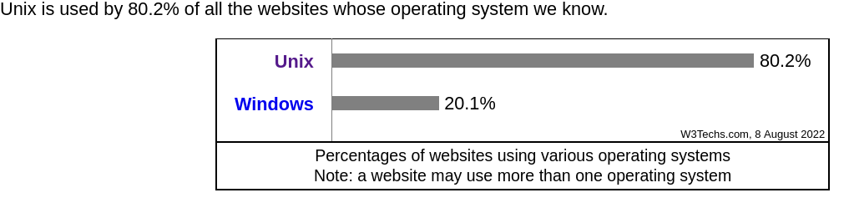
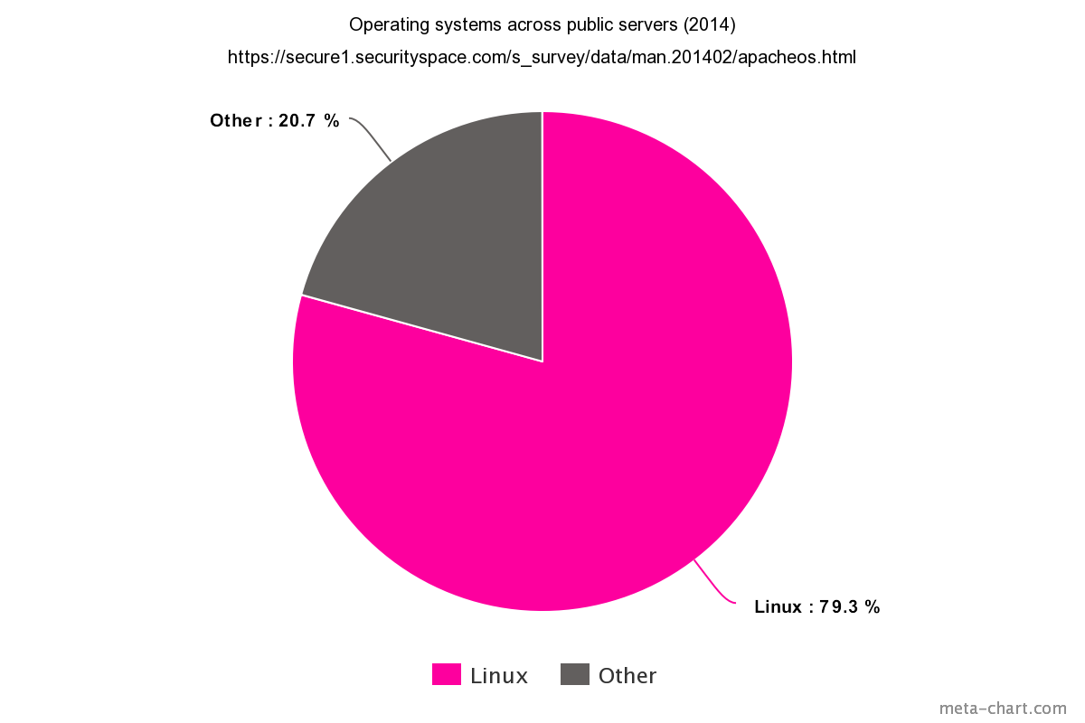

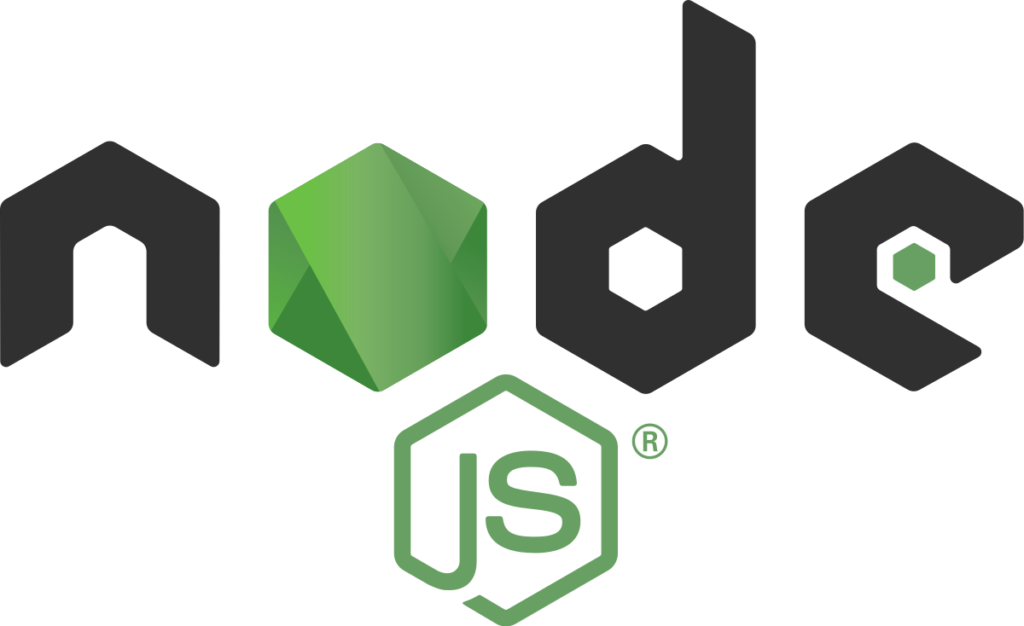


Open Source: on the web
@jwf@floss.social
Notes:
Linux is a free and open source operating system
In 2014, study found 79.3% of all public servers on the Internet ran Linux or other UNIX-like operating system
Eight years later, as recent as August 2022, that number is almost unchanged, sitting at 80.2% according to W3 Tech Surveys
Apache HTTPD web server: Open source web server that delivers web content to browsers
Various other technologies: NodeJS, Python Flask, Ruby on Rails
---
Sources:
https://w3techs.com/technologies/overview/operating_system
---

Slide 13


Open Source: in this room
@jwf@floss.social
Notes:
Linux is a free and open source operating system
In 2014, study found 79.3% of all public servers on the Internet ran Linux or other UNIX-like operating system
Eight years later, as recent as August 2022, that number is almost unchanged, sitting at 80.2% according to W3 Tech Surveys
Apache HTTPD web server: Open source web server that delivers web content to browsers
Various other technologies: NodeJS, Python Flask, Ruby on Rails
---
Sources:
https://w3techs.com/technologies/overview/operating_system
---

Slide 14



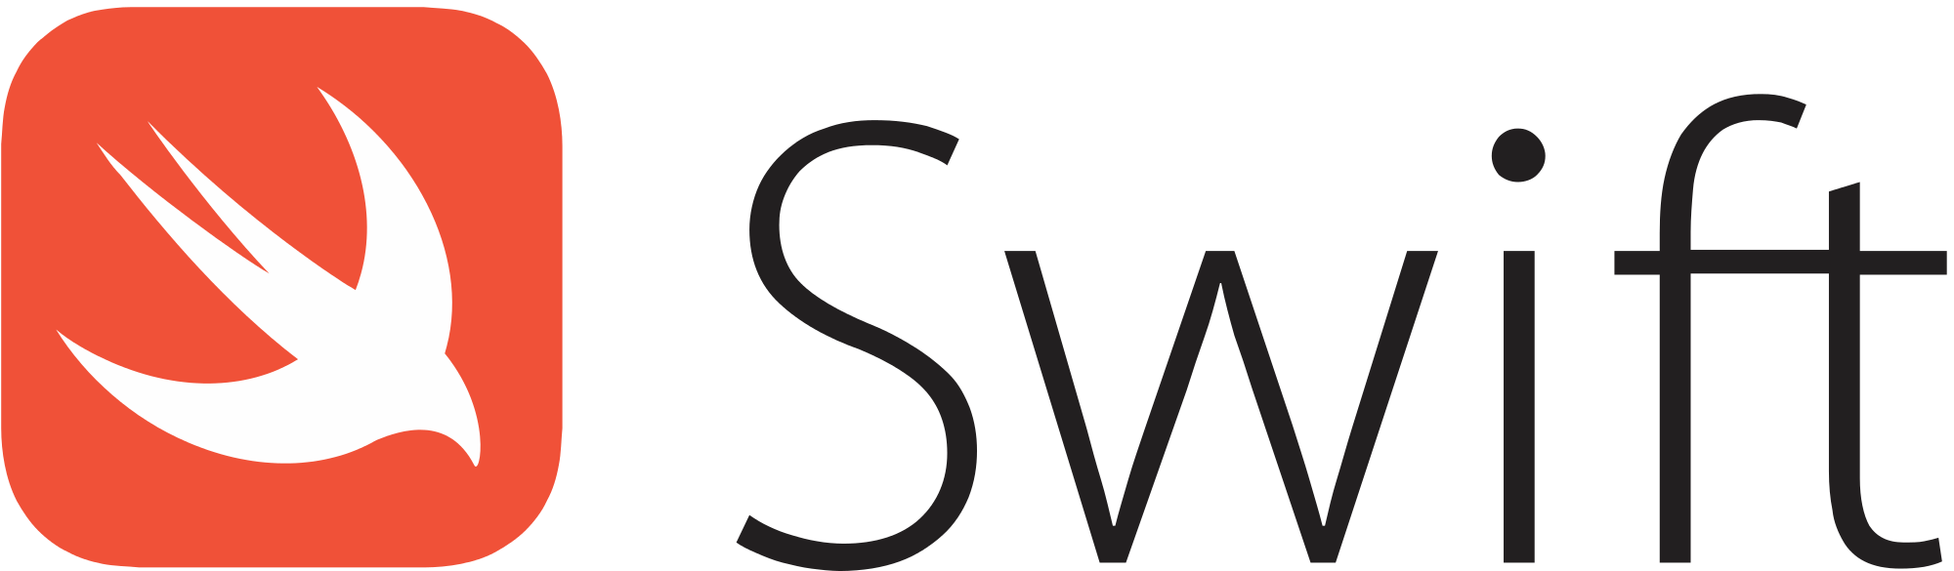
Open Source: in code
@jwf@floss.social

Slide 15
Control
Training
Security
Stability
Public code, but why?
@jwf@floss.social
Notes:
Control:
Always possible to study and understand how it works.
Nobody can tell you what and how to use the software.
Training:
Learning happens in the public.
Connection to a wider ecosystem beyond a closed source work.
Get faster feedback.
Security:
Easier to audit.
Often quick to fix problems due to more eyes.
Stability:
Build on open, common standards.
Improved interoperability.
Easier to fork and continue on, if needed.

Slide 16
Linus's Law: Given enough eyeballs, all bugs are shallow.
@jwf@floss.social
Slides: j.jwf.io/GNOMEAsia23
Notes:
In August 2001, Red Hat published a whitepaper, which has a whole section called “Strength in Numbers: The Security of “Many Eyeballs” and says:
> “The security benefits of open source software stem directly from its openness. Known as the “many eyeballs” theory, it explains what we instinctively know to be true – that an operating system or application will be more secure when you can inspect the code, share it with experts and other members of your user community, identify potential problems, and create fixes quickly.”

Slide 17
The Open Source story not taught in school??
@jwf@floss.social

Slide 18
“First they ignore you, then they laugh at you, then they fight you, then you win.”
1980s
1990s
2000s
2010s
A famously
misattributed quote
@jwf@floss.social
Notes:
First, by show of hands: how many of you in this room have heard the quote, “First they ignore you, then they laugh at you, then they fight you, then you win”?
*pause, then transition*
We can describe the history of the open source movement to this quote.

Slide 19


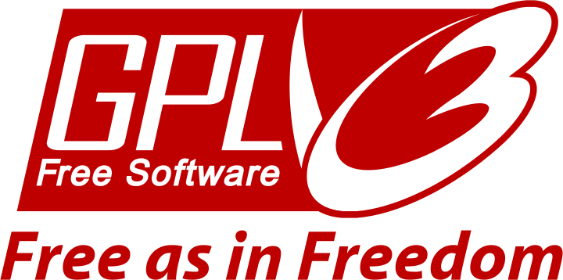
First they ignore you.
@jwf@floss.social
Notes:
1983 – GNU:
Beginning of the free culture movement applied to software / technology
MIT Media Lab
A man named Richard Stallman worked there as a researcher / faculty
Lived through a period of open access to software
Commercial market shift to software (from hardware) was a paradigm shift in how software was used and distributed
Motivated belief that software should protect the user and respect their rights
How to act on it? Define your values and build an Open Source operating system.
1985 – FSF:
Founded in part by Stallman; helped sustain efforts on GNU operating system
First notable institution to protect and embrace free software
Advocated for many parts of free culture movement outside of written code only
1989 – GPL:
Drafted by Free Software Foundation
Technically not very first, but the first of its kind: introducing copyleft
Marked a significant shift in perspective on the way software is developed and how we distribute and share it with each other

Slide 20

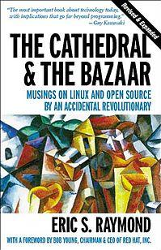
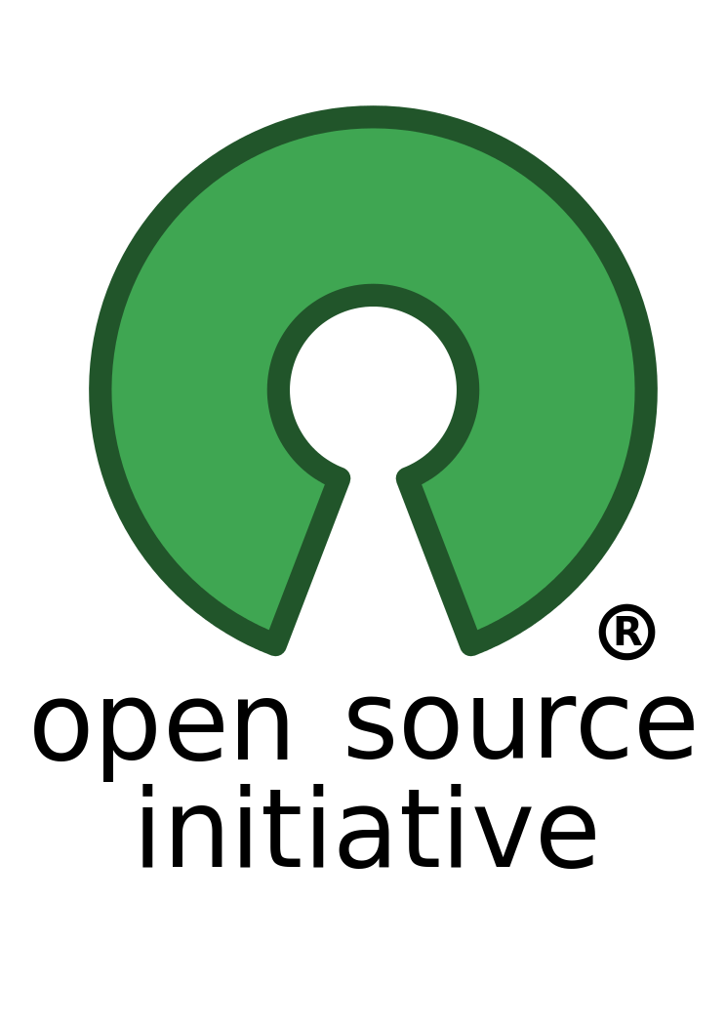
They they laugh at you.
@jwf@floss.social
Notes:
1991 – Linux kernel:
One of the earliest open source projects
Also an early adopter of the GPL
Linux kernel development practices shaped a decade of the free culture movement inside of technology world
1997 – Cathedral & Bazaar:
Open source goes mainstream
International breakthrough came in late 1990s, partially marked by The Cathedral and the Bazaar
Book to describe two significantly different models of software development
Cathedral == closed / proprietary software development
Bazaar == open / free software development
One problem: business world thinks the word “free” is scary!!
1998 – Open Source Initiative:
OSI forms in 1998 to act as a liaison between free culture movement to business world
Convincing the business world that “free” does not mean “no bottom line”
First usages of term “open source software” emerge around this time

Slide 21
Then they fight you.
“…open source is an intellectual property destroyer. I can't imagine something that could be worse than this for the software business and the intellectual-property business.”
Microsoft, 2001 (Jim Allchin)
@jwf@floss.social
Notes:
In the early 2000s, the tides had not yet turned. Open Source was this weird, gross thing that businesses and companies wanted nothing to do with.
Microsoft made their feelings no secret. Top executives in Microsoft have famously trashed open source and free software in the early 2000s. This quote from Jim Allchin is notable. (*read*)
Also notable is other Microsoft executives at the time calling Linux a “cancer.”

Slide 22
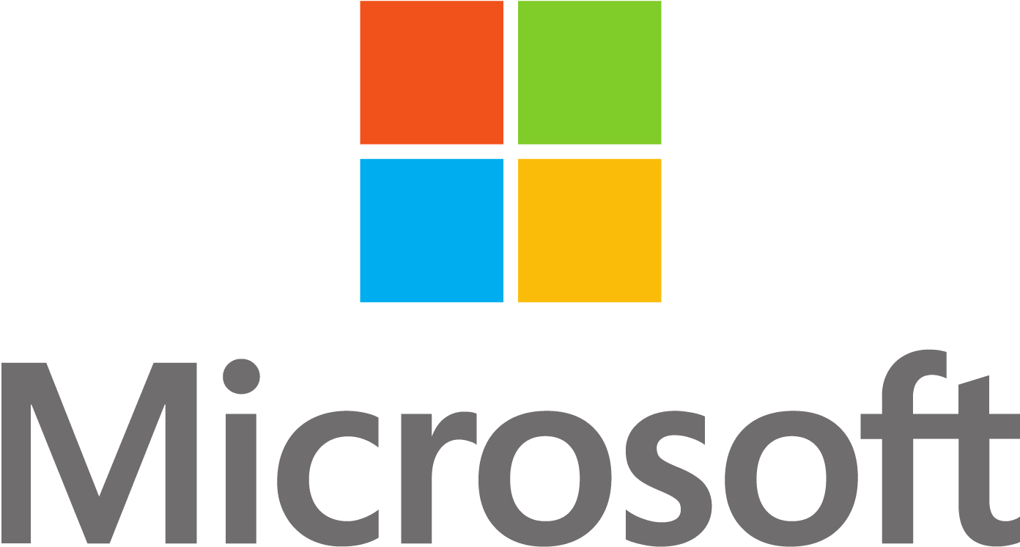


Then you win.
From Microsoft officially in love with open source:
“Microsoft has been working with open source for a while — over ten years already. It started with support for Novell and PHP. […] Last year, Microsoft CEO Satya Nadella publicly declared the company's love for Linux, and he's remained true to his word since. Microsoft is now involved with 140 workgroups dealing with open standards, and actively supports more than 400 projects where code is written before being given back to the community.”
Microsoft, 2015 (Satya Nadella)
$34 billion
$7.5 billion
https://news.microsoft.com/2018/06/04/microsoft-to-acquire-github-for-7-5-billion/
redhat.com/en/about/press-releases/ibm-closes-landmark-acquisition-red-hat-34-billion-defines-open-hybrid-cloud-future
@jwf@floss.social
Notes:
And suddenly, do the tides ever turn. The 2010s see open source finally become part of the mainstream narrative.
First, Microsoft announces publicly that they are all in on Linux and open source. Satya Nadella leads the charge after Bill Gates yields the throne.
Second, Microsoft doubles down on open source by acquiring GitHub for $7.5 billion in 2018. At the time, this was one of the largest technology acquisitions.
Third, IBM acquires Red Hat (my employer) for a whopping $34 billion in 2019. This remains one of the largest-ever technology acquisitions to date (you can count the bigger acquisitions on one hand).
Needless to say, from a capitalist market perspective, open source won. But now that open source is finally not controversial and it is often expected, what does it actually mean to be open source?

Slide 23
Four Freedoms of Open Source
Freedom to…
READ
RUN
Four essential principles. These are the rules of ALL Open Source licenses. These freedoms are guaranteed when using genuine Open Source licenses.
REVISE
REDISTRIBUTE
Remember the Four Freedoms.
@jwf@floss.social
Notes:
Always remember these Four Freedoms of Open Source, or Free Software. Whenever someone uses an open source license on a software project, they are guaranteeing you four things (although how that is guaranteed can sometimes be different depending on the license).
READ: Ability to see how it works and study the source.
RUN: No restrictions on use. Run the software in any way you see fit.
REVISE: You are always allowed to make changes to the software.
REDISTRIBUTE: You are allowed to share your changes with others.

Slide 24
What is the future of working on Open Source?
@jwf@floss.social

Slide 25
100+ million
Developers on GitHub (announcement)
GitHub 2023 end of year report: octoverse.github.com
Open Source landscape in 2023? [⅓]
@jwf@floss.social
Notes:
As of 2023, GitHub has over 100 million developers; in India alone, more than 10 million developers use GitHub to build software.
More than 20.5 million joined in 2022 alone.
That’s larger than the number of people who live in The Netherlands (17M) and just shy of Sri Lanka (21.5M)
Not that far behind Nepal (30.1M)
Imagine how silly it is for a moment, if the entire country of The Netherlands became GitHub developers in one year!
So, there are a lot of developers out there, even counting just one website.
Historical growth:
2018: 31 million [8 million new]
2019: 44 million
2021: 73 million
2022: 94 million [20.5 million new] [doubled from 2019!]
2023: 100+ million

Slide 26
98+ million
New repositories created in 2023 on GitHub
GitHub 2023 end of year report: octoverse.github.com
Open Source landscape in 2023? [⅔]
@jwf@floss.social
Notes:
GitHub has over 98 million repositories created in the last year alone; there is no shortage of projects to choose from!
There is a shortage of open source projects that provide infrastructure that supports communities around their projects
Standing out and attracting new contributors to a project is a competitive space!
Historical growth:
2019: 44 million
2021: 61 million [72% increase of developers creating their first repositories over 2019]
2022: 85.7 million
2023: 98 million

Slide 27
4.5+ billion
Total contributions to all projects on GitHub
GitHub 2023 end of year report: octoverse.github.com
Open Source landscape in 2023? [3⁄3]
@jwf@floss.social
Notes:
There were over 4.5 billion contributions to all projects on GitHub in 2023 alone.
Contributions include commits, issues, pull requests, discussions, gists, pushes, and pull requests reviews.
Clearly, there is a lot happening in this space.
Historical growth:
2022: 3.5+ billion
2023: 4.5+ billion

Slide 28
Three samples of Open Source careers in tech.
@jwf@floss.social
Notes:
Finally, let’s look at three different spaces where Open Source is a critical part of building a tech career:
In commercial uses and companies/corporations.
In government.
In international NGOs and agencies.

Slide 29


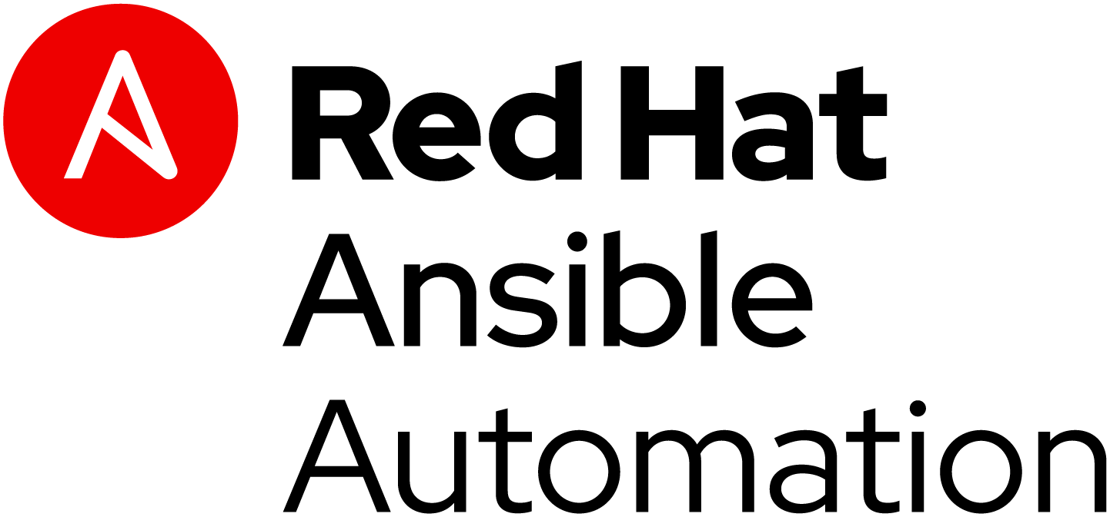
Commercial.
@jwf@floss.social
Notes:
Earlier I mentioned that the Internet would not exist without Open Source. This is also true with several commercial, for-profit products. Without critical Open Source building blocks, many commercial products would also not exist. In the case of Red Hat, many of our commercial products are also Open Source!
Red Hat owns these different products, but each of them have diverse communities who participate in making the products better for everyone. We also discussed earlier how building in the open can be an advantage for innovation and bringing the best new ideas to the table.
Beyond Red Hat and commercial products, many tech companies have an Open Source Program Office, or OSPO. OSPOs grow awareness and investment into Open Source in the business. Google has an OSPO, which runs their famous Google Summer of Code program. Meta is also very big on Open Source and many Meta engineers contribute to projects that keep Facebook and Instagram going.

Slide 30

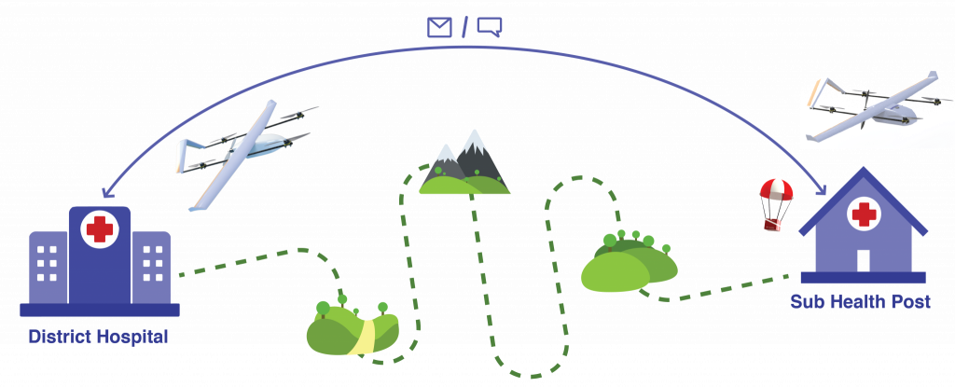
Example: Prokura Innovations
@jwf@floss.social
Notes:
Earlier in the presentation, I mentioned that I mentored a project team from Nepal building drones with open source hardware schematics to create affordable drones in a Nepalese context.
The team behind this work is Prokura Innovations. Their drones connect the hardest to reach places in Nepal to provide last mile medical delivery in a cheap, quick and efficient manner.
Common examples of payloads delivered by their drones were vaccines, medical supplies, blood, and more.

Slide 31

Read: Medical Delivery in Nangi, Myagdi
@jwf@floss.social

Slide 32
Government.
@jwf@floss.social
Notes:
18F, USA General Services Administration, Open Source policy.
From the policy:
18F, a digital services delivery team within the General Services Administration, develops in-house digital solutions to help agencies meet the needs of the people and businesses they serve. This requires flexibility in how we code, with a focus on lowering costs for the American people, while improving their interactions with the U.S. Government.
The default position of 18F when developing new projects is to:
Use Free and Open Source Software (FOSS), which is software that does not charge users a purchase or licensing fee for modifying or redistributing the source code, in our projects and contribute back to the open source community.
Develop our work in the open.
Publish publicly all source code created or modified by 18F, whether developed in-house by government staff or through contracts negotiated by 18F.

Slide 33
International NGOs & agencies.
@jwf@floss.social
Notes:
Srna & Cboard (via UNICEF Serbia). UNICEF Innovation Fund.

Slide 34
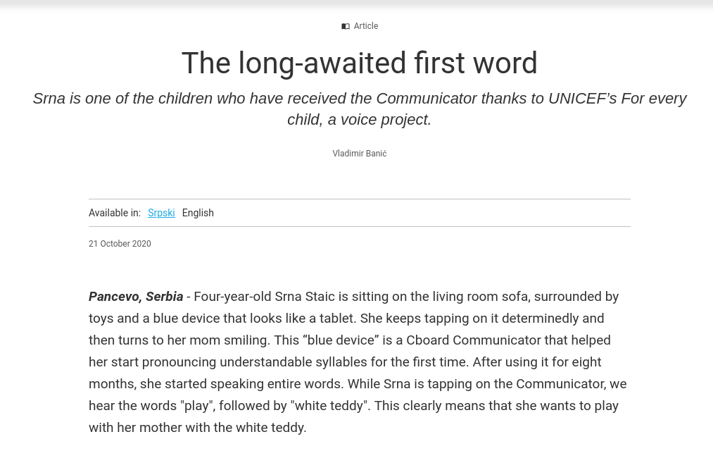
Open Source in government.
@jwf@floss.social
Notes:
Cboard is an open source AAC (Augmentative and Alternative Communication) application for children and youth with speech-impediment disabilities.

Slide 35
How could this connect to your career?
@jwf@floss.social
Slides: j.jwf.io/GNOMEAsia23

Slide 36
The Four Freedoms to…
READ
RUN
REVISE
REDISTRIBUTE
First, know what people when they say “Open Source.”
@jwf@floss.social
Notes:
Open Source is like a buzzword these days. So, always know what “Open Source” really means. When someone says software, content, or data is Open Source, does their definition of Open Source include the Four Freedoms?
If not, whatever they are talking to you about is not actually Open Source.

Slide 37

Second, use Open Source to launch or grow your career.
@jwf@floss.social
Notes:
Open Source is everywhere. Participating in Open Source projects and communities can help you apply new skills you are learning, network with other industry professionals, and build connections that can lead to a big break, either for a first tech job or pivoting your career into a new direction.
---
Photo by Dr.Sourabh Panari on Unsplash.
---

Slide 38
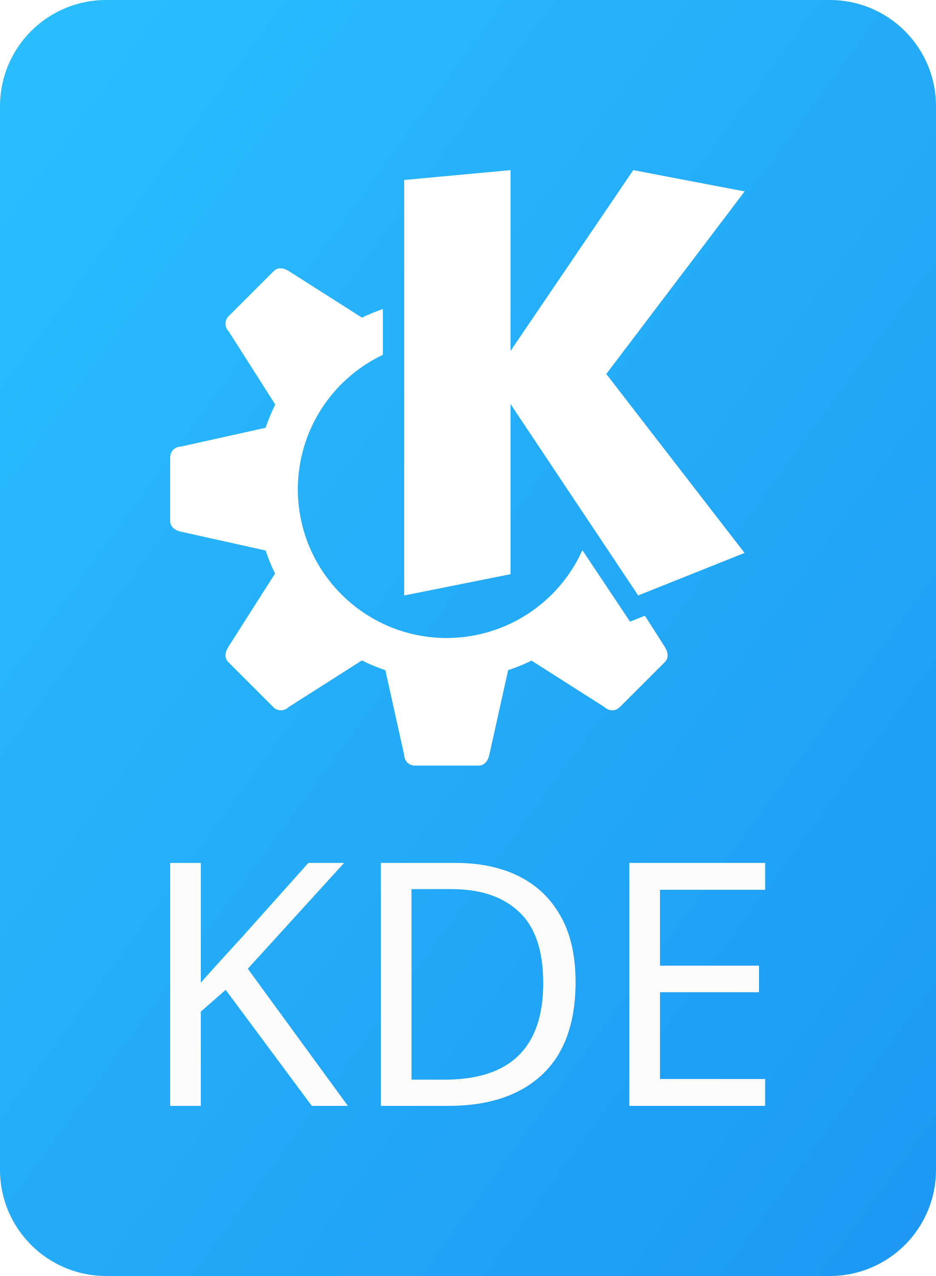


Third, get to know your fellow peoples!
@jwf@floss.social
Notes:
Third and finally, use events like these to network, get to know others, and to learn something new.
There is a lot of knowledge in the room. Think about how to go from being a passive to active attendee, so that you leave the event with more than you had coming into the event.
I really cannot overemphasize the importance of networking and getting to know others! For example, if I hadn’t gotten to know Kristi, I might not have had this privilege to be here and present to all of you.
---
Logos are owned by their respective projects, used here under Fair Use.
---

