Slide 1
PROJECT PRESENTATION
BudgetBuddy AI
An AI-powered expense tracker built with Firebase, FastAPI and Groq
Anushay Ayat
AI and Data Science | SMIT
Notes:
Introduce yourself and the project: a personal expense tracker where users can type or paste what they spent and ask questions about their own spending. Mention the three pieces: Firebase for sign-in and data, a Python FastAPI backend, and Groq for the AI.

Slide 2



Why BudgetBuddy AI?
Hard to keep up
Local habits ignored
Privacy and secrets
Notes and spreadsheets are easy to start and quickly abandoned.
JazzCash, Easypaisa, bank SMS alerts and Roman Urdu notes are everyday reality.
Financial data must stay private and API keys must never reach the browser.
Goal: record spending in seconds, in your own words, and get answers from your own data.
Notes:
Explain the problem: people stop tracking because it is slow. Local payment methods and languages are rarely supported. We also wanted a safe design where the API key is never exposed.

Slide 3






What it does
Expense tracking
AI quick add
Ask your spending
Form, table, edit, delete with Undo, live totals
Type or paste an SMS; AI fills the form
Plain-language questions about your own data
Budgets and charts
Wallets and bills
Offline and Urdu
6-month chart, forecast, custom categories
Income, wallets, recurring bills, bill splitting
Installable PWA, English and Urdu (RTL)
Notes:
Walk through the six groups. The first row is the core assignment plus AI. The second row is extra: budgets, wallets, recurring bills, splitting, offline use and Urdu.

Slide 4
Assignment requirements: all met
Requirement | Implementation | Status
AI Expense Tracker using Groq | AI page via FastAPI /api/ai | Done
Form: Title, Amount, Category, Date, Add | Five required categories + custom ones | Done
Store records in Firestore | users/{uid}/expenses | Done
Table of saved expenses below form | Real-time listener | Done
Delete button | With one-tap Undo | Done
Total count and total amount | Update instantly | Done
Deploy and share live link | Firebase Hosting + Vercel | Done
Notes:
Read through the table quickly. Every requirement from the assignment is implemented; everything else in the project is extra. The form also lets users create their own categories on top of the five required ones.

Slide 5
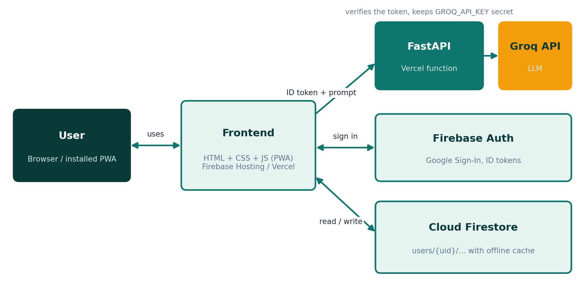
System architecture
1
Frontend
Static site on Firebase Hosting or Vercel
2
Firebase
Google sign-in and Firestore data per user
3
FastAPI
Verifies token, calls Groq with the secret key
Notes:
Three parts. The frontend talks to Firebase directly for sign-in and data. For AI features it talks to our own FastAPI backend, which holds the Groq key.

Slide 6

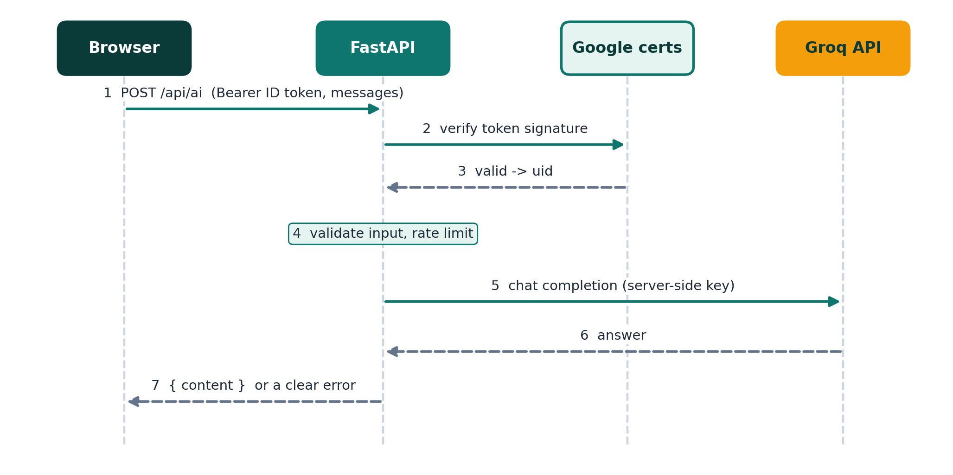


How an AI request is protected
Key stays on the server
GROQ_API_KEY is an environment variable
Only signed-in users
Firebase ID token is verified on every call
Validated and limited
Roles, sizes, 30 requests per minute
Notes:
Walk the sequence left to right. The browser never sees the Groq key. The backend verifies the Firebase token, validates the body, applies the rate limit and only then calls Groq.

Slide 7




Technology stack
Frontend
Backend
Firebase
AI and hosting
HTML5, CSS3
Vanilla JavaScript
SVG charts
Service Worker (PWA)
Python, FastAPI
Pydantic, httpx
google-auth
pytest
Authentication (Google)
Cloud Firestore
Security rules
Hosting
Groq LLM API
llama-3.3-70b
Vercel serverless
GitHub
Notes:
No frontend framework or build step. The backend is a single small Python file. Firebase handles identity and data; Groq provides fast LLM inference.

Slide 8
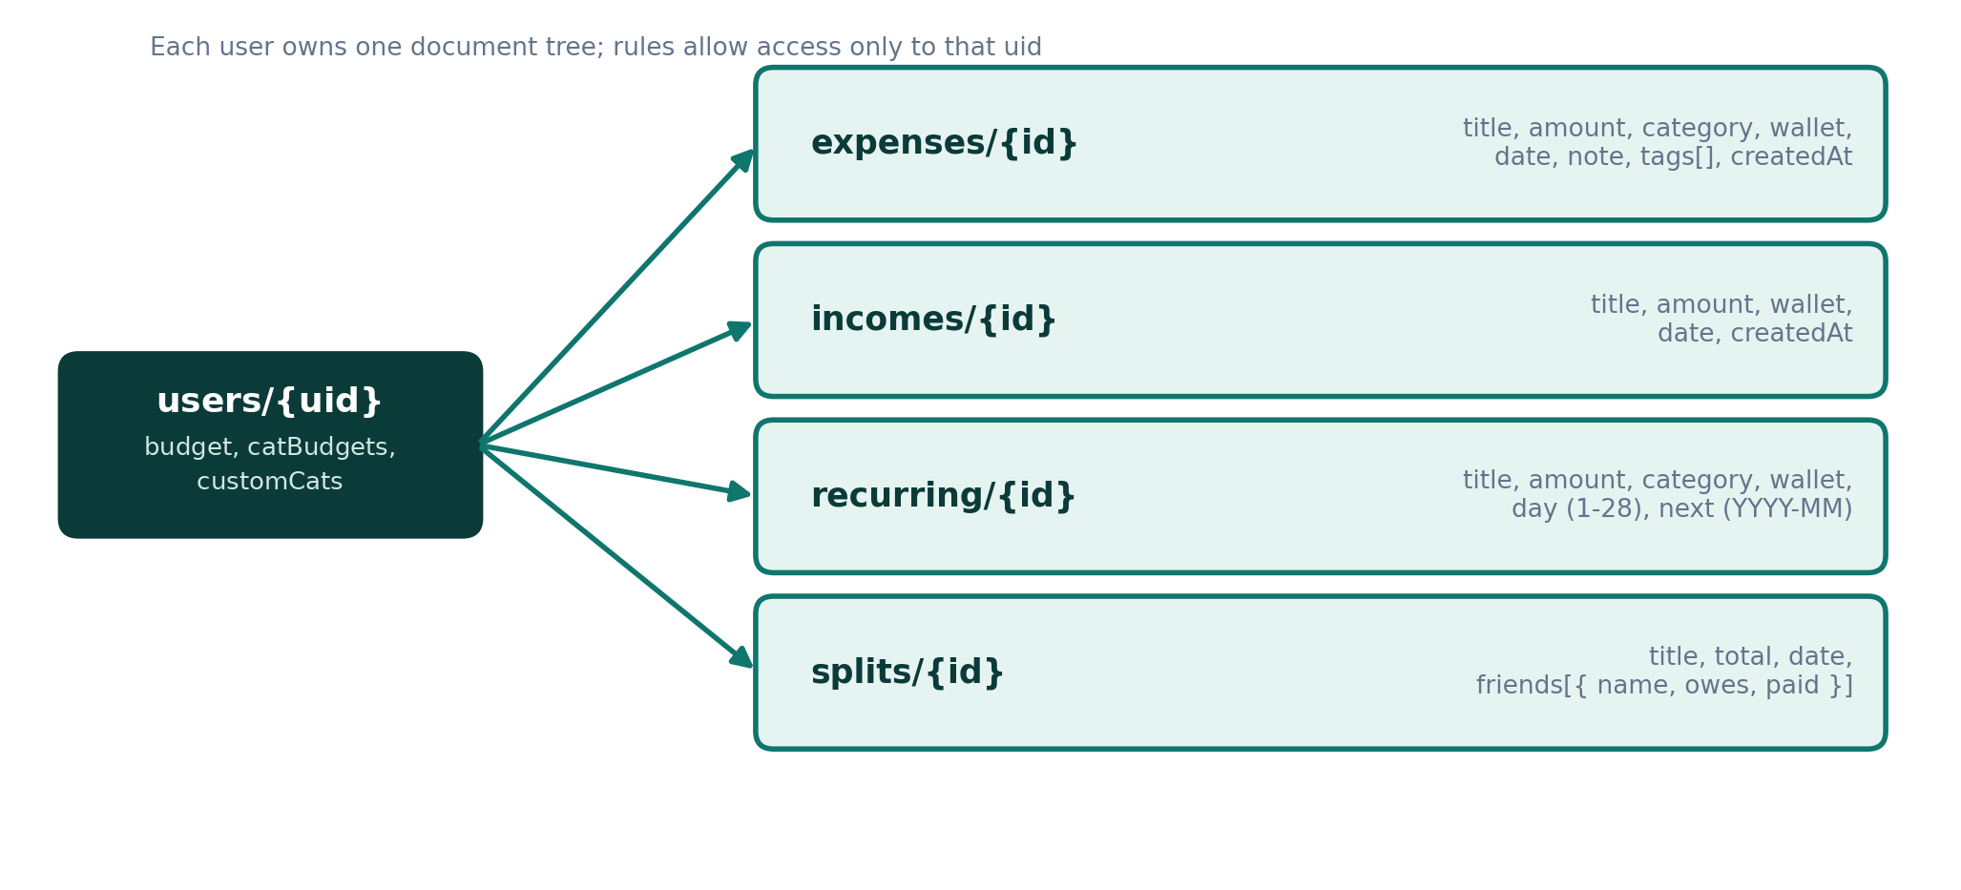
Data model and privacy
firestore.rules
match /users/{uid}/**
allow read, write:
if request.auth.uid
== uid;
Each user owns one tree of documents.
Nothing is shared between users.
Offline cache and sync
Real-time listeners
Escaped user text
Custom categories in customCats
Notes:
All records live under users/{uid}. One security rule means a user can only read and write their own documents. Firestore also keeps an offline cache so the app works without internet. Custom categories are stored on the same user document as a customCats list, so the same rule protects them.

Slide 9



AI features and prompt design
Quick add
Prompt design
Free text or bank SMS becomes a pre-filled form
JSON mode with fixed allowed values
Grounded: answer only from supplied data
Titles and notes treated as data, not instructions
AI fills the form; the user confirms
Ask your spending
Answers only from your own data
Auto-category
Suggests one of your categories
Monthly review
Overview, 2 highlights, 2 suggestions
Notes:
Four AI capabilities share one client function. Prompts use JSON mode where structured output is needed, are told to use only the supplied data and to ignore instructions hidden in expense titles. The AI never saves anything by itself.

Slide 10



Custom categories
Create anywhere
How it is stored
New category… in any form, or Manage categories
Saved as users/{uid}.customCats
Same security rule; no rule change
Names escaped, colours validated
29 automated jsdom checks pass
Name and colour
Up to 24 characters, 20 per user, no duplicates
Works everywhere
Charts, limits, filters, reports and AI
Safe delete
Expenses move to Other; the limit is removed
Notes:
Every user can create their own categories. Open the Category dropdown and choose New category, or use Manage categories on the dashboard. Categories have a name and a colour, are stored on the user document as customCats, and show up in charts, limits, filters, reports and the AI prompts. Deleting one moves its expenses to Other. A jsdom test with 29 checks covers this feature.

Slide 11
Backend API and testing
FastAPI endpoints
17 / 17
Route | Purpose
GET /api/health | Status, key configured, model
POST /api/ai | Groq chat, needs Firebase token
pytest tests passing
Validation and error mapping
Firebase token checks
Rate limit and CORS
Mocked Groq: no real calls
1 to 6 messages, 12,000 characters each
30 requests per minute per user
CORS limited to allowed origins
Groq errors mapped to clear messages
Notes:
The backend is one file. Tests replace Groq with a mock transport and Firebase verification with a stub, so they run in a fraction of a second without network access.

Slide 12
Deployment
1
GitHub
2
Vercel
3
Firebase Hosting
Push the project to a repository
Backend + frontend. Add 3 environment variables, deploy, open /api/health
Set API_BASE to the Vercel URL, then firebase deploy
Environment variables
GROQ_API_KEY
FIREBASE_PROJECT_ID
ALLOWED_ORIGINS
Notes:
Deploy Vercel first so you have a backend URL. Remember to add the Vercel domain and later the Firebase Hosting domain to Firebase Authentication authorized domains and to ALLOWED_ORIGINS, then redeploy after changing variables.

Slide 13
Limitations and future work
Current limitations
Next steps
Rate limiter is per instance (in memory)
Recurring bills created when the app opens
Voice input needs Chrome or Edge
Equal-share bill splitting only
Frontend mostly tested manually
Categories cannot be renamed yet
Persistent rate limiting (Redis or Firestore)
Scheduled recurring bills and reminders
Receipt photo upload
Unequal splits, editable recurring rules
End-to-end frontend tests
Rename and re-colour categories
Notes:
Be upfront about limits. The most important one is the in-memory rate limiter, which is fine for a student project but would move to Redis or Firestore in production.

Slide 14
Thank you
Questions?
Firebase
https://YOUR_PROJECT_ID.web.app
Vercel
https://YOUR_APP.vercel.app
GitHub
github.com/YOUR_USERNAME/budgetbuddy-ai
Anushay Ayat | AI and Data Science | SMIT
Notes:
Replace the three link placeholders with your real addresses after deployment. Offer a live demo: sign in, add an expense, use quick add and ask a question.

