Slide 1
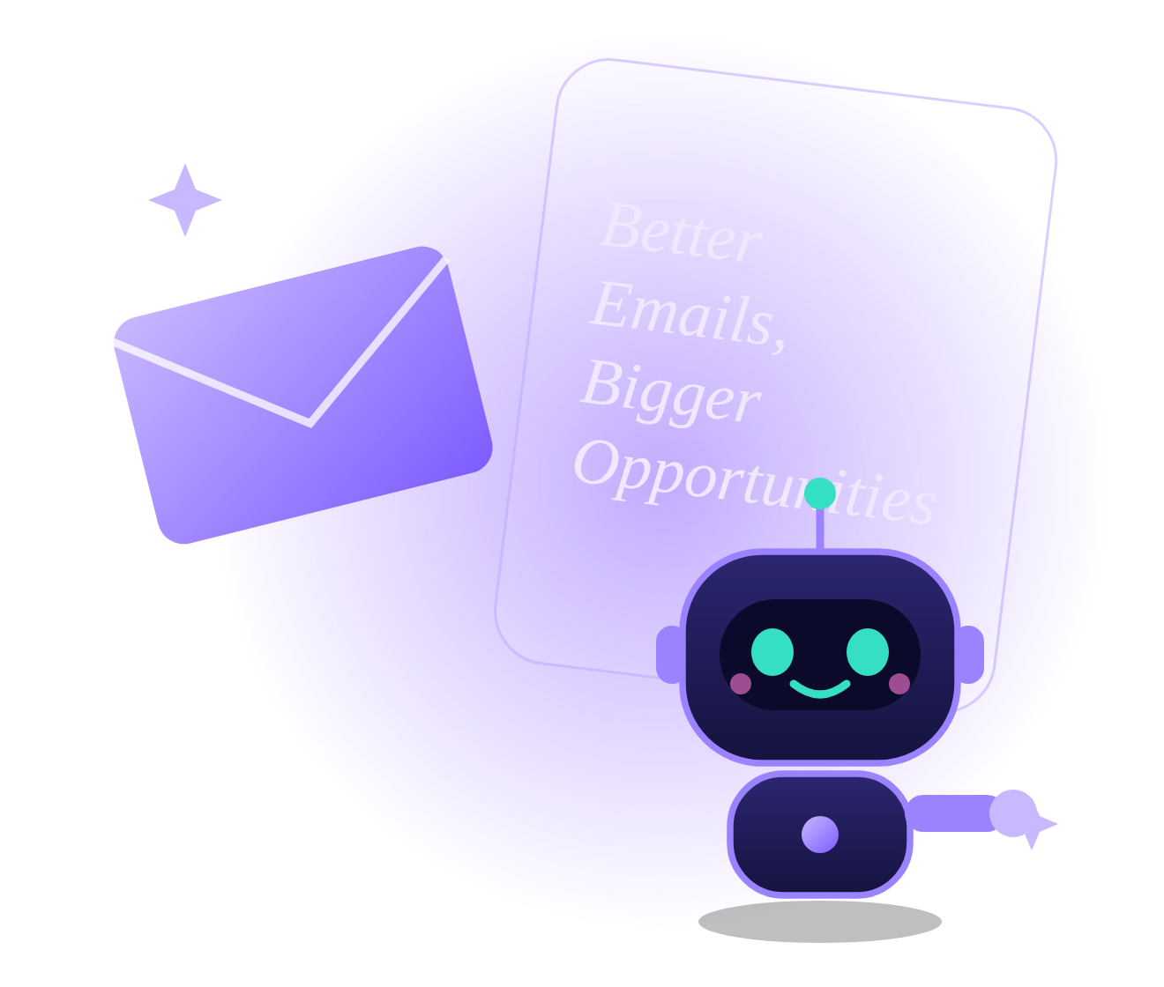
AI EMAIL GENERATOR
LetterLy
Turn your thoughts into perfect emails
FastAPI | Groq | Firebase | Vercel
Prepared by Anushay Ayat
SMIT (Saylani Mass IT Training), AI and Data Science
October 2026
Notes:
Welcome everyone. LetterLy is my AI email generator project built with FastAPI and the Groq LLM API. In this talk I will show the problem, how it works, the features, the design, how it was tested and how it is deployed.

Slide 2
What we will cover
01
Objective and scope
05
Design
What the assignment asks and how LetterLy answers it
Brand, interface and responsive layout
02
How it works
06
Data and privacy
Request flow, tech stack and architecture
Storage, visitor spaces and secrets
03
Features
07
Quality
Generation, AI tools and productivity features
Testing approach and results
04
AI integration
08
Delivery
Prompt design and safe handling of output
Deployment, challenges and next steps
Notes:
Here is the plan for the next few minutes: first the objective, then how the system works, the features, the AI integration, the design, data and privacy, testing, and finally deployment and next steps.

Slide 3

The assignment and our answer
THE ASSIGNMENT ASKS FOR
LETTERLY DELIVERS
A FastAPI backend
FastAPI app with 22 API endpoints
Recipient name, purpose and tone
Plus length, language and sender name
An LLM writes the full email
Groq (llama-3.3-70b-versatile) in JSON mode
Show it on an HTML page
Landing page and a six-view dashboard
GitHub link and a screenshot
README, setup guide and deploy guide
Notes:
The assignment asked for a simple FastAPI app: take a recipient name, a purpose and a tone, ask an LLM to write the email, and show it on a web page. LetterLy meets every requirement and then goes further on each one.

Slide 4



LetterLy at a glance
22
10
3
7
3,200+
API endpoints
Built-in templates
Tones
Screens
Lines of code
Generation, AI tools, data
Plus your own saved ones
Professional, Friendly, Formal
Landing page and 6 dashboard views
Backend, frontend and tools
English and Urdu
Five ways to take it away
Voice and dark mode
Right-to-left text in the page and in Word
Copy, text, Word, PDF or your mail app
Speak the purpose, switch themes any time
Notes:
A quick look at the size of the project. Twenty-two API endpoints, ten ready-made templates, seven screens, two languages and more than three thousand lines of code, all written for this project.

Slide 5

From idea to email in six steps
1
2
3
4
5
6
Fill the form
Send the request
Build the prompt
Ask the AI
Parse and save
Show the email
Recipient, purpose, tone, length, language
Browser checks input, then calls the API
FastAPI validates and writes the prompt
Groq replies with a subject and a body
The JSON is checked and stored
Typing effect, then edit or refine
While the AI works, the form locks and a progress label shows. When the email arrives it types out, and every field stays editable.
Notes:
This is the journey of one email. The user fills the form, the browser sends a request, FastAPI validates it and builds a prompt, Groq answers with JSON, the server checks and saves it, and the page shows the email with a typing effect.

Slide 6







The technology behind it
FastAPI
Groq API
SQLite
Firestore
Python web framework with 22 routes and input validation
Fast LLM inference with llama-3.3-70b-versatile
Zero-setup database for local development
Firebase cloud database used in production
python-docx
HTML, CSS, JS
Web Speech API
Vercel
Builds Word files, including right-to-left Urdu
No build step, fast pages, no framework needed
Voice input in the browser, English and Urdu
Hosting with a CDN for pages and a function for the API
Notes:
These are the building blocks. FastAPI for the API, Groq for the language model, SQLite locally and Firestore in production, python-docx for Word export, plain HTML, CSS and JavaScript for the interface, the browser speech API for voice, and Vercel for hosting.

Slide 7
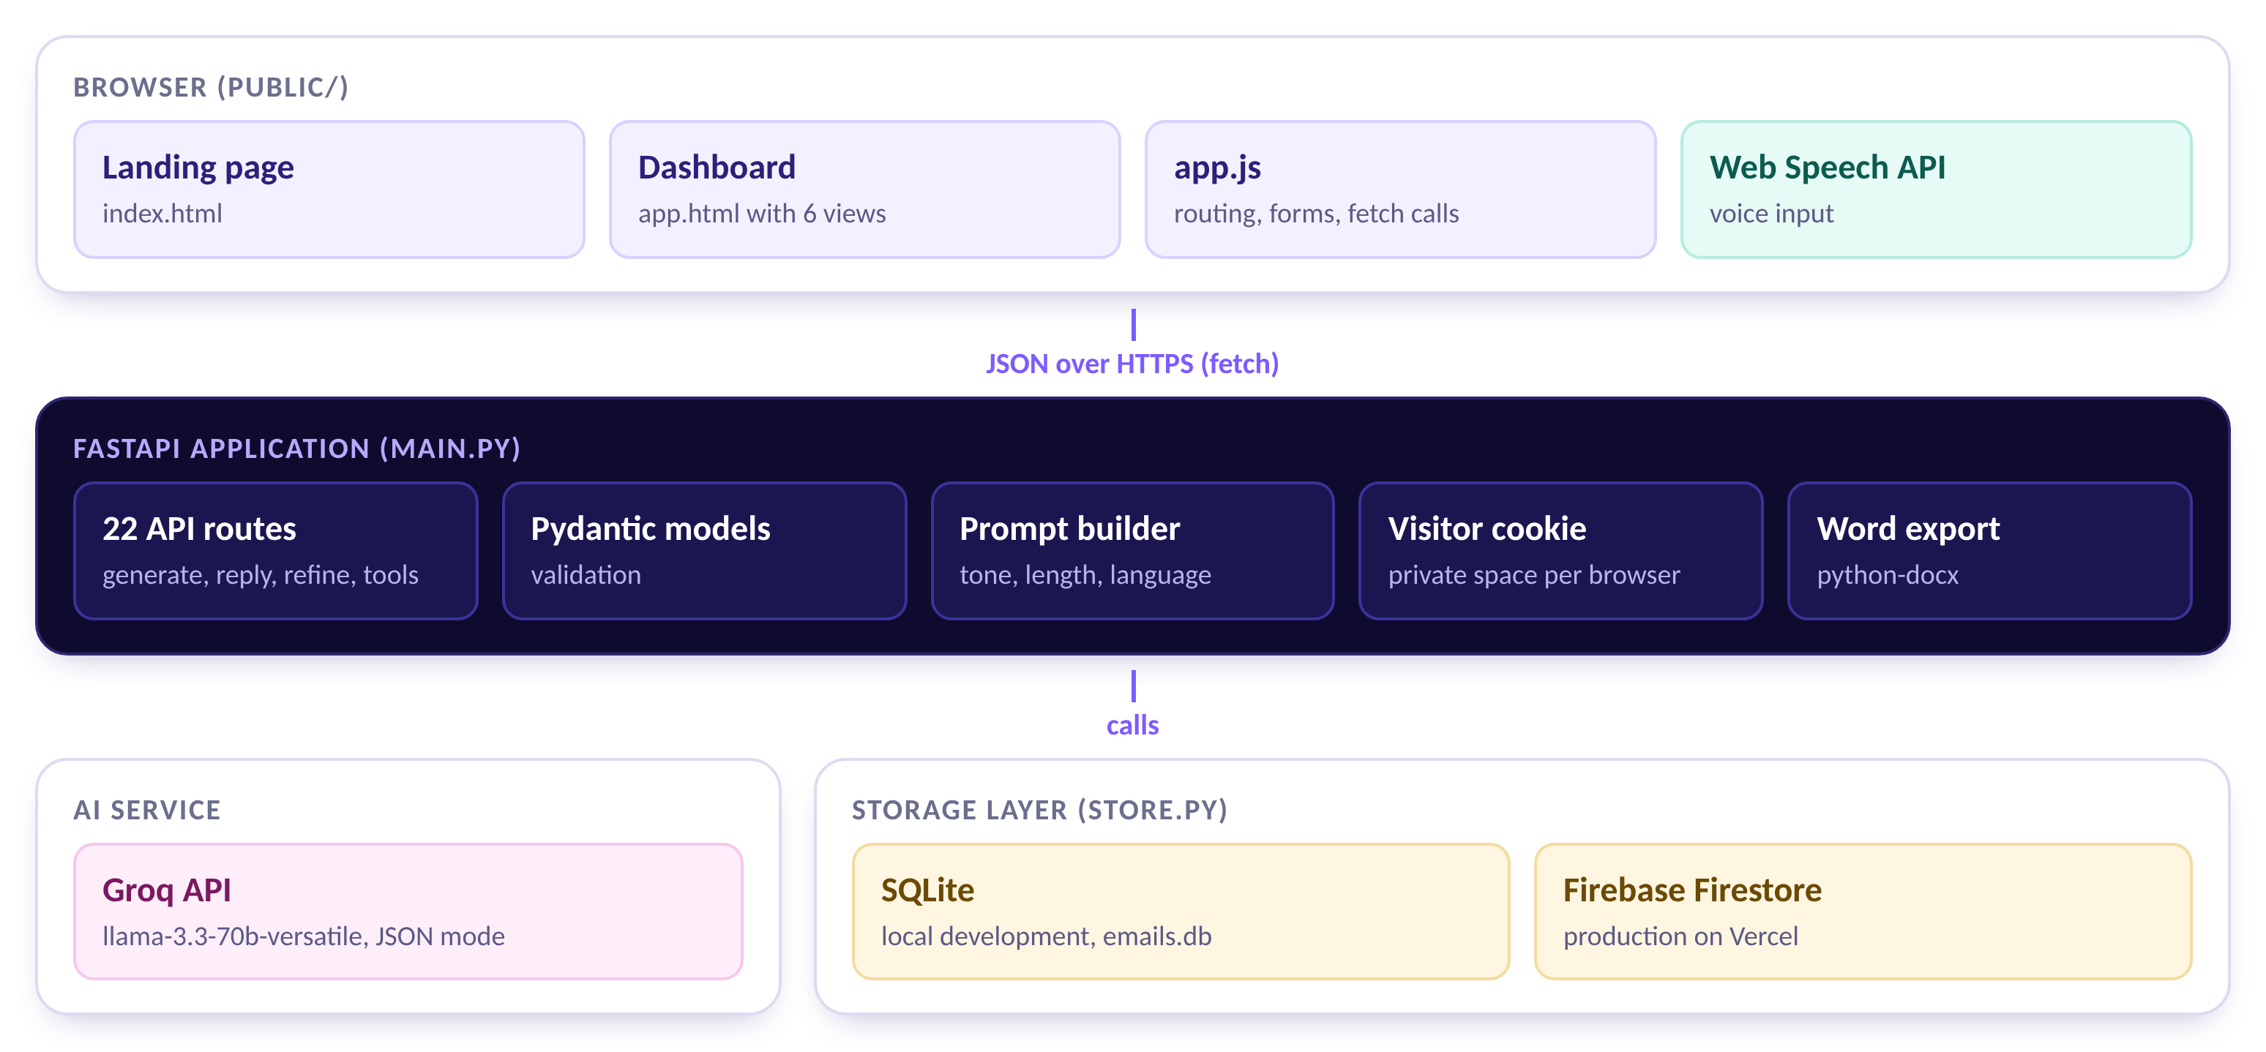
System architecture
Notes:
The system has three layers. The browser holds the landing page and the dashboard. FastAPI exposes the routes, validates input and builds prompts. Behind it sit the Groq API and the storage layer, which uses SQLite locally and Firestore on Vercel.

Slide 8
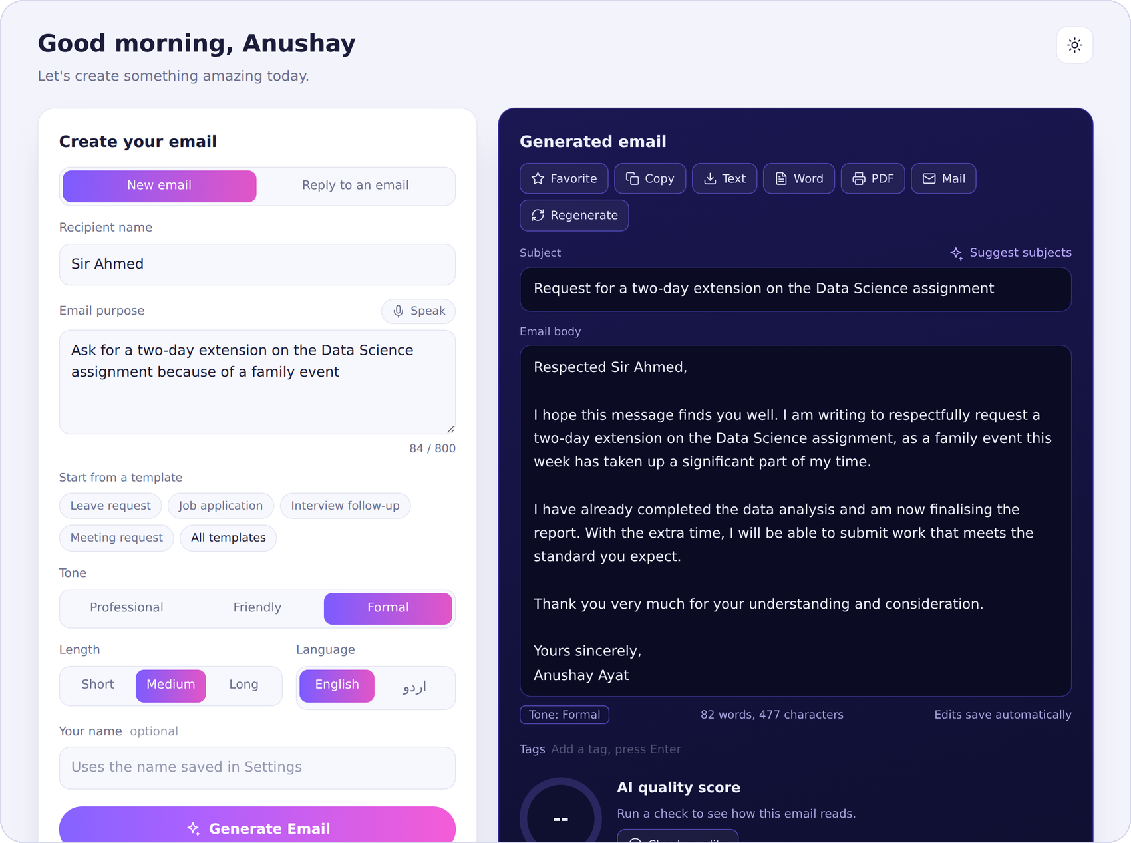




Generate an email
Recipient name
Who the email is for
Email purpose
Type it, speak it or start from a template
Tone
Professional, Friendly or Formal
Length
Short, Medium or Long
Language
English or Urdu
The dashboard with sample data: form on the left, generated email on the right.
Notes:
This is the heart of the product. The form on the left takes the recipient, the purpose, tone, length and language. The generated email appears on the right with a subject, a full body, and editing, export and refine controls.

Slide 9








Eight AI tools around every draft
Reply mode
Custom changes
Subject ideas
Quality score
Paste a received email and get a reply
Type "make it more polite" and it rewrites
Three alternative subject lines to pick from
A 0 to 100 score with practical tips
Tone detector
Grammar fix
Thread summary
Quick refine
Percentages across four tones
Corrects spelling and punctuation only
Gist, questions and deadlines in a long thread
Shorter, longer or translate to Urdu
Notes:
Around every draft there are eight AI tools: reply mode, custom instructions, subject suggestions, a quality score, a tone detector, grammar fixing, thread summaries, and quick shorten, lengthen and translate buttons.

Slide 10
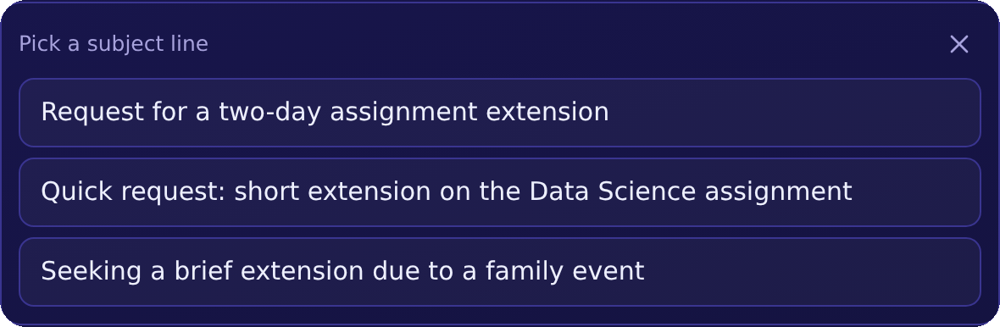

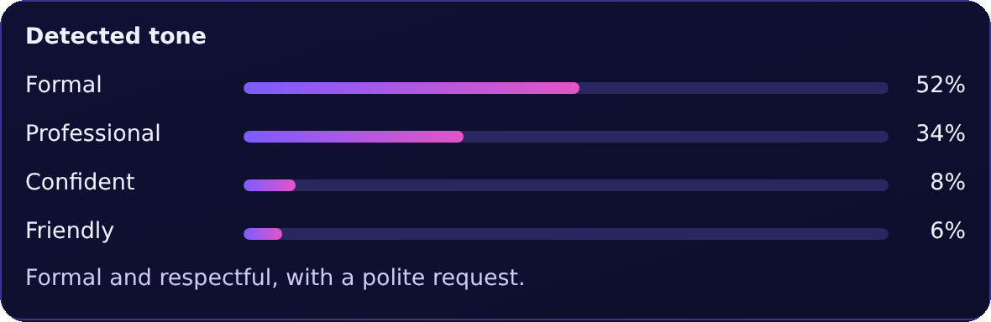
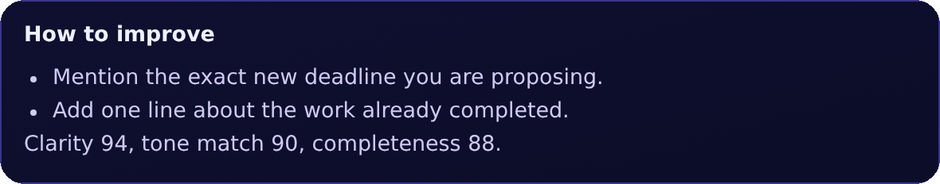
The AI tools in action
Subject suggestions
Quality score and tips
Tone detector
Three options, one click to apply
A score, a verdict and what to improve
How formal, friendly or confident it sounds
Each tool is a single API call: /subjects, /analyze and /tone. The quality score is saved with the email, so it is still there when you reopen it from history.
Notes:
Here are three of the tools in the real interface: the three subject suggestions you can click to apply, the quality score with tips, and the tone detector with percentages.

Slide 11
Prompt design and AI integration
1
System prompt
Task | Temperature | Why
Generate email | 0.7 | Natural, varied wording
Refine or translate | 0.5 | Change it, keep the facts
Subject ideas | 0.9 | Three clearly different options
Quality score | 0.3 | Steady, honest scoring
Tone detector | 0.2 | Consistent measurement
Summary | 0.2 | Faithful to the thread
Grammar fix | 0.1 | Fix only, never rewrite
Sets the role and demands a JSON object
2
User prompt
Recipient, purpose, tone guide, length guide
3
JSON mode
Groq is asked for a JSON response
4
Safe parsing
Tolerant parser, clear error if unreadable
Pasted emails and threads are marked as content to respond to, so instructions hidden inside them are not followed.
Notes:
The prompts are designed so the model always replies with JSON that the server can validate. Each task has its own temperature: creative tasks are warmer, checking tasks are colder. Pasted emails are treated as content to answer, not as instructions.

Slide 12

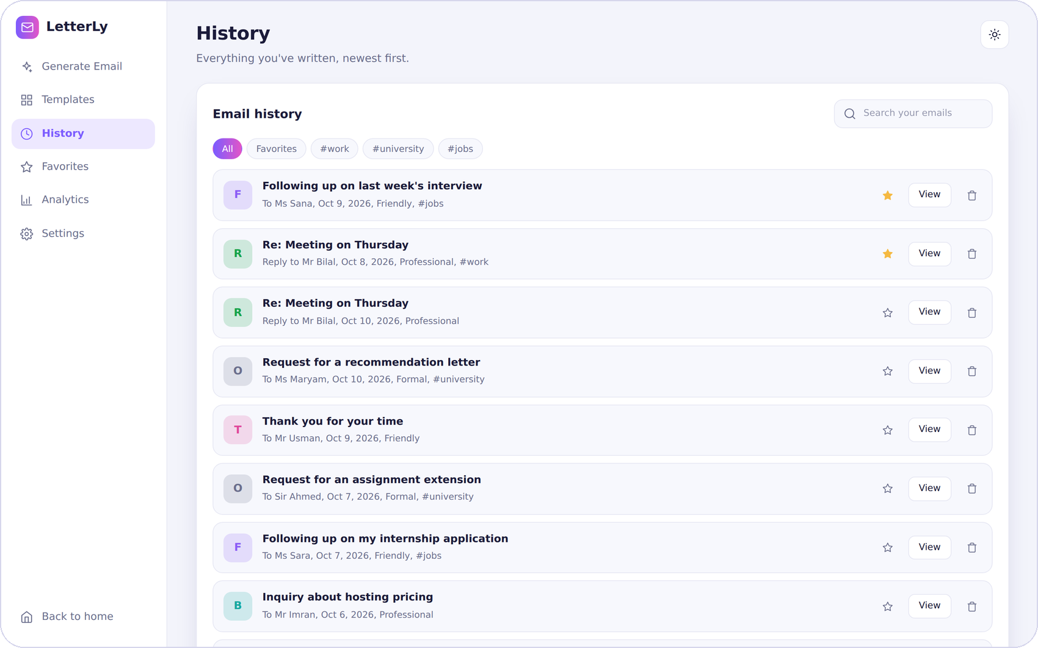



Built to save you time
Templates
10 built in, plus templates you save
Favorites and tags
Star emails and add up to five tags
Searchable history
Search and filter by tag or favorite
Export
Copy, text, Word, PDF or mail app
Voice input
Speak the purpose in English or Urdu
History view with sample data
Analytics
10
templates
5
export options
2
voice languages
Emails, quality, tone mix, weekly chart
Notes:
Beyond writing, LetterLy helps you organise and reuse your work: templates, favourites and tags, searchable history, five export options, voice input and analytics.

Slide 13
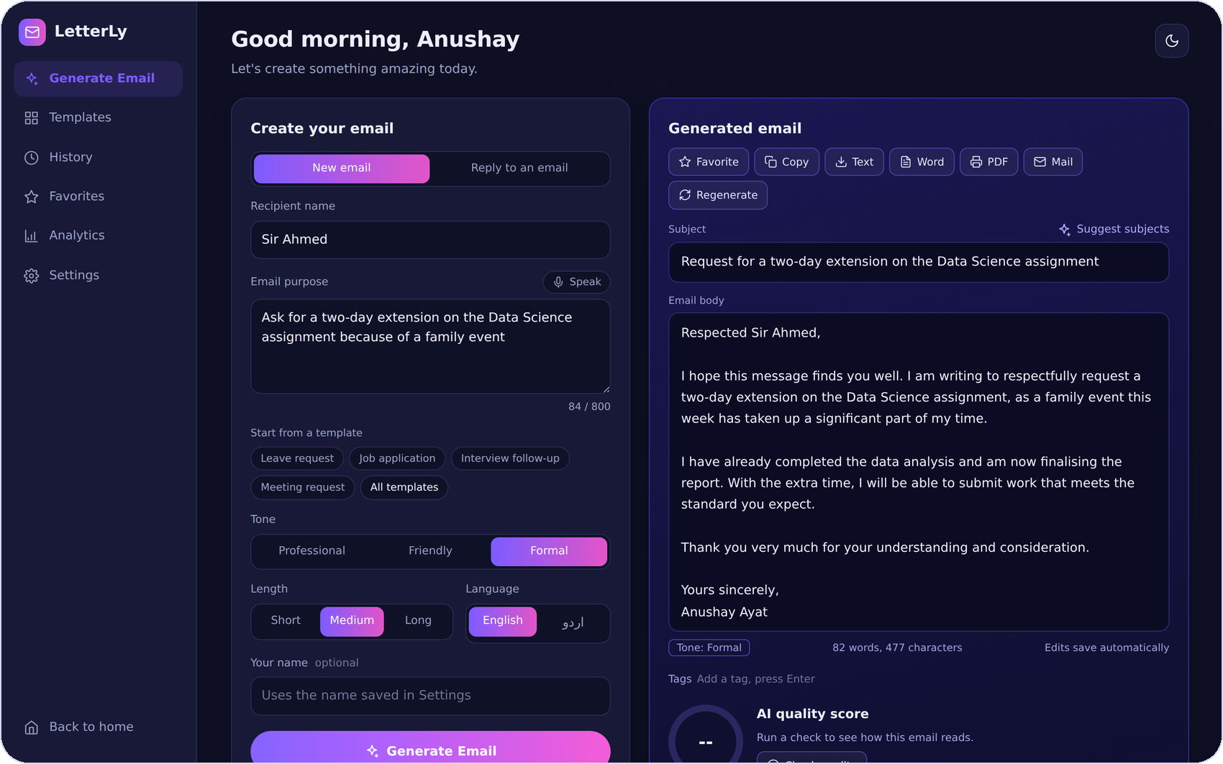
A design system with two themes
Violet
Pink
Teal
Ink
Night
Mist
#7C5CFF
#E255C7
#35E0C2
#1B1B3A
#0A0620
#F3F4FB
TYPOGRAPHY
Headings: Playfair Display (serif)
Body: Inter (clean sans)
PRINCIPLES
The same dashboard in the dark theme (sample data)
Rounded cards and soft shadows
One gradient accent, used sparingly
Large touch targets and clear focus rings
Keyboard focus, labelled controls and reduced-motion support are built in.
Notes:
The look follows a clear design system: a violet to pink accent, a deep night background for the landing page, a soft light dashboard, and a friendly robot mascot. Everything also works in dark mode.

Slide 14
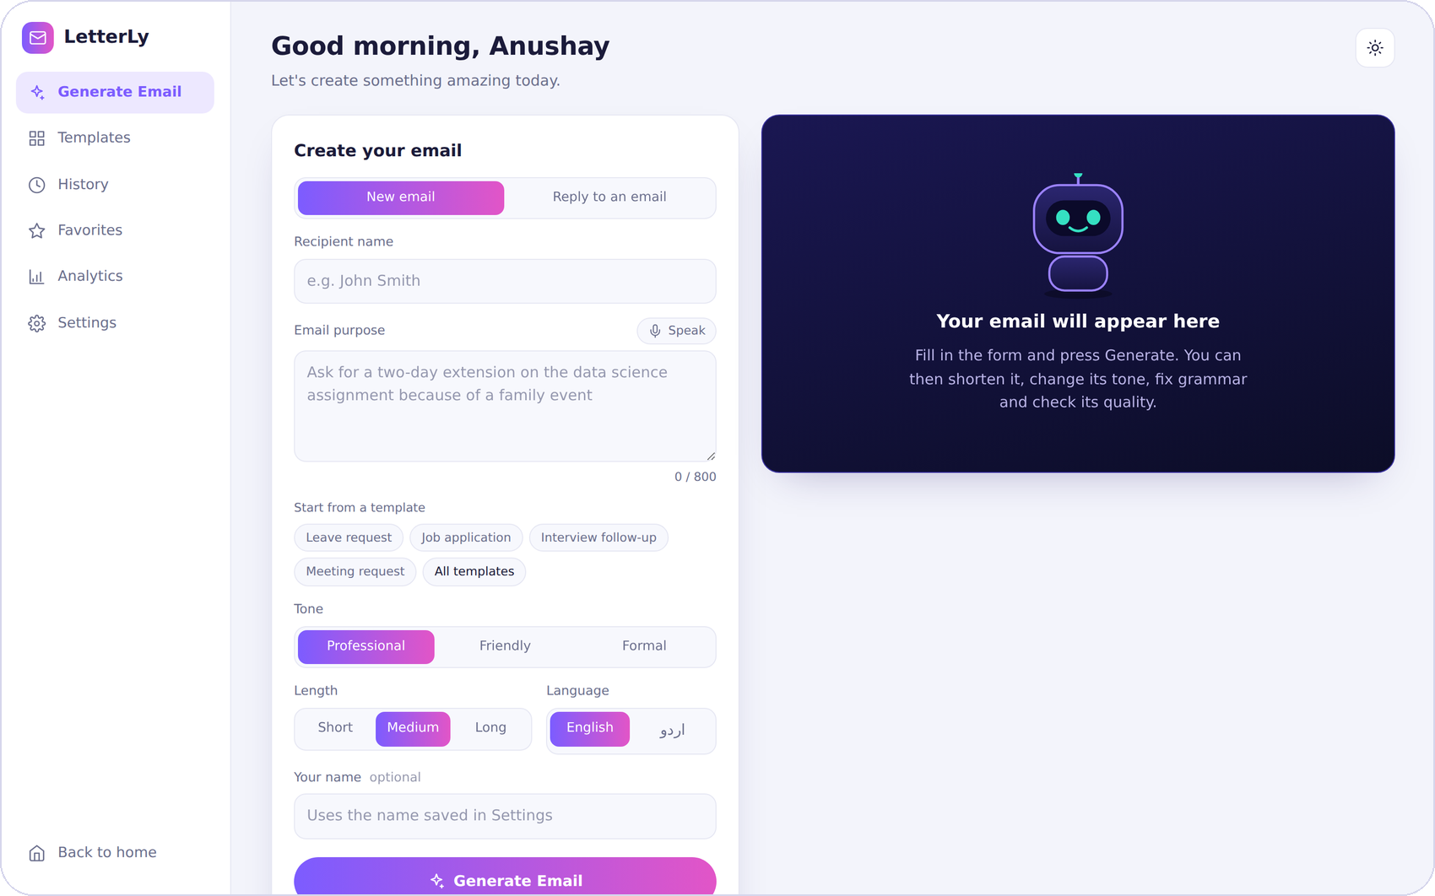
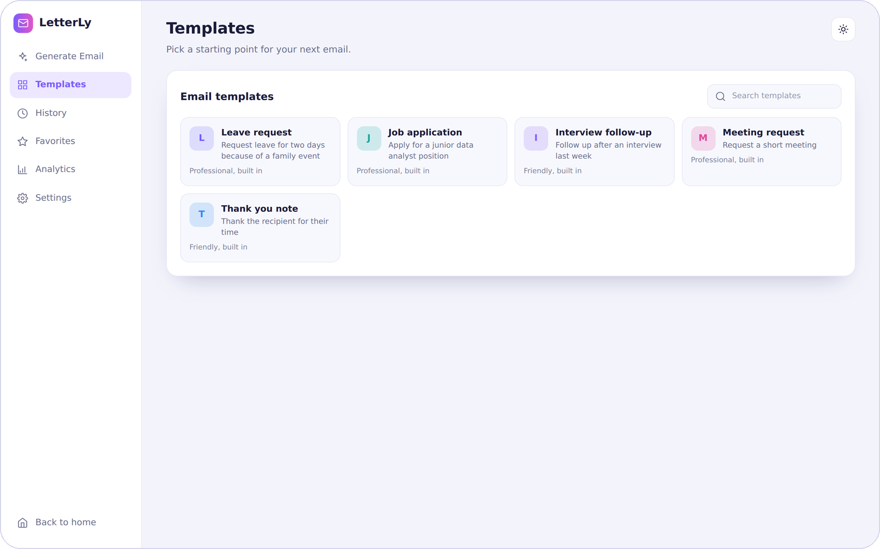
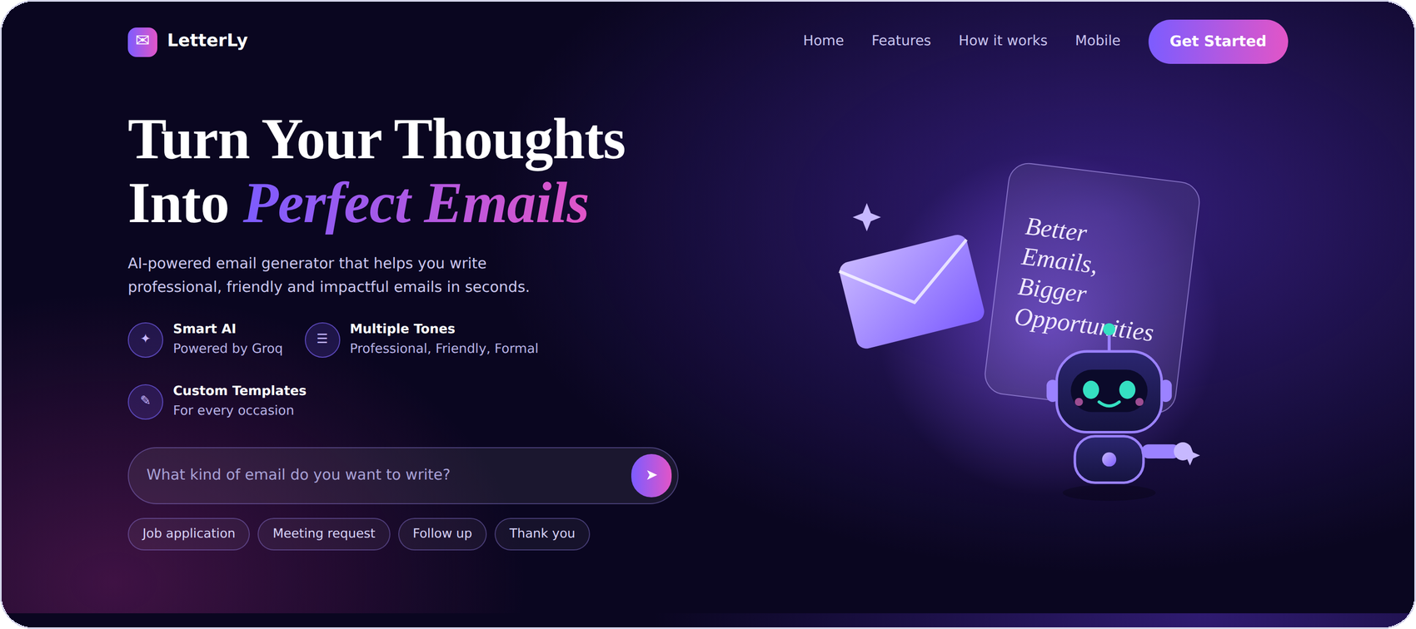
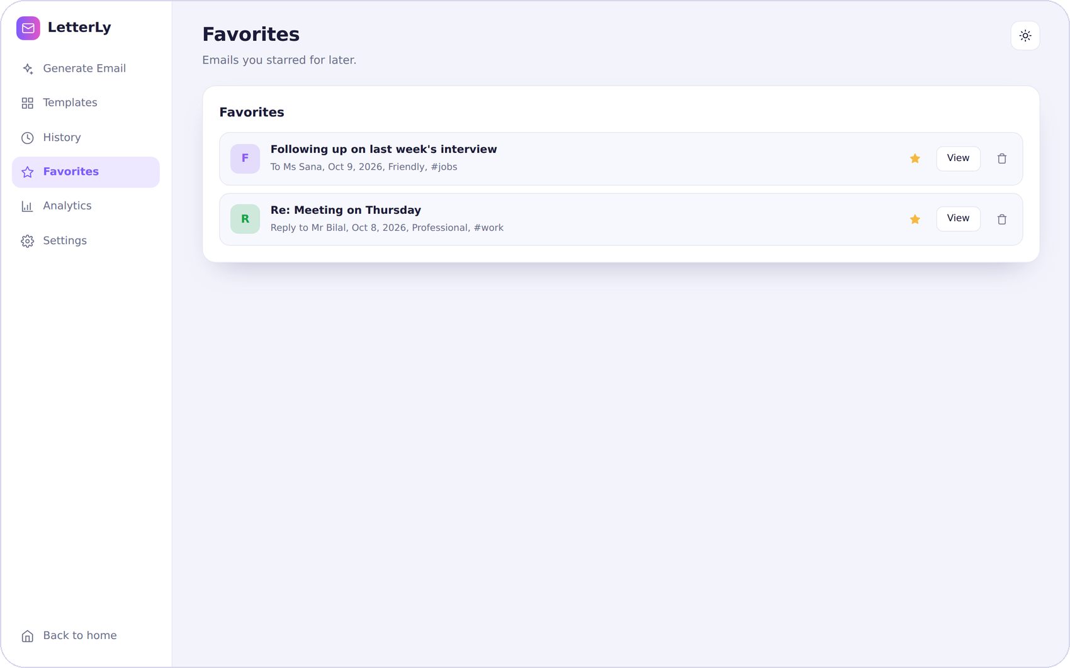
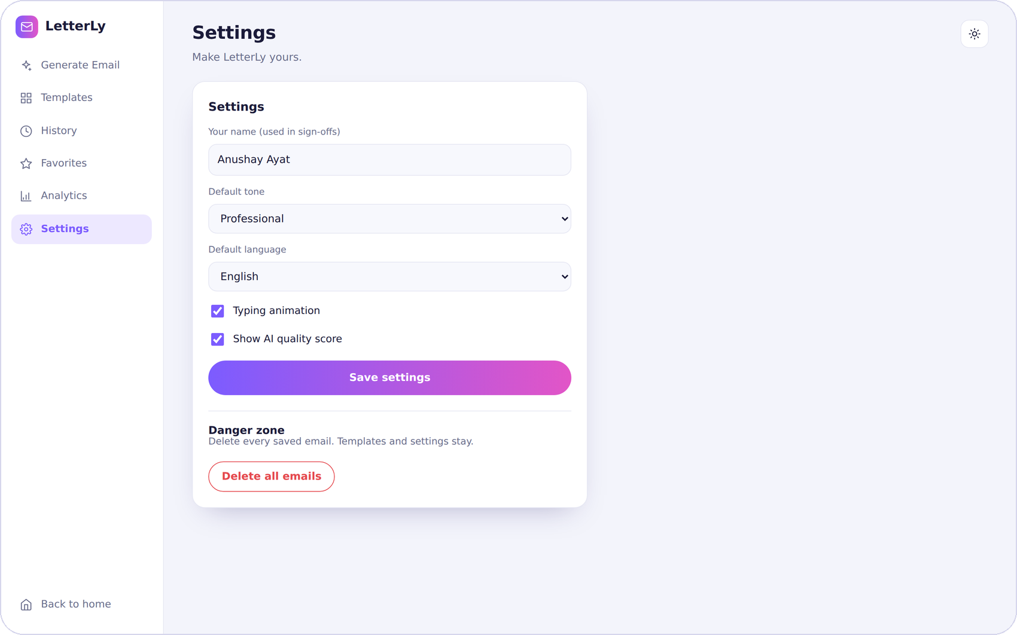
Screens across the product
Landing page
Dashboard
Templates
History
Favorites
Settings
Notes:
A tour of the screens: the landing page, the empty dashboard, templates, history, favourites and settings. All of them share the same design system and work on phones too.

Slide 15
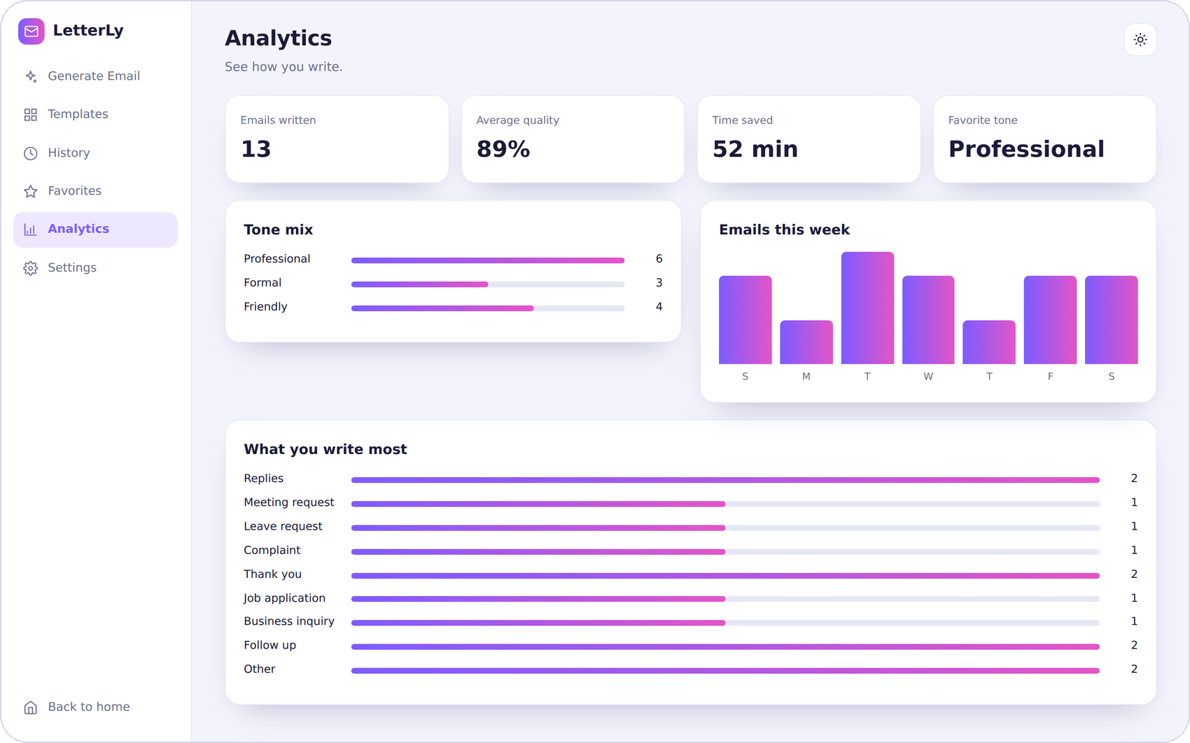
Analytics and settings
Analytics
Emails written and time saved
Average AI quality score
Tone mix and what you write most
Emails per day this week
Settings
Name used in sign-offs
Default tone and language
Typing animation on or off
Quality score on or off
Analytics view with sample data
Notes:
The analytics page turns history into numbers: how many emails, the average quality score, time saved at about four minutes per email, favourite tone, and a weekly chart. Settings store your name, default tone and language, and two display switches.

Slide 16



Data, privacy and security
users
one document per visitor
Secrets stay out of code
Keys live in environment variables
Keys never reach GitHub
visitor id
random cookie value
.gitignore blocks .env and key files
Private space per visitor
Cookie is HttpOnly, Secure, SameSite=Lax
emails
drafts and meta
templates
saved by you
settings
preferences
Server-only database access
Firestore rules stay locked
Input limits everywhere
Firestore layout. Locally, SQLite keeps the same data in tables.
Pydantic checks every request
Notes:
Data is stored per visitor. In Firestore each browser gets its own users document with emails, templates and settings below it. Secrets live in environment variables, and the Firestore rules stay locked because only the server talks to it.

Slide 17
Testing and quality
110
checks, all passing
across three test runs
What is covered
Every dashboard view and AI tool
Reply mode, templates, export hooks
Private visitor spaces and clearing data
Phone layout without sideways scroll
Notes:
I tested the project with automated checks. A headless browser drove the real interface against a mock API, and the backend was tested with both storage adapters. The mock API and an in-memory Firestore stand-in were used, so a live Groq and Vercel check is part of the manual checklist in the report.

Slide 18
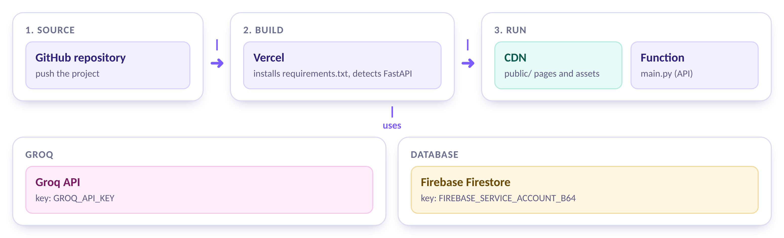
Deploying on Vercel with Firebase
Add GROQ_API_KEY
Add the Firebase key
Check /api/health
Your Groq key, kept in the Vercel settings
FIREBASE_SERVICE_ACCOUNT_B64, made with the encoder tool
It should report storage: firestore
Notes:
Deployment is simple. Push the repository to GitHub, import it into Vercel, add two environment variables, and deploy. Vercel serves the public folder from its CDN and runs main.py as a function. The health endpoint confirms which storage is active.

Slide 19
Challenges and how we solved them
Challenge | Solution
Vercel's disk is read-only | A storage layer picks Firestore in production and keeps SQLite for local work
The AI does not always return clean JSON | JSON mode, a tolerant parser and a clear error message
Pasted emails could contain instructions | Prompts mark them as content to answer, not commands
A public link would share one database | A cookie gives every browser a private space
Urdu in Word and PDF | Right-to-left support in the page, in Word, and a print-only sheet for PDF
The page must feel alive while the AI works | Locked controls, progress labels and a typing effect
Notes:
These were the main engineering challenges and how each was solved. The biggest was Vercel's read-only disk, which led to the storage layer with an automatic choice between SQLite and Firestore.

Slide 20

Where LetterLy can go next
Next
Later
Ideas
Sign-in
More languages
Subject A/B tests
Accounts instead of cookie spaces
Arabic, Hindi and more
Compare open rates
Rate limits
Send from Gmail
Calendar-aware replies
Protect the shared AI key
Mail provider integration
Suggest meeting times
Streaming
Team templates
Installable app
Show the email as it is written
Share templates with a group
A phone-friendly web app
Notes:
There are many ways to take LetterLy further. These are ideas to explore, not promises: accounts and rate limits first, then more languages and mail integration, and finally larger ideas such as a phone app.

Slide 21

Thank you
Questions?
A complete product, not just a form: 22 endpoints and 7 screens
AI used with care: structured prompts, validation and safe handling
Ready to ship: tested, documented and set up for Vercel and Firebase
Anushay Ayat
SMIT (Saylani Mass IT Training) | AI and Data Science
Notes:
To close: LetterLy is a complete product rather than a simple form. The AI is used with care, and the project is tested, documented and ready to deploy. Thank you, and I am happy to take questions.

