Slide 1
B
SMIT | AI & DATA SCIENCE
AI Bug Report Analyzer
Built with LangGraph, Gemini and FastAPI
SUBMITTED BY
COURSE
Anushay Ayat
AI and Data Science
BATCH
SUBMISSION DATE
12
22 / 10 / 2026
Notes:
Introduce yourself, the course and the assignment title.

Slide 2
Agenda
What this presentation covers
01
Problem & objective
02
Solution overview
03
LangGraph workflow
04
System architecture
05
Backend implementation
06
Frontend & user experience
07
Screenshots / demo
08
Testing & challenges
09
Future scope & conclusion

Slide 3
Problem & Objective
Why a bug report analyzer?
The problem
The objective
Bug reports are written in free-form, unstructured language
Developers waste time asking for missing details
Severity is judged inconsistently between reporters
Root-cause hunting starts from zero every time
Accept a bug description in natural language
Extract title, feature and summary automatically
Classify severity: Critical, High, Medium, Low
Suggest likely root causes
Produce one clean, structured bug report

Slide 4
Solution Overview
A multi-step AI workflow instead of a single prompt
Input
LangGraph
Gemini
Output
User pastes a bug description in the web app
4 specialised nodes pass a shared typed state
Structured (Pydantic) output keeps every step reliable
Readable report + JSON, copy / download ready
→
→
→
Why LangGraph? Each task is isolated, testable and easy to extend - e.g. adding a duplicate-detection node later needs only one new node and one edge.

Slide 5
LangGraph Workflow
START → 4 nodes → END
Bug text
↓
Node 1
Node 2
Node 3
Node 4
Bug Analysis
Severity Detection
Root Cause
Format Report
Title, affected feature, issue summary
→
Critical / High / Medium / Low + reason
→
3-5 possible technical causes
→
Steps to reproduce, next steps, final report
Shared state: bug_description → title, affected_feature, summary → severity, severity_reason → root_causes → steps, next_steps, final_report

Slide 6
Technology Stack
Modern, lightweight and easy to deploy
Backend
AI orchestration
LLM
Python 3.10+, FastAPI, Uvicorn
LangGraph (StateGraph), LangChain
Google Gemini via langchain-google-genai
Validation
Frontend
Streaming
Pydantic v2 structured output
HTML5, CSS3, vanilla JavaScript
Server-Sent Events (SSE)

Slide 7
Project Structure
Clean separation of concerns
ai-bug-report-analyzer/
├── backend/app/
│ ├── main.py FastAPI entry
│ ├── config.py settings (.env)
│ ├── schemas.py Pydantic models
│ ├── api/routes.py REST + SSE
│ ├── graph/
│ │ ├── state.py BugState
│ │ ├── prompts.py prompts
│ │ ├── nodes.py 4 nodes
│ │ └── workflow.py graph
│ └── services/ llm + demo
├── frontend/ (html, css, js)
├── tests/ docs/ README.md
Design principles
Prompts separated from logic
One file per responsibility
LLM access isolated in services/
Graph wiring in one place
Frontend served by FastAPI
Config via environment variables

Slide 8
State & Node Implementation
Each node returns a partial state update
class BugState(TypedDict, total=False):
bug_description: str
title: str
affected_feature: str
summary: str
severity: str
severity_reason: str
root_causes: List[str]
steps_to_reproduce: List[str]
suggested_next_steps: List[str]
final_report: str
g.add_edge(START, "bug_analysis")
g.add_edge("bug_analysis",
"severity_detection")
... g.add_edge("format_report", END)
How it works
Node calls Gemini with a focused prompt
with_structured_output(Schema) returns validated Pydantic objects
Result is merged into shared state
Format node renders the final Markdown report
Any LLM failure falls back to the offline engine

Slide 9
Severity Classification
Four levels with clear definitions
Critical
Crash, data loss, security hole or payments fully blocked
High
Major feature broken, no reasonable workaround
Medium
Feature degraded or inconsistent, workaround exists
Low
Cosmetic issue or minor inconvenience

Slide 10
REST API
Interactive docs available at /docs
Method | Endpoint | Purpose
GET | /api/health | Status, version and active engine
GET | /api/samples | Sample bug descriptions for the UI
POST | /api/analyze | Run workflow, return full JSON report
POST | /api/analyze/stream | Stream one SSE event per finished node
Request body: { "description": "Users cannot log in after the latest update..." } (10 - 4000 characters, validated by Pydantic)

Slide 11
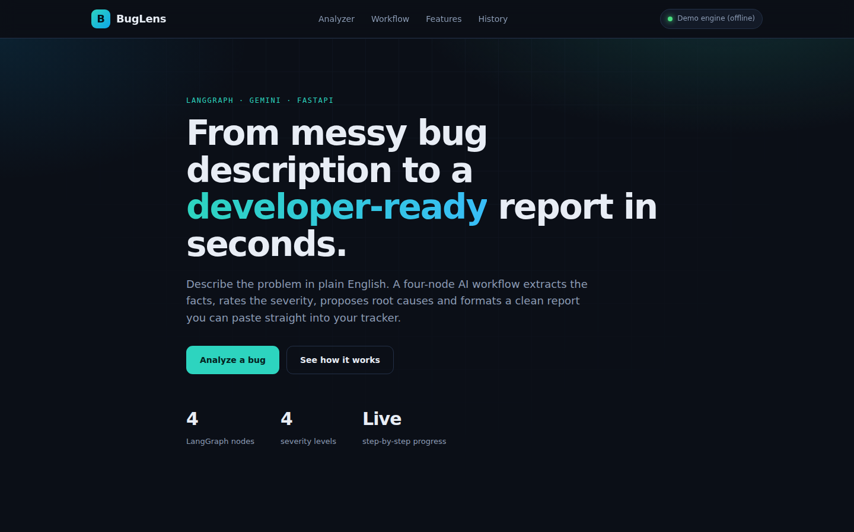
Home page
Hero section with clear call to action

Slide 12
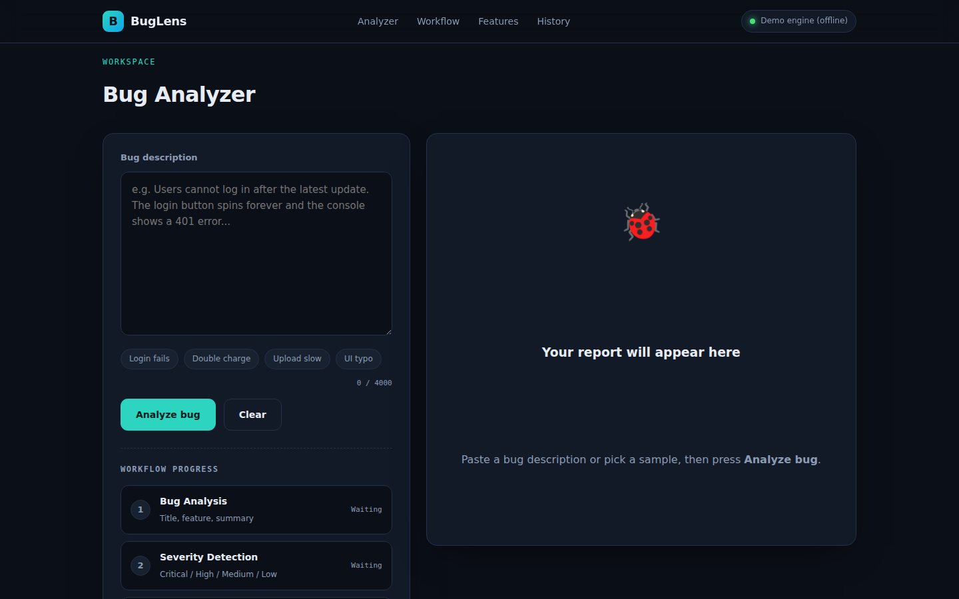
Bug analyzer workspace
Input, sample bugs and workflow tracker

Slide 13
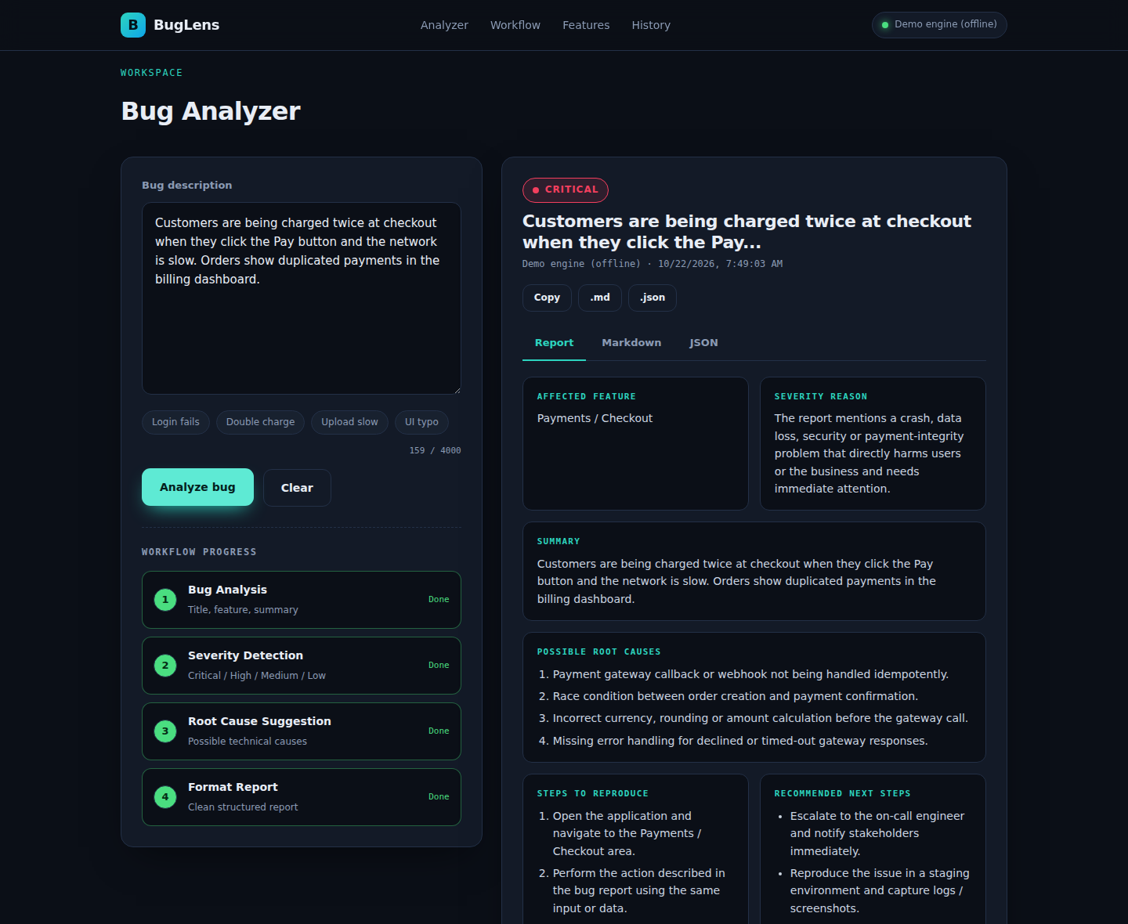
Live workflow & report
Nodes finish one by one; report appears on the right

Slide 14
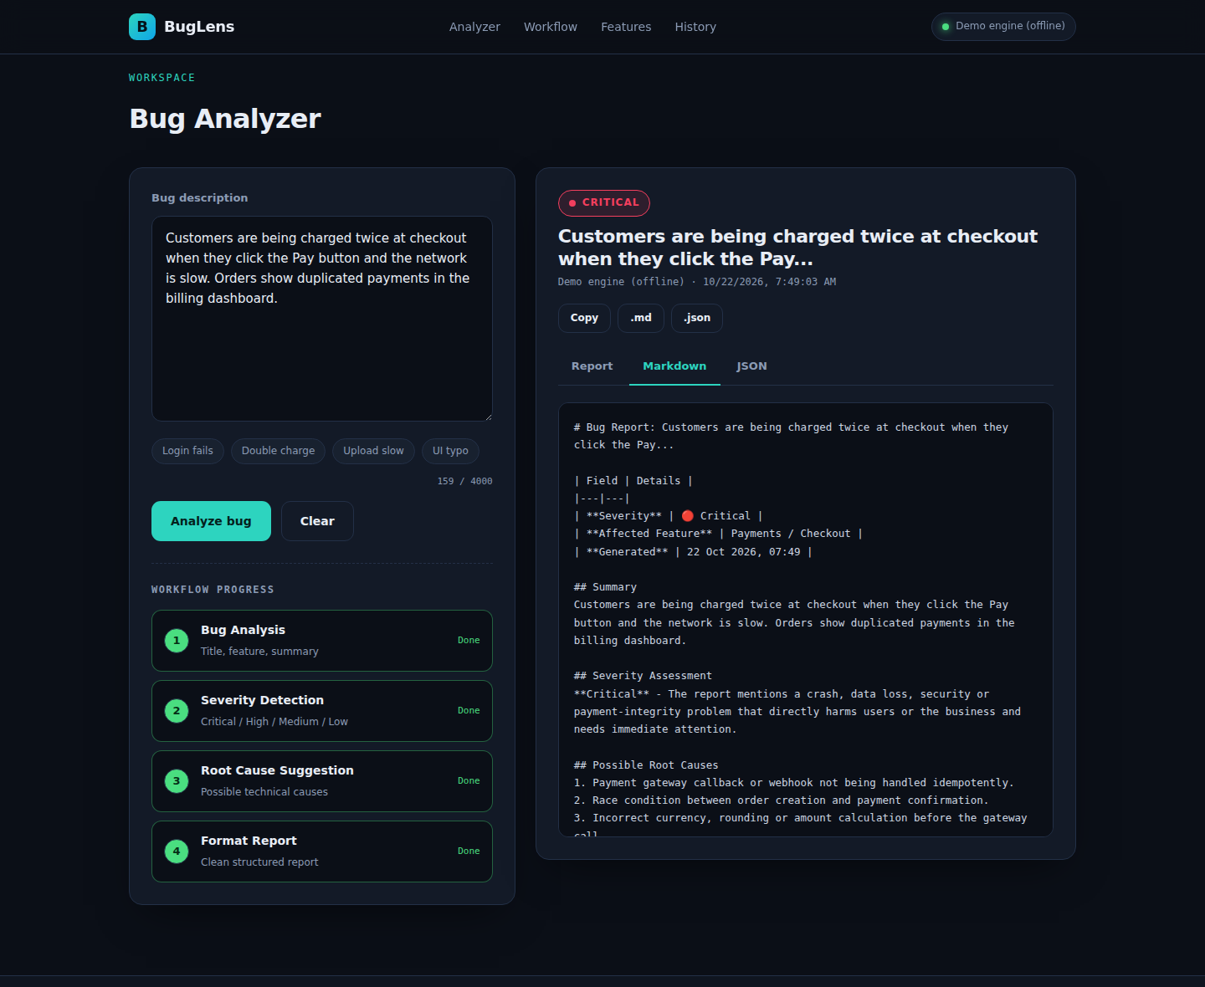
Markdown & JSON output
Developer-ready exports

Slide 15
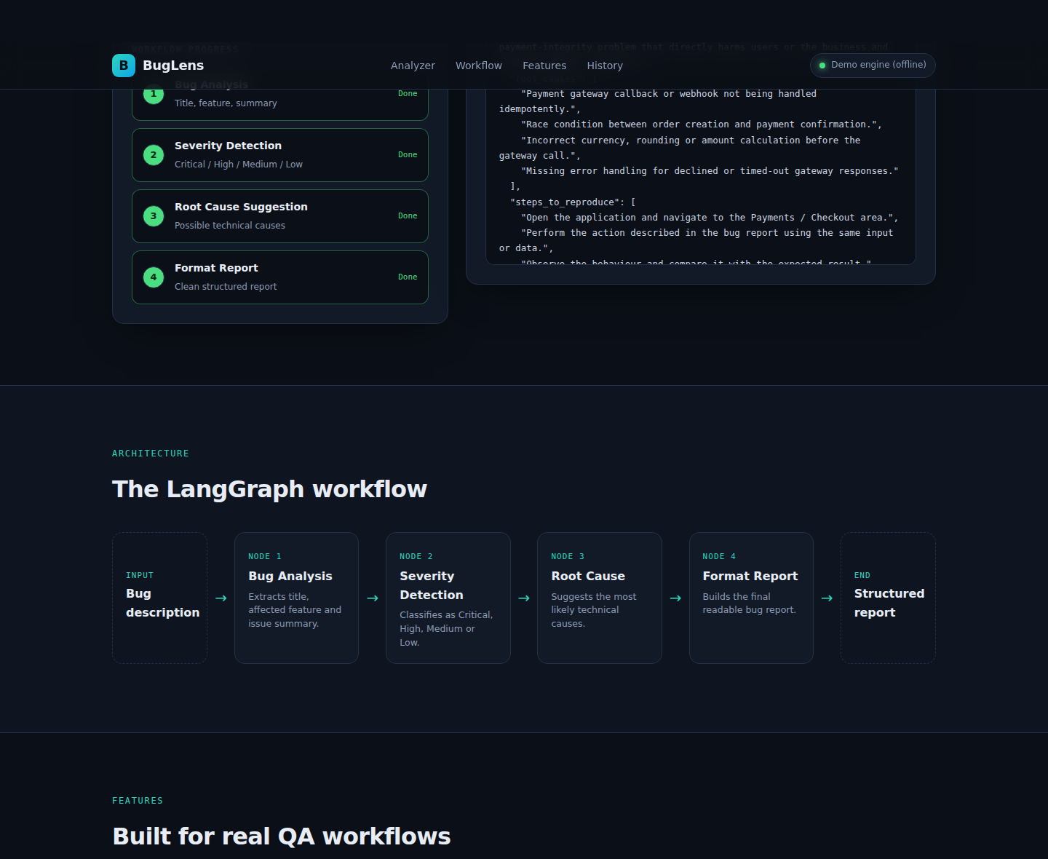
Architecture & features
Workflow explainer section

Slide 16
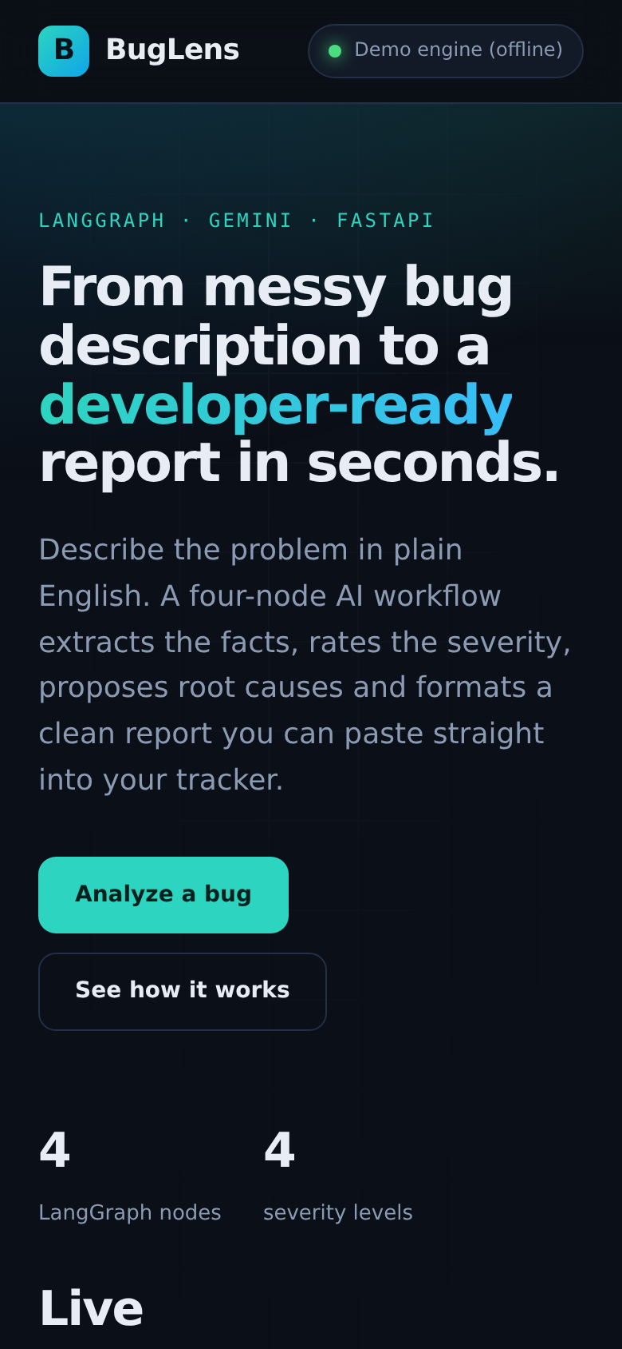
Responsive design
Works on phones as well as desktops
Frontend highlights
Dark, professional design system with CSS variables
Fully responsive grid (desktop, tablet, mobile)
Real-time stepper driven by Server-Sent Events
Severity badges: red, orange, yellow, green
Copy, .md and .json export buttons
Local history of the last six analyses

Slide 17
Sample Output
Input → structured bug report
Input
Output (excerpt)
Customers are being charged twice at checkout when they click the Pay button and the network is slow. Orders show duplicated payments in the billing dashboard.
Severity: Critical
Feature: Payments / Checkout
Root causes:
1. Gateway callback not handled idempotently
2. Race condition between order creation and payment confirmation
Next steps: escalate to on-call, reproduce on staging, add regression test
→

Slide 18
Testing & Quality
Automated tests with pytest
What is tested
Reliability measures
Full graph run returns every state field
Critical vs Low severity classification
/api/health and /api/analyze endpoints
Input validation (too-short text → 422)
Pydantic validates all LLM output
Fallback engine if Gemini fails or key missing
Input length limits on the API
Clear error messages shown in the UI

Slide 19
Challenges & Solutions
Unreliable free-text LLM output
→
Used structured output with Pydantic schemas for every node
App unusable without API key
→
Built an offline rule-based fallback engine
Users wait without feedback
→
Streamed node-by-node progress with SSE
Keeping nodes independent
→
Typed shared state + partial updates per node

Slide 20
Future Enhancements
Where the project can grow
Duplicate bug detection with embeddings
Direct export to Jira / GitHub Issues
Screenshot and log-file analysis (multimodal)
User accounts and a persistent database
Team dashboards with severity analytics
Docker deployment and CI pipeline

Slide 21
Conclusion
What was achieved
Implemented the complete 4-node LangGraph workflow from the assignment
Delivered a professional full-stack application: FastAPI backend + responsive website
Structured Gemini output, live progress, exports and history go beyond the brief
Clean folder structure, documentation, tests and screenshots included
Ready to extend with more nodes and integrations

Slide 22
Thank You
Questions?
Anushay Ayat | AI and Data Science | Batch 12 | SMIT

