Slide 1
Gradewise
AI Assignment Reviewer with a teacher-in-the-loop
LangChain | LangGraph | LangSmith | Groq | FastAPI
Anushay Ayat - AI and Data Science, SMIT

Slide 2
Problem and objective
The problem
The objective
Reviewing many student answers by hand is slow and inconsistent. A plain LLM score is fast, but borderline answers need a human decision.
Build a workflow that scores answers against a rubric, flags borderline results (4-6 / 10) for a teacher, and records every run in LangSmith.
What was delivered
The teacher's terminal script was turned into a complete web application: FastAPI backend, multi-page frontend, SQLite storage, custom rubrics, teacher queue, analytics dashboard, PDF and CSV export, automated tests and LangSmith tracing.

Slide 3
Technology stack
Backend
AI workflow
Observability
FastAPI, Pydantic, SQLite, ReportLab, pypdf, python-docx
LangChain prompt + Groq model with structured output, LangGraph state graph
LangSmith tracing, run names, tags, metadata, teacher feedback
Frontend
Quality and security
Demo mode
Vanilla JavaScript single-page app, SVG charts, command palette, English/Urdu, dark mode
12 pytest tests, PBKDF2 passwords, signed HttpOnly sessions, input validation, escaped output
Offline keyword grader so the app runs without an API key

Slide 4
System architecture
Browser
SPA: review, history, queue, dashboard
FastAPI
REST API + static files
LangGraph
evaluate, route, teacher_review, finish
Groq LLM
via LangChain
SQLite
questions and reviews
LangSmith
traces and teacher feedback
Request flow: the browser calls the API, the API runs the graph, the result is stored and returned.

Slide 5
LangGraph workflow
3a. teacher_review
Flagged for the teacher queue
START
Answer + rubric
1. evaluate
LLM scores each criterion, scores are clamped and normalised to /10
2. route
Is score 4 to 6?
3b. finish
Feedback ready
The routing rule is the teacher's original design; the band is configurable through REVIEW_MIN and REVIEW_MAX.

Slide 6
Rubric scoring and routing
Step | Rule
Criteria | Each question has 1-8 criteria with its own max points and description
Model output | Structured JSON: score + comment per criterion, feedback, one improvement
Validation | Scores are clamped to each criterion maximum; missing criteria get 0
Normalisation | score = round(total / max_total x 10)
Routing | 4 to 6 goes to the teacher; everything else is final
Safety | Prompt treats the answer as data and ignores instructions inside it

Slide 7
LangSmith tracing
What is traced
Teacher feedback loop
Every review is one named run ("Assignment review") with tags, the student name and question title as metadata, and a unique run id stored with the review. Each node and the Groq call appear as child spans.
When the teacher approves or overrides a score, the final score is posted to the same run as feedback (teacher_final_score), so AI and human scores can be compared in LangSmith.
How to read a trace
evaluate (LangChain prompt + ChatGroq openai/gpt-oss-120b + PydanticToolsParser) -> route -> teacher_review or finish. Latency and token counts are shown per step, so slow or costly calls are easy to find.

Slide 8
Feature overview
Rubric AI scoring
Custom questions
Teacher queue
Batch review
Per-criterion marks and comments
Weighted rubrics you define
Approve or override with a note
CSV or many files, live progress
File upload
Integrity check
AI vs teacher
Re-evaluate
PDF, DOCX and TXT answers
Finds near-identical answers
Agreement rate on the dashboard
Re-run and compare scores
Login and roles
PDF and CSV
Command palette
English and Urdu
Teacher and student accounts
Result PDFs, class CSV export
Ctrl+K, shortcuts, guided tour
RTL support, dark mode, print

Slide 9
Accounts and roles
Teacher
Student
Account comes from .env. Can create questions, run batch reviews, decide queue items, re-evaluate, view the dashboard and integrity check, and export CSV.
Registers a free account. Can submit answers and see only their own reviews and PDFs. Teacher pages return 403; other students' reviews return 404.
How sessions are protected
Passwords are hashed with PBKDF2-SHA256. Sessions are signed HttpOnly cookies that expire. Repeated failed logins are throttled. Students never receive similarity data or trace ids.

Slide 10
Batch review and file upload
Batch review
File upload
Upload a CSV with student_name,answer, or drop many answer files (one per student). Reviews run one after another with a live progress bar, a summary, and a results CSV download.
PDF, DOCX, TXT and MD are read on the server (5 MB limit). The text fills the answer box, so the teacher can check it before reviewing.
Limits
Up to 100 answers per batch, 6000 characters per answer. Scanned PDFs without a text layer cannot be read.

Slide 11
Integrity check
How it works
How to read it
Each answer is turned into a set of three-word sequences. Two answers are compared with the Jaccard overlap of those sets. New submissions are compared with earlier answers to the same question and flagged at 60% or more.
The Integrity page lists pairs above an adjustable threshold with both answers side by side. A high match is a reason to look closer, not proof of copying; short model answers can match naturally.

Slide 12
AI vs teacher agreement
The metric
Why it matters
Of all borderline reviews the teacher decided, the agreement rate is the share approved without change. For overrides, the average change in points is also shown.
It measures how much the AI can be trusted. The same decisions are sent to LangSmith as feedback, so traces can later be filtered by teacher score.

Slide 13
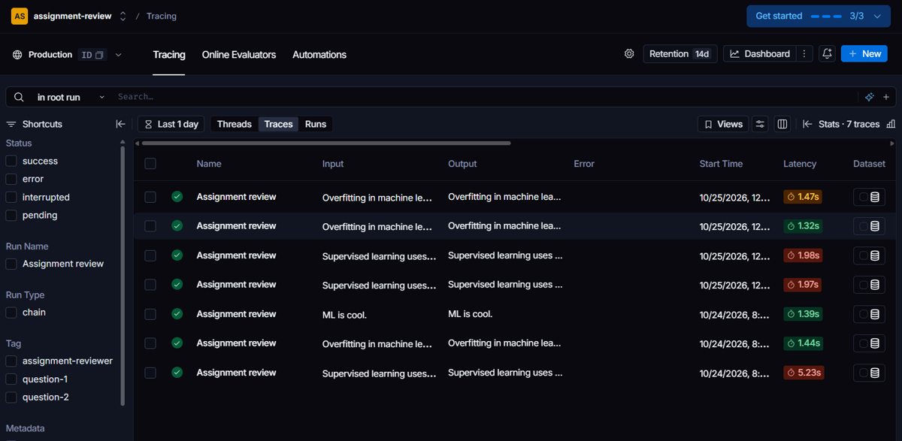
LangSmith: runs
Every review is one "Assignment review" run in the assignment-review project

Slide 14
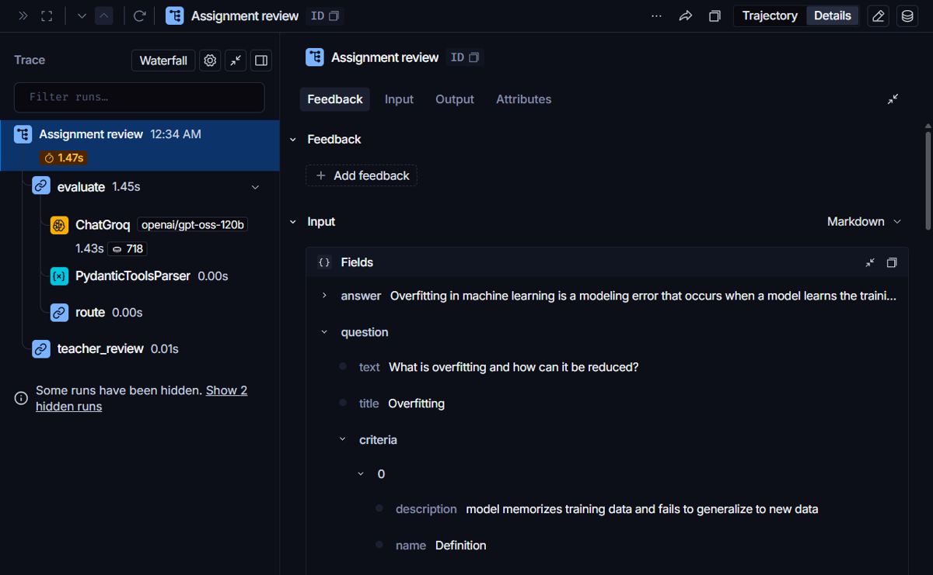
LangSmith: trace
Trace tree: evaluate, ChatGroq, PydanticToolsParser, route, teacher_review

Slide 15
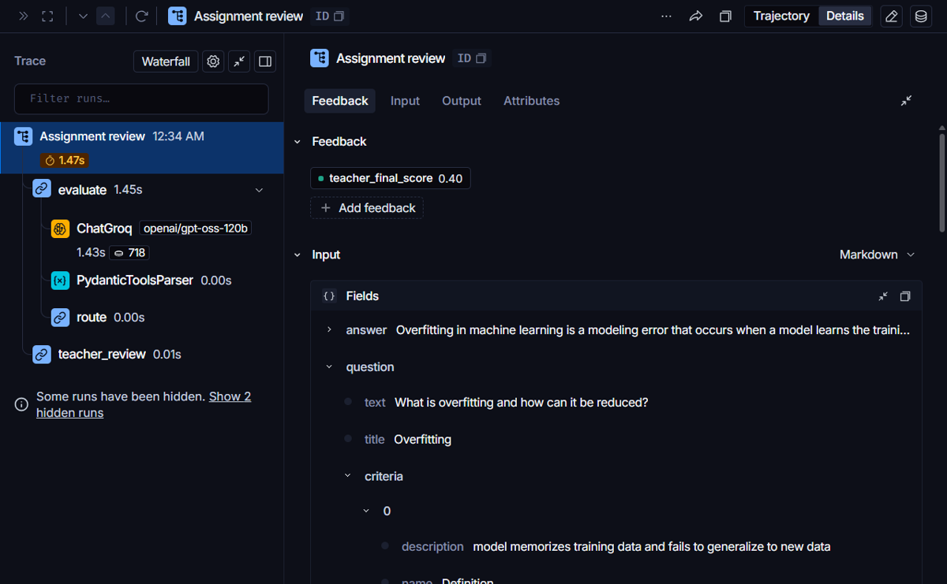
LangSmith: teacher feedback
The teacher's decision is attached to the run as teacher_final_score (0.40 = 4/10)

Slide 16
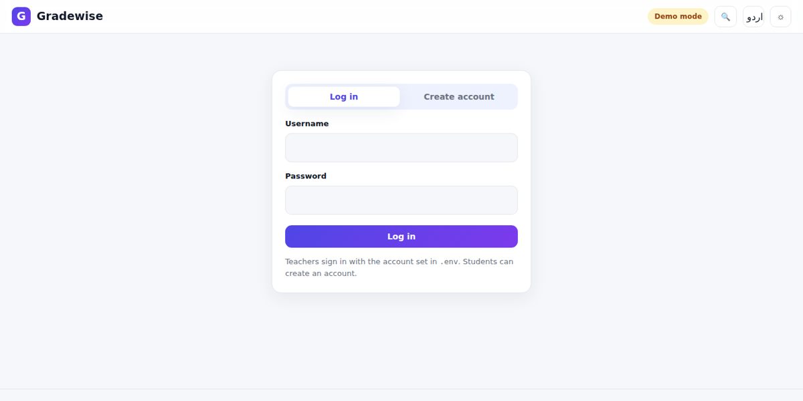
Login
Login and student registration

Slide 17
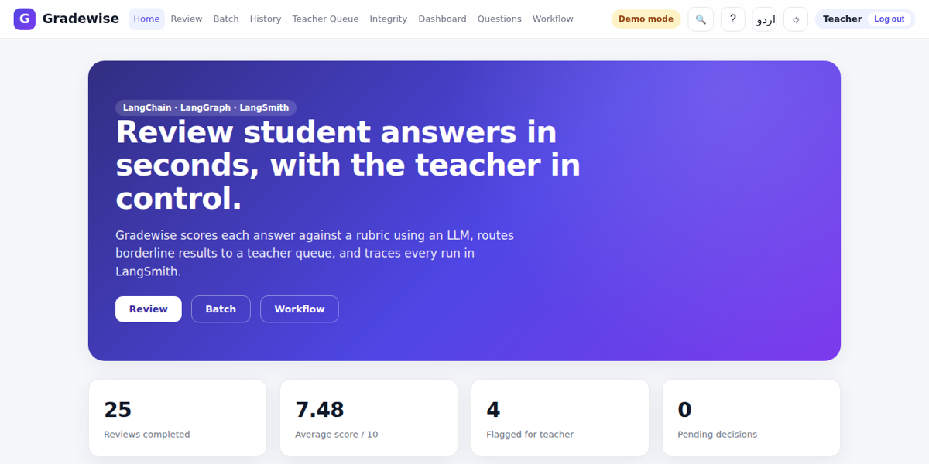
Home page
Landing page with live statistics (teacher view)

Slide 18
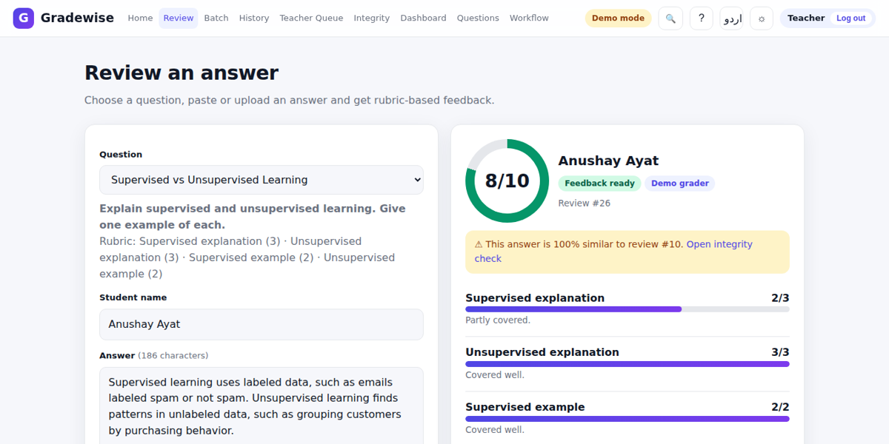
Review result
Animated score ring, rubric bars, feedback, similarity warning, PDF, print, re-evaluate

Slide 19
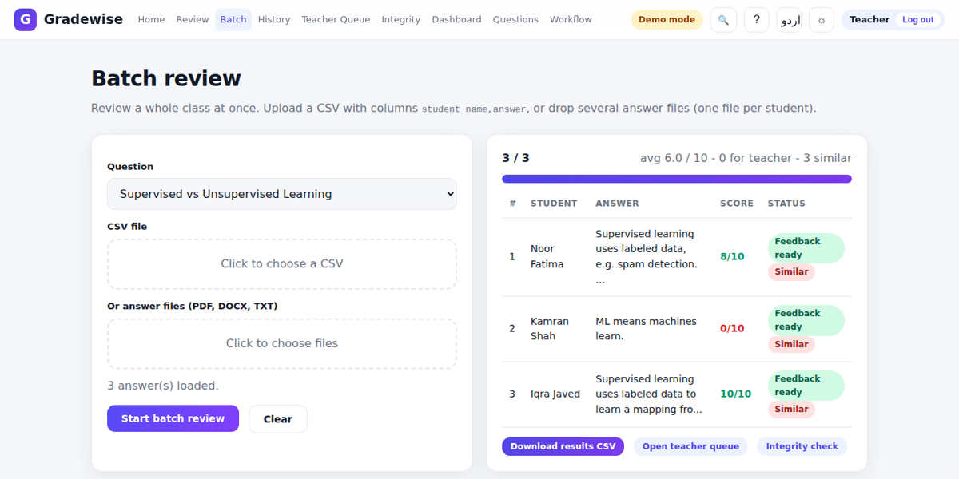
Batch review
Whole-class review from a CSV with live progress

Slide 20
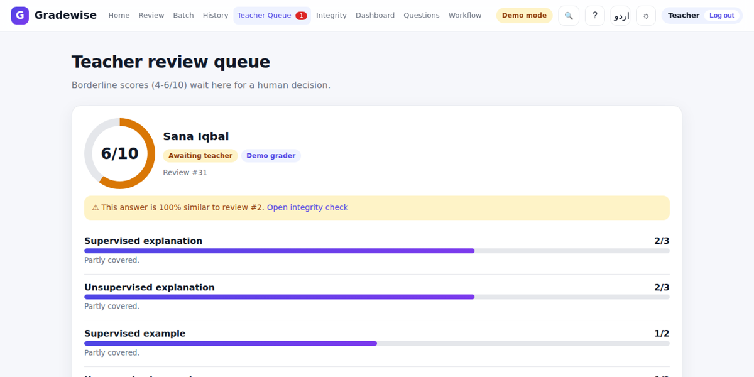
Teacher review queue
Borderline reviews wait for approve or override

Slide 21
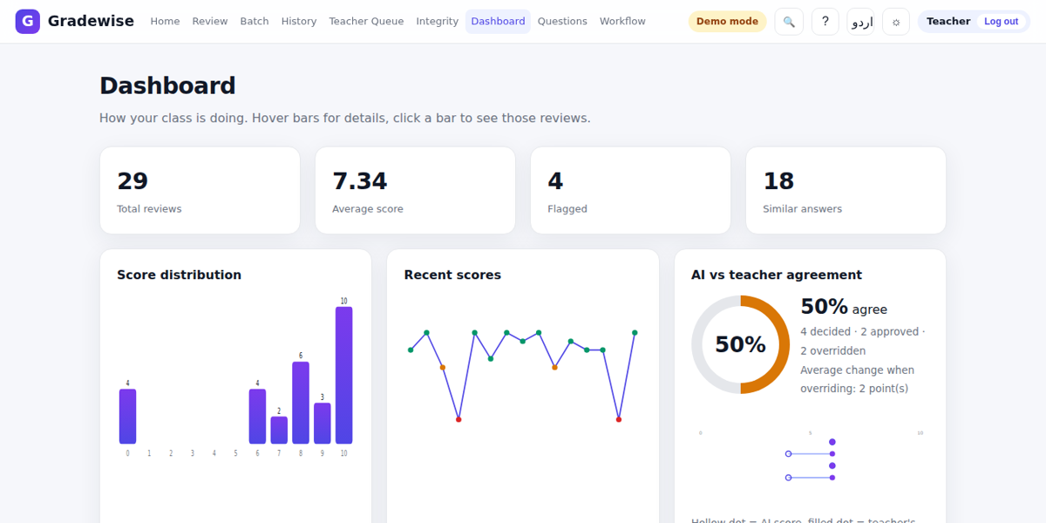
Analytics dashboard
Distribution, trend and AI vs teacher agreement, with tooltips and click-through

Slide 22
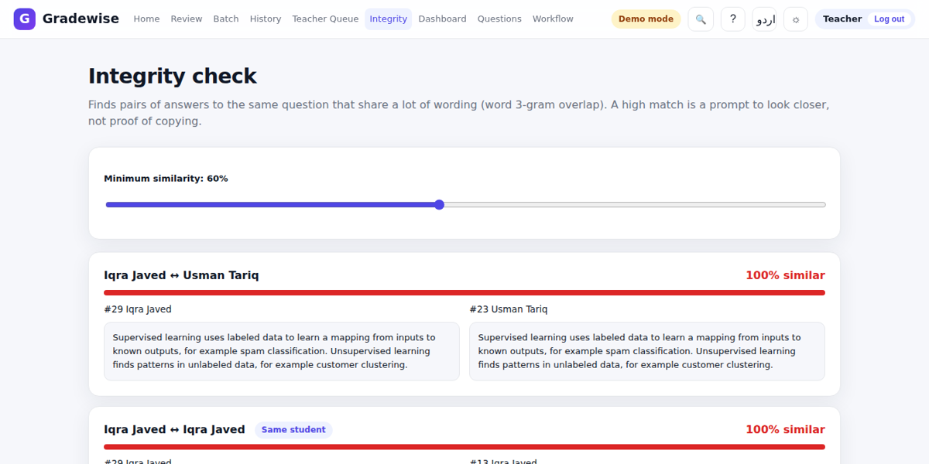
Integrity check
Side-by-side comparison of similar answers

Slide 23
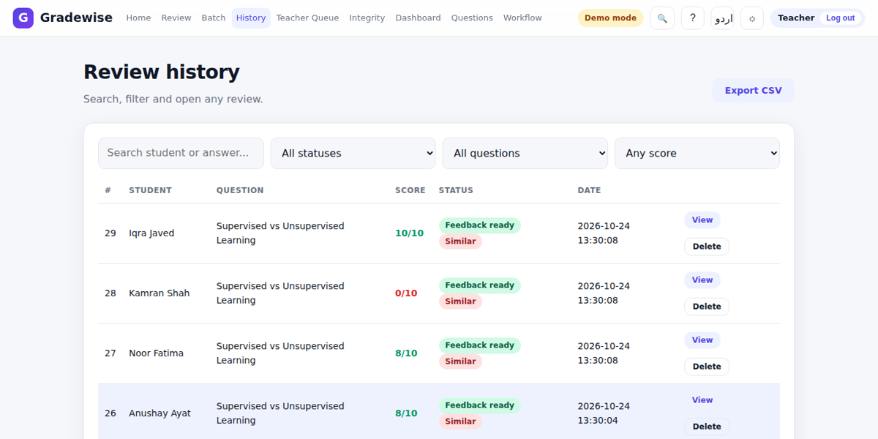
History and filters
Search by student, filter by status, question or score

Slide 24
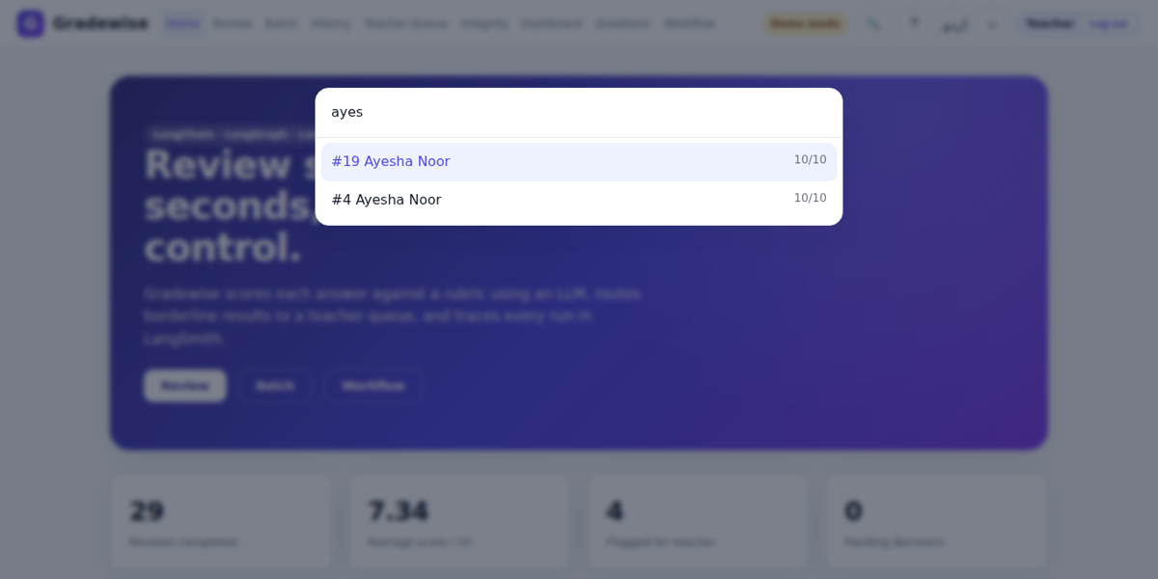
Quick search
Ctrl+K command palette finds pages and reviews

Slide 25

Urdu and dark mode
Right-to-left Urdu interface in dark theme

Slide 26
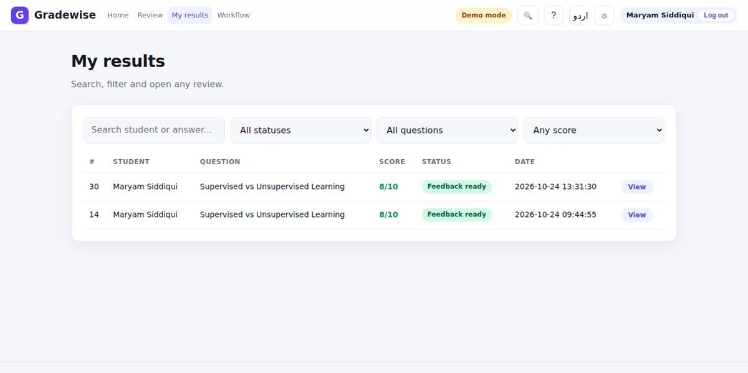
Student view
Students see only their own results

Slide 27
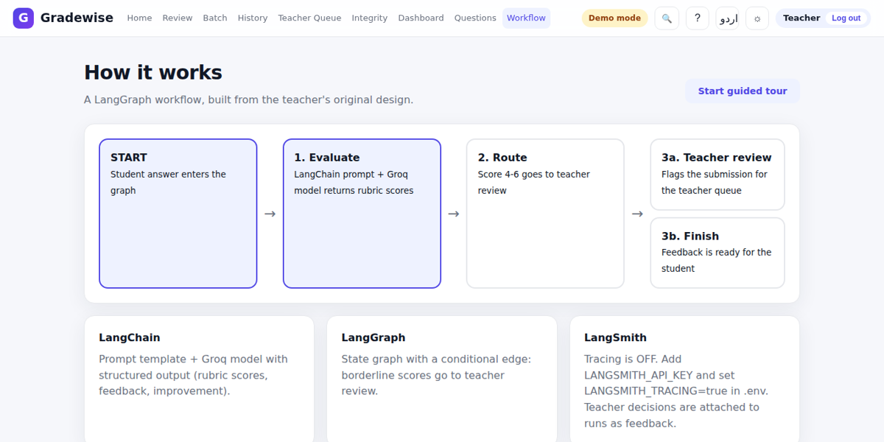
Workflow page
The graph and the active runtime mode shown inside the app

Slide 28
Project structure
assignment-reviewer/
run.py start the app
requirements.txt .env.example README.md
backend/app/
main.py config.py db.py schemas.py
api/routes.py REST endpoints
graph/ state, nodes, builder (LangGraph)
services/ llm tracing pdf auth ...
backend/tests/ pytest suite
frontend/ index.html, css/, js/
docs/ report, slides, screenshots
Why this layout
Routes, graph logic, services and storage are separate modules, so the LLM, tracing or database can change without touching the rest. Config comes from environment variables only.

Slide 29
Testing and quality
Automated tests
Safety and robustness
12 pytest tests: login and roles, student isolation (403/404), review flow, score range, routing band edges, teacher override, PDF, similarity detection, re-evaluate, file extraction (txt, docx), agreement stats and CSV.
Pydantic validation on every input, escaped output, hashed passwords and signed sessions, rate-limited login, CSV formula protection. LangSmith failures never break a review.
Honest limits
Demo mode is a keyword grader and is not a replacement for the LLM. Live Groq and LangSmith runs need the student's own API keys; the AI score is a suggestion and the teacher decides.

Slide 30
Conclusion and future work
Summary
Future work
The teacher's CLI idea is now a complete, traced and tested web application. It keeps the original graph and routing rule, and adds rubrics, roles, batch review, integrity checks, a teacher queue, analytics and LangSmith feedback.
LangSmith datasets and evaluators, OCR for scanned answers, semantic (embedding) similarity, email notifications, deployment with HTTPS.

