Slide 1

AI AND DATA SCIENCE PROJECT
BATON
A crew of AI agents that researches, analyses and writes for you
PRESENTED BY
ANUSHAY AYAT
AI and Data Science | SMIT | November 2026
Notes:
Introduce yourself and the project: Baton is a crew of three AI agents that turns a topic into a report.

Slide 2
Project at a glance
3
3
5
2
Specialist agents
Report lengths
Writing voices
Modes: local and cloud
Describe a topic. A Researcher, an Analyst and an Editor hand the work to each other and deliver a structured report, while you watch every step on a live mission-control dashboard. Reports are stored privately in your own account and every agent run is traced.
Notes:
Four numbers that describe the product.

Slide 3
What we will cover
01
02
03
04
05
The idea
The crew
The design
Product tour
Build and deploy
Estimated talk time: about 20 minutes
Notes:
Five parts.

Slide 4
01
The idea
Why research needs a crew, and what Baton sets out to do.
Notes:
Why research needs a crew, and what Baton sets out to do.

Slide 5
From scattered work to one crew
Without Baton
With Baton
Research, analysis and writing in separate tools
One chatbot answer hides how it was made
Hard to repeat, review or keep results
No record of what happened
Three specialists, one clear hand-off
Every step visible live, with timings
Private archive of every report
Every agent run traced in LangSmith
Notes:
Left: today. Right: with Baton.

Slide 6




Project objectives
Divide the work
Make it visible
Specialist agents with clear roles and hand-offs
Live progress, mission log and output previews
Keep it private
Ship it
Secure sign in and a per-user report archive
Deploy on Vercel and Firebase with LangSmith tracing
Notes:
Four goals that shaped the build.

Slide 7
02
The crew
Three agents, one job each.
Notes:
Three agents, one job each.

Slide 8



Meet the crew
R-01
A-02
E-03
Researcher
Analyst
Editor
Gathers facts, concepts, developments and applications. Never invents sources.
Weighs insights, risks and opportunities. Uses only the research it is given.
Writes a structured Markdown report in the chosen length and voice.
Input: Topic
Output: Research notes
Input: Research notes
Output: Analysis
Input: Notes and analysis
Output: Final report
Notes:
Each agent has a role, an input and an output.

Slide 9
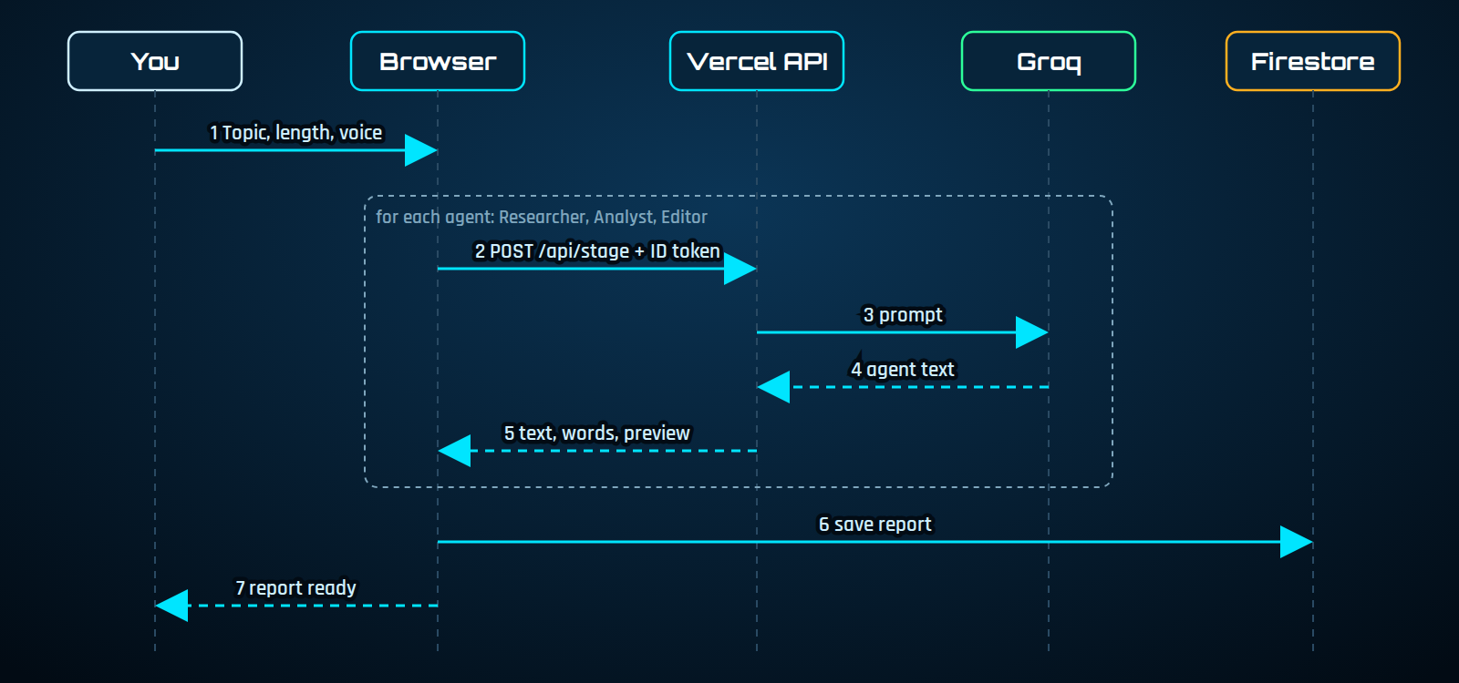
The relay, step by step
Each agent is its own request. Earlier output is passed forward and the report is saved when the Editor finishes.
Notes:
Walk through the numbered steps. Each agent is a separate short request.

Slide 10
03
The design
Architecture, technology, data and look.
Notes:
Architecture, technology, data and look.

Slide 11
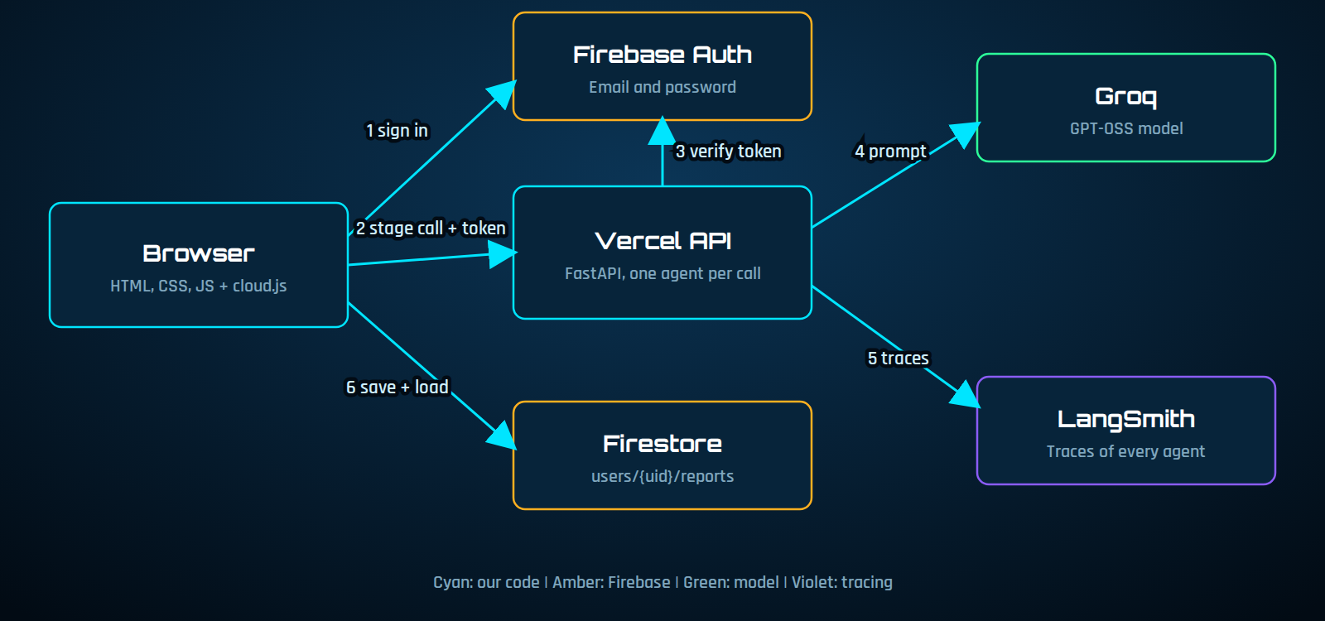
System architecture
The browser handles login and storage. The API verifies the token on every call, asks Groq and sends traces to LangSmith.
Notes:
Browser, Vercel API and three services.

Slide 12







Technology stack
Python and FastAPI
CrewAI
Groq
LangSmith
Backend and API
Local multi-agent crew
Fast GPT-OSS inference
Tracing and debugging
Firebase
Vercel
HTML, CSS, JS
GitHub
Auth and Firestore
Hosting and serverless API
Futuristic HUD interface
Source and deployment
Notes:
Why each tool was chosen.

Slide 13
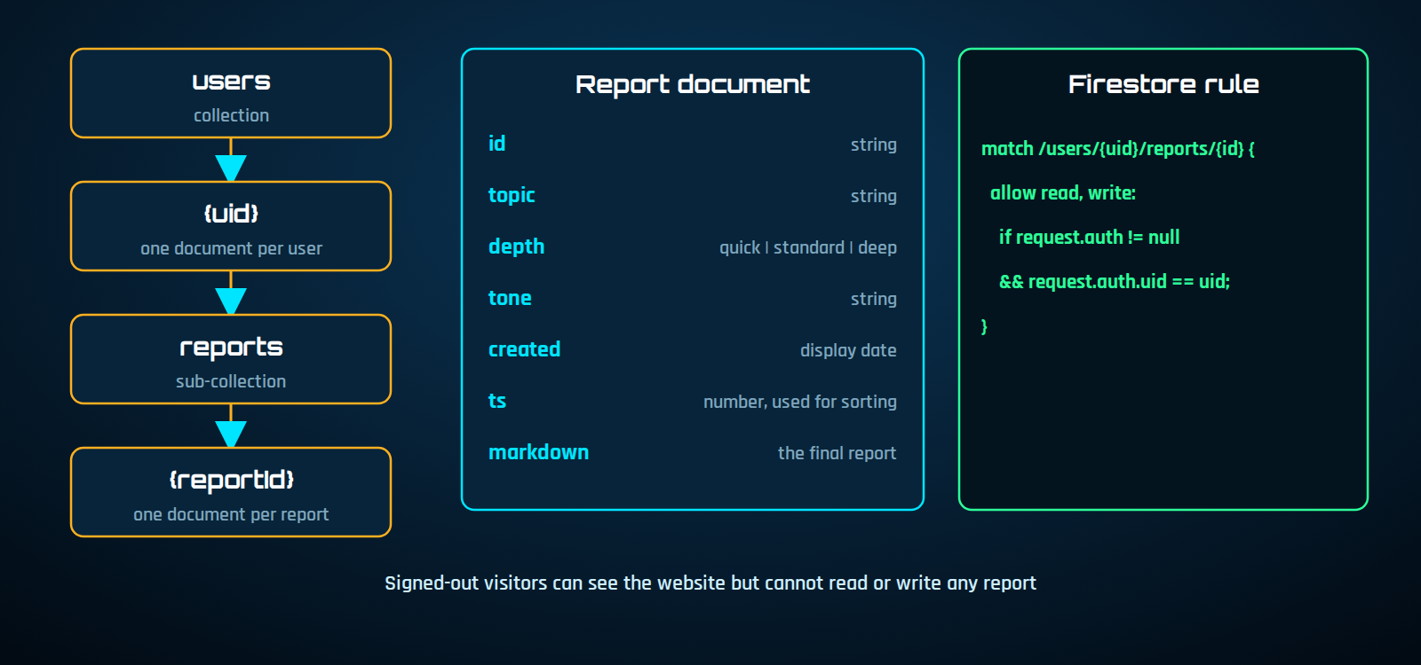
Data model and security
Firebase Auth signs users in, the API checks the ID token, and the rule isolates each user's reports.
Notes:
Reports live under each user. The rule blocks everyone else.

Slide 14
Look and feel
Void
Panel
Cyan: primary and done
#020B14
#07243A
#00E5FF
Blue: rings
Amber: working
Green: online
#1E90FF
#FFB020
#2DFF9A
Headings: Orbitron Text: Rajdhani Motifs: corner brackets, scanlines, particle network, arc reactor
Notes:
A heads-up-display style: dark, glowing, precise. Amber means working, cyan means done.

Slide 15
04
Product tour
The website, mission control, report and login.
Notes:
The website, mission control, report and login.

Slide 16
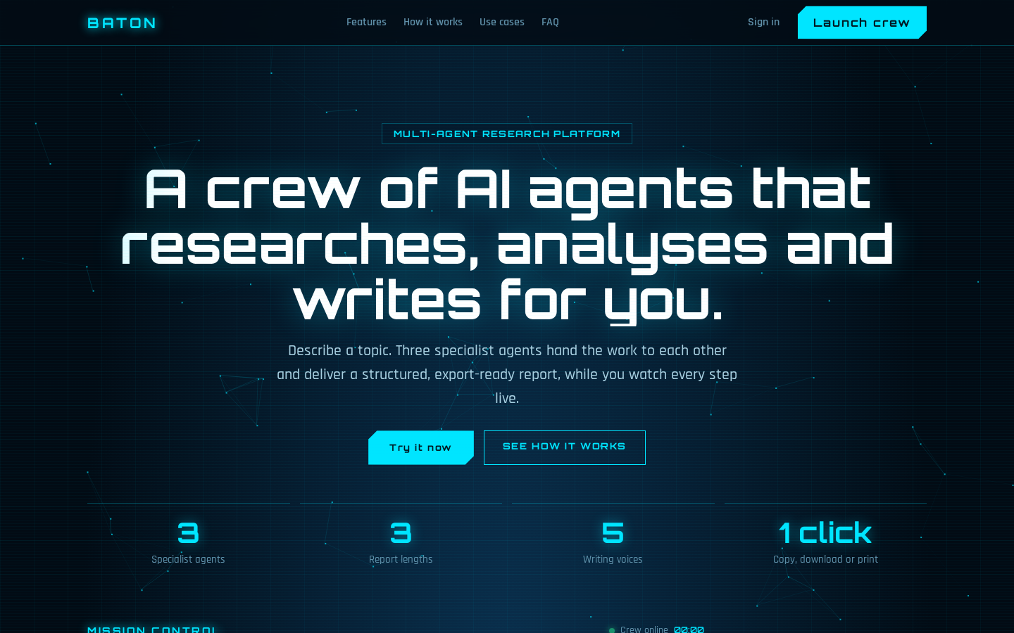
Landing page
Sticky navigation
Live particle background
Clear call to action
Feature, steps and FAQ sections
Notes:
Public site with hero, features, steps, use cases and FAQ.

Slide 17
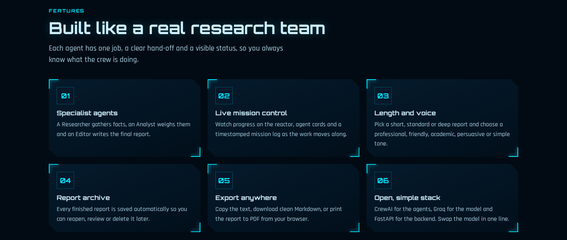
Features
Notes:
Six features, each with a clear job.

Slide 18
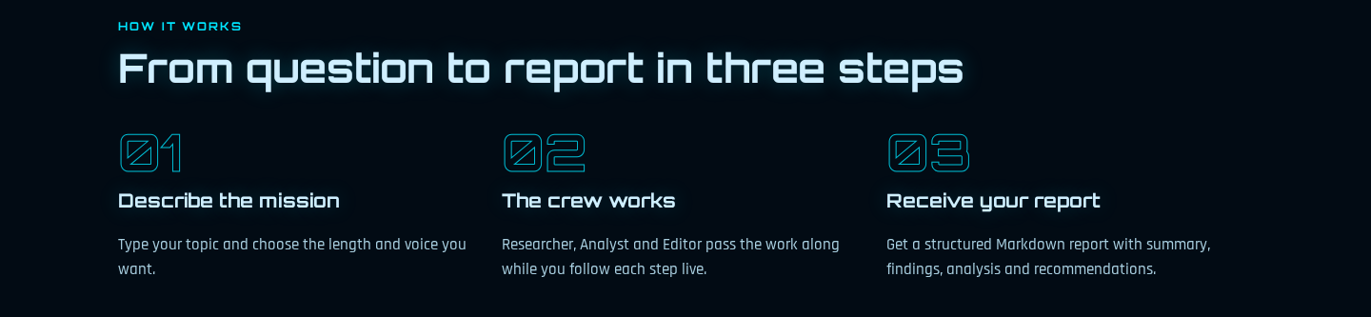
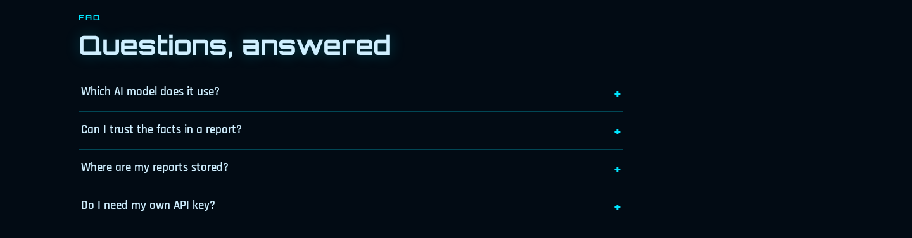
How it works and FAQ
Notes:
Three steps, then common questions.

Slide 19
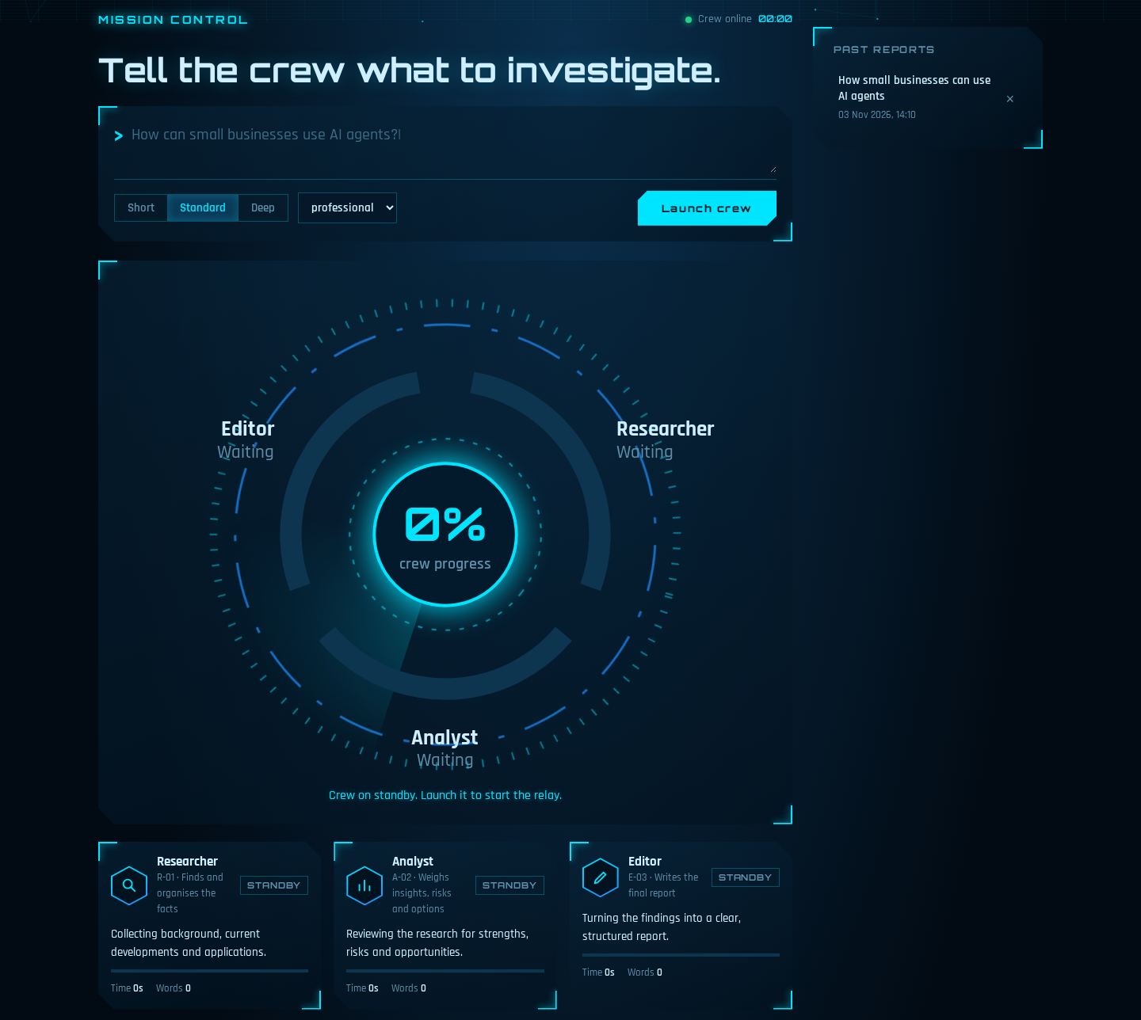
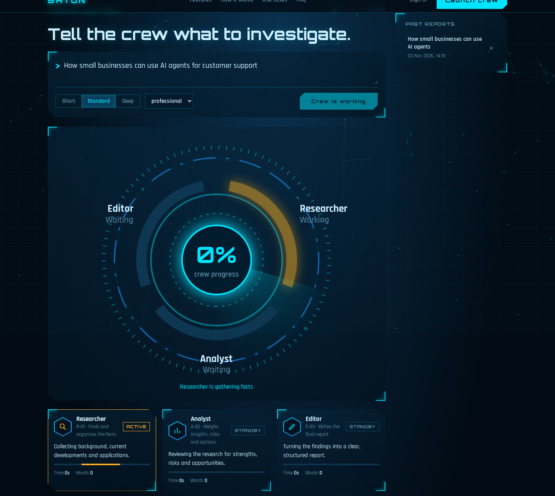
Mission control: ready and running
Ready: command bar, reactor, agent cards
Running: active agent glows amber
Notes:
Left: standby. Right: an agent working in amber.

Slide 20
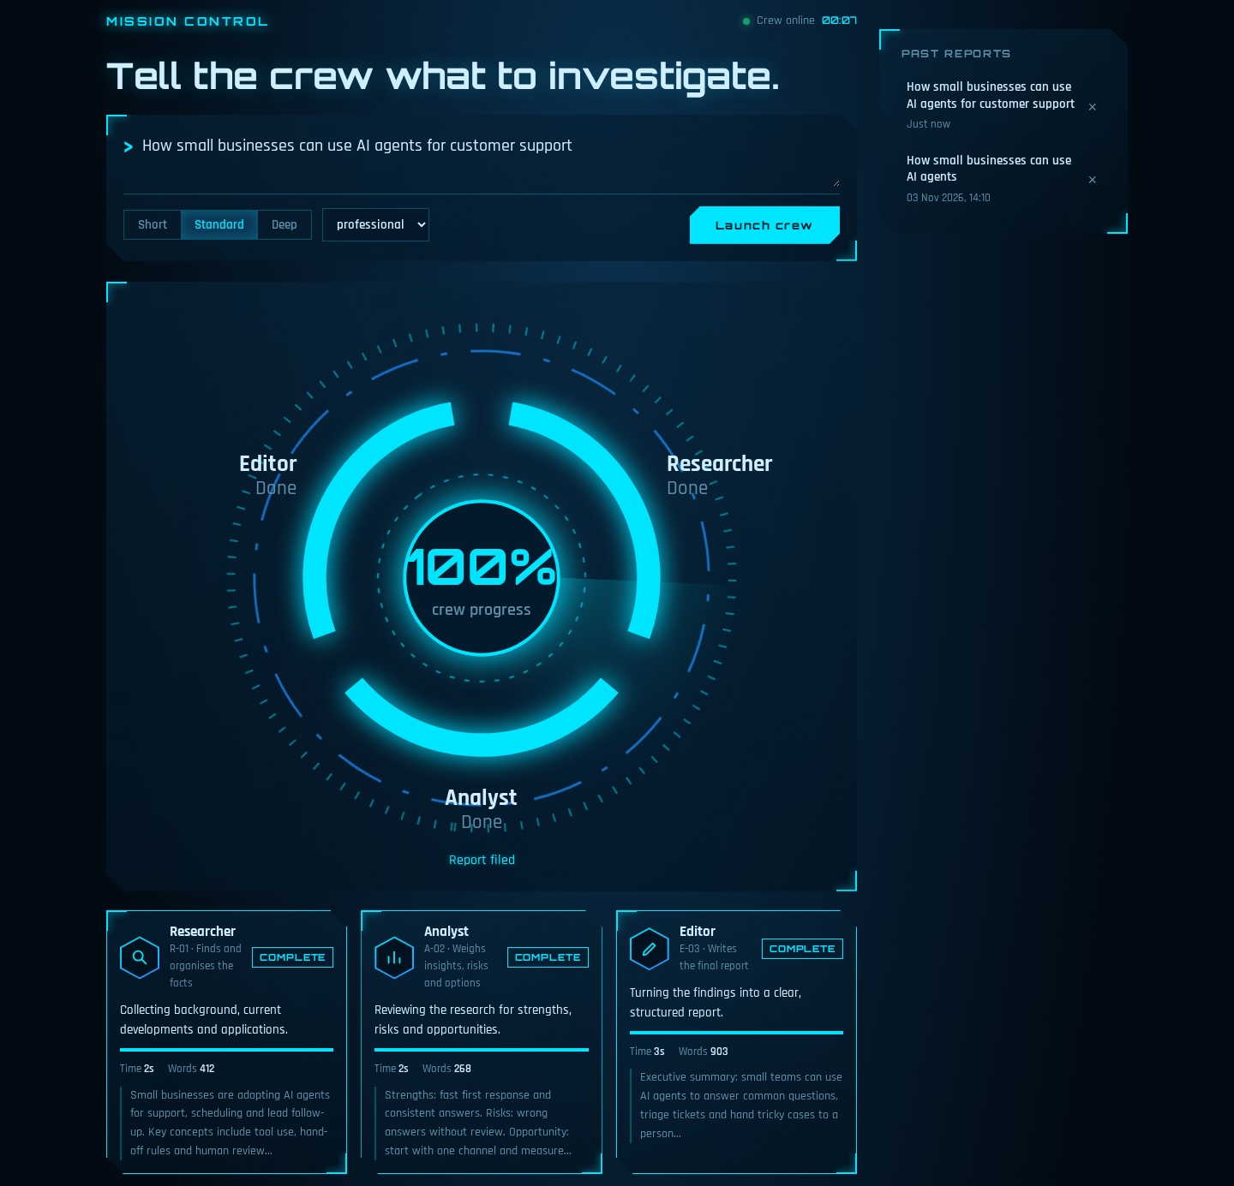
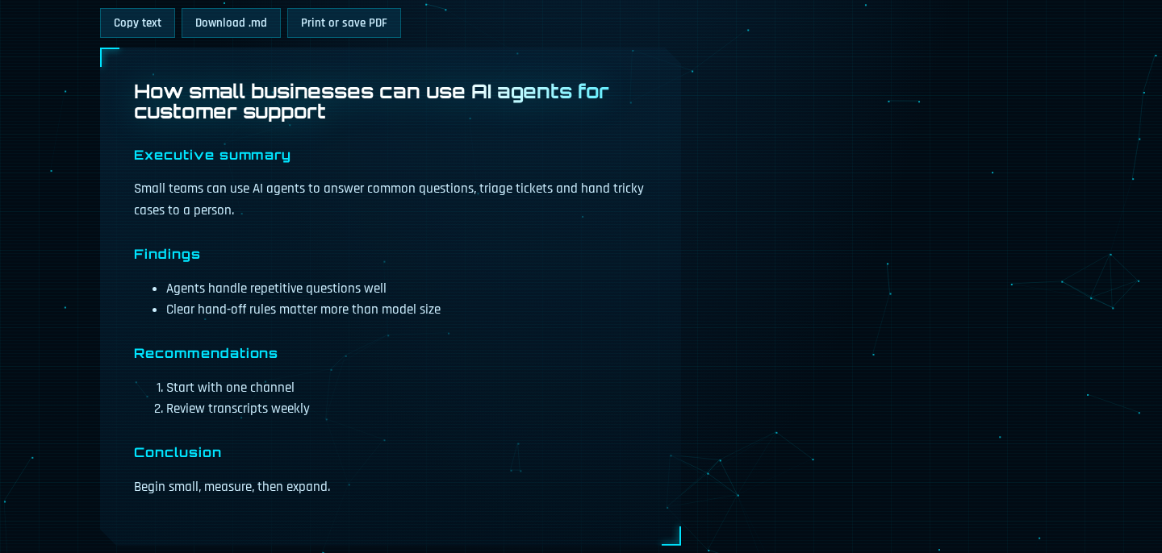
Complete and report
Time, words and preview for each agent
Copy, download or print the report
Notes:
Left: all agents done with previews. Right: the finished report.

Slide 21
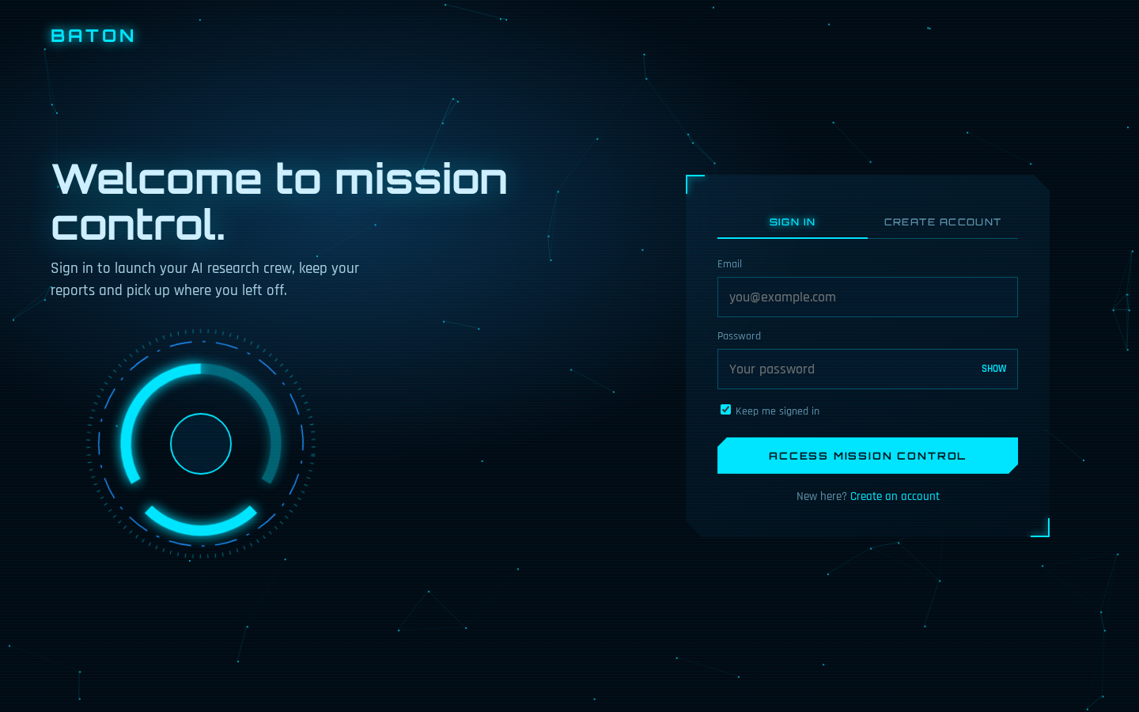
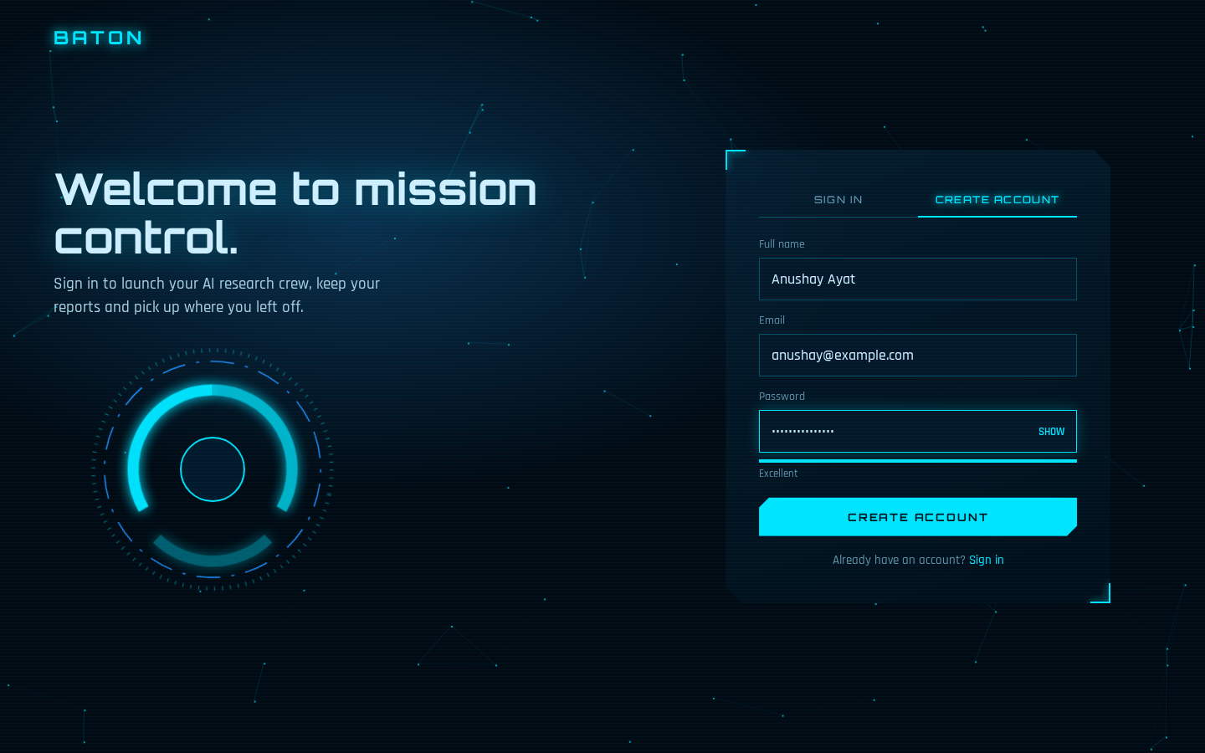
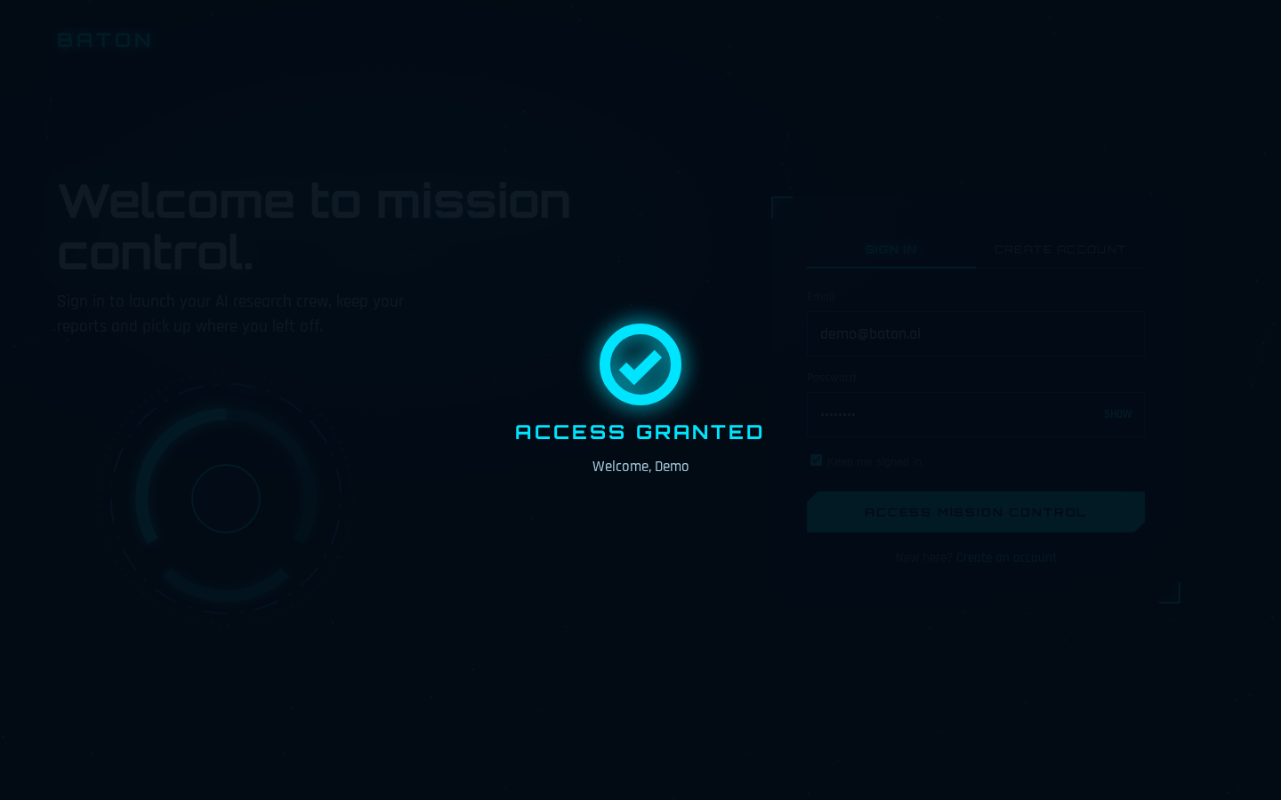
Accounts
Sign in
Create account with strength meter
Access granted
Clear errors, show or hide password, Google sign-in and a confirmation animation.
Notes:
Sign in, create account with strength meter, access granted.

Slide 22
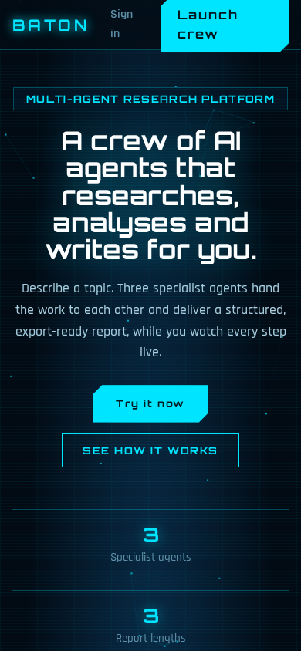
Works on phones
One-column layout on small screens
Navigation condenses to a single button
Cards and tables stack cleanly
Touch-friendly buttons
Notes:
The layout folds to one column on small screens.

Slide 23
05
Build and deploy
Tracing, deployment, testing and what comes next.
Notes:
Tracing, deployment, testing and what comes next.

Slide 24



Observability with LangSmith
One trace per agent
Metadata and tags
Debug quickly
Chain run wraps the model call
Agent name, user id and baton tag
Inspect prompts, outputs and errors
LANGSMITH_TRACING | LANGSMITH_API_KEY | LANGSMITH_PROJECT=baton
Notes:
Every agent call is a traced run.

Slide 25
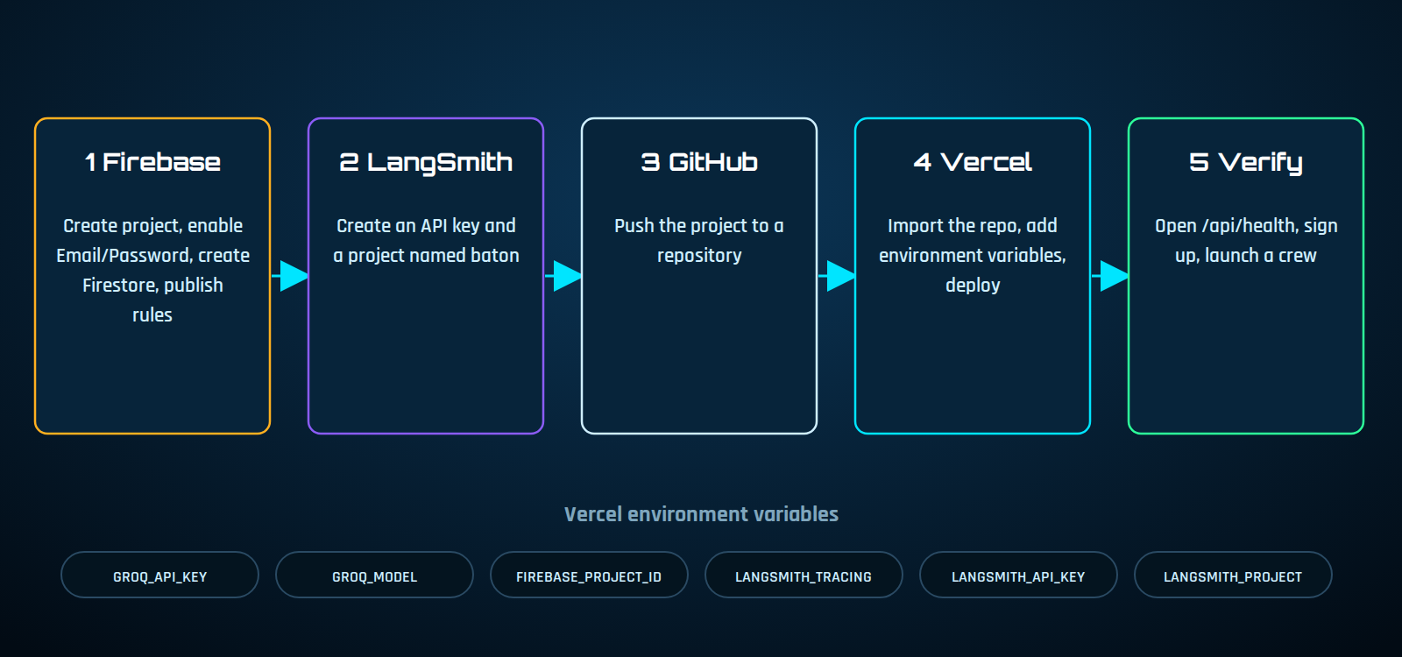
Deployment pipeline
Five steps from an empty project to a live website: crewai-baton.vercel.app
Notes:
Vercel documents 300 seconds maximum duration on Hobby with Fluid compute and a 500 MB limit for Python functions, which is why each agent is its own request.

Slide 26
Testing
3/3
6/6
3/3
Live
API stages return the right agent
Cloud browser flow checks
Login page checks
Run on Vercel and Firebase passed
API: wrong order gives 400, missing token gives 401
Browser: login, launch, three stages, report saved, history, sign out
Login: wrong password error, access granted, strength meter
Live: deployed on Vercel, signed in with Google, crew run completed
Notes:
Simulated tests passed, and the live run on the deployed site passed too.

Slide 27
Challenges and fixes
Challenge | Cause | Fix
Circular import error | File named app.py imported from app | Import from crewai instead
Groq rejected requests | CrewAI added a cache_breakpoint key | llm_patch.py removes the key
Serverless limits | CrewAI is heavy, runs take minutes | Each agent is a short API stage
No saved files in cloud | Serverless storage is temporary | Reports stored in Firestore
Buttons did nothing | A quoting error stopped the script | Syntax checks and simulated tests
Session expired after login | Token check read uid, Firebase uses user_id | Read user_id or sub from the token
Notes:
Real problems met while building.

Slide 28
Roadmap
Now
Next
Then
Later
Three agents, Google sign-in, tracing, live on Vercel
Fact-checker agent and source links
PDF export and report sharing
Password reset, evaluation datasets
Notes:
Four ideas for the next version.

Slide 29
Key takeaways
01
02
03
Specialists beat one generalist
Visibility builds trust
Design for the platform
Splitting research, analysis and writing makes each step clearer.
Live progress, previews and traces show how the answer was made.
Short agent stages and Firestore make it fit serverless hosting.
Notes:
Close with three takeaways.

Slide 30

THANK YOU
Questions?
ANUSHAY AYAT
AI and Data Science | SMIT
Live demo: crewai-baton.vercel.app
Notes:
Thank the audience and invite questions.

