Slide 1

AI & DATA SCIENCE FINAL PROJECT
◆ PropMind
AI Real Estate Intelligence Platform
Predict prices · Explained recommendations · AI advisor · Document RAG
Anushay Ayat
SMIT (Saylani Mass IT Training) · October 2026
Notes:
Good morning. I am Anushay Ayat, and this is PropMind, an AI real estate intelligence platform. It is not only a model: it is a full product with price prediction, explained recommendations, an AI advisor and a document assistant. I will show the problem, how it works, the results, and then the product itself.

Slide 2




Buying a home is a decision made in the dark
Opaque pricing
Manual matching
Dense documents
Fragmented tools
Is this asking price fair for this specific home?
Filtering is slow and nobody explains why a home fits.
Guides and legal steps are long and difficult to search.
Valuation, search, advice and documents sit in different places.
PropMind turns these four gaps into one explainable product.
Notes:
Buyers face four connected problems. Prices are opinions, so it is hard to know if an asking price is fair. Matching homes to a budget is manual and rarely explained. Buying guides and legal documents are long and hard to search. And all these tools live in different places. PropMind brings them together.

Slide 3





One platform, five capabilities
Predict
Discover
AI advisor
Document RAG
Insights
Fair price, likely range and what-if effects
Ranked homes, each with reasons
Prompt-engineered Groq assistant
Answers with citations from documents
Neighborhood and model analytics
Python · scikit-learn · FastAPI · Groq (Llama 3.3) · TF-IDF RAG · HTML, CSS, JavaScript
Notes:
PropMind has five capabilities. Predict gives a fair price with a range. Discover recommends homes and explains why. The AI advisor answers questions with prompt engineering. The document assistant uses RAG to answer from guides with citations. Insights shows market patterns. All of it sits on one FastAPI backend.

Slide 4
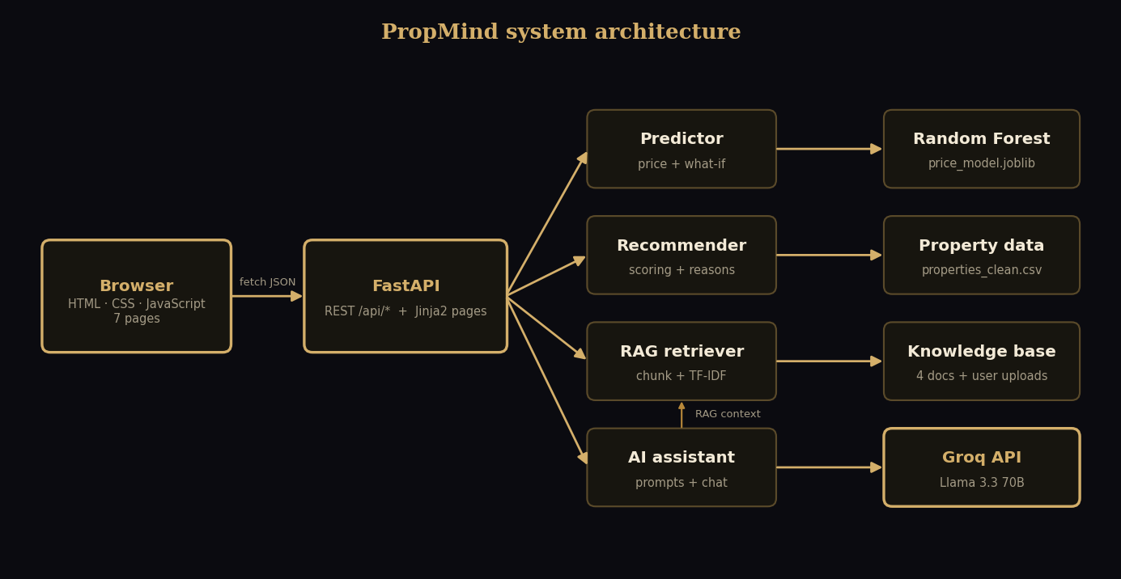
A clean architecture: thin API, testable services
Thin API layer
FastAPI serves JSON and the seven pages.
Testable services
Plain Python modules with 10 automated tests.
Graceful AI
Groq answers, with an offline fallback.
Notes:
The browser calls a small JSON API in FastAPI, which also renders the pages. The real logic lives in plain Python services for prediction, recommendation, RAG and the assistant. This makes them easy to test. The assistant calls Groq, and if there is no key it falls back to an offline mode instead of failing.

Slide 5
Data: Ames housing sales, cleaned and understood
1,458
25
79 → 9
cleaned home sales, no missing values
Ames neighborhoods
features in the data vs. model inputs
Cleaning highlights
NA often means the feature is absent, so it became its own category
Lot frontage filled from the neighborhood median
Two known outliers removed (huge area, very low price)
New features: TotalSF, HouseAge and PricePerSqft
Notes:
We use the Ames Housing dataset from Kaggle: 1,460 sales and 79 features. After cleaning, 1,458 homes with no missing values remain. A key lesson: in many columns, NA means the feature does not exist, so we made it its own category instead of deleting data. The deployed model uses nine simple inputs that a buyer can know.

Slide 6
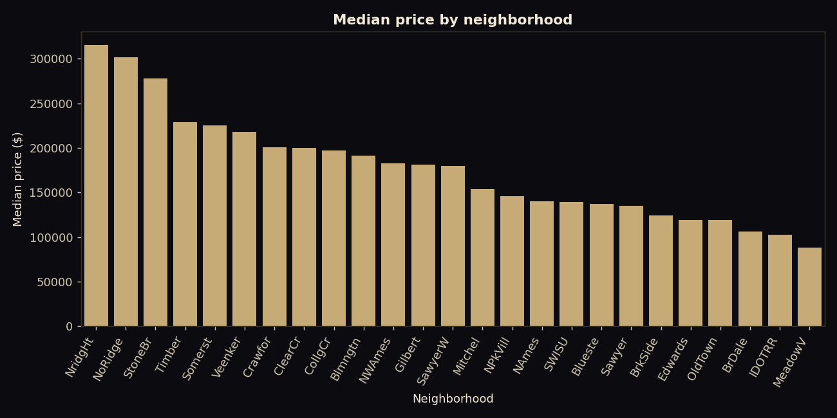
Location and quality drive the price
3.6×
median price gap: NridgHt vs. MeadowV
0.80
correlation of quality with price
1.88 → 0.12
price skewness before and after log
Notes:
Location matters a lot: the median price in the most expensive neighborhood is about three and a half times that of the cheapest. Overall quality has a correlation of about 0.8 with price. Prices are right-skewed, so we predict the log of the price, which brings the skewness from 1.88 down to 0.12.

Slide 7
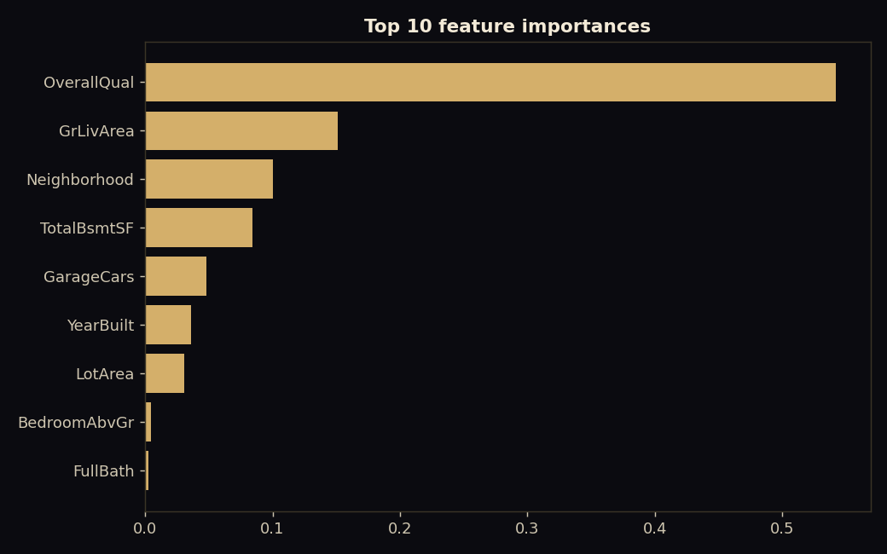
Overall quality is the strongest signal
54%
of the model's importance is overall quality
Living area 15%
Neighborhood 10%
Basement size 8.5%
Garage capacity 4.8%
Notes:
In the final Random Forest, overall quality carries more than half of the total importance, followed by living area, neighborhood, basement size and garage. Bedrooms and bathrooms add very little once size and quality are known, which matches the analysis.

Slide 8
Three models compared, Random Forest deployed
0.885
R² of the deployed Random Forest
0.876
R² of Linear Regression, close behind
0.840
R² of the single Decision Tree
Notes:
We compared Linear Regression, a Decision Tree and a Random Forest on a held-out test set. The Random Forest has the lowest average error, about seventeen thousand eight hundred dollars, and the best R squared. Linear Regression is close and even has a slightly higher cross-validated score, so the margin is small; we chose the forest for its lower error and its ability to capture non-linear effects.

Slide 9
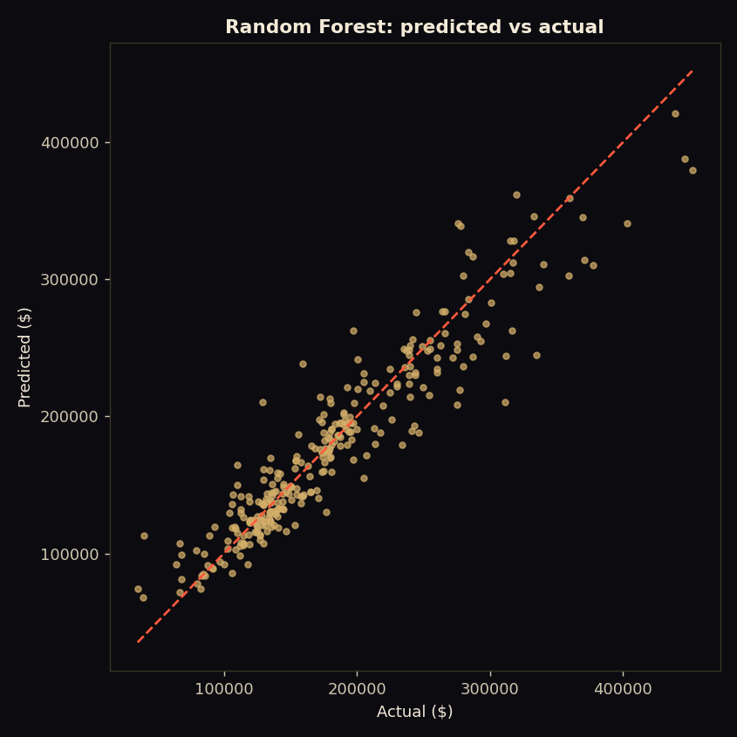
How close are the predictions?
63%
77%
of test homes within 10% of the real price
within 15% of the real price
87%
6.6%
within 20% of the real price
median absolute percentage error
Notes:
On homes the model never saw, sixty-three percent of predictions are within ten percent of the real price, seventy-seven percent within fifteen, and eighty-seven percent within twenty. The median error is six point six percent. The model is less accurate for the rare, very expensive homes.

Slide 10
A bug that only testing could find
BEFORE: one-hot encoding
AFTER: target encoding
$203,204
$165K – $211K
the same estimate for most neighborhoods, so choosing a location changed nothing
range for the same home across neighborhoods, with 21 distinct values
Test the model as a product, not only with a metric.
Notes:
This is my favorite lesson. The first model looked good on the metrics, but a test showed that for the same house most neighborhoods returned the identical price of 203,204 dollars. The one-hot neighborhood columns were almost never used by the trees. I switched to target encoding. Now the same home ranges from about 165 thousand to 211 thousand dollars across neighborhoods. We must test a model as a product, not only with a metric.

Slide 11

Recommendations that explain themselves
“Listed 9% below the AI fair-value estimate of $268,289”
An example of a real reason shown with a result
Notes:
The recommender filters by budget, bedrooms and neighborhoods, then scores each home. Thirty percent for how well it uses the budget, thirty for value compared with the AI fair price, twenty for quality and twenty for matching preferences. Every result lists its reasons, so the ranking can be checked.

Slide 12






An AI advisor with guardrails
Role and tone
A concise professional advisor
Real market facts
Statistics injected from the data
No invented numbers
Figures only from context or the user
Professional limits
Not legal, tax or financial advice
Offline fallback
Keeps working without an API key
Notes:
The advisor uses a structured system prompt. It sets the role and tone, injects real market facts from our data, forbids invented numbers, states professional limits, and asks for balanced advice. If the Groq key is missing the product still works in an honest offline mode.

Slide 13
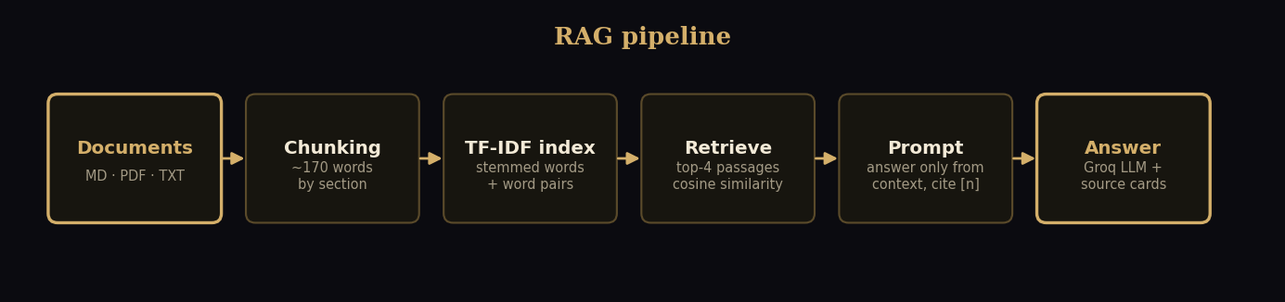
RAG: answers grounded in real documents
4 docs
100%
[1] [2]
buying guide, Iowa legal process, investing, area data
right document ranked first on 15 questions (baseline 93%)
every answer cites its source passages
Notes:
For the document assistant, we split four property documents into passages and index them. A question retrieves the top four passages, and the language model must answer only from them and cite them. On our 15-question test, the right document was ranked first every time after we added light stemming and title weighting, up from 93 percent. The test set is small, so we treat this as evidence, not a guarantee.

Slide 14

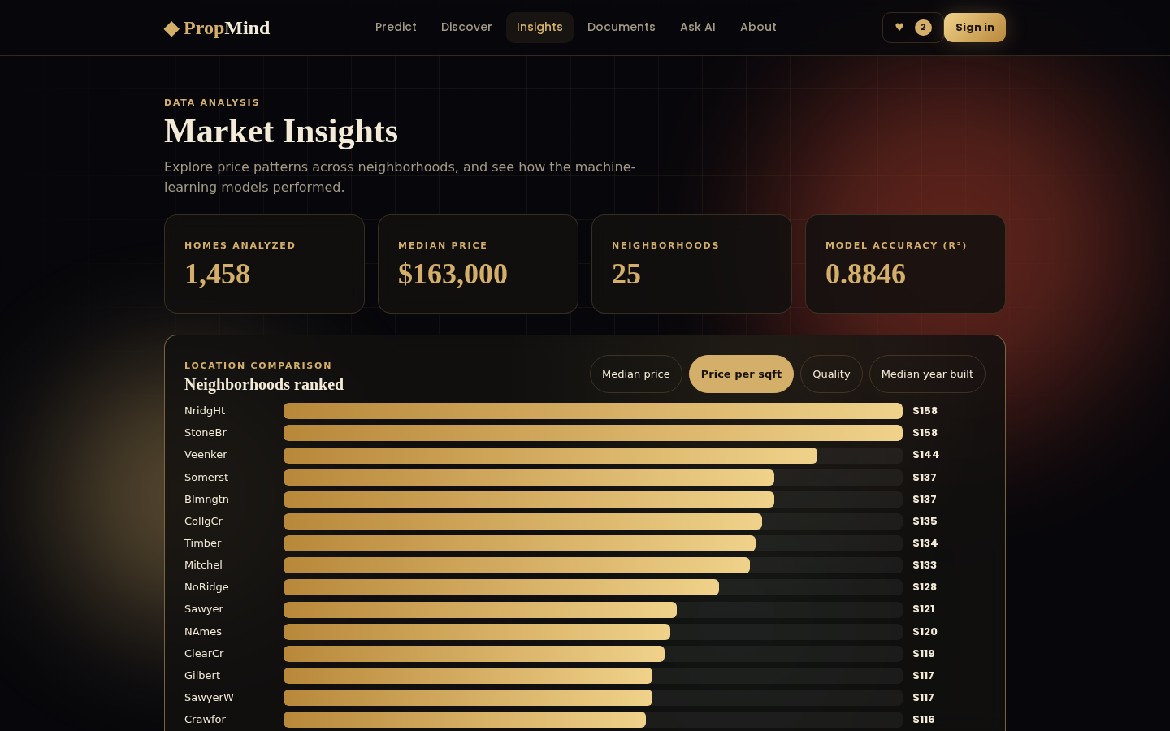
Product tour
Price prediction with what-if analysis
Recommendations with reasons and compare
Interactive market insights
Also: login, saved homes, compare up to three, AI summaries, PDF report, document upload
Notes:
Here are three of the seven pages. The predictor shows the price, the likely range and what-if effects, and can download a PDF report. The recommendation page explains matches and lets you compare. Insights ranks neighborhoods interactively. There is also login, saved homes, and a document upload page.

Slide 15





Built like a real product
10 automated tests
GitHub
prediction, recommender, RAG and fallbacks
source, data, tests
Browser-tested pages
Vercel
filters, compare, PDF, chat and sign-in
backend + website
Offline-safe
Firebase
works without an API key
static frontend
Notes:
Quality was part of the plan. There are ten automated tests, the pages were exercised in a real browser, and the app has an offline fallback. For deployment, the code lives on GitHub, the backend and website run on Vercel, and a static copy can be hosted on Firebase Hosting, all on free plans without a billing card.

Slide 16
Limitations and what comes next
Limitations
Next steps
One city, 2006-2010: educational, not an appraisal
Nine inputs ignore renovations and exact location
TF-IDF matches words, not meaning
Demo login lives only in the browser
Embedding-based semantic retrieval
Real accounts with Firebase Authentication
Gradient boosting and a larger, newer dataset
Map view and listing photos
Urdu and English interface
Estimates are educational, not appraisals: the honest limits are part of the design.
Notes:
Being honest about limits: the data is one city from 2006 to 2010, so estimates are educational, not appraisals. Retrieval matches words, not meaning. Login is a demo stored in the browser. Next steps are embedding-based retrieval, real authentication with Firebase, better models and a larger dataset, a map view, and Urdu support.

Slide 17
Thank you
Questions?
◆ PropMind · AI Real Estate Intelligence Platform
Anushay Ayat · AI & Data Science · SMIT
Notes:
Thank you. To summarize: PropMind combines data analysis, machine learning, generative AI and RAG in one tested, deployable product, and I was careful to measure its limits honestly. I am happy to take questions or show the live demo.

