Slide 1
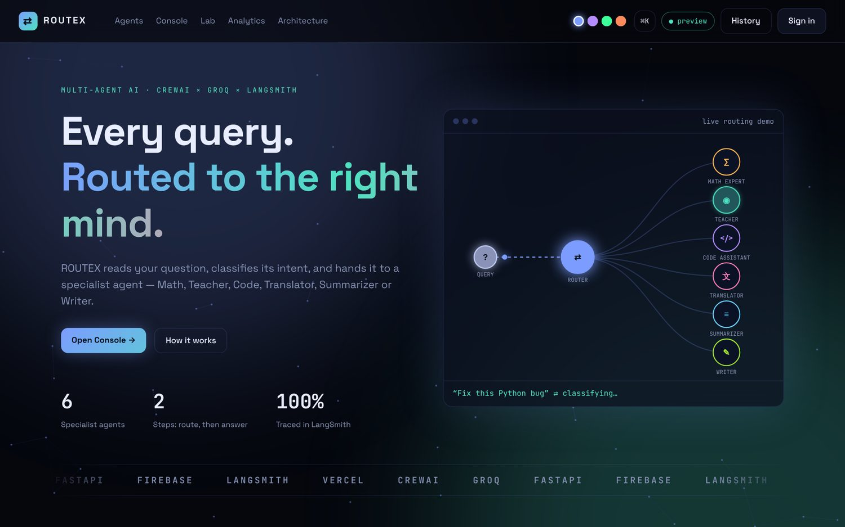
MULTI-AGENT AI · CREWAI × GROQ
ROUTEX
Smart Query Router Using CrewAI
Every query, routed to the right mind.
Anushay Ayat
AI and Data Science, SMIT
Notes:
Welcome. ROUTEX is a smart query router built with CrewAI and Groq. A router agent decides what kind of question it is, and a specialist agent answers it.

Slide 2
One chatbot is not best at everything
1
2
3
Quality
Transparency
Robustness
Each agent has a role, goal and backstory built for one kind of task.
The user sees the decision, the confidence and the reasoning.
A rule-based fallback keeps routing alive when the model fails.
Notes:
A maths problem, a coding task and a translation each need a different role and instructions. Routing separates deciding who answers from how they answer.

Slide 3
One router, six specialists
∑ Math Expert
◉ Teacher
Router
agent
User query
</> Code Assistant
文 Translator
Each specialist runs as a single-task CrewAI crew on a Groq model
≡ Summarizer
✎ Writer
Notes:
The query enters the router. The router returns a category, confidence and reasoning. The matching specialist agent produces the answer.

Slide 4
Assignment requirements: done
Requirement | Status
Router agent classifies the query | Done
Math agent | Done
Explanation agent (Teacher) | Done
Built with CrewAI and a Groq LLM | Done
User enters a query, gets a routed answer | Done
Extra: Code, Translator, Summarizer, Writer agents | Added
Extra: web app, Firebase, LangSmith, analytics | Added
Notes:
Every requirement from the assignment is met, and the project goes further with four more agents, a full web app, Firebase, LangSmith and deployment configuration.

Slide 5
Meet the six agents
∑
Math Expert
◉
Teacher
</>
Code Assistant
Solves problems step by step and checks the answer
Explains ideas with simple analogies
Writes, debugs and explains clean code
文
Translator
≡
Summarizer
✎
Writer
Translates while keeping tone and meaning
Condenses long text into key points
Drafts emails, essays and posts in your tone
Notes:
Each agent has its own role, goal and backstory in CrewAI. Delegation is switched off so that the router alone decides who answers.

Slide 6
How a query gets routed
1
2
3
4
Classify
Validate
Answer
Trace
Router agent returns category, confidence, reason
Parse JSON, check category, clamp confidence
Specialist agent runs as a one-task crew
Timings and LangSmith run for every step
Fallback: if the model is unavailable or its output is invalid, regex rules choose the category and the trace marks the step as fallback.
Notes:
The router returns JSON with a category, a confidence between zero and one, and a short reason. The output is validated. If anything fails, a rule-based classifier takes over.

Slide 7
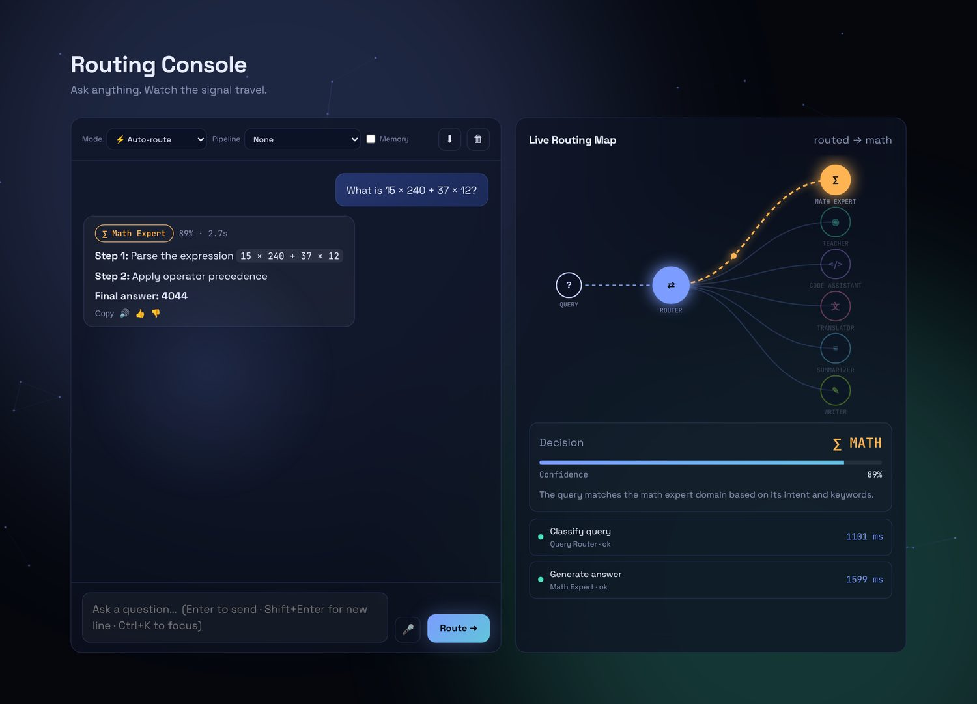
The routing console
Live routing map
A signal travels from the query, through the router, to the chosen agent.
Decision card
Category, confidence meter and the router’s reasoning.
Step trace
Every step with its time in milliseconds.
Notes:
In the console, a query is classified, a signal travels on the live map to the chosen agent, and the answer is typed out. The panel shows the decision, confidence and a trace with timings.

Slide 8
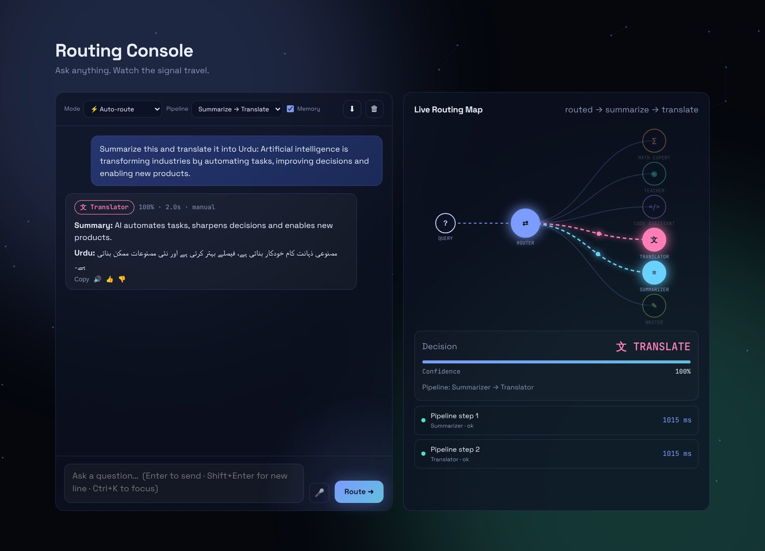
Pipelines and memory
Agent chaining
Summarize → Translate, Explain → Summarize and more.
Conversation memory
The last four turns are sent as context.
Read aloud
Text-to-speech on every answer.
Notes:
Pipelines chain agents. For example the summarizer output flows into the translator. Memory sends the last four turns as context.

Slide 9
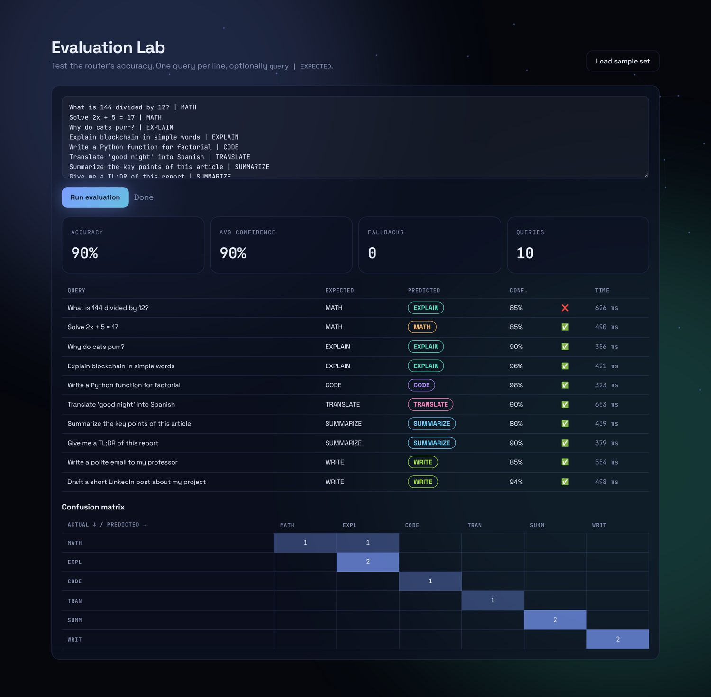
Evaluation Lab
Measure, don’t guess
One query per line, with an optional expected label.
You get accuracy, average confidence, fallback count, a per-query table and a confusion matrix.
Backed by POST /api/batch and traced in LangSmith.
Notes:
The lab lets you paste labelled queries, run the router on them and see accuracy and a confusion matrix. The screenshot uses demonstration data.

Slide 10
Fallback classifier: 30 of 36
83.3%
30 of 36 labelled queries
Misses: “divided by”, “square root”, “condense”, “boil down”, and “how do I calculate” (an explanation request).
Notes:
We ran the rule-based fallback on a labelled set of 36 queries, six per category. It got 30 correct, 83.3 percent. It misses phrases like divided by, square root, condense and boil down. These are the cases the language-model router is meant to handle.

Slide 11
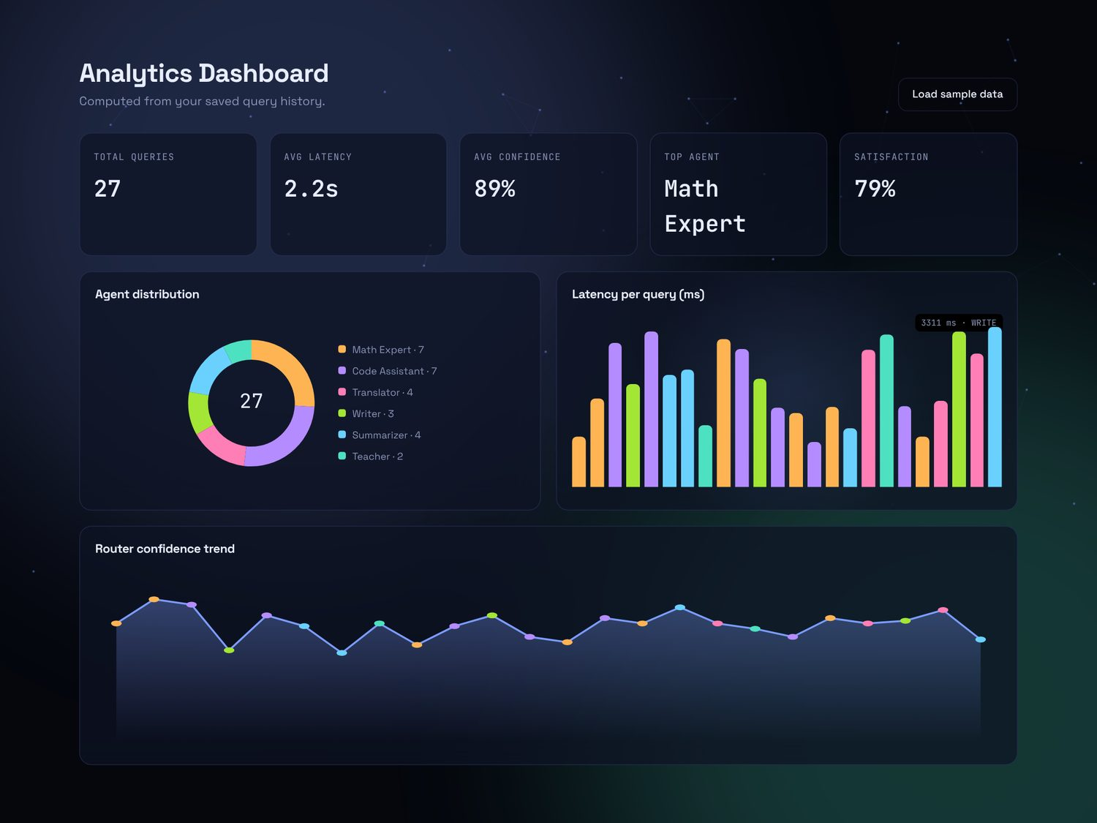
Analytics dashboard
What it tracks
Queries, latency, confidence, top agent and satisfaction.
Charts
Agent distribution, latency per query and a confidence trend, drawn in SVG.
Export history as CSV or JSON.
Notes:
The dashboard is computed from the saved history: total queries, latency, confidence, top agent and satisfaction from thumbs up and down. The screenshot uses sample data.

Slide 12
Technology stack
CrewAI
Groq
FastAPI
Vanilla JS
Agents, tasks, crews
Fast LLM inference
REST API, validation
UI, SVG charts, no build
Firebase
LangSmith
Vercel
Render
Auth and Firestore history
Run traces
Serverless hosting
Backup API host
Notes:
CrewAI and Groq power the agents. FastAPI serves the API. The frontend is plain JavaScript. Firebase handles login and history, LangSmith traces runs, and Vercel hosts it.

Slide 13
Every run is traceable
router_agent_classify
LANGSMITH_TRACING
LANGSMITH_API_KEY
LANGSMITH_PROJECT
smart_query_router
specialist_agent_answer
Batch runs in the Evaluation Lab appear as router_batch_item.
Notes:
With three environment variables, every request appears in LangSmith as a trace with child runs for the router and the specialist, so decisions can be inspected and compared.

Slide 14
Deployment
Vercel
Firebase
Render
Static frontend and serverless FastAPI, with rewrites for /api.
Hosting for the frontend, plus Auth and Firestore with per-user rules.
Backup host for the API if CrewAI exceeds the Vercel size limit.
Notes:
The static frontend and serverless API can deploy to Vercel. Firebase Hosting can serve the frontend. If CrewAI is too large for Vercel, the backend runs on Render with the same code.

Slide 15
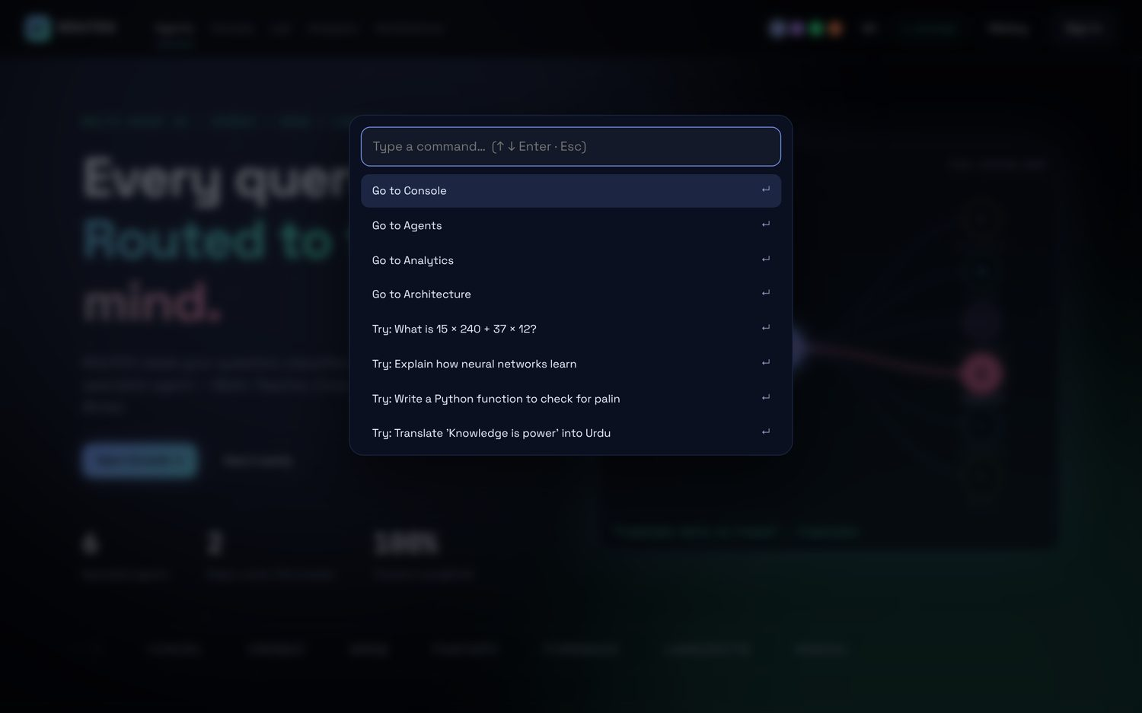
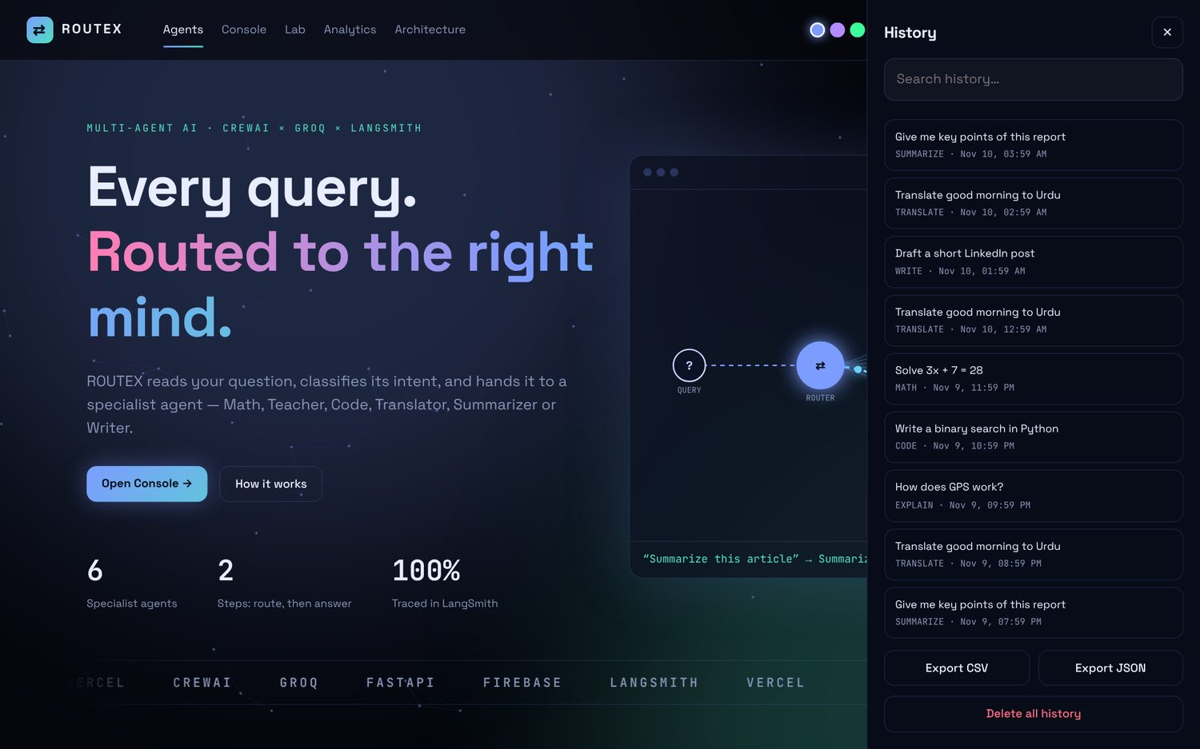
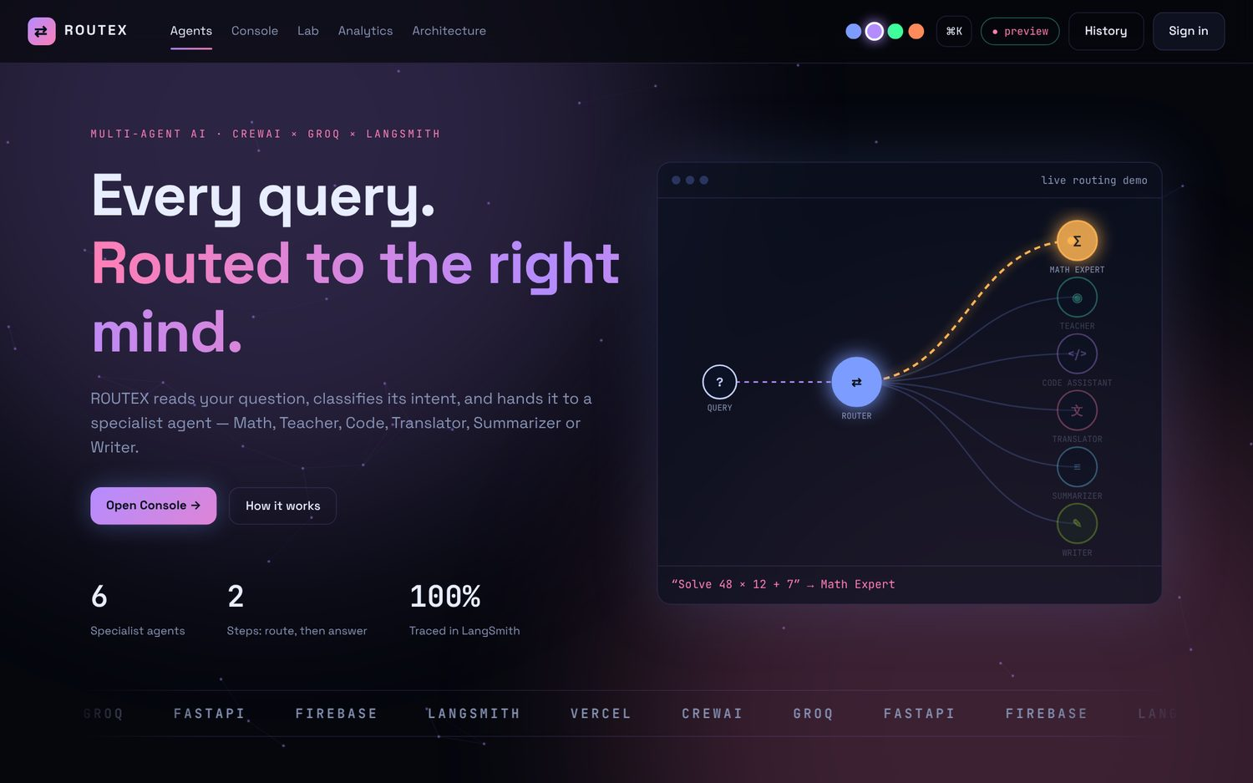
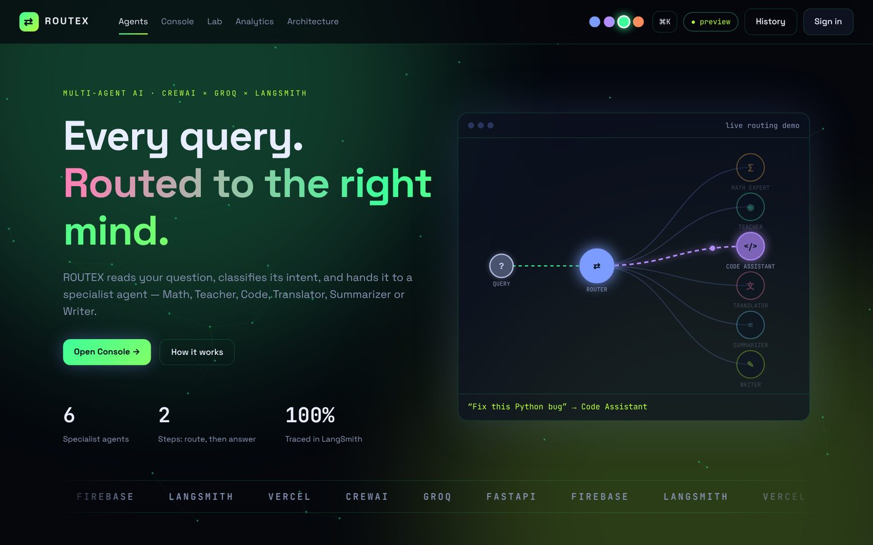
Built to demo well
Command palette
Ctrl+K jumps anywhere.
Four themes
Blue, purple, green, orange.
Voice in, voice out
Mic input and read-aloud.
Notes:
A command palette, four themes and history search make the interface fast and personal.

Slide 16
Limits and next steps
Current limits
Next steps
No rate limiting or admin panel yet
Memory is held in the browser
Answers arrive in one piece, not streamed
English, dark theme only
PDF upload with retrieval (RAG)
Admin panel and usage limits
Urdu interface and light theme
Streaming and automatic multi-step plans
Notes:
Rate limiting and an admin panel are not built yet. Next steps are PDF upload with retrieval, Urdu interface, a light theme, streaming and automatic multi-step plans.

Slide 17
Thank you
Questions?
ROUTEX · Anushay Ayat · SMIT
Notes:
Thank you for listening. Happy to take questions.

