Slide 1
Waypoint
PROJECT PRESENTATION
A LangGraph RAG question-answering system you can watch run
Anushay Ayat | SMIT, AI and Data Science

Slide 2
Problem and goal
Language models can sound confident while being wrong about your own documents. Retrieval-augmented generation grounds each answer in text you supply.
Answer only from the user’s documents
1
2
Make the workflow visible, step by step
3
Keep the stack simple: FastAPI, LangGraph, Groq, plain HTML, CSS, and JavaScript

Slide 3
What is RAG?
1
2
3
Retrieve
Augment
Generate
Find the passages most similar to the question, using embeddings.
Place those passages into the prompt as context.
The model answers using only that context.
Result: answers grounded in your documents, with sources you can check.

Slide 4
Three tools, three roles
LangChain
LangGraph
LangSmith
Build the application
Control the workflow
Inspect and improve
Connect models, prompts, retrievers, and tools.
Define steps, branches, and shared state.
Trace runs and evaluate output quality.
In Waypoint: LangGraph runs the workflow, LangChain integrations connect Groq and Hugging Face embeddings, and LangSmith tracing can be switched on with environment variables.

Slide 5
System architecture
Browser
FastAPI
LangGraph
HTML, CSS, JavaScript
REST and streaming API
retrieve, route, generate
The same FastAPI app also serves the frontend, so one command runs everything.
Library
Groq LLM
vector store, MiniLM embeddings
gpt-oss-120b

Slide 6
The LangGraph workflow
good match
generate
START
retrieve
END
fallback
weak match
A conditional edge compares the best match score with MIN_SCORE. Weak matches take the fallback branch, which makes no model call.

Slide 7
State, nodes, and edges
class State(TypedDict):
question: str
k: int
sources: list[dict]
context: str
answer: str
builder = StateGraph(State)
builder.add_node("retrieve", retrieve)
builder.add_node("generate", generate)
builder.add_node("fallback", fallback)
builder.add_edge(START, "retrieve")
builder.add_conditional_edges(
"retrieve", route,
{"generate": "generate",
"fallback": "fallback"})
builder.add_edge("generate", END)
builder.add_edge("fallback", END)
graph = builder.compile()
State
Data shared by every node
Nodes
Plain Python functions that return state updates
Edges
A conditional edge picks generate or fallback

Slide 8
Backend API and streaming
Method | Path | Purpose
GET | /api/health | Mode, models, passage count
GET | /api/graph | Nodes and edges of the graph
GET, POST | /api/documents | List or add passages
POST | /api/documents/upload | Upload a PDF, TXT, or MD file
POST | /api/ask/stream | Ask and stream node-by-node events
Stream events: start, node_start, node_end, done, error. Each is one JSON object per line, so the interface can animate every step as it happens.

Slide 9
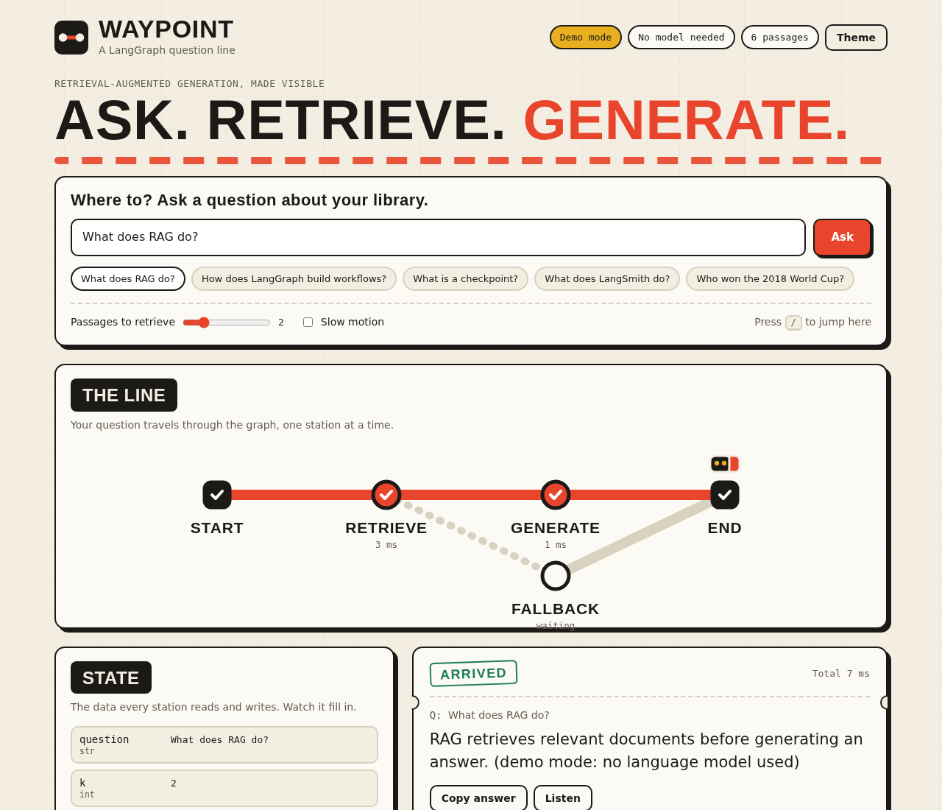
Frontend: the transit-map idea
The graph is drawn as a metro line
A train stops at each node and shows its timing
The state panel fills in as nodes finish
Answers carry citations that jump to their source
Plain HTML, CSS, and JavaScript, no build step

Slide 10
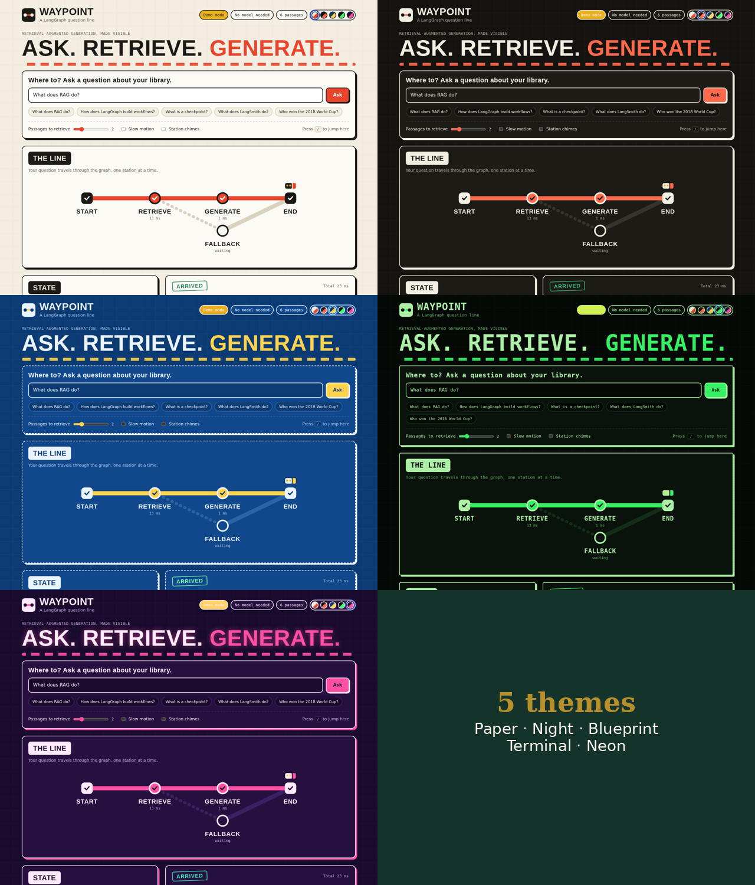
Features and themes
Conditional routing with a fallback branch
Citations, sources, and match scores
PDF, TXT, and MD upload into the library
Journey log with Markdown export
Slow motion, chimes, and Listen
Five themes: Paper, Night, Blueprint, Terminal, Neon
Demo mode that needs no API key
Responsive layout for phones

Slide 11
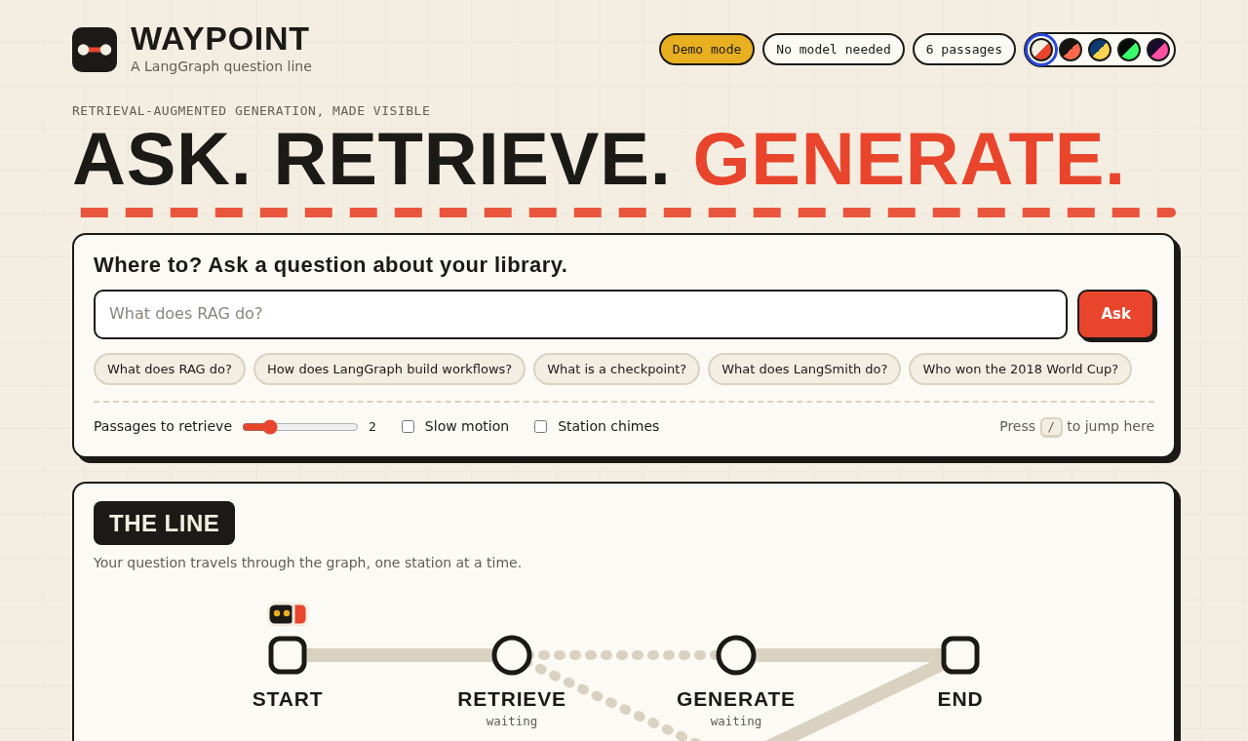
Ask a question
Type a question or click an example
Choose how many passages to retrieve
Slow motion and station chimes help in demos

Slide 12
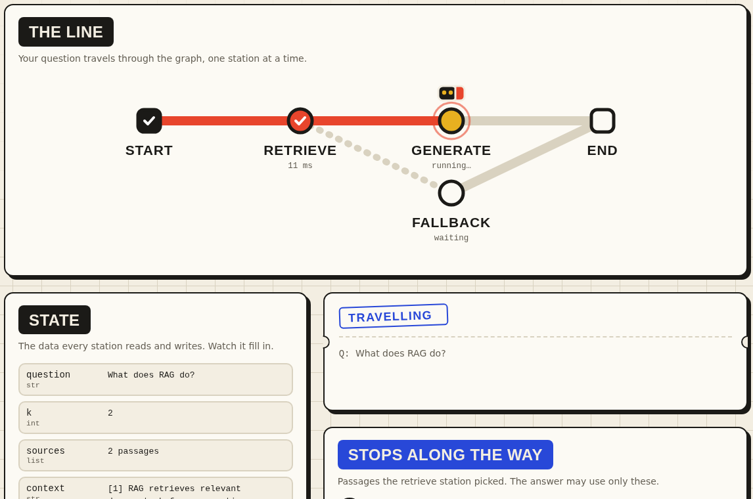
Watch the line
The train stops at retrieve, then generate
Each station shows its timing
The state fills in as each node finishes

Slide 13
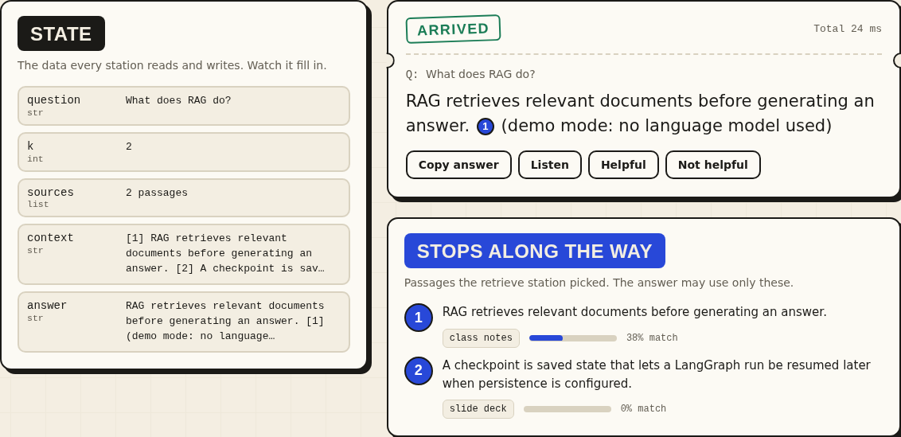
The answer
The answer appears on a ticket
Citations such as [1] link to sources
The state panel shows what each node wrote

Slide 14
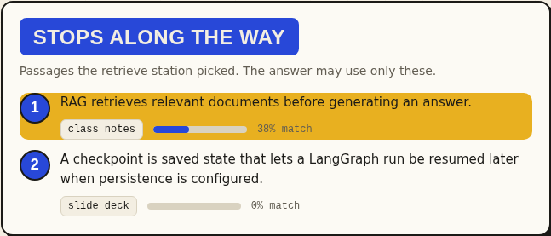
Citations and sources
Clicking a citation scrolls to its source passage and highlights it. Each source shows its library label and a match score.

Slide 15
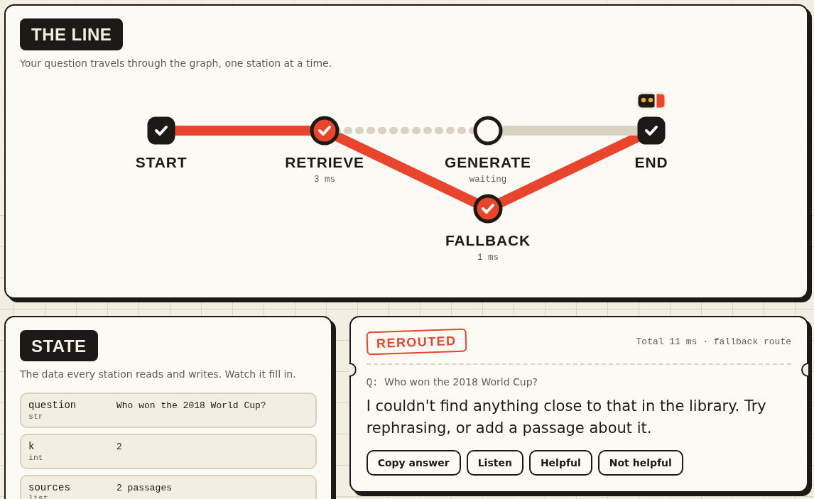
The fallback route
An unrelated question scores below MIN_SCORE
The conditional edge sends it to fallback
No model call is made, and the stamp reads Rerouted

Slide 16
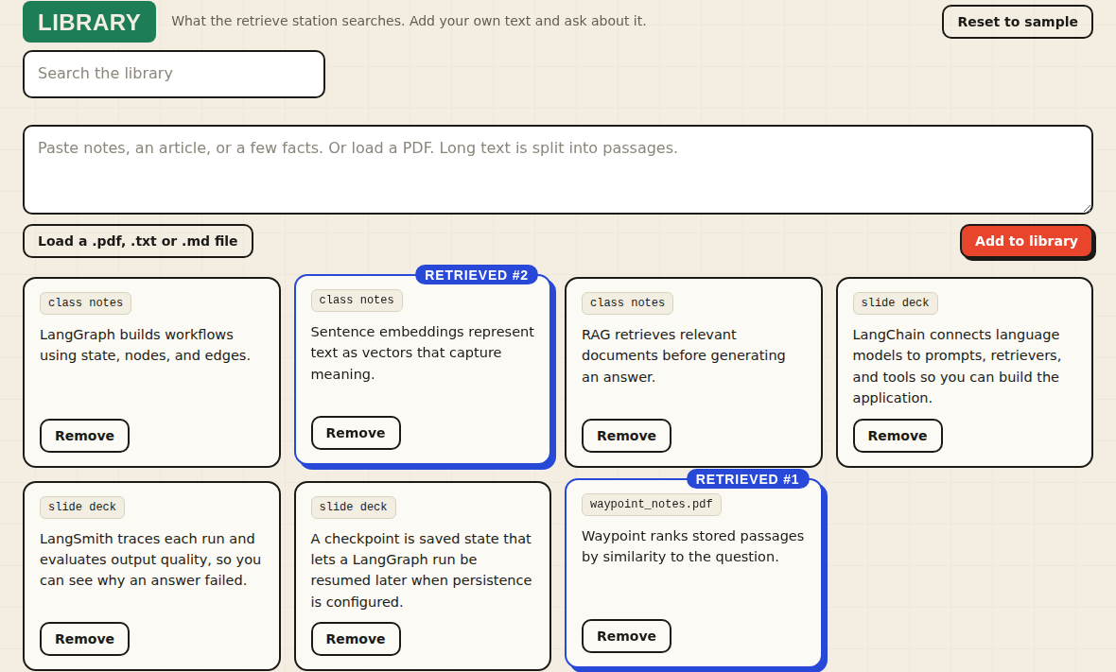
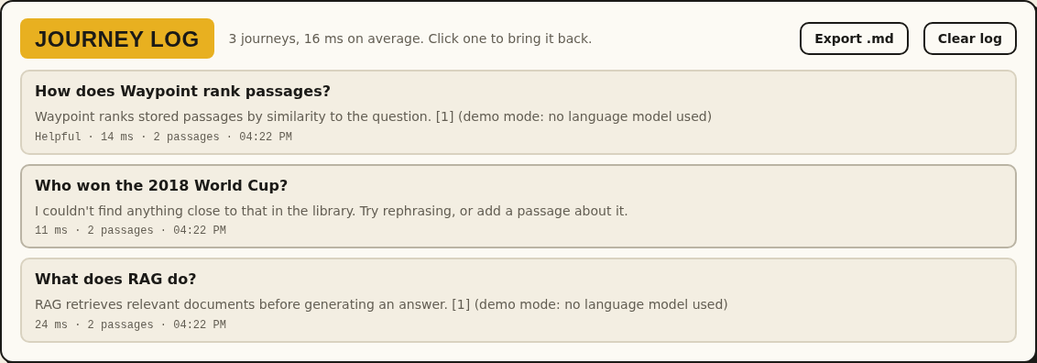
Library and journey log
Journey log: past questions, answers, and feedback, with Markdown export.
Library: paste text or load a PDF, then see which passages were retrieved.

Slide 17
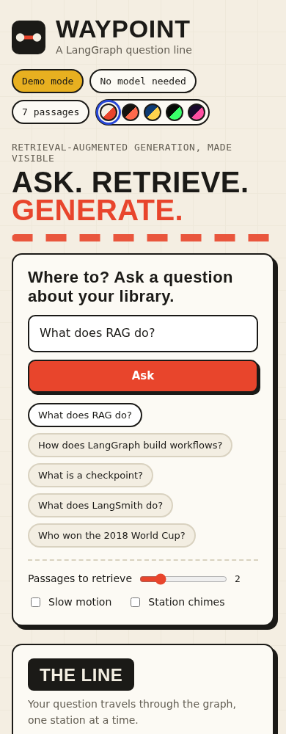
On a phone
The layout switches to one column
The map turns vertical
Every feature stays available

Slide 18
Testing and quality
Testing
Quality
16 automated tests with pytest
Demo mode runs offline, so tests need no key
GitHub Actions runs them on every push
Input validation with clear error messages
Keyboard focus, screen-reader labels, and reduced-motion support
Responsive layout for phones

Slide 19
Lessons and future work
Lessons
Next steps
Streaming each node makes a workflow easy to explain
A fallback branch is better than an invented answer
Keeping demo mode on the same code path made testing simple
Conversation memory with a LangGraph checkpointer
Token-by-token streaming
A persistent vector store
Compare mode and OCR for scanned PDFs

Slide 20
Thank you
Questions?
github.com/scientistayat-engineer/waypoint-langgraph-rag

