Slide 1
TRENDS

Slide 2
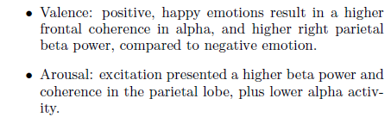
Based on paper 4 EEG Based Emotion Recognition

Slide 3
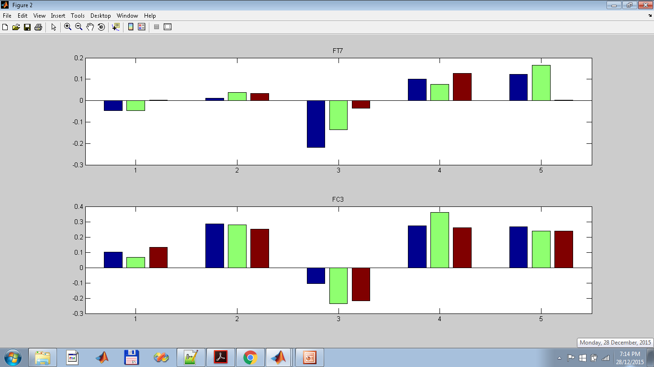
Increasing frontal alpha asymmetry for increasing valence as rated by subject
ratingLimit -4-6-
with car filter
However, the counter-argument would be if this is seen in other frontal electrodes. Hence, one way would be to say: no discernable differences on other frontal electrodes in the experiment. It may seem that using 2 classes i.e. rating1-4 versus 4-7 might be better since medium and high valence not easily distinguisable

Slide 4
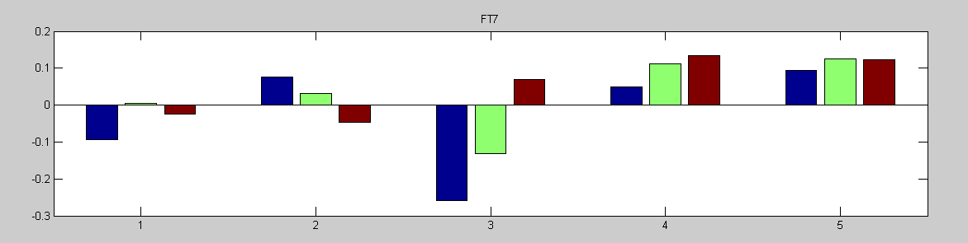
Increasing frontal alpha asymmetry for increasing valence as rated by subject
XiaMian Tiffany ZhengYang XiangJun Yiheng
ratingLimit -3-7-
with car filter
Need to say: Except for Subject 2 which shows a decreasing trend.

Slide 5
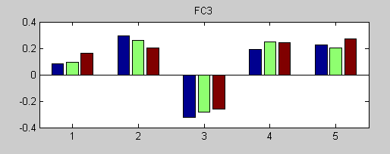
Increasing frontal alpha 9-12 asymmetry for increasing valence as rated by subject
ratingLimit -3-7-
with car filter
As long as you mention Subject 2 is the exception is ok, not expected everyone will perform the same.

Slide 6
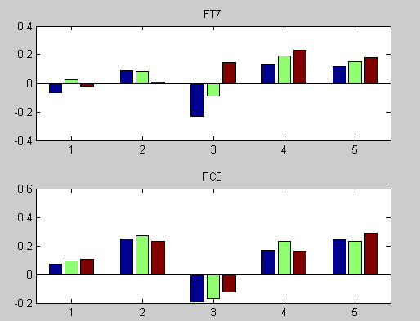
Increasing frontal alpha 8-13 asymmetry for increasing valence as rated by subject
ratingLimit -3-7-
with car filter

Slide 7
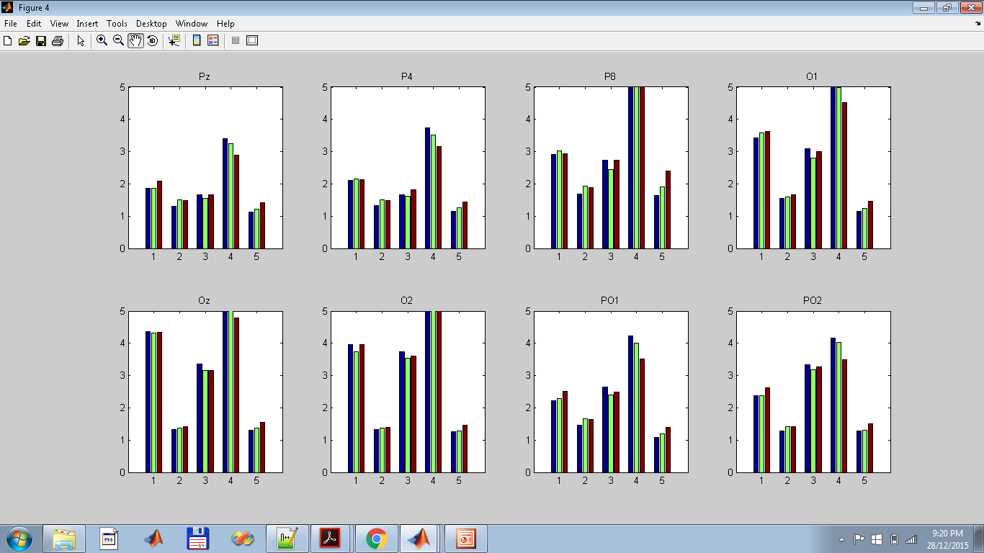
Increasing beta-alpha ratio at parietal lobe
For subjects 1,2,5
Arousal by subject
ratingLimit -4-6
Car filter
no ratio
What is meant by no ratio? I think it means alpha power of this channel divided by total alpha power of all channels?

Slide 8
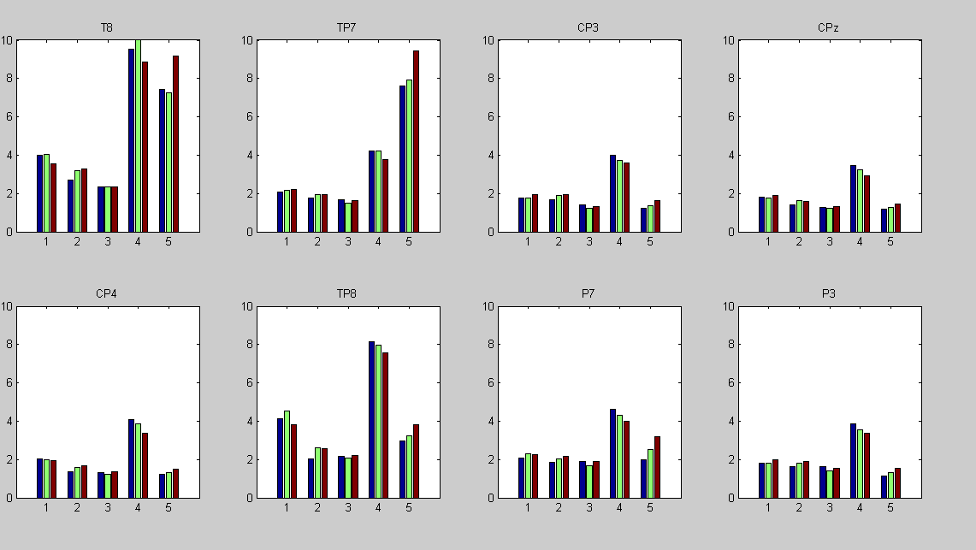
Increasing beta-alpha ratio at
parietal lobe
For subjects 1,2,5
Arousal by subject
ratingLimit -4-6
Car filter
no ratio
Good results , concurs with high beta, low alpha in literature

Slide 9
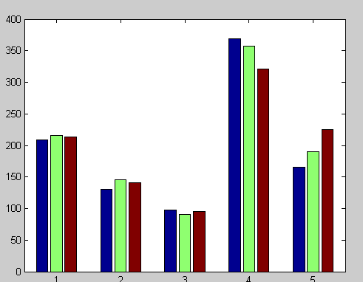
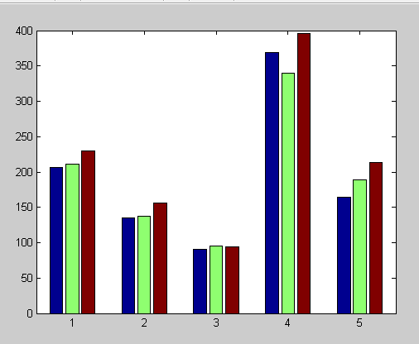
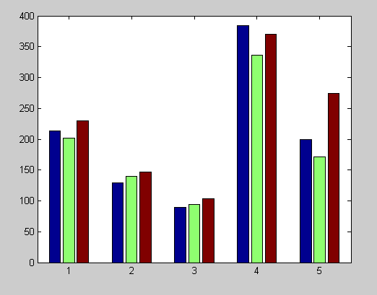
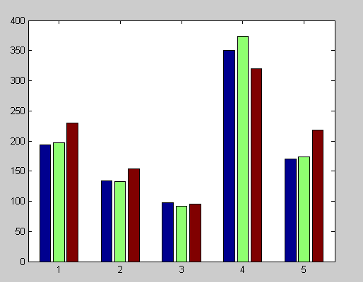
Increasing global beta-alpha ratio with increasing
Arousal by IAPS
ratingLimit -4-6
Car filter
Arousal by IAPS
ratingLimit -3.5-6.5-
Car filter
Arousal by subject
ratingLimit -4-6-
Car filter
Arousal by subject
ratingLimit -3-7
Car filter

Slide 10
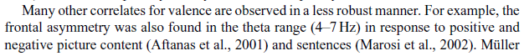
Based on theta asymmetry (Aftanas)

Slide 11
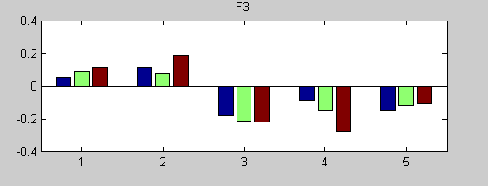
Increasing theta 4-6 asymmetry for increasing valence as rated by IAPS
ratingLimit -4-6-
with car filter
Except for subject 3 and 4?

Slide 12
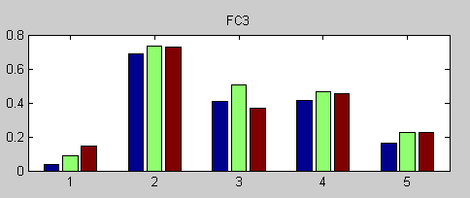
Increasing theta 4-6 asymmetry for increasing valence as rated by subject
ratingLimit -4-6-
with car filter

Slide 13
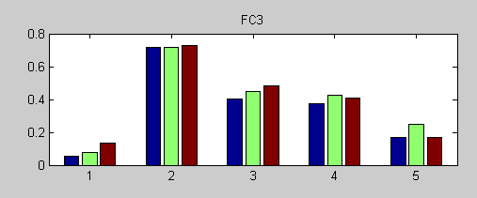
Increasing theta 4-7 asymmetry for increasing valence as rated by subject
ratingLimit -3-7-
with car filter

Slide 14

Based on Medial and fronto-medial theta

Slide 15
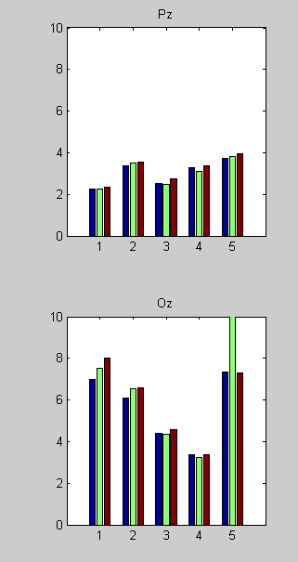
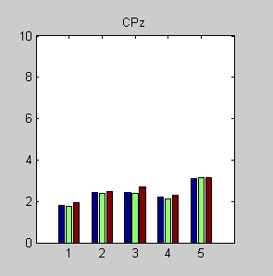
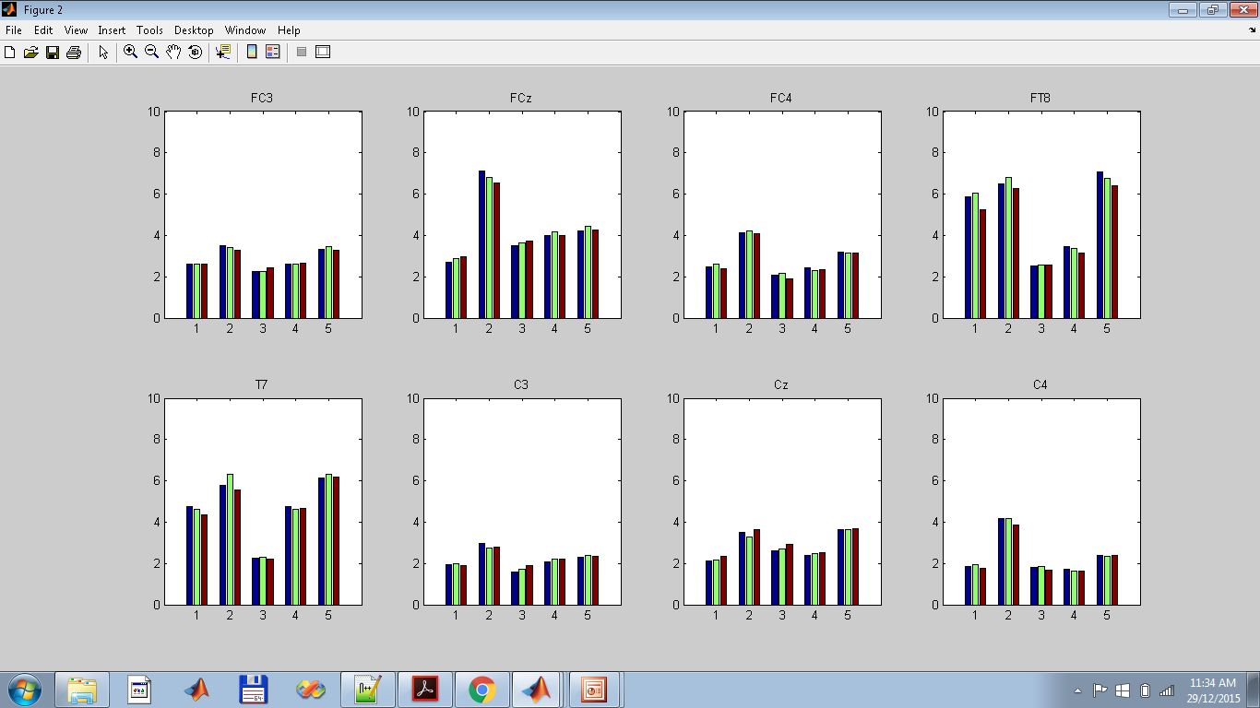
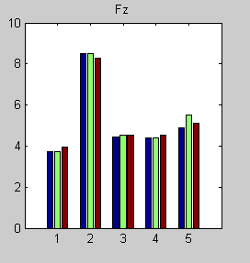
Increasing midline theta power for increasing valence as rated by subject
ratingLimit -4-6-
with car filter
Anomaly in Oz for subject 5? His value is 10 or > 10?

Slide 16

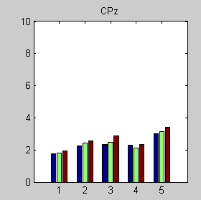
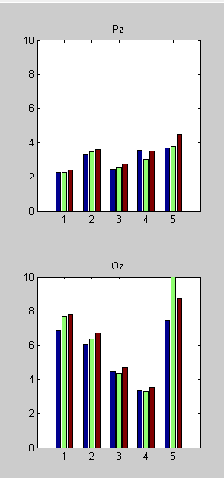
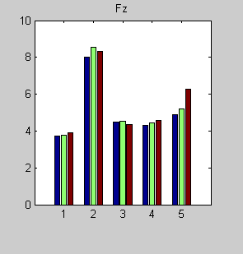
Increasing midline theta power for increasing valence as rated by subject
ratingLimit -3-7-
with car filter

Slide 17
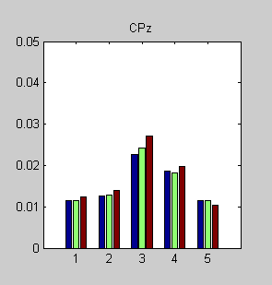
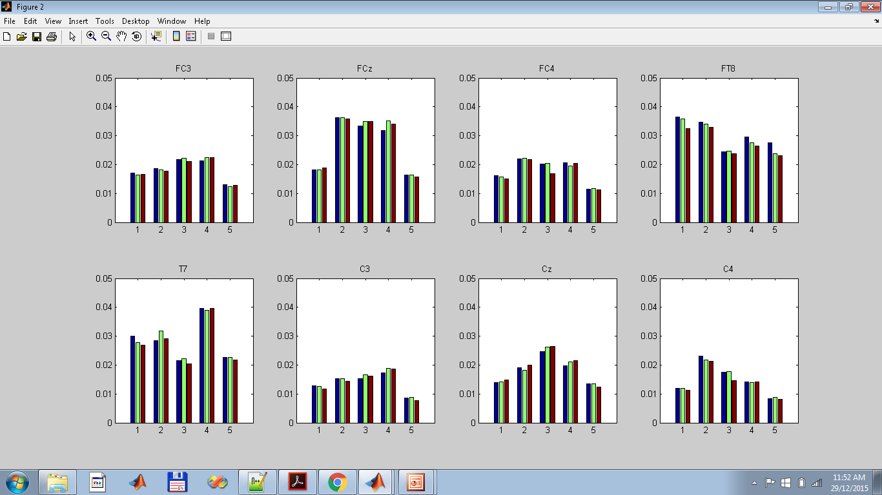
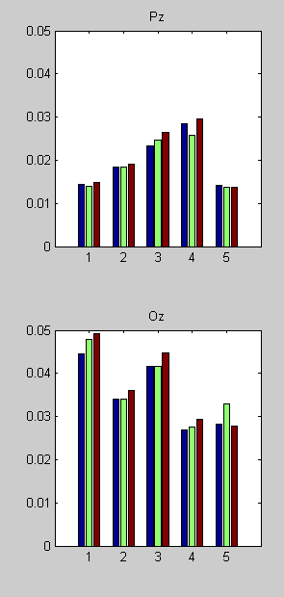
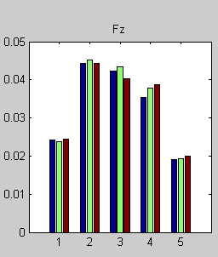
Increasing midline theta power for increasing valence as rated by subject
ratingLimit -3-7-
with car filter, theta ratio

Slide 18
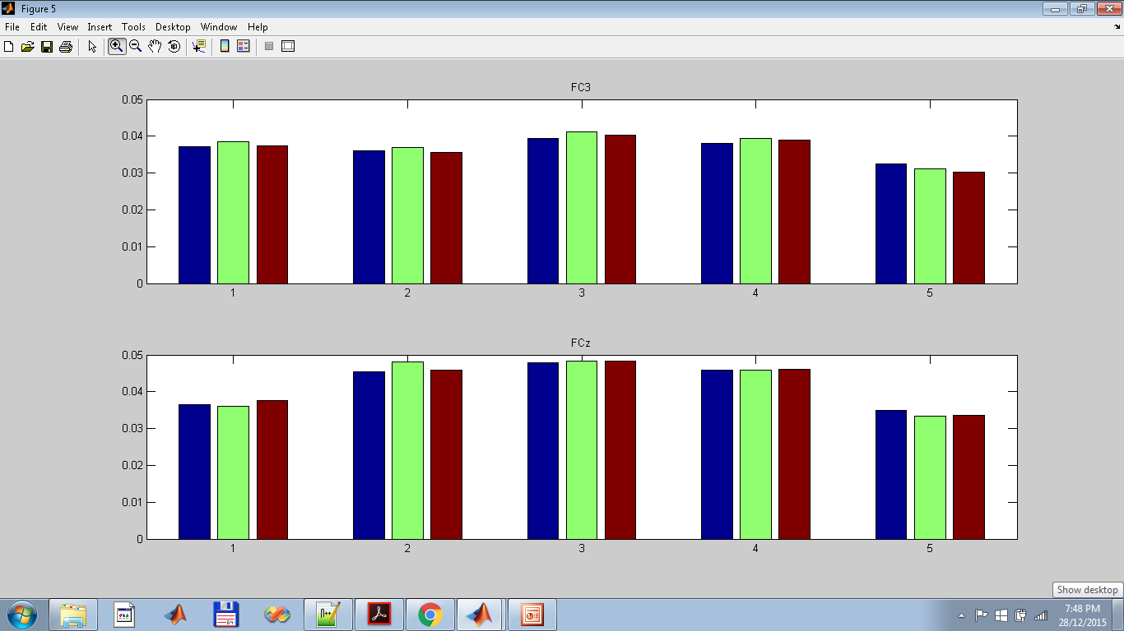
Increasing theta at FCz for increasing valence as rated by IAPS
ratingLimit -4-6-
with car filter
And theta ratio
Results not so clear though, because the scale of increase seems minor

Slide 19
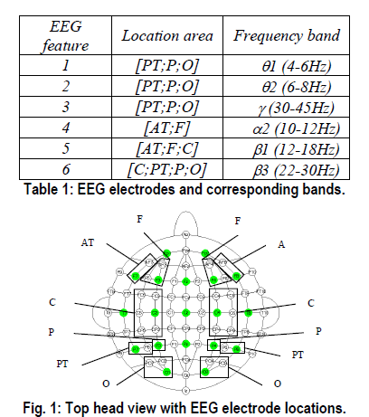
Based on paper 2 Emotion Assessment…

Slide 20
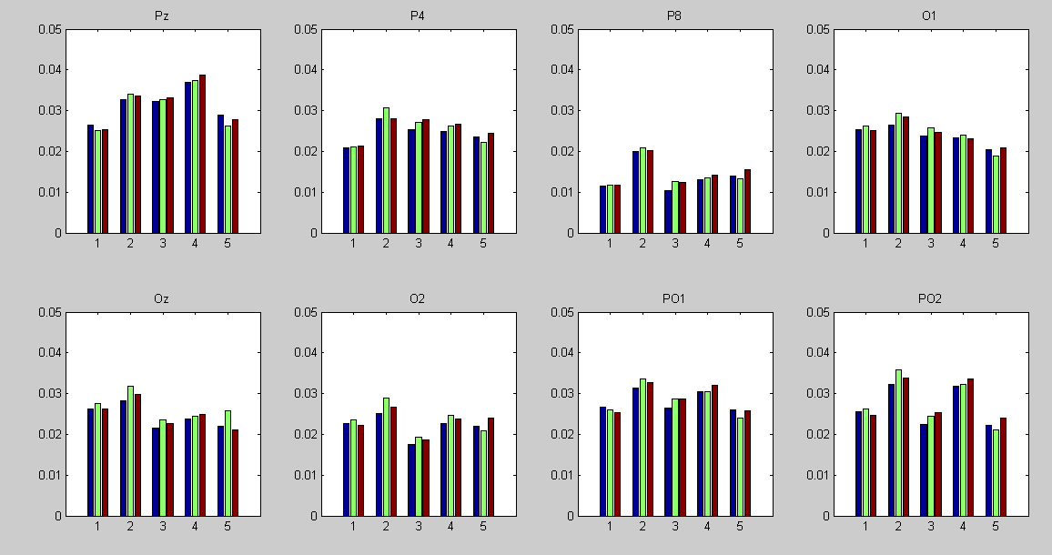
Increasing theta in parietal lobe and occipital lobe
Arousal by subject
ratingLimit -4-6
Car filter
Ratio
Hard to distinigish between mid and high arousal? 2 classes instead of 3 easier to see?

Slide 21
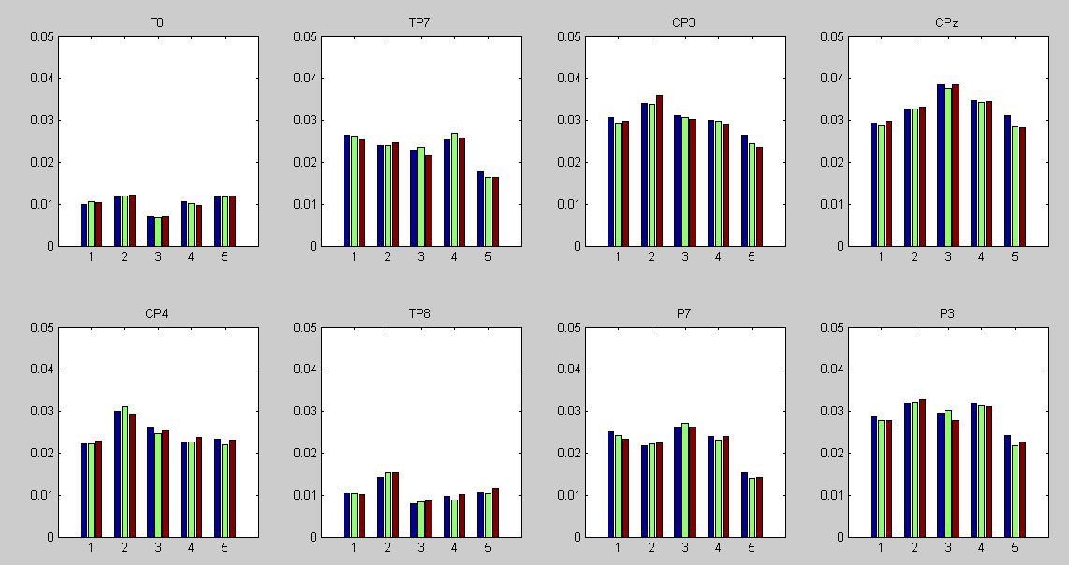

Slide 22
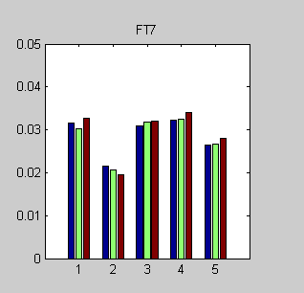
Increasing frontal alpha
Arousal by subject
ratingLimit -4-6
Car filter
ratio

Slide 23
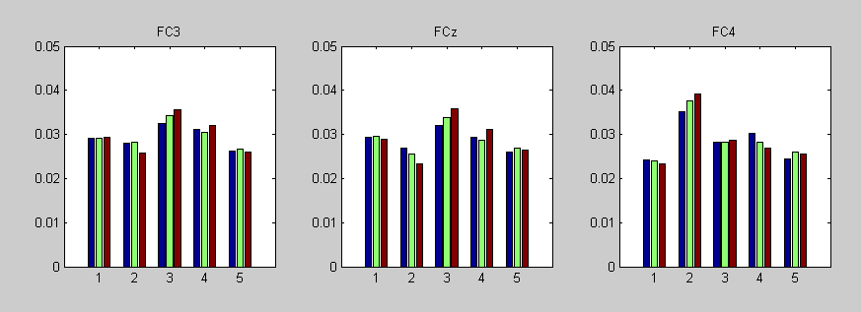
Increasing frontocentral beta 12-18
Arousal by subject
ratingLimit -4-6
Car filter
ratio

Slide 24
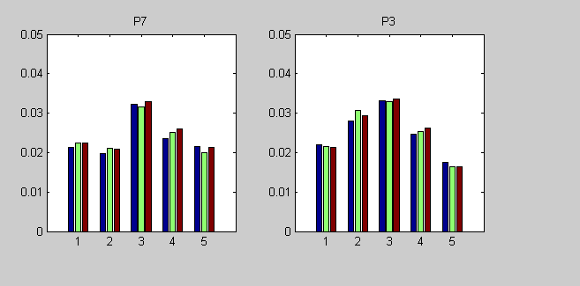

Slide 25
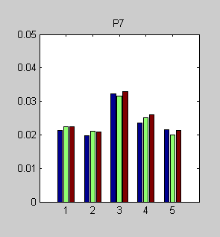
Increasing parietal beta 22-30
Arousal by subject
ratingLimit -4-6
No car filter
ratio

Slide 26
Other trends by paper 12 valence, arousal, dominance in EEG during gameplay

Slide 27
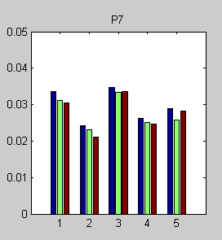
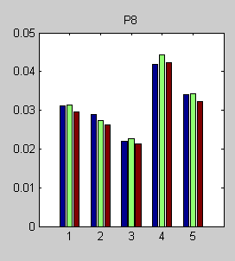
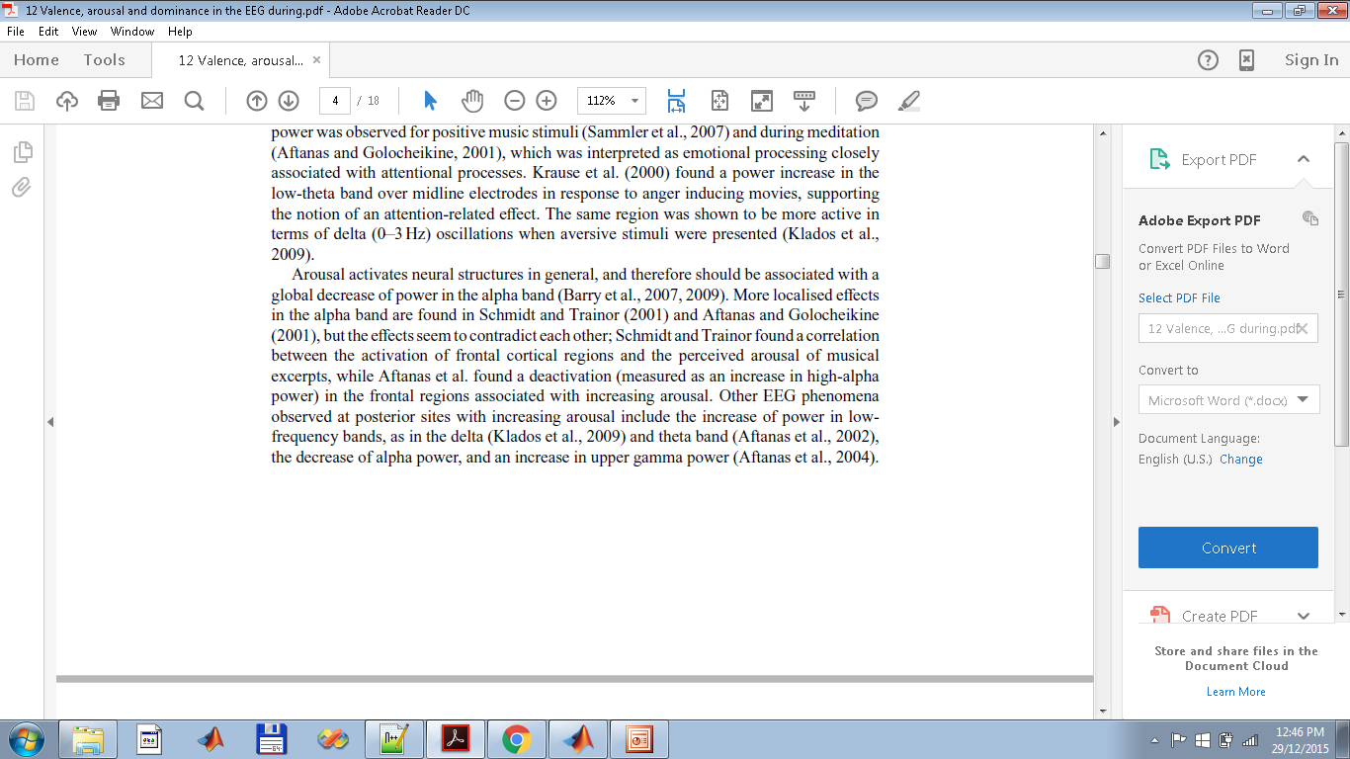
Decreasing alpha at parietal lobes
With increasing arousal by subject
ratingLimit -4-6-
Car filter
ratio

Slide 28
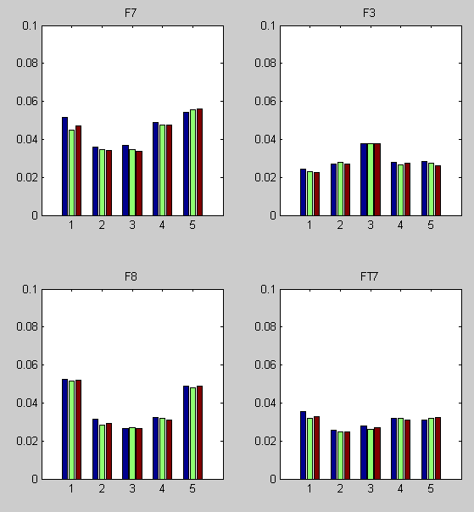
Decreasing alpha/ activation at frontal lobes
With increasing arousal by subject
ratingLimit -4-6-
Car filter
ratio

