Slide 1

ThinkFreedom Stack (TFS)

Slide 2
The problem
Our world is not always friendly to people with mobility (e.g. tetraplegia), vision, hearing or other accessibility problems. It is very hard for them to use their computer, to watch television, to spend time more creatively, to communicate with more people…
Here, at SciFY we thought it is about time we changed this. We owe it to them.
The goal
To increase accessibility to the computer or any other kind of electrical device to people with special needs, no matter what the needs are. That is, to give them the ability use home appliances and other devices by themselves easier, so that they can be and feel as autonomous and free as they can be.
The way
The Project ThinkFreedom.

Slide 3
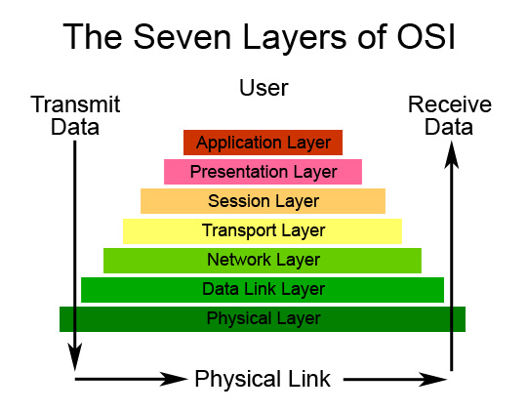
The Architecture of the ThinkFreedom
OSI model used in the communications
The OSI model is a conceptual model that characterizes and standardizes the communication functions of computing system without regard of their underlying internal structure and technology.

Slide 4
ThinkFreedom Hardware Stack
Our model is designed as appears bellow

