Slide 1

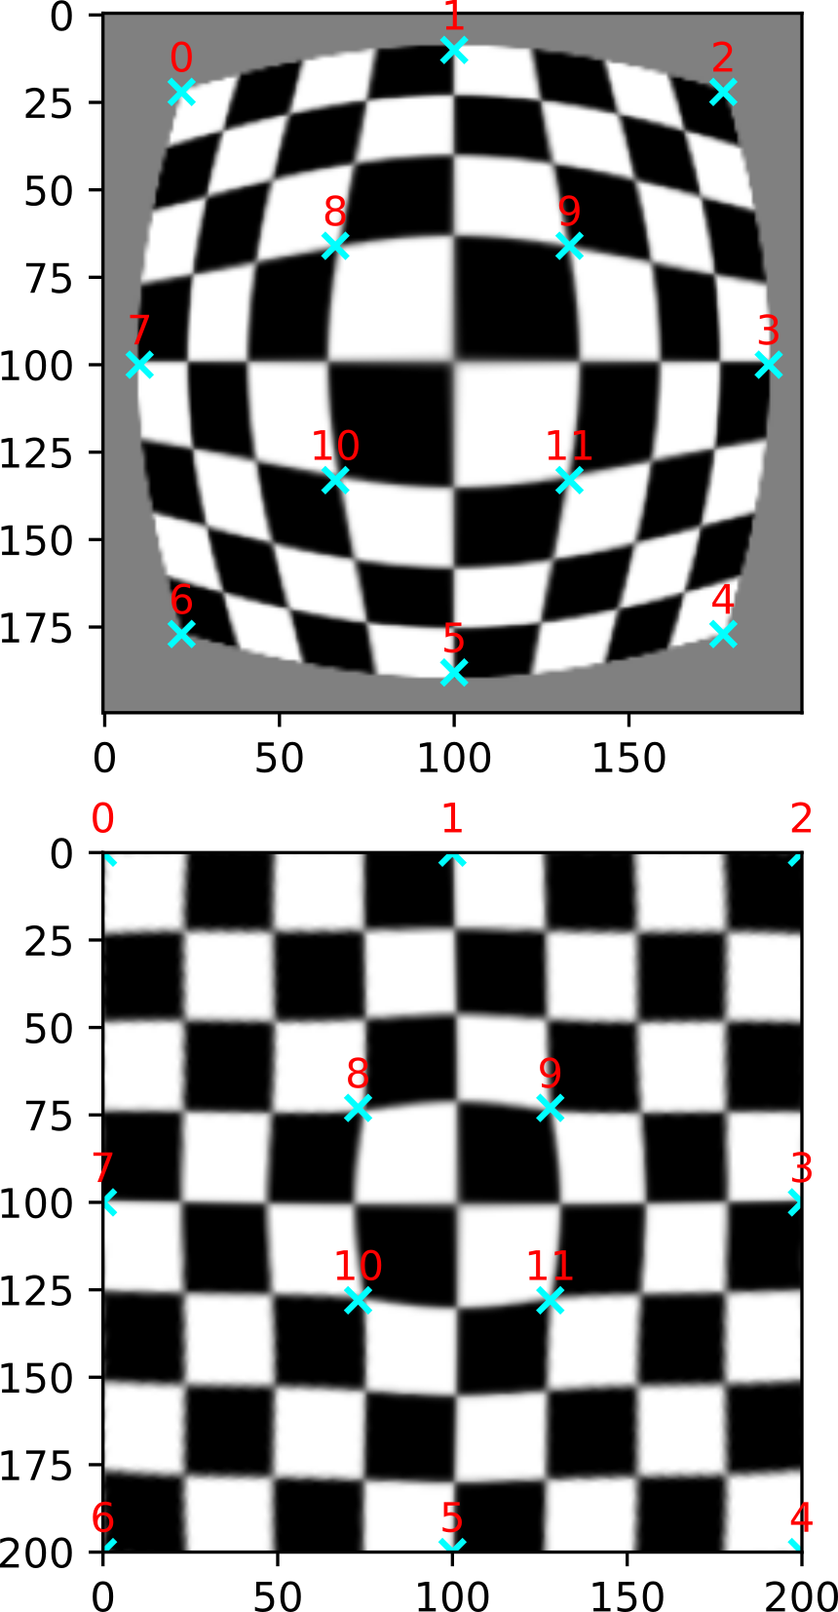
scikit-image @ SciPy 2024
What's happened?
Releases 0.23, 0.24
ThinPlateSplineTransform()
remove_objects_by_distance()
tinyurl.com/scipy24-skimage-update

Slide 2
scikit-image @ SciPy 2024
What's happened?
Better border handling in erosion(), dilation(), opening(), closing(), …
Support for NumPy 2
…
tinyurl.com/scipy24-skimage-update

Slide 3
scikit-image @ SciPy 2024
What's next?
Transition to skimage2 namespace
Type annotations with docstub (protocols?)
Pyodide in docs
Logo update: import skimage ⛷️ 🧙
tinyurl.com/scipy24-skimage-update

