Slide 1


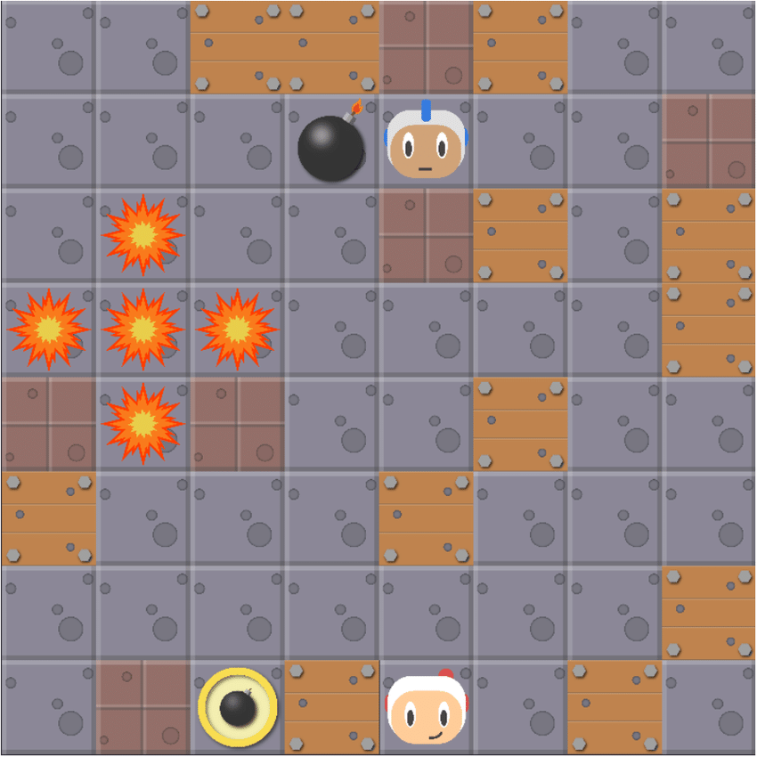
Final Challenge
Pommerman Tournament: One vs. one on a 6x6 grid
Varying starting positions (0: top left; 1: bottom right)
Sparse and delayed rewards
Noisy reward signal because of potential opponent suicides

Slide 2
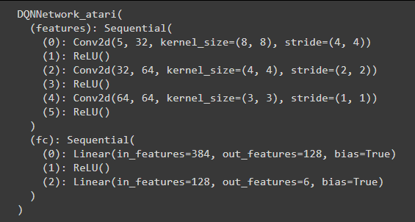
Approach
Deep Q-Network: Separate training and target value function.
Replay Buffer to ensure that the training data is i.i.d.
We use the group‘s best-performing agent network as training and target value function
Other group agents, simple agent and random agent act as opponents

Slide 3



Opponents
Score 0.1
Score 0.56
Score 0.68
Opponent 1
Opponent 2
Simple Agent
Score 0.62
Score 0.02
Main Agent
Opponent 3
Opponent 4
Random Agent

Slide 4
Training
Trains 2000 episodes against each of the six opponents
Total number of episodes = 6*2000 = 12000
First starting position 1: Opposite from the position the agent has been trained on
Alternating starting positions afterwards
Opponent
Main Agent

Slide 5
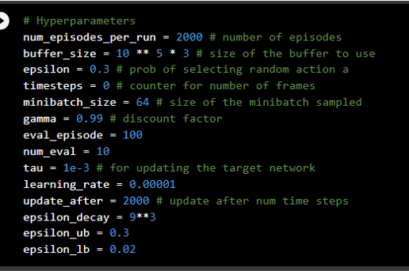
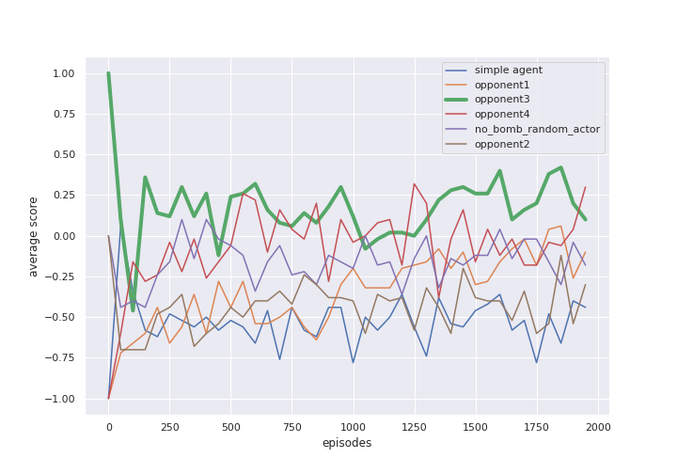
Training
Opponent
Main Agent

