Slide 1


Slide 2
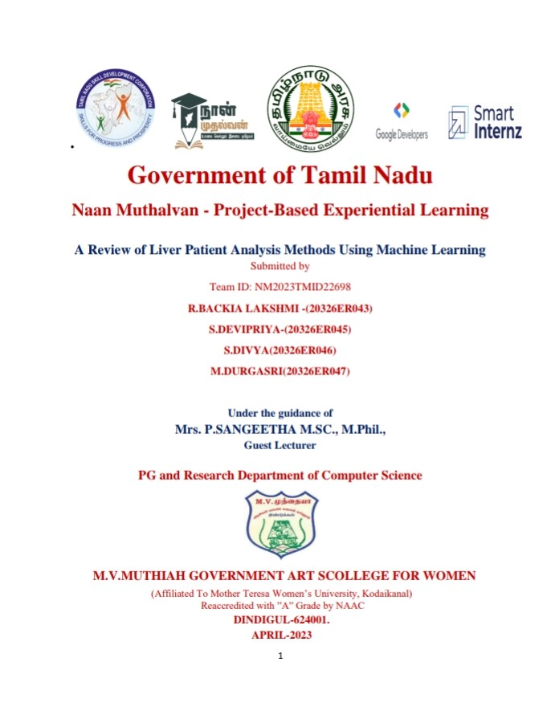
IMPLEMENTING CRM FOR RESULT TRACKING OF A CANDIDATE WITH INTERNAL MARKS
Submitted by
Team ID:NM2023TMID07753
N.SCINDHIA-(20322ER027)
S.ISWARYA-(20322ER006)
M.SATHIYA PRIYA-(20322ER0250)
M.ANANTHI-(20322ER001)
Under the guidance of
Dr. M.RAMESH M.Sc., M.Phil., Ph.D.,
Assistant Professor
PG DEPARTMENT OF PHYSICS
M.V.MUTHIAH GOVERNMENT ARTS COLLEGE FOR WOMEN

Slide 3
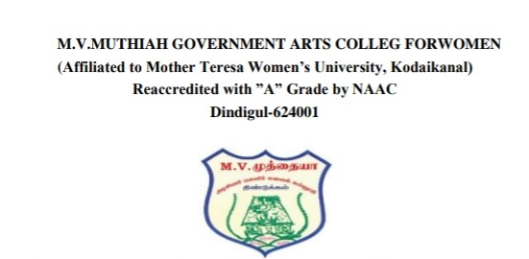
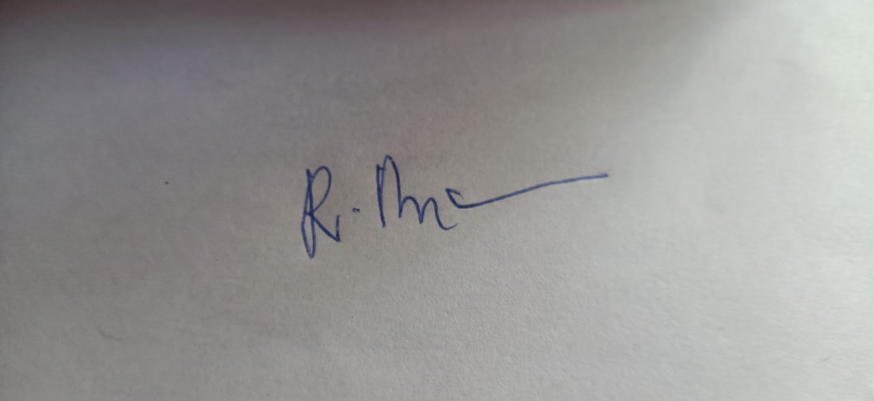


PG Department Of Physics
BONAFIDE CERTIFICATE
This is to certify that this is a bonafide record of the project entitled,”IMPLEMENTING CRM FOR RESULY TRACKING OF
A CANDIDATE WITH INTERNAL MARKS “ done by N.SCINDHIA(20322ER027), S.ISWARYA(20322ER006),M.SATHIYA PRIYA(20322ER025),M.ANANTHI(20322ER001).
This submitted in partial fulfillment for the award of the degree of Bachelor of Science in Physics in M.V.MUTHIAH GOVERNMENT ARTS COLLEGE FOR
WOMEN,DINDIGUL during the period of December 2022 to April 2023.
Project mentor(s)
Head of the Department
Submitted for viva-voice Examination held on_12.04.2023_________

Slide 4
IMPLEMENTING CRM FOR RESULT TRACKING OF A CANDIDATE WITH INTERNAL MARKS

Slide 5
IMPLEMENTING CRM FOR RESULT TRACKING OF A CANDIDATE WITH INTERNAL MARKS
PROJECT BASED EXPERIMENTAL LEARNING PROGRAM
SUBMITTED BY
N.SCINDHIA (20322ER027)
S.ISWARYA
(20322ER006)
M.SATHIYA PRIYA
(20322ER025)
M.ANANTHI
(20322ER001)
TEAM ID :NMM2023TMID07753
UNDER THE GUIDANCE OF
Dr M.RAMESH M.sc .,M.Phil.,Ph.D.,
UG DEPARTMENT OF PHYSICS
M.V.MUTHIAH GOVERNMENT ARTS COLLEGE FOR WOMEN
DINDIGUL -624
APRIL -2023

Slide 6
MILESTONE 1: CREATION SALESFORCE ORG:
1. INTRODUCTION
Customer relationship management (CRM) software is not just about sales
and service automation. It is also how to engage with customers, anticipate their journey
and exceeds their needs .
Customer Relationship Management implementation is the process of
Centralizing all communication between a company and its customers.This involves a CRM software
With features that match your need. These can include storing customer conversation ,tracking
Leads you want to follow up with and more.

Slide 7
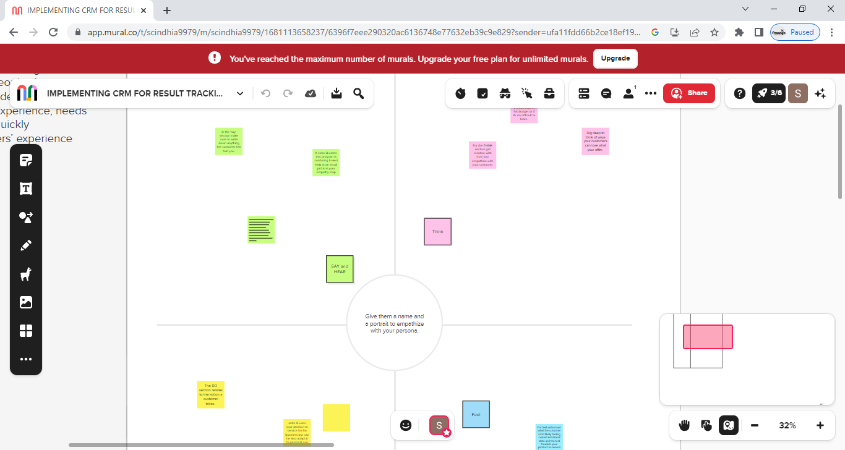
2. PROBLEM DEFINITION AND DESIGN THINKING
2.1 EMPATHY MAP:

Slide 8
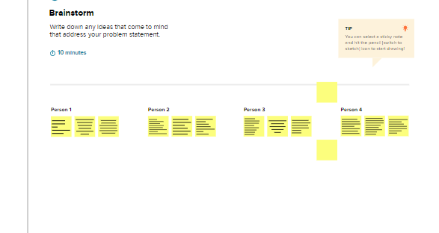
2.2 IDEATION AND BRAINSTORMING MAP:

Slide 9
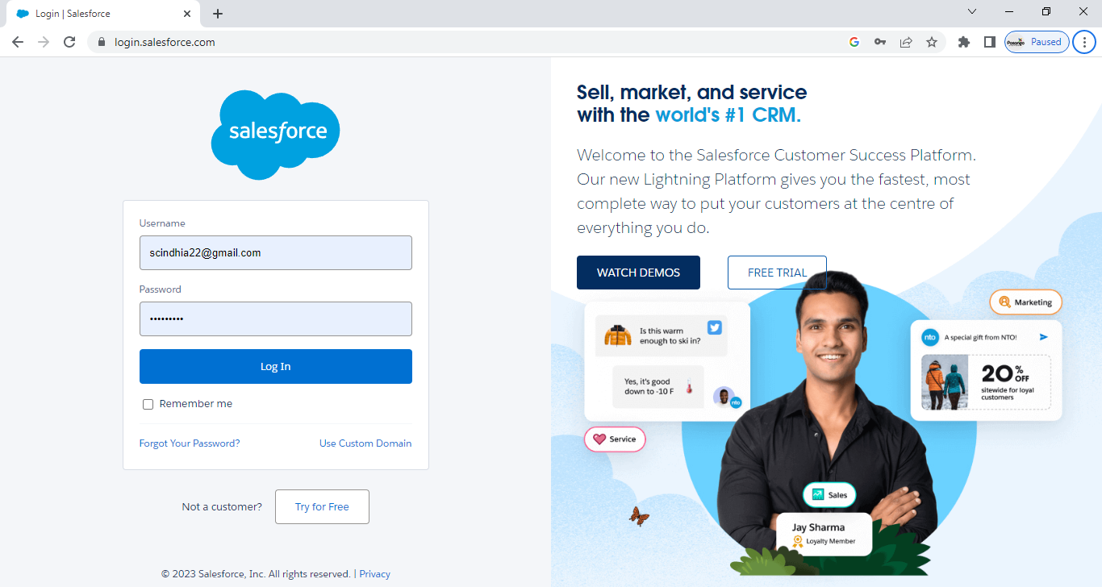

Slide 10
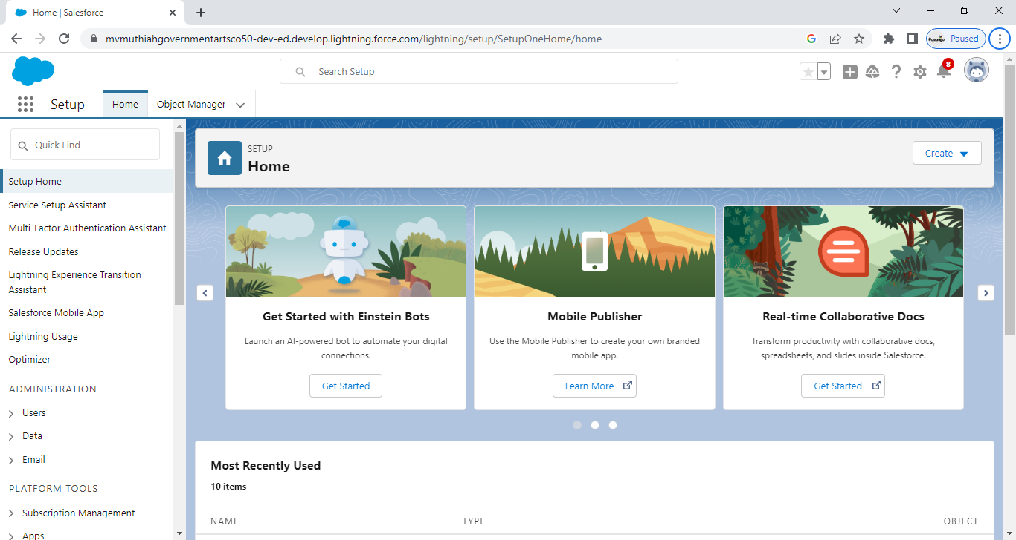
LOGIN TO YOUR SALESFORCE ACCOUNT

Slide 11
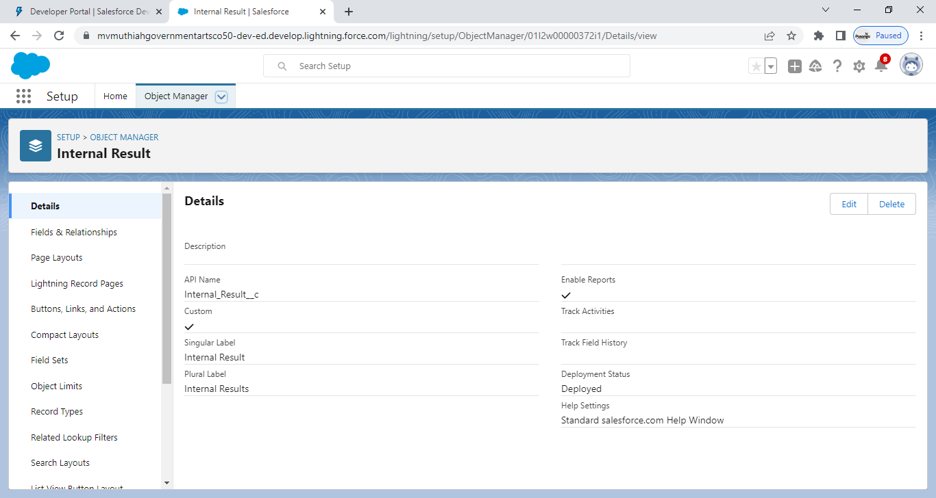
MILESTONE 2 :OBJECT

Slide 12
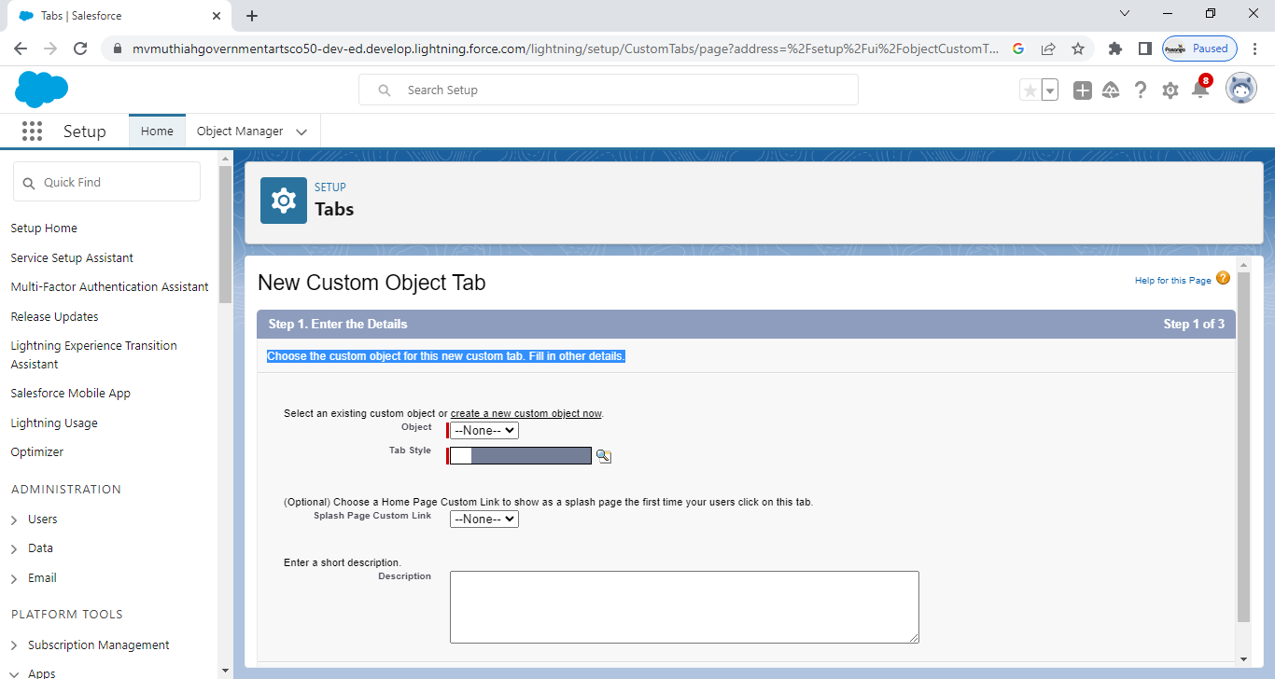
NOW CREATE CUSTOM TAB

Slide 13

FOR OBJECT, SELECT COURSE DETAILS

Slide 14
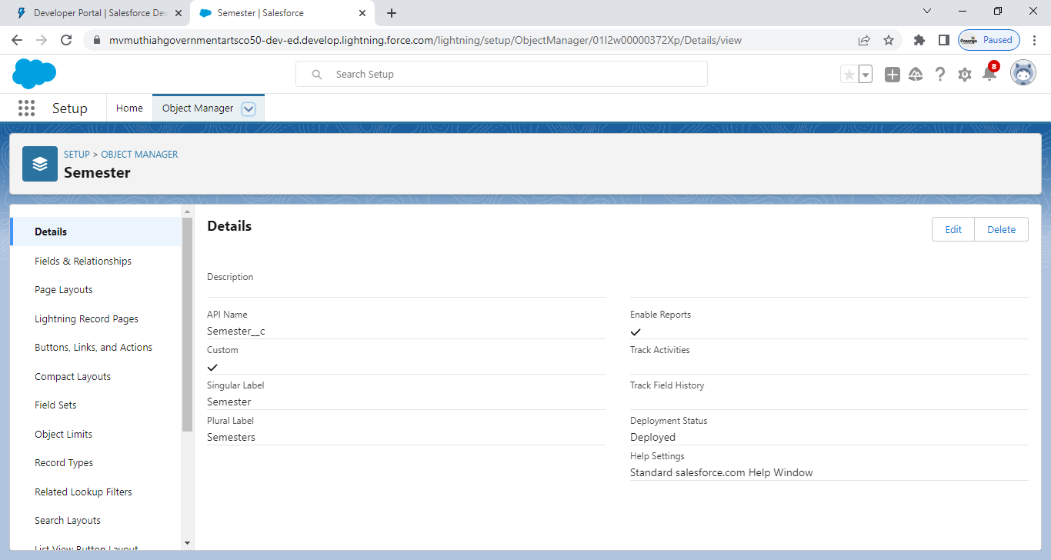
FOR OBJECT ,SELECT SEMESTER

Slide 15

OBJECT :LECTURER DETAIL

Slide 16

OBJECT : CANDIDATE DETAILS

Slide 17
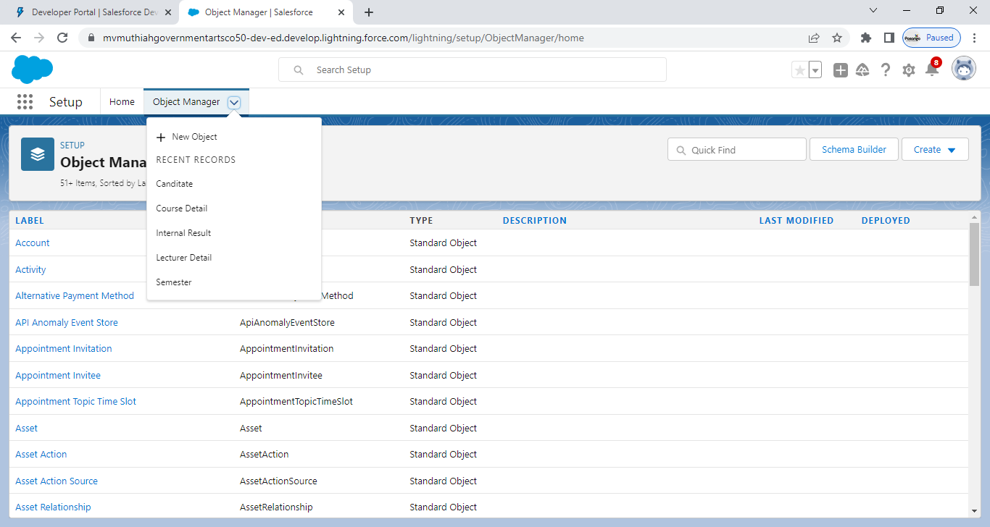
MILESTONE 2: FIELD AND RELATIONSHIP

Slide 18
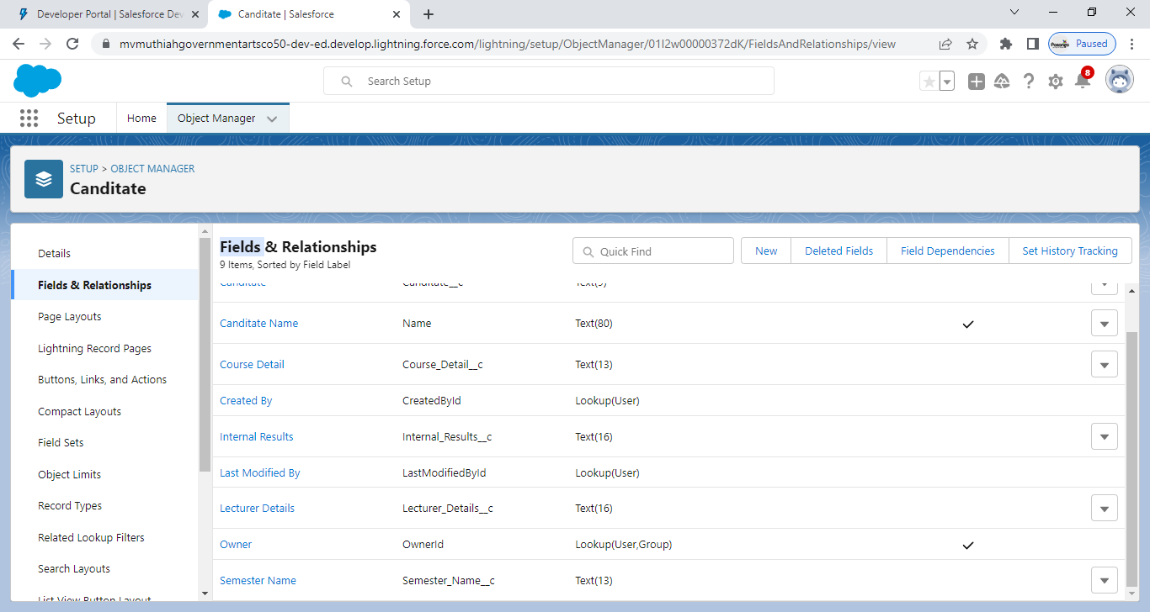

Slide 19
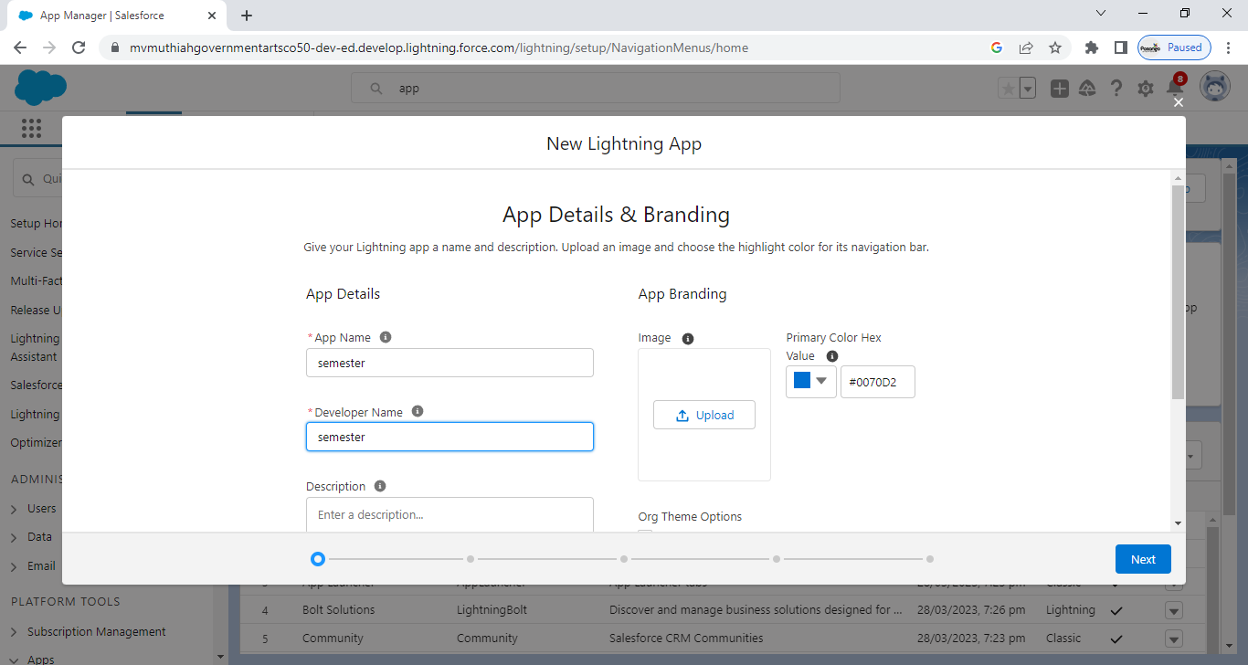
MILESTONE 3: LIGHTING APP

Slide 20
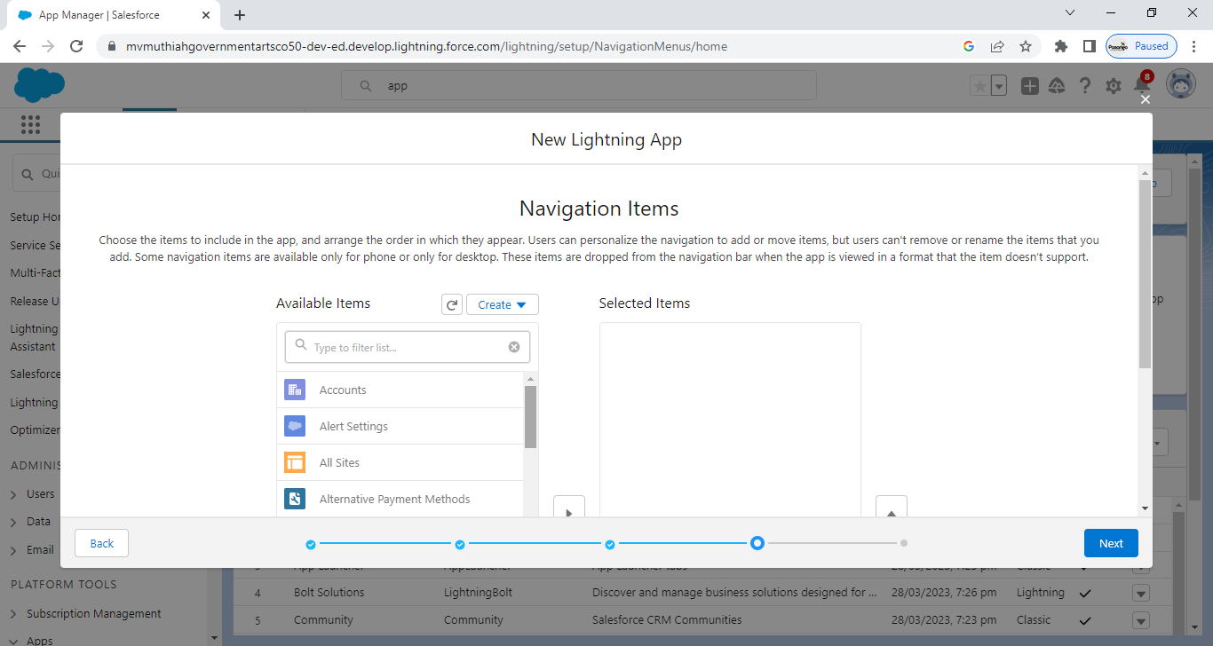

Slide 21
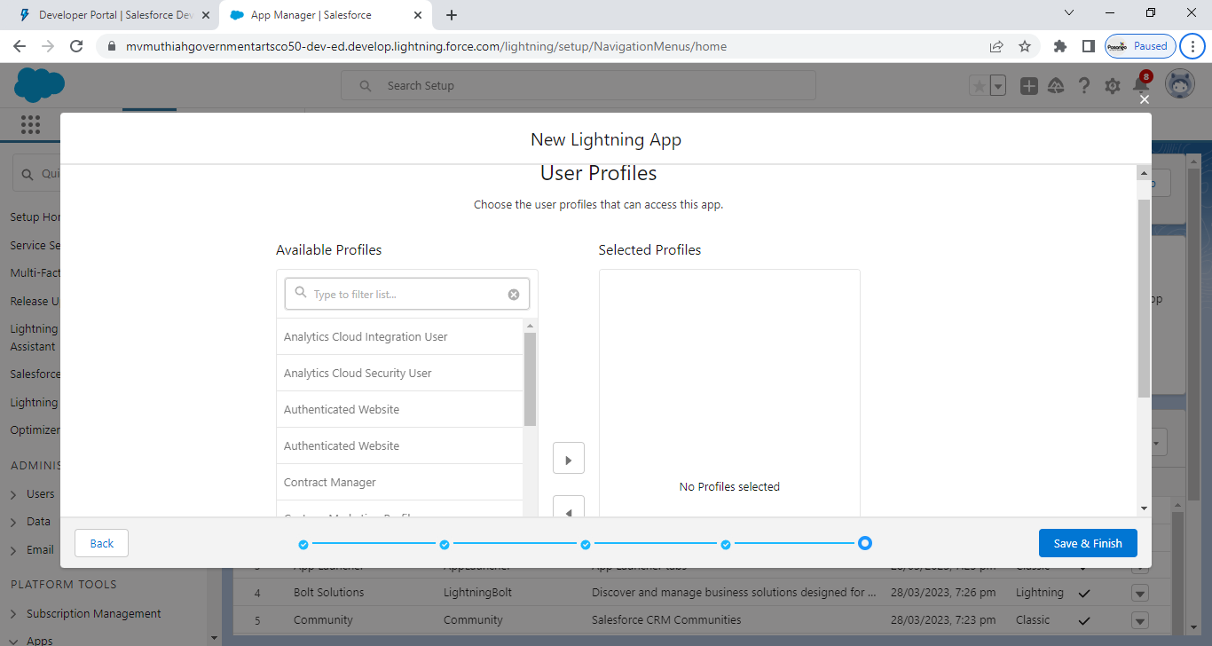

Slide 22
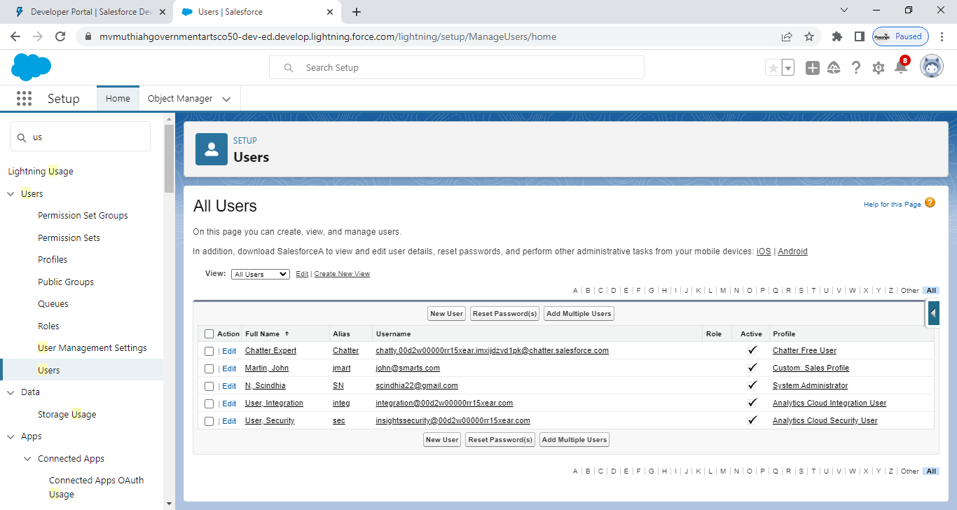
MILESTONE 4: USERS

Slide 23
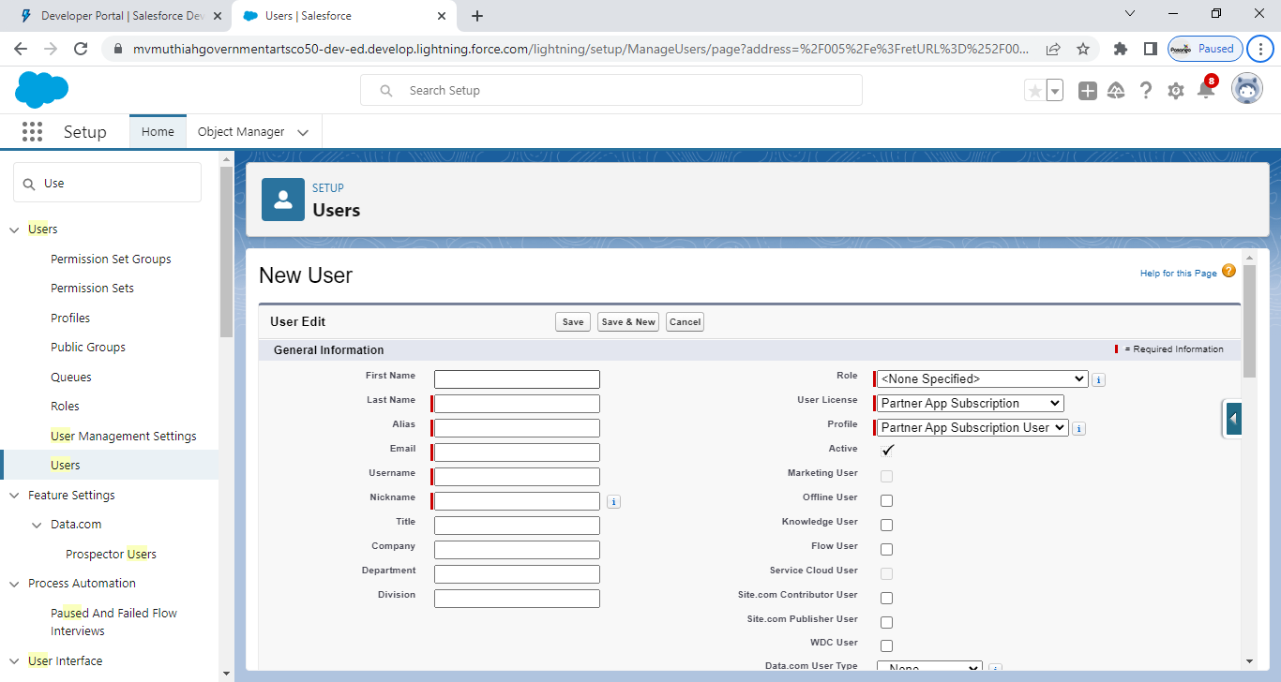

Slide 24
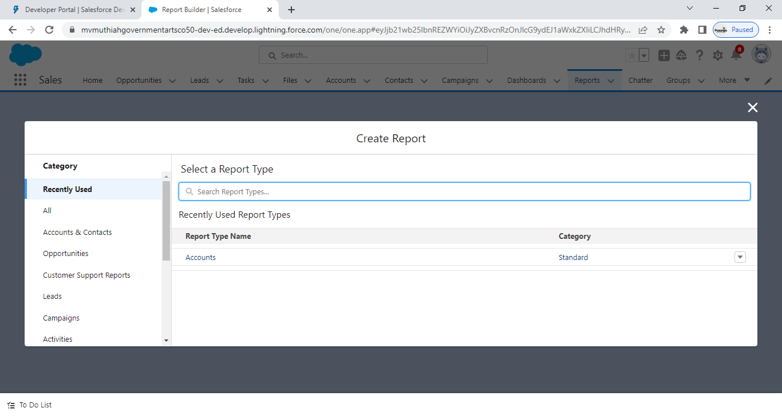
MILESTONE 5: REPORTS

Slide 25
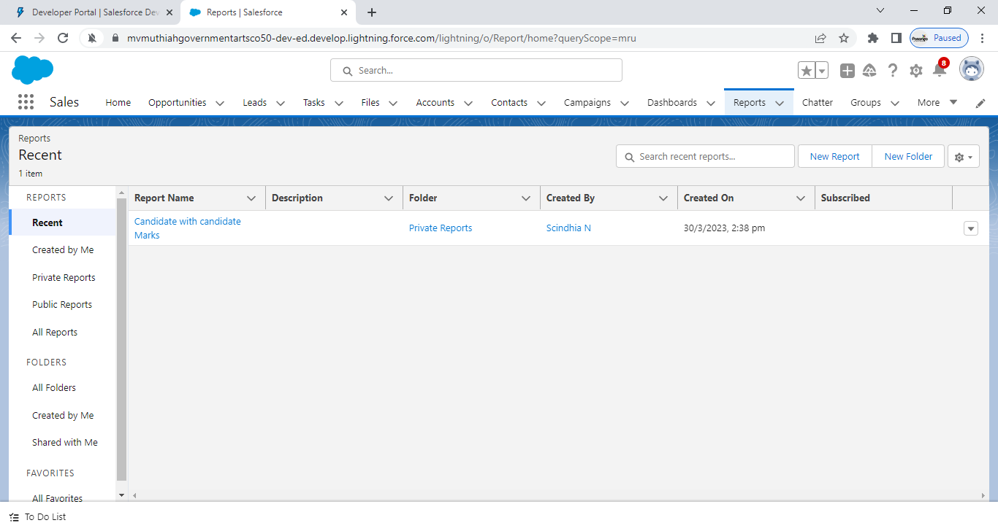

Slide 26
CONCLUION:
Customer Relationship Management(CRM) enables a company to align
Its strategy with the needs of customer in order to best meet those needs and thus
Ensure long term customer loyalty .CRM is a technology for managing all your company’s
Relationships and interactions with customers and potential customers.
The approach will be of particular interest to companies operating in
highly competitive markets where it is easy to attract new customers

Slide 27
THANK YOU

