Slide 1

Week of 6/1 -> 6/8

Slide 2
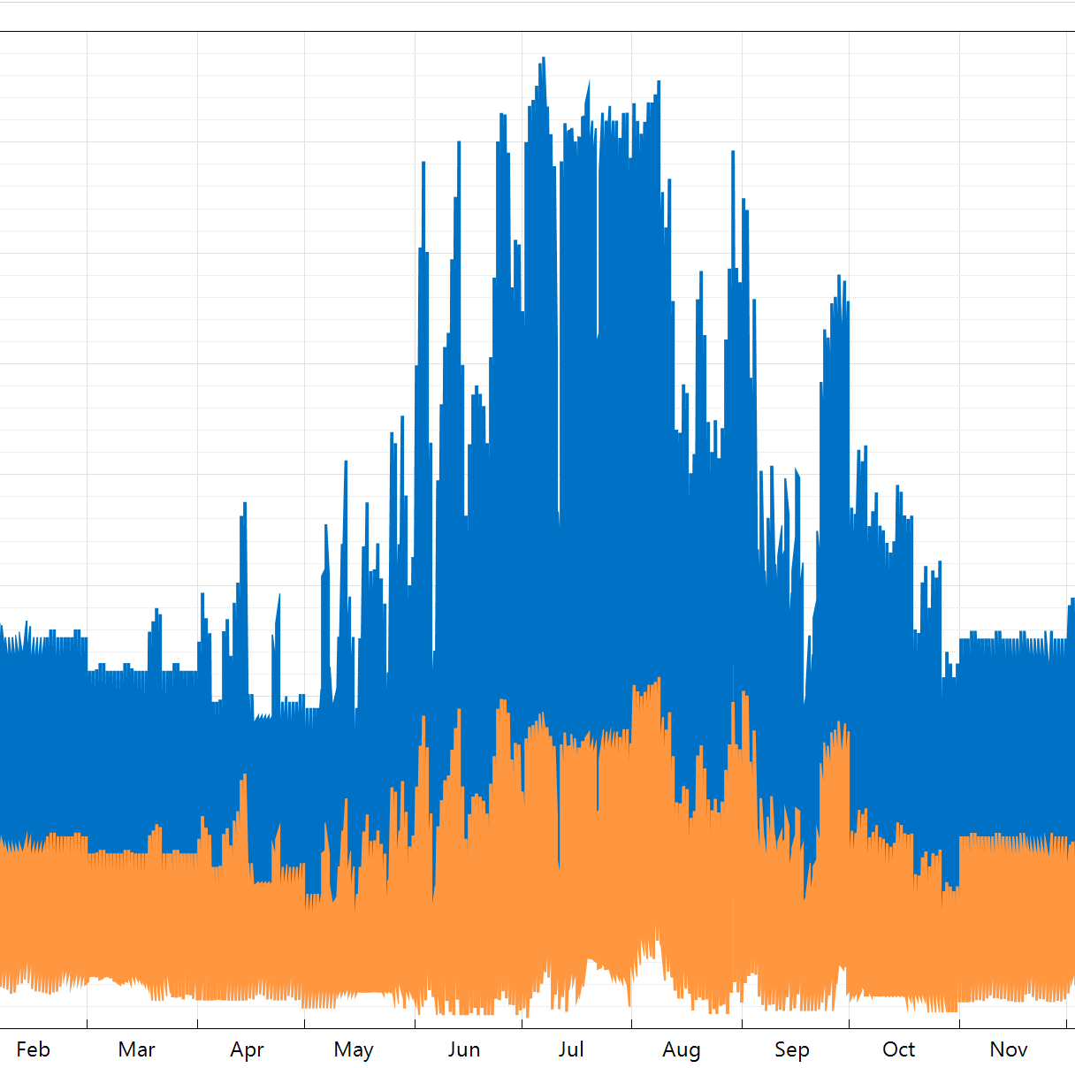
Electrical Use Data
For the more detailed model I can use actual data collected by the utility
For our generic buildings we can create a value from sqft, people living in space, and season (Power use can increase May -> September). Will probably create and external script to simplify

Slide 3

Sizing a Solar Installation
Going to stay smaller scale for now (~5kW Installations)
Stick within certain manufacturers ecosystems (LG and SMA-Americas)
Created a script to find minimum and maximum strings per subarray for larger installations in the future. Keep DC to AC ratio good! Small oversize and eventual clipping are efficient in some scenarios so testing values is important
Change was required to size a smaller system with better warranties (Original system ~$120,000, New system ~$8,000)

Slide 4
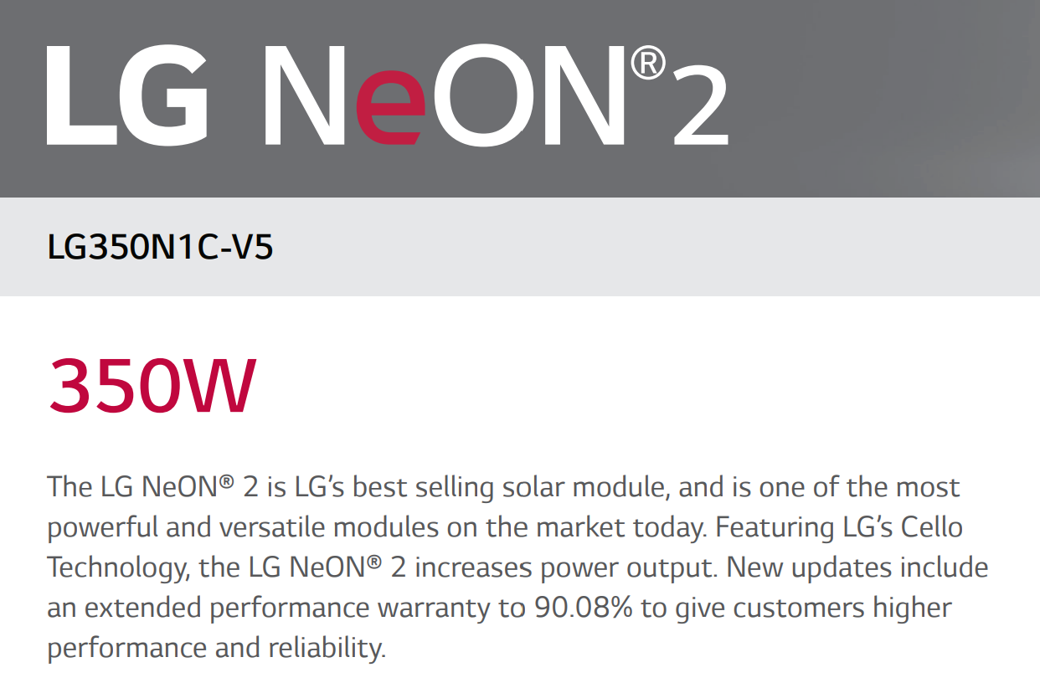

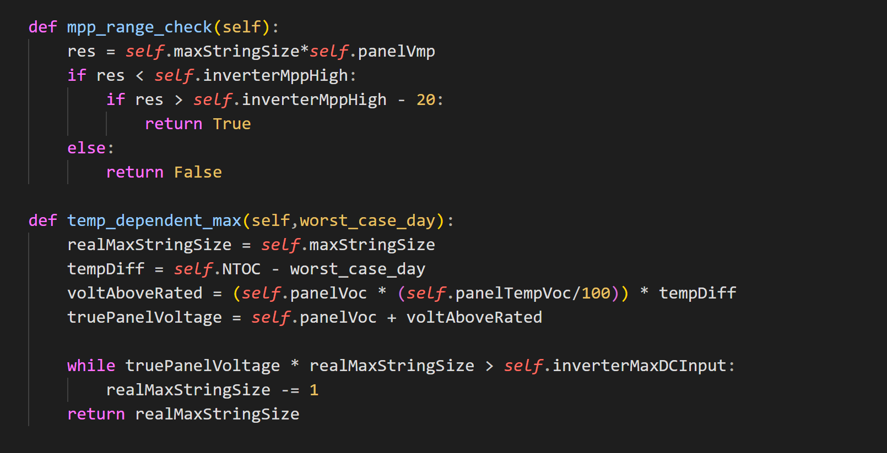

Slide 5
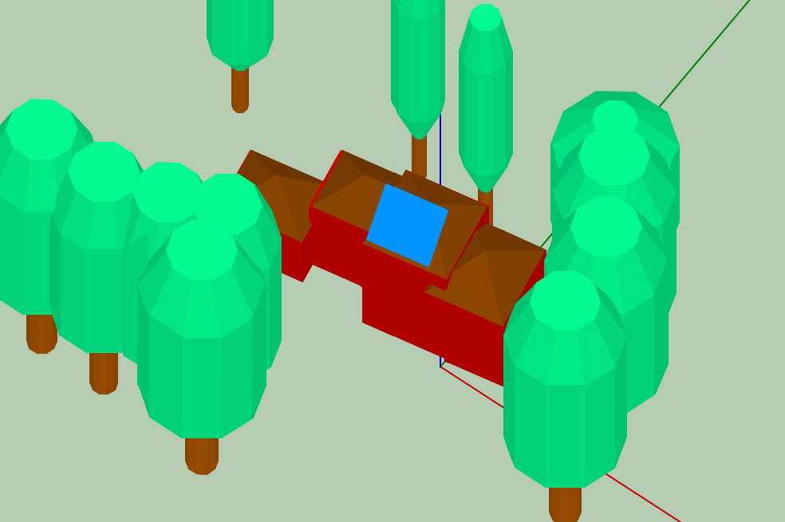
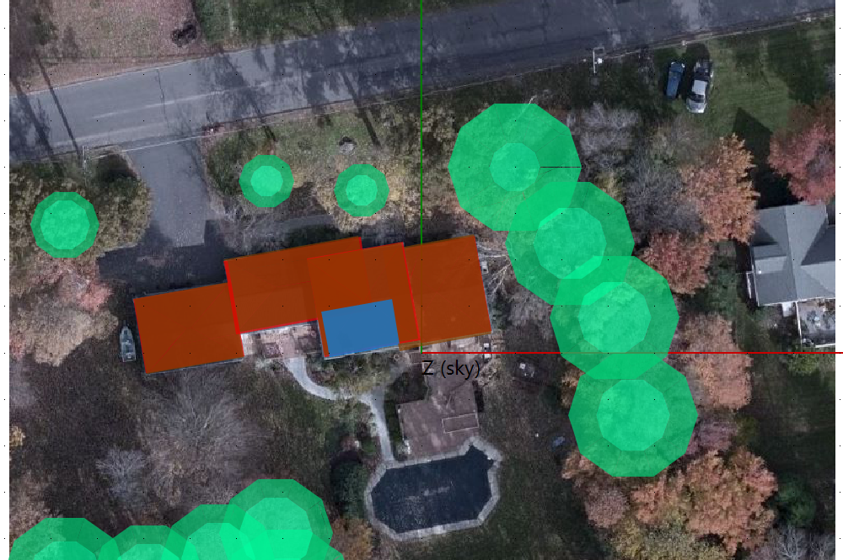
Shading

Slide 6
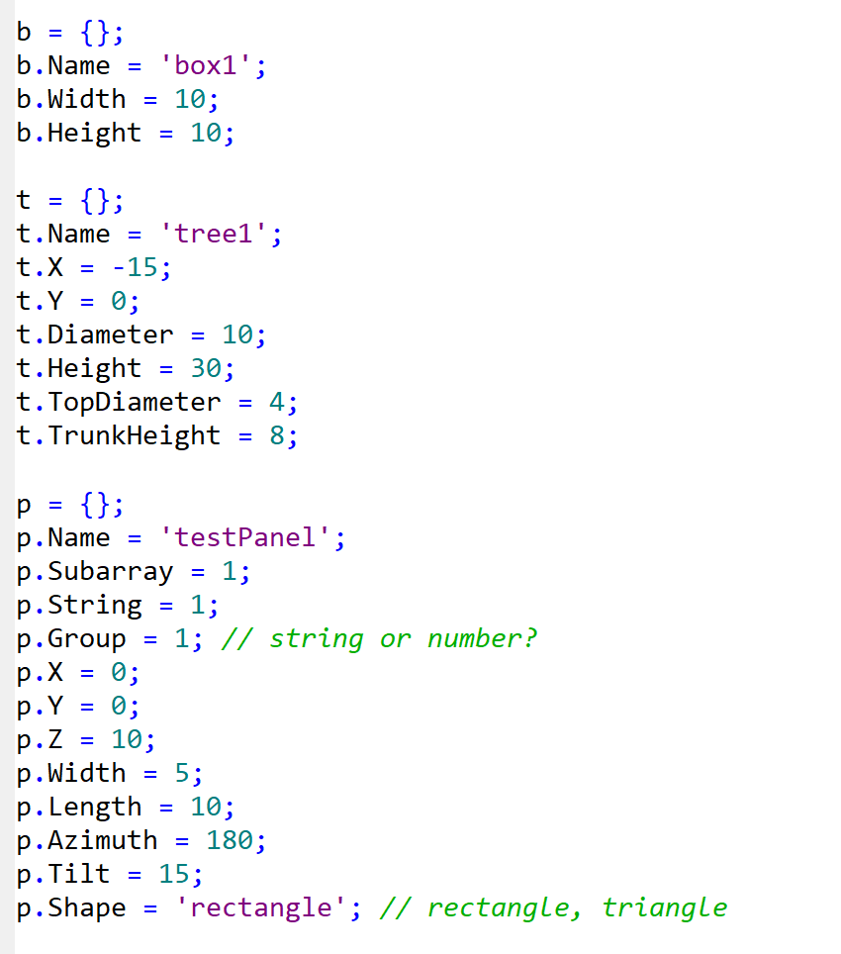
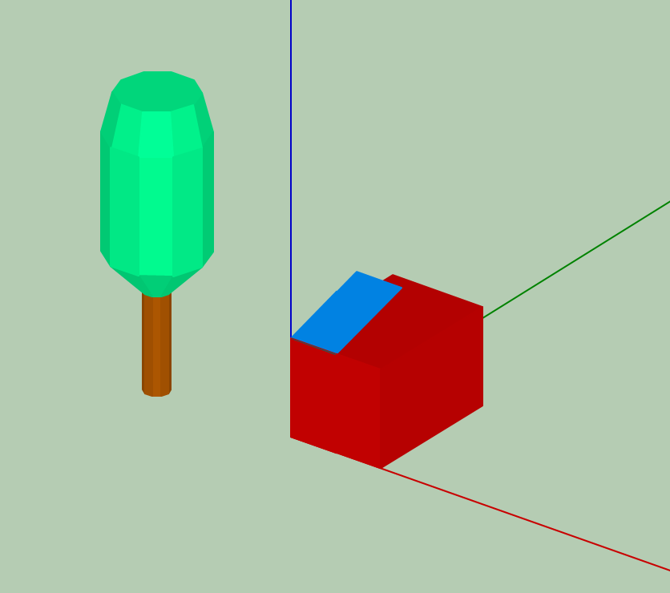
Shading Script (LK)
Create a script which creates a standard house and solar array system with a random tree arrangement. We can focus this to create random tree arrangements for designs which make sense (i.e. only south facing 20deg tilt arrays).

Slide 7
6/8 -> 6/15
Read lk documentation
Research and implement the financial and incentive information for my installation and create an initial simulation
Review and change if needed

Slide 8
Week of 6/8 -> 6/15

Slide 9
Home Model
Finished the initial model of my home with a solar panel installation and ran a few basic tests to find out some information.
What are the most space efficient designs?
What is the affect of creating subarrays with different shading profiles?
Have a few space efficient designs. I will pick for one for the final design

Slide 11
Shading
LK scripting has no random function nor an ability to check OS time clock so a different method is required.
Parametric modeling will cut down on scripting requirements for finding optimized values.

Slide 12
Financial Research
System Costs
Direct Capital: Installer labor, margin, overhead, and BOS equipment are often priced by solar contractors as a percentage of the component costs. So these costs can be programmed to be based on the system design.
Indirect Capital: Environmental studies and Grid interconnection are constant prices.
O&M: This costs are often negligible in residential solar. By picking panels and inverters with good warranties we can ignore this risk assessment to focus on other financial metrics.

Slide 13
Financial Research cont.
Financial Parameters: Analysis period is constant, but loan length, down payment percentage, and loan conditions can be changed for different situations (i.e. 50% down payment on a $10,000 system can increase net present value
Incentives: Can be country, state, installed capacity, or production capacity, can be used to lower the price of specific systems over others or generally decrease prices
Electricity Rates: Set by utility company, much harder to change than incentives or component costs. Also much more complex. They can be left constant based on the location of the site

Slide 14
What Parameters Can Be Changed?
Lat/Long
Module Price
Inverter Price
Shading (variable)
Loan parameters
Investment tax credit
Production tax credit
Investment based incentive
Capacity based incentive
Production based incentive

Slide 15
6/15 -> 6/22
Script to create variable tree placement.
Understand and catalog all constant values. Why are they constant? Why are they the value they are? If x or y change, how does everything else change e.g. size of house?
Create a model using a space efficient solution that is not positive net present value because of a combo of shading and poor sunlight location. Applying the lessons learned in creating the “home” model.

Slide 16
Week of 6/15 -> 6/22

Slide 17
Location + Shading Trouble
When testing variable locations, even ones that traditionally should be poor for solar still often can make positive profit
I also realized that poor locations for solar panels should not be promoted per say, why direct limited resources to marginal cases when more intelligent placements are still available?
I also realized that shading plays about the same importance as location and due to the above realization, it may be the correct factor to research

Slide 18
3 Different Shading Configurations
1. No Shading
2. ~20% Shading
3. ~50% Shading

Slide 19
Outcomes
More shading coverage makes cutting trees down more price efficient, but often more shading coverage is due to more trees
In my example even though the heavier shade had more gain, it was overall still a poorer investment then the lighter shade due to the cost of removing trees.

Slide 20
Week of 6/22 -> 6/29

Slide 21
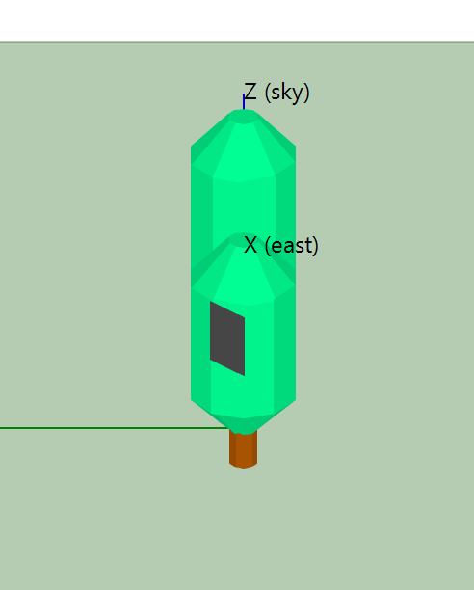
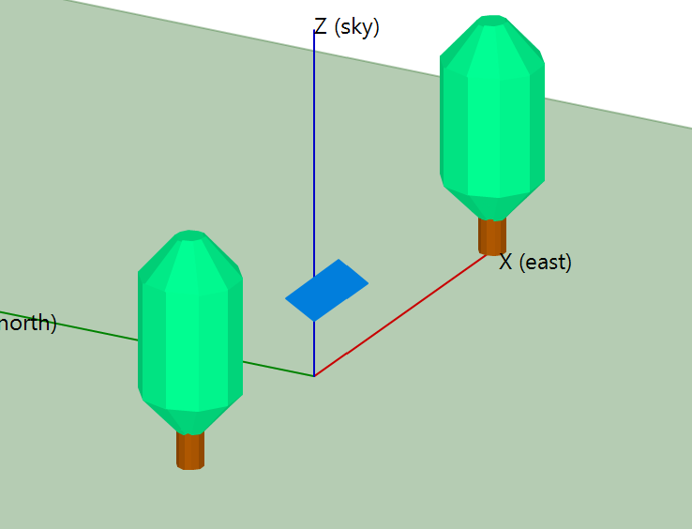
Shading Experiment 1
What is the affect on energy output of a solar array from shading due to trees in the East/West direction with full length coverage of the solar array.
Measuring shading % at three separate days, does the time of the year change the shading situation? Is energy constantly increasing or logarithmically?

Slide 24
Results
In the East West Direction - Tree shading always trends towards the constant of no shading, but at different rates. If trees only covered 50% on east west direction the rate does not change but the initial maximum is reduced by the % initial tree coverage. Energy production is a log. As trees go further away from the active surface their effect on energy production becomes less pronounced. The rate is dependent on the tree height and could affect the max shading amount.
Tree Diameter -> Max Shading Amount
Tree Height -> Rate of Shading Decrease, Max Shading Amount in Edge Cases
Tree Amount -> Max Shading Amount
A mix of trees is the mix of these variables

Slide 25
Trees vs. Solar Panels
Method for Calculating Carbon Sequestration by Trees in Urban and Suburban Settings
https://www3.epa.gov/climatechange/Downloads/method-calculating-carbon-sequestration-trees-urban-and-suburban-settings.pdf
eGRID 9th edition Version 1.0 Year 2010 GHG Annual Output Emission Rates
https://www.epa.gov/sites/production/files/2015-02/documents/egrid_9th_edition_v1-0_year_2010_ghg_rates.pdf
Typical 7500 W (21 350 Panels) System -> ~50 Trees in terms of C02 emissions

