Slide 1
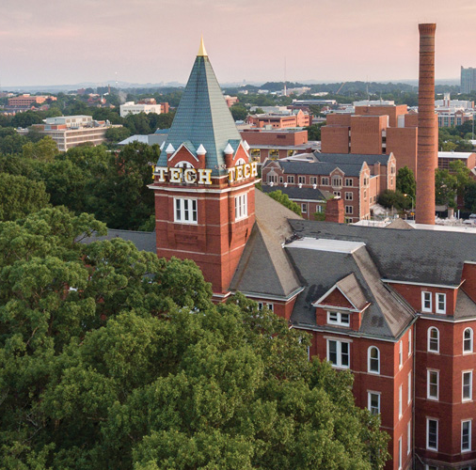

How to Structure a Successful SciOly Team
Georgia Tech Event Workshop Series 2024-25

Slide 2

01
Get to Know Me!
02
Icebreaker
03
5 Tips to organizing a successful team
04
Problem Solving
05
How to get more involved in your team
06
Game!
Notes:
For Builds: Replace difficult topics with physical principles involved in the build and replace common questions with common designs

Slide 3
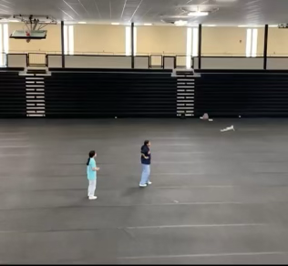
A Little about me…
Name: Anisha Suryadevara
College: University of Georgia
Graduated from Lambert High School- May 2024
My SciOly Events:
Cell Biology, Anatomy and Physiology, Flight, and
Microbe mission
Active member since 2021
2022-23 Junior Captain
2023-2024 Captain
Notes:
Highlight key points from the rules sheet: DESIGN LOGS that basically grant free points, most tested-on topics, point distribution so that competitors know what to prioritize, allowed notes and equipment, etc.

Slide 4

Your turn!
What event are you most excited for this year?
What is your favorite event?
Icebreaker:
Words associated with TEAM and SCIOLY
What five-letter word has one left when two letters are removed?
You can’t see me, but I can see you. To be more specific, I see through. What am I?
Notes:
Highlight key points from the rules sheet: DESIGN LOGS that basically grant free points, most tested-on topics, point distribution so that competitors know what to prioritize, allowed notes and equipment, etc.

Slide 5
5 tips to organizing a successful team!
Each team you are a part of has a different dynamic and will have a different definition of success. Having and setting goals for teams is an important way to show growth and progress.
TIP # 1 : Communication
TIP # 2: Having respect and compassion for others
TIP # 3: Time management/ setting deadlines
TIP # 4: Delegation of roles and tasks
TIP # 5: Creating shared goals

Slide 6

Communication
-Open communication allows goals and ideas to be shared to the team
-Asking questions or addressing concerns
-Allows you to get to know others strengths and weaknesses
-Specific Platforms (GroupMe) to help distribute information and announcements

Slide 7

Respect/Compassion
Having respect for others, will help you gain respect from them (mutual respect)
Being respectful is courteous and will help people actually listen to you
Being compassionate and understanding is important
Be mindful that everyone is starting from a different part- knowledge or experience wise
Ex. Team A vs Team C

Slide 8

Time management
There is only so much time in a day, so use it wisely!
Weekly Meetings: Good way to track progress of team, allows for time to prepare materials for exams, time to ask questions
Preparing for events: Allotting time to read your event rules, time for builds(not procrastinating them), and building kits for events that require you to bring materials.
Deadlines: setting dates for having specific tasks done can help delegate time
For a team to be successfully, time management is crucial!

Slide 9

Delegating roles
Teamwork and leadership skills are needed
Know when to step up
The team is made up of many teams (3)
Being able to work with your partner or group to successfully complete and event
Officers should be setting good examples and helping team members who need help with their events, work, or partners
Assigning events- placement tests
Build/ Test events
Invitationals, Regions, and State

Slide 10

Creating goals
Goals help a team make progress towards something
Can be about placing top 5 or 10, making progress in learning content, mastering a topic, etc.
Creating goals as a team will strengthen the team
Able to foster some creativity and inspiration in a team

Slide 11
Problem Solving!!!
Tools to resolve conflict
Some of the big problems I have seen-
1 partner doing all the work
Communication problems
Time management
To solve these-
If you find yourself doing all the work you need to EFFECTIVELY COMMUNICATE with your partner and maybe assign them tasks to do (scioly is team based; u should not be doing everything solo)
Make sure you have a way of communicating and reaching your partner so you can prepare for events
Start your prep as early as you can and don’t procrastinate!
Being Patient
Being Attentive
Looking at other perspectives
Talking it out
Ex. students being assigned to events they didn’t originally want to compete in.

Slide 12

SciOly Funding!
Teams are costly!
T Shirt costs
Competition fees
Transportation fees
food/snacks
Event materials
You need to be aware of the costs that come with SciOly

Slide 13
How to get more involved in your team
-SHOW UP!!
-show commitment to the team
-have a strong work ethic
-try your best
-work well with others
There are the best ways for you to get noticed by leadership/ teachers and for you to get leadership opportunities.

Slide 14

Questions!!

Slide 15
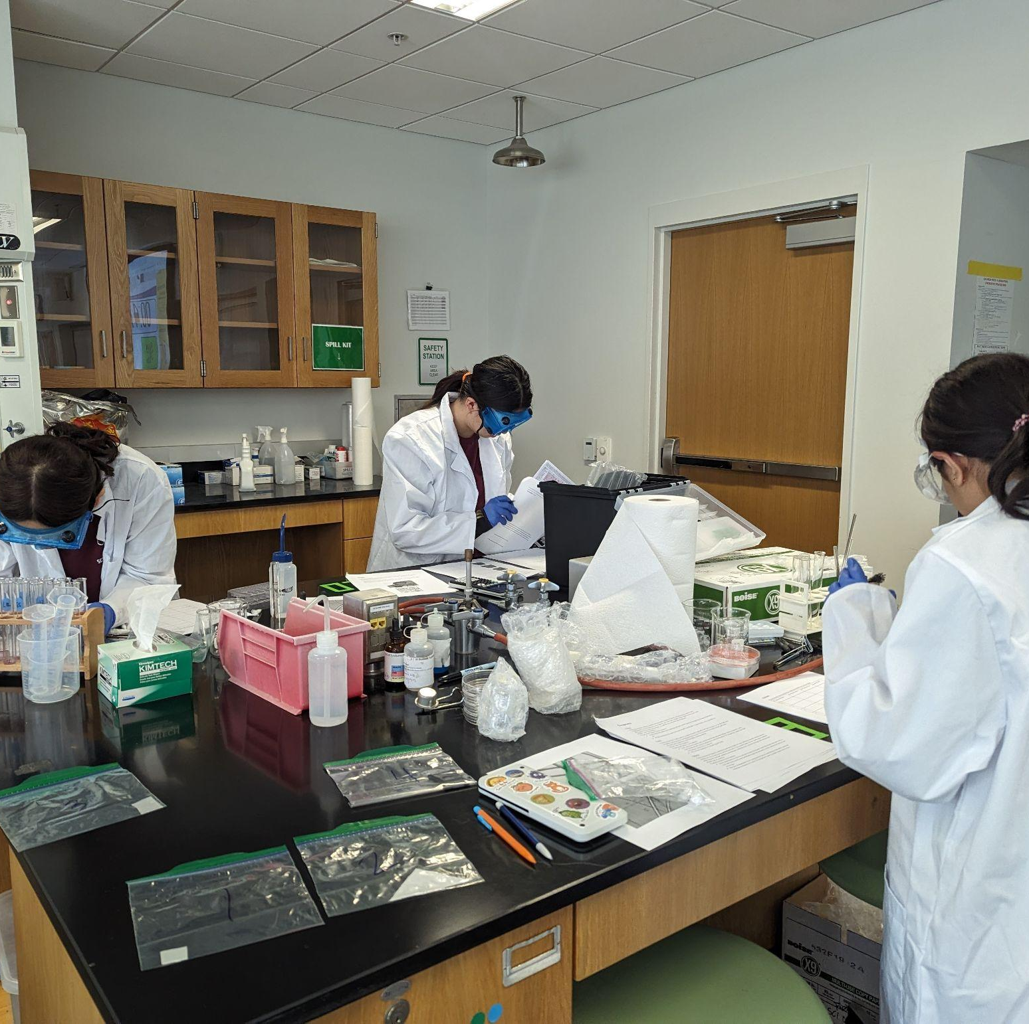
THANKS!
Notes:
(replace picture with a picture from one of our tournaments)

