Slide 1
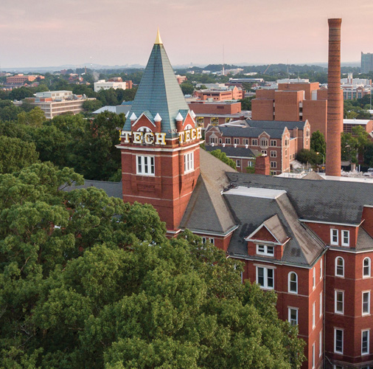

Road to Gold
Division B/C
Georgia Tech Event Workshop Series 2024-25

Slide 2
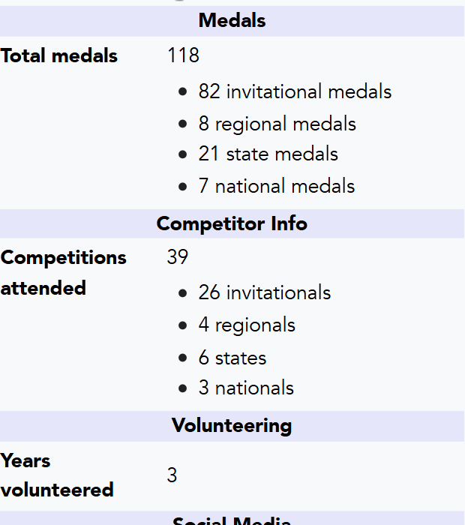
About
This is Allen: https://scioly.org/wiki/index.php/User:Builderguy135

Slide 3
01
STUDY EVENTS
02
BUILD EVENTS
03
COMPETITION DAY
Notes:
For Builds: Replace difficult topics with physical principles involved in the build and replace common questions with common designs

Slide 4
A Disclaimer
Science Olympiad is not (just) about winning!
Winning will come with a genuine understanding of the concept, NOT the other way around
Notes:
Highlight key points from the rules sheet: DESIGN LOGS that basically grant free points, most tested-on topics, point distribution so that competitors know what to prioritize, allowed notes and equipment, etc.

Slide 5

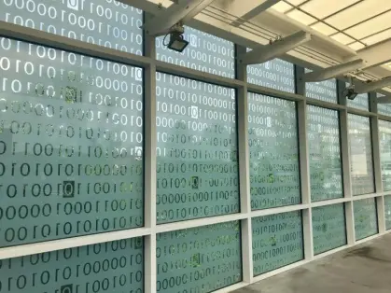
Study Events
Notes:
This section should focus on topics that are more math-based (harder to self-teach), concepts that come only usually up in college level courses, or concepts that you struggled with when you competed in this event

Slide 6
Tip 1: Know your Cheatsheet
What is the cheatsheet or binder for?
❌ Dumping Wikipedia pages
❌ Restating basic information just in case you forget it on the exam
❌ Cramming the most information so your notes are denser than everyone else
✅ Things you don’t want to memorize (numbers, formulas)
✅ Increasing your test-taking speed
✅ A general reference tool for niche information

Slide 7
Tip 1: Know your Cheatsheet
Many events allow cheatsheets and binders, but are you using them efficiently?
Do not just copy/paste information into your notes. Instead, take your time to process the information. Restating your notes will help it stick.
Know your cheatsheet. Your notes should be to speed up information lookup during the event, not to relearn concepts during the event.
3pt Stint Ultra Condensed slows you down. Stick with a more readable font
Use highlighting, formatting, and color to emphasize information and increase lookup speed.
Notes should be dynamic. Update them often.
There’s no point having a binder if you don’t know how to use it!
Notes:
Recommend taking a look at the champion cheatsheets recording as its very helpful

Slide 8
Tip 2: Practice Exams
Practice exams help with identifying weak spots in knowledge. Do as many as you can.
Familiarize yourself with your partner, so that you can learn how you and your partner takes exams.
Read the solutions afterwards! This is how you fill in the gap in your knowledge.
If public knowledge, learn from event supervisor’s past exams
Sometimes published on tournament’s website or information packet
Will help you be more prepared during the event
NEVER reach out to the event supervisor before the event, or try to find the event supervisor through non-public means
Notes:
Make your own tests!

Slide 9
Tip 3: Know your Basics
A solid foundation in event knowledge to have good intuition goes a long way when dealing with problems you’ve never seen before
Don't just learn the “advanced stuff" (most of this won’t be on the exam anyways)
Instead, understand basic biology, physics, chemistry concepts fully
Know what the event is about and generalize your studying
Optics → Wave Physics
Road Scholar → Earth Science
Notes:
Maybe discuss custom search engines

Slide 10
Build Events

Slide 11
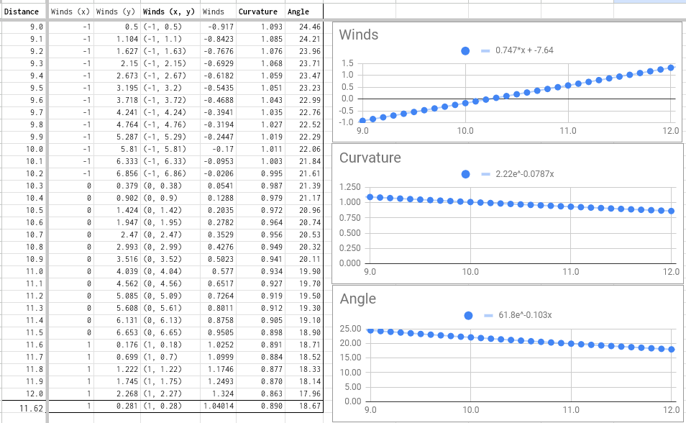
Tip 1: Consistency is Key
Familiarize yourself with your device
Know how your device changes under different situations—test as much as possible
Collect as much good data as you can (vehicle, flight events). Never fake your data.
Build precisely. Take your time so that the end result is consistent.
This is more important than anything about the design and quality of your build. A well-trimmed poorly built plane will outperform a poorly-trimmed well built plane every time
Battery Buggy data (Nationals 2019, 4th Place)
Notes:
Emphasize time is of the essence with builds: fail fast fail often

Slide 12
Tip 1: Consistency is Key
Eliminate as many variables as you can.
(Flight) Is there draft?
(Vehicle events) Is the floor dirty? What floors are you practicing on?
(Mission Possible) Is the surface angled?

Slide 13
Tip 2: Time Yourself
All build events have a relatively short competition period. Know exactly what you and your partner will do during that time.
Practice if you were in competition.
Ask a friend to name target times/distances or generate them randomly
Do everything you would do during competition. Reset testing surface if needed.
Notes:
Be prepared to answer questions about the actual build event: Almost got DQ’d at nationals for this

Slide 14
Tip 3: Know the Venue
It is always best to know the venue that you are competing in!
Sometimes you can know this by finding the venue online
Spectate, if allowed, before you compete. Know mistakes people have been making at this venue
NEVER practice at the venue without permission. People have been disqualified for this
(Flight) Ceiling height? Draft?
(Vehicle) Floor surface? Is it clean? Tiled?

Slide 15
Tip 4: Double Check Everything
Always double check that your build is allowed within the rules manual.
A dimension limit is not the goal, it is the limit.
Build your devices so that you are, without a doubt, within the rules.
Read the rules ten times over, especially in build events.
Know how rules can be interpreted, as your interpretation may be different.
Figure out if there are clever designs or optimizations you can make under the rules.
My philosophy: always try to know the rules better than the event supervisor.
Notes:
Really important: Talk about DQ of Roller coaster at Nationals

Slide 16
Competition Day

Slide 17
Tip 1: Have a Plan
Always have a plan about how you will approach the event.
If it’s a study event, take the test normally like you have done with your partner.
If it’s a build event, execute your plan as well as possible.
Have backup plans (build)
You should always have backup plans, especially if builds, if something goes wrong.
Knowing your device will help you change things on the fly.

Slide 18
Tip 2: Take a Breather
Regardless of if you prepped well or not, competition day is the end of the road
If it’s a study event, don’t second guess yourself
Go in with confidence, run through the test and check your answers after
Don’t burn time on questions you or your partner don’t know
If it’s a build event, execute your plan as well as possible.
Be prepared for it all to change, and to go with the flow of the event
Remember the ESs are people too, who are just doing their job
With that in mind, also stand your ground

Slide 19
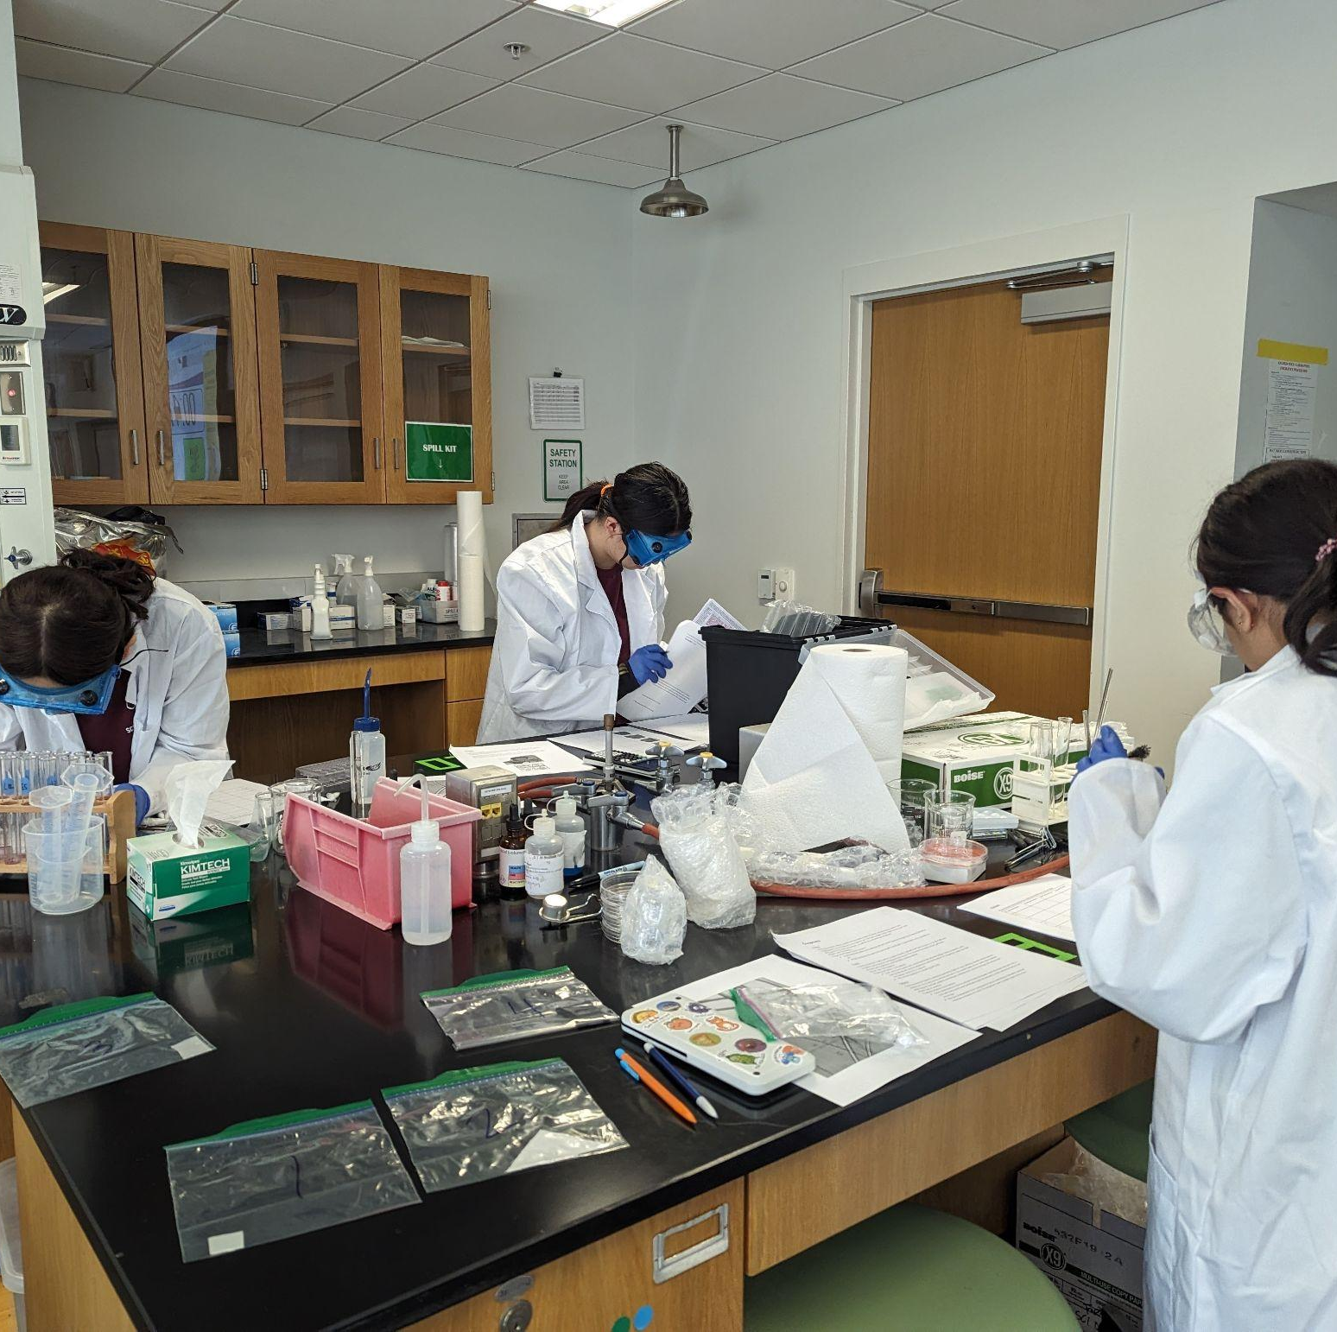
THANKS!
Notes:
(replace picture with a picture from one of our tournaments)

