Slide 1
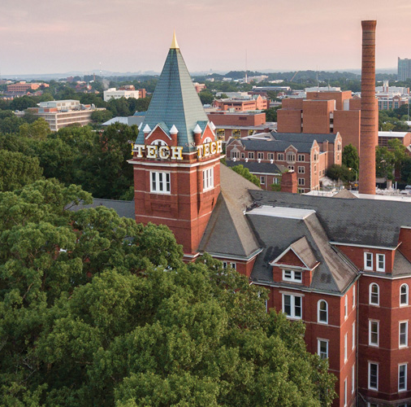

Codebusters
Division B/C
Georgia Tech Event Workshop Series 2024-25

Slide 2
A Bit About Me & This Workshop
Hi, I’m Klebb!
Senior at the University of Illinois Urbana-Champaign
Mathematics & Secondary Education
Previously Hopkins JHS, Mission San Jose HS (CA-N)
Competed 2014 - 2021, Volunteering/ESing/etc. 2021 - Now
This workshop will be similar to the 2024 Sierra Vista & UT Workshops
I wrote and presented at SV, and helped prepare the UT one too.
There’s some new stuff, but some of it is repeated :/

Slide 3
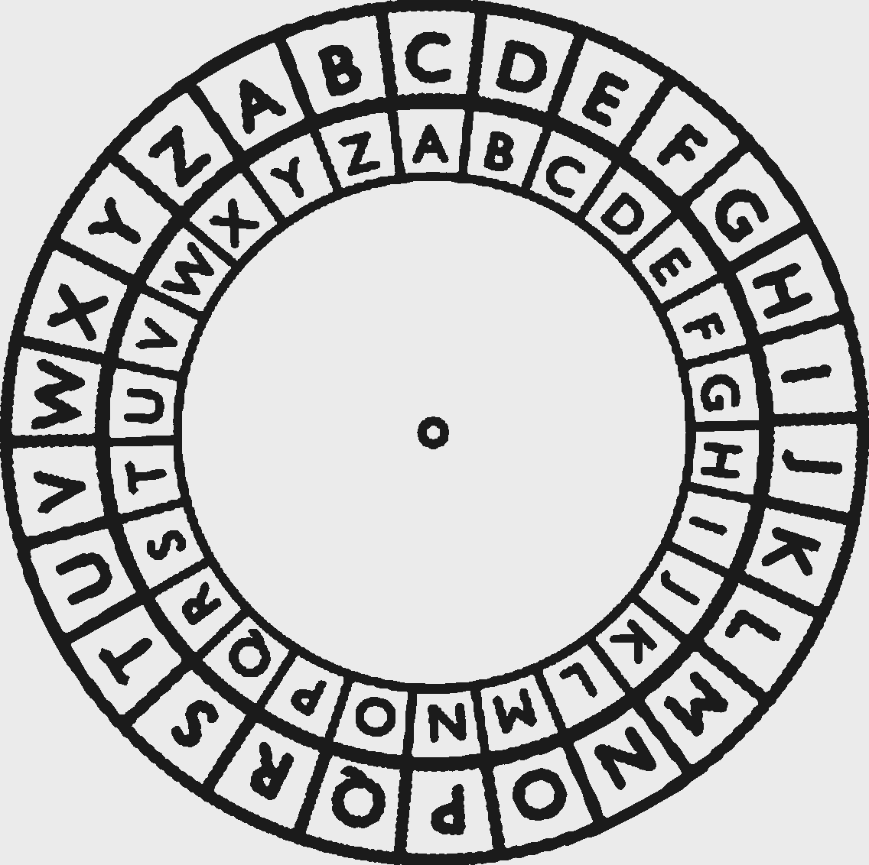
01
RULES
02
MICRO-STRATEGIES
03
MACRO-STRATEGIES
04
HOW TO LEARN
05
RESOURCES / LINKS

Slide 4
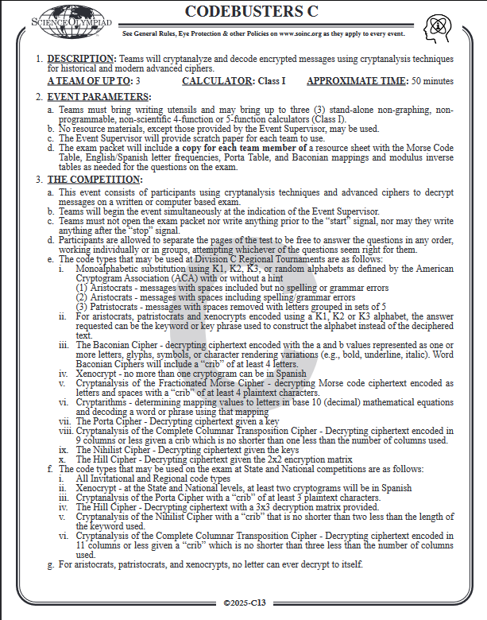
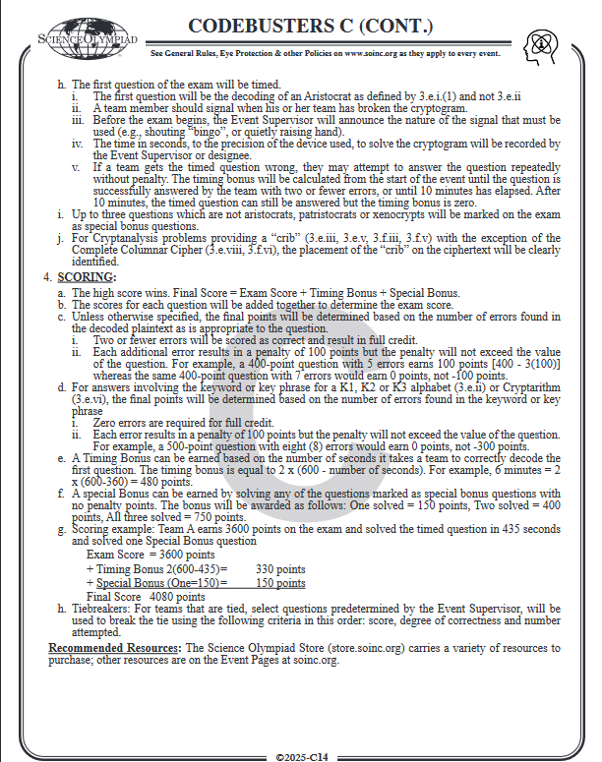
What’s in the Rules?
Cipher List 2024 - 2025:
Aristocrats (Random, K1, K2, K3 (C only), Error)
Patristocrats
Spanish Aristocrats (Xenocrypts)
Baconian
Fractionated Morse
Cryptarithms
Porta
Complete Columnar
Nihilist
Hill (C only)
Affine, Atbash, Caesar (B only)

Slide 5
Rules, Cont.
Timed Question:
1st question: solve within 10 minutes for bonus points!
Bonus = 2 * (600 - time taken in s)
Up to 3 Special Bonus questions
Not Aristocrats, Patristocrats, or Xenocrypts
Scoring:
2 or fewer errors: full credit
Each error over 2 = 100 point penalty (min. of zero)
Cryptarithms & Key Extraction (C only) do not have this 2-error buffer
Materials:
4 or 5 function calculators, not scientific/graphing!
Please go read the rules for yourself for all the details

Slide 6
Vocabulary
Plaintext - the original message before it has been encoded
Ciphertext - the encoded message
Cipher - a reversible process that transforms plaintext to ciphertext and back
Key - information that is input into an encoding process to generate the relationship between the plaintext and ciphertext
Monoalphabetic - each plaintext letter encodes to the same ciphertext letter every time
Polyalphabetic - each plaintext letter encodes to a different ciphertext letter

Slide 7

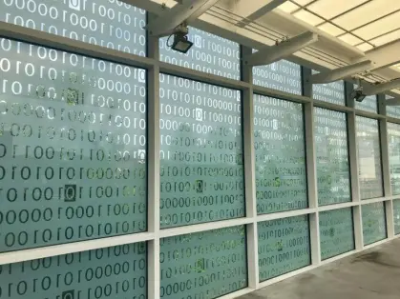
MICRO-
STRATEGIES

Slide 8
Aristocrats are #1
The most fundamental cipher in all of Codebusters
Make sure that everyone is proficient at them, no matter your role
They make up around ~30% of tests (and TQ)!
Aristocrat skills transfer to other ciphers very well
Phases of Aristocrat Solves:
Break-in: first observations you make
A-ha: observations that give new information based on your break-in(s)
Fill-in: filling in letters you already know and letters that only appear once or twice to finish
Fill-in tends to take the most time, but the other two are harder

Slide 9
Frequency is Overrated
Aristocrats can be solved on 4 levels:
Letters: one letter at a time (writing in all the E’s, T’s, etc.)
Letter Combinations: parts of words (-TION, -ING, -MENTE, etc.)
Words: especially word patterns (PEOPLE, NOTHING, THAT, etc.)
Phrases +: grammatical pieces (e.g., ONE OF THE…)
In general, think bigger than you first expect.
Word patterns are your best friend for break-in
Filling is much faster if you think about reasonable phrases and sentences instead of going letter-by-letter
A-ha’s come from realizing that a word makes sense in the plaintext
Letter frequency isn’t useless, but don’t over-rely on it!

Slide 10
Grammar & Syntax
Remember that languages have rules!
Knowing what parts of speech are possible in a sentence can narrow down your options a lot!
For example, 2021 GGSO #13
Small rules like subject-verb agreement can give you free letters/words!
For example, ARE vs. IS, or an S at the end of a noun/verb
Punctuation can give conjunctions, contractions, etc.
Spanish has much more well-defined rules!
Learn how Spanish’s grammar works, for example:
“-MENTE” changes an adjective to an adverb
Most nouns have a [gendered] article (e.g., UN, LA) before them
You can get by with a very limited vocabulary, speaking from experience!

Slide 11
Misc. Cipher Tips
Patristocrats
Play aggressive! (More on this later)
Practice abusing K-alphabets (JK, VWXYZ, aggressive fill-ins)
This goes for Fractionated Morse too!
Scan the entire ciphertext first before starting (repeated letter combos!)
Baconian
Stop writing A’s and B’s and start writing dots
BBxxx does not exist in Baconian
Think big picture: does what you’re writing down make sense?
Hill & Affine
Use negative numbers (and leverage 0, 13, and previous calculations)
Don’t decode everything

Slide 12
Misc. Cipher Tips - Cont.
Cryptarithms
Use the answer line to your advantage
E.g., every word needs vowels, letter combos may be impossible
You usually don’t need to solve for the entire calculation
Google how to take square roots by hand!
Two Question Types for Another Time:
K3 Keyword Extraction
Nihilist Cryptanalysis
Read the guide at toebes.com/codebusters for worked examples
Then practice, practice, practice! (more on this later)
Complete Columnar
Stack columns on top of each other!

Slide 13
MACRO-
STRATEGIES

Slide 14
Timed Question
Put at least 2 people on timed question!
3-person setups can work
Some top teams do 1 person on timed, but this is not recommended for most teams
The main point is to speed up fill-in
Write simultaneously (one right-handed and one left-handed is great!)
Putting your brains together is a secondary help
Split up who is writing on what part of the question
Transition into the test as quickly as possible
Have one person look through the rest of the test as the others finish
Get started on something else while your TQ is getting checked!

Slide 15
The Test & Roles
Have a plan going in of who is doing what ciphers
Find roles that work for your team based on your individual abilities
Be flexible! Adapt your plan to the needs of the test
Example (based on my old team; ciphers were different back then):
Person 1: TQ -> Aristocrats -> Caesar/Atbash/Affine -> Flex
Person 2: TQ -> Patristocrats -> Baconian -> Xenocrypt -> Flex
Person 3: Scout -> Pollux/Morbit -> Vigenere -> Flex
Designate a team leader/shotcaller to make final decisions
Keep morale up!
Make “All good” your motto mid-test
You can discuss what went right and wrong later

Slide 16
Endgame
Final 10-15 minutes: SHIFT GEARS!
Move from “doing the test” to finishing individual questions
Remember, you only get points for (mostly) finishing questions
Ending with 3 questions each 60% finished = 0 points!
Team leader should direct who is doing what for the finish
Be prepared to make adjustments on the fly
Very common to double or triple up on questions now
Be decisive - better to commit to the wrong call than to only half-commit to the “correct” call
But also be realistic on what is feasible
Play extra aggressive here

Slide 17
On Aggression
Two schools of thought:
Deduction: Solving step-by-step with almost-sure logical decisions
Intuition: Solving with assumptions or patterns and checking as you go
Essentially: low- vs. high- risk playstyles
I lean towards intuition, mainly because it’s faster
Try to suppress the fear of being wrong:
Make fast, bold guesses (e.g., words & phrases vs. letters)
Constantly sanity check your work as you go
Trust your intuition that is built up from practice

Slide 18
Communication
Practice keeping your communication frequent, clear, and positive
You can always discuss what went wrong after the event is over
Communication is in 3 main categories:
Facilitation: Test-wide strategy, starting or finishing a question, which questions are on which page, etc.
Make sure we’re all on the same page on what is done and what needs to be done by whom.
Help: Asking for word patterns, Morse Code, Cipher mechanics, etc.
For whenever you’re stuck, and/or moving on when you’re too stuck
Morale: Keeping your team spirits high
Build each other up, and avoid tilt

Slide 19


BUILDING FUNDAMENTALS & PRACTICING
Notes:
\

Slide 20
What is Codebusters actually about?
My answer: Not really cryptography. Instead, maybe:
Linguistics
Pattern recognition
Puzzle-solving
Strategy development
As a result, Codebusters is much more about practice than about content.
Focus on the skills you’re building instead of the content you’re learning

Slide 21
How to Practice
Consistency:
Practice a little bit regularly (e.g., 30 minutes each day)
Long sessions can be useful for endurance and team strategy
Make time for strategy development!
Scrimmages:
Practice both with and against your teammates / other teams
If your school has two or more teams, scrim against each other!
Write tests for one another with varied cipher compositions
Look up a quote generator if you don’t want to write your own
Online Resources (cryptograms.org)
Great for learning a lot early on, warming up, staying sharp
Diminishing returns

Slide 22
How to Learn Ciphers
Read up on how the cipher works (say, on dcode.fr)
Play around with an encoder/decoder, especially the one on toebes.com
Work through at least 1 example in full detail
You may want to do one already knowing the answer, focusing on how to actually arrive at said answer
Do a few practice questions until you’re comfortable with the cipher mechanically
(Have a partner write some for you!)
In general, spend more time doing, and less time reading

Slide 23
Resources
https://cryptograms.puzzlebaron.com/
dcode.fr/tools-list
SUBWAY STATIONS
https://toebes.com/codebusters/
My User Page!
(User:Klebb)
Yes, Saturn is the ringed one. This planet is a gas giant, and it’s composed mostly of hydrogen and helium

Slide 24
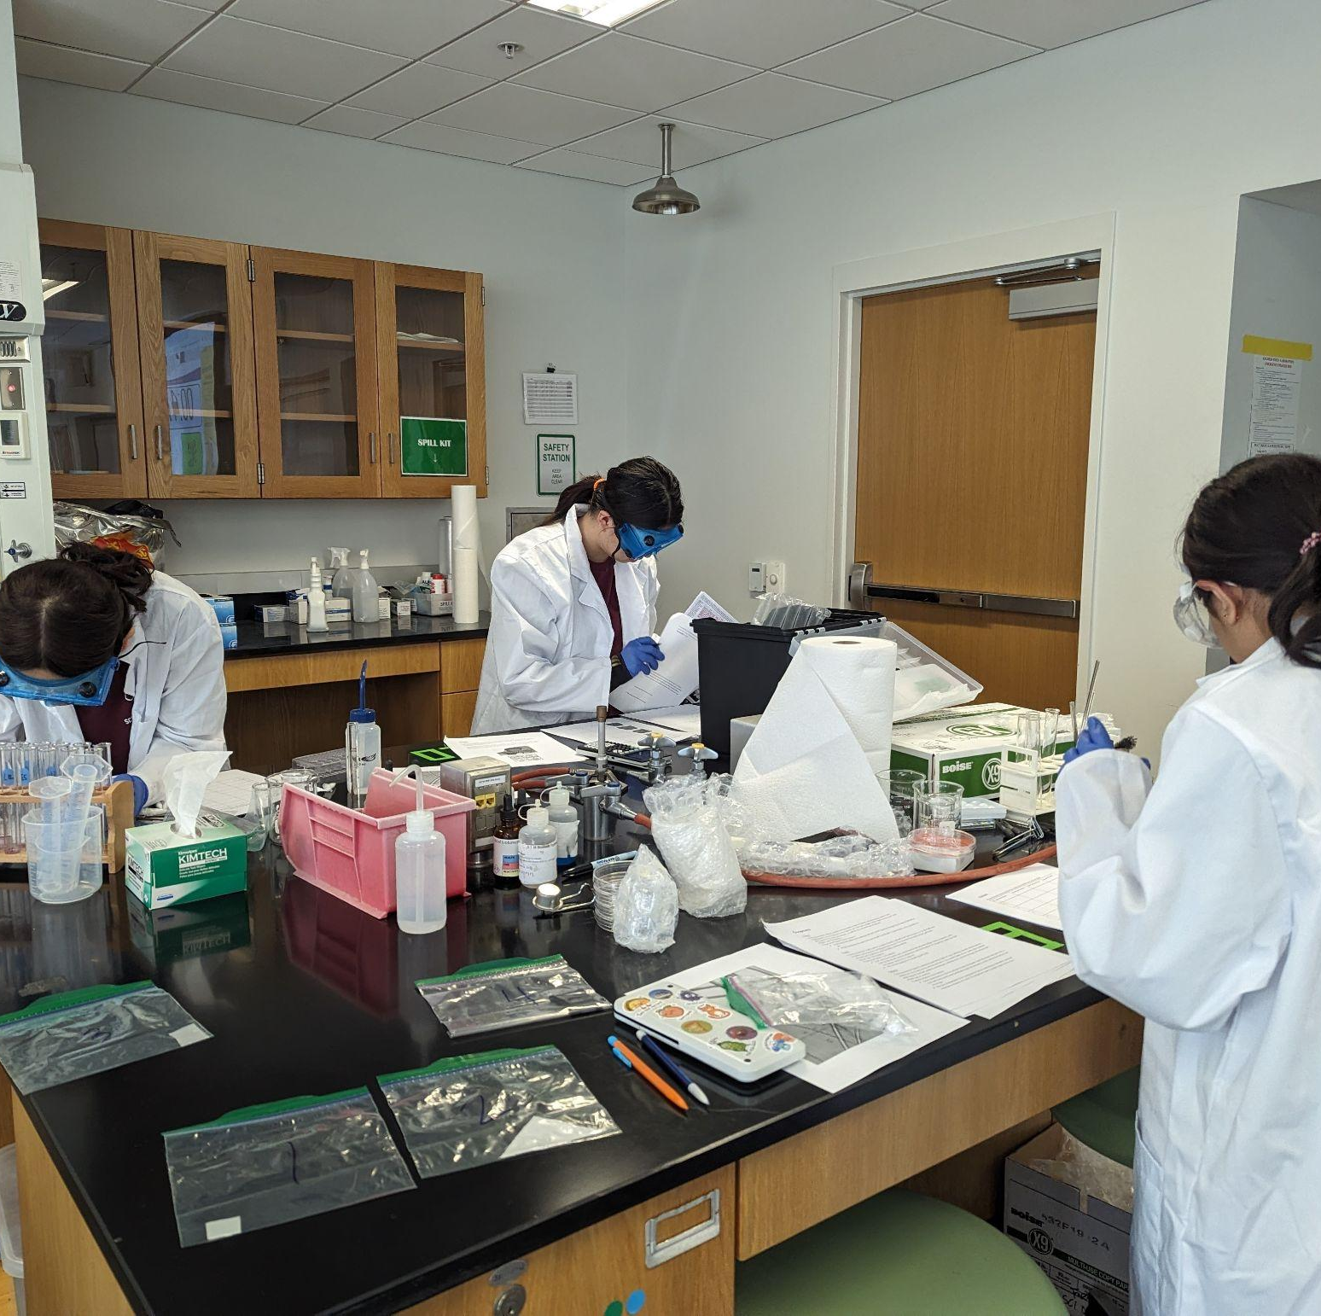
THANKS!

