Slide 1
Time-Dependent processes with Neural Quantum States
23 May 2022
Thomas Rothe
Pim Veefkind
Physics and Classical/Quantum Information ‘22

Slide 2
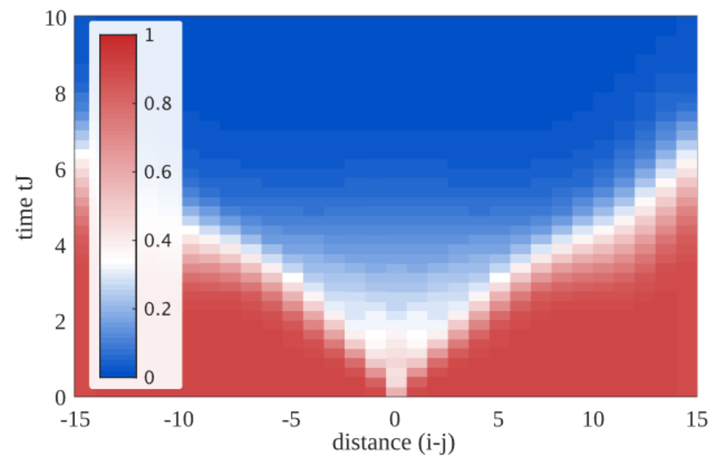
[1]
Intro - …..
1

Slide 3
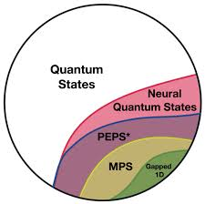
[?]
Theory - Neural Quantum States + RBM
2

Slide 4
[?]
Results - Time evolution
?

Slide 5

Time-Dependent processes with Neural Quantum States
[Insert Take-home message]
Pim Veefkind / Thomas Rothe
github.com/scipham/PCQI

Slide 6
References
[ 1 ] A. Bohrdt et al (2017), Scrambling and thermalization in a diffusive quantum many-body system, New Journal of Physics, 10.1088/1367-2630/aa719b
[ 2 ] G. Carleo & M. Troyer (2017), Solving the quantum many-body problem with artificial neural networks, Science, 10.1126/science.aag2302
[ ? ] …
[ ? ] …

