Slide 1
CausaliT 4 Industry

Slide 2
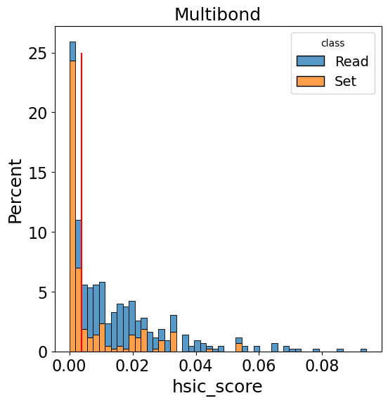
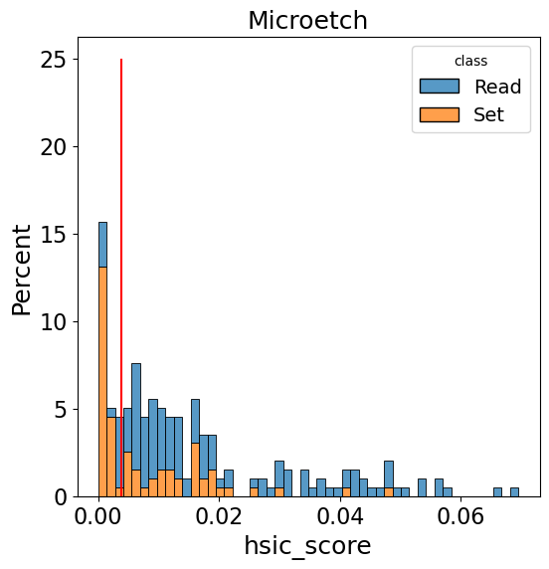
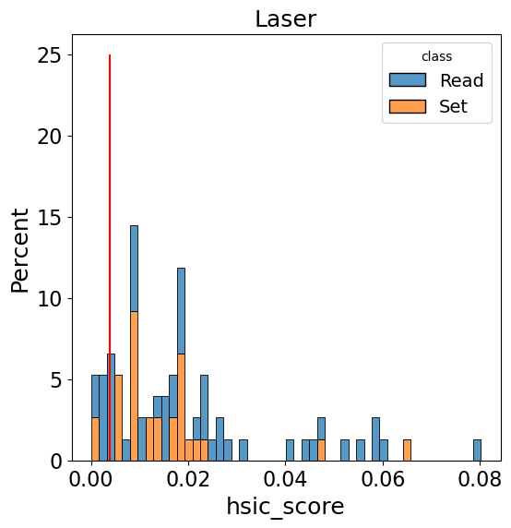
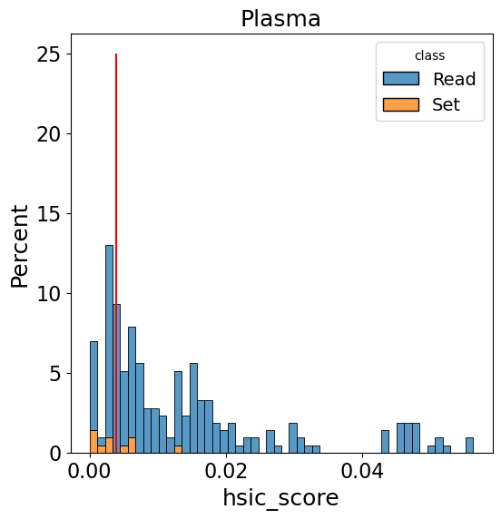
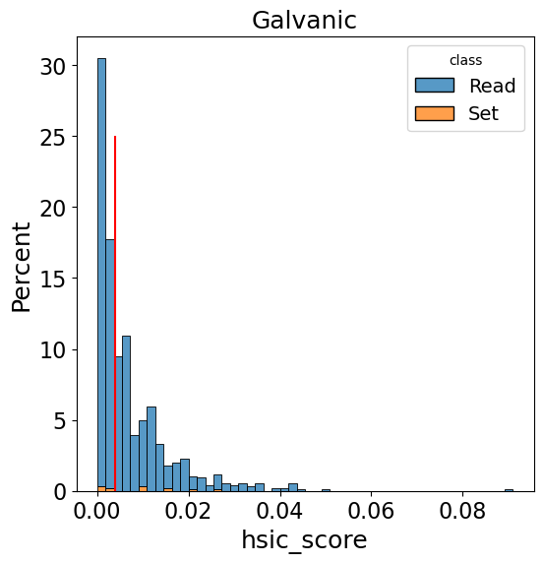
HSIC(X,m) assuming Y=m*n_cycle, ds: "dyconex_test_params_class"
← more independent
more info contained in the READ (Markov assumption is reasonable, i.e. Y\perp S | X)
We cannot use Plasma and Galvanic, Laser is borderline
First test on Multibond and Microetch.

Slide 3
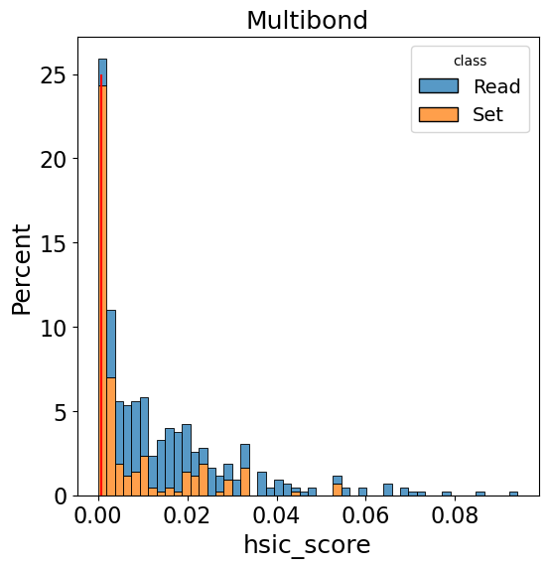
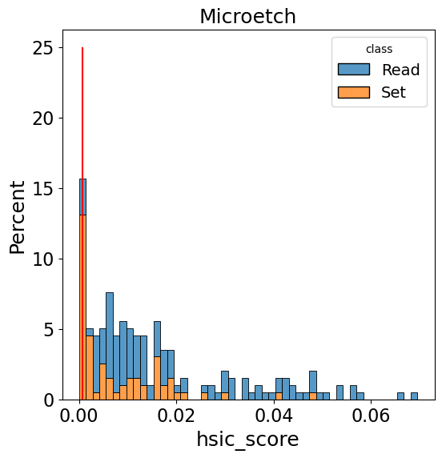
HSIC(X,m) assuming Y=m*n_cycle, ds: "dyconex_SX_MuMi_260302"
← more independent
Train (S: (1526, 106, 12), X: (1526, 173, 12), Y: (1526, 400, 9))
Test (S: ( 394, 106, 12), X: ( 394, 173, 12), Y: ( 394, 400, 9))

Slide 4





2-stage decoder
De-embed
De-embed
S: Set
X: Read
Y: IST
Two masks
1) CA category*: X of category j can only be caused by S of category j
2) Time (CA and SA)
* category can be process, {process, occurrence, steps} or any other defined subset of features
$${\hat{X}}_{1}$$ | $${\hat{X}}_{2}$$
$${\hat{Y}}_{1}$$ | $${\hat{Y}}_{2}$$
+
+
Self-Attention
Self-Attention
$$S_{1}$$ | $$S_{2}$$ | $$S_{3}$$
Norm
Norm
Embed
Embed
+
+
Cross-Attention
Cross-Attention
Norm
Norm
Embed
(Learnable)
Embed
(Learnable)
$$X_{1}$$ | $$X_{2}$$
$$Y_{1}$$ | $$Y_{2}$$

Slide 5
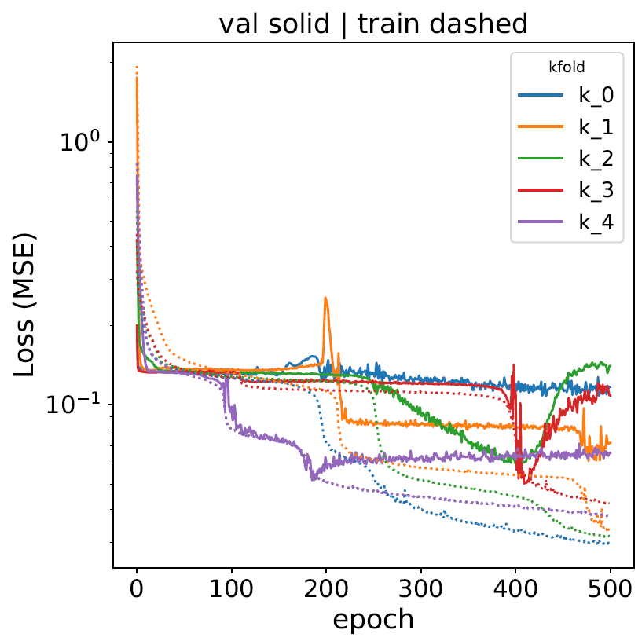
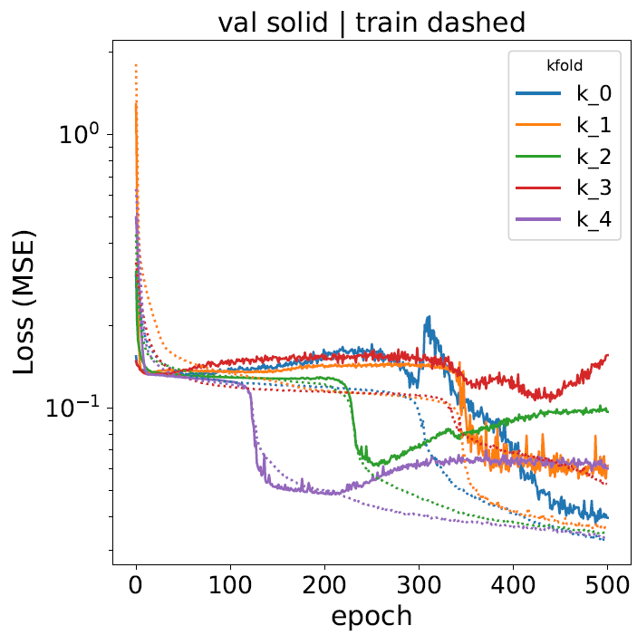
Training
Masks OFF
Masks ON

Slide 6
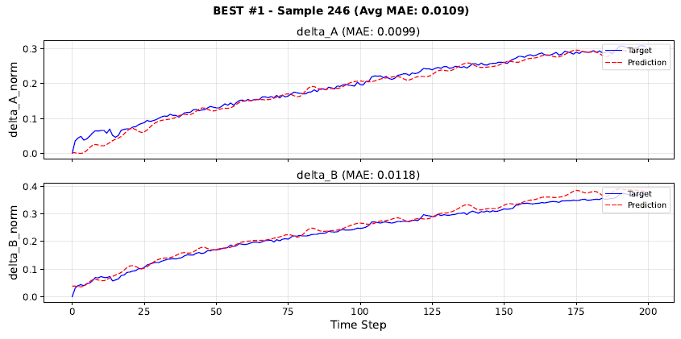
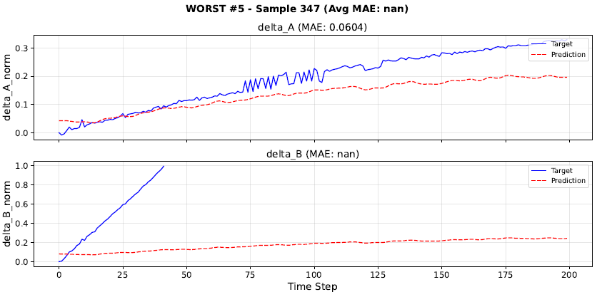
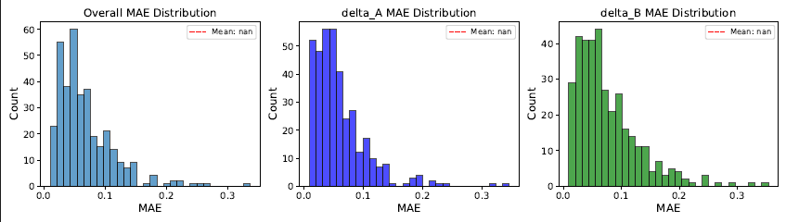
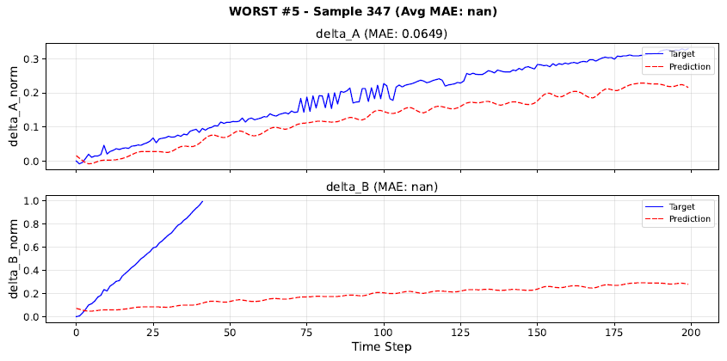
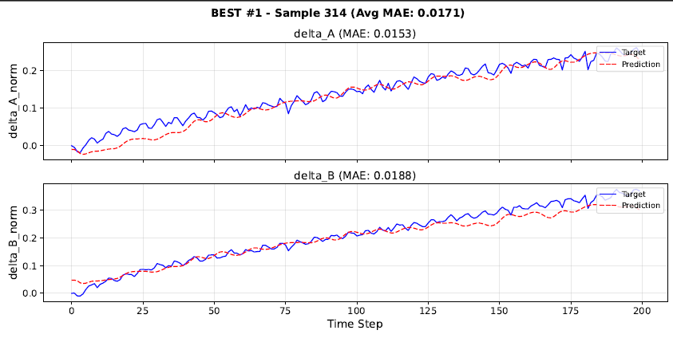
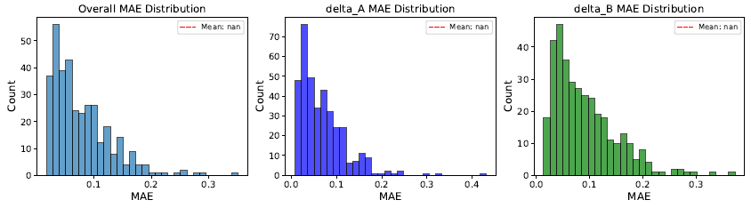
Test Prediction
Masks OFF
Masks ON

Slide 7
Your Task
The model is trained on real data with different input lengths. You must define your input, i.e. your recipe.
The prediction is a time-series, you need to define an objective function.
Define input bounds: parameters are normalized; therefore you could use [0,1] and never go beyond the maximum observed value
Do not worry too much about the surrogate, take a checkpoint and test your optimization
Can you do better than the best sample? If yes, how do the parameters change?
Can we optimize one parameter to be minimized as well?

