Slide 1
Proj. Overview and M.Sc. Thesis
F. Scipione

Slide 2
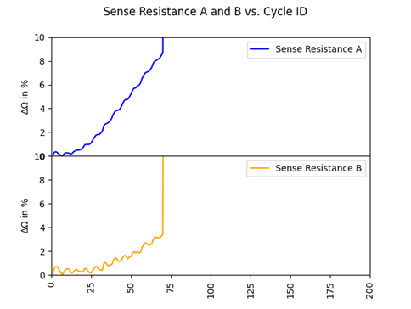
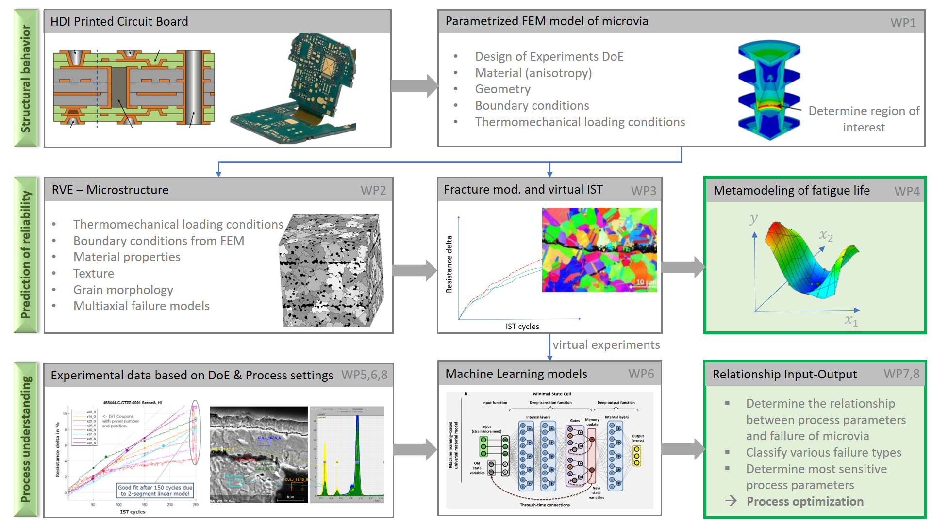
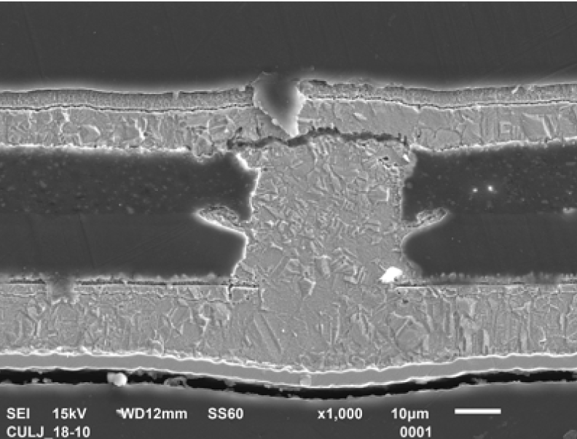
Printed Circuit Board (PCB) Reliability
PCB for biomed. must be reliable.
Reliability Test: Thermal loading and R increase measurements
fracture

Slide 3
Reliability Depends on Manufacturing
Ätzen Multibond
Pos 200
Ätzen Multibond
Pos 410
Start
Laser
Pos 40
Pos 250
Laser L3
Pos 460
Laser L5
Laser L2
Pos 260
Laser L4
Pos 470
Vias
L-1
Vias
L-2 & L-3
Via
L-4 & L-5
Ende
Galvanik L1
Plasma L2
Galvanik
L2 &3
Plasma
L2 & 3
Galvanik
L4 & 5
Plasma L4 & 5
Pos 90
Pos 60
Pos 300
Pos 270
Pos 510
Pos 480
Ätzen (Microetch) L2 & 3
Ätzen (Microetch)
L4 & 5
Pos 290
Pos 500
Prozess
Pos / PaPosNr.

Slide 4

Project Structure
Process Data
(2000 points)
Reliability Tests(IST)
input
Model
target
Deep Representation
Prediction
Deterministic
Global Sensitivity Analysis
Process Optimization
Anomaly Detection*

Slide 5
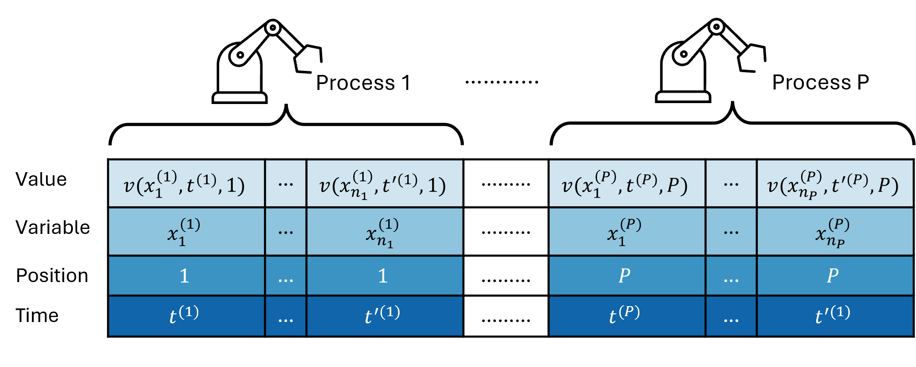
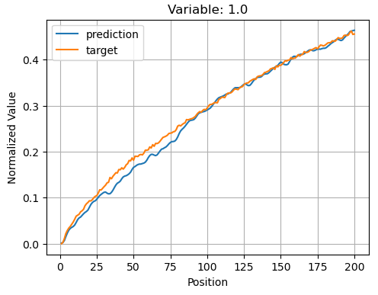
Starting Point
optimize the chain
define an objective function
Model

Slide 6
Possibilities
Gradient
Multi-Object
Planning Recipe
Surrogate Model
Model Based RL
Operator Virtual Assistant
Online Decision
Data
Model Free RL

Slide 7
Preparation
Setup GitHub
Setup Euler
Literature Review
Planning

