Slide 1

Weather Eye
Team “Your Name Goes Here”
GM Hackathon, Tampa, 2017

Slide 2
What Can Your Car Know For You?
Lots of data from sensors…
Internet access…
Synthesize, decide and notify

Slide 3
When It Rains
and your windows are down…
You get wet
Your passengers get wet
Your stuff gets wet

Slide 4
If only your car could tell
you when it’s going to rain…
You could roll up your windows
Your passengers would stay dry
Your stuff stays dry

Slide 5
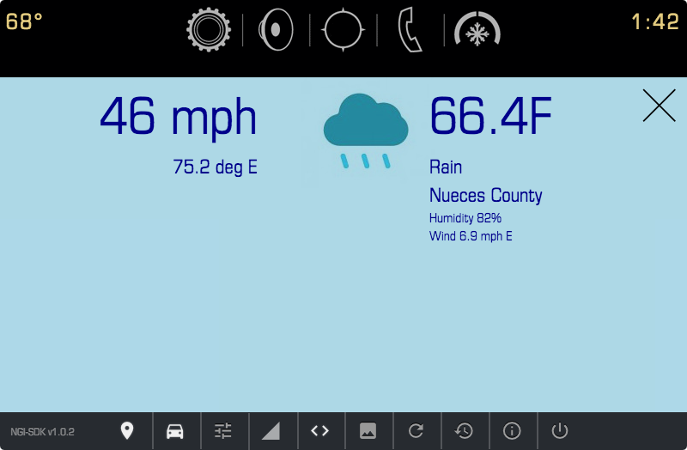

Your progress
Where you’re headed

Slide 6
Weather Eye
Tracks the vehicle location, speed and heading
Predicts where you’ll be in 10 miles
Gets current weather at that location
Tells you to roll the windows up…

Slide 7
Demo

Slide 8
Other Uses…
Get upcoming speed limits
Get traffic data from Google
Get construction warnings & accidents
Generic to-do lists, etc.

