Slide 1
Combining C++ and Python in the LSST Software Stack Jim Bosch Princeton University SciPy 2013 Austin, TX, June 26-29

Slide 2
Outline
LSST Introduction and Overview
The LSST Software Stack: what it is, what it will be
Lessons learned for hybrid C++/Python software:
Where do we draw the line?
Swig and the search for the least-bad tool for generating wrappers
A spin-off project: the ndarray C++ library
Notes:
Broad range of topics, so I hope to have something both for astronomers (current state of our software) and others interested in the C++/Python boundary (what we’ve learned, and a library we’ve built that may be of more general use).

Slide 3
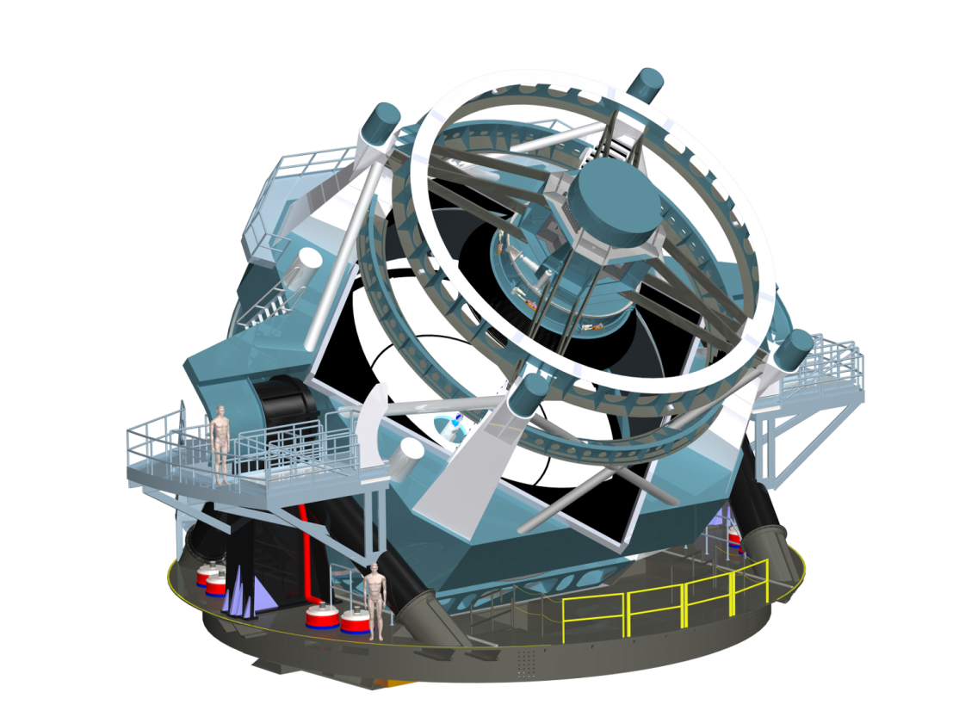
The Large Synoptic Survey Telescope
8.4m telescope 18000+ deg² 10mas astrom. r<24.5 (<27.5@10yr)
ugrizy 0.5-1% photometry
3.2Gpix camera 2x(15sec exp+2sec rd) 15TB/night 20 B objects
Imaging the visible sky, once every 3 days, for 10 years (825 revisits)
Notes:
Highlight cadence: full sky every few days.
Lots to tell about hardware, site, but I won’t.

Slide 4
Pixels to Catalogs: Nightly Processing
Moving Object
Calibration Images
Raw Science Images
Calibrated Science Images
MOPS
link “tracklets” into “tracks”
determine orbits
Difference
Source
Instrument Signature Removal
combine amplifier images
apply flat, bias, fringe frames
Source Association
match transients to known objects
Deep
Coadd Images
Difference Imaging
match PSFs
subtract images
detect sources
Object
Alert Generation
1 minute after readout!

Slide 5
Pixels to Catalogs: Data Release Processing
Re-run Nightly Processing
Object
Source Association
match objects to sources
Deep Coadd
Images
Deep Detection
threshold image, deblend
PARALLELIZE OVER LARGE SKY PATCHES
Forced Source
Image Coaddition
match PSFs
warp images
add images
PARALLELIZE OVER SMALL SKY PATCHES
MultiFit and Forced Photometry
fit models to all exposures simultaneously
PARALLELIZE OVER OBJECTS
Source
Calibrated Science Images
Single-Frame Detection and Measurement
threshold image, deblend, measure
PARALLELIZE OVER CCDS
Notes:
We don’t do all of all of these things yet, but we at least mostly do almost all of them

Slide 6
Software Stack Overview
Multi-package framework for astronomical image processing
Low-level algorithmic code and primitives in C++; wrapped for Python using Swig
High-level pipeline and data access code in Python
Build system uses SCons (with lots of customization)
Most third-party libraries we use are C/C++ (Boost, CFITSIO, wcslib, GSL, ...), but we do use NumPy and Matplotlib.
Thin specialization layer for different instruments, surveys: most code is camera-agnostic:
we’ve already processed data from LSST Simuluations, Subaru Suprime-Cam, Subaru Hypersuprime-Cam, SDSS, CFHT, NOAO MOSAIC, DES, SST, ...

Slide 7
Software Stack Overview
Pure Python
Astronomical Primitives
geometry (points, boxes, transforms, ellipses)
images, masks, threshold-based detection
convolution, warping/resampling
image statistics, spatial functions
camera geometry abstraction layer
catalogs
Data Access and Pipeline Framework
data butler abstraction layer for I/O: instrument-agnostic access to raw data and processing outputs
Python-parsed plugin-capable configuration “language”
command-line parsing
basic parallelization
Pixel-level Algorithms
PSF modeling
deblending
source measurement
difference-kernel estimation
High-level Processing Scripts
basic single-CCD processing
image coaddition
forced photometry
image subtraction
C++/Swig
Notes:
TODO: add some code examples

Slide 8
Software Stack Maturity/Stability
Lots of extremely useful astronomical primitives...
...with unstable and generally unpythonic APIs
Moderately mature high-level algorithms, many of them state-of-the-art...
...with generally poor documentation
Camera-agnostic pipeline-level processing scripts
...with a fair amount of overhead necessary before running on even extremely simple data
Already a very powerful framework for those who are willing to dive in, read code, and adapt to frequent changes
Casual users should probably wait a year or two

Slide 9
C++ and Python: Where to draw the line?
We probably all agree on this much:
loops over pixels need to happen in a compiled language
high-level script code should be in Python
The Big Question: Where do you put the primitives?
In Python
easier and faster to write the primitives themselves
probably a nicer, more pythonic API, leading to easier-to-read high-level code
can use more third-party Python libraries
In C++, with wrappers
low-level algorithmic code is easier to read and write
no need to refactor when “bumping” performance-critical algorithms from Python to C++
Notes:
The fact that we’ve put the primitives in C++ is why we use so few third-party Python astronomy libraries; we’d need C/C++ APIs to be able to make full use of them. But clearly this isn’t an ideal situation, and we should discuss how we could all be sharing code better.

Slide 10
C++ to Python Tools: What’s Available
LSST is currently using Swig.
It’s great for simple C++ code and isolated modules.
Most of the time, it still works well for more complex C++ code and multiple interrelated modules.
When it doesn’t work, it can be extremely difficult to debug.
Many of Swig’s customization features are documented as being purely declarative, but the order in which they appear actually matters; determining the correct order is often a matter of trial and error.
Swig-generated modules that depend on a large number of other Swig-generated modules can be huge, resulting in long compile times and heavy memory usage during compilation.
I’m a big Boost.Python fan, from my pre-LSST days.
Excellent handling of advanced C++ (but not C++11)
Can be extended directly with C++ and the Python C-API
Virtually no active development; STL and code generation is third-party
Notes:
I don’t know enough about Cython to include it in this comparison (it wasn’t really an option when we started this project). One of my goals at SciPy 2013 is to learn more about it.

Slide 11
C++ to Python Tools: How It Should Be Done
If we were to write a new tool to perform this job, here are some guidelines:
DO extract as much information as possible from the original C++ headers, so users don’t have to repeat any of it. DON’T expect that information to be sufficient to specify how to map C++ to Python for any but the simplest classes.
DON’T write your own C++ parser. DO use clang’s (or gccxml?)
DO provide detailed control over how to do memory management for C++ functions that return raw pointers and references.
DO use C++ RTTI to look up type conversions.
DON’T silently map instances of unrecognized C++ classes to opaque Python objects; unrecognized classes should generate errors as early as possible.
DO concentrate on generating high-quality wrappers (even in edge cases) before coming up with a pretty way to specify them, and DON’T mix your pretty-specification-parsing code with your wrapper-generation code.

Slide 12
One Custom Tool: ndarray
ndarray is a C++ library that provides multidimensional array classes that are designed to behave as much as possible like NumPy arrays:
shared, strided memory model
similar view-specification syntax
More importantly, it also provides to/from NumPy conversions for both Swig and Boost.Python. These allow memory to be shared between C++ and Python, with correct reference counting, whether the arrays originate in C++ or Python.
Currently LSST is the main consumer, but it’s available for general use, and it’s starting to pick up outside users.

Slide 13
Continuing the Conversation
Interested in talking about any of this in greater detail?
Please find me later in the week!
Or email: jbosch@astro.princeton.edu
Interested in using the LSST software stack?
https://dev.lsstcorp.org/trac/wiki/DM/Policy/UsingDMCode/FAQ
https://dev.lsstcorp.org/cgit/
Interested in using ndarray?
https://github.com/ndarray/ndarray

Slide 14
This page intentionally left blank.

Slide 15
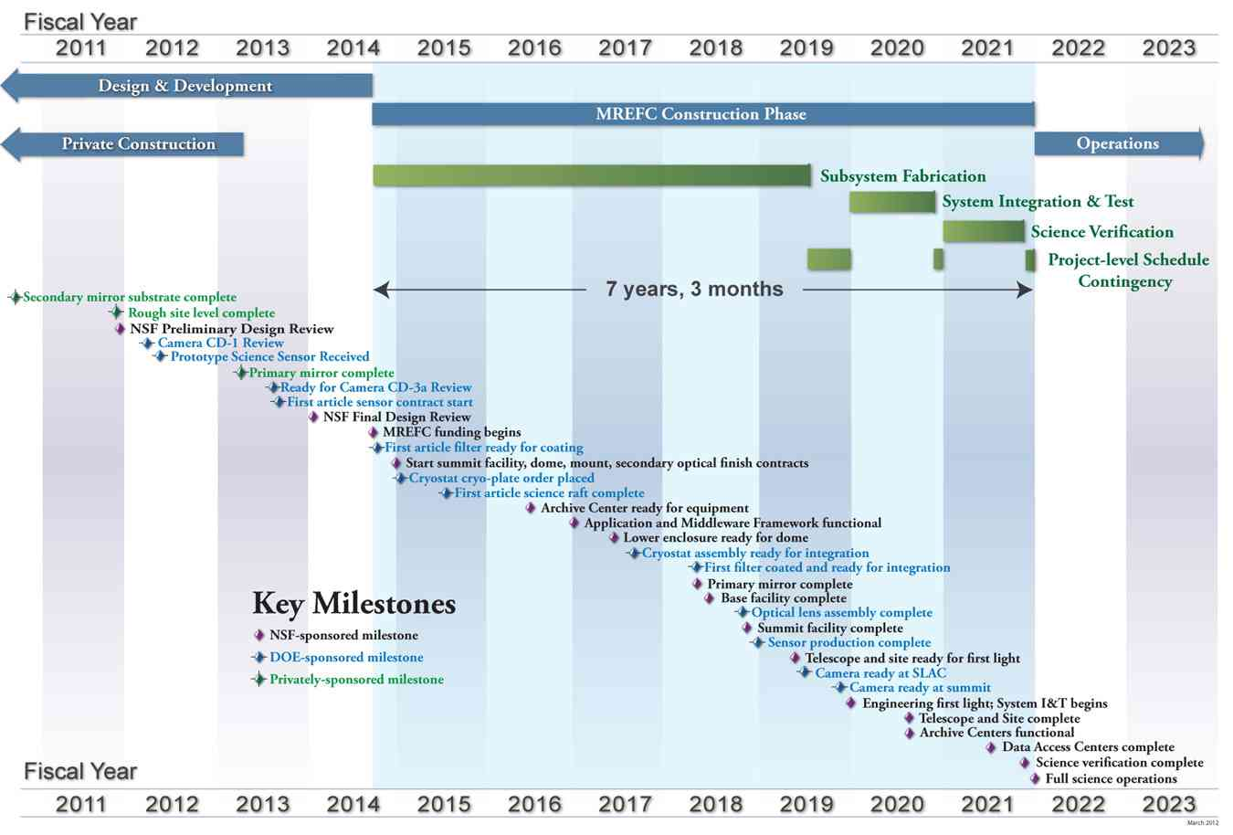
Timeline
Subaru
Hyper-Suprime Cam
Commissioning and Survey
Notes:
Construction underway, but it will ramp up significantly in the next year or two.
Software is in many ways ahead of schedule – it has to be, because we’re also using it for HSC: recurring theme: camera-generic.

Slide 16
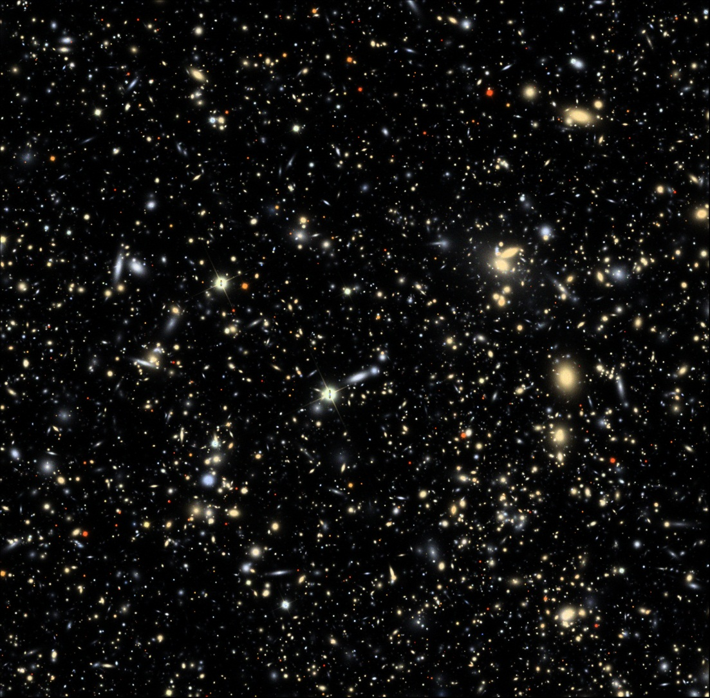
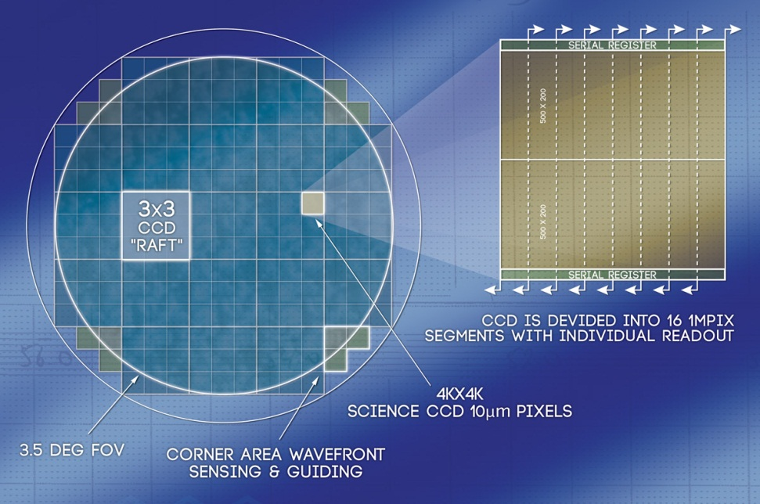
Visualizing 3.2 Gigapixels

