Slide 1

Data Agnosticism: Feature Engineering Without Domain Expertise
SciPy2013
June 27th
Nick Kridler
nkridler@accretivehealth.com

Slide 2

About Me Generalist
Applied Mathematician
Data Scientist
Kaggle Master
Level 50 Dragoon
Former Defense Scientist
New to Healthcare

Slide 3
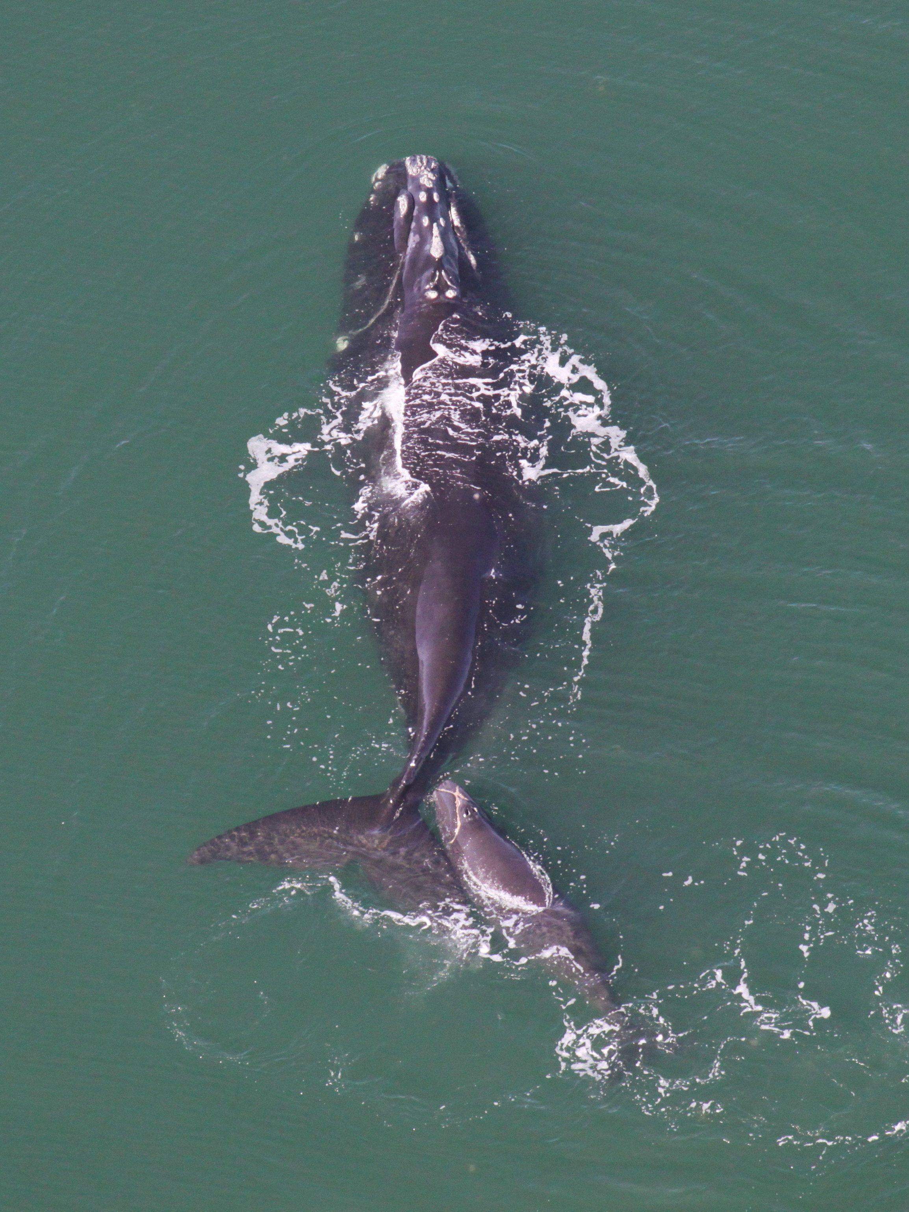
Today’s Talk
Elaborate on
‘Data Agnosticism’
Save Whales from
Ship Collisions
Illustrate my
data analysis process
Discuss Python’s
impact on my work
http://www.nmfs.noaa.gov/pr/species/mammals/cetaceans/rightwhale_photos.htm

Slide 4
Responsible Data Analysis and Quick Iteration Produce High-Performing Predictive Models
No Domain Expertise Required!

Slide 5
“In data science, domain expertise is more important than machine learning skill.”
– Motion from the “Data Science Debate” at Strata CA 2012^{1,2}
Subject Matter Experts Know Which Data and Features are Important
http://strata.oreilly.com/2012/03/machine-learning-expertise-google-analytics.html
http://medriscoll.com/post/18784448854/the-data-science-debate-domain-expertise-or-machine
Notes:
Good debate with excellent points on both sides

Slide 6
Algorithms Don’t Care They don’t know who generated the data
Just Like Garbage In Garbage Out,
Bad Assumptions Bad Model
Models Will Help Us Find Features
(Without Domain Expertise!)

Slide 7
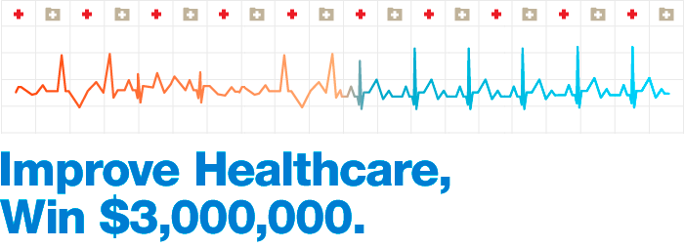
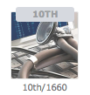
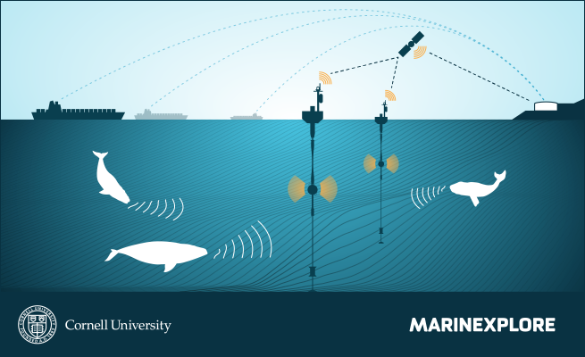

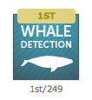
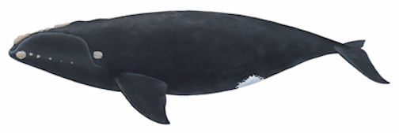


Kaggling With an Emphasis on Feature Engineering No Prior Healthcare or Bio-Acoustics Experience

Slide 8
The Secret to My Success:

Slide 9
…and a Lot of Terrible Ideas
Responsible Data Analysis and Quick Iteration
Responsible Data Analysis?
Look at samples, not just the aggregates
Pay attention to sources of over-fitting
Be skeptical of everything
Quick Iteration?
Reduce the advantage of having domain expertise
How else are you going to get through all those bad ideas?

Slide 10
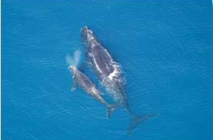
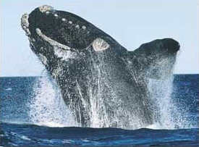
A Process For Finding Whales
http://www.birds.cornell.edu/brp/research

Slide 11
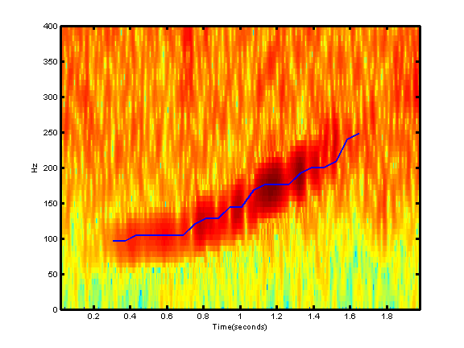
North Atlantic Right Whale Up-Call Detection
Determine the Probability a 2 Second Audio Clip Contains a Whale Call
Maximize Area Under Curve (AUC) Metric
Marine Mammal Acoustics
Signal Processing
Frequency (Hz)
Audio Spectrograms
Mel-Frequency Cepstral Coefficients
Spectrogram of a Right Whale Call
Time (s)

Slide 12
Where Do We Start?
Google ‘Whale Detection’?
Found Competition Website
Throw The Whole Thing In A Random Forest?
What Would We Do After That?
What can we do in a few hours?

Slide 13
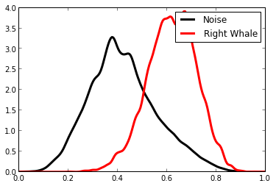
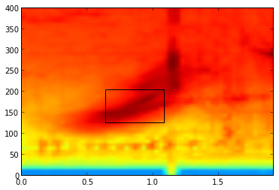
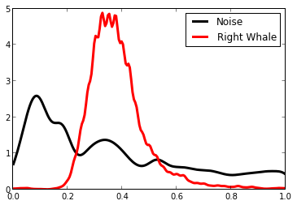
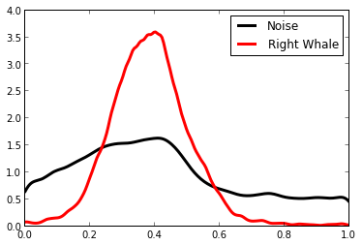
Start Simple A Correlation-Based Model
Max Correlation
Mean of Right Whale Spectrograms
Max Frequency Location
*
Probability Density
Frequency (Hz)
Time (s)
Max
Time
Location
How well does this chip correlate with the spectrograms from the audio clips?
Normalized Feature Value

Slide 14

Max Correlation
Leverage Great Work
Max Frequency Location
Probability Density
*
Random Forest
Max
Time
Location
Random Forests are Quick, High Performing, and Easy to Interpret
Normalized Feature Value

Slide 15
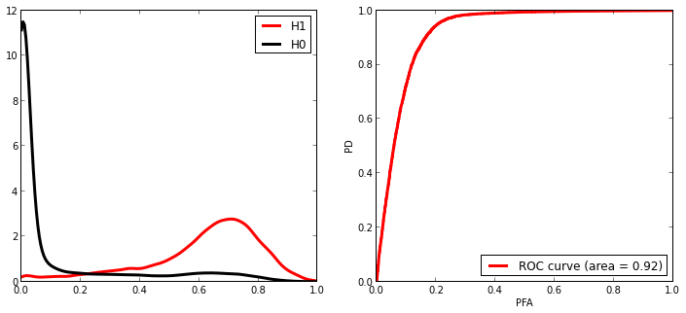
How’d We Do?
Probability Density
Receiver Operating Characteristic Curve
What’s going on over here?
True Positive Rate
Area Under Curve ~0.92!
Probability of Right Whale
False Alarm Rate

Slide 16
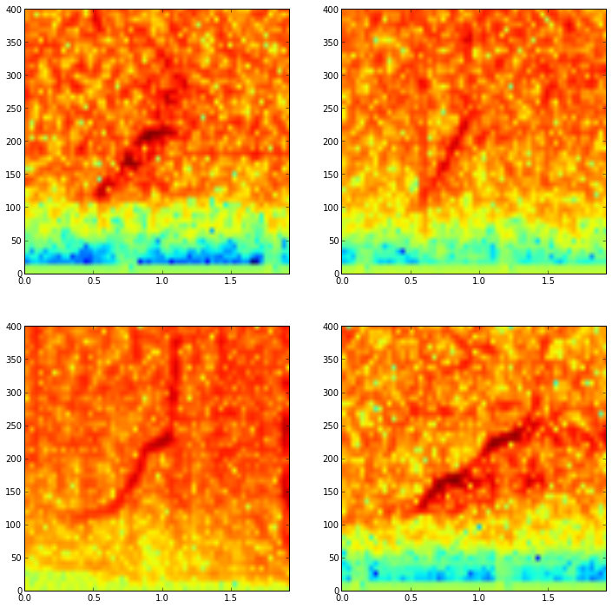
The Model Missed These Whales Notice Anything?

Slide 17
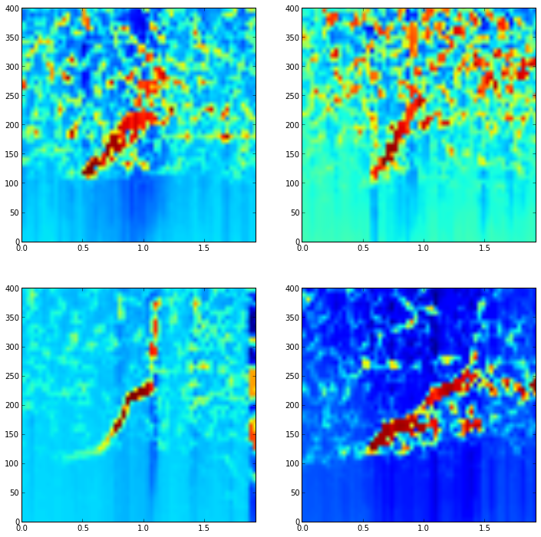
How About Now?

Slide 18
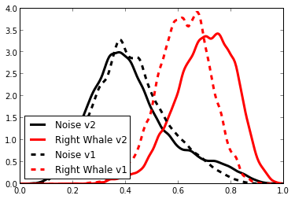
Do Our Changes Make A Difference?
Max Template-Sample Correlation
Probability Density
Normalized Feature Value
More Separation! AUC = 0.94

Slide 19
The Process (Good Vs. Bad)
Random Walk Through Algorithm Land
Make
Prediction
Make
Prediction
Improve Model
Evaluate
Don’t Get Stuck In Algorithm Land!
Focus on Putting Better Data in the Algorithm

Slide 20

How Do We Iterate Quickly?
Choose an Algorithm, Generate a Model
Make
Prediction
Turn Ideas into Code!
Evaluate the Model,
Visualize The Failures
Improve Model
Evaluate

Slide 21



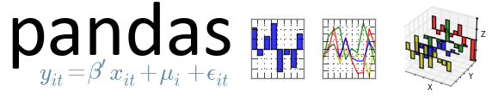


From Data to Model in No Time Leveraging Great Work
Shift the Focus From Algorithm Implementation to Data Analysis

Slide 22
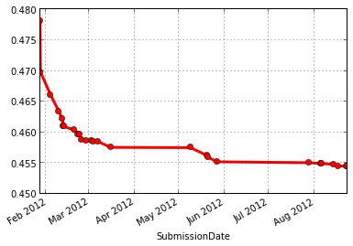
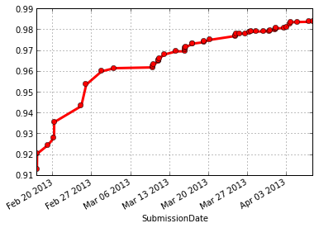
Consistent Data-Driven Improvement
Public Leaderboard Scores
Heritage Health Prize
Marinexplore/Cornell Whale Detection Challenge

Slide 23

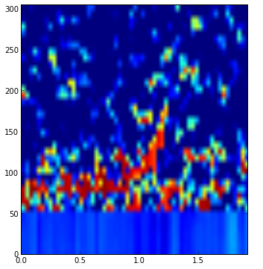
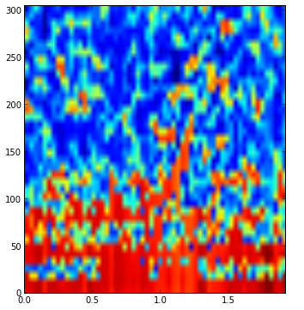
ICML 2013 Whale Challenge Right Whale Redux
Marinexplore Challenge Code -> 0.98707
Make
Prediction
Improve Model
Evaluate
Just notch out low frequencies
WTF is this?

Slide 24
Algorithms Only Care About Better Data Data Agnosticism
Expert approaches involve…
Audio Enhancement
Mel-Frequency Cepstral Coefficients
Zero Crossing Rate
…and many other things I didn’t use

Slide 25
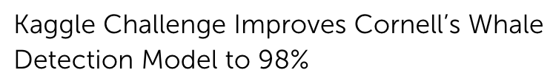
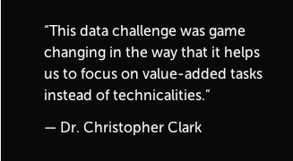
Responsible Data Analysis and Quick Iteration Produce High-Performing Predictive Models
No Domain Expertise Required!

Slide 26
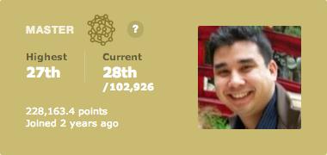

Contact Me
nkridler@accretivehealth.com
http://www.kaggle.com/users/7947/nick-kridler
http://www.linkedin.com/pub/nicholas-kridler/2b/a67/376
https://github.com/nmkridler
https://twitter.com/nmkridler
Accretive is Hiring!

