Slide 1

Automation of Inertial Fusion Target Design
with Python
Matt Terry and Joseph Koning
Lawrence Livermore National Laboratory
Python for Scientific Computing Conference
Austin, Texas
July 13, 2011
This work was performed under the auspices of the U.S. Department of Energy by
Lawrence Livermore National Laboratory under Contract DE-AC52-07NA27344.
Lawrence Livermore National Laboratory, P.O. Box 808, Livermore, CA 94551

Slide 2
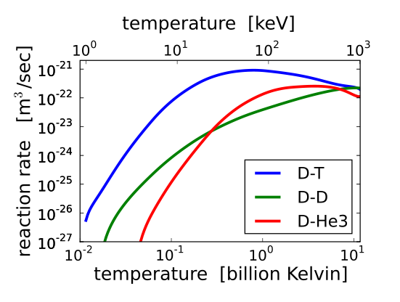
Fusion releases energy by combining small light nuclei into heavier nuclei
Thermonuclear fusion requires very high temperatures to overcome the Coulomb barrier
Energy must be confined long enough to react and propagate
Need sufficient density (fuel) to release significant energy
Lawson criteria illustrates required ignition conditions

Slide 3
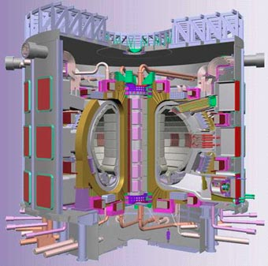
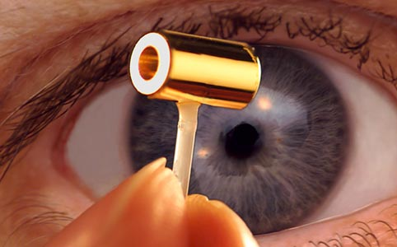
Go BIG
or go FAST

Slide 4
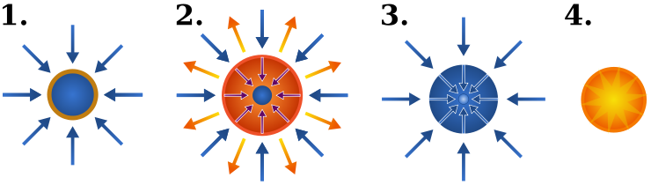
ICF works by compressing DT fuel to high density and relying on the fuel inertial to confine it
A high intensity driver (x-rays, laser, heavy ion beam, etc) illuminates the surface of a layered spherical pellet
The outer surface of the pellet ablates, compressing DT fuel and driving an imploding spherical rocket
The dense imploding shell stagnates on axis and converts its kinetic energy to thermal energy
The high stagnation temperature initiations a fusion burn wave. The burn wave propagates faster than the shell can disassemble, releasing large amounts of energy
http://en.wikipedia.org/wiki/File:Inertial_confinement_fusion.svg

Slide 5
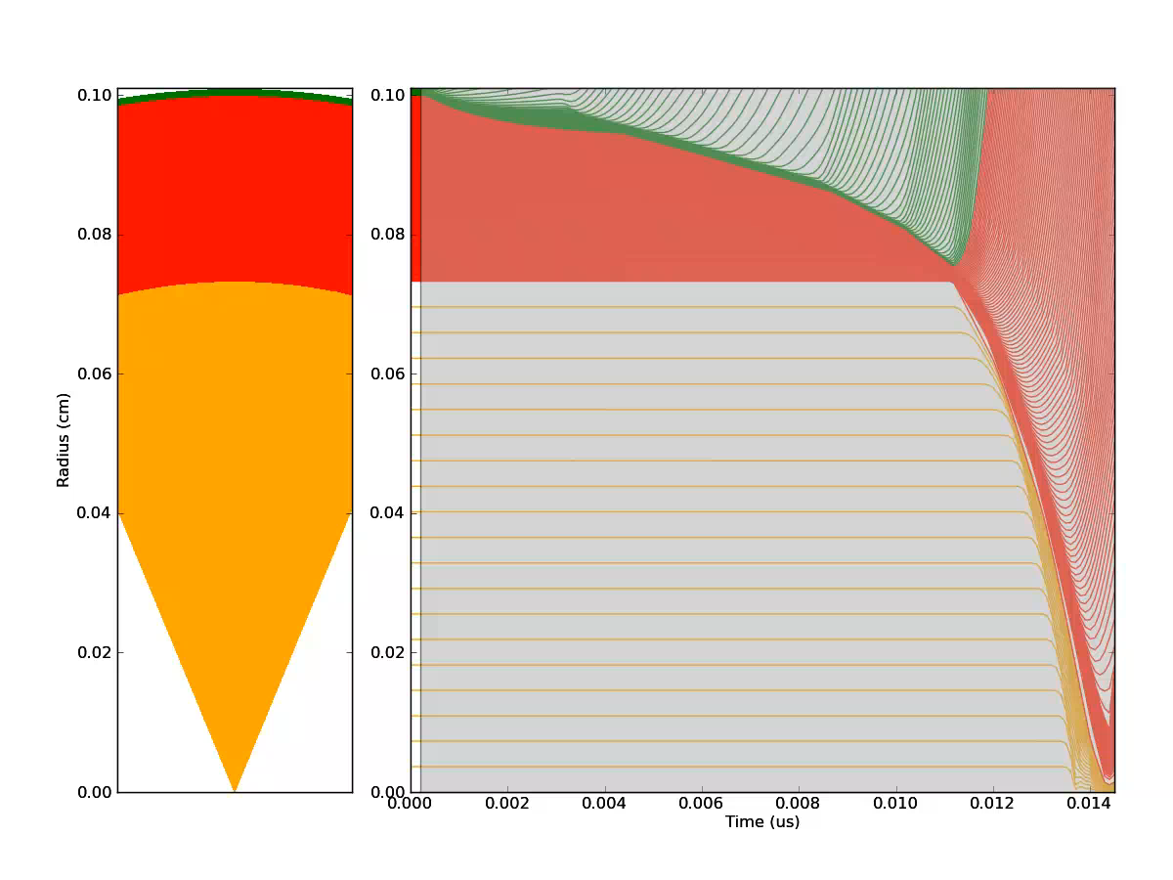
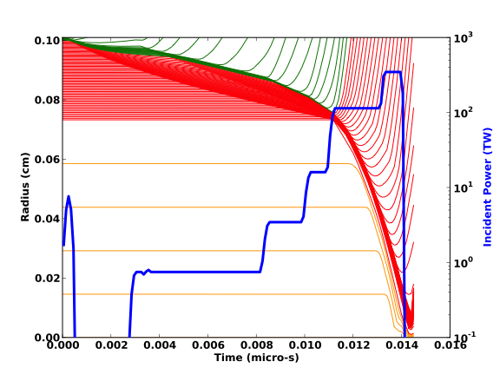
Implosion Movie Coming

Slide 6
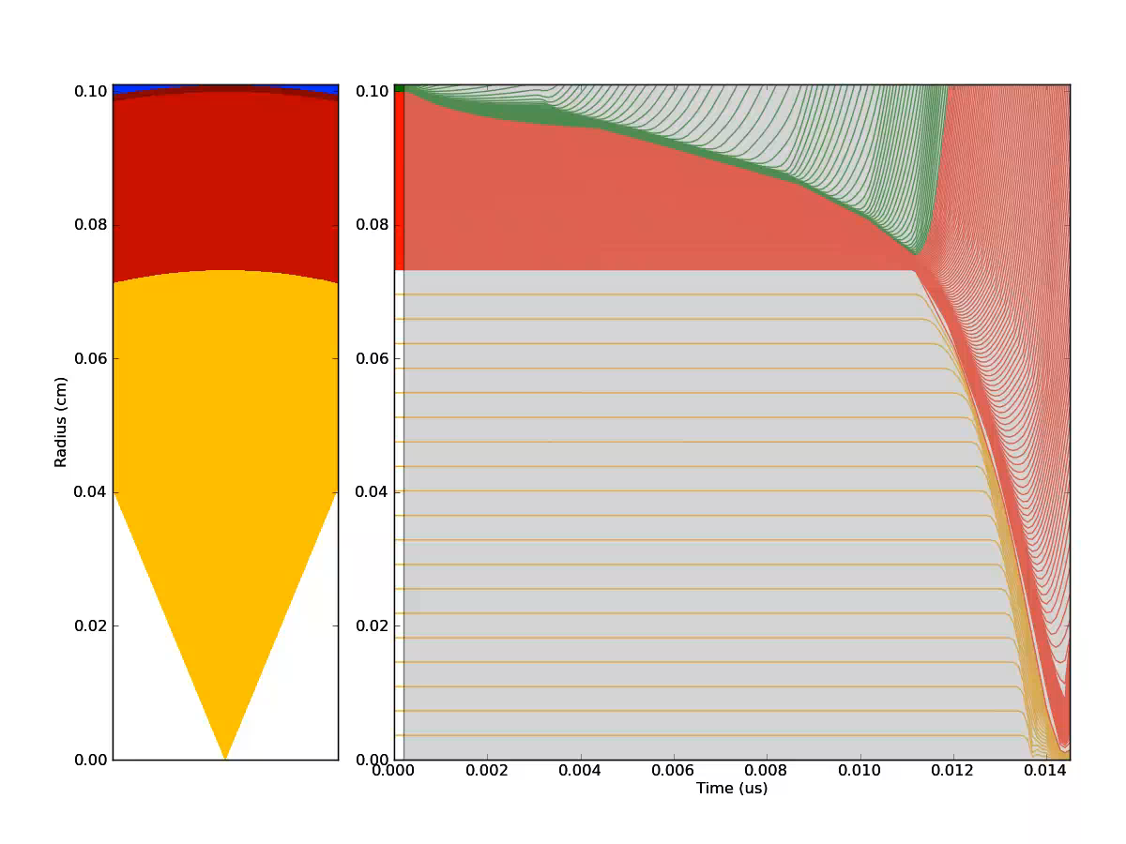

Slide 7
Igniter Pulse
Main Pulse
Pre-pulse

Slide 8
Build a tuned pulse by appending optimized the pieces
Pulse start times and powers must be adjusted to have the correct behavior
Adjusting (“tuning”) by hand has high latency and is labor intensive
We can construct objective functions that implement the “eye balling” heuristics that people use when manually tuning
Construct a tuned pulse by appending tuned pieces
tuners = 3*[shock_sync] + [max_rhor, max_yield]
segments = [‘shock2’, ‘shock3’, ‘shock4’, ‘main’, ‘ignite’]
laser = Laser()
for tuner, seg in zip(tuners, segments):
tune_val = tuner(deck, laser, seg)
laser[seg] = tune_val

Slide 9
Autotuner Program flow
Python Controller
Tuning Strategy
Input file generation
Numerical Optimization
Fork
Join
HYDRA
Hydrodynamics
Radiation Transport
Embedded Python
Shock Tracking
ρR monitors
Output frequency control

Slide 10

Hydra is a massively parallel multi-physics code developed at LLNL
50+ users at National Labs and in academia
Use to model high energy density plasmas
In development since 1993
ALE Hydrodynamics
2D / 3D block structured mesh
Radiation (Photon) transport
Laser beams
Heavy ion beams
Resistive MHD
Ion/Electron conduction
PIC
Atomic physics
Equation of State
Opacity
Fusion Burn

Slide 11
Python is both extended by and embedded in Hydra
Python is extended through a module called “hydra” which contains functions and objects to manipulate hydra data structures
Python is then embedded in the Hydra executable
Bottom line: Hydra makes available a Python interpreter running concurrently in parallel with the main Hydra executable. The two processes are loosely coupled through the “hydra” Python module

Slide 12
Interesting lessons learned
Python readline cannot be overridden for non-interactive tty’s
Python is not the primary interpreter
Subject to master node, so not even second in line
Solution: use custom interactive interpreter
Saving the state of __main__ across restarts is tricky
Cobble together many methods to collect state
Pickle state as a string and add it to restart files
Some objects pickle but do not unpickle!
If your program uses different indexing than Python, resist the urge to emulate your program’s indexing in Python

Slide 13
Embedded Python interpreter enables “introspective” programs without major software development effort
Flexible in code diagnostics
High frequency sampling without dumping to disk
Watch for shock breakout
Watch for peak ρR
Steer simulation based on gathered information
Finer output resolution near interesting features
Turn on additional physics based on software triggers
Don’t need access to the source & no recompile

Slide 14
Auto-tuner needs to generate, run and process many simulations
Input file generators that wrap a “template” input file
Modify simple Hydra variable assignments
Delegate complicated input file structures to special purpose objects
Inject commands into the input file by overwritings sentinels with str(python_proxy_of_complicated_thing)
Output file wrappers extract data from Hydra binary output files
Embedded diagnostics using embedded Python interpreter
Characteristic (shock) trackers with finish line triggers
Change graphics dump frequency based on shock locations
ρR monitors

Slide 15
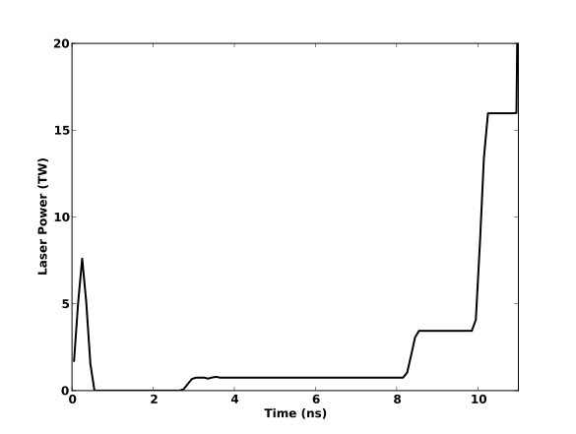
Physics and design rational for pre-pulse
Picket launches a decaying 1 MBar shock and acts as a fiducial for synchronizing subsequent shocks
Intensity and shape of picket are set by 2D stability considerations and are assumed as givens for this work (see future work)
Pedestals launch shocks which increase density by ~4x
Near maximum compression for a planar shock
Stronger shocks decrease performance by increasing entropy (drop compressibility)
Maximum fuel compressibility is very important so shocks should coalesce outside of fuel

Slide 16
Lets focus on the pre-pulse shocks

Slide 17
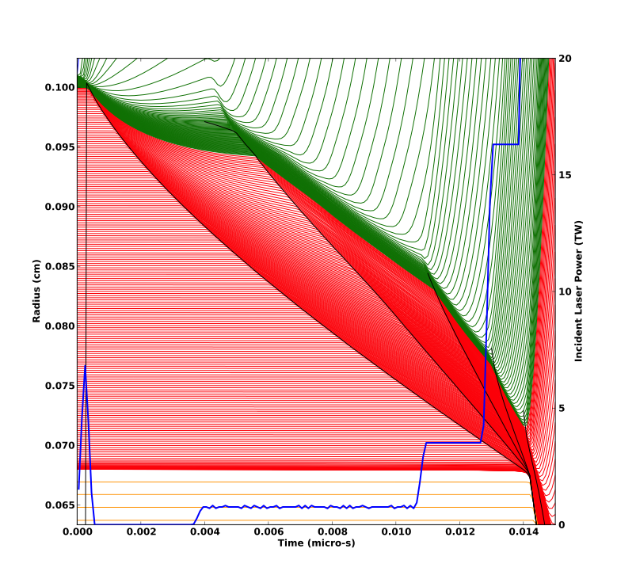
Each pulse segment launches shock which can be unambiguously identified and tracked
20
15
Picket Shock
Incident Laser Power (TW)
Radius (cm)
10
Fourth Shock
Second Shock
Third Shock
5
0
Time (μs)

Slide 18
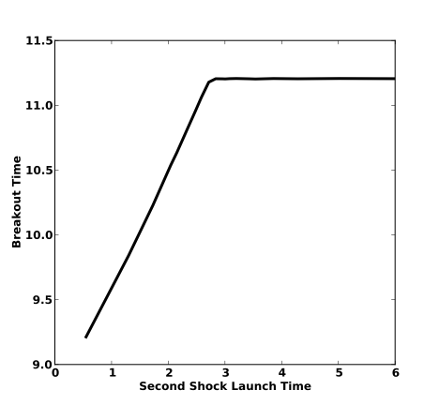
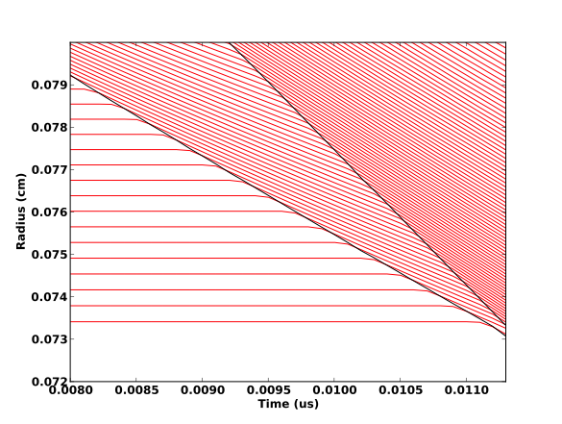
To maintain low fuel entropy, pre-pulse shocks should be timed to coalesce at gas/ice interface within 50 ps of each other
Good Timing
Interface
Mis-timing < 50ps
“Breakout time” is when the first shock crosses the gas/ice interface
All pre-pulse shocks should coalesce at the gas/ice interface at the same time

Slide 19
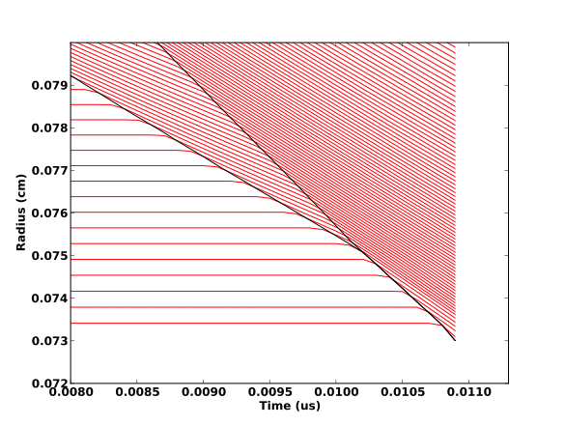
To maintain low fuel entropy, pre-pulse shocks should be timed to coalesce at gas/ice interface within 50 ps of each other
Bad Timing
Shocks merge before interface
Breakout time for bad timing is earlier than for good timing
Shocks coalesce in fuel if second shock launched too soon
Combined shock is faster than individual shocks
Breakout time decreases

Slide 20
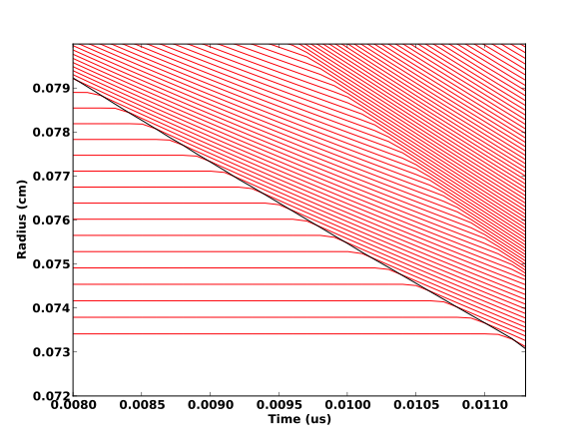
To maintain low fuel entropy, pre-pulse shocks should be timed to coalesce at gas/ice interface within 50 ps of each other
Bad Timing
If the second shock is launched too late, the first shock “wins”
Breakout time is unchanged

Slide 21
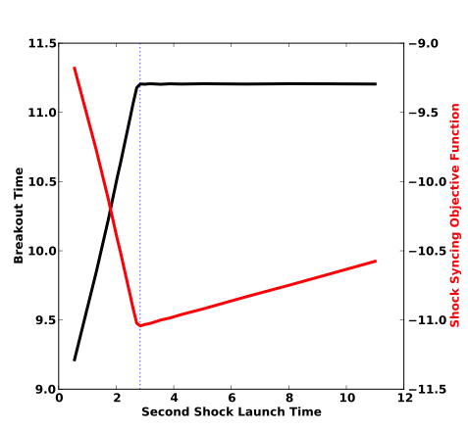
We construct an objective function which is biased to find the earliest launch with the saturated breakout time
A tuned shock is the earliest shock launched that also has the asymptotic breakout time
Experimentally tune ω to ensure good convergence, but introducing minimal error
ω = 10% slope between first & last point works well

Slide 22
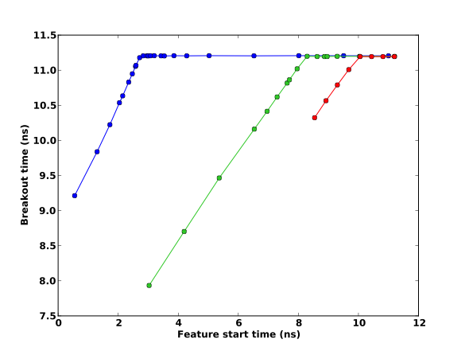
Tuning method demonstrates breakout time unchanged after iteratively tuning of segments of pre-pulse
Foot Shock Start
Third Shock Start
Fourth Shock Start

Slide 23
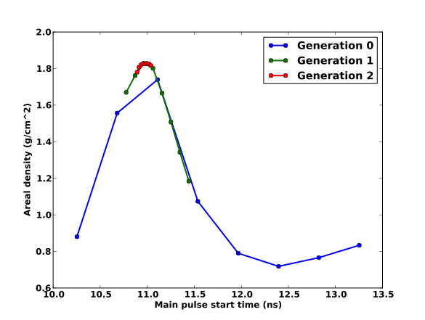
Main pulse is tuned to maximize burn fraction by maximizing areal density
Having assembled the fuel to high density with the pre-pulse, the main pulse accelerates the shell to high velocity
The duration of main pulse constrained by energy budget, so the onset of the main pulse must be timed to get the most “effective” acceleration
Largest potential burn fraction is a good definitions of “effective”
Assuming ignition, the fuel burn fraction scales with areal density (ρR) :
Tune main pulse to maximize areal density

Slide 24
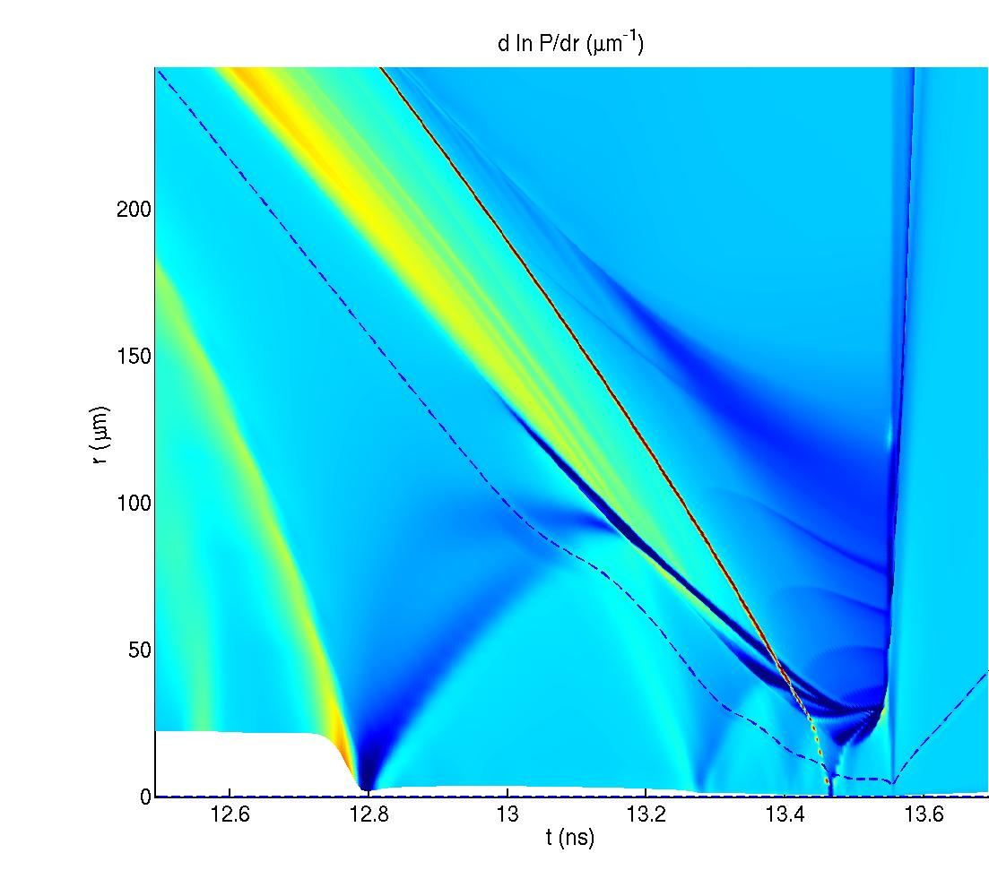
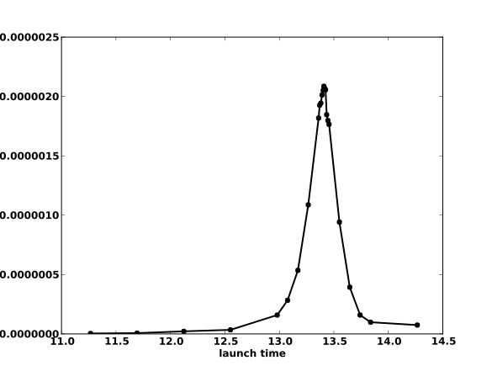
Igniter pulse is tuned to maximize thermonuclear yield
Igniter shock should arrive near peak compression
Too early and shock energy is diluted over large hot spot
Too late and hot spot will disassemble before arrival of igniter shock
Robust targets should have an “ignition window” where target burns robustly despite some mistiming
Shell boundary
Ignition shock
Shock Collision
Yield
Rebound shocks
First Shock
Igniter Shock Launch Time
G. Schurtz X.Ribeyre et al.

Slide 25
Summary
Manually tuning a laser pulse to a specific target is normally a labor intensive, high latency process
Tuning can be automated given a sufficiently unambiguous description of “tuned”
For laser shock ignition targets, the initial picket pulse sets the shock breakout time and other pre-pulse shocks should break out as close to this shock without changing the overall breakout time
Main pulse should maximize areal density as to maximize burn fraction when ignited
Igniter shock should be timed to maximize TN yield
Timing algorithm assumes interaction between different pulse features is primarily hydrodynamic, allowing for tuning method to ignore interaction between features
Future work
Autotune pedestal powers
Restart from prior completed calculations
Unfold experimental breakouts to infer pulse shape (inverse tuning)

Slide 26
Optimizations use a parallel 8-wide direct search method
Function evaluations are relatively expensive (10-20 minutes) so want parallel method that minimizes number of iterations rather than number of function evaluations
8 parallel function evaluations per iteration (1 per processor)
Start times equally spaced between end points
If f(x_{i}) is a maximum, refine end points to x_{i-1} and x_{i+1}
Jobs within an iteration have nearly the same run-time, so processor utilization is high
Converging timing error to < 50 ps typically takes 3-4 generations
~1 hour wall time
Method is simple to implement and has acceptable convergence rate

