Slide 1
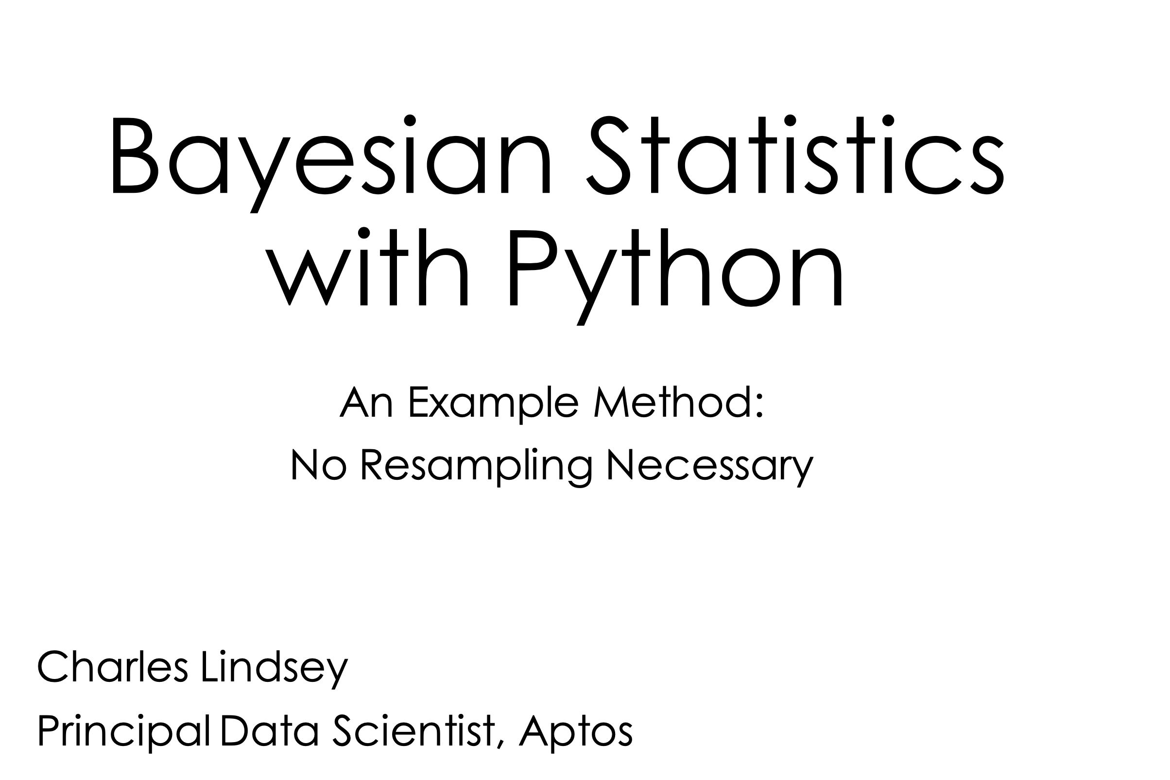



Affinity POC
5/24/2023

Slide 2

Affinity POC
5/24/2023

Slide 3

Data
Bayesian Statistics with Python
Everything begins with data.

Slide 4

Data
Bayesian Statistics with Python
Everything begins with data.
Once collected and organized, we want to learn from it.
What methods should we use?

Slide 5

Black box methods
Bayesian Statistics with Python
Some techniques are very powerful at making accurate predictions.
But the model they are providing predictions from is not easily interpretable.
This can lead to misapplication of the methods as well, as analysts don't understand.
Which can lead to bad prediction outside of training data.

Slide 6

Bayesian Parametric
Bayesian Statistics with Python
Parametric models have parameters and an easily interpreted structure.
They are based on statistical principles that let us interpret predictions and parameter estimates in terms of probabilities.
Some black box methods only provide point estimates. No probabilities or confidence intervals. Not even a standard error to estimate how precise your answer is.
And Bayesian?

Slide 7

Bayesian Prior
Bayesian Statistics with Python
Frequentist methods see parameters as fixed.
You get new data and you re-estimate the parameters.
You ignore the past.
You ignore domain expertise (beyond setting up the observed data model).
Bayesian analysis incorporates the past and domain expertise into a prior.
The prior density is the model for the belief in the parameters before any data is observed.

Slide 8
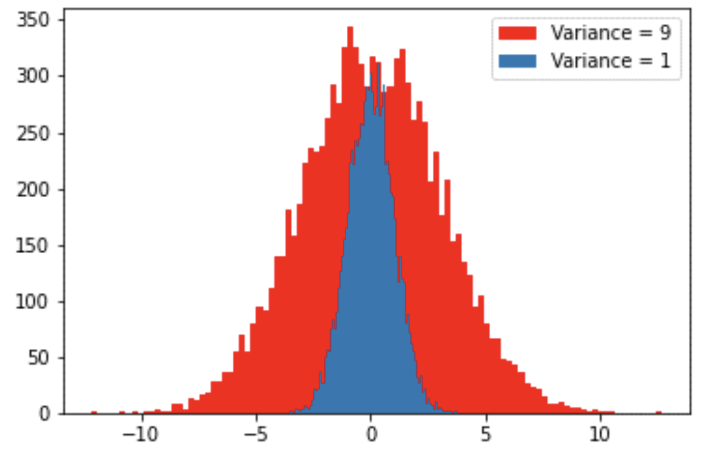
Prior Distributions
Bayesian Statistics with Python
We might believe that elasticity should be centered below 1 for products with static demand in the past.
The variation of average temperature may be greater in the desert than on the coast.
Some parameters are constrained to be positive, while others could range over reals.
We can have more confidence in some parameters than others being closer to their center.

Slide 9

Regularization
Bayesian Statistics with Python
The prior information can regularize the modeling, preventing overfitting on the training data.
The regularization is easily interpretable.
It is based on the meaning of the parameters, not their sizes like L2 regularization.

Slide 10
Prior, Likelihood, Posterior
Bayesian Statistics with Python
The parameters and their confidence are evaluated using the parameter's probability distributions, characterized by their density.
Prior density π(θ) represents the prior belief in parameters θ.
Likelihood of the observed data x, L(θ∣x) is the probability density of the observed data conditional on the parameters. You could view this as π(x∣θ)
Posterior density π(θ∣x) represents the updated belief in the parameters based on the observed data.
π(θ∣x) L(θ∣x)π(θ)

Slide 11
Posterior Distribution
Bayesian Statistics with Python
That proportionality does not give us a distribution.
Resampling methods like Markov Chain Monte Carlo methods can be used to estimate the posterior distribution. These make potential draws from the distribution and accept or reject the draws based on some criteria.
Computationally intensive is a good adjective for resampling.
Asymptotically, the posterior density is thankfully normal.
So as the observed data x grows large in sample size we can approximate the posterior density with a multivariate normal distribution.

Slide 12
Posterior Distribution Approximation
Bayesian Statistics with Python
Details are given in the proceedings paper and attached references.
At the posterior mode estimate, we can approximate the posterior with
Score S(θ), is the derivative of the log posterior with respect to the parameters θ.
Hessian H(θ), is the second derivative of the log posterior with respect to θ.
Our approximation gets more accurate as the amount of observed data increases and the mode estimate gets closer to θ (like sample mean getting closer to population mean).
Using Calculus, this means S(θ) goes to zero at the posterior mode and so...

Slide 13
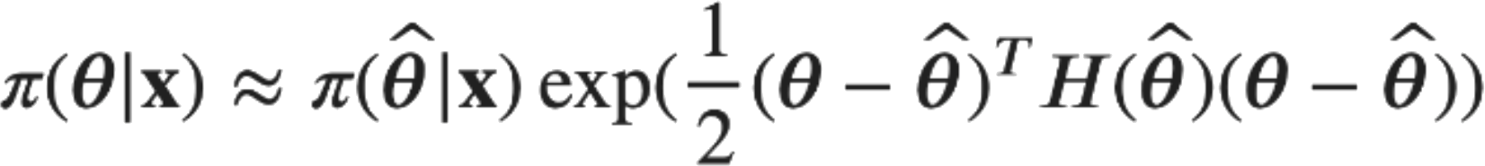
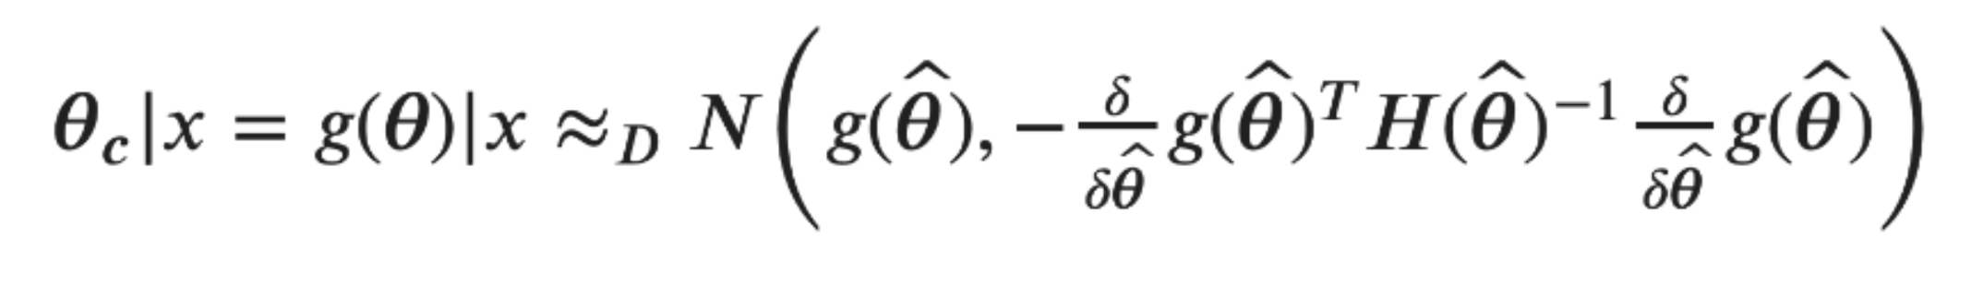
Posterior Distribution Approximation
Bayesian Statistics with Python
This is proportional to a normal density.
Optimizing parameters over the real line can be easier than optimizing parameters on constrained spaces. So, we can formulate our true parameter space as being unconstrained.
Transformed, or constrained parameters, θ_{c} = g(θ) are the final parameters that we will interpret. Then using the Delta method, we get:

Slide 14
bayes_mapvar
Bayesian Statistics with Python
Finally, time for some Python.
The package bayes_mapvar takes a Bayesian model specification and observed data, then outputs:
Posterior Mode estimate, called the Maximum A Priori (MAP)
This is provided for the unconstrained parameters and a transform of it for the constrained.
Posterior Variance estimate
Hessian estimate
Delta matrix (derivative of g) estimate
Posterior Variance of Constrained parameters estimate

Slide 15
TensorFlow Probability
Bayesian Statistics with Python
Bayesian model is specified using a dictionary of TensorFlow Probability (TFP) Distributions.
TFP is a Probabilistic Programming Language. This lets us build powerful models in a modular way and estimate them automatically.
TensorFlow, a leading software library for machine learning and artificial intelligence is the engine used to implement TFP.
The Distribution class is how TFP represents a probability distribution, the set of rules that govern the likelihood of how a random variable (vector, or even general tensor) takes its values.
Together with callables that ingest and output distributions, you can form a complex Bayesian model using a single dictionary.

Slide 16
SciPy Optimization
Bayesian Statistics with Python
The dictionary of tensor parameter values are stacked together into a vector, and this is passed into scipy.optimize to maximize the posterior density.
We use method= 'L-BFGS-B' to use the Limited memory Broyden–Fletcher–Goldfarb–Shanno (L-BFGS) algorithm in optimization.
This is classified as a quasi-Newton method, being based on the Scores and an approximation of the Hessian matrix.
TFP's automatic differentiation function tfp.math.value_and_gradient provides the gradient / score of the log posterior density to the loss function used by scipy.optimize.

Slide 17
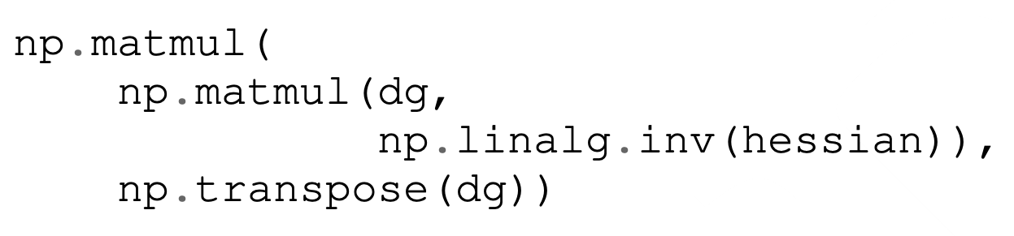
Variance Estimation
Bayesian Statistics with Python
Details on variance estimation are in the proceedings paper.
We use numeric derivatives of the scores to estimate the Hessian of the unconstrained parameters.
Numeric derivatives are also used for calculating the Delta matrix for the constrained parameters.
The final variance matrix is computed as

Slide 18
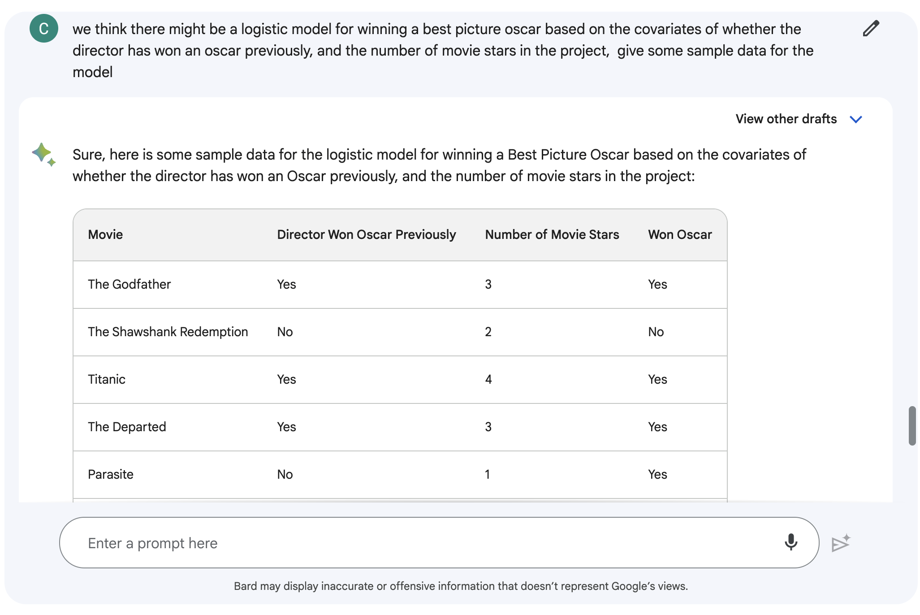
Simple Example
Bayesian Statistics
We'll use Bard to get some data.
Then we will setup a dictionary of distributions in TFP.
We stick with a fun example with publicly available data.

Slide 19
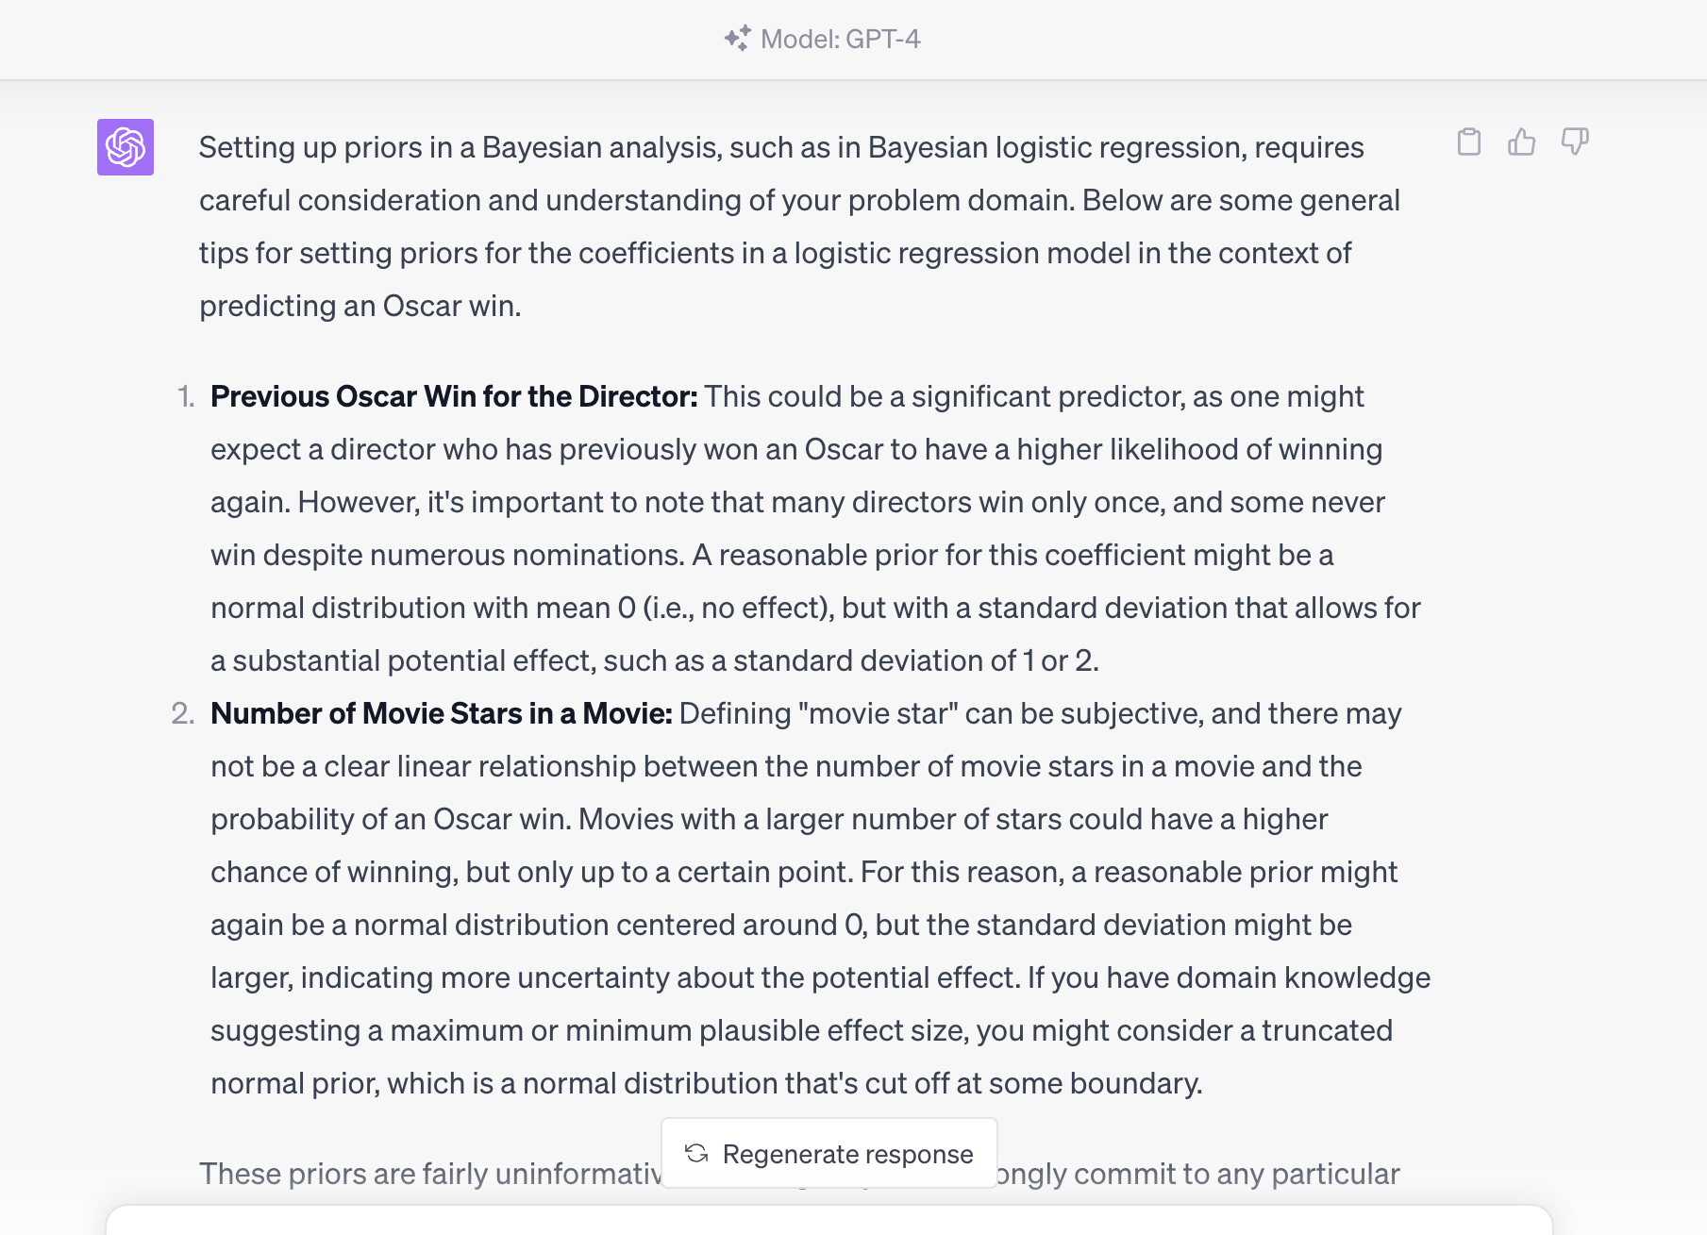
Example
Bayesian Statistics
We asked ChatGPT about priors for the coefficients.
We will constrain the movie stars coefficient to be positive. Star power!
See collab notebook at link.

Slide 20
Simulation
Bayesian Statistics with Python
A simulation study was performed to corroborate that bayes_mapvar is estimating correctly. Details are in the proceedings paper, and this collab.
The map estimates, variance estimates, and asymptotic normality of the posterior distribution was checked by comparing the mapvar results using MCMC methods implemented in TFP and the Anderson Darling tests from scipy.stats.
We simulated draws from a linear regression model with an intercept that had a χ2 prior for the intercept and a normal prior for the slope.

Slide 21
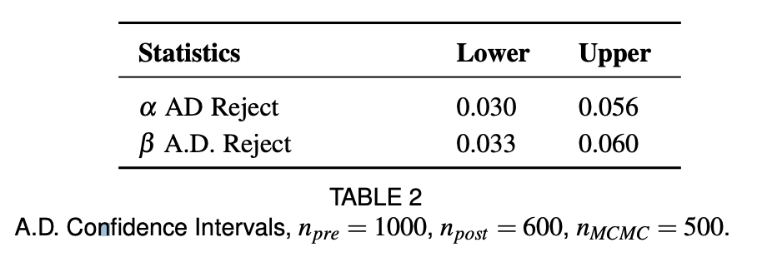
Simulation
Bayesian Statistics with Python
Standardizing based on the estimated map and posterior variance from bayes_mapvar, we should find that the posterior density is approximately standard normal. The Anderson Darling test was used to assess this.
We performed a successful hypothesis test of whether the rejection rate is .05 by checking whether .05 is in the confidence interval for the proportion. We used the proportion_confint function from statsmodels.

Slide 22
References
Bayesian Statistics with Python
Full references are in the proceedings paper.
[1] A. Gelman, J. Carlin, H. Stern, D. Dunson, A. Vehtari, and D. Rubin, Bayesian Data Analysis, Third Edition. Chapman & Hall/CRC Texts in Statistical Science, Taylor & Francis, 2013.
[2] G. W. Oehlert, “A note on the delta method,” The American Statistician, vol. 46, no. 1, pp. 27–29, 1992.
[3] A. G. Baydin, B. A. Pearlmutter, A. A. Radul, and J. M. Siskind, “Automatic differentiation in machine learning: a survey,” 2018.
[4] W. Press and S. Teukolsky, Numerical Recipes 3rd Edition: The Art of Scientific Computing. Numerical Recipes: The Art of Scientific Computing, Cambridge University Press, 2007.

Slide 23

Thank you!
Bayesian Statistics with Python
Happy Modeling Everybody!
Thanks for your time.
GitHub: https://github.com/cdlindsey/bayes_mapvar
Proceedings Paper (temporary): https://procbuild.scipy.org/download/cdlindsey-23_lindsey

