Slide 1
Programmatically Identifying Cognitive Biases Present in Software Development
Amanda E. Kraft, Matthew Widjaja, Trevor M. Sands, Brad J. Galego

Slide 2


The Problem & Datasets
Artificial Intelligence- (AI) and Machine Learning- (ML) based systems are increasingly supporting decision-making but are also being questioned for its objectivity.
Though efforts are underway to make AI/ML systems more explainable and debias datasets, little research is directed at the cognitive biases that developers unintentionally introduce while developing software.
We manually collated data from two internal codebases and an open-source dataset from refactoring tasks on various open-source projects.
Internal Project A
1405 Commit Messages
Internal Project B
227 Commit Messages
469 Code Comments
181 Code Docstrings
Open-Source Code Smell [6]
441 Commit Messages
https://smilevo.github.io/self-affirmed-refactoring/IWoR19_index.html
SciPy 2021
© 2021 Lockheed Martin Corporation. All Rights Reserved.

Slide 3





Cognitive Bias Types
Cognitive Biases are systematic deviations from cognitive processes, and hundreds have been identified [1]. 40 of those biases have been investigated in Software Engineering [2] and we selected four of those to focus on.
Anchoring Bias
Tendency to rely too heavily on pre-existing or first information found when making a quantitative judgement. [2]
Confirmation Bias
Tendency to search for & focus on information that confirms one preconception(s) while ignoring or rejecting sources that challenge it. [4]
Availability Bias
Tendency to overestimate the likelihood of events based on the ease of which examples come to mind. [3]
Hyperbolic Discounting
Tendency to prefer immediate payoffs over larger rewards at a later point. [2]
Subjective/Other
This is not an official type of cognitive bias but was used on this project to categorize biases that weren’t listed above.
SciPy 2021
© 2021 Lockheed Martin Corporation. All Rights Reserved.

Slide 4
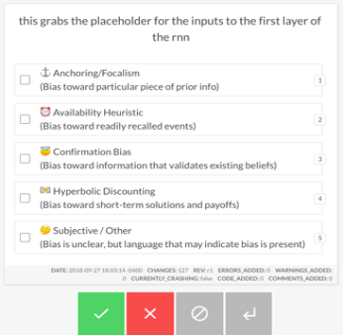
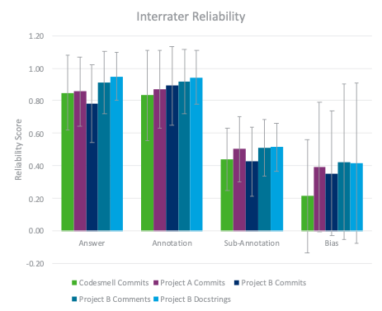
Data Curation & Annotation process
A group of 5-6 reviewers independently reviewed each entry for cognitive bias (if any) using Prodigy
The green ‘accept’ button meant bias was found. The red ‘reject’ button meant that no bias was found. The grey ‘ignore’ meant that the message had no meaningful content.
A reviewer finalized the labels, selecting one bias type per entry.
Interrater reliability (IRR) was rather low in terms of specific biases found. While reviewers typically agree if an entry is or isn’t biased, reviewers tend to disagree on which bias is present. More details about the IRR process is in our paper.
Raw Data
Project A Commits
Project B Commits,
Project B Comments
Project B Docstrings
Code Smell Commits
This table visualizes the interrater reliability across datasets. Error bars show standard deviation in the reliability scores.
Reliability was higher for the initial answer on if an entry was or wasn’t biased, but they dropped when reviewers had to select the specific bias type. More information is on page 3 of the paper.
SciPy 2021
© 2021 Lockheed Martin Corporation. All Rights Reserved.

Slide 5
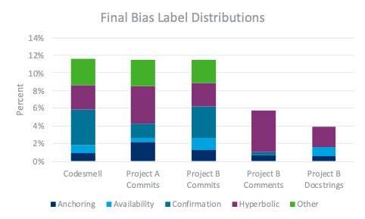
Modeling process
The final dataset was ingested into a spaCy text classification model.
This plot shows the distribution of the final cognitive bias labels from each dataset our team annotated. This data is ingested into our models, either per codebase or as a combined dataset.
SciPy 2021
© 2021 Lockheed Martin Corporation. All Rights Reserved.

Slide 6


Models ran + model Results
The spaCy text classification model was configured so it could either predict for the presence of bias (binary) or for the specific type of cognitive bias found.
Binary Models
Models which identified whether text entries contained bias performed better, averaging 79-83% F1.
This aligns with how human raters tended to agree whether an entry is biased or not.
Project B Commits’ performed poorer, which correlates with the smaller size of the dataset.
Dataset | Total Items | Mean F1 | Std. Dev
Project A Commits | 1405 | 81.2% | 2.6%
Project B Commits | 227 | 65.9% | 14.0%
Project A + B Commits | 1632 | 79.0% | 5.1%
Project B Commits + Comments | 696 | 78.6% | 6.8%
All Data | 2282 | 82.3% | 3.9%
Multi-Label Models
Models which identified the specific type of cognitive bias performed poorer, in line with how human raters tended to disagree on how a specific entry is biased.
Dataset | Total Items | Mean F1 | Std. Dev
Project A + B Commits | 1632 | 72.1% | 5.8%
SciPy 2021
© 2021 Lockheed Martin Corporation. All Rights Reserved.

Slide 7
References
[1] Delgado-Rodriguez, M., & Llorca, J. (2004). Bias. Journal of Epidemiology & Community Health, 58(8), 635-641. 10.1136/jech.2003.008466
[2] Mohanani, R., Salman, I., Turhan, B., Rodríguez, P., & Ralph, P. (2018). Cognitive biases in software engineering: a systematic mapping study. IEEE Transactions on Software Engineering, 46(12), 1318-1339. 10.1109/TSE.2018.2877759
[3] Stacy, W., & MacMillan, J. (1995). Cognitive bias in software engineering. Communications of the ACM, 38(6), 57-63. 10.1145/203241.203256
[4] Calikli, G., & Bener, A. (2015). Empirical analysis of factors affecting confirmation bias levels of software engineers. Software Quality Journal, 23(4), 695-722. 10.1109/ICIST.2013.6747696
[6] AlOmar, E., Mkaouer, M. W., & Ouni, A. (2019, May). Can refactoring be self-affirmed? an exploratory study on how developers document their refactoring activities in commit messages. In 2019 IEEE/ACM 3rd International Workshop on Refactoring (IWoR) (pp. 51-58). IEEE. 10.1109/IWoR.2019.00017
SciPy 2021
© 2021 Lockheed Martin Corporation. All Rights Reserved.

Slide 8



Who We are
This project was developed by the Intelligent Systems Works (ISW) team, within Lockheed Martin’s Advanced Technology Laboratories. ISW focuses on research and development to create technologies that will accelerate the hybrid existence of human and machine intelligence.
The ISW team is multidisciplinary and includes over 75 scientists and engineers with advanced degrees in computer science, electrical & mechanical engineering, system engineering, mathematics, cognitive science, neuroscience/psychology, materials science and biology.
The ISW team, along with its academic and industry partners, is leading multiple contracts in the US Government and technology organizations, infusing and augmenting human capabilities with machine intelligence.
To learn more or ask questions, email brad.j.galego@lmco.com and/or matthew.widjaja@lmco.com
SciPy 2021
© 2021 Lockheed Martin Corporation. All Rights Reserved.

