Slide 1

High Performance Pandas 2
Time Based Analysis Using Pandas
David Camacho – Lead Data Architect

Slide 2
Outline
Intro
Pandas Datetime Objects
Time Based Querying
Grouping Information Using Time
Aggregations and Custom Operations

Slide 3

Data Analysis is the most time consuming task of an ML project… some times is waiting the algorithm to train!

Slide 4
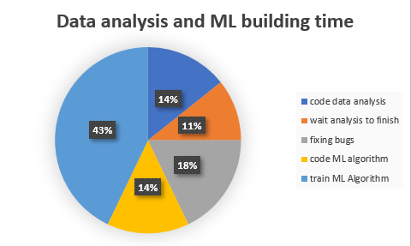
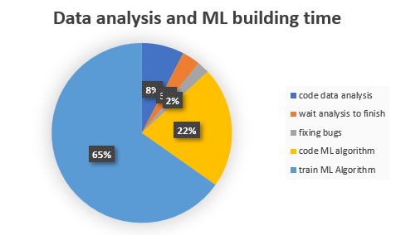

Intro
Repeat until achieving desired result
Repeat until achieving desired result
Total time per iteration: ~10+ hours
Total coffee consumption: 2lt
Total time per iteration: ~7 hours
Total coffee consumption: 2lt

Slide 5
Datetime Objects
DataType | Description | Related Methods | RelatedIndexes | Base Object
Timestamp | Basic Timestamp data type. Represents a point in time | to_datetime, date_range, bdate_range | DatetimeIndex | Pd.Timestamp
TimeDelta | Absolute time duration. Represents duration between 2 given times | to_timedelta, timedelta_range | TimedeltaIndex | Pd.Timedelta
Period | Represents a span of time from a point in time. | period_range | PeriodIndex | Pd.Period
DateOffset | Represents a span of time. |  |  | Pd.DateOffset
Notes:
Support for several date and time formats
Pd.to_datetime & pd.to_timedelta & pd.Period
Pd.date_range & pd.timedelta_range & pd.period_range
Pd.DateOffset
Pd.Timestamp
Pd.localization
Time based resampling
NaT

Slide 6
Datetime Objects
Property | Description
year | The year of the datetime
month | The month of the datetime
day | The days of the datetime
hour | The hour of the datetime
minute | The minutes of the datetime
second | The seconds of the datetime
microsecond | The microseconds of the datetime
nanosecond | The nanoseconds of the datetime
date | Returns datetime.date (does not contain timezone information)
time | Returns datetime.time (does not contain timezone information)
timetz | Returns datetime.time as local time with timezone information
dayofyear | The ordinal day of year
weekofyear | The week ordinal of the year
week | The week ordinal of the year
dayofweek | The number of the day of the week with Monday=0, Sunday=6
weekday | The number of the day of the week with Monday=0, Sunday=6
day_name | The name of the day in a week (ex: Friday)
quarter | Quarter of the date: Jan-Mar = 1, Apr-Jun = 2, etc.
days_in_month | The number of days in the month of the datetime
is_month_start | Logical indicating if first day of month (defined by frequency)
is_month_end | Logical indicating if last day of month (defined by frequency)
is_quarter_start | Logical indicating if first day of quarter (defined by frequency)
is_quarter_end | Logical indicating if last day of quarter (defined by frequency)
is_year_start | Logical indicating if first day of year (defined by frequency)
is_year_end | Logical indicating if last day of year (defined by frequency)
is_leap_year | Logical indicating if the date belongs to a leap year
DatetimeIndex
Series.dt

Slide 7
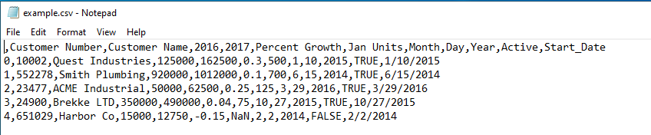
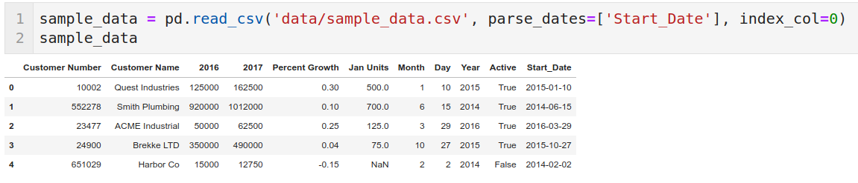
Creating Time Series
Loading data
When importing data to pandas you can load it directly as a time series (object Series fiill with timesatmp)
The same response is returned if you pass a Series pd.to_datetime method.

Slide 8
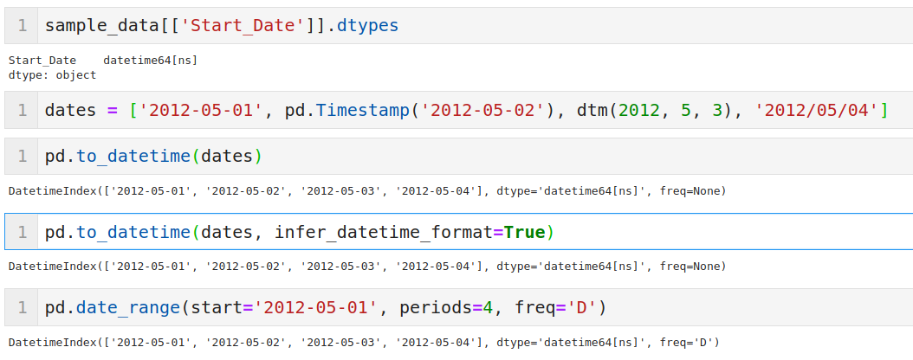
Creating Time Indexes
DatetimeIndex

Slide 9
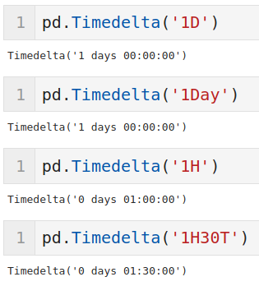
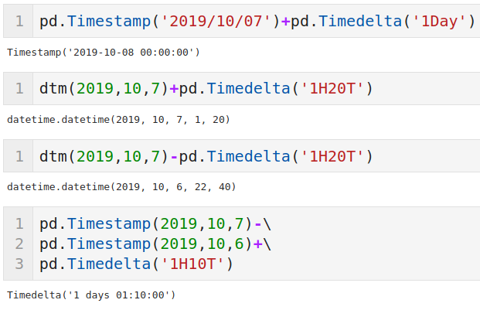
Creating Time Indexes
TimedeltaIndex

Slide 10
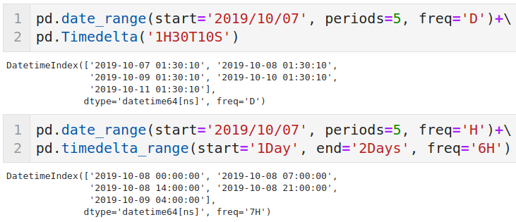
Creating Time Indexes
TimedeltaIndex

Slide 11
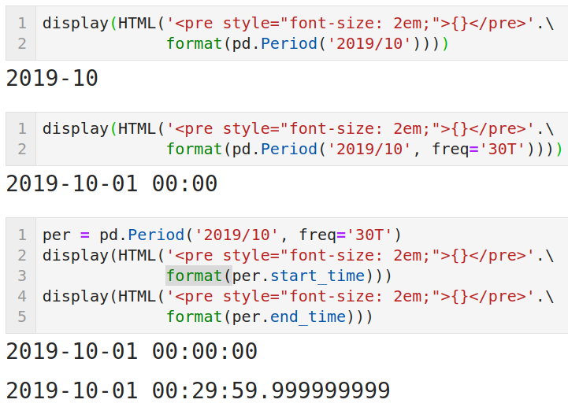
Creating Time Indexes
PerioIndex
09/10/2019
David Camacho - Time Based Analysis Using Pandas

Slide 12
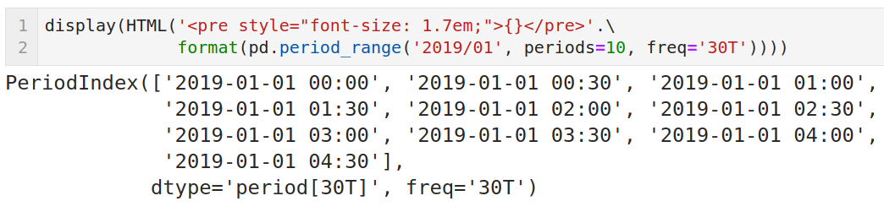
Creating Time Indexes
PerioIndex
09/10/2019
David Camacho - Time Based Analysis Using Pandas

Slide 13
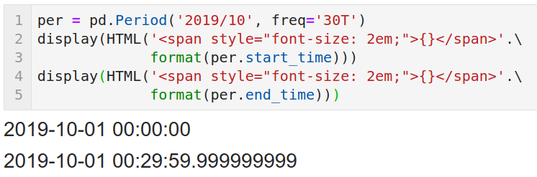
Creating Time Indexes
PerioIndex
09/10/2019
David Camacho - Time Based Analysis Using Pandas

Slide 14
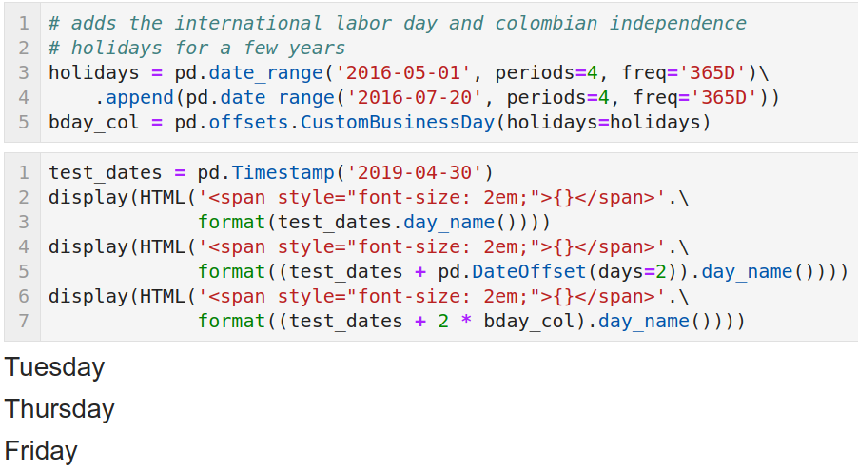
Creating Time Indexes
DeteOffset

Slide 15
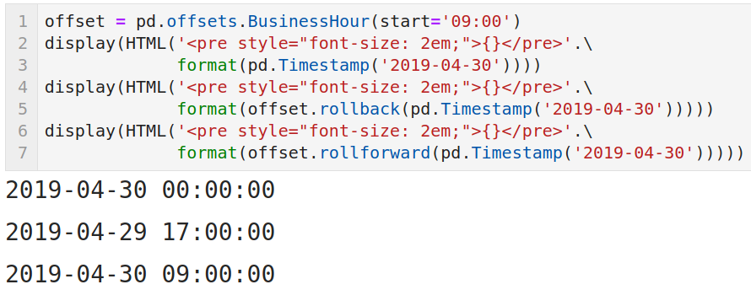
Creating Time Indexes
DeteOffset

Slide 16
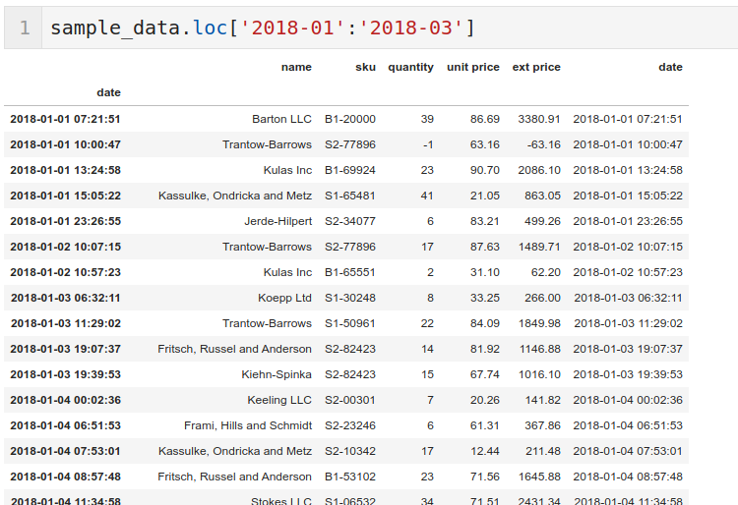
Time Based Querying

Slide 17
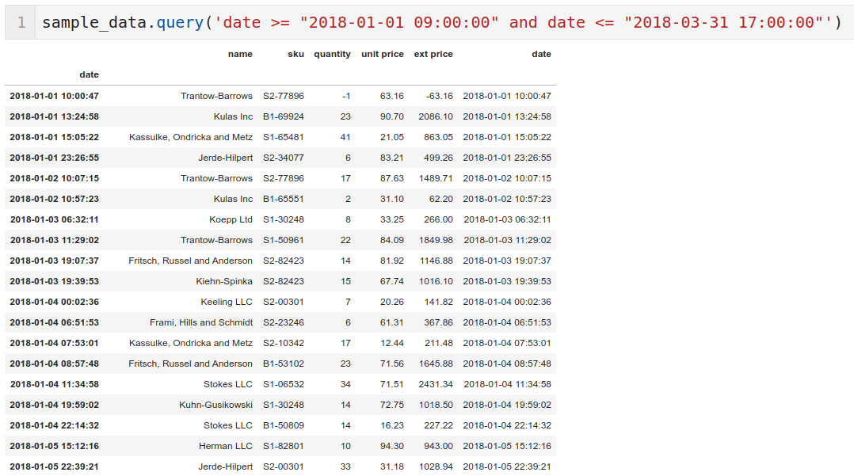
Time Based Querying

Slide 18
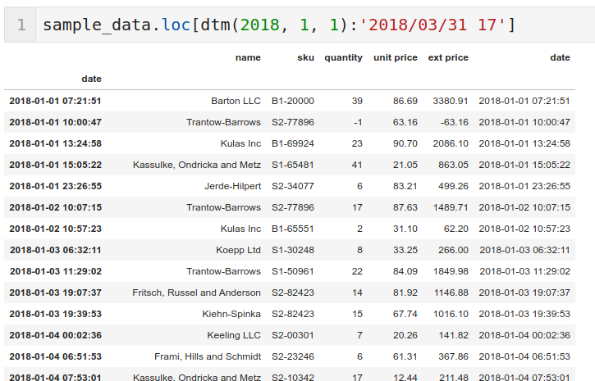
Time Based Querying

Slide 19
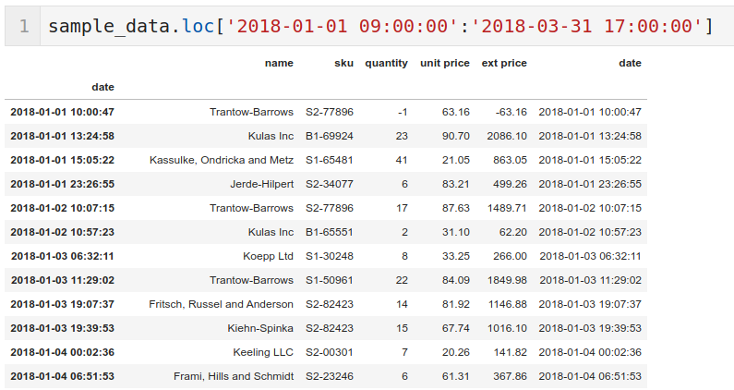
Time Based Querying

Slide 20
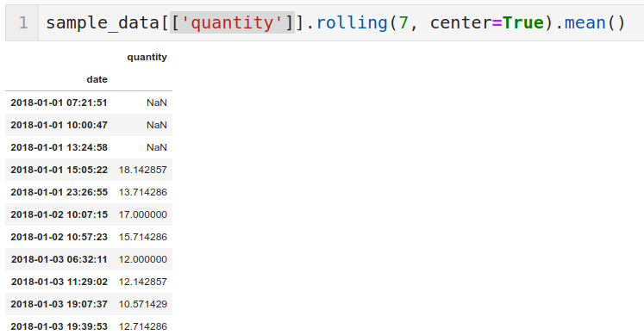
Creating Rolling Windows Based on Time

Slide 21
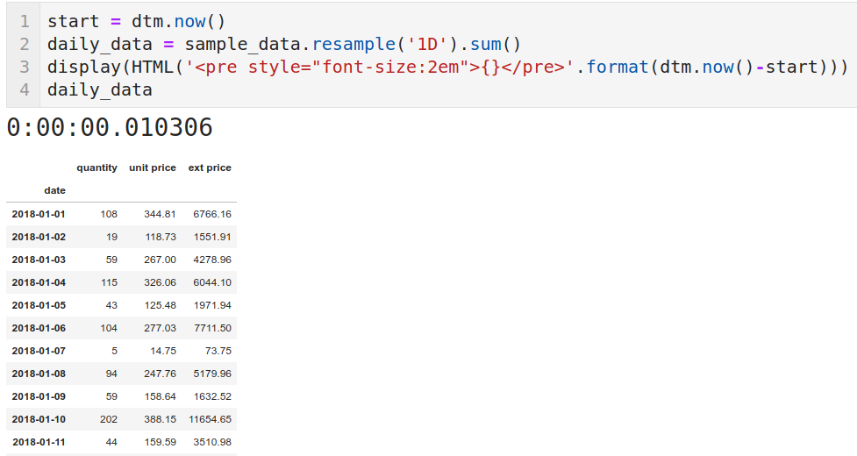
Aggregations and Custom Operations

Slide 22
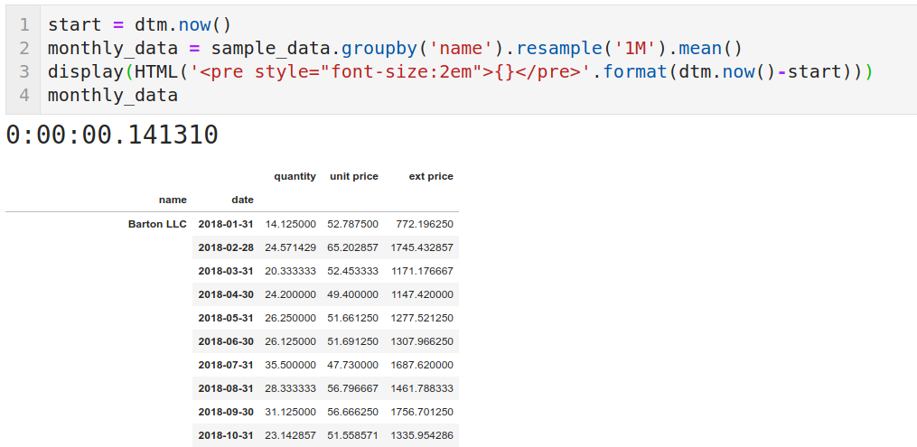
Aggregations and Custom Operations

Slide 23
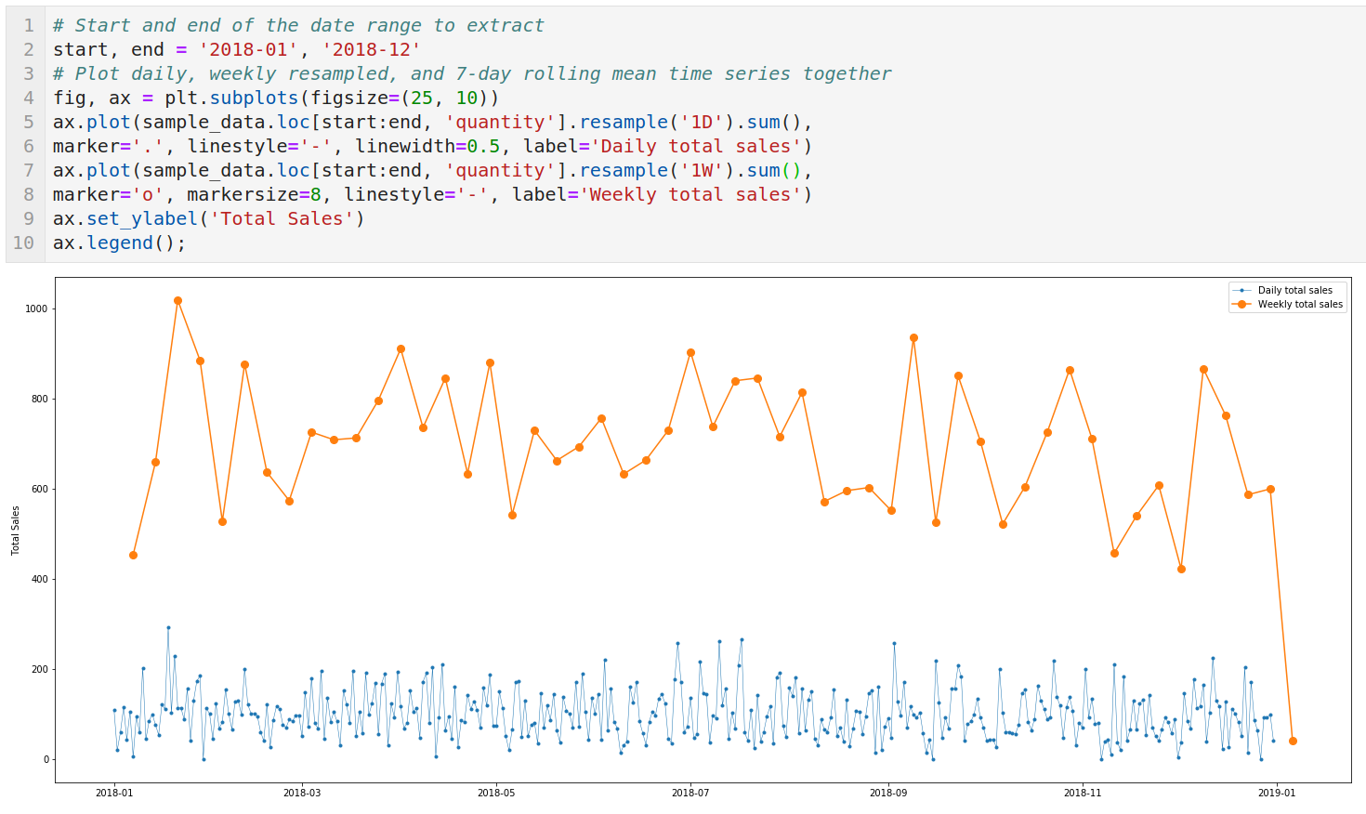
Plotting Results

Slide 24
Plotting Results

Slide 25




Thanks!
@luisdcamachog
luis.camacho@cyxtera.com
https://www.linkedin.com/in/luisdcamachog/
https://github.com/LuisDavidCamacho

