Slide 1
PyTrilinos: A Python Interface to Trilinos, a Set of Object-Oriented Solver Packages
Bill Spotz
Sandia National Laboratories
SciPy 2005
Pasadena, CA 22 Sep 2005
With special thanks to
Marzio Sala, Eric Phipps, Alfred Lorber,
Mike Heroux, Jim Willenbring and Mike Phenow

Slide 2


Outline
An Overview of Trilinos
  Motivation
  Philosophy & Infrastructure
  Packages
An Overview of PyTrilinos
  Packages
  Performance
Summary

Slide 3
Trilinos Motivation
Sandia does LOTS of solver work
Challenges
  Code reuse
  Leverage development across projects
  Consistent APIs
  ASCI SQA/SQE requirements
Bringing object-oriented tools to scientific computing
  Frameworks, inheritance, operator overloading…

Slide 4
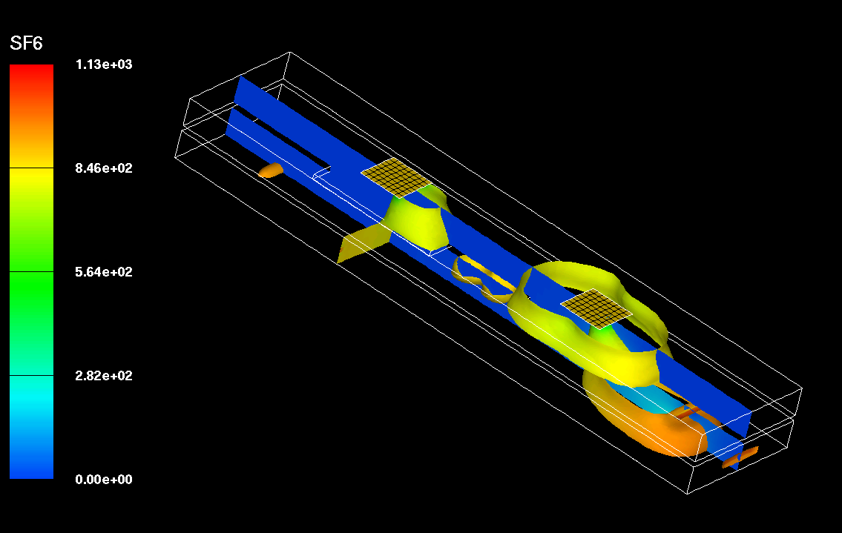
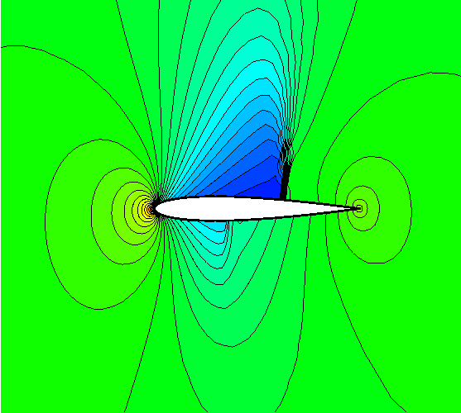
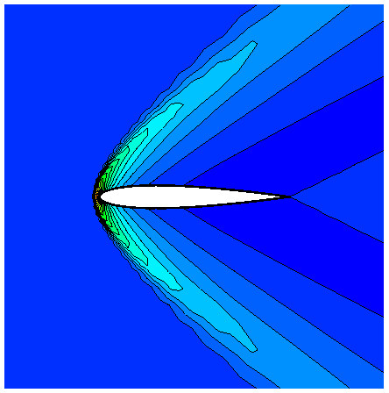
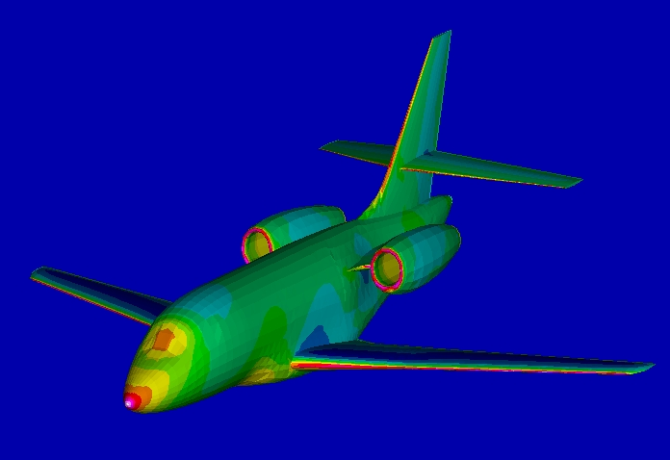
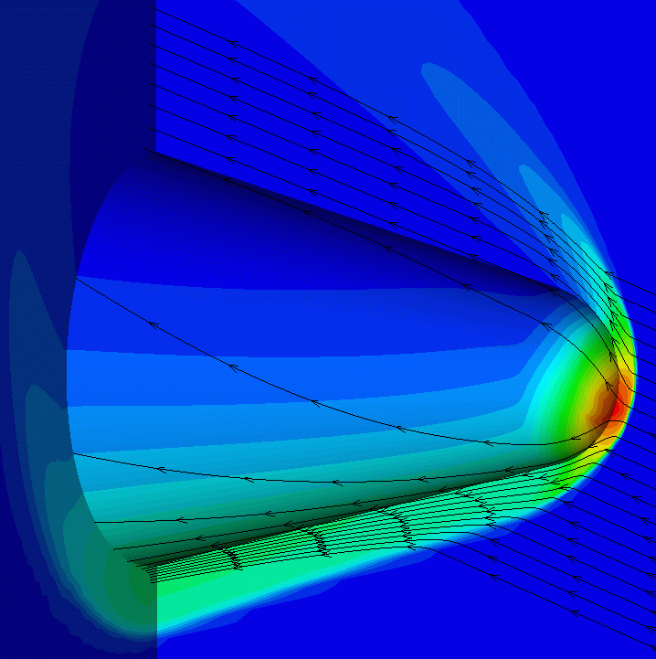
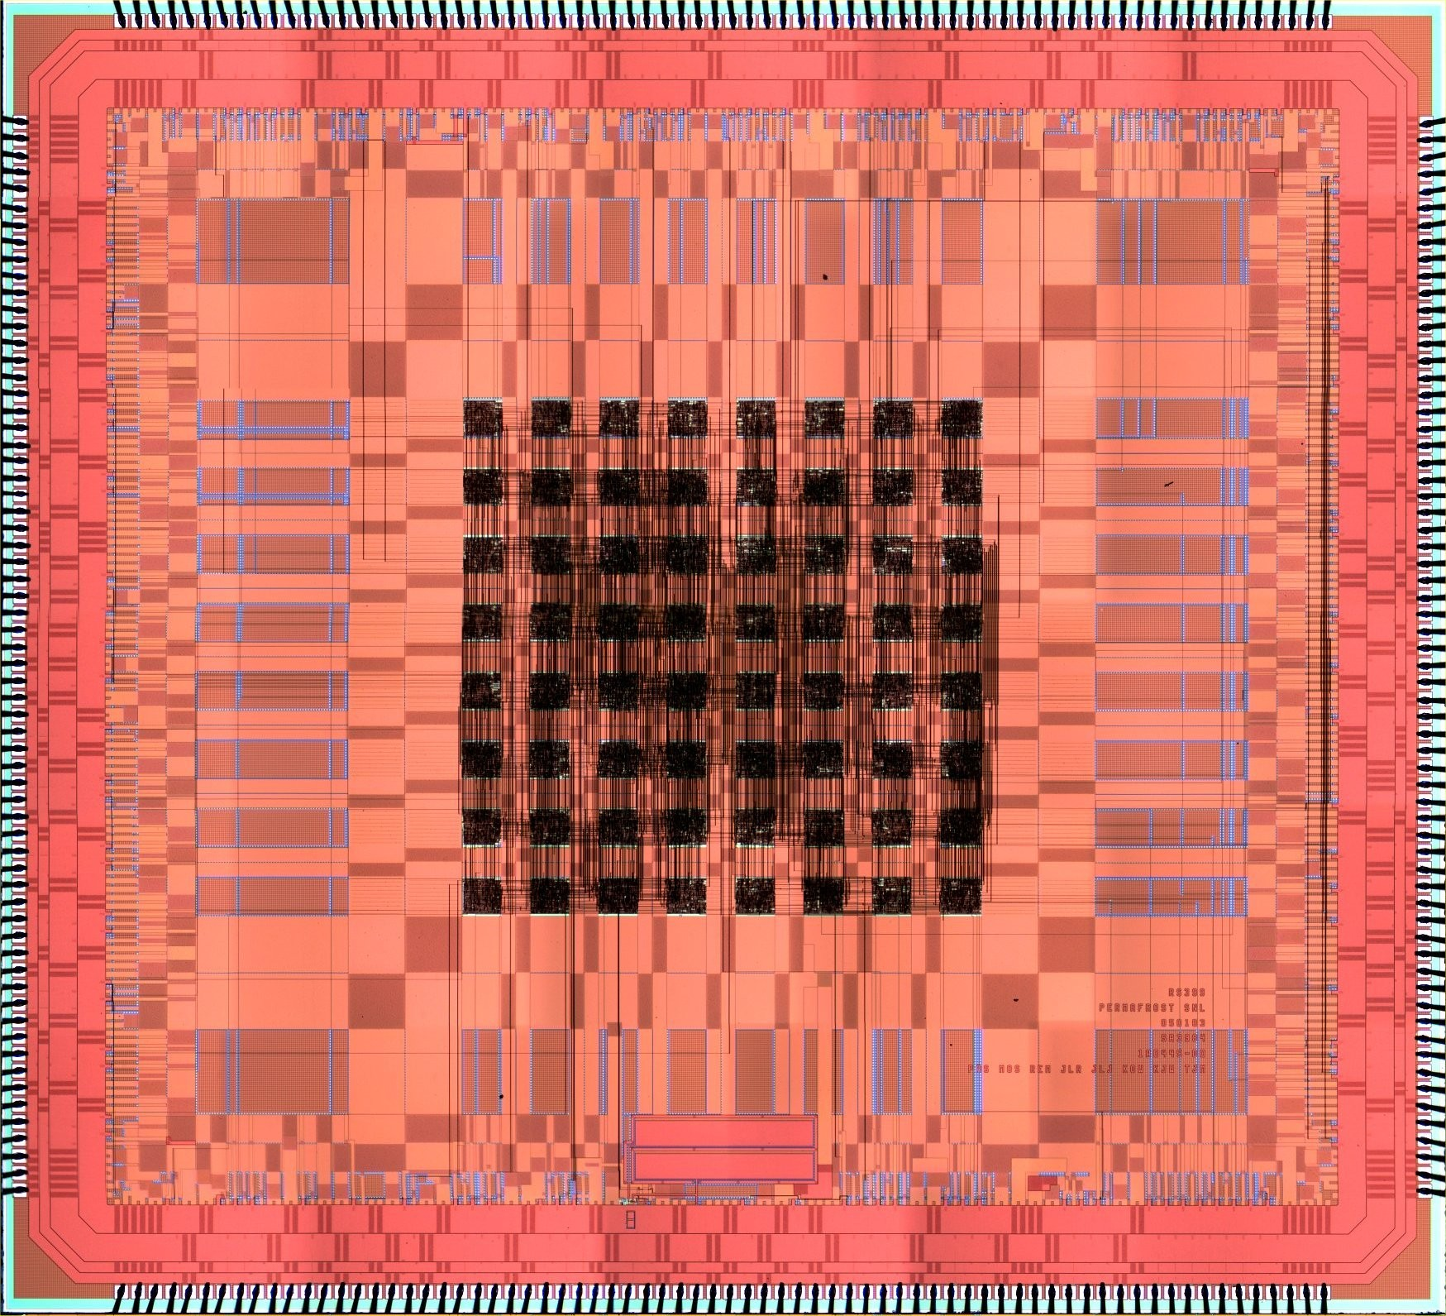
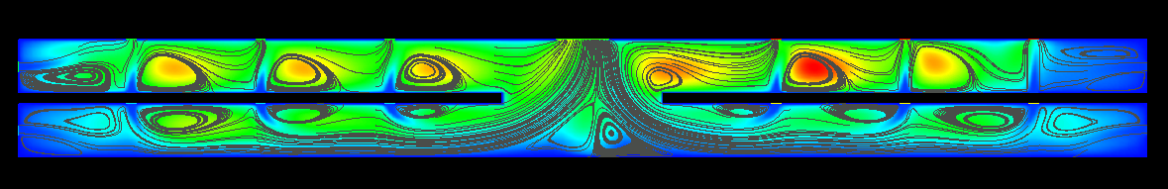
Trilinos Motivation
PDEs and Circuits

Slide 5
Evolving Trilinos Solution
Trilinos¹ is an evolving framework to address these challenges:
  Fundamental atomic unit is a package.
  Includes core set of vector, graph and matrix classes (Epetra/Tpetra packages).
  Provides a common abstract solver API (Thyra package).
  Provides a ready-made package infrastructure (new_package package):
    Source code management (cvs, bonsai, bugzilla).
    Build tools (autotools).
    Automated regression testing (~20 builds, 5+ platforms, >3000 tests).
    Communication tools (mailman mail lists).
  Specifies requirements and suggested practices for package SQA.
In general allows us to categorize efforts:
  Efforts best done at the Trilinos level (useful to most or all packages).
  Efforts best done at a package level (peculiar or important to a package).
  Allows package developers to focus only on things that are unique to
  their package.
1. Trilinos loose translation: “A string of pearls”

Slide 6
Trilinos Development Team
Ross Bartlett
Lead Developer of Thyra
Developer of Rythmos
Paul Boggs
Developer of Thyra
Todd Coffey
Lead Developer of Rythmos
Jason Cross
Developer of Jpetra
David Day
Developer of Komplex
Clark Dohrmann
Developer of CLAPS
Michael Gee
Developer of ML, NOX
Bob Heaphy
Lead developer of Trilinos SQA
Mike Heroux
Trilinos Project Leader
Lead Developer of Epetra, AztecOO,
Kokkos, Komplex, IFPACK, Thyra, Tpetra
Developer of Amesos, Belos, EpetraExt, Jpetra
Ulrich Hetmaniuk
Developer of Anasazi
Robert Hoekstra
Lead Developer of EpetraExt
Developer of Epetra, Thyra, Tpetra
Russell Hooper
Developer of NOX
Vicki Howle
Lead Developer of Meros
Developer of Belos and Thyra
Jonathan Hu
Developer of ML
Sarah Knepper
Developer of Komplex
Tammy Kolda
Lead Developer of NOX
Joe Kotulski
Lead Developer of Pliris
Rich Lehoucq
Developer of Anasazi and Belos
Kevin Long
Lead Developer of Thyra,
Developer of Belos and Teuchos
Roger Pawlowski
Lead Developer of NOX
Michael Phenow
Trilinos Webmaster
Lead Developer of New_Package
Eric Phipps
Developer of LOCA and NOX
Marzio Sala
Lead Developer of Didasko and IFPACK
Developer of ML, Amesos
Andrew Salinger
Lead Developer of LOCA
Paul Sexton
Developer of Epetra and Tpetra
Bill Spotz
Lead Developer of PyTrilinos
Developer of Epetra, New_Package
Ken Stanley
Lead Developer of Amesos and New_Package
Heidi Thornquist
Lead Developer of Anasazi, Belos and Teuchos
Ray Tuminaro
Lead Developer of ML and Meros
Jim Willenbring
Developer of Epetra and New_Package.
Trilinos library manager
Alan Williams
Developer of Epetra, EpetraExt, AztecOO, Tpetra

Slide 7
Trilinos Packages
Linear Algebra
Services
Epetra
Kokkos
Komplex
Linear Solvers
AztecOO
Amesos
Pliris
Belos
Preconditioners
IFPACK
ML
Claps
Meros
Eigensolvers
Anasazi
PyTrilinos
Nonlinear
Solvers
NOX
= Next-Generation
Continuation
Algorithms
LOCA
Abstract
Interfaces
Thyra
TSFCore
TSFCoreUtils
TSFExtended
Utilities
Teuchos
EpetraExt
Triutils
Didasko
Notes:
Pliris: parallel dense linear solver
Belos: next-generation iterative linear solvers
Claps: domain decomposition preconditioning
Meros: segregated block preconditioning

Slide 8
Trilinos Interoperability & Dependence
Although most Trilinos packages have no explicit dependence, each package must interact with some other packages:
  NOX needs operator, vector and solver objects.
  AztecOO needs preconditioner, matrix, operator and vector objects.
  Interoperability is enabled at configure time. For example, NOX:
    --enable-nox-lapack compile NOX/LAPACK interface libraries
    --enable-nox-epetra compile NOX/Epetra interface libraries
    --enable-nox-petsc compile NOX/PETSc interface libraries
Trilinos configure script is vehicle for:
  Establishing interoperability of Trilinos components…
  Without compromising individual package autonomy.

Slide 9
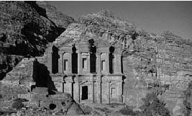
Trilinos Packages: Epetra
Petra: “foundation” (E for “essential”)
Linear Algebra Services
  Communicators: encapsulate parallelism
  Maps: describe distribution of LA objects
  Vectors/multivectors
  Sparse graphs
  Sparse matrices
  Base classes for operators and matrices
  Views and copies

Slide 10
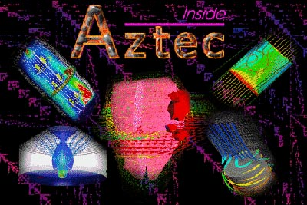
Trilinos Packages: AztecOO
Krylov subspace solvers: CG, GMRES, BiCGStab…
Incomplete factorization preconditioners
Aztec is the workhorse solver at Sandia
  Extracted from MPSalsa reacting flow code
  Dozens of Sandia applications
  1900+ external licenses
AztecOO improves on Aztec by
  Using Epetra objects
  Providing more preconditioners/scalings
  Enabling more sophisticated OO use
AztecOO interfaces allow:
  Continued use of Aztec for functionality
  Introduction of new solver capabilities outside of Aztec

Slide 11
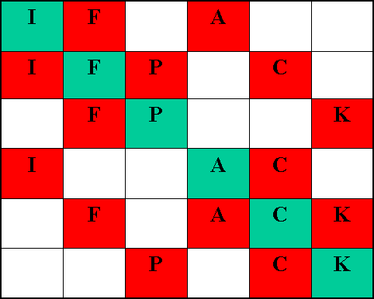
Trilinos Packages: IFPACK
Algebraic preconditioners
Overlapping Schwarz preconditioners with incomplete factorizations, block relaxations, block direct solves
Abstract matrix interface (including Epetra)
Separates graph construction from factorizations
Compatible with AztecOO, ML, Amesos
Can be used by NOX and ML

Slide 12
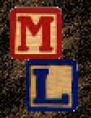
Trilinos Packages: ML
Multi-level preconditioners
  Smoothed aggregation
  Multi-grid
  Domain decomposition
Compatibilities:
  Accepts any implementation of Epetra_RowMatrix
  Implements Epetra_Operator interface . . . AztecOO
Can be used completely independent of other Trilinos packages

Slide 13
Trilinos Packages: Amesos
Distributed sparse direct solvers
Challenge:
  Many third-party direct solvers available
  Different APIs, data formats
  Interface can change with versions
Amesos offers:
  Single, consistent interface
  Common look and feel for all classes
  Separation from specific solver details
  Internal data redistribution
Third-party packages:
  LAPACK, KLU, UMFPACK, SuperLU, SuperLU_DIST, MUMPS, ScaLAPACK, DSCPACK, PARDISO, WSMP

Slide 14
Trilinos Packages: NOX
Suite of nonlinear solution methods
Uses abstract vector and “group” interfaces:
  Allows flexible selection and tuning of directions and line searches
  Abstract vector & group interfaces for Epetra, AztecOO, ML, LAPACK and PETSc
Controlled by flexible parameter list objects

Slide 15
Trilinos Packages: LOCA
Library of Continuation Algorithms
Continuation:
  Zero-order, first-order, arc length
  Multi-parameter, turning point, phase transition
  Pitchfork- and Hopf-bifurcation
Eigenvalue approximation
  ARPACK or Anasazi

Slide 16
Trilinos Packages: EpetraExt
Extensions to Epetra . . . useful, but nonessential
Examples:
  Graph/matrix view extraction
  Zoltan interface
  Sparse transpose
  Singleton removal, static condensation filters
  Overlapped graph constructors
  Graph coloring algorithms
  Matlab, MatrixMarket I/O functions
  Etc…

Slide 17

Trilinos Packages: Anasazi
Eigensolvers written in templated C++
Generic interface to a collection of algorithms
Interfaces are derived from vector and operator base classes

Slide 18

Trilinos Packages: Teuchos
Utility package of useful tools
Includes
  LAPLACK, BLAS wrappers
  Dense matrix & vector classes
  FLOP counters, timers
  Reference-counted pointers
  Parameter lists
Uses
  Templates, STL

Slide 19
Trilinos Packages: Triutils
Trilinos Utilities (intended for test harness, but sometimes useful elsewhere)
  Matrix Galleries
  Command-line parser
  Input file reader

Slide 20
PyTrilinos
Python interface to selected Trilinos packages
  Epetra, AztecOO, IFPACK, ML, Amesos, NOX, LOCA, EpetraExt, TriUtils (and New_Package)
Uses SWIG to generate wrappers
Prerequisites
  Python 2.3 or higher
  Swig 1.3.23 or better
  Numeric
Python build system integrated into Trilinos configure/ make system
  Building Trilinos is not for the compiler-shy
  To build PyTrilinos, simply add --enable-python (or --with-python) to the configure invocation
  Interfaces will be built for enabled packages w/wrappers
  make calls swig and then setup.py (distutils)
  My MakefileVariables module

Slide 21
PyTrilinos.Epetra
from PyTrilinos import Epetra # MPI_Init, MPI_Finalize for MPI builds
comm = Epetra.PyComm() # Epetra.SerialComm or Epetra.MpiComm
size = 4 * comm.NumProc() # Scaled problem size
map = Epetra.Map(size,0,comm) # One of several constructors
v1 = Epetra.Vector(map) # v1 is also a Numeric array!
print v1
v1.Print()
v1.shape = (2,2)
print v1
[ 0. 0. 0. 0.]
MyPID GID Value
0 0 0
0 1 0
0 2 0
0 3 0
[[ 0. 0.]
[ 0. 0.]]

Slide 22
PyTrilinos.Amesos (Triutils, Epetra)
from PyTrilinos import Amesos, Triutils, Epetra
comm = Epetra.PyComm()
gallery = Triutils.CrsMatrixGallery("laplace_2d",comm)
gallery.Set(”nx",100)
gallery.Set(”ny",100)
problem = Epetra.LinearProblem(gallery.GetMatrix(),
gallery.GetStartingSolution(),
gallery.GetRHS() )
factory = Amesos.Factory()
solver = factory.Create("SuperLU", problem)
amesosList = {"PrintTiming" : True, "PrintStatus" : True }
solver.SetParameters(amesosList)
solver.SymbolicFactorization()
solver.NumericFactorization()
solver.Solve()
soln = problem.GetLHS()
print "||x_computed||_2 =", soln.Norm2()

Slide 23
PyTrilinos.AztecOO (and IFPACK)
from PyTrilinos import IFPACK, AztecOO, Triutils, Epetra
comm = Epetra.PyComm()
gallery = Triutils.CrsMatrixGallery("laplace_2d",comm)
gallery.Set(”nx",8)
gallery.Set(”ny",8)
matrix = gallery.GetMatrix(),
lhs = gallery.GetStartingSolution()
rhs = gallery.GetRHS()
IFPACK.PrintSparsity(matrix, "matrix.ps")
solver = AztecOO.AztecOO(matrix, lhs, rhs)
solver.SetAztecOption(AztecOO.AZ_solver, AztecOO.AZ_cg )
solver.SetAztecOption(AztecOO.AZ_precond, AztecOO.AZ_dom_decomp)
solver.SetAztecOption(AztecOO.AZ_subdomain_solve, AztecOO.AZ_ilu )
solver.SetAztecOption(AztecOO.AZ_graph_fill, 1 )
solver.Iterate(50, 1e-5) # Max iteration = 50, tolerance = 1e-5

Slide 24
PyTrilinos Performance vs MATLAB
n | MATLAB | PyTrilinos
10 | 0.00001 | 0.000416
100 | 0.0025 | 0.0357
1000 | 0.0478 | 3.857
CPU sec to fill nxn dense matrix
CPU sec to fill nxn diagonal matrix
CPU sec for 100 MatVecs
n | MATLAB | PyTrilinos
10 | 0.00006 | 0.000159
1000 | 0.00397 | 0.0059
10,000 | 0.449 | 0.060
50,000 | 11.05 | 0.313
100,000 | 50.98 | 0.603
n | MATLAB | PyTrilinos
50 | 0.02 | 0.0053
100 | 0.110 | 0.0288
500 | 3.130 | 1.782
1000 | 12.720 | 7.150

Slide 25
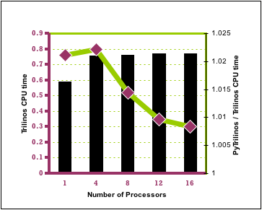
PyTrilinos Performance vs Trilinos
n | Trilinos | PyTrilinos
1000 | 0.010 | 0.15
10,000 | 0.113 | 0.241
100,000 | 0.280 | 1.238
1,000,000 | 1.925 | 11.28
Fine-grained script:
Course-grained script:

Slide 26
PyTrilinos Performance
Some Trilinos packages are designed for users to derive classes from pure virtual base classes
  Epetra_Operator
  Epetra_RowMatrix
  NOX::Abstract::Interface . . .
Numerical kernels (matvecs, nonlinear function evaluations) are therefore written by users
Using PyTrilinos, numerical kernels are therefore written in python (fine-grained . . . bad)
If efficiency is a consideration,
  Use array slice syntax
  Use weave
  Inefficient code is 20-100x slower

Slide 27
Summary
Trilinos is a major software development project at Sandia National Laboratories
  Interoperable, independent, object-oriented, parallel, sparse linear and nonlinear solver packages
  Release 6.0: September, 2005
PyTrilinos provides python access to selected packages
  Numeric compatibility (NumArray?)
  Still in early stages . . . portability, guinea pigs
  Parallelism
  Rapid prototyping
  Unit testing
  Application development

