Slide 1
SciPy Core
(Next Generation Numeric)
Background
Incompatibilities
New Features
  Array Object
  Ufunc Object
  C-API
Outline of SciPy Core
Roadmap for Release
Documentation

Slide 2
Background
Numarray introduced a lot of great features.
Many adopted it. Some needed speed and/or features still only available with Numeric.
Result: Split in the community

Slide 3
Background
I'm bothered by the split:
  Encourages some to go elsewhere (Ruby?)
  Discourages the development of something like SciPy: things have to be developed twice....
Solution: Add the features introduced by numarray to Numeric and call the result SciPy Core.

Slide 4
SciPy Core
The new Numeric (Numeric 24.0 is the last Numeric).
scipy_core is the package name of the replacement (module name is scipy and scipy.<xxxxx>)
Core package includes all that Numeric did (linear algebra, FFT's, random numbers, masked arrays, matrices).

Slide 5
SciPy Core
Does not rely on Fortran code.
Easy to install (need more platforms to test to make sure this is true).
A super-enhanced replacement for Numeric.
Contains the features of numarray so both camps can come together.

Slide 6
Incompatibilities
There is a little bad news --> code will need some adapting to run with the new scipy core distribution.
Nearly all of the changes are search-and replace.
There is a script called convertcode.py to help.

Slide 7
Importing changes
  Numeric, Mlab, Matrix --> scipy
  FFT --> scipy.fftpack
  LinearAlgebra --> scipy.linalg
  RandomArray --> scipy.stats
  RNG --> scipy.stats
  MA --> scipy.ma
  multiarray --> scipy.base.multiarray
  umath --> scipy.base.umath

Slide 8
Method Changes
typecode() --> dtypechar
iscontiguous() --> flags['CONTIGUOUS']
byteswapped() --> byteswap()
itemsize() --> itemsize
spacesaver() gone
savespace() gone
flat --> .ravel() (mostly)

Slide 9
Other Changes
Typecodes
  'c' --> 'S1'
  'b' --> 'B'
  '1' --> 'b'
  's' --> 'h'
  'w' --> 'H'
  'u' --> 'I'
typecode= keywords changed to dtype=
savespace= keyword replaced with fortran=

Slide 10
New Features
There is a lot of great news!!!
Core SciPy is more powerful than Numeric (and numarray)
Core SciPy should have little speed hit over Numeric
  100% faster in select parts
  5-15% slower in others
  Needs more testing and benchmarking.

Slide 11
New Features: Arrays
Standard arrays inherit from a new bigarray that does not use sequence protocol or buffer protocol.
The bigarray can be as large as platform memory allows (no 32-bit limit on 64-bit platform)
Very new addition.... Needs testing.

Slide 12
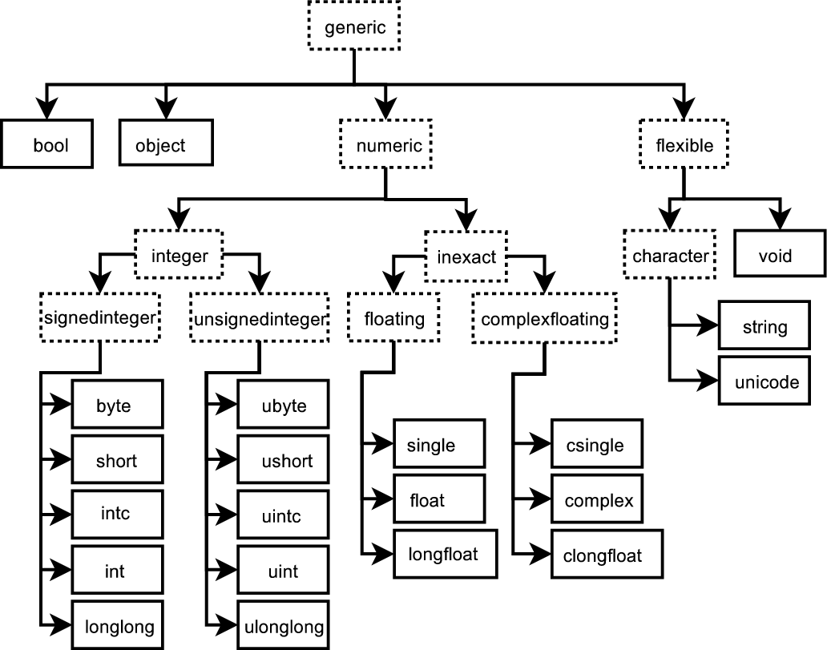
New Features: Arrays
  There are now 21 different data types (10 integers, 3 float, 3 complex, 1 bool, 1 object, 3 flexible).

Slide 13
New Features: Arrays
Flexible data types
  String, Unicode, Void
  Can have any itemsize.
  Void can represent any C-structure
Data types are true Python types in a hierarchy of types.
Data types are all type objects of new Python scalars (21 of them).

Slide 14
New Features: Arrays
Many methods on arrays instead of just functions.
    .tofile(file, sep='', format='') method and fromfile function
    dump, dumps, __reduce__, __setstate__
    view, getfield, setflags
    reshape, resize, transpose, swapaxes, flatten, ravel, squeeze, take, put, putmask, repeat, choose, where, sort, argsort, searchsorted, nonzero, compress, diagonal, trace, max, argmax, min, argmin, ptp, clip, conj, sum, cumsum, prod, cumprod, mean, std, all, any, sign, round

Slide 15
New Features: Arrays
Many new attributes (which reveal and/or modify the array itself) more clearly distinguished from methods
    flags : arrays can be misaligned, swapped, and in Fortran order.
    strides, ndim, data, size, itemsize, base
    dtype, dtypenum, dtypechar, dtypestr
    real, imag, flat

Slide 16
New Features: Arrays
Fancy Indexing
  Can use standard slice based indexing
  Can use Boolean mask
  Can use integer indexing sequences
  Can combine slices and integer indexing sequences.
  All the flexibility of numarray, plus..

Slide 17
New Features: UFuncs
Coercion rules altered for mixed scalar / array operations
Needed coercion uses temporary buffers whose size is user controlled.
Control on local, module, builtin scope.

Slide 18
New Features: UFuncs
Errors are handled using IEEE floating point status flags.
divbyzero, under, over, invalid can be individually set to ignore, warn, raise, and call.
Flexibility on local, module, builtin level for handling these errors.
Can define a call back function for error handling.

Slide 19
New Features: UFuncs
ufunc reduce, accumulate, and reduceat can take place using a different type then the array type (without entire-array being copied).
output arrays passed in can be of different data type, then the input.
Arbitrary classes with __array__, __array_wrap__, and __array_priority__ can be passed into and returned from ufuncs.

Slide 20
New Features: UFuncs
UFuncs can be created from Python functions.
Ufuncs have several attributes which including doc strings which include their calling syntax.
    nin, nout, nargs, ntypes, types, identity
New ufuncs: (frexp, modf, ldexp, isnan, isfinite, isinf, signbit)

Slide 21
New Features: C-API
More functionality available from compiled code
More macros available for structure access
New iterator objects make it easy to handle discontiguous arrays.
No magic function lists in C-code. All needed functions are part of data type descriptor.

Slide 22
Overview of SciPy Core
scipy (contains namespace of scipy.base plus a few select functions)
scipy.base (ndarray and ufunc)
scipy.lib
  .lapack_lite
  .fftpack_lite
  .random_lite
scipy.linalg
scipy.fftpack
scipy.stats

Slide 23
Overview of SciPy Core
scipy.distutils
Modules not under scipy package structure but included in the distribution:
  f2py
  weave

Slide 24
Roadmap to Release
Try to released Beta by the end of SciPy 2005 conference.
Configuration needs the most work (so it can install on every platform desired).
Records array and masked arrays need a little work.
linalg, fftpack, stats need some grooming.
Bugs fixed and optimizations.

Slide 25
Documentation
Guide to Scipy (www.trelgol.com).
Can be pre-ordered for discount to get current version.
Full version available (hopefully) by the end of October.
Released under a MBDR for maximum of 7 years, and a minimum of how long it takes to sell about 10,000 copies.

Slide 26
Where to get it
Current version is on svn.scipy.org under a branch of the scipy_core package.
  http://svn.scipy.org/svn/scipy_core/branches/newcore

