Slide 1

Enstaller
Egg Package Installation Management
Travis N. Vaught
8/17/2006

Slide 2
Overview
Browse egg package repositories
Install/uninstall egg-based packages
GUI, (command-line and script interfaces coming soon)
Development in early stages

Slide 3
How is this different from easy_install?
Ability to browse repositories of available packages and show dependencies for each package before installing
Support for a wider variety of eggs
  Non-python packages (SWIG, MinGW, etc.)
  Post-install scripts
Egg making just by pointing to a dir -no setup.py needed (coming soon…)

Slide 4
How to Get Enstaller
Download enhanced Python 2.4.3 msi—includes small script called after installation of Python completes. This script bootstraps the other components needed for Enstaller (by installing the appropriate eggs, of course)
or…
Download the run_enstaller.py script and run it with Python 2.4 to bootstrap the GUI.
Both available at: http://code.enthought.com/enthon/enstaller.shtml

Slide 5
Enstaller GUI
Uses
  wxPython
  Traits/TraitsUI
  setuptools

Slide 6
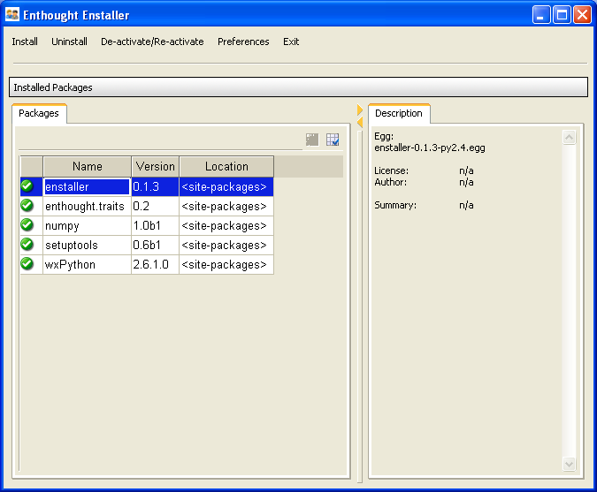

Slide 7
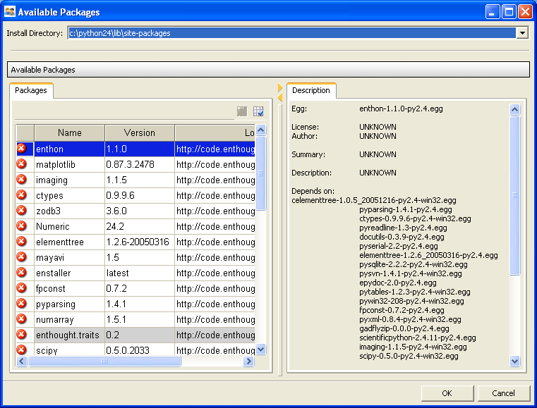

Slide 8
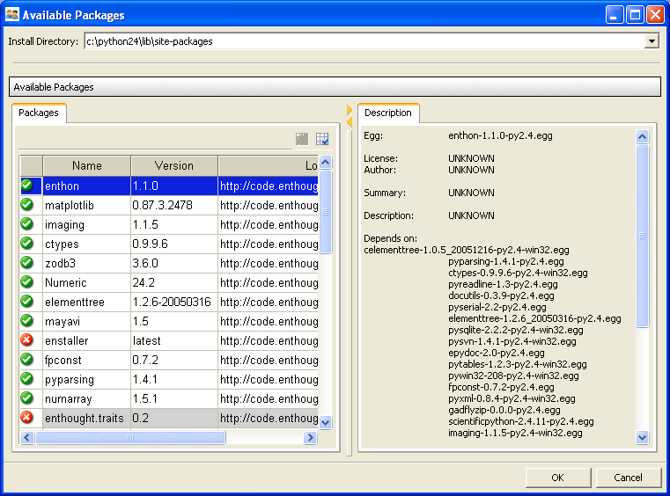

Slide 9
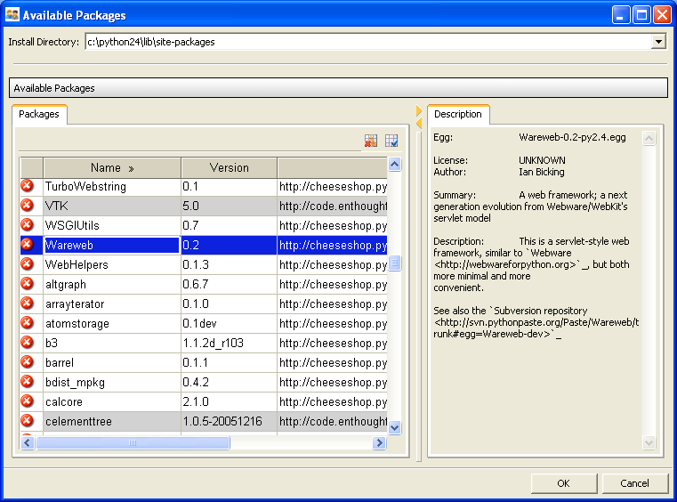

Slide 10
What’s on the horizon?
More Linux eggs
Egg-making (hen) functionality
Command line and scripting interfaces
Support for authenticated repository access
Improved uninstall
Follow the progress at:
  http://enthought.com/enthought/wiki/Enstaller

Slide 11
Acknowledgement
Enstaller Author: Rick Ratzel, Enthought
Direct all issues to rlratzel@enthought.com
or visit the enthought trac:
http://www.enthought.com/enthought
(and assign a ticket to Rick
sub-project: Enstaller)

