Slide 1
Cooking with Sloan
Evidence for Asteroid Space Weathering
Jordan Raddick
The Johns Hopkins University
American Astronomical Society summer meeting
Calgary, AB

Slide 2
Outline
Welcome and introduction
Set the table
Introduce the kitchen
Gather the ingredients
Enjoy the feast

Slide 3
Welcome
Purpose: Teach how to use SDSS data access tools for research
Rationale: Best to learn in specific context
Focus: Specific research questions
  Rediscover recent interesting findings
Method: Interactive demo
  Ask questions
  Follow along on your laptop
Mood: fun

Slide 4
Scientific problems
Asteroid weathering
  Nesvorny et al. 2005
Hypervelocity stars
  Brown et al. 2006
Color-magnitude diagram for galaxies
  Baldry et al. 2004
Measuring the Hubble constant
  Hubble 1929

Slide 5
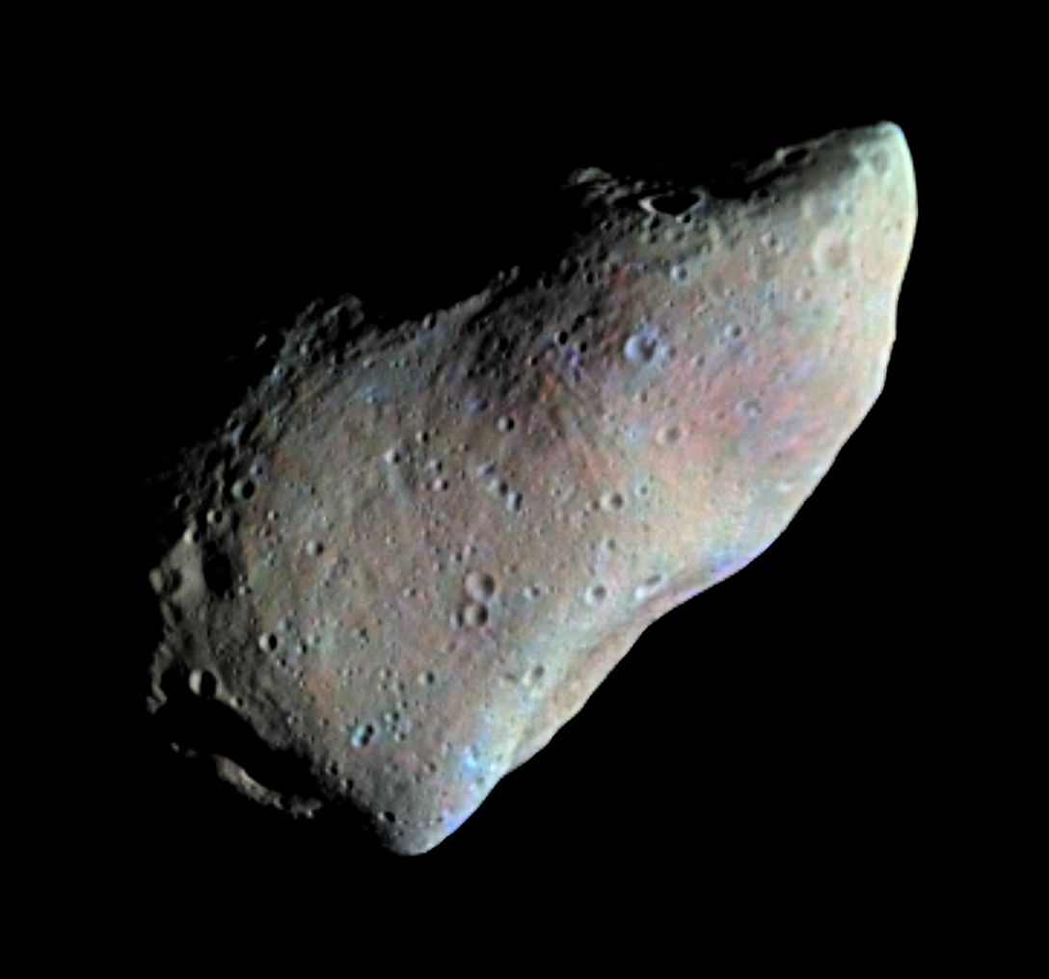
The Problem
How does the space environment change objects?
  Micrometeroite impacts
  Solar wind
  Cosmic rays
Any airless body
  Moon
  Asteroids

Slide 6
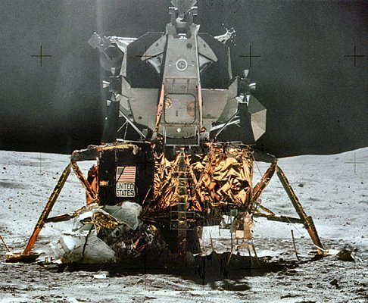
Research Strategies
Take samples
  Apollo
Look from close-up
  Galileo
  NEAR Shoemaker
Look through a telescope
  But then you need a large
  sample
  We’ll get a sample with SDSS

Slide 7
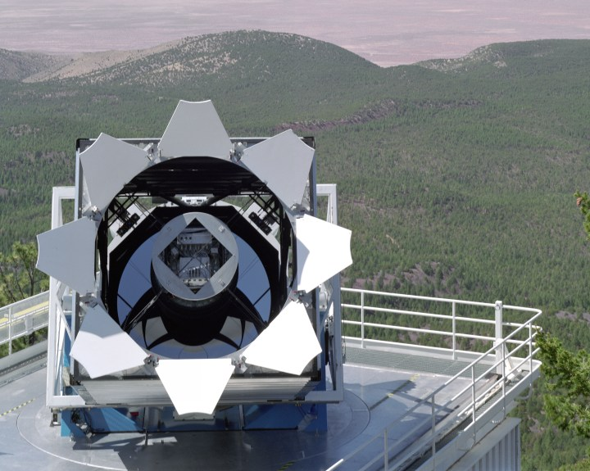
Introducing the SDSS

Slide 8
Participating Institutions
The American Museum of Natural History
Astrophysical Institute Potsdam
University of Basel
Cambridge University
Case Western Reserve University
University of Chicago
Drexel University
Fermilab
The Institute for Advanced Study
The Japan Participation Group
Johns Hopkins University
The Joint Institute for Nuclear Astrophysics
The Kavli Institute for Particle Astrophysics and Cosmology
The Korean Scientist Group
The Chinese Academy of Sciences (LAMOST)
Los Alamos National Laboratory
The Max-Planck-Institute for Astronomy (MPIA)
The Max-Planck-Institute for Astrophysics (MPA)
New Mexico State University
Ohio State University
University of Pittsburgh
University of Portsmouth
Princeton University
The United States Naval Observatory
The University of Washington
(there are a lot of us)

Slide 9
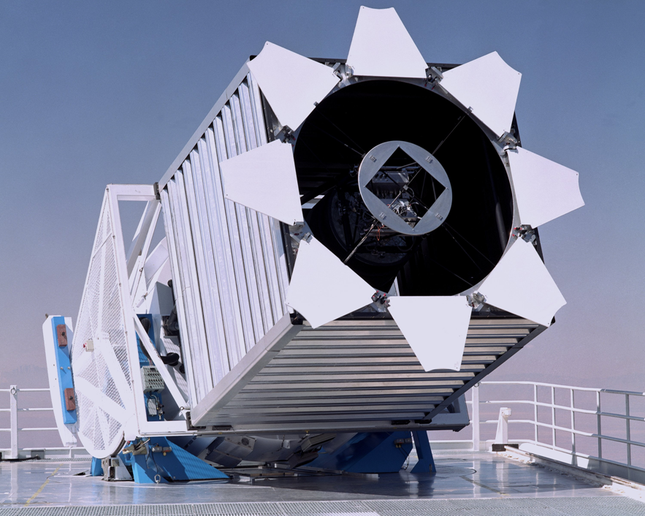
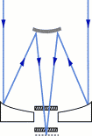
The Telescope
2.5 meter F/5 reflector
Very wide
(~3 degree)
field of view
Alt-az mount
Drift scanning

Slide 10
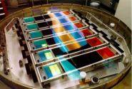
The Camera
CCD Imaging
  30 chips
  2048 x 2048 pixels
  Arranged in six
  columns
Five rows for five
filters: u, g, r, i, z
54 second exposure
time in each filter

Slide 11
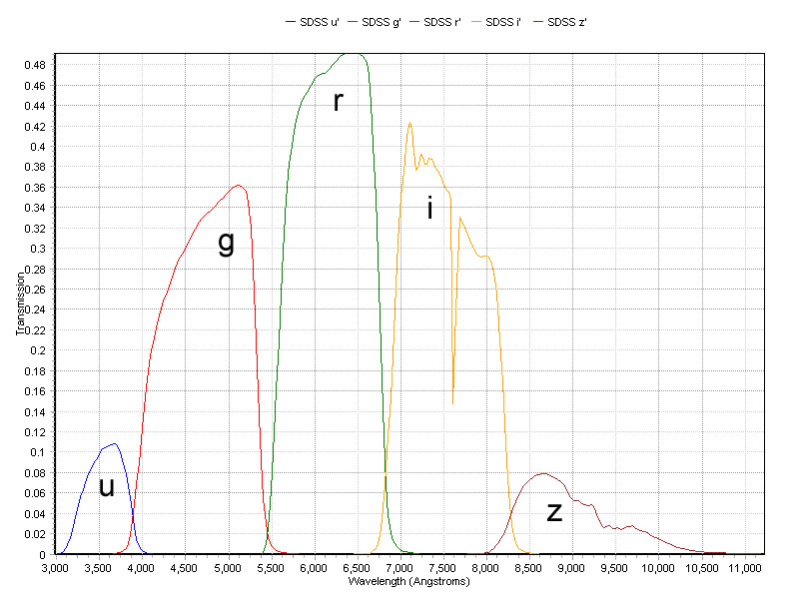
Filter Profiles

Slide 12
Spectral Target Selection
All galaxies brighter than g < 17.77
A luminous red galaxy sample
Quasar Candidates
  “stars” with unusual colors
Objects with VLA FIRST or ROSAT matches

Slide 13
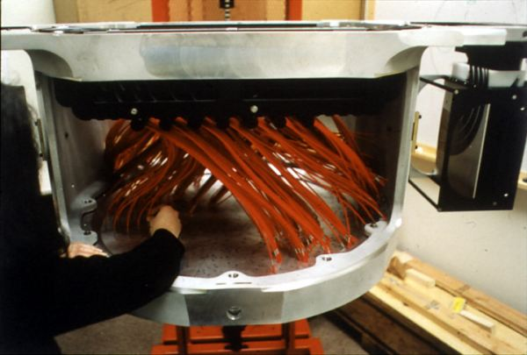
Spectrographs
Two fiber-fed spectrographs
Telescope tracks stars with plug plate in focal plane
Records
640 spectra
simultaneously

Slide 14
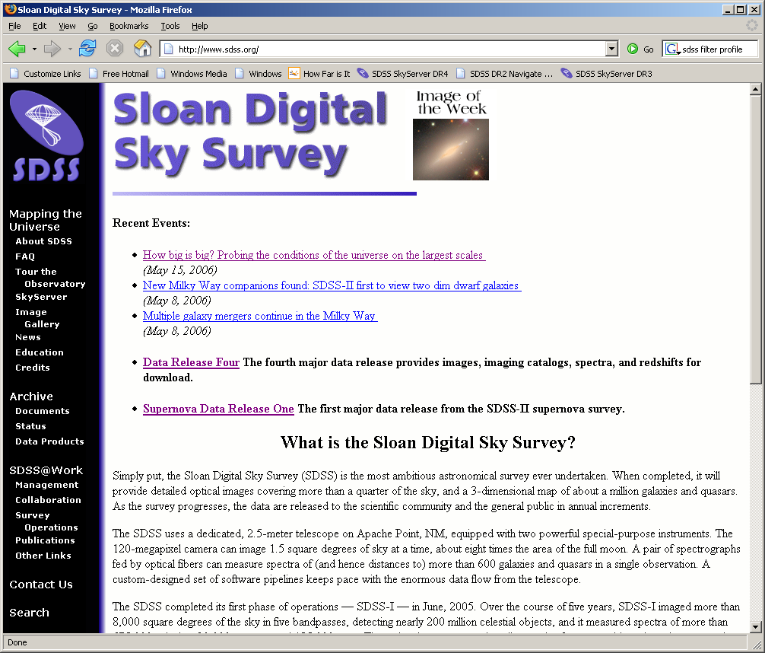
Let’s start cooking…
Go to
www.sdss.org
Read News
See Education
Click on
Data Release 4

Slide 15
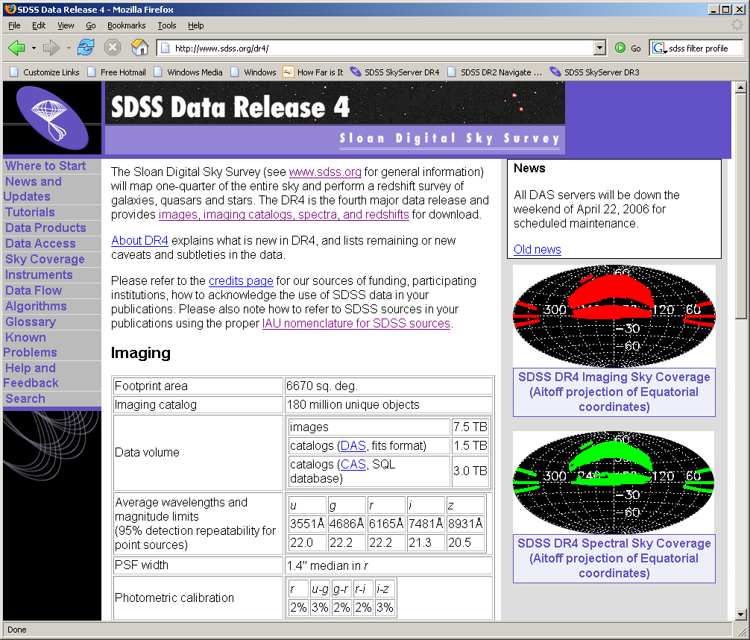
Demo of DR4 site

Slide 16
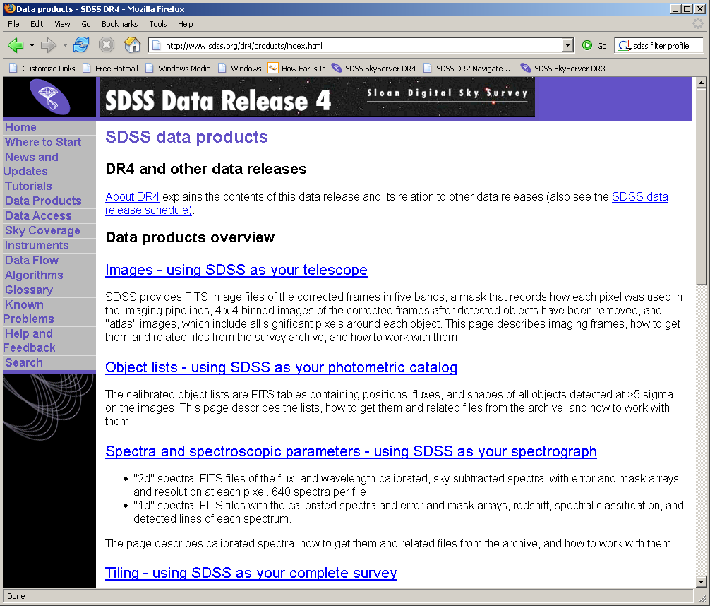
Data Products

Slide 17
Data Access Methods
Data Archive Server (DAS)
  http://das.sdss.org/DR4/data/ (or replace with DRx)
  All the FITS data
  Accessible via rsync, wget
Catalog Archive Server (CAS)
  http://cas.sdss.org/
  All the catalog data (i.e. numbers)
  Back end: MS SQL Server database management
Two distinct sites, both hosted at Fermilab
We’ll focus on the CAS

Slide 18
Why use databases?
Tycho Brahe’s notebooks
  lifetime of work (1570-1601)
  About 500 kB
POSS – 1950s
  About 10 GB
SDSS – today
  3 TB
LSST – 2012
  5 PB or more

Slide 19

Today’s tools, tomorrow’s data
You can…
  GREP 1 MB in 1 second, FTP for < 1¢
  GREP 1 GB in 1 minute, FTP for $1
  GREP 1 TB in 2 days, FTP for $1,000
  GREP 1 PB in 3 years, FTP for
  $1,000,000
  …and 1 PB is 5,000 disks

Slide 20
Large-database science
Data in a database
Bring tools to data, not data to tools
Link data to literature

Slide 21
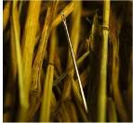
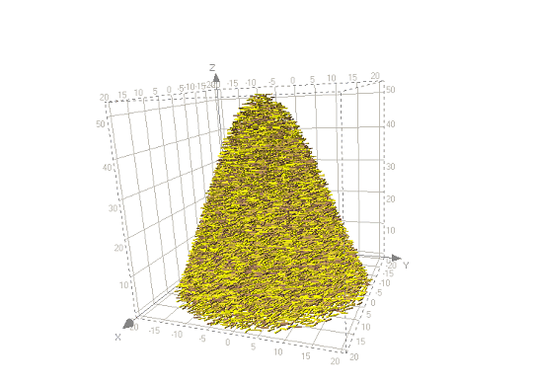
Types of Problems
Needles in haystacks
  Brown dwarfs
  Higgs particle
  Disease-causing genes
Haystacks
  Dark matter
  Dark energy
  Protein folding models
Needles are easier!
Our problem is a bit of
both

Slide 22
Let’s see some asteroids…
Go to Catalog Archive Server (CAS)
  Click “CAS” link on SDSS DR4 site
  Go to http://cas.sdss.org
  Go to www.google.com, type “CAS SDSS”
Notice Projects – great for your teaching!
Important: click “For Astronomers”
  Now the site is optimized for you

Slide 23
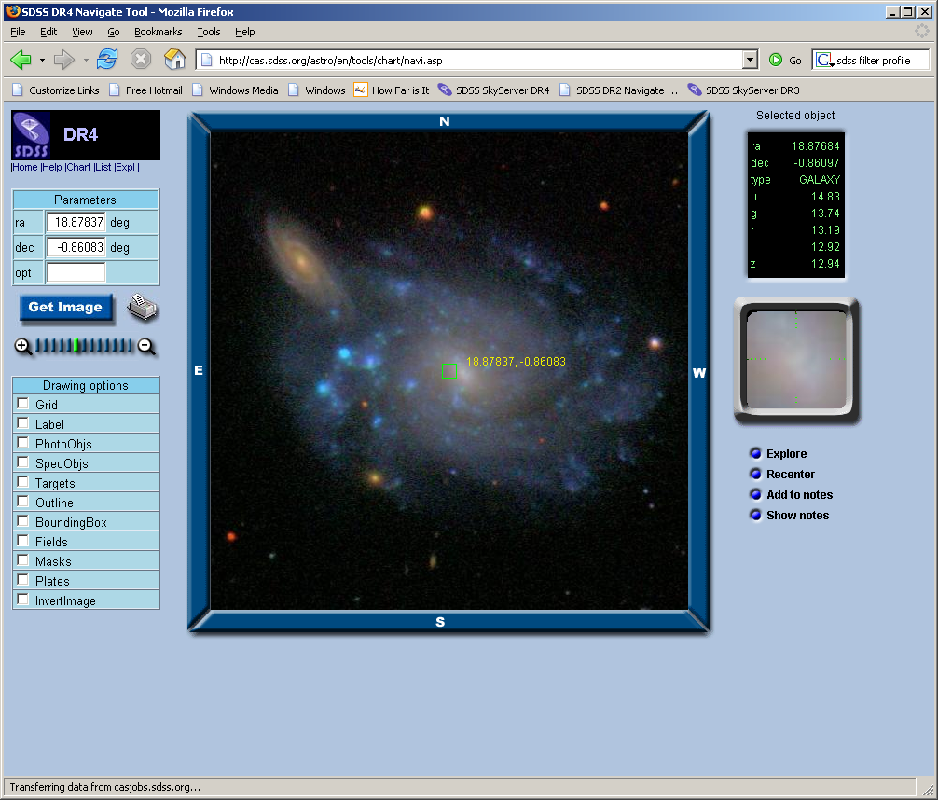
Browse for Asteroids
http://cas.sdss.org/astro/
Click on “Navigate”
Mapquest-like
interface
Click on any
object for data
Online notebook

Slide 24
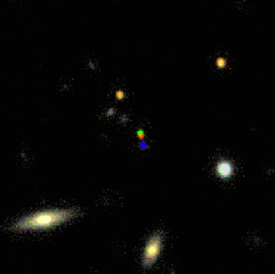
Asteroids in the SDSS
Each SDSS filter scans for
54 sec
During that time, the
asteroid moves a little
Color JPGs made with
g, r, i filter images
  Mapped to RGB
So you see 3 (sometimes 2) colored dots
Check RA = 178.535, Dec = 0.188

Slide 25
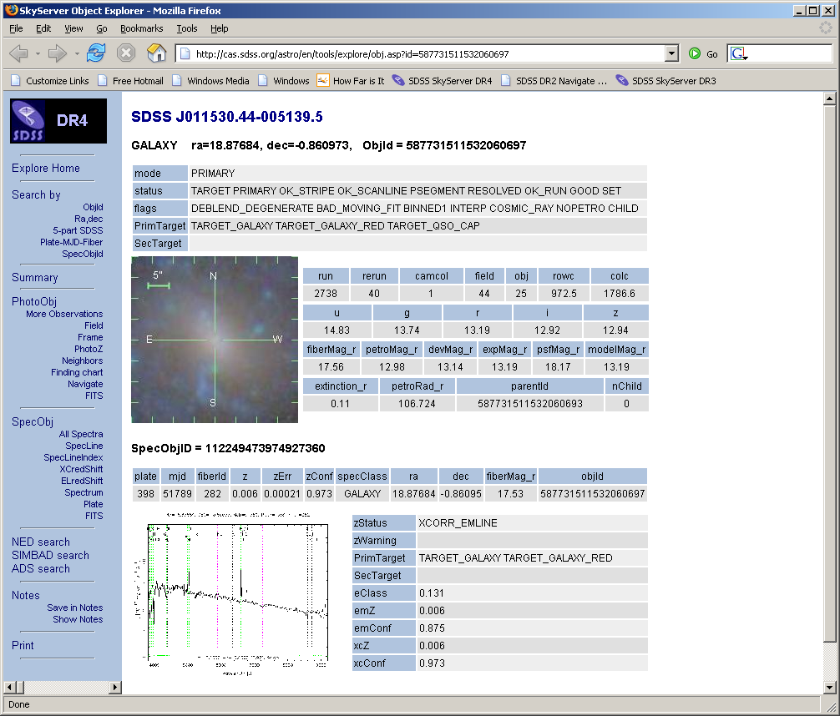
Explore an Asteroid
Summary of
image data and
(if available)
spectral data
Links to
complete data
Get FITS of
images (5 filters),
spectrum

Slide 26
Explore an Asteroid
Links to NED,
SIMBAD, ADS
Links to
multiple SDSS
observations
Print

Slide 27
Special Asteroid Data
PhotoObj -> Flags ->
OBJECT_DEBLENDED_AS_MOVING
MOVED
PhotoObj ->
  rowv, colv
  rowvErr, colvErr

Slide 28
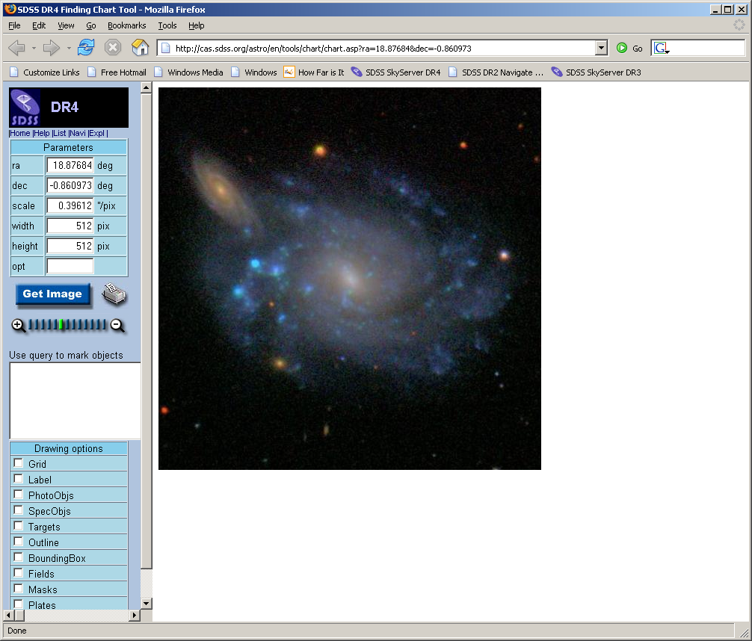
You could observe it…
Click image to go
to Finding Chart
Enter ra, dec,
scale (arcsec /
pixel), image
width
Print (inverted)
Point your
telescope!

Slide 29
But It’s Gone!

Slide 30
Searching the Database
Repeat as many times as you need to
But… there are hundreds of thousands of asteroids!
How do you search the database?

Slide 31
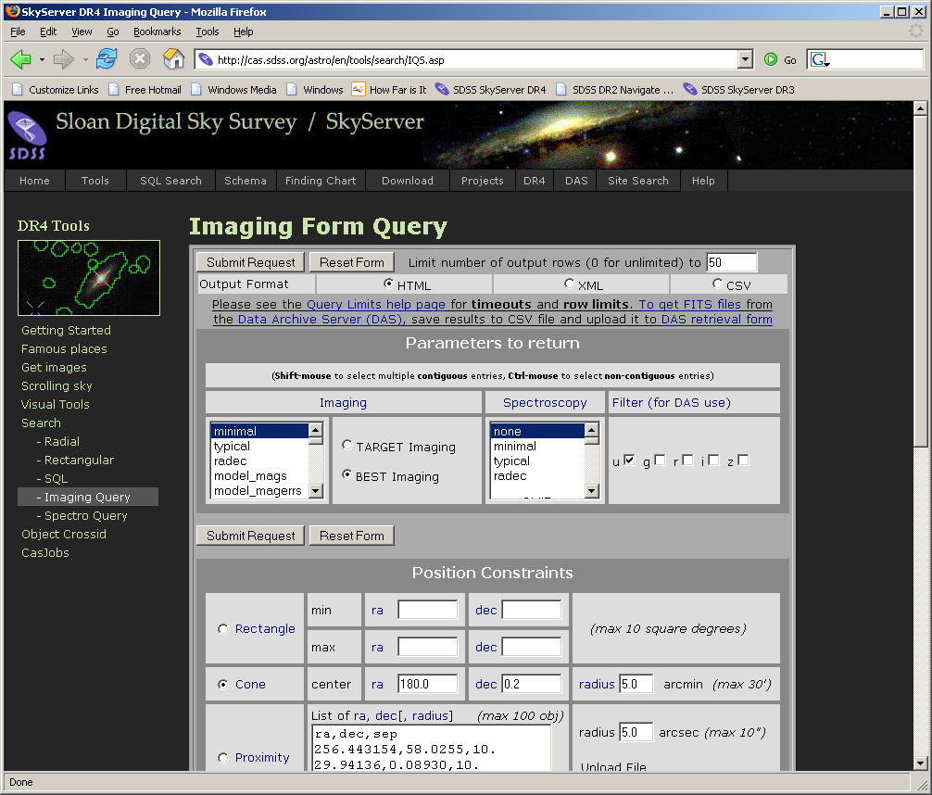
Imaging Query

Slide 32
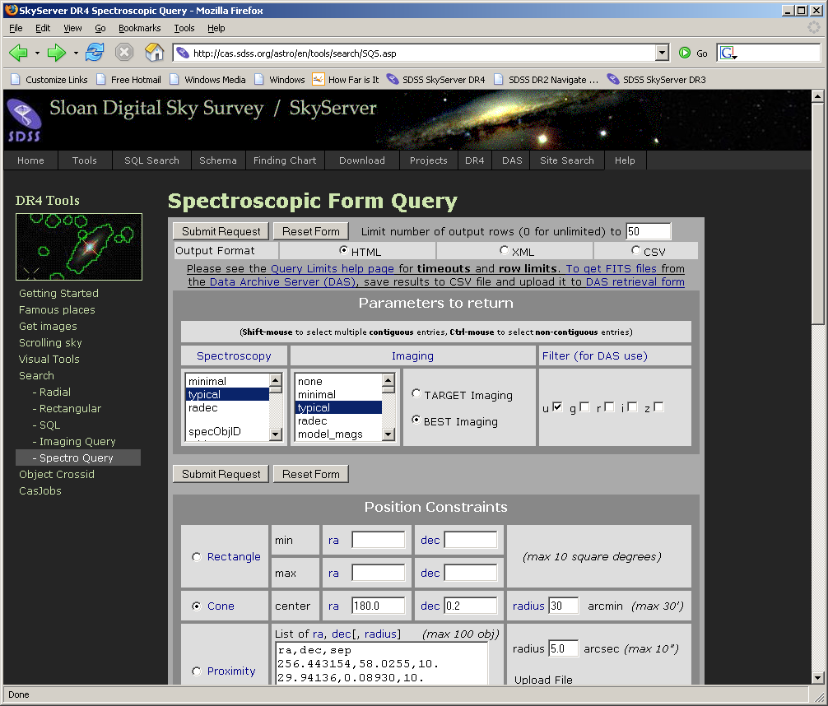
Spectro Query

Slide 33
SQL Searching
SQL – Structured Query Language
  Common database access language
  Industry standard (not just astronomy)
Allows advanced searches (“queries”) of data
Search using constraints on any variable
Return any or all types of data

Slide 34
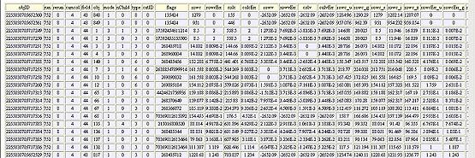
SQL Concepts
Data are stored in a database
Similar data types are stored in tables
  photoObj (photometry), specObj (spectroscopy), etc.
A VERY small part of the photoObj table:

Slide 35
SQL Concepts
Within a table:
  Horizontal rows are individual data points, or records
  Vertical columns are types of data, or columns
A request to a database to return data is called a query
Queries usually request data that meets certain constraints

Slide 36
SQL as a foreign language
Languages have grammar and vocabulary
Dutch grammar
  With modal verb, auxiliary verb goes at the end
English:
  I want TO SEE star positions.
Dutch:
  Ik wil de posities van de sterren ZIEN.

Slide 37
SQL Grammar
Select – choose which columns of data you want to see
From – choose the table(s) from which you want to retrieve data
Where – set constraints on the search

Slide 38
Dutch vocabulary
INFINITIVE | PAST | PAST PART. | MEANING
beginnen | begon, begonnen | begonnen | to begin
begrijpen | begreep, begrepen | begrepen | to understand
bieden | bood, boden | geboden | to offer

Slide 39
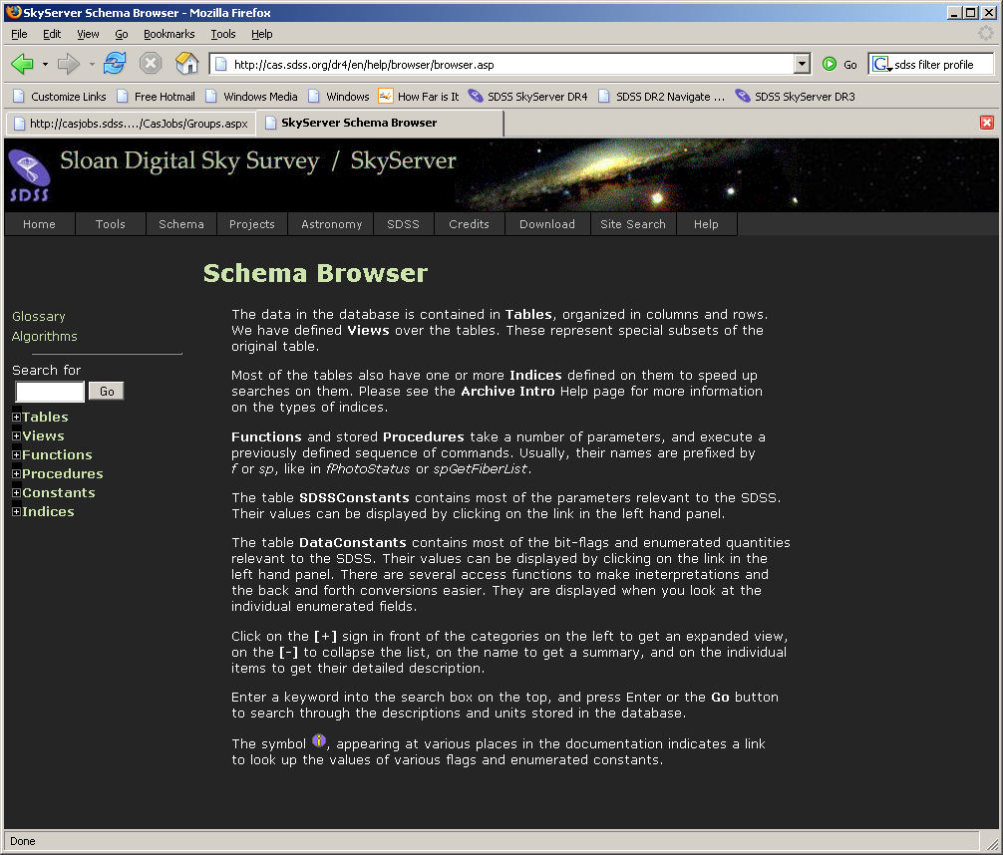
SQL Vocabulary

Slide 40
Translations
English:
  I want to see positions of 15th magnitude stars.
Dutch:
  Ik wil de posities van de 15de magnitude sterren zien.
SQL:
  select ra, dec
  from star
  where r between 15 and 16

Slide 41
SQL Help Resources
See Help link on SkyServer
  Introduction to SQL
  How-to -> Searching for Data
  Sample SQL Queries
  Query Limits
To submit a query, go to Tools -> Search -> SQL Search

Slide 42
Asteroid Query
  SELECT
  objID, sqrt( power(rowv,2) + power(colv, 2) ) as velocity
  FROM
  PhotoObj
  WHERE
  (power(rowv,2) + power(colv, 2)) > 50 arcmin/day
  AND rowv >= 0
  AND colv >=0
  AND (flags & 0x0000000100000000) > 0

Slide 43
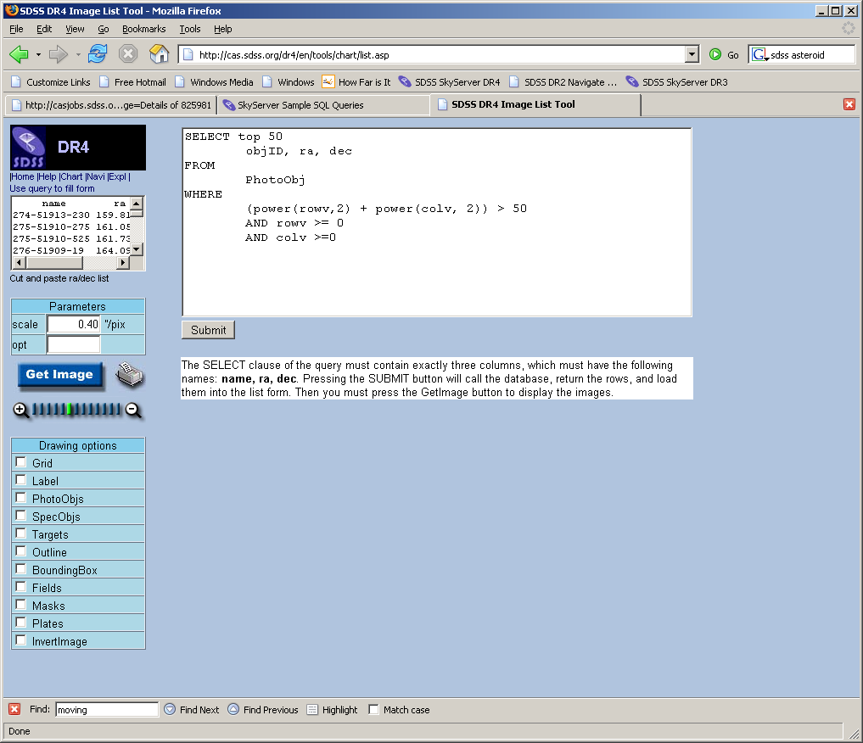
First, a sanity check…
Advanced Tools ->
Image Lists
Use query to fill
form
Two changes
  Add “TOP 50”
  Select block must
  be ONLY
  name, ra, dec

Slide 44
But…
But the query takes too long to run!
We need to find another approach

Slide 45
Moving Object Catalog (MOC)
By Zeljko Ivezic (U. of Washington) et al
Available to all:
  http://www.astro.washington.edu/ivezic/sdssmoc/sdssmoc.html
  Or Google “SDSS MOC”
From Data Release 3 (note: not 4, but 4 is coming…)
n = 204,305

Slide 46
Moving Object Catalog (MOC)
Contains:
  Unique Moving Object ID
  RA, dec, MJD at time of observation
  Observed Magnitudes (ugriz and VB)
Identifications available for 67,637 (33%)
  Number and designation
  Osculating elements
  Proper elements (if known)

Slide 47
Moving Object Catalog (MOC)
Available as
  Gzipped DAT file from web site
  Table in CasJobs (as of Friday)
CasJobs…

Slide 48
CasJobs
Advanced Tools -> CasJobs
  Best method for fairly long, complex queries
  Personal user DB (MyDB)
  Quick mode: 1 minute cutoff (don’t need to register)
  Register for…

Slide 49
CasJobs
Advanced Tools -> CasJobs
  Submit mode: up to 8 hours in “long” queue
  MyDB database to save results of your queries
    Define your own functions, procedures
    Share tables with collaborators (groups)
  Job history, plotting, FITS/CSV/VOTable output

Slide 50
Back to asteroid weathering…
Strategy:
  Find asteroid families (groups likely formed by a single large impact event)
  Find families by looking for similar proper elements
  Estimate age of each family
  Find optimum colors for classifying and comparing asteroids
  Graph age vs. optimum color

Slide 51
Viewing the MOC
Let me know if you want access
I’ll invite you
Click Groups
Accept the Invitation
Click Query
Set context to MyDB
Search “group.valueadded.DR3_MOC”

Slide 52
Finding asteroid families
Search proper elements
  Orbital elements stable for millions of years
  Found through n-body simulations of orbits
  Proper semimajor axis (aprime)
  Proper eccentricity (eprime)
  Sin of proper inclination (sin_iprime)
  Graph proper eccentricity vs. proper semimajor axis

Slide 53

CasJobs Options
View data
(preview)
Query your MyDB (just like SDSS tables)
  Change context to “MyDB”
Job shows how table was created
Plot creates a simple x-y plot
Download lets you download data
  CSV, FITS, XML
Neighbors lets you search around each object

Slide 54
CasJobs Options
Publish lets you
share table with
colleagues (see Groups feature)
Rename
Drop (delete)

Slide 55
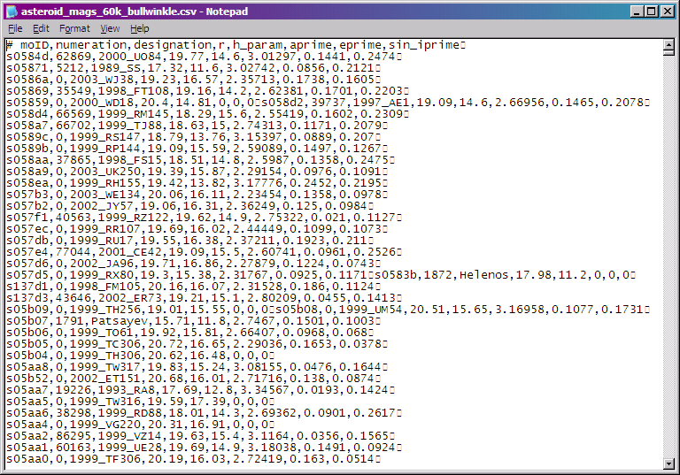
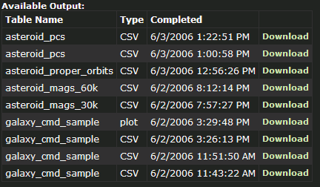
Download Table
I’ll get it as CSV

Slide 56
Plot Results
Use your favoruite program
I used Excel
The plot is…

Slide 57
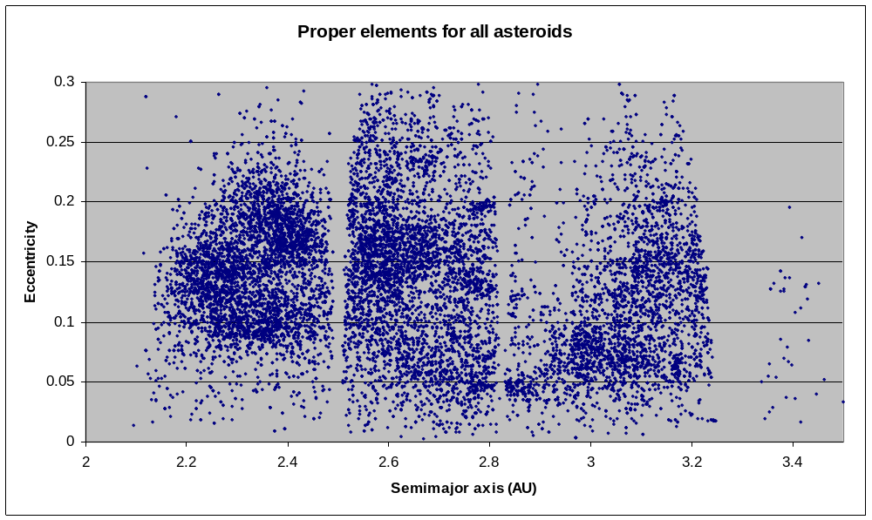
Finding asteroid families

Slide 58
Finding optimum colors
Look at all colors from u,g,r,i,z filters
Find fewest number of orthogonal base colors
“Principal Component Analysis”
PC₁ = 0.396(u-g) + 0.553(g-r) + 0.567(g-i) + 0.465(g-z)
PC₂ = -0.819(u-g) + 0.017(g-r) + 0.09(g-i) + 0.567(g-z)

Slide 59
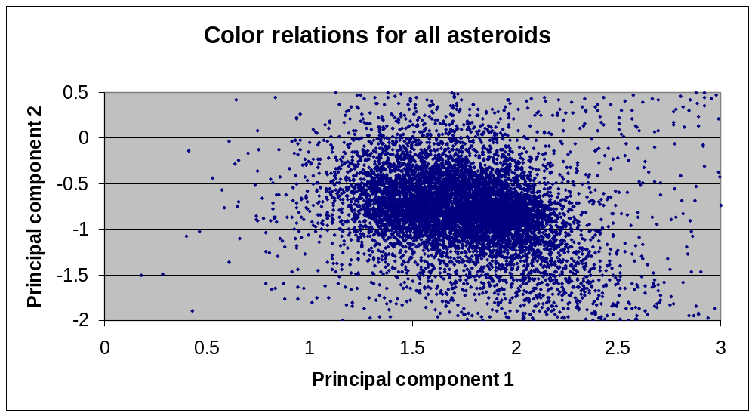
Optimum Colors
Note: not corrected for solar colors

Slide 60
Significance of PCs
PC1 is proxy for spectral slope (0.35 to 0.9 µm)
PC2 is related to spectral curvature
So let’s look at PCs as a function of age

Slide 61
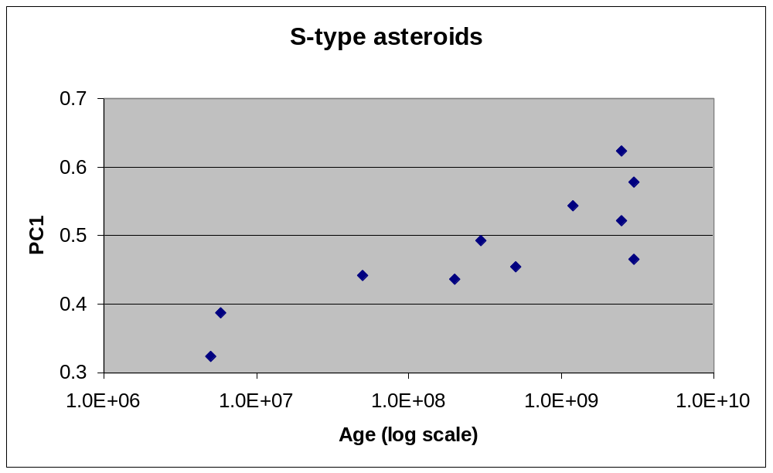
S-Type (stony) Asteroids
Note: large error bars

Slide 62
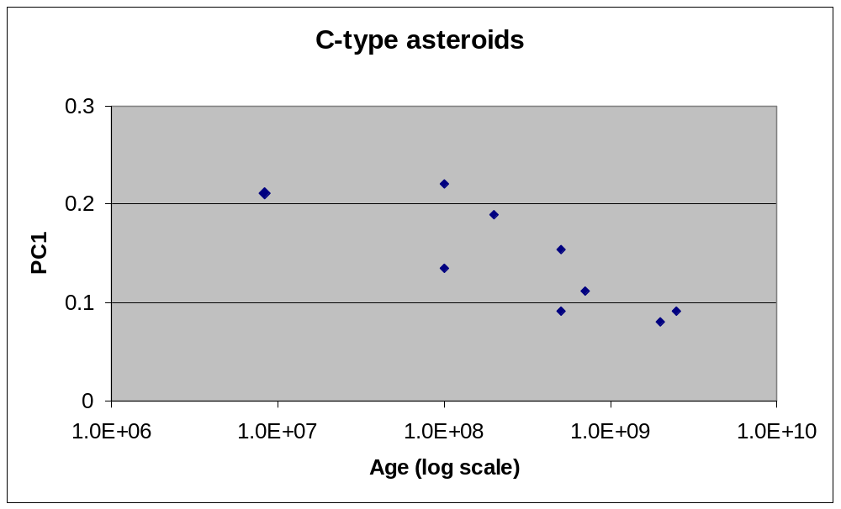
C-Type (carbonaceous)
Note: large error bars, trend not statistically significant

Slide 63
Results
We have shown change of spectral properties with age
Not a compositional effect – see paper
  832 Karin family formed from breakup of object in 158 Koronis family
  We know this from orbit backtracking
  But Karin family has totally different colors!
Conclusion: impact event exposed fresh terrain in Karin family, which is now being weathered

Slide 64
Further questions
How does reflectivity change with age?
Why do S-type and C-type trend in opposite directions?
Can color someday be used to find age?

Slide 65
Tips
Use astronomers’ site
  All tools linked directly from main page
  More generous query limits (timeouts, row limits)
  Imaging/Spectro form query
Each release has separate sites
  http://cas.sdss.org/DR4/ (current site)
  http://cas.sdss.org/DR3/ … etc…
Teach yourself SQL by modifying sample queries

Slide 66
Tips
Use CasJobs for anything complex
Use Image List to sanity-check your queries
Start with simple problems, learn more complex features later

Slide 67
For more help
E-mail the SDSS Helpdesk
  sdss-helpdesk@fnal.gov
Or talk to any SDSS person here

Slide 68

Bon Appétit!

