Slide 1
Cooking with Sloan
Color-Magnitude Diagram for Galaxies
Jordan Raddick
The Johns Hopkins University
American Astronomical Society summer meeting
Calgary, AB

Slide 2
Outline
Welcome and introduction
Set the table
Introduce the kitchen
Gather the ingredients
Enjoy the feast

Slide 3
Welcome
Purpose: Teach how to use SDSS data access tools for research
Rationale: Best to learn in specific context
Focus: Specific research questions
  Rediscover recent interesting findings
Method: Interactive demo
  Ask questions
  Follow along on your laptop
Mood: fun

Slide 4
Scientific problems
Asteroid weathering
  Nesvorny et al. 2005
Hypervelocity stars
  Brown et al. 2006
Color-magnitude diagram for galaxies
  Baldry et al. 2004
Measuring the Hubble constant
  Hubble 1929

Slide 5
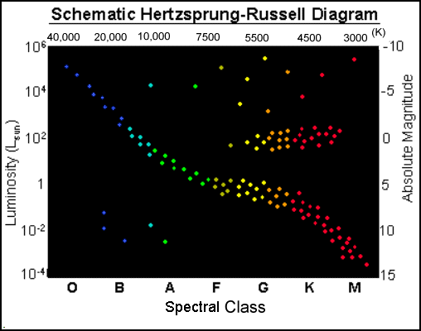
The Problem
Color-magnitude
diagram of stars
  Well-understood
  Unlocked mysteries of
  stellar evolution
Picture for galaxies
not so clear

Slide 6
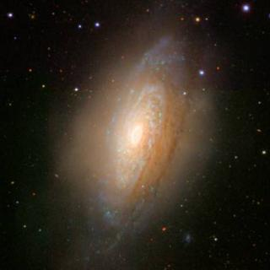
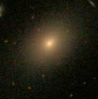
The Problem
So how do we make progress?
One approach: morphology
But hard to get morphology of many small faint galaxies

Slide 7
One Solution
Get a representative sample
  all galaxies in a certain magnitude range
Let’s try that approach with the SDSS

Slide 8
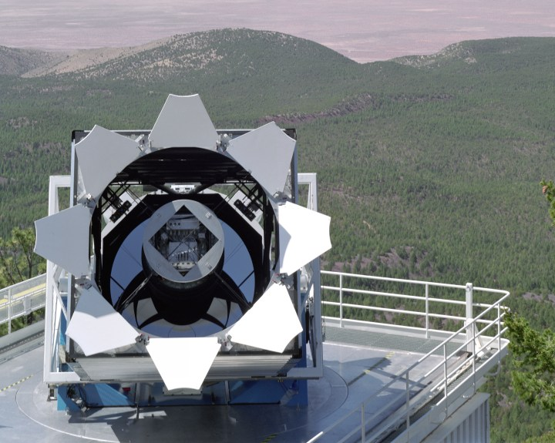
Introducing the SDSS

Slide 9
Participating Institutions
The American Museum of Natural History
Astrophysical Institute Potsdam
University of Basel
Cambridge University
Case Western Reserve University
University of Chicago
Drexel University
Fermilab
The Institute for Advanced Study
The Japan Participation Group
Johns Hopkins University
The Joint Institute for Nuclear Astrophysics
The Kavli Institute for Particle Astrophysics and Cosmology
The Korean Scientist Group
The Chinese Academy of Sciences (LAMOST)
Los Alamos National Laboratory
The Max-Planck-Institute for Astronomy (MPIA)
The Max-Planck-Institute for Astrophysics (MPA)
New Mexico State University
Ohio State University
University of Pittsburgh
University of Portsmouth
Princeton University
The United States Naval Observatory
The University of Washington
(there are a lot of us)

Slide 10
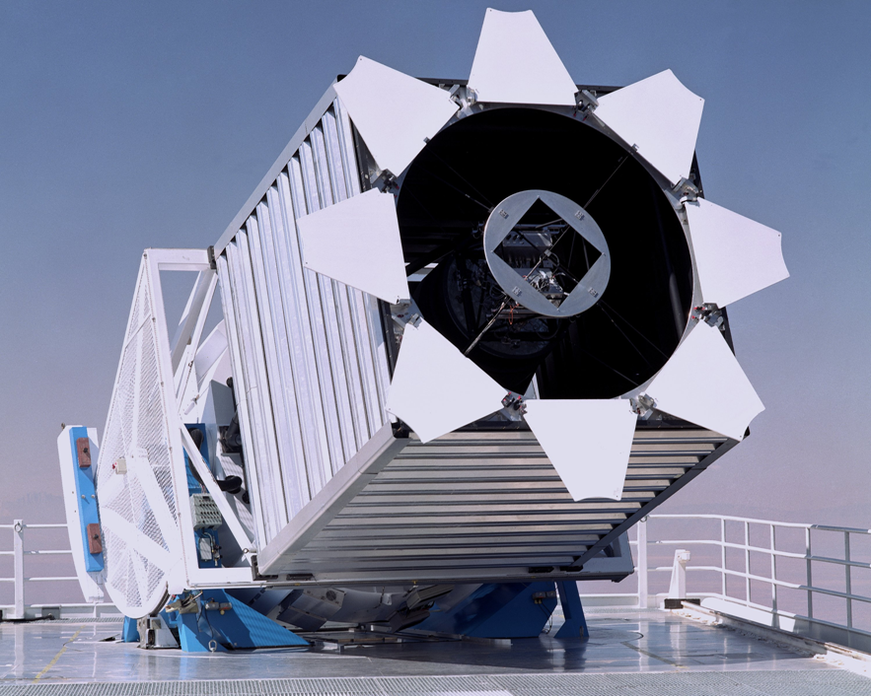
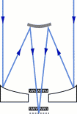
The Telescope
2.5 meter F/5 reflector
Very wide
(~3 degree)
field of view
Alt-az mount
Drift scanning

Slide 11
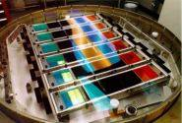
The Camera
CCD Imaging
  30 chips
  2048 x 2048 pixels
  Arranged in six
  columns
Five rows for five
filters: u, g, r, i, z
54 second exposure
time in each filter

Slide 12
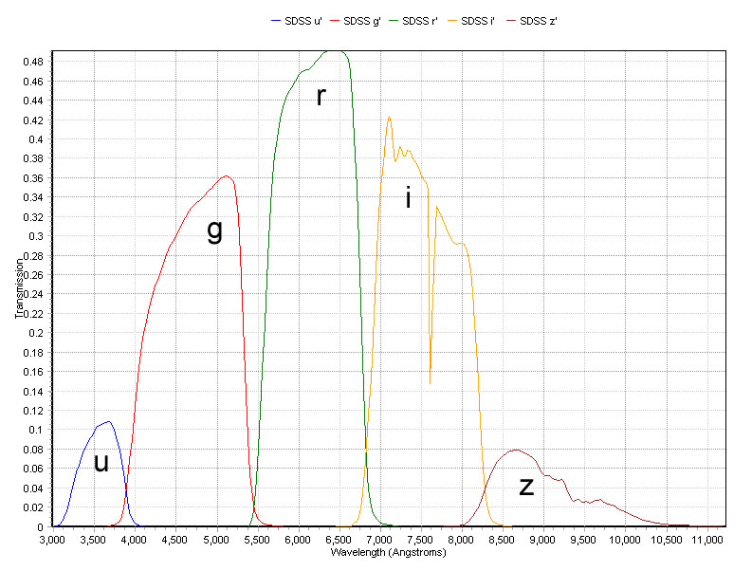
Filter Profiles

Slide 13
Spectral Target Selection
All galaxies brighter than g < 17.77
A luminous red galaxy sample
Quasar Candidates
  “stars” with unusual colors
Objects with VLA FIRST or ROSAT matches

Slide 14
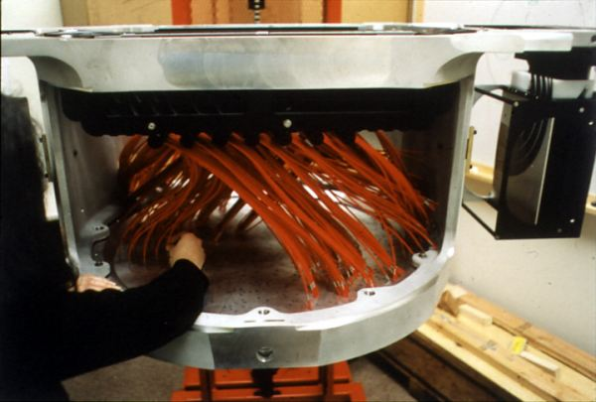
Spectrographs
Two fiber-fed spectrographs
Telescope tracks stars with plug plate in focal plane
Records
640 spectra
simultaneously

Slide 15
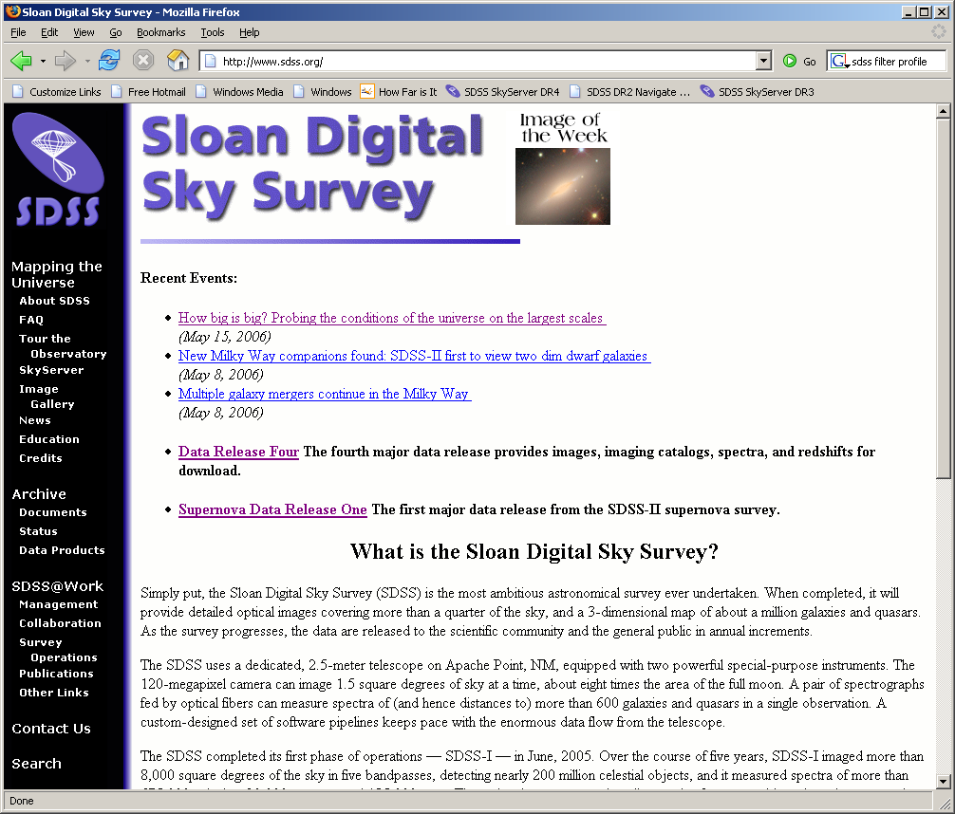
Let’s start cooking…
Go to
www.sdss.org
Read News
See Education
Click on
Data Release 4

Slide 16
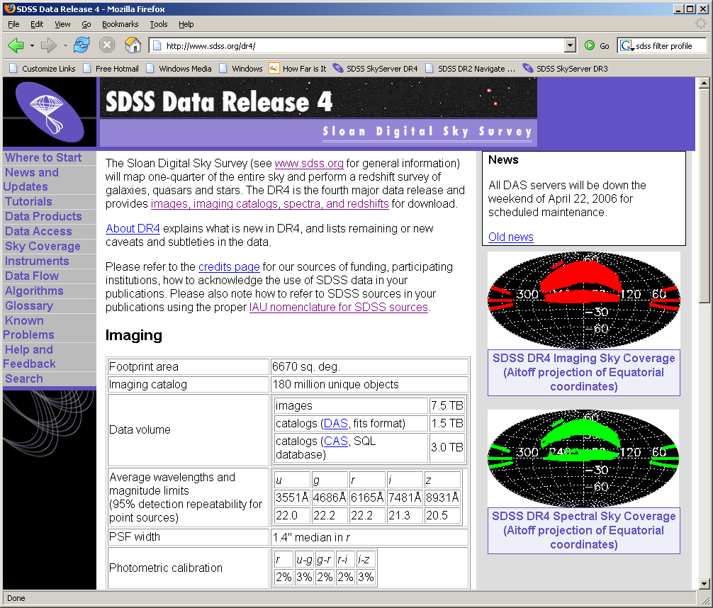
Demo of DR4 site

Slide 17
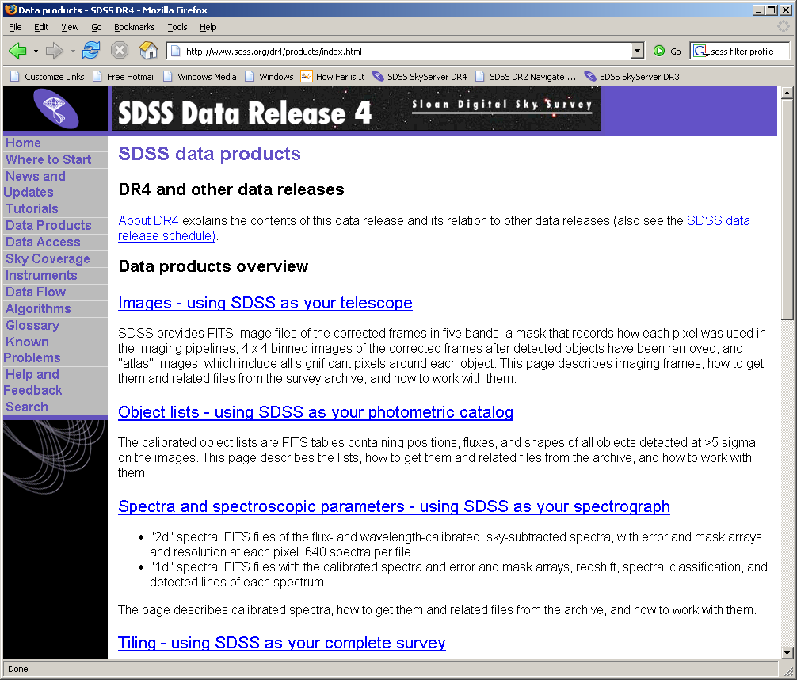
Data Products

Slide 18
Data Access Methods
Data Archive Server (DAS)
  http://das.sdss.org/DR4/data/ (or replace with DRx)
  All the FITS data
  Accessible via rsync, wget
Catalog Archive Server (CAS)
  http://cas.sdss.org/
  All the catalog data (i.e. numbers)
  Back end: MS SQL Server database management
Two distinct sites, both hosted at Fermilab
We’ll focus on the CAS

Slide 19
Why use databases?
Tycho Brahe’s notebooks
  lifetime of work (1570-1601)
  About 500 kB
POSS – 1950s
  About 10 GB
SDSS – today
  3 TB
LSST – 2012
  5 PB or more

Slide 20

Today’s tools, tomorrow’s data
You can…
  GREP 1 MB in 1 second, FTP for < 1¢
  GREP 1 GB in 1 minute, FTP for $1
  GREP 1 TB in 2 days, FTP for $1,000
  GREP 1 PB in 3 years, FTP for
  $1,000,000
  …and 1 PB is 5,000 disks

Slide 21
Large-database science
Data in a database
Bring tools to data, not data to tools
Link data to literature

Slide 22
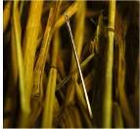
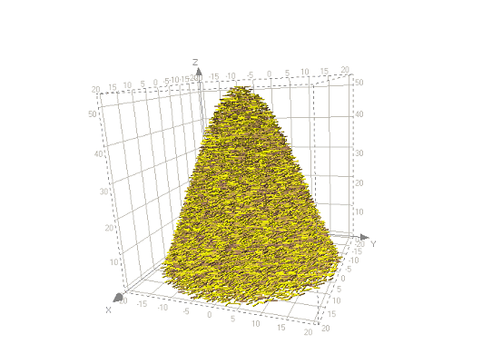
Types of Problems
Needles in haystacks
  Brown dwarfs
  Higgs particle
  Disease-causing genes
Haystacks
  Dark matter
  Dark energy
  Protein folding models
Needles are easier!
Our problem is “haystack”

Slide 23
Let’s see some galaxies…
Go to Catalog Archive Server (CAS)
  Click “CAS” link on SDSS DR4 site
  Go to http://cas.sdss.org
  Go to www.google.com, type “CAS SDSS”
Notice Projects – great for your teaching!
Important: click “For Astronomers”
  Now the site is optimized for you

Slide 24
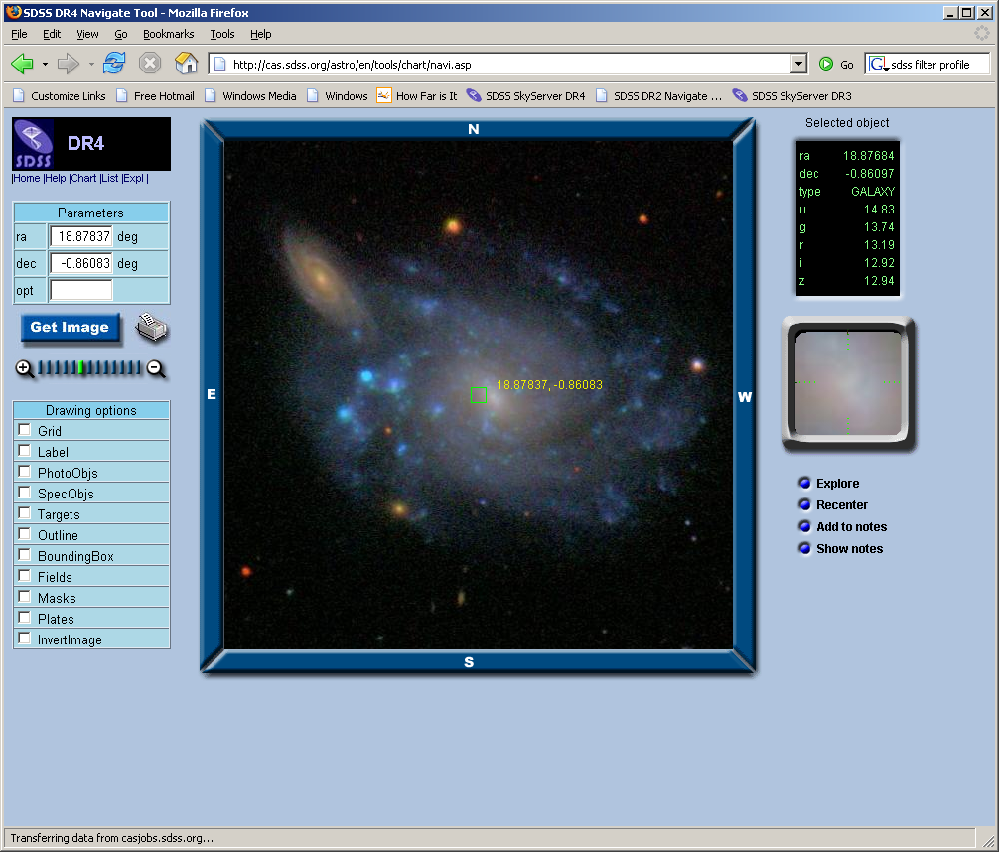
Browse for Galaxies
http://cas.sdss.org/astro/
Click on “Navigate”
Mapquest-like
interface
Click on any
object for data
Online notebook
Click “Explore”

Slide 25
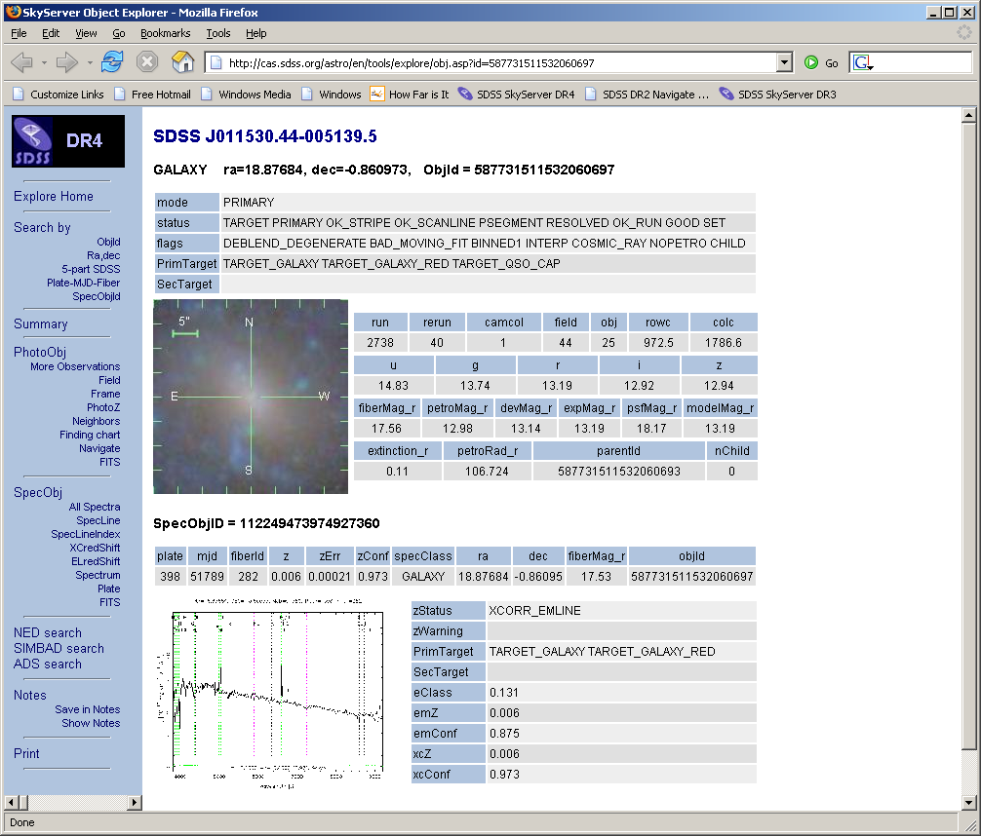
Explore a Galaxy
Summary of
image data and
(if available)
spectral data
Links to
complete data
Get FITS of
images (5 filters),
spectrum

Slide 26
Explore a Galaxy
Links to NED,
SIMBAD, ADS
Links to
multiple SDSS
observations
Print

Slide 27
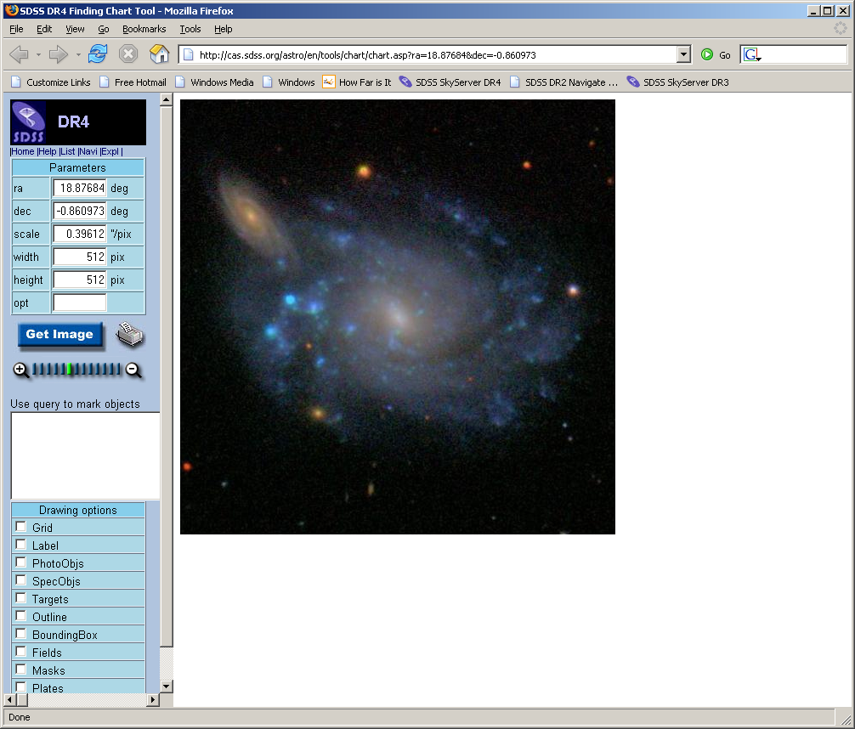
Observe this Galaxy
Click image to go
to Finding Chart
Enter ra, dec,
scale (arcsec /
pixel), image
width
Print (inverted)
Point your
telescope!

Slide 28
Searching the Database
Repeat as many times as you need to
But… there are 100 million galaxies!
How do you search the database?

Slide 29
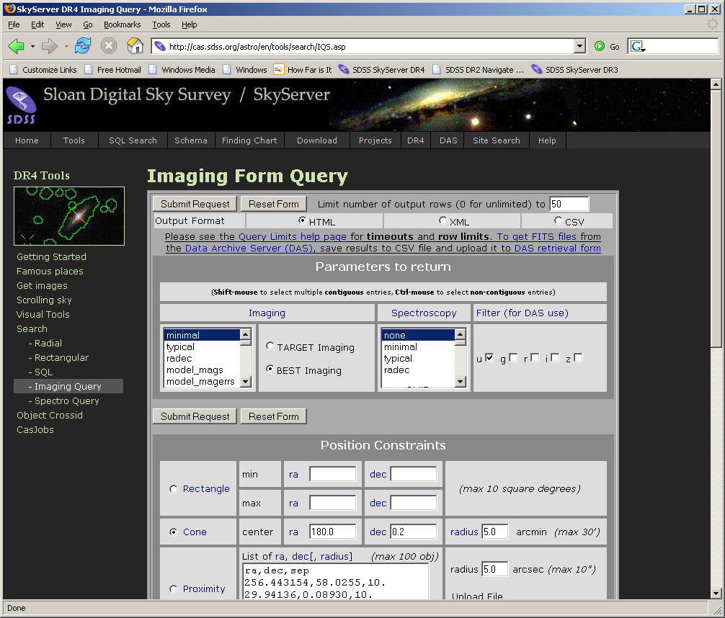
Imaging Query

Slide 30
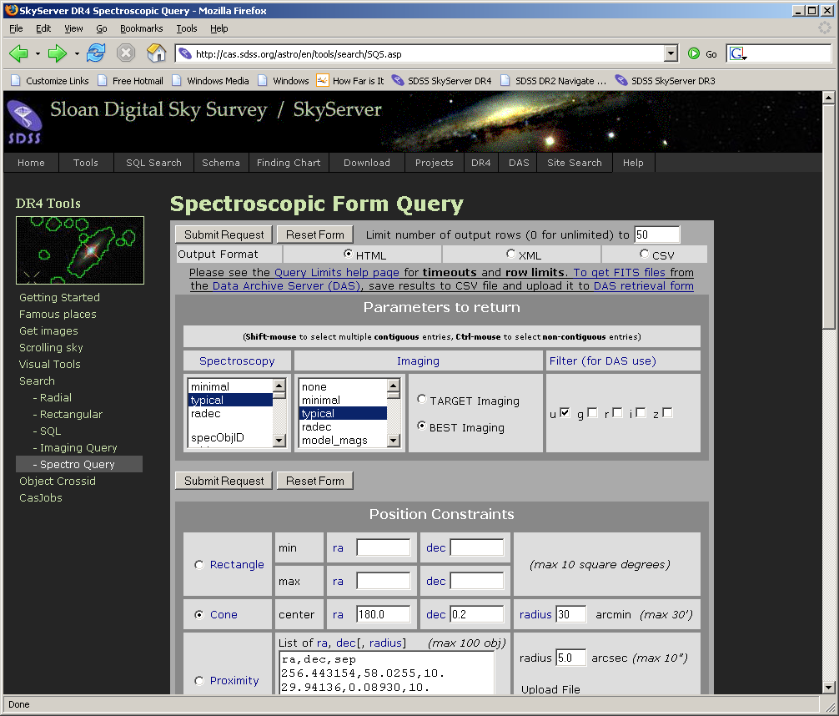
Spectro Query

Slide 31
Searching for Galaxies
Constraints from Baldry et al (2004):
  Clean photometry (not NOPROFILE, PEAKCENTER, NOTCHECKED, PSF_FLUX_INTERP, SATURATED, or BAD_COUNTS_ERROR, DEBLEND_NOPEAK, or COSMIC_RAY)
  Spectra available
  In main galaxy sample (primTarget = GALAXY but not GALAXY_RED)

Slide 32
Searching for Galaxies
Constraints from Baldry et al (2004):
  13.5 < r < 17.77
  0.004 < z < 0.08
  z_{conf} > 0.35
  -23.5 < M_{r} < -15.5*
  *to simplify, let’s assume Hubble cosmology:
  -23.5 < r - 5*log10(4.27E+08*z) < -15.5
  Wait… you can’t specify that in the IQS!

Slide 33
SQL Searching
SQL – Structured Query Language
  Common database access language
  Industry standard, so students have practical advantages to learning
Allows advanced searches (“queries”) of data
Search using constraints on any variable
Return any or all types of data

Slide 34
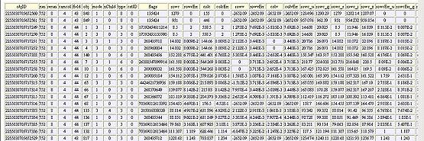
SQL Concepts
Data are stored in a database
Similar data types are stored in tables
  photoObj (photometry), specObj (spectroscopy), etc.
A VERY small part of the photoObj table:

Slide 35
SQL Concepts
Within a table:
  Horizontal rows are individual data points, or records
  Vertical columns are types of data, or columns
A request to a database to return data is called a query
Queries usually request data that meets certain constraints

Slide 36
SQL as a foreign language
Languages have grammar and vocabulary
Dutch grammar
  With modal verb, auxiliary verb goes at the end
English:
  I want TO SEE star positions.
Dutch:
  Ik wil de posities van de sterren ZIEN.

Slide 37
SQL Grammar
Select – choose which columns of data you want to see
From – choose the table(s) from which you want to retrieve data
Where – set constraints on the search

Slide 38
Dutch vocabulary
INFINITIVE | PAST | PAST PART. | MEANING
beginnen | begon, begonnen | begonnen | to begin
begrijpen | begreep, begrepen | begrepen | to understand
bieden | bood, boden | geboden | to offer

Slide 39
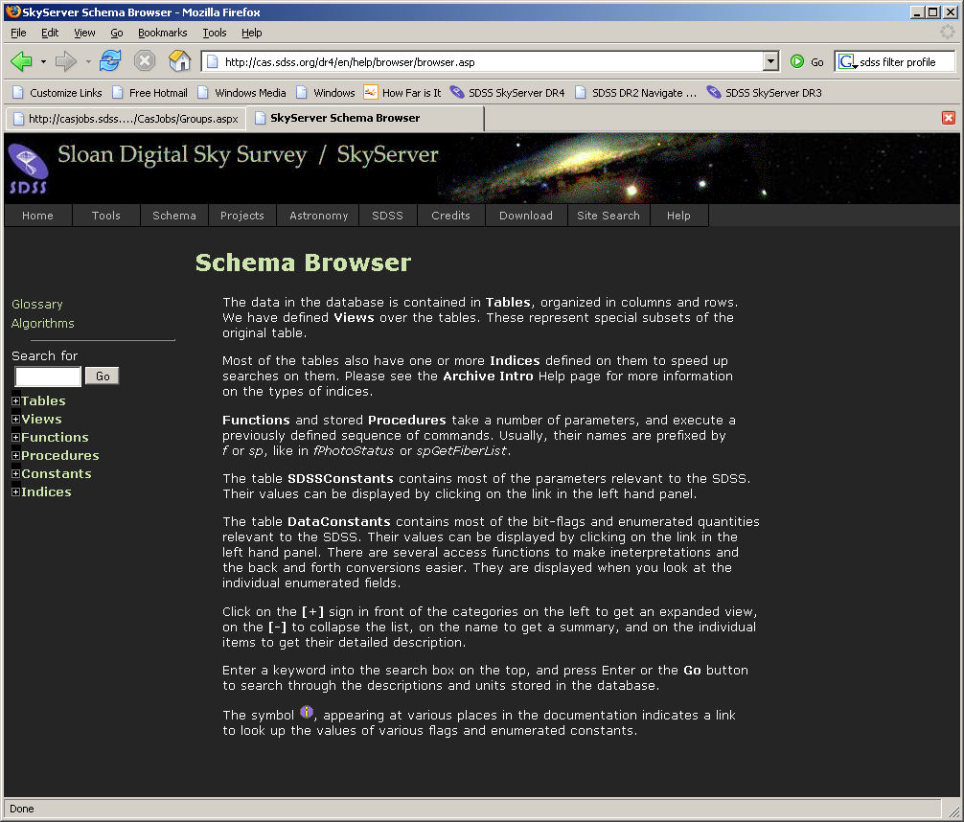
SQL Vocabulary

Slide 40
Translations
English:
  I want to see positions of 15th magnitude stars.
Dutch:
  Ik wil de posities van de 15de magnitude sterren zien.
SQL:
  select ra, dec
  from star
  where r between 15 and 16

Slide 41
SQL Help Resources
See Help link on SkyServer
  Introduction to SQL
  How-to -> Searching for Data
  Sample SQL Queries
  Query Limits
To submit a query, go to Tools -> Search -> SQL Search

Slide 42
Galaxy CMD Query
select
objid,ra,dec,
modelmag_u,modelmag_g,modelmag_r,modelmag_i,modelmag_z,
z,4.27E+3*z as d_hubble_mpc,
modelmag_u-modelmag_r as u_minus_r,
modelmag_r-5*log10(4.27E+8*z) as abs_mag_r
from
specphoto
where
specclass=2
AND modelmag_r between 13.5 and 17.7
AND ((flags & 0x10000000) != 0)
AND ((flags & 0x8100000c00a0) = 0)
AND (((flags & 0x400000000000) = 0) or (psfmagerr_g <= 0.2))
AND (((flags & 0x100000000000) = 0) or (flags & 0x1000) = 0)
AND (primtarget & 0x00000040) > 0
AND (primtarget & 0x00000020) = 0
AND zConf > 0.35
AND z BETWEEN 0.004 and 0.08
AND modelmag_r - 5*log10(4.27E+08*z) BETWEEN -23.5 and -15.5

Slide 43
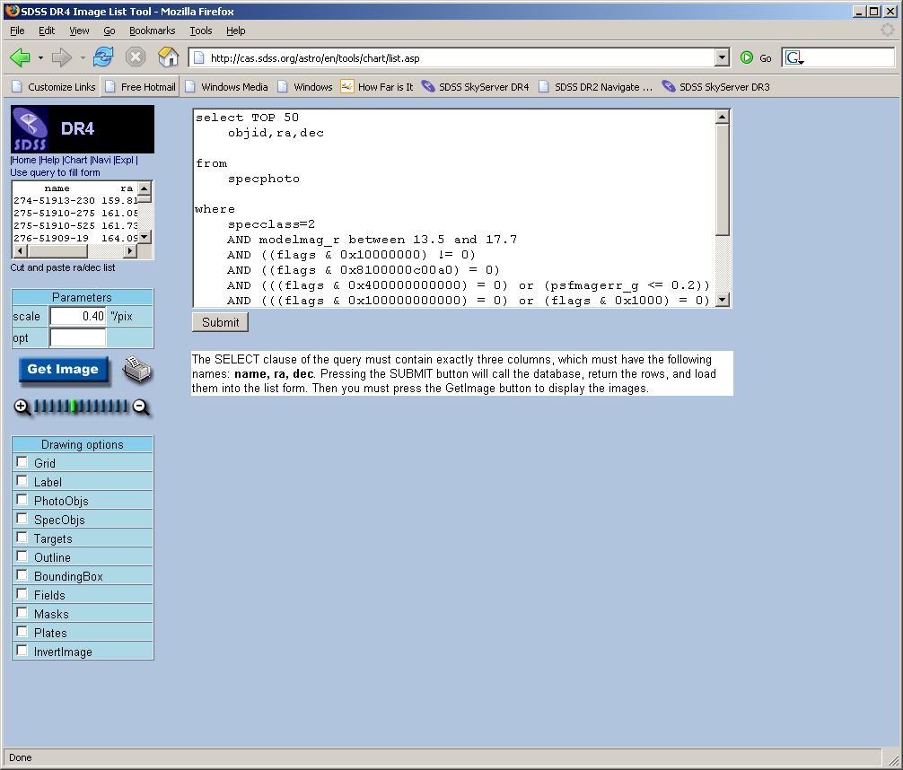
First, a sanity check…
Advanced Tools ->
Image Lists
Use query to fill
form
Two changes
  Add “TOP 50”
  Select block must
  be ONLY
  name, ra, dec

Slide 44
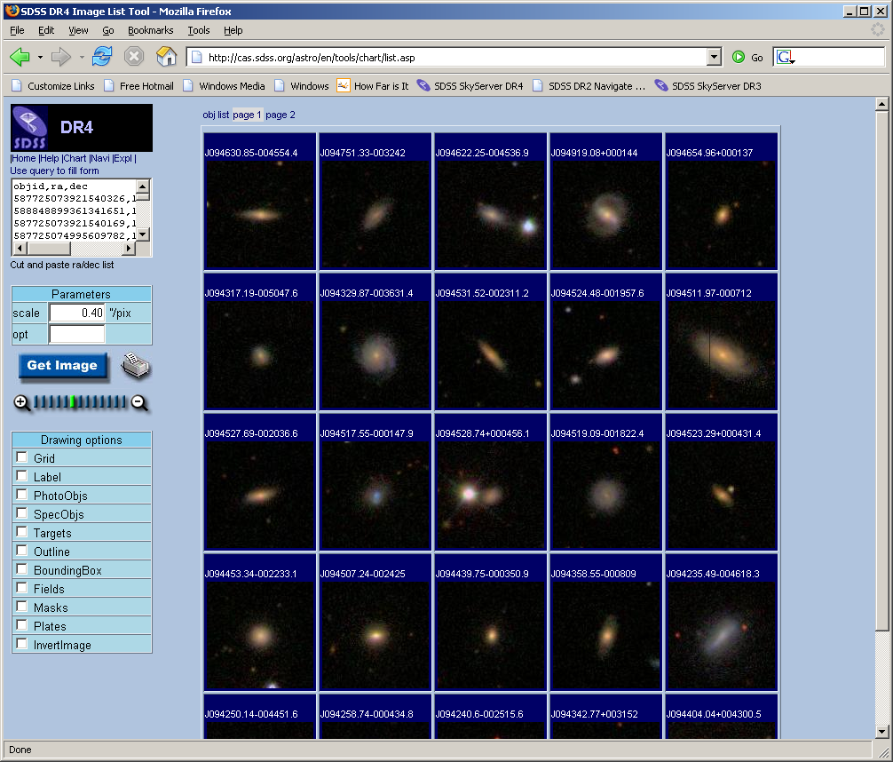
We’re sane!

Slide 45
Running the Query
How many galaxies will we get?
Select count(*) ->
n = 86,478
That’s too many to use web browser
Solution: CasJobs

Slide 46
CasJobs
Advanced Tools -> CasJobs
  Best method for fairly long, complex queries
  Personal user DB (MyDB)
  Quick mode: 1 minute cutoff (don’t need to register)
  Register for…

Slide 47
CasJobs
Advanced Tools -> CasJobs
  Submit mode: up to 8 hours in “long” queue
  MyDB database to save results of your queries
    Define your own functions, procedures
    Share tables with collaborators (groups)
  Job history, plotting, FITS/CSV/VOTable output

Slide 48
Run the Query in CasJobs
Go to “Query”
Select “DR4” as “Context”
Give results table a name (for your MyDB)
Give your query a name
Wait until it says “started”
Go play outside
When you return, results will be in MyDB

Slide 49
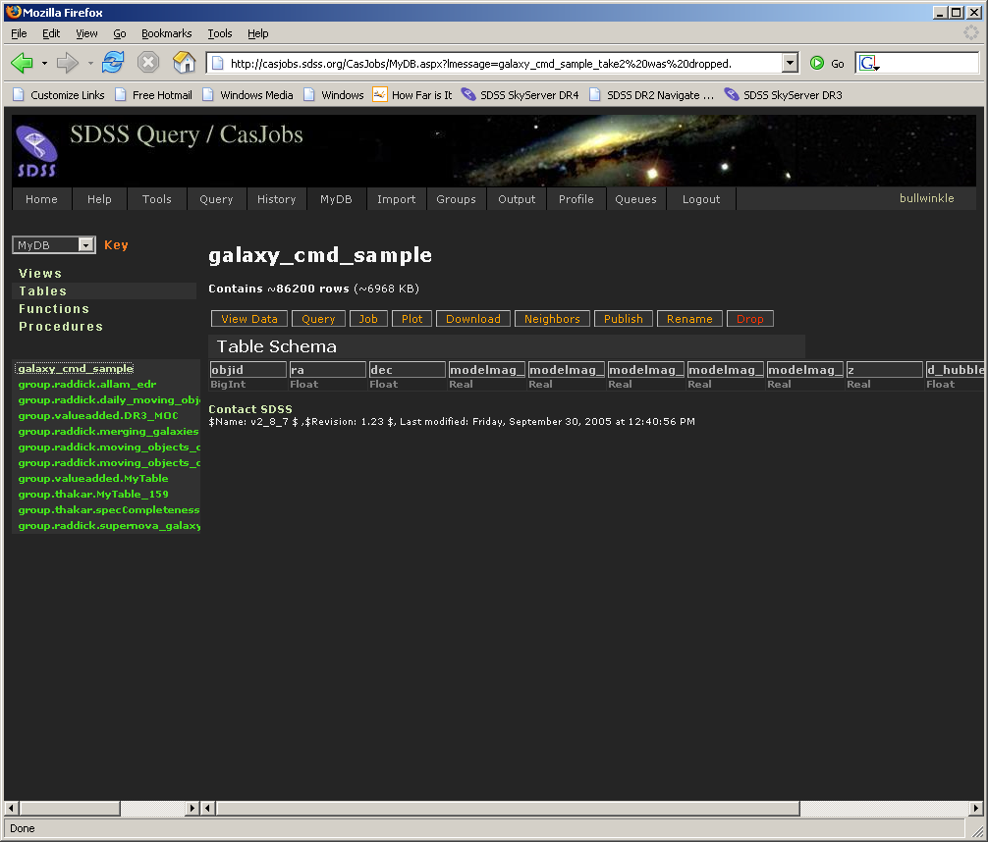
Results
Query ran in 1 min. 59 sec.
  Varies due to server load

Slide 50

CasJobs Options
View data
(preview)
Query your MyDB (just like SDSS tables)
  Change context to “MyDB”
Job shows how table was created
Plot creates a simple x-y plot
Download lets you download data
  CSV, FITS, XML
Neighbors lets you search around each object

Slide 51
CasJobs Options
Publish lets you
share table with
colleagues (see Groups feature)
Rename
Drop (delete)

Slide 52
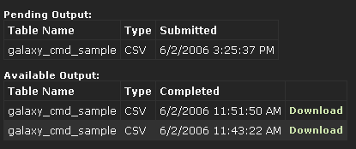
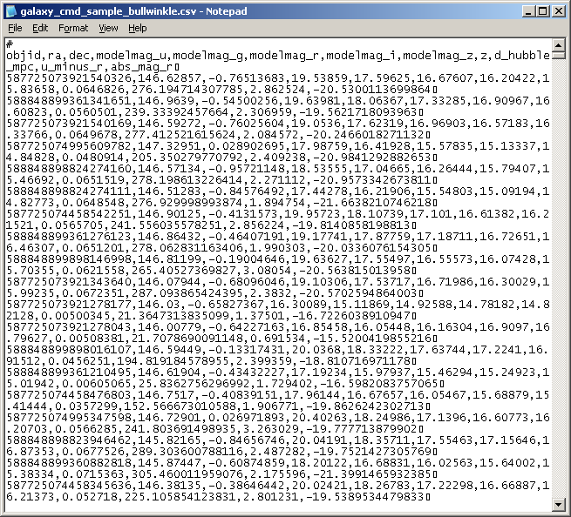
Download Galaxy Table
I’ll get it as CSV

Slide 53
Plot Results
Use your favorite program
I used wgnuplot
The plot is…

Slide 54
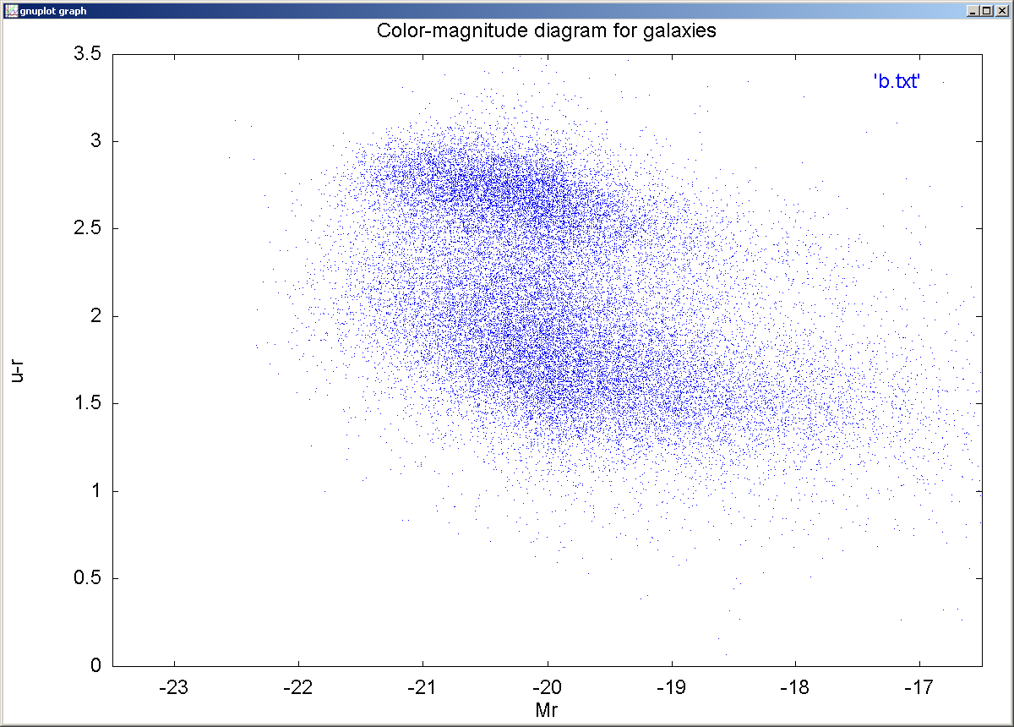
Plot Results

Slide 55
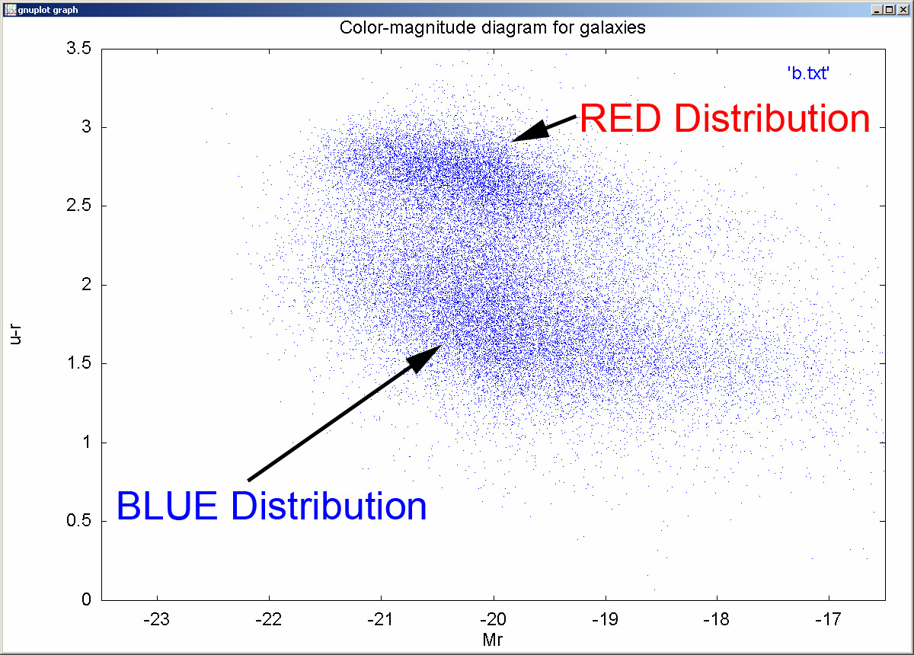
Plot Results

Slide 56
Further questions
What is red vs. blue
distribution at each
absolute magnitude?
What is optimum
red/blue separator?
What are the
luminosity functions of
each distribution?
What are the physical mechanisms that produce the plot?

Slide 57
Tips
Use astronomers’ site
  All tools linked directly from main page
  More generous query limits (timeouts, row limits)
  Imaging/Spectro form query
Each release has separate sites
  http://cas.sdss.org/DR4/ (current site)
  http://cas.sdss.org/DR3/ … etc…
Teach yourself SQL by modifying sample queries

Slide 58
Tips
Use CasJobs for anything complex
Use Image List to sanity-check your queries
Use PhotoTag table whenever possible
Start with simple problems, learn more complex features later

Slide 59
For more help
E-mail the SDSS Helpdesk
  sdss-helpdesk@fnal.gov
Or talk to any SDSS person here

Slide 60

Bon Appétit!

